Slide 1


Slide 2
QUOTE OF THE DAY
Build your own dreams or someone else will hire you to build theirs.

Slide 3
Lipids
Zakir Ahmad

Slide 4
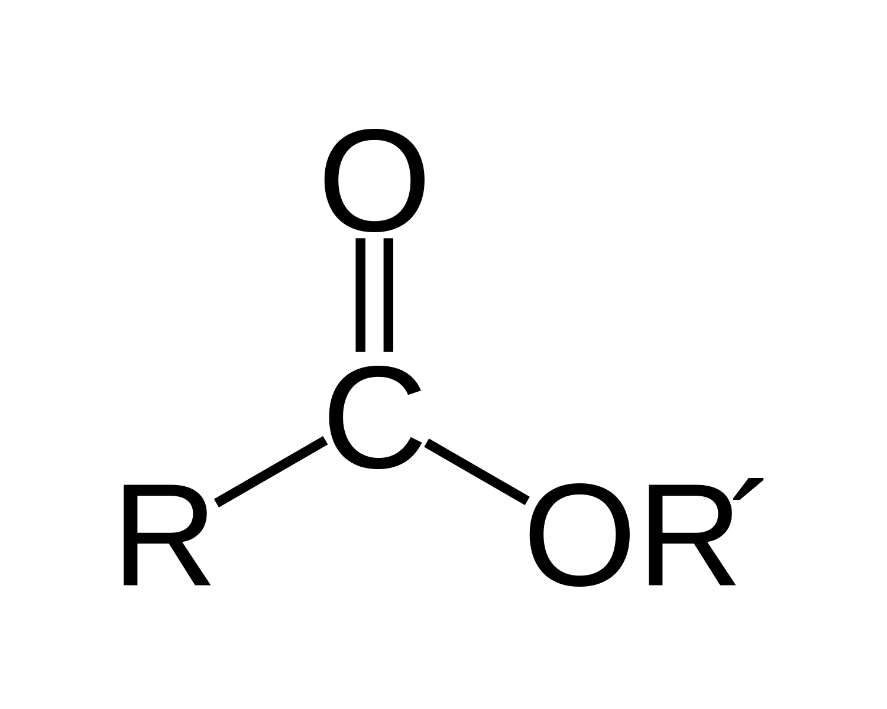
Lipids
Lipids may be regarded as organic substances relatively insoluble in water, soluble in organic solvents (alcohol, ether etc.), potentially related to fatty acids and utilized by the living cells. Chemically they are esters of fatty acids.
Unlike the polysaccharides, proteins and nucleic acids, lipids are not polymers and are mostly small molecules.
Esters: These are chemical compounds derived from reacting an oxoacid with a hydroxyl compound such as alcohol or phenol. They are ubiquitous
Acids that contain hydrogen, oxygen, plus another element are
called oxoacids

Slide 5
Fatty acid: Chemical compound. In chemistry, particularly in biochemistry, a fatty acid is a carboxylic acid with an aliphatic chain, which is either saturated or unsaturated. Most naturally occurring fatty acids have an unbranched chain of an even number of carbon atoms, from 4 to 28.

Slide 6
Bloor’s Criteria
According to Bloor, lipids are compounds having the following characteristics:
• They are insoluble in water.
• Solubility in one or more organic solvents, such as ether, chloroform, benzene, acetone, etc, so called fat solvents.
• Possibility of utilization by living organisms

Slide 7
Classification of lipids
Simple lipids: Esters of fatty acids with alcohols. These are mainly of two types
Fats and oils (triacylglycerols): These are esters of fatty acids with glycerol. The difference between fat and oil is only physical. Thus, oil is a liquid while fat is a solid at room temperature.
Waxes: Esters of fatty acids (usually long chain) with alcohols other than glycerol.
Waxes are used in the preparation of candles, lubricants, cosmetics, ointments, polishes etc.

Slide 8
Classification of lipids
Complex (or compound) lipids: These are esters of fatty acids with alcohols containing additional groups such as phosphate, nitrogenous base, carbohydrate, protein etc. They are further divided as follows
Phospholipids: They contain phosphoric acid and frequently a nitrogenous base in addition to alcohol and fatty acids.
Glycerophospholipids: These phospholipids contain glycerol as the alcohol

Slide 9
SphingPhospholipids: Sphingosine is the alcohol in this group of phospholipids e.g., sphingomyelin.
Sphingosine (2-amino-4-trans-octadecene-1,3-diol) is an 18-carbon amino alcohol with an unsaturated hydrocarbon chain, which forms a primary part of sphingolipids, a class of cell membrane lipids that include sphingomyelin, an important phospholipid.

Slide 10
Classification of lipids
Glycolipids: These lipids contain a fatty acid, carbohydrate and nitrogenous base. The alcohol is sphingosine; hence they are also called as glycosphingolipids. Glycerol and phosphate are absent e.g., cerebrosides, gangliosides.
Lipoproteins: Macromolecular complexes of lipids with proteins.
Other complex lipids: Sulfolipids (SQDG. Sulfoquinovosyl Diacylglycerol), amino lipids (Phosphatidylethanolamine, PE) and lipopolysaccharides are among the other complex lipids.

Slide 11
Classification of lipids
Derived lipids: These are the derivatives obtained on the hydrolysis of group 1 and group 2 lipids which possess the characteristics of lipids. These include glycerol and other alcohols, fatty acids, mono- and diacylglycerols, lipid (fat) soluble vitamins, steroid hormones, Eicosanoids, hydro-carbons and ketone bodies.
Miscellaneous lipids: These include many compounds possessing the characteristics of lipids e.g., carotenoids, hydrocarbons such as pentacosane (in bees wax), terpenes etc.

Slide 12
Functions of lipids
They are the concentrated fuel reserve of the body (triacylglycerols).
Lipids are the constituents of membrane structure and regulate the membrane permeability (phospholipids and cholesterol).
They serve as a source of fat-soluble vitamins (A, D, E and K).
Lipids are important as cellular metabolic regulators (steroid hormones and prostaglandins).
Lipids protect the internal organs, serve as insulating materials and give shape and smooth appearance to the body.

Slide 13
Fatty acids
Fatty acids are carboxylic acids with hydrocarbon side chain
They are the simplest form of lipids.
Fatty acids mainly occur in the esterified form as major constituents of various lipids.
They are also present as free (unesterified) fatty acids.
Fatty acids of animal origin are much simpler in structure in contrast to those of plant origin which often contain groups such as keto, hydroxy and cyclopentane rings.

Slide 14
Even and odd carbon fatty acids
Most of the fatty acids that occur in natural lipids are of even carbons (usually 14C – 20C).
This is because biosynthesis of fatty acids mainly occurs with the sequential addition of 2 carbon units.
Palmitic acid (16C) and stearic acid (18C) are the most common.
Among the odd chain fatty acids, propionic acid (3C) and valeric acid (5C) are well known.

Slide 15
Saturated and unsaturated fatty acids
Saturated fatty acids do not contain double bonds, while unsaturated fatty acids contain one or more double bonds.
Both saturated and unsaturated fatty acids almost equally occur in the natural lipids.
Fatty acids with one double bond are monounsaturated, and those with 2 or more double bonds are collectively known as polyunsaturated fatty acids (PUFA).

Slide 16
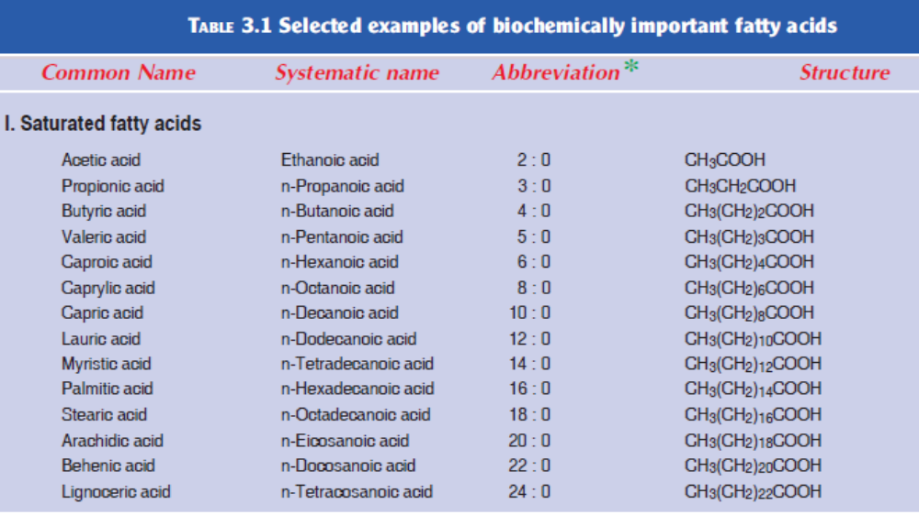

Slide 17
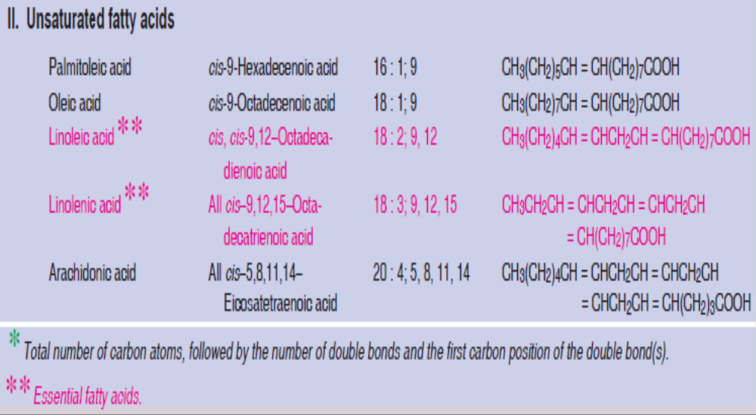

Slide 18
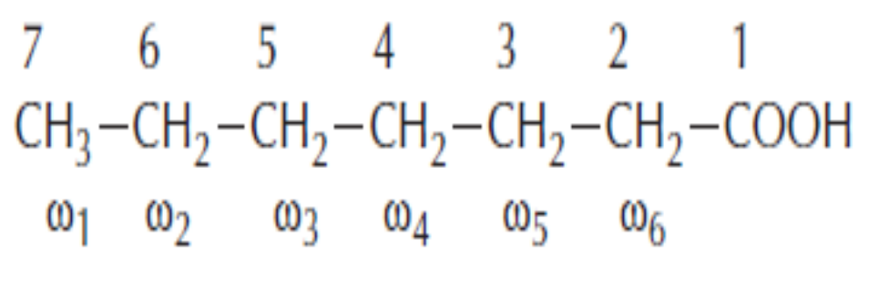
Nomenclature of FA
According to standard nomenclature, Carbon atoms are numbered from the – COOH carbon (carbon No. 1).
The carbon adjacent to –COOH gr. i.e. carbon number 2 is known as α-carbon, carbon atom 3 is β-carbon and the end –CH₃ carbon is known as the ω-carbon (‘Omega’ carbon).
Saturated acids end in “anoic” e.g. octanoic acid and Unsaturated acids with double bonds end in enoic, e.g. octadecenoic acid (oleic acid)

Slide 19
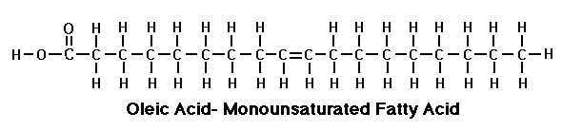
Nomenclature of FA
A widely used convention is to express the fatty acids by a formula to indicate the no. of carbon atoms, no. of double bonds and position of double bond.
The (Δ) sign is used for double bond, e.g. Δ⁹ denotes double bond between 9 and 10 C.
For example oleic Acid (mol. formula C₁₇H₃₃ COOH) has one double bond between C9 and C10, thus: 18: 1^{Δ9}

Slide 20
Nomenclature of FA- Omega FA
For polyunsaturated fatty acids (PUFAs), an alternative convention is used.
The carbon of the methyl group is called the (omega) carbon and is given the number 1.
In this convention, PUFAs with a double bond between C-3 and C-4 are called omega-3 fatty acids, and those with a double bond between C-6 and C-7 are omega-6 fatty acids.

Slide 21
Omega FA
ω3 series Linolenic acid (18 : 3; 9, 12, 15)
ω6 series Linoleic acid (18 : 2; 9, 12)
Arachidonic acid (20 : 4; 5, 8, 11, 14)
ω9 series Oleic acid (18 : 1; 9)

Slide 22
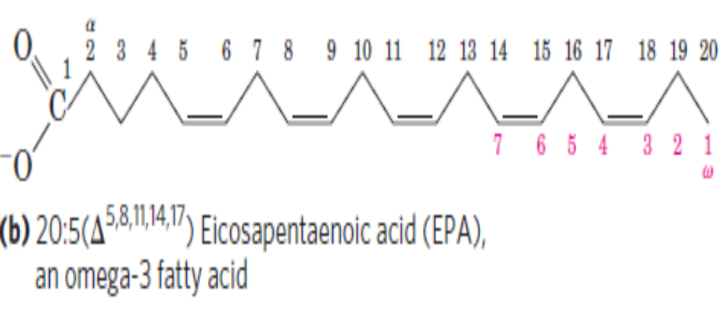
Nomenclature of FA

Slide 23
Length of hydrocarbon chain of fatty acids
Depending on the length of carbon chains, fatty acids are categorized into 3 groups:
Short chain with less than 6 carbons
Medium chain with 8 to 14 carbons
Long chain with 16 to 24 carbons.

Slide 24
Essential fatty acids
The fatty acids that cannot be synthesized by the body and, therefore, should be supplied in the diet are known as essential fatty acids (EFA).
Chemically, they are polyunsaturated fatty acids, namely linoleic acid (18 : 2; 9, 12) and linolenic acid (18 : 3; 9, 12, 15).
Arachidonic acid (20 : 4; 5, 8, 11, 14) becomes essential, if its precursor linoleic acid is not provided in the diet in enough amounts.

Slide 25
Why essential?
Although humans and other mammals can synthesize saturated fatty acids and some monounsaturated fatty acids from carbon groups in carbohydrates and proteins, they lack the delta Δ12 and Δ15 desaturase enzymes necessary to insert a cis double bond at the n-12 or the n-15 position of a fatty acid.
Consequently, omega-6 and omega-3 fatty acids are essential nutrients.
Functions of EFA: Essential fatty acids are required for the membrane structure and function, transport of cholesterol, formation of lipoproteins, prevention of fatty liver.
They are also needed for the synthesis of another important group of compounds, namely eicosanoids.

Slide 26
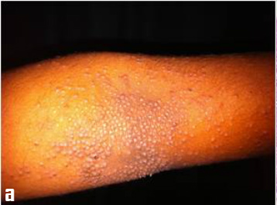
Deficiency of EFA
The deficiency of EFA results in phrynoderma or toad skin, characterized by the presence of horny eruptions on the posterior and lateral parts of limbs, on the back and buttocks, loss of hair and poor wound healing.

Slide 27
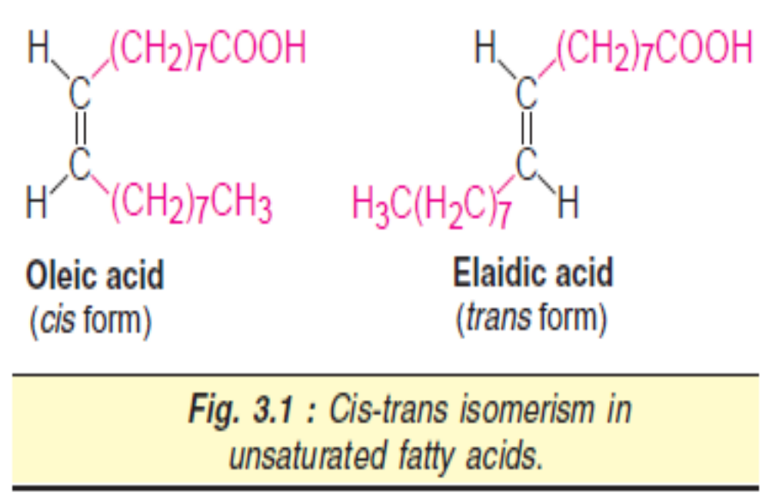
Isomerism in unsaturated fatty acids
Unsaturated fatty acids exhibit geometric isomerism depending on the orientation of the groups around the double bond axis.
If the atoms or acyl groups are present on the same side of the double bond, it is a cis configuration.
If the groups occur on the opposite side, it is a trans configuration.
Thus oleic acid is a cis isomer while elaidic acid is a trans isomer
Most of the naturally occurring unsaturated fatty acids exist as cis isomers.

Slide 28
Positional Isomers
A variation in the location of the double bonds along the unsaturated fatty acids chain produces an isomer of that compound. Thus, oleic acid could have 15 different positional isomers.

Slide 29
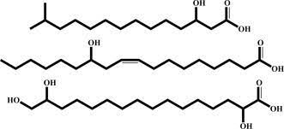
Hydroxy fatty acids
Some of the fatty acids are hydroxylated
Beta-Hydroxybutyric acid, one of the ketone bodies produced in metabolism, is a simple example of hydroxy fatty acids.
Cerebronic acid and recinoleic acid are long chain hydroxy fatty acids.

Slide 30
Triacylglycerols
Triacylglycerols (triglycerides) are the esters of glycerol with fatty acids.
The fats and oils that are widely distributed in both plants and animals are chemically triacylglycerols.
They are insoluble in water and non-polar in character and commonly known as neutral fats.
Fats as stored fuel: Triacylglycerols are the most abundant group of lipids that primarily function as fuel reserves of animals.

Slide 31
Triacylglycerols
Adipocytes of adipose tissue—predominantly found in the subcutaneous layer and in the abdominal cavity—are specialized for storage of triacylglycerols.
The fat is stored in the form of globules dispersed in the entire cytoplasm.
And surprisingly, triacylglycerols are not the structural components of biological membranes.

Slide 32
Structures of acylglycerols
Monoacylglycerols, diacylglycerols and triacylglycerols, respectively consisting of one, two and three molecules of fatty acids esterified to a molecule of glycerol
Simple triacylglycerols contain the same type of fatty acid residue at all the three carbons e.g., tristearoyl glycerol or tristearin.
Mixed triacylglycerols are more common.
They contain 2 or 3 different types of fatty acid residues.
In general, fatty acid attached to C1 is saturated, that attached to C2 is unsaturated while that on C3 can be either.

Slide 33
Properties of triacylglycerols
Hydrolysis: Triacylglycerols undergo stepwise enzymatic hydrolysis to finally liberate free fatty acids and glycerol.
The process of hydrolysis, catalyzed by lipases is important for digestion of fat in the gastrointestinal tract and fat mobilization from the adipose tissues.
Saponification: The hydrolysis of triacylglycerols by alkali to produce glycerol and soaps is known as saponification.
Triacylglycerol + 3 NaOH Glycerol + 3 R-COONa (soaps)

Slide 34
Properties of triacylglycerols
Rancidity: Rancidity is the term used to represent the deterioration of fats and oils resulting in an unpleasant taste.
Fats containing unsaturated fatty acids are more susceptible to rancidity.
Rancidity occurs when fats and oils are exposed to air, moisture, light, bacteria etc.
Hydrolytic rancidity occurs due to partial hydrolysis of triacylglycerols by bacterial enzymes.
Oxidative rancidity is due to oxidation of unsaturated fatty acids.
This results in the formation of unpleasant products such as dicarboxylic acids, aldehydes, ketones etc.
Rancid fats and oils are unsuitable for human consumption.

Slide 35
Properties of triacylglycerols
Trace amounts of antioxidants such as tocopherols (vitamin E), hydroquinone, gallic acid and alpha-naphthol are added to the commercial preparations of fats and oils to prevent rancidity.
Propyl gallate, butylated hydroxy anisole (BHA) and butylated hydroxy-toluene (BHT) are the antioxidants used in food preservation.

Slide 36
Properties of triacylglycerols
Lipid peroxidation in vivo: In the living cells, lipids undergo oxidation to produce peroxides and free radicals which can damage the tissue.
The free radicals are believed to cause inflammatory diseases, ageing, cancer, atherosclerosis etc.
It is fortunate that the cells possess antioxidants such as vitamin E and superoxide dismutase to prevent in vivo lipid peroxidation

Slide 37
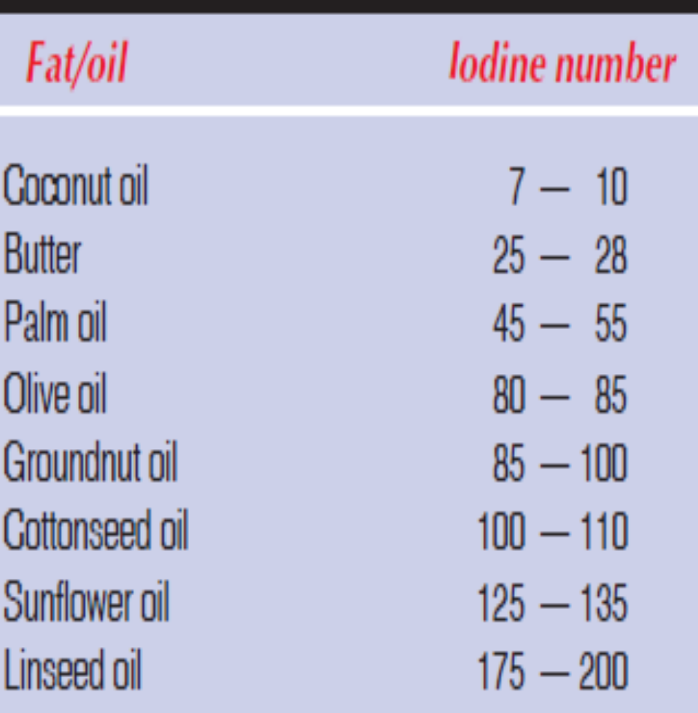
Tests to check purity of fats and oils
Iodine number: It is the number grams of iodine absorbed by 100 g of fat or oil.
Iodine number is useful to know the relative unsaturation of fats and is directly proportional to the content of unsaturated fatty acids.
Thus lower is the iodine number, less is the degree of unsaturation.
Determination of iodine number will help to know the degree of adulteration of a given oil.

Slide 38
Saponification number
The number of mg of KOH required to hydrolyze (saponify) one gram of fat or oil.
Saponification number is a measure of the average molecular size of the fatty acids present.
The value is higher for fats containing short chain fatty acids.
The saponification numbers of a few fats and oils are given below
Human fat: 195–200
Butter: 230–240
Coconut oil: 250–260

Slide 39
Phospholipids
These are complex or compound lipids containing phosphoric acid, in addition to fatty acids, nitrogenous base and alcohol.
There are two classes of phospholipids
Glycerophospholipids (or Phosphoglycerides) that contain glycerol as the alcohol.
Sphingophospholipids (or sphingomyelins) that contain sphingosine as the alcohol.

Slide 40
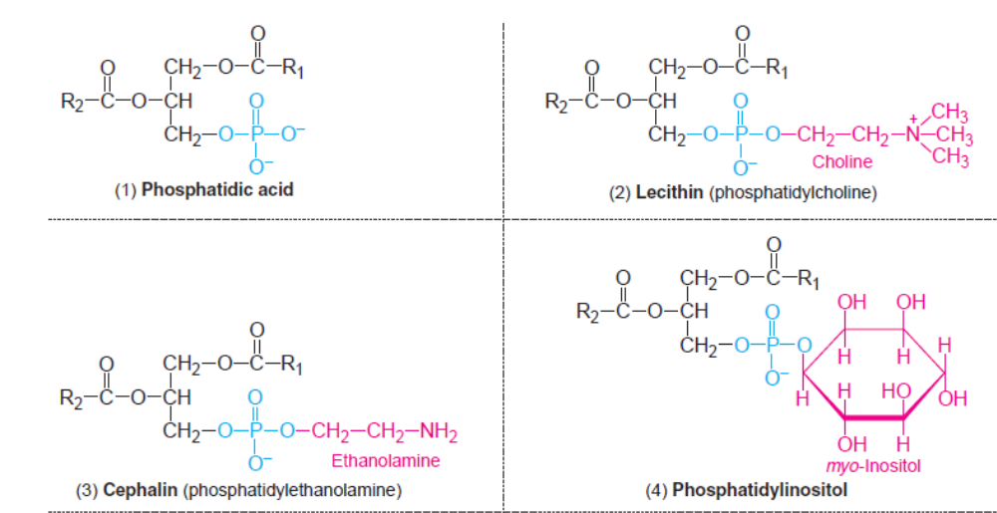

Slide 41
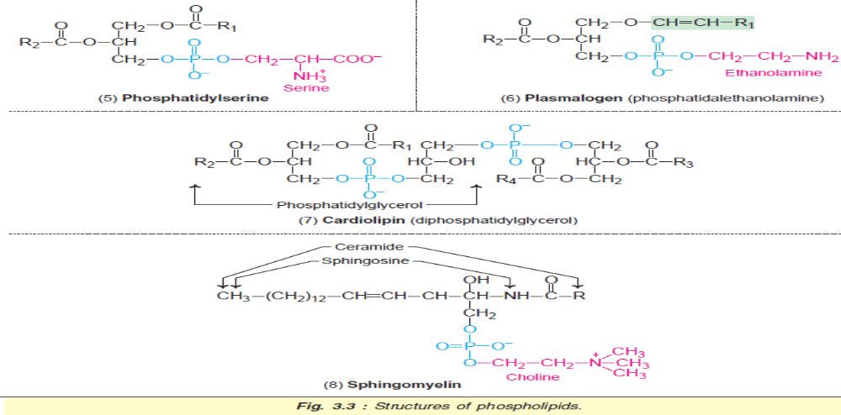

Slide 42
Glycerophospholipids
Glycerophospholipids are the major lipids that occur in biological membranes.
They consist of glycerol 3-phosphate esterified at its C₁ and C₂ with fatty acids.
Usually, C₁ contains a saturated fatty acid while C₂ contains an unsaturated fatty acid.
Phosphatidic acid: This is the simplest phospholipid.
It does not occur in good concentration in the tissues.
Basically, phosphatidic acid is an intermediate in the synthesis of triacylglycerols and phospholipids.
Notes:
The Action of Phospholipases The venom of the Eastern diamondback rattler and the Indian cobra contains phospholipase A2, which catalyzes the hydrolysis of fatty acids at the C-2 position of glycerophospholipids. The phospholipid breakdown product of this reaction is lysolecithin (lecithin is phosphatidylcholine). At high concentrations, this and other lysophospholipids act as detergents, dissolving the membranes of erythrocytes and lysing the cells. Extensive hemolysis may be life-threatening.

Slide 43
Glycerophospholipids
Lecithins (phosphatidylcholine): (phosphoric acid, Cholines, esters of glycerols and 2 fatty acids) These are the most abundant group of phospholipids in the cell membranes.
Chemically, lecithin (Greek: lecithos—egg yolk) is a phosphatidic acid with choline( an essential nutrient) as the base.
Phosphatidylcholines represent the storage form of body’s choline.
Dipalmitoyl lecithin ( dipalmitoylphosphatdylcholine) is an important phosphatidylcholine found in lungs. It is a surface-active agent and prevents the adherence of inner surface of the lungs due to surface tension. Respiratory distress syndrome in infants is a disorder characterized by the absence of dipalmitoyl lecithin.
Lysolecithin is formed by removal of a single fatty acid from lecithin.

Slide 44
Glycerophospholipids
Cephalins (phosphatidylethanolamine): Ethanolamine is the nitrogenous base present in cephalins. Thus, lecithin and cephalin differ about the base.
Phosphatidylinositol: This is an important component of cell membranes. The action of certain hormones (e.g. oxytocin, vasopressin) is mediated through PI.
Phosphatidylserine: The amino acid serine is present in this group of glycerophospholipids.

Slide 45
Glycerophospholipids
Plasmalogens: When a fatty acid is attached by an ether linkage at C₁ of glycerol in the glycerophospholipids, the resultant compound is plasmalogen.
Phosphatidylethanolamine is the most important one
Choline, inositol and serine may substitute ethanolamine to give other plasmalogens.

Slide 46
Glycerophospholipids
Cardiolipin: It is so named as it was first isolated from animal heart muscle.
Structurally, a cardiolipin consists of two molecules of phosphatidic acid held by an additional glycerol through phosphate groups.
It is an important component of inner mitochondrial membrane and essential for mitochondrial function.
Decreased cardiolipin levels may result in mitochondrial dysfunction, aging, hypothyroidism, cardioskeletal myopathy (Barth syndrome).
Cardiolipin is the only phosphoglyceride that possesses antigenic properties.

Slide 47
Sphingomyelins
Sphingosine is an amino alcohol present in sphingomyelins (sphingophospholipids).
They do not contain glycerol at all.
Sphingosine is attached by an amide linkage to a fatty acid to produce ceramide.
The alcohol group of sphingosine is bound to phosphorylcholine in sphingomyelin structure (Fig.3.3).
Sphingomyelins are important constituents of myelin and are found in good quantity in brain and nervous tissues.
Ceramide, acts as a second messenger (signaling molecule) by regulating programmed cell death (apoptosis), cell cycle and cell differentiation.
A ceramide containing a 30-carbon fatty acid is a major component of skin, and it regulates skin’s water permeability.

Slide 48
Functions of phospholipids
In association with proteins, phospholipids form the structural components of membranes and regulate membrane permeability.
Phospholipids (lecithin, cephalin and cardiolipin) in the mitochondria maintain the conformation of electron transport chain components, and thus cellular respiration.
Phospholipids participate in the absorption of fat from the intestine.
Phospholipids are essential for the synthesis of different lipoproteins, and thus participate in the transport of lipids.
Accumulation of fat in liver (fatty liver) can be prevented by phospholipids, hence they are regarded as lipotropic factors.

Slide 49
Functions of phospholipids
Arachidonic acid, an unsaturated fatty acid liberated from phospholipids, serves as a precursor for the synthesis of eicosanoids (prostaglandins, prostacyclins, thromboxanes etc.).
Phospholipids participate in the reverse cholesterol transport and thus help in the removal of cholesterol from the body.
Phospholipids act as surfactants (agents lowering surface tension). For instance, dipalmitoyl phosphatidylcholine is an important lung surfactant.
Respiratory distress syndrome in infants is associated with insufficient production of this surfactant.

Slide 50
Functions of phospholipids
Cephalins, an important group of phospholipids participate in blood clotting.
Phosphatidylinositol is the source of second messengers—inositol triphosphate and diacylglycerol, that are involved in the action of some hormones.

Slide 51
Steroids
Steroids are the compounds containing a cyclic steroid nucleus namely cyclopentanoperhydrophenanthrene (CPPP).
It consists of a phenanthrene nucleus (rings A, B and C) to which a cyclopentane ring (D) is attached.
The steroid nucleus represents saturated carbons, unless specifically shown as double bonds.
The methyl side chains (19 & 18) attached to carbons 10 & 13 are shown as single bonds.
At carbon 17, steroids usually contain a side chain.

Slide 52
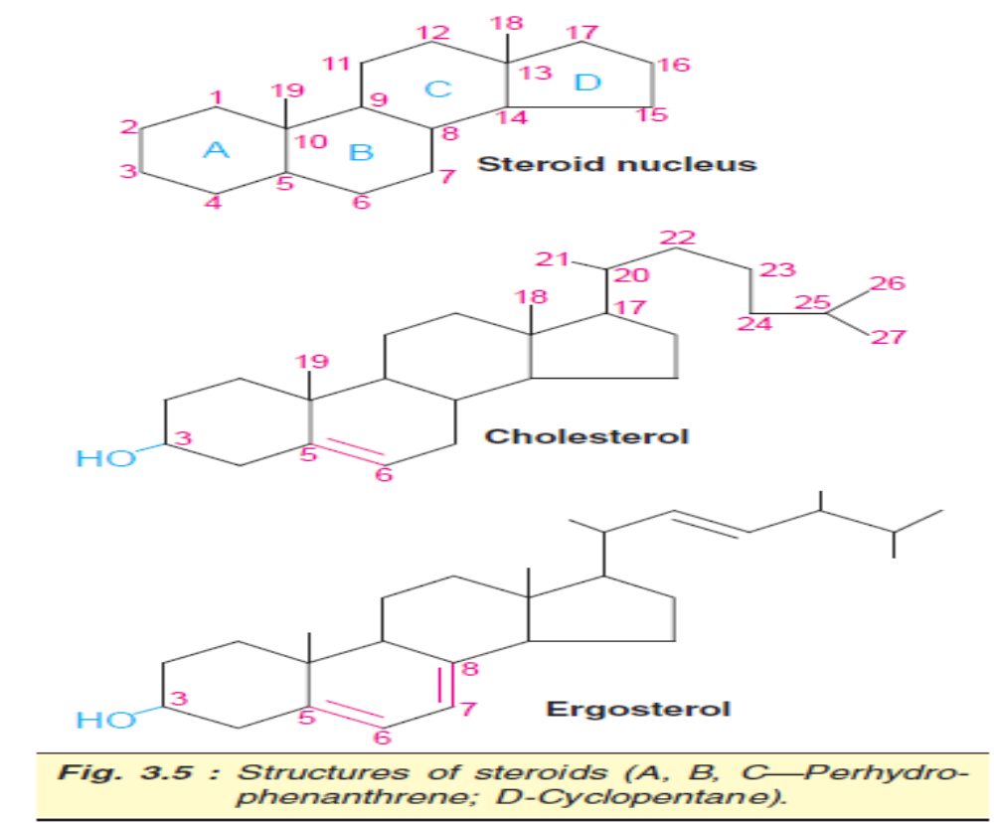

Slide 53
Steroids of biological importance
Cholesterol, bile acids, vitamin D, sex hormones, adrenocortical hormones, sitosterol, cardiac glycosides and alkaloids.
If the steroid contains one or more hydroxyl groups it is commonly known as sterol.

Slide 54
Cholesterol
Cholesterol, exclusively found in animals, is the most abundant animal sterol.
It is widely distributed in all cells and is a major component of cell membranes and lipoproteins.
Cholesterol (Greek : chole–bile) was first isolated from bile.
Structure and occurrence: The structure of cholesterol (C₂₇H₄₆O) is depicted in Fig.3.5.

Slide 55
Cholesterol
It has one hydroxyl group at C₃ and a double bond between C₅ and C₆.
An 8-carbon aliphatic side chain is attached to C₁₇.
Cholesterol contains a total of 5 methyl groups.
Due to the presence of an –OH group, cholesterol is weakly amphiphilic.
As a structural component of plasma membranes, cholesterol is an important determinant of membrane permeability properties.
The occurrence of cholesterol is much higher in the membranes of subcellular organelles.

Slide 56
Cholesterol
Properties and reactions: Cholesterol is a yellowish crystalline solid.
The crystals, under the microscope, show a notched appearance.
Cholesterol is insoluble in water and soluble in organic solvents such as chloroform, benzene, ether etc.
Several reactions given by cholesterol are useful for its qualitative identification and quantitative estimation.
These include Salkowski’s test, Liebermann-Burchard reaction and Zak’s test.

Slide 57
Functions of cholesterol
Cholesterol is a poor conductor of heat and electricity, since it has a high dielectric constant.
It is present in abundance in nervous tissues.
It appears that cholesterol functions as an insulating cover for the transmission of electrical impulses in the nervous tissue.
Cholesterol performs several other biochemical functions which include its role in membrane structure and function, in the synthesis of bile acids, hormones (sex and cortical) and vitamin D.

Slide 58
Ergosterol
Ergosterol occurs in plants. ( it is the cholesterol of plants)
It is also found as a structural constituent of membranes in yeast and fungi.
Ergosterol is an important precursor for vitamin D.
When exposed to light, the ring B of ergosterol opens and it is converted to ergocalciferol, a compound containing vitamin D activity.
The other sterols present in plant cells include stigmasterol and beta-sitosterol.

Slide 59
Amphipathic lipids
As per definition, lipids are insoluble (hydrophobic) in water.
However, some of the lipids possess polar or hydrophilic groups which tend to be soluble in water.
Molecules which contain both hydrophobic and hydrophilic groups are known as amphipathic (Greek : amphi-both, pathos—passion).
Examples of amphipathic lipids: Fatty acids, phospholipids, sphingolipids, bile salts and cholesterol (to some extent) are amphipathic in nature.

Slide 60


Slide 61


