Slide 1


Slide 2


Slide 3
Cell Membrane, Composition & Functions
Zakir Ahmad

Slide 4
THANKS TO THE AUTHORS
This lecture was prepared using
Textbook of Medical Biochemistry Eighth Edition by Dr (Brig) MN Chatterjea
& different online resources including but not limited to ( PubMed, Google Scholar & Web of Science)
Special thanks to (Sir Noor Ullah (IPMS) & Sir Abdur Rehman (IPMS)) for providing with the basic framework for the lecture

Slide 5
Plasma membrane
The plasma membrane is an envelope surrounding the cell
It separates and protects the cell from the external hostile environment
Besides being a protective barrier, plasma membrane provides a connecting system between the cell and its environment
Most of the properties attributed to living organisms (e.g., movement, growth, reproduction, and metabolism) depend, either directly or indirectly, on membranes
The subcellular organelles such as nucleus, mitochondria, lysosomes are also surrounded by membranes

Slide 6
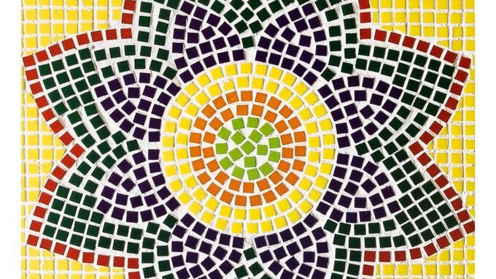

Slide 7
Structure of membranes
Fluid mosaic model, proposed by Singer and Nicolson, is a more recent and acceptable model for membrane structure
A membrane is essentially composed of a lipid bilayer
The hydrophobic (nonpolar) regions of the lipids face each other at the core of the bilayer while the hydrophilic (polar) regions face outward
Globular proteins are irregularly embedded in the lipid bilayer
The biological membranes usually have a thickness of 5-8 nm

Slide 8
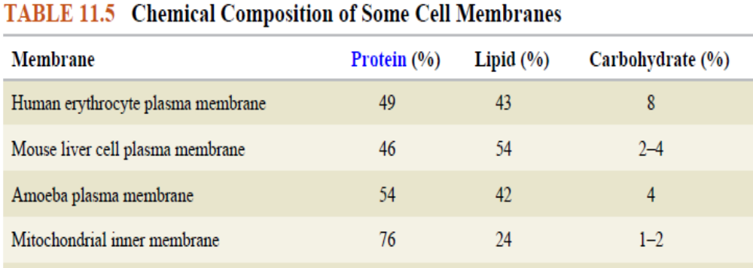
Chemical composition
The membranes are composed of lipids, proteins and carbohydrates
The actual composition differs from tissue to tissue
Among the lipids, amphipathic lipids namely phospholipids, glycolipids and cholesterol, are found in the animal membranes

Slide 9
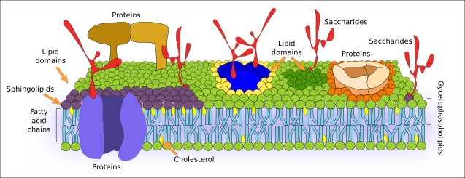
Membrane structure
Membrane Lipids
Membrane Proteins
Glycocalyx

Slide 10
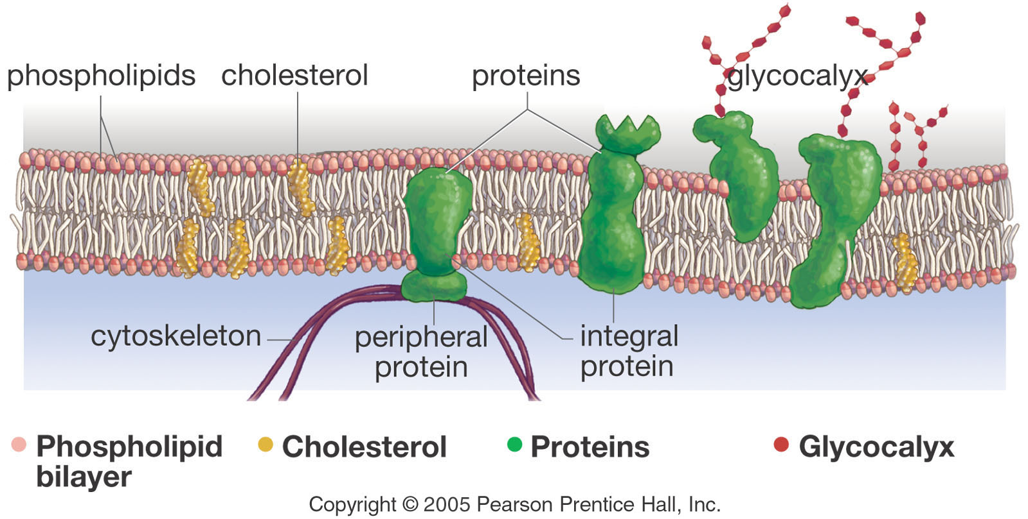
Membrane Components

Slide 11
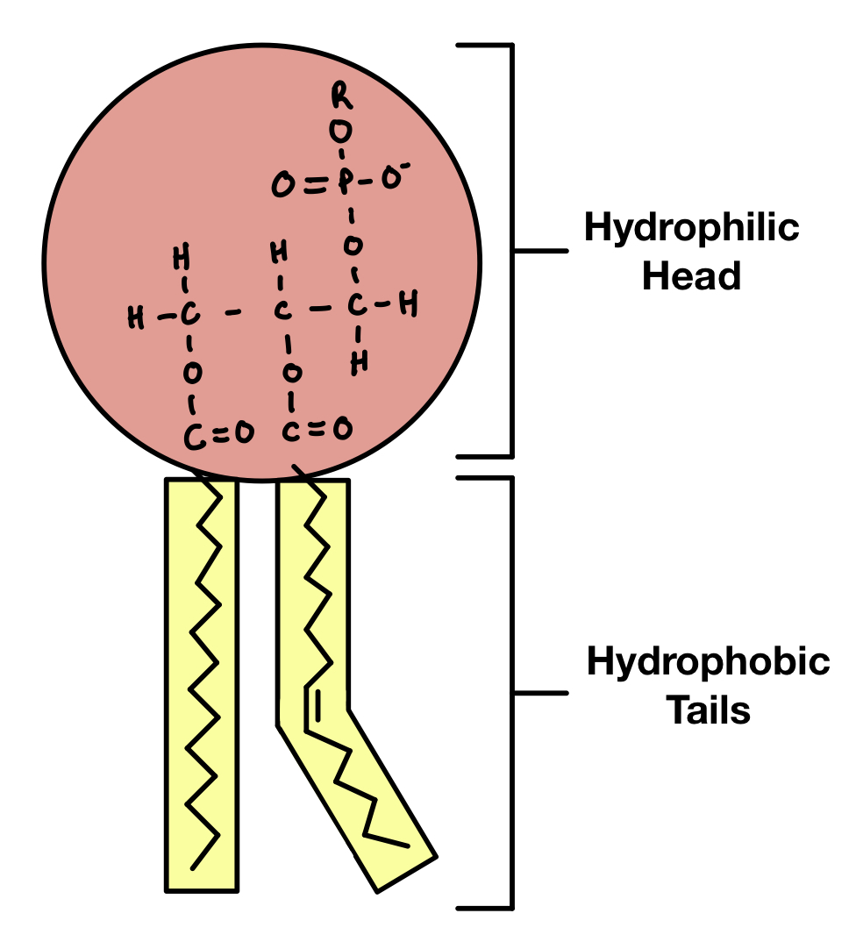
Membrane Lipids
Phospholipids & Sphingosines
  Outer Membrane ( Phosphatidyl Choline, Sphingomyelin)
  Inner Membrane ( Phosphatidyl Serine, Phosphatidyl Ethanolamine)
(Negative charged due to phosphate groups therefore hydrophilic)
  Fatty acid chains attached to phosphate heads ( Saturated & Unsaturated)
  Cholesterol ( Present in between the outer and inner membrane and helps in membrane stability i.e. Fluidity)

Slide 12
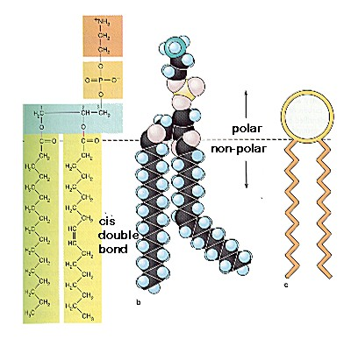
Phospholipid bilayer
Contains 2 fatty acid chains that are nonpolar
Head is polar & contains a Phosphate group

Slide 13
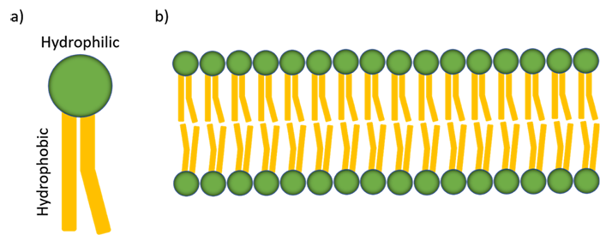

Slide 14
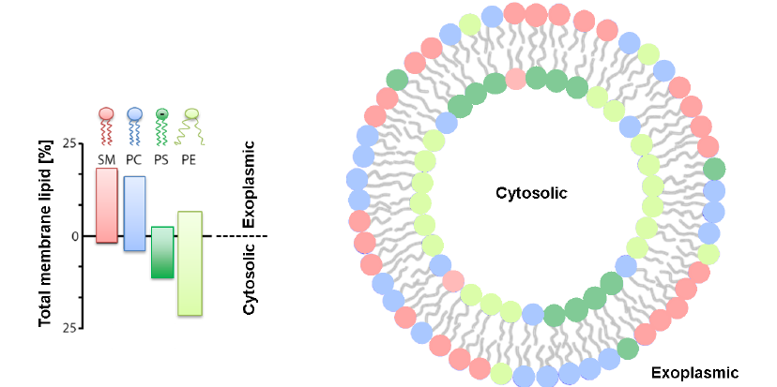

Slide 15
PROTEINS
Proteins make up the second major component of plasma membranes. Integral proteins (some specialized types are called integrins) are, as their name suggests, integrated completely into the membrane structure, and their hydrophobic membrane-spanning regions interact with the hydrophobic region of the phospholipid bilayer. Membrane proteins serve a range of important functions that helps cells to communicate, maintain their shape, carry out changes triggered by chemical messengers, and transport and share material.

Slide 16
Structure of membranes
Membrane proteins are categorized into two groups.
Extrinsic (peripheral) membrane proteins ( Positively charged) are loosely held to the surface of the membrane by hydrogen bonds, and they can be easily separated e.g. cytochrome c of mitochondria
Intrinsic (integral) ( Transmembrane Proteins) membrane proteins are tightly bound (Covalently bounded) to the lipid bilayer, and they can be separated only using detergents or organic solvents e.g. hormone receptors, cytochrome P₄₅₀
The lipid and protein subunits of the membrane give an appearance of a mosaic or a ceramic tile. Unlike a fixed ceramic tile, the membrane freely changes, hence the structure of the membrane is considered a fluid mosaic

Slide 17
Structure of RBC membrane
Two major integral proteins found in red cells membrane are:
(a) Glycophorin
(b) Band-3-Protein.
Glycophorins: Glycophorins are glycoproteins. It contains 60% carbohydrates.
Function: Some of the oligosaccharides of glycophorin are the M and N blood group antigens. Other carbohydrates bound to glycophorin are sites through which the influenza virus becomes attached to red blood cells.

Slide 18
Structure of RBC membrane
Band-3-Protein: It is another major integral protein found in red cell membrane.
Function: As red blood cells flow through the capillaries of the lungs, they exchange bicarbonate anions (HCO3–.) produced, by the reaction of CO2 and H2O, for chloride (Cl–) ions. This exchange occurs by way of a channel in band-3-protein, which forms a Pore through the membrane. Thus band-3-protein is an example of a membrane transport protein.

Slide 19
Structure of RBC membrane
Peripheral proteins: The inner face of the red blood cells membrane is laced with a network of proteins called cytoskeletons that stabilizes the membrane and is responsible for the biconcave shape of the cells: The special peripheral membrane proteins participate in this stability of red cells are:
• Spectrin
• Actin
• Ankyrin and Band 4, 1 protein.

Slide 20
CARBOHYDRATES
Carbohydrates are the third major component of plasma membranes. They are always found on the exterior surface of cells and are bound either to proteins (forming glycoproteins) or to lipids (forming glycolipids). These carbohydrate chains may consist of 2–60 monosaccharide units and can be either straight or branched. Along with peripheral proteins, carbohydrates form specialized sites on the cell surface that allow cells to recognize each other. This recognition function is very important to cells, as it allows the immune system to differentiate between body cells (called “self”) and foreign cells or tissues (called “non-self”).

Slide 21
Glycocalyx
They are attached to both Integral and peripheral proteins.
These are sugar residues ( Usually Oligosaccharides)
  Glycoproteins ( Sugars attached to the Integral and peripheral proteins)
  Glycolipids ( Directly attached to membrane lipids)
  Functions
  Water Movement Regulation
  Antigenic function (MHC Complexes)
  Blood typing

Slide 22
Similar types of glycoproteins and glycolipids are found on the surfaces of viruses and may change frequently, preventing immune cells from recognizing and attacking them.
The glycocalyx is highly hydrophilic and attracts large amounts of water to the surface of the cell. This aids in the interaction of the cell with its watery environment and in the cell’s ability to obtain substances dissolved in the water.

Slide 23
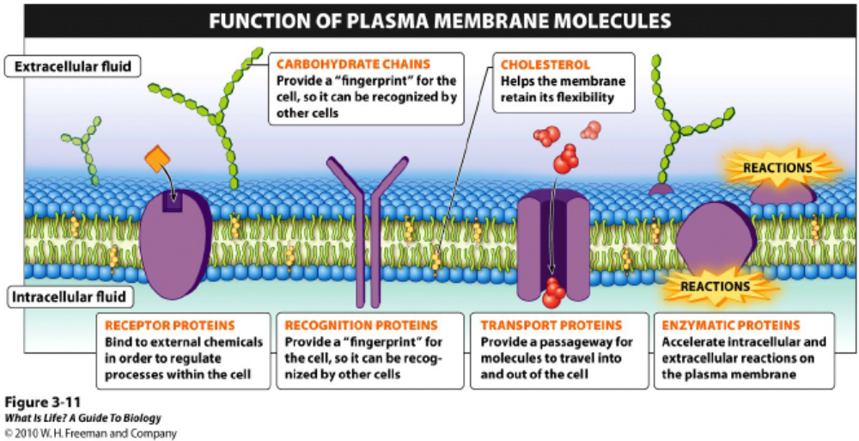

Slide 24
Additional Special Features of Some Membranes
(a) Lipid rafts: They are dynamic areas of the exoplasmic leaflet of the lipid bilayers enriched in cholesterol and sphingolipids.
Function: They are involved in signal transduction, membrane trafficking, cell-cell communication, pathogen entry.
(b) Caveolae: They are probably derived from lipid rafts. Many of the caveolae contain a special protein called caveolin-1, which probably may be involved in their formation from lipid rafts.
Functions: They also take part in signal transduction.

Slide 25
Membrane asymmetry
Biological membranes are asymmetric; that is, the lipid composition of each half of a bilayer is different
For example, the human red blood cell membrane possesses substantially more phosphatidylcholine and sphingomyelin on its outside surface
Most of the membrane’s phosphatidylserine and phosphatidylethanolamine are on the inner side
The protein components of membranes also exhibit considerable asymmetry, with distinctly different functional domains within the membrane and on the cytoplasmic and extracellular faces of the membrane

Slide 26
Membrane fluidity/Function of Lipids in cell membrane
The term fluidity refers to the viscosity of the lipid bilayer or the ability of the cell to adopt shape and movement.
It depends on
  Temperature
  Presence or absence of cholesterol
  Types of fatty acid present ( Saturated/Unsaturated)

Slide 27
Membrane fluidity
  Temperature
    High Temperature increases fluidity
    Cold Temperature decreases fluidity in the absence of cholesterol.
  Presence or absence of cholesterol
    Cholesterol sticks to phospholipids like glue so more cholesterol more fluidity and vice versa
  Types of fatty acid present ( Saturated/Unsaturated)
    Saturated –Less fluidity
    Unsaturated-high fluidity

Slide 28
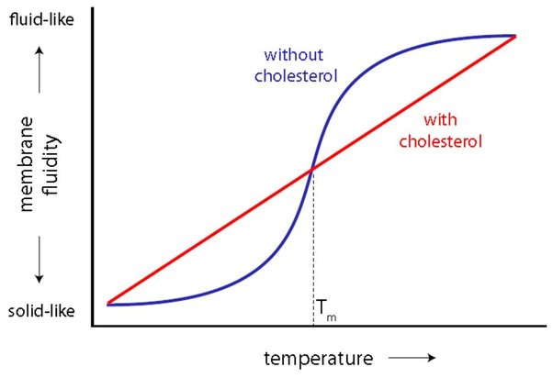

Slide 29
Membrane fluidity
Membrane fluidity is largely determined by the percentage of unsaturated fatty acids in its phospholipid molecules (Recall that the hydrocarbon chains of unsaturated fatty acids pack less densely than saturated chains)
A membrane’s fluidity increases as its percentage of unsaturated fatty acids increases
Cholesterol contributes stability to animal cell membranes because of its rigid ring system and ability to form van der Waals interactions with adjacent hydrocarbon chains- prevents the membrane from becoming ‘crispy’

Slide 30
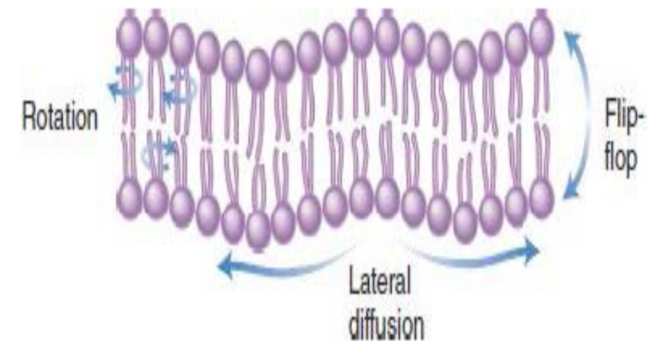
Membrane fluidity
Lateral movement/Lateral Diffusion (Movement of Phosphate groups within the membrane) of phospholipid molecules is usually relatively rapid
Transverse movement/ Transverse Diffusion it is the Movement of Phosphate groups between the outer and inner membrane
“Flip-flop,” the transfer of a lipid molecule from one side of a lipid bilayer to the other, occurs during new-membrane synthesis and membrane remodeling
Rotation of phospholipids within cell membranes is rapid
Flippase transfers phospholipids from the outer to the inner membrane leaflet, whereas floppase transfers them from the inner to the outer membrane.

Slide 31
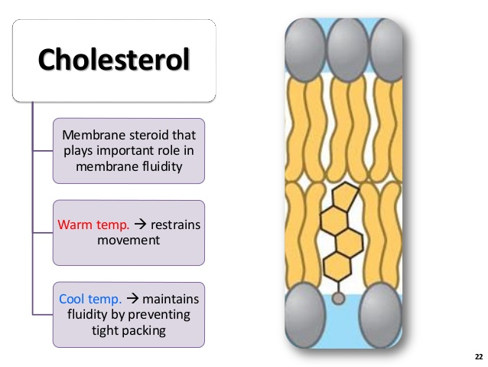
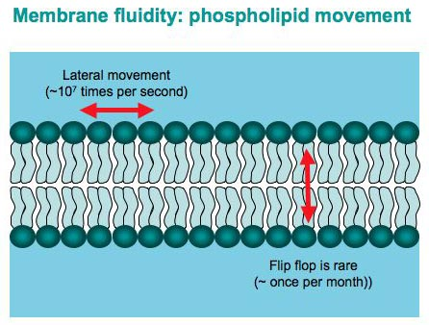
Concept of membrane fluidity
Notes:
Give space preventing lipids from gelling into crystalline state
Lipid rafts-secure important proteins in the memb
Without cholesterol, cell membranes would be too fluid, not firm enough, and too permeable to some molecules. In other words, it keeps the membrane from turning to mush.

Slide 32
Selective Permeability
Hydrophobic hydrocarbon chains in lipid bilayers provide a virtually impenetrable barrier to the transport of ionic and polar substances
To cross a lipid bilayer, a polar substance must bind to a carrier protein for membrane translocation or pass through an aqueous protein channel
Both methods shield the hydrophilic molecule from the hydrophobic core of the membrane
Water crosses the membrane through protein channels called aquaporins (AQPs), which exhibit cell-type variation in their permeability to both water and accompanying ions
Nonpolar substances simply diffuse through the lipid bilayer down their concentration gradients

Slide 33
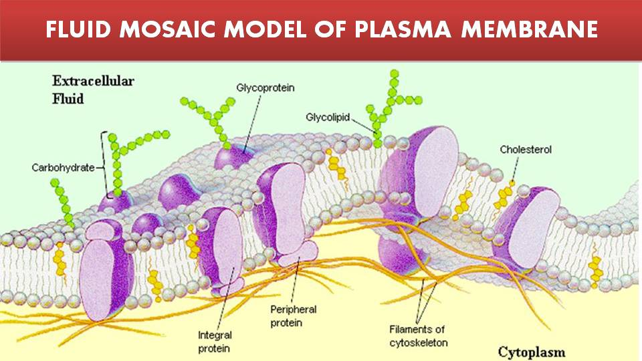

Slide 34
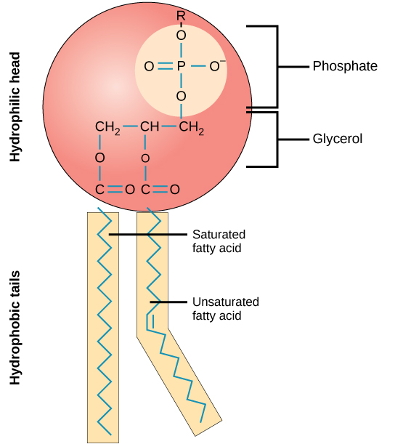

Slide 35
Membrane transport process
Membrane transport process
Active transport
Passive transport
Simple diffusion
Facilitated diffusion and Osmosis

Slide 36
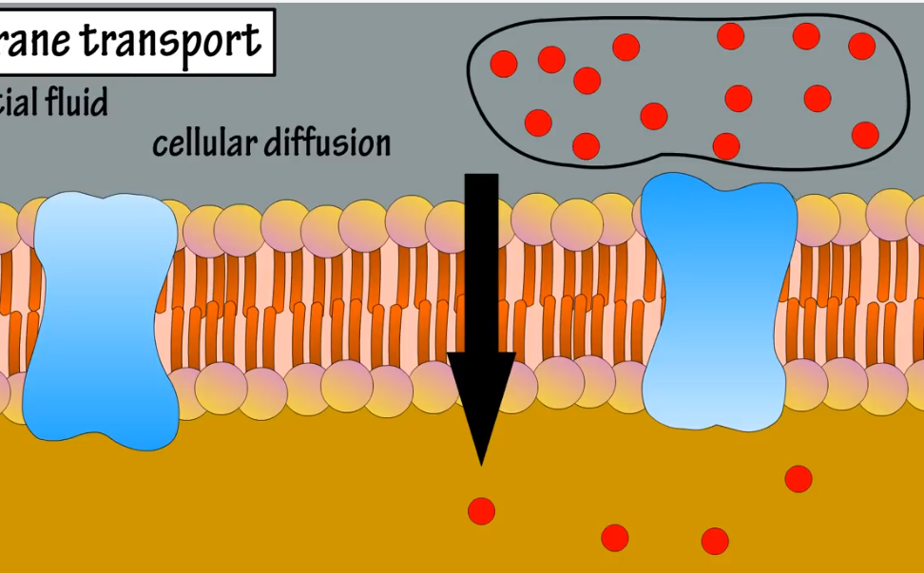
Simple Diffusion
It is the movement of substance from high concentration to low concentration
Small nonpolar substances like O₂ , CO₂ and small fatty acids

Slide 37
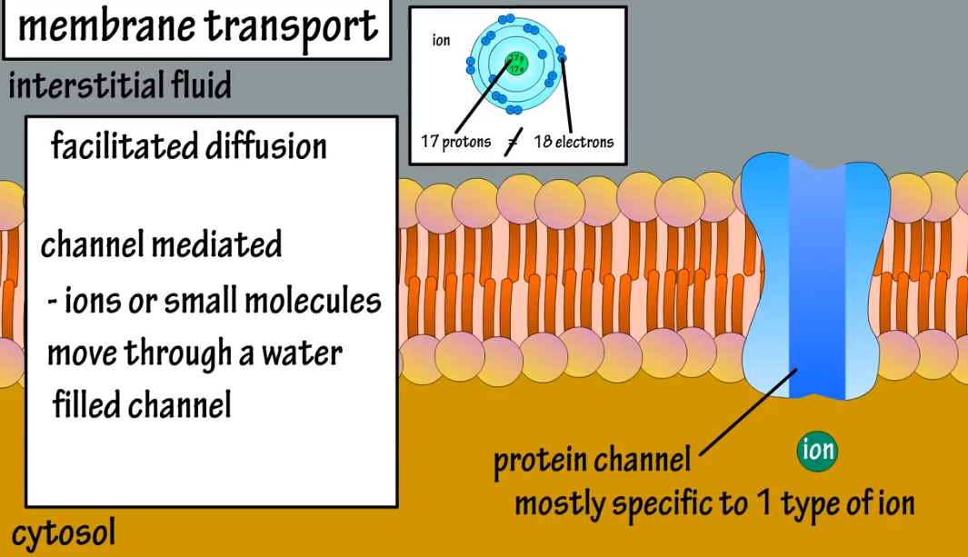
Facilitated diffusion
This occurs through the mediation of carrier or transport protein
Small charged or polar solutes
Two types- Channel mediated and carrier mediated diffusion

Slide 38
Facilitated diffusion
Channel mediated diffusion: These form selective channels or pores in the cell membranes(based on size charge or other characteristics)
Ions or small molecules move through a water filled channel
Aquaporins (facilitate water movement)
Ion channels (Allow ions like Na Ca etc)

Slide 39
Facilitated diffusion
Gap Junctions (Direct Exchange of ions or other small molecules between adjacent cells)
Important for cell communication & coordination like in cardiac and smooth tissues.
Porins (Outer membranes of bacteria, Mitochondria and chloroplasts)
These form large pores , facilitating the exchange of nutrients and wastes.

Slide 40
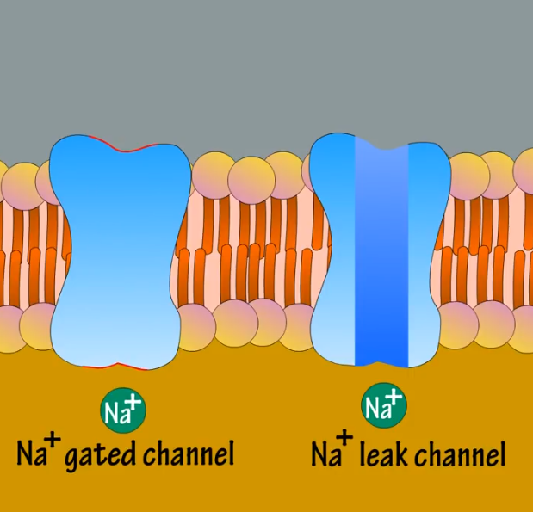
Types of channel proteins
Two types of channel proteins- a leaked channel & Gated channel-
leaked channel which are always open and allow ions to pass through membrane continuously.
Help in maintenance of resting membrane potential and electrical properties of membranes. (Na+ leaked channels K+ leaked channels).

Slide 41
Types of channel proteins
Gated channel- which require a stimulus ( changes in membrane potential, ligand binding, or mechanical forces) to open or close for only frictions of second..
These are use for precise control of ions movement.

Slide 42
These are further classified in three groups based on the stimulus that triggers their opening or closing.
Voltage gated channels
Ligand gated channels
Mechanically gated channels

Slide 43
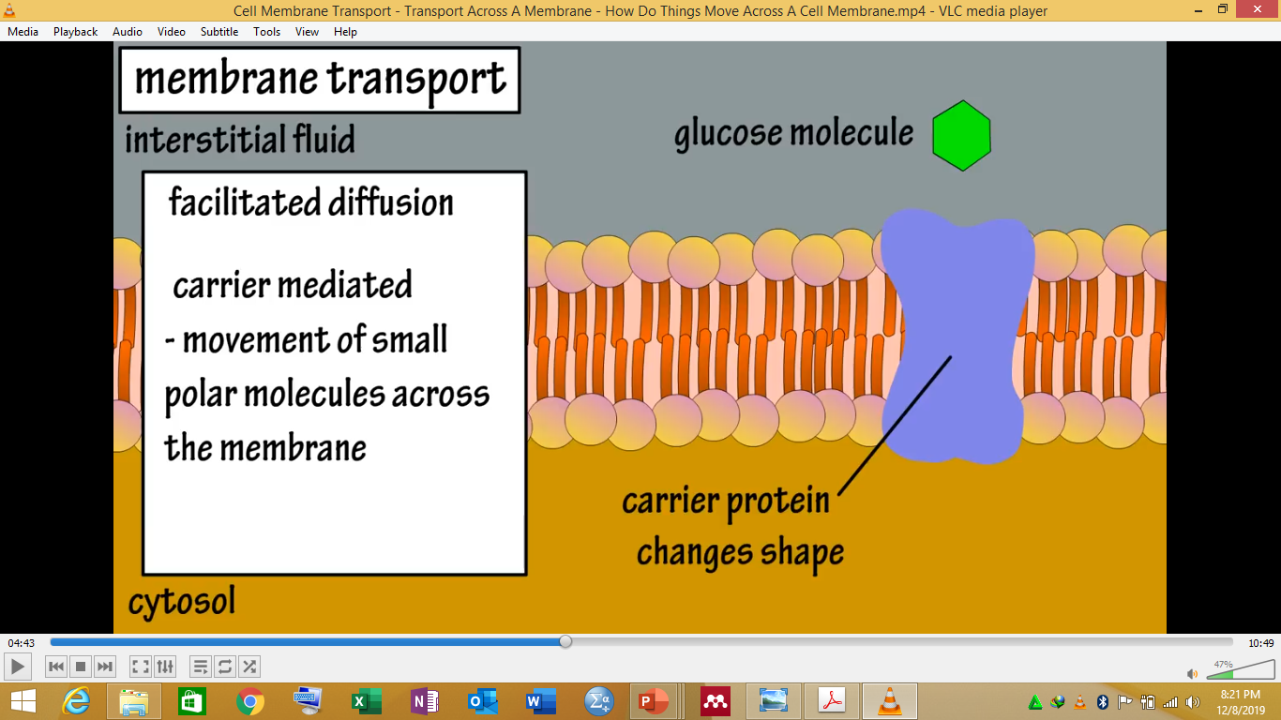
Carrier mediated diffusion
Carrier proteins bind to specific molecules on one side of the membrane , undergo conformational changes and than releases the molecule on the other side.
It is usually linked to a revolving door.
Glucose transport occurs using this mechanism

Slide 44
Mechanism of facilitated diffusion
A ping-pong model is put forth to explain the occurrence of facilitated diffusion
According to this mechanism, a transport (carrier) protein exists in two conformations
In the pong conformation, it is exposed to the side with high solute concentration
This allows the binding of solute to specific sites on the carrier protein

Slide 45
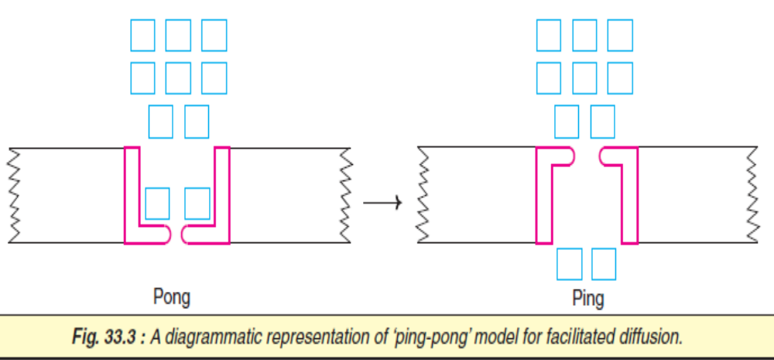
Mechanism of facilitated diffusion
The protein then undergoes a conformational change (ping state) to expose to the side with low solute concentration where the solute molecule is released
Hormones regulate facilitated diffusion
For instance, insulin increases glucose transport in muscle and adipose tissue; amino acid transport in liver and other tissues

Slide 46
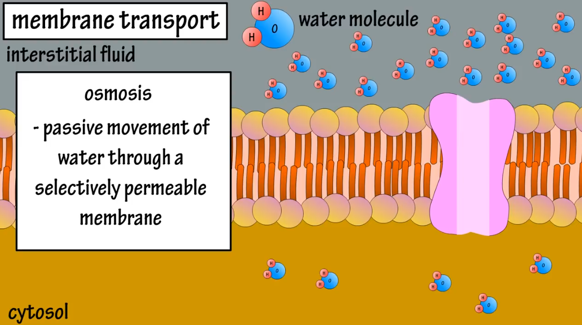
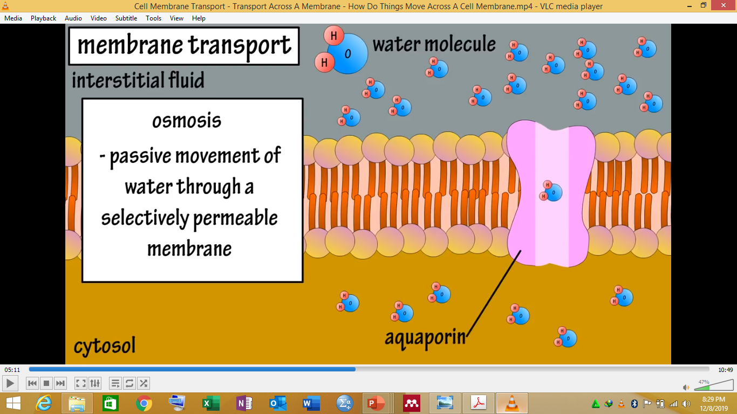
Osmosis
Passive movement of water through a selectively permeable membrane- occurs when there is a difference of concentration of water molecules on either side of the membrane
This occurs in two ways-
Water can slip between the phospholipid molecules of the membrane
Or through protein water channel- aquaporin

Slide 47
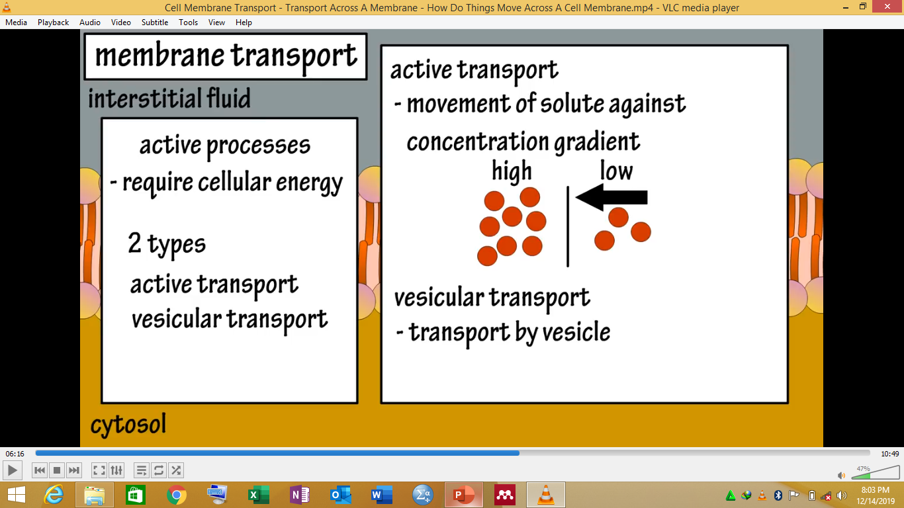
Active process
Requires cellular energy
Two types- Active transport and vesicular transport
Active transport- Movement of solutes against concentration gradient

Slide 48
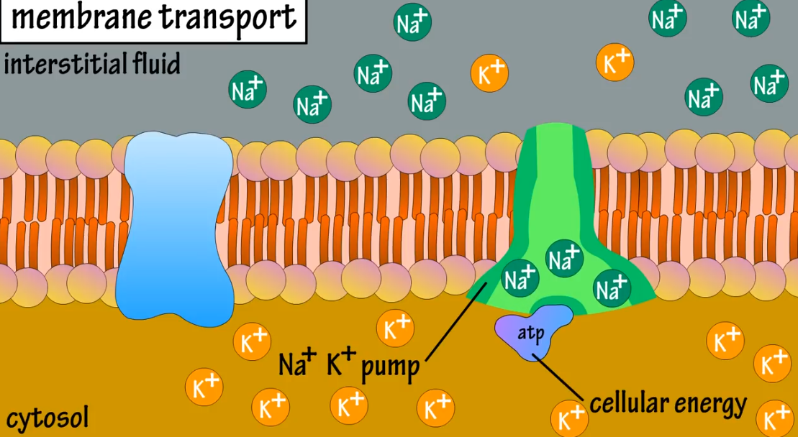
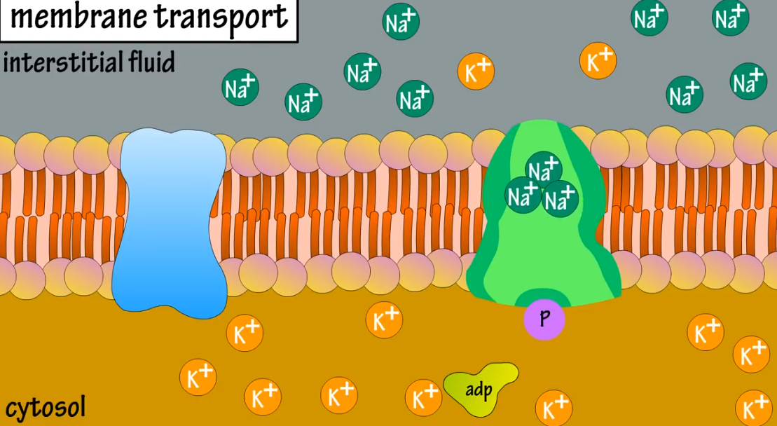
Active transport
Active transport has two types
Primary Active transport
Secondary Active transport
In primary active transport cellular protein pumps (ion pumps) move ions across the plasma membrane against concentration gradient

Slide 49
Na⁺-K⁺ pump
The cells have a high intracellular K⁺ concentration and a low Na⁺ concentration which is essentially needed for the survival of the cells
High cellular K⁺ is required for the optimal glycolysis (pyruvate kinase is dependent on K⁺) and for protein biosynthesis
Further, Na⁺ and K⁺ gradients across plasma membranes are needed for the transmission of nerve impulse
The Na⁺-K⁺ pump is responsible for the maintenance of high K⁺ and low Na⁺ concentrations in the cells

Slide 50
Na⁺-K⁺ pump
This is brought about by an integral plasma membrane protein, Na⁺-K⁺ ATPase
It consists of two α and two β subunits which may be represented as (αβ)₂.
Na⁺-K⁺ ATPase pumps 3Na⁺ ions from inside the cell to outside and brings 2K⁺ ions from the outside to the inside with a concomitant hydrolysis of intracellular ATP
A major portion of the cellular ATP (up to 70% in nerve cells) is in fact utilized by Na⁺-K⁺ pump to maintain the requisite cytosolic Na⁺ and K⁺ levels

Slide 51
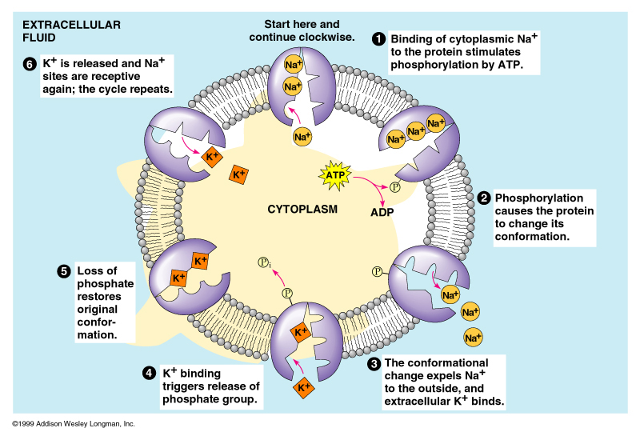
Na⁺-K⁺ pump

Slide 52
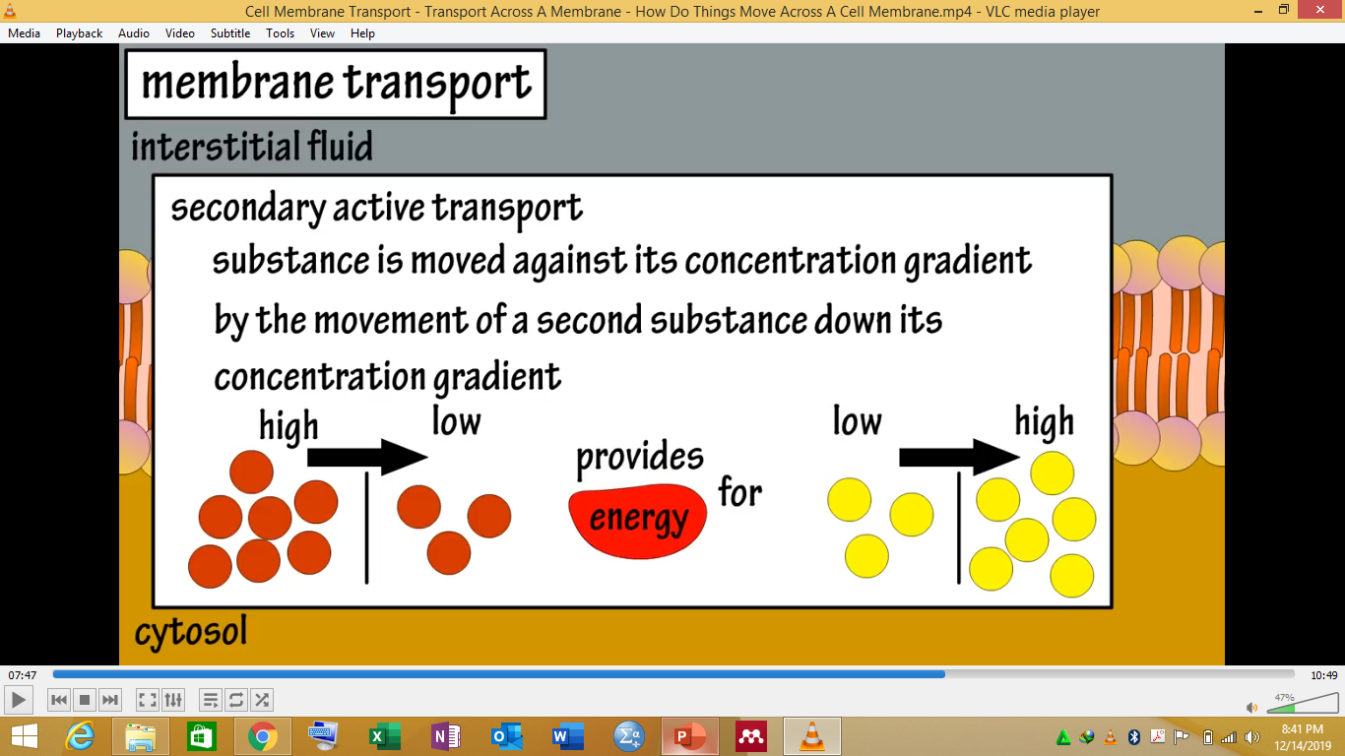
Secondary active transport/Cotransport/coupled transport
In secondary active transport substance is moved against its concentration gradient by using energy provided by the movement of a second substance down its concentration gradient

Slide 53
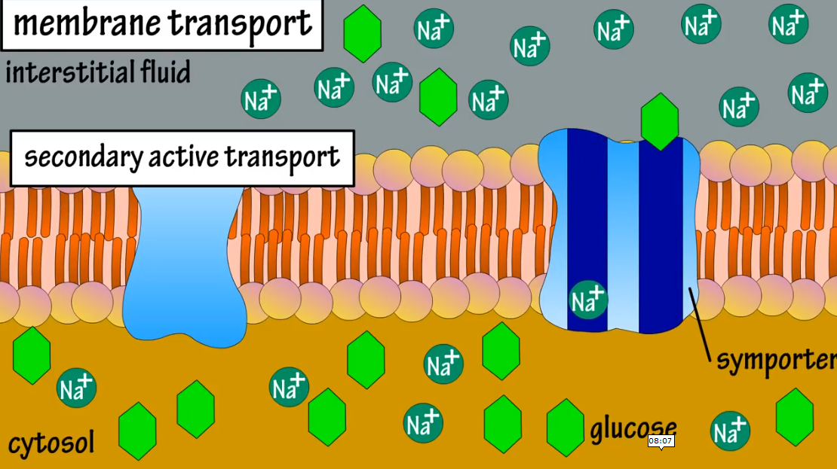
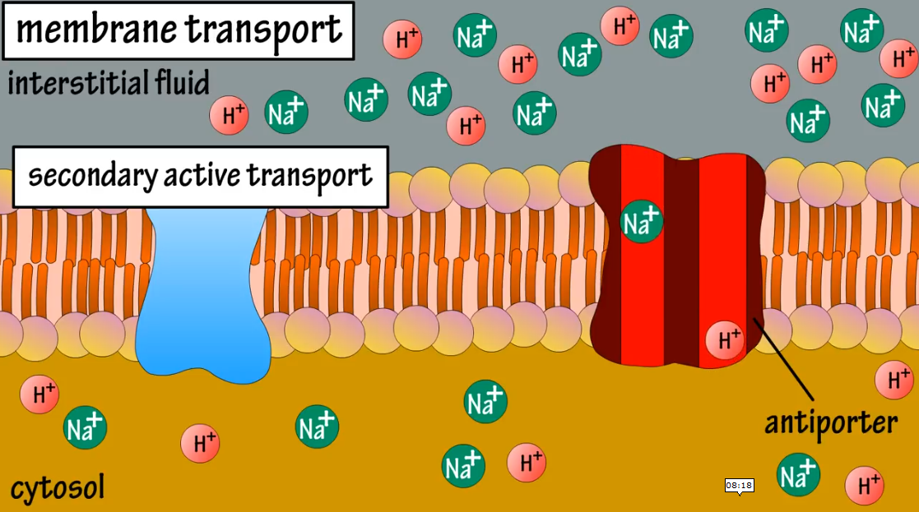
Types of secondary active transport
Two types
Symport: Two substances move in the same direction (Na+ dependent glucose transport)
Anti- port: Two substances move in opposite direction ( Na+ Ca+ transport)

Slide 54
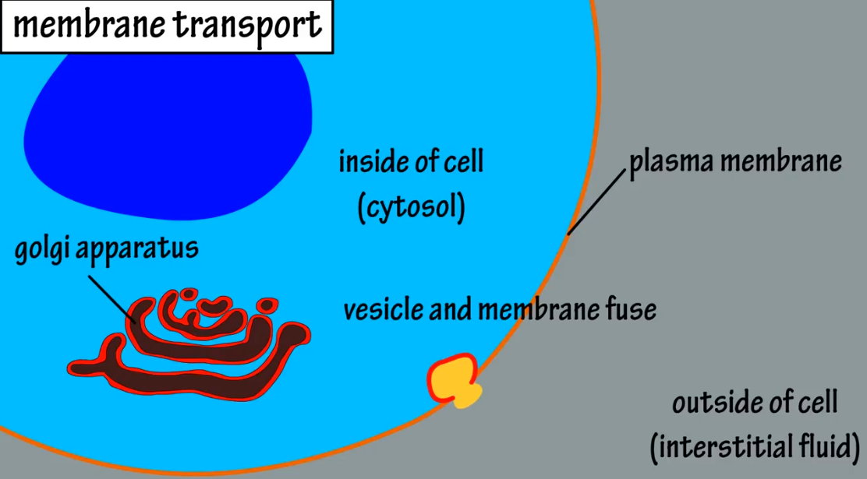
Vesicular transport
Transport of large substances across the plasma membranes by vesicles- a membrane bound sac filled with materials
Proteins and large polysaccharides
Two types: Exocytosis and endocytosis
Exocytosis: Materials are secreted from cell to the interstitial fluid outside the cell

Slide 55
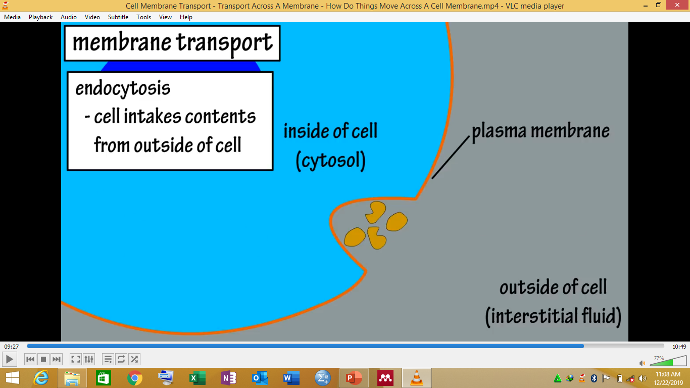
Endocytosis
Cell intakes contents from outside of the cell
Three main forms of endocytosis:
Phagocytosis, Pinocytosis and receptor mediated endocytosis

Slide 56
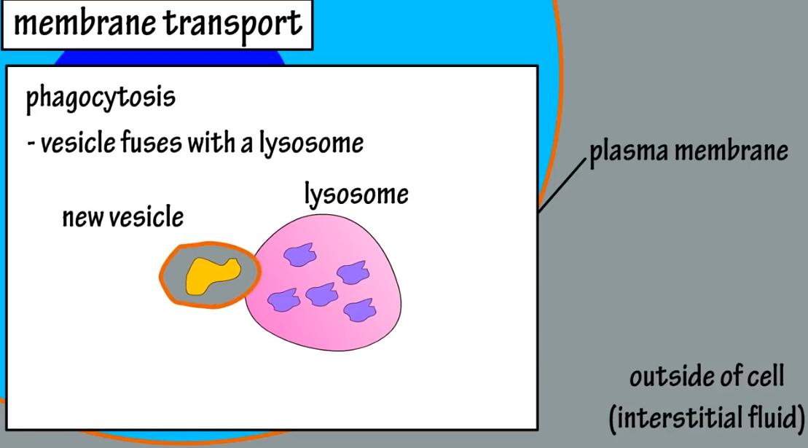
Phagocytosis
A large particle is engulfed by a newly formed vesicle which fuses with a lysosome that contains digestive enzymes that hydrolyze the engulfed material- cell eating

Slide 57
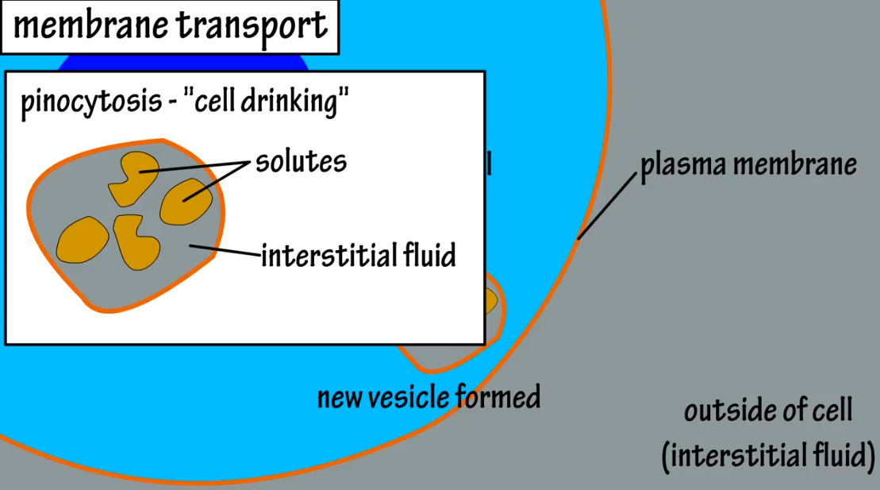
Pinocytosis
When plasma membrane folds inwards and engulfs interstitial fluid that contains dissolved solutes that can be used by the cell- cell drinking

Slide 58
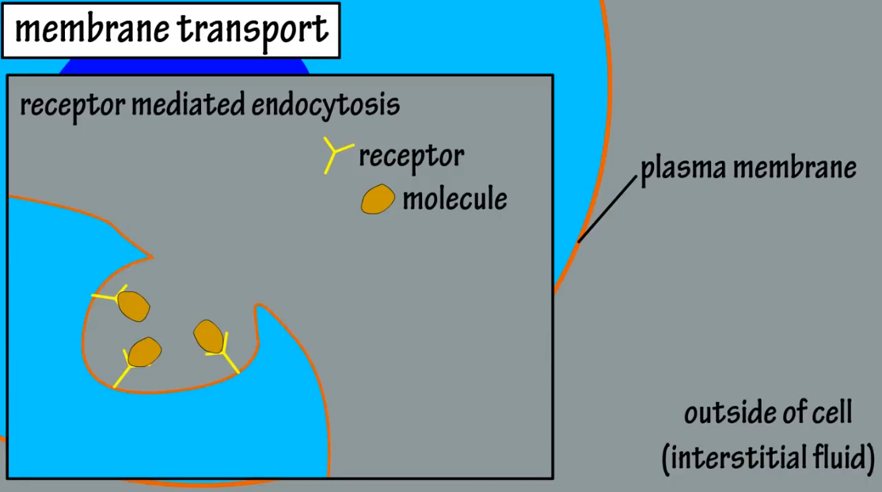
Receptor mediated endocytosis
This type of transport uses receptors located on the surface of cell membrane
Molecules in the interstitial fluid bind with these receptors and the membrane folds inside in the form of a vesicle
Both endocytosis and exocytosis require energy

Slide 59
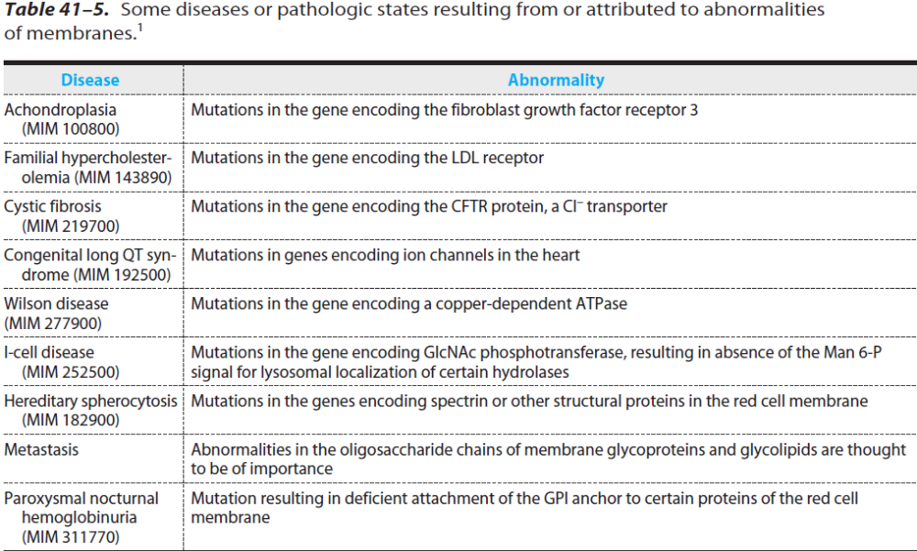

Slide 60


Slide 61


