Slide 1
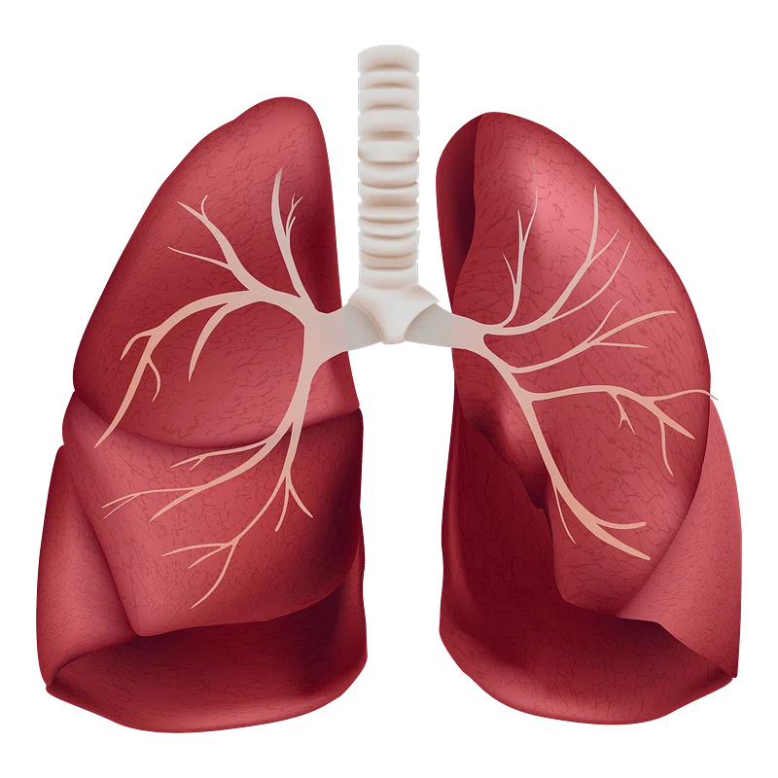
Respiratory Physiology
Khushal Khan

Slide 2
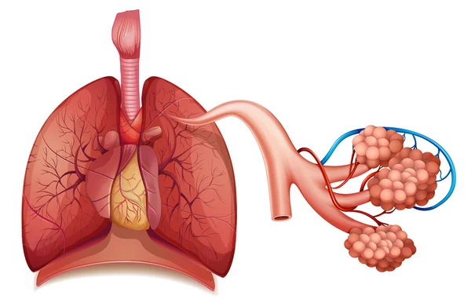
Respiratory System

Slide 3
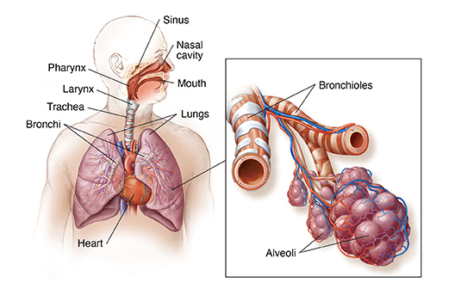
Respiratory System
Definition:
  an organ system also known as the respiratory apparatus or ventilatory system.
  The respiratory system is the network of organs and tissues crucial for breathing.
Composition:
  It consists of respiratory organs and structures for gaseous exchange.
Function:
  Provides the pathway for:
    Oxygen from the atmospheric air to enter the body.
    Carbon dioxide from the body to be expelled into the atmosphere.

Slide 4
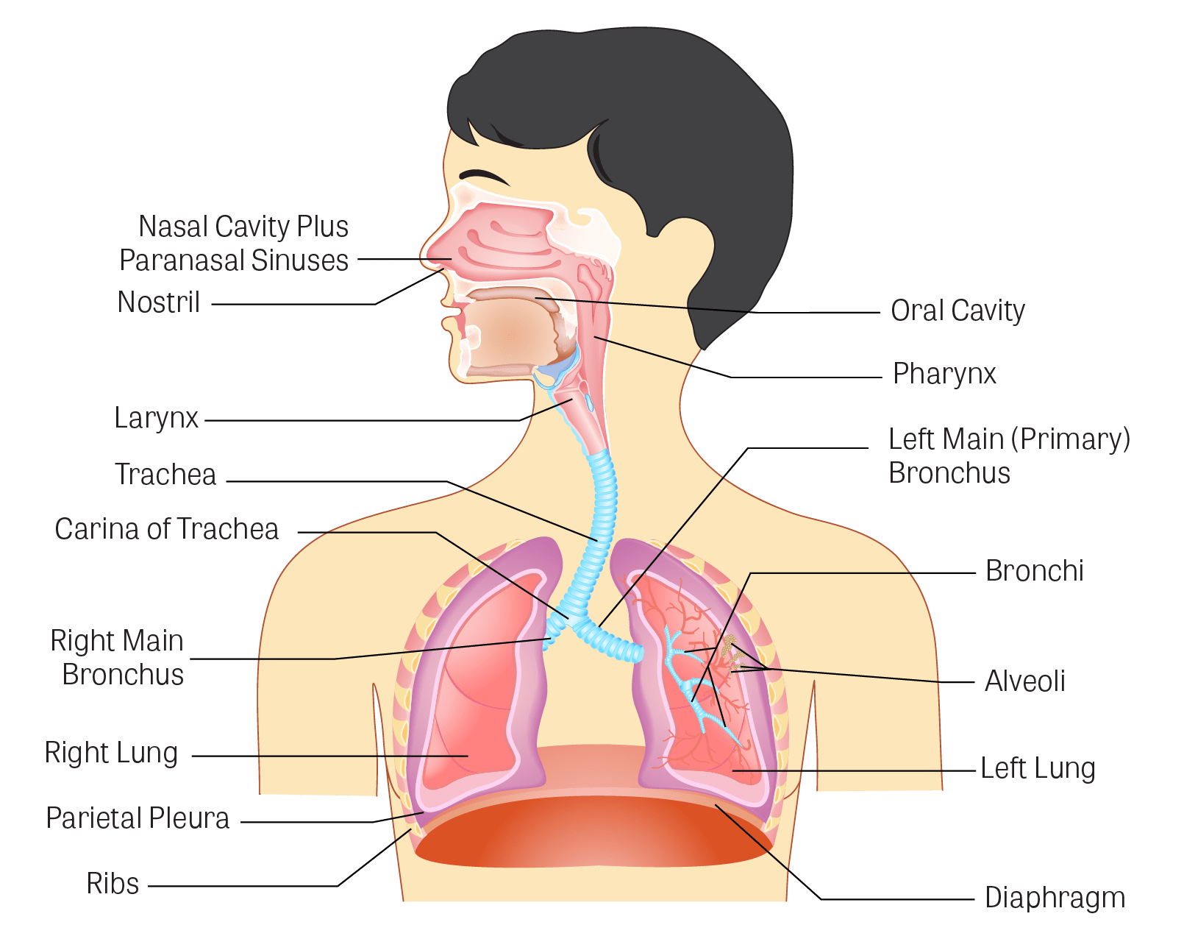
Parts of Respiratory System
Organs of the Respiratory System:
  Nose
  Pharynx
  Larynx
  Trachea
  Bronchi (one bronchus to each lung)
  Bronchioles
  Lungs
  Muscles for breathing
Muscles Involved in Breathing:
  Intercostal muscles
  Diaphragm

Slide 5
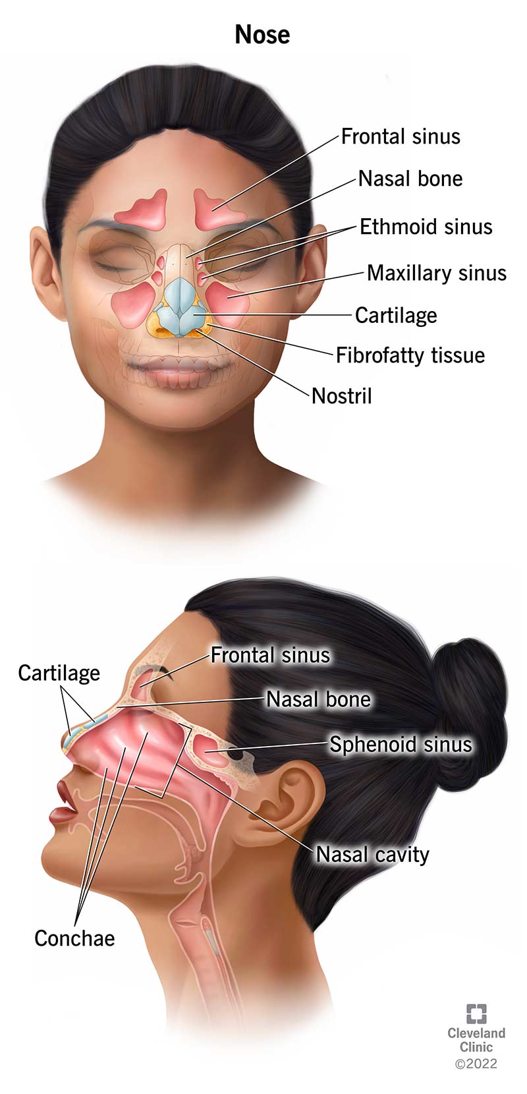
Nose
Function:
  First passage for inspired air.
Composition:
  Lined with ciliated columnar epithelium.
  Contains mucus-secreting goblet cells.
Nares (Nostrils):
  Anterior Nares: Openings from the exterior to the nasal cavity.
    Nasal hairs present, coated in sticky mucus.
  Posterior Nares: Openings from the nasal cavity to the pharynx.

Slide 6
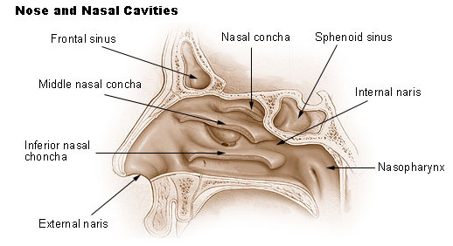
Nasal Cavity
Role:
  Main route for air entry.
Structure:
  Large, irregular cavity.
  Divided into two equal passages by a septum.
Paranasal Sinuses:
  Cavities in facial and cranial bones, filled with air.
  Tiny openings between nasal cavity and sinuses.
  Lined with mucous membrane.

Slide 7
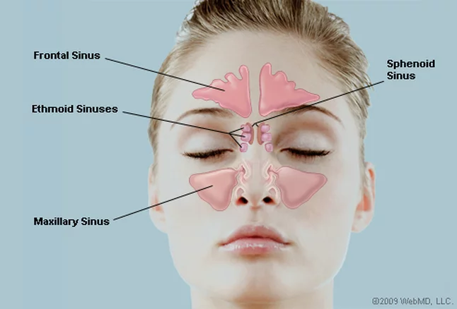
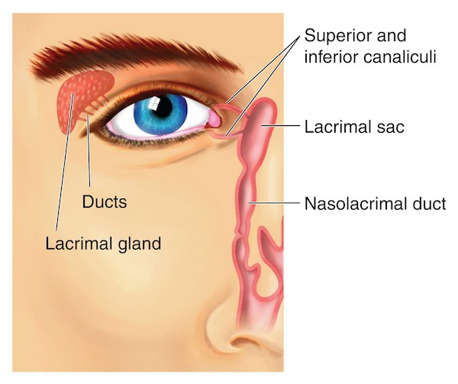
Paranasal Sinuses
Four Sinuses:
  Functions:
    Aid in speech.
    Lighten the skull.
Nasolacrimal Ducts:
  Location: Extends from the lateral walls of the nose to the conjunctival sacs of the eye.
  Function: Drains tears from the eyes.
  Purpose: Facilitates the removal of excess tears, contributing to ocular lubrication and preventing overflow.

Slide 8
Functions of Nose and Nasal Cavity
Warming of air:
  Due to immense vascularity of the mucosa.
Filtering and Cleaning:
  Hairs at the anterior nares trap larger particles.
  Smaller particles (dust and bacteria) settle in the mucus.
  Mucus protects epithelium, prevents drying.
  Cilia beat synchronously, moving mucus to the throat for swallowing or coughing.
Humidification:
  Air, as it passes over moist mucosa, becomes saturated with water vapours.

Slide 9
Irritation Response:
  Nasal mucosa irritation leads to sneezing, forcibly expelling irritants through reflex action.
Sense of Smell:
  The nose serves as the organ for the sense of smell (olfaction).

Slide 10
Pharynx
Structure:
  Tube, 12 to 14 cm long.
  Extends from the base of the skull to the level of the 6th cervical vertebra.
  Positioned behind the nose, mouth, and larynx; wider at its upper end.
Division:
  Nasopharynx: Behind the nose.
  Oropharynx: Behind the mouth.
  Laryngopharynx (Hypopharynx): Extends from the oropharynx and continues as the esophagus below.
Dual Role:
  Involved in both respiratory and digestive systems.
  Air passes through nasal and oral sections.
  Food passes through oral and laryngeal sections.

Slide 11
Functions
Warming and Humidification:
  Air further warmed and moistened as it passes through the pharynx.
Taste:
  Olfactory nerve endings sense taste in the epithelium of oral and pharyngeal parts.
Hearing:
  Auditory tube from nasopharynx to middle ear allows air entry.
Protection:
  Lymphatic tissue produces antibodies; tonsils larger in children, tend to atrophy in adults.
Speech:
  Acts as a resonating chamber, contributing to the voice's individual characteristics.

Slide 12
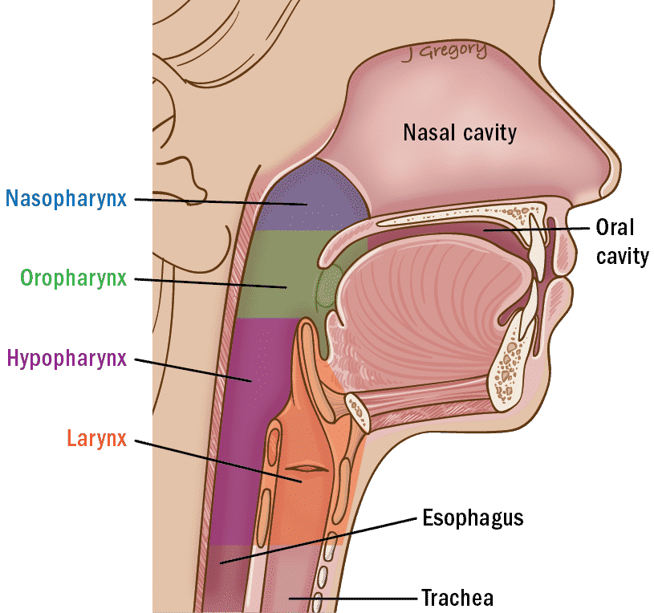
Larynx (Voice Box)
Location:
  Links laryngopharynx and trachea.
  Positioned at the 3rd, 4th, 5th, and 6th cervical vertebrae.
Puberty Effects:
  After puberty, it enlarges in males, leading to the 'Adam’s apple' and a deeper voice.
Composition:
  Thyroid cartilage
  Cricoid cartilage
  Arytenoid cartilage
  Epiglottis (elastic fibrocartilage)

Slide 13
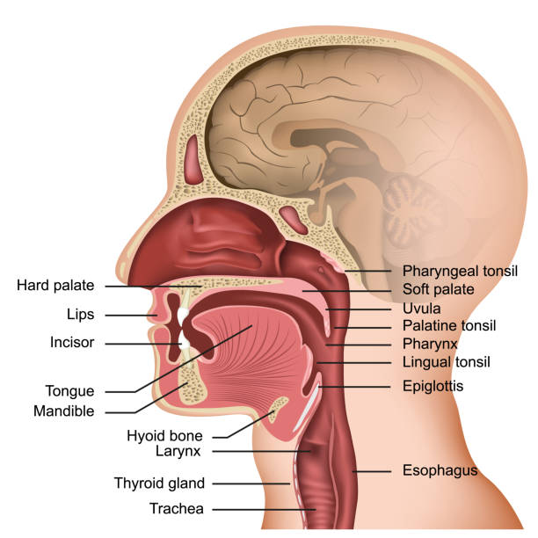
Epiglottis:
  Leaf-shaped fibroelastic cartilage.
  Acts as a lid, closing off the larynx during swallowing to prevent inhalation of foreign objects.
Vocal Cords:
  Two pale folds of mucous membrane with cord-like free edges.
  Essential for voice production.

Slide 14
Functions
Sound Production:
  Puberty leads to longer male vocal cords, resulting in lower pitch.
  Sound intensity depends on the force of expired air; resonance on mouth shape, tongue, lips, facial muscles, and paranasal sinuses.
Speech:
  Manipulation of vocal cord sounds by the tongue, cheeks, and lips.
Protection of Lower Respiratory Tract:
  Larynx moves upward during swallowing, blocking the opening from the pharynx.
  Epiglottis closes, ensuring food enters the esophagus, not the trachea.
Air Passageway:
  Connects pharynx above with trachea below.
Humidification, Filtering, Warming:
  Processes continue as inspired air passes through the larynx.

Slide 15
Trachea (windpipe)
Continuation:
  Extends downward from the larynx to approximately the level of the 5th thoracic vertebra.
Carina:
  At the carina, the trachea bifurcates into:
    Right primary bronchi (to the right lung)
    Left primary bronchi (to the left lung)
Length:
  Approximately 10 to 11 cm.
Location:
  Lies mainly in the median plane in front of the esophagus.

Slide 16
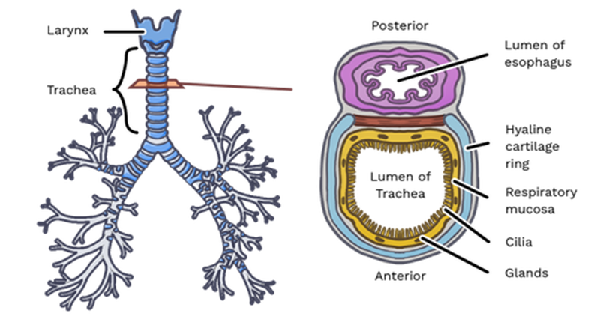
Structural Composition:
  Composed of 16 to 20 incomplete (C-shaped) rings of hyaline cartilage.
  Incomplete posteriorly, embedded in smooth muscle and connective tissue.
  The soft tissue posterior wall is in contact with the esophagus.

Slide 17
Functions
Support and Patency
  Tracheal cartilages maintain trachea openness (patency).
  Absence of cartilage posteriorly allows flexibility and response to nerve stimulation.
  Contraction or relaxation of the trachealis muscle regulates trachea diameter.
Mucociliary Escalator:
  Synchronous beating of cilia in the mucous membrane moves mucus with particles upward, either swallowed or coughed up.
Warming, Humidifying, and Filtering:
  Continues similar processes as in the nose, although air is typically saturated and at body temperature upon reaching the trachea.

Slide 18
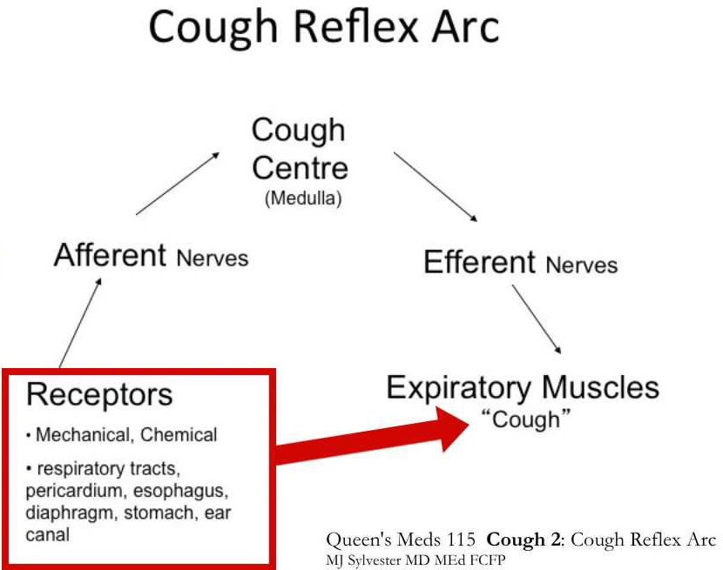
Cough Reflex:
  Nerve endings in larynx, trachea, and bronchi detect irritation.
  Generates nerve impulses via the vagus nerves to the respiratory center in the brain stem.
  Reflex involves deep inspiration, glottis closure, contraction of abdominal and respiratory muscles, and forceful release of air to expel mucus or foreign material from the mouth.

Slide 19
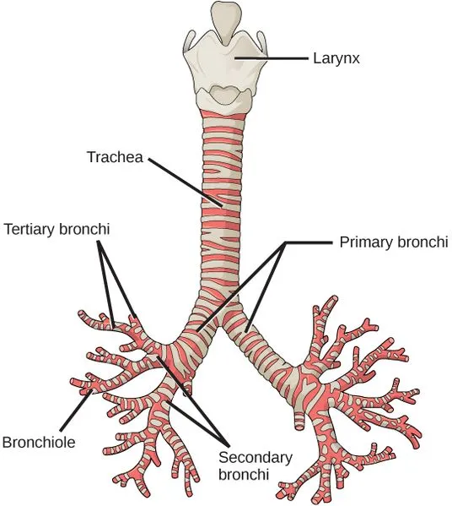
Bronchi and Bronchioles
Division from Trachea:
  The trachea divides into two primary bronchi at the level of the 5th thoracic vertebra.
Bronchial Wall Composition:
  Walls composed of the same tissues as the trachea.
  Lined with ciliated columnar epithelium.
Progressive Subdivision:
  Bronchi divide into bronchioles, including:
    Terminal bronchioles
    Respiratory bronchioles
    Alveolar ducts
    Alveoli
Conducting Airways:
  Wider passages designed for air transport into the lungs.
  Walls are too thick for efficient gas exchange.

Slide 20
Right Bronchus:
  Characteristics:
    Wider, shorter, and more vertical than the left bronchus.
    Greater susceptibility to obstruction by inhaled foreign bodies.
    Approximately 2.5 cm long.
  Branching in Right Lung:
    After entering the right lung at the hilum, it divides into three branches, one to each lobe.
    Each branch further subdivides into numerous smaller branches.
Left Bronchus:
  Characteristics:
    About 5 cm long and narrower than the right.
  Branching in Left Lung:
    After entering the lung at the hilum, it divides into two branches, one to each lobe.
    Each branch further subdivides into progressively smaller airways within the lung substance.

Slide 21
Functions
Control of Air Entry
  Smooth muscle contraction or relaxation regulates the diameter of respiratory passages.
  Controls the speed and volume of airflow into and within the lungs.
Warming, Humidifying, and Support:
  Warming and Humidifying:
    These functions continue from the upper airways.
  Support and Patency:
    Smooth muscle maintains support and openness.
Removal of Particulate Matter and Cough Reflex:
  Removal:
    Efficient filtration to prevent entry of particulate matter.
  Cough Reflex:
    Mechanism to expel irritants or foreign material.

Slide 22
Defence Against Infection:
  Structural Changes:
    Ciliated epithelium, goblet cells, and mucus are absent to prevent interference with gas exchange and reduce infection risk.
  Protective Cells:
    Lymphocytes, plasma cells, and alveolar macrophages defend against infections.
    Active in distal air passages with flattened cells replacing ciliated epithelium.
Continuation of Warming and Humidifying:
  Essential for maintaining mucosal health and preventing irritation or infection.

Slide 23
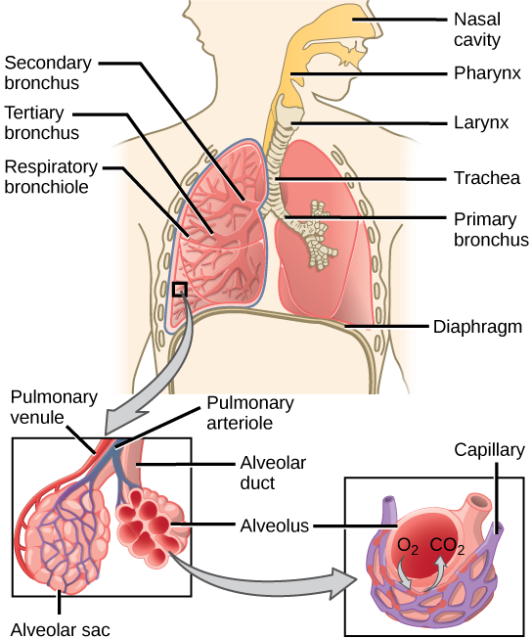
Alveoli
Definition:
  Tiny air sacs serving as basic respiratory units.
Structure:
  Hollow cup-shaped cavities in the lung parenchyma.
Location:
  Found in the acini at the beginning of the respiratory zone.
  Sparsely located in respiratory bronchioles, lining alveolar duct walls.
  More numerous in blind-ended alveolar sacs.
Quantification:
  Approximately 300 million alveoli in two lungs.
  Average diameter of each alveolus is about 0.2 millimeters.

Slide 24
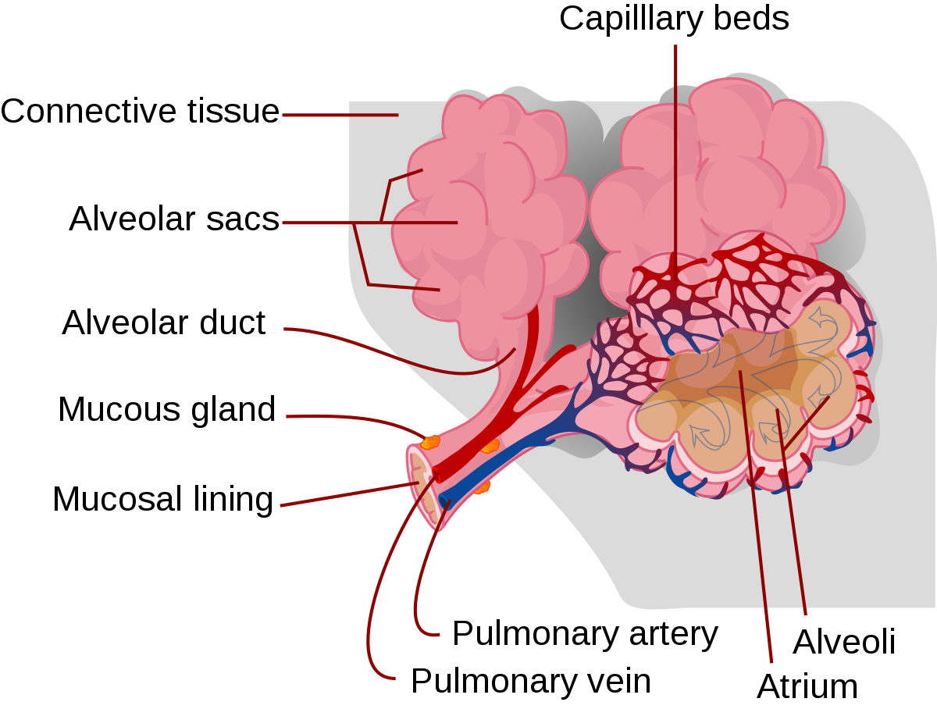
Respiratory Bronchiole Connection:
  Respiratory bronchioles lead into alveolar ducts, deeply lined with alveoli.
  Each respiratory bronchiole gives rise to 2 to 11 alveolar ducts.
Ducts and Sac Arrangement:
  Each duct opens into five or six alveolar sacs.
  Clusters of alveoli open into these sacs.
Developmental Changes:
  Exponential increase in the number of alveoli during the first two years of life.
  Continued growth, albeit at a reduced rate, through adolescence.
Functional Surface:
  Alveolar membrane serves as the gas exchange surface.

Slide 25
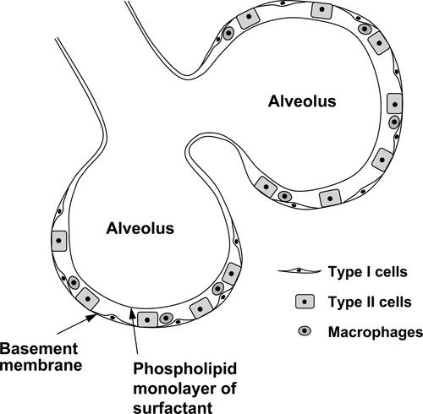
Capillary Network:
  Surrounded by a network of capillaries for efficient gas exchange.
Cell Types:
  Alveolar cells have diverse functions.
  Major types include:
    Pneumocytes (Type I Cells)
    Pneumocytes (Type II Cells)
Cell Locations:
  Found in the alveolar wall.
  Large phagocytic cell, alveolar macrophage, moves within alveoli and connective tissue.

Slide 26
Functions of Pneumocytes
Functions of Pneumocytes (Type I Cells):
  Facilitate efficient gas exchange by providing a thin barrier for oxygen and carbon dioxide diffusion between alveoli and capillaries.
  Form delicate structures in the alveolar wall, contributing to overall alveoli integrity.
Functions of Pneumocytes (Type II Cells):
  Produce surfactant to reduce surface tension within alveoli, preventing alveolar collapse during exhalation and aiding lung expansion during inhalation.
  Contribute to alveolar stability by maintaining structure and preventing collapse.
  Serve as progenitor cells for type I cells, aiding in alveolar repair and regeneration.

Slide 27
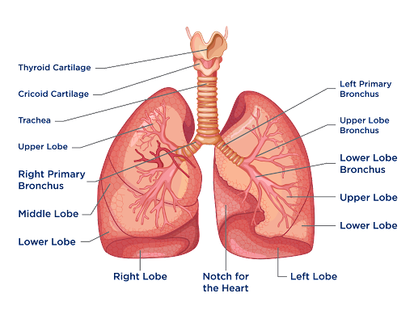
Lungs
Number:
  Two lungs, situated on either side of the midline within the thoracic cavity.
Shape:
  Cone-shaped.
Surfaces:
  Apex
  Base
  Costal Surface
  Medial Surface
Mediastinum:
  The area between the lungs.

Slide 28
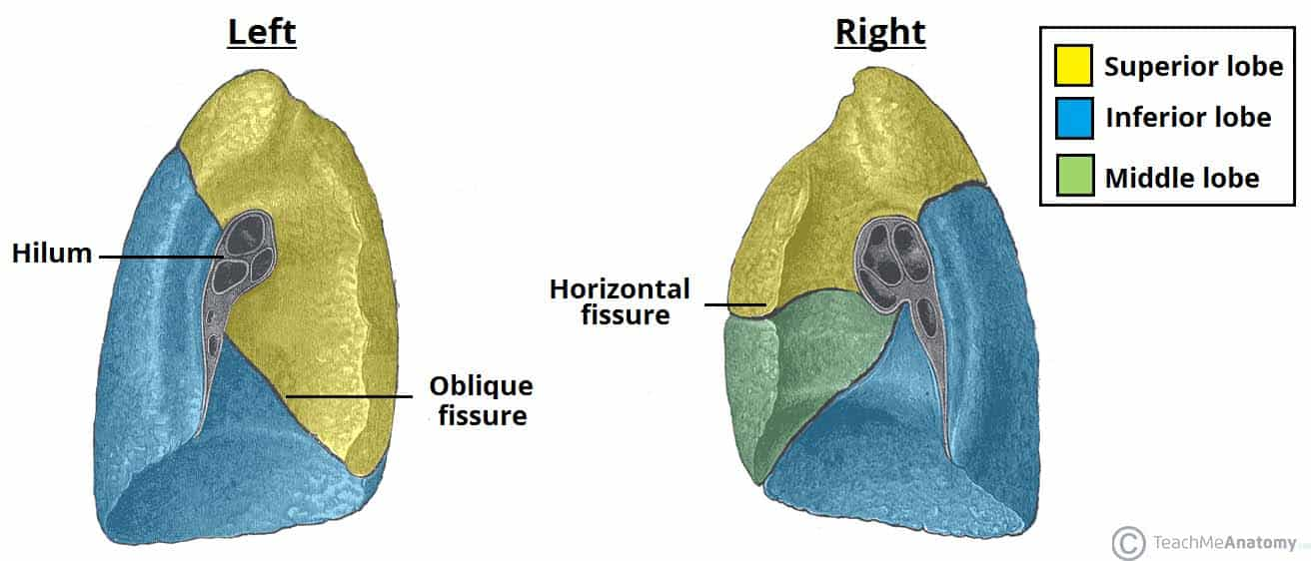
Lobe Division:
  Right Lung: Divided into superior, middle, and inferior lobes.
  Left Lung: Divided into superior and inferior lobes.
Fissures:
  Divisions between lobes.

Slide 29
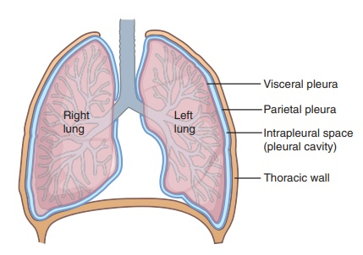
Pleura
Pleura:
  Closed sac of serous membrane for each lung.
  Contains a small amount of serous fluid.
Layers of Pleura:
  Visceral Pleura: Adherent to the lung, covering each lobe and extending into fissures.
  Parietal Pleura: Adherent to the chest wall and diaphragm, not attached to structures in the mediastinum, continuous with visceral pleura around the hilum edges. A potential space containing no air.
Pleural Fluid:
  Thin film between the two layers, allowing gliding motion and preventing friction during breathing.
  Secreted by epithelial cells of the pleural membrane.

Slide 30
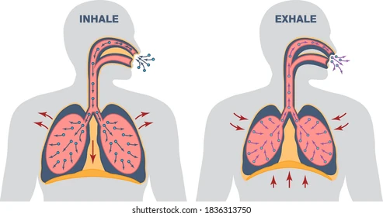
Respiration

Slide 31
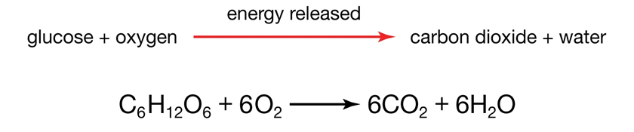
Respiration
Physiological Respiration
  Movement of oxygen from the outside environment to cells within tissues.
  Removal of carbon dioxide from cells to the environment.
Components of Respiration
  Oxygen intake.
  Carbon dioxide release.
Involves the diffusion and transport of metabolites between the organism and the external environment.
Essential for sustaining cellular respiration.
Vital for animal life.
Cellular Respiration
  Metabolic process for obtaining energy (ATP and NADPH).
  Involves the oxidation of nutrients and the release of waste products.
Cellular Respiration Location
  Occurs in individual cells of the organism.

Slide 32
Four Major Components of Respiration
Pulmonary Ventilation:
  Inflow and outflow of air between the atmosphere and lung alveoli.
Diffusion of Gases:
  Exchange of oxygen (O2) and carbon dioxide (CO2) between alveoli and blood.
Transport in Blood:
  Conveyance of oxygen and carbon dioxide in the blood and body fluids to and from tissue cells.
Regulation of Respiration:
  Control and adjustment of ventilation and other aspects of respiration.

Slide 33
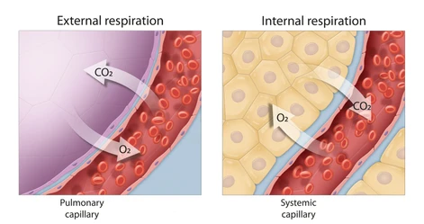
Respiration
Definition
  Exchange of gases between body cells and the environment.
Processes of Respiration
Breathing (Pulmonary Ventilation)
  Movement of air into and out of the lungs.
Exchange of Gases
  In the Lungs (External Respiration):
    Involves inhalation (bringing air into the lungs).
    Exhalation (releasing air to the atmosphere).
  In the Tissues (Internal Respiration):
    Exchange of oxygen and carbon dioxide between cells and blood vessels.

Slide 34
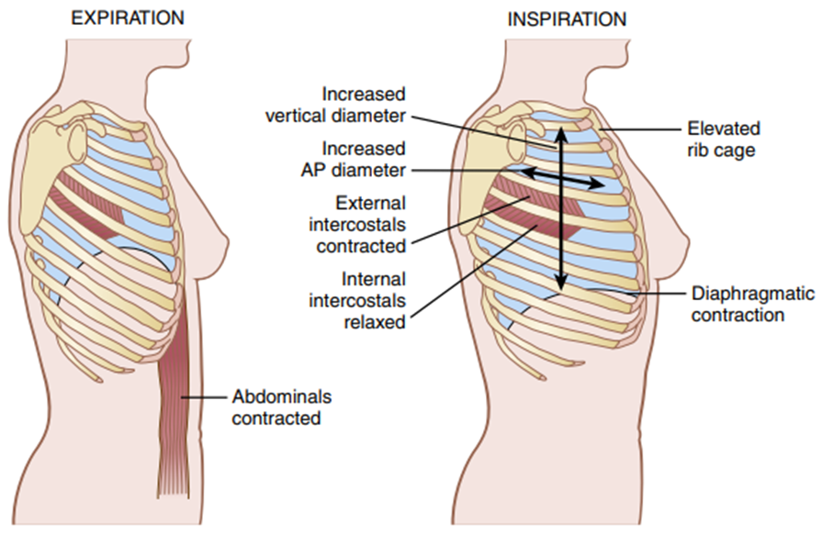
Mechanics of Pulmonary Ventilation / Breathing
Muscles for Lung Expansion and Contraction:
Two primary ways to expand/contract lungs:
  Movement of diaphragm (downward for inspiration, upward for expiration).
  Elevation/depression of ribs (increases/decreases anteroposterior diameter).
Normal Breathing:
  Diaphragm's contraction pulls lungs downward during inspiration.
  Elastic recoil during expiration, aided by abdominal muscles during heavy breathing.

Slide 35
Rib Cage Movement:
  Elevation expands lungs, increasing anteroposterior thickness.
  Muscles elevating chest cage are inspiratory; those depressing it are expiratory.
Muscles Involved:
  Inspiratory: External intercostals, sternocleidomastoid, anterior serrati, scaleni.
  Expiratory: Abdominal recti, internal intercostals.

Slide 36
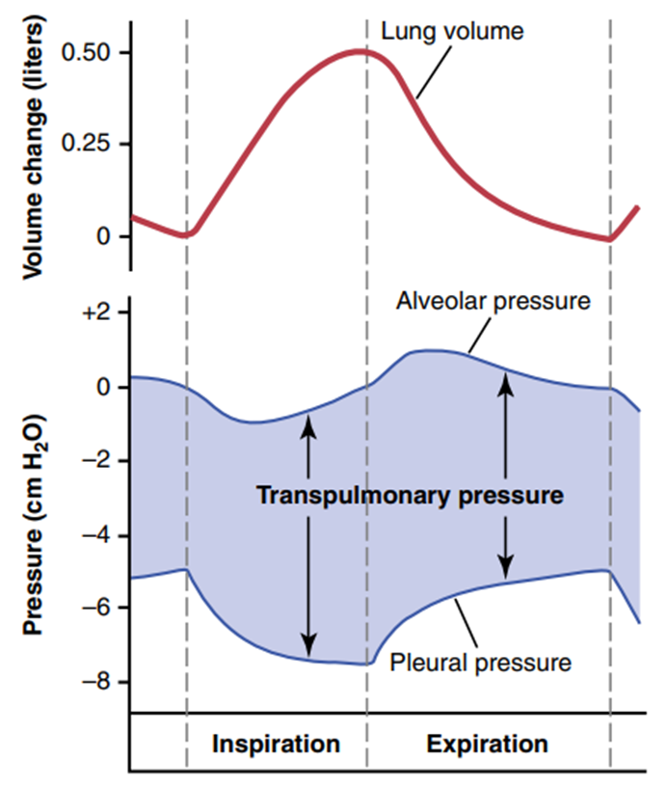
Pressures in Respiratory System
Pleural Pressure:
The pressure of the fluid in the thin space between the lung pleura and chest wall pleura.
Normally negative, a slight suction
  About -5 cm H2O at the beginning of inspiration
  -7.5 cm H2O during normal inspiration
Helps keep lungs open, increases during inspiration.
Alveolar Pressure:
The pressure of air inside lung alveoli.
When the glottis is open and no air is flowing into or out of the lungs, the pressures in all parts of the respiratory tree, all the way to the alveoli, are equal to atmospheric pressure, which is considered to be zero reference pressure in the airways—that is, 0 cm H2O pressure.
During inspiration, falls to about -1 cm H2O, drawing air into lungs.
During expiration, rises to about +1 cm H2O, expelling air from lungs.

Slide 37
Pressures in Respiratory System
Transpulmonary Pressure:
  Difference between alveolar and pleural pressures.
  Represents elastic forces preventing lung collapse.

Slide 38
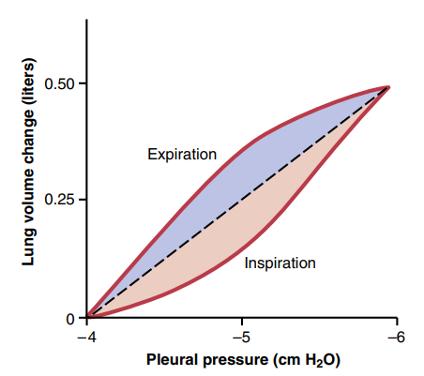
Lung Compliance
Extent of lung expansion per unit increase in transpulmonary pressure.
Averages about 200 ml of air/cm H2O transpulmonary pressure in adults.
Every time the transpulmonary pressure increases by 1 cm H2O, the lung volume will expand 200 ml.
Compliance Diagram:
  Inspiratory and expiratory compliance curves show relationship between lung volume and pleural pressure.
  Determined by elastic forces of lung tissue and surface tension forces.

Slide 39
Surface Tension and Surfactant:
  Surface tension tends to collapse alveoli; surfactant reduces this tension.
  Surfactant secreted by type II alveolar epithelial cells.
  Components: Dipalmitoyl phosphatidylcholine, surfactant apoproteins, calcium ions.
Effect of Thoracic Cage:
  Compliance of the entire pulmonary system (lungs and thoracic cage) is about half that of lungs alone.
  Thoracic cage has elastic and viscous characteristics, requiring muscular effort for expansion.
  Compliance decreases at extreme lung volumes, near chest limits.

Slide 40
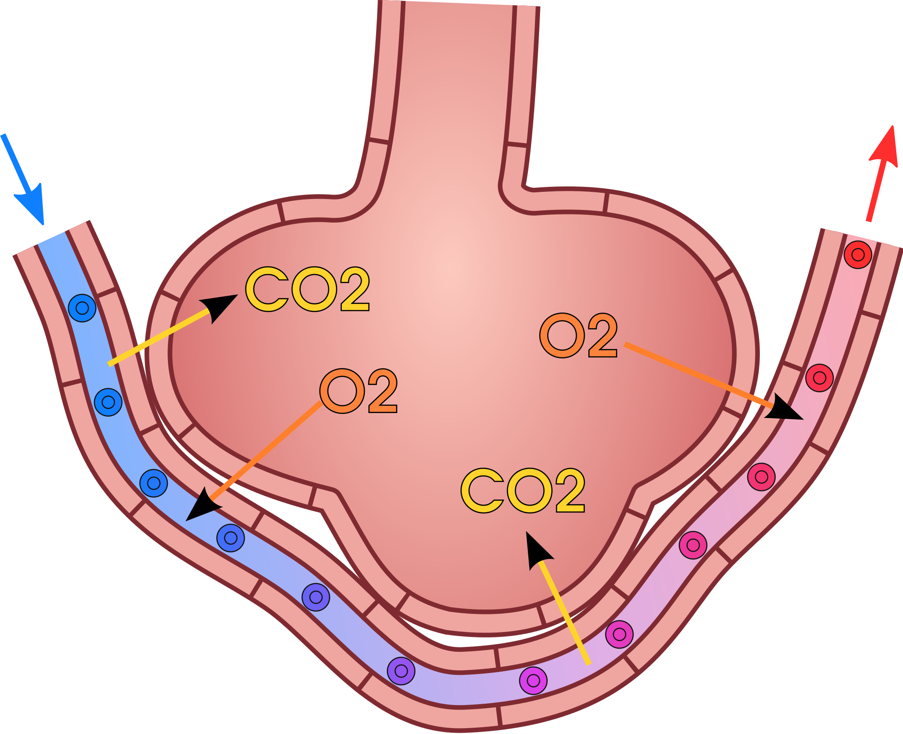
Exchange of Respiratory Gases

Slide 41
Exchange of Respiratory Gases
Alveolar Ventilation:
  The total volume of new air entering the alveoli and adjacent gas exchange areas each minute.
  It is equal to the RR times the amount of new air that enters these areas with each breath:
  VA = Freq × (VT −VD)
    where VA is the volume of alveolar ventilation per minute, Freq is the frequency of respiration per minute,
    Vt is the tidal volume, Vd is the physiological dead space volume
    Thus, with a normal tidal volume of 500 ml, a normal dead space of 150 ml, and a respiratory rate of 12 breaths/ min, alveolar ventilation equals 12 × (500 − 150), or 4200 ml/min.
Ventilation and Gas Exchange:
  Alveoli are ventilated with fresh air during respiration.
  After the alveoli are ventilated with fresh air, the next step in respiration is diffusion of respiratory gases.
  Oxygen (O2) diffuses from alveoli into pulmonary blood.
  Carbon dioxide (CO2) diffuses from blood into alveoli.
Diffusion
  Diffusion is the random motion of molecules through the respiratory membrane and adjacent fluids.
  Involves the movement of gases in different directions.

Slide 42
Composition of Alveolar and Atmospheric Air
Partial Replacement and Gas Absorption:
  Alveolar air is only partially replaced by atmospheric air with each breath.
  Oxygen (O2) is continuously absorbed into pulmonary blood from alveolar air.
  Carbon dioxide (CO2) constantly diffuses from pulmonary blood into the alveoli.
Humidification of Air:
  Atmospheric air is dry and contains minimal water vapours.
  Upon entering the respiratory passages, air gets humidified even before reaching alveoli.
  Alveolar air is, therefore, humidified and has different gas concentrations than dry atmospheric air.

Slide 43
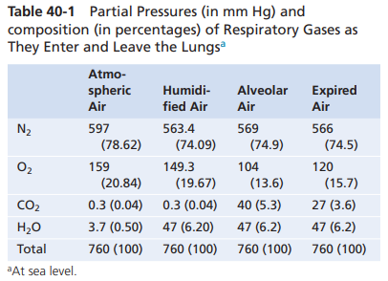
Composition of Alveolar and Atmospheric Air
Composition Changes:
  Alveolar air composition differs from atmospheric air as given in the table below.
  Humidification dilutes oxygen and nitrogen partial pressures in alveolar air compared to atmospheric air.

Slide 44
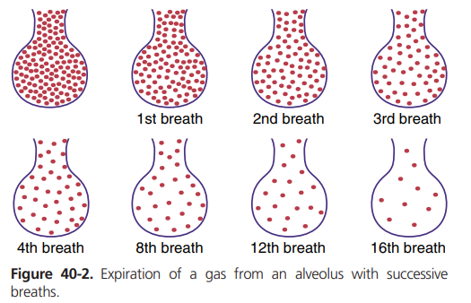
Slow Renewal of Alveolar Air:
  Functional residual capacity of lungs is about 2300 ml, but only 350 ml of new air enters alveoli with each breath.
  Alveolar air is slowly renewed, requiring multiple breaths for significant exchange.
  Slow renewal helps stabilize respiratory control, preventing sudden changes in blood gas concentrations.

Slide 45
Concentration & Partial Pressure of O2 and CO2 in Alveoli
1. Oxygen Control:
Oxygen concentration in alveoli is controlled by the rate of absorption into the blood and the rate of entry from ventilation.
  ↑ rate of absorption into the blood ↓Oxygen concentration in alveoli
  ↑ new O2 is breathed into the alveoli from the atmosphere ↑ Oxygen concentration in alveoli
Alveolar Po2 is influenced by alveolar ventilation and the rate of O2 absorption into the blood.
  ↑ rate of absorption into the blood ↓ Po2 in alveoli
  ↑ new O2 is breathed into the alveoli from the atmosphere ↑ Po2 in alveoli

Slide 46
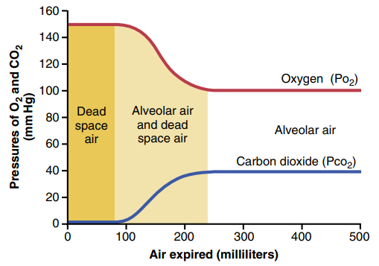
Concentration & Partial Pressure of O2 and CO2 in Alveoli
2. Carbon Dioxide Control:
  Alveolar Pco2 is affected by alveolar ventilation and the rate of CO2 excretion.
  Pco2 ↑ with ↑ CO2 excretion
  Pco2 ↓ with ↓ alveolar ventilation

Slide 47
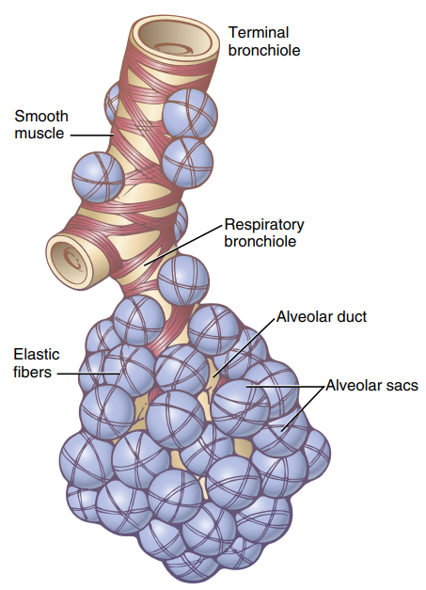
Respiratory Membrane and Gas Diffusion
1. Respiratory Unit:
  Composed of respiratory bronchiole, alveolar ducts, atria, and alveoli.
  About 300 million alveoli in the lungs, forming a respiratory lobule.
2. Respiratory Membrane:
  Comprises alveolar fluid, alveolar epithelium, basement membranes, interstitial space, and capillary endothelium.
  Ultrastructure shows thinness (0.2-0.6 micrometers) and extensive surface area.
3. Factors Affecting Gas Diffusion:
  Thickness, surface area, diffusion coefficient, and partial pressure difference influence diffusion.
  Diseases causing membrane thickening or surface area reduction impede gas exchange.

Slide 48
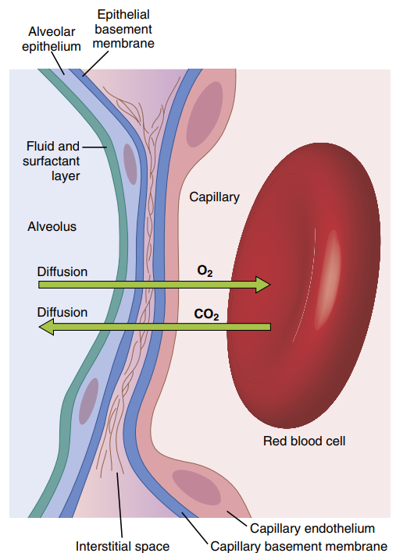
Respiratory Membrane and Gas Diffusion
Following are different layers of the respiratory membrane:
A layer of fluid containing surfactant that lines the alveolus
The alveolar epithelium, composed of thin epithelial cells
An epithelial basement membrane
A thin interstitial space b/w alveolar epithelium and capillary membrane.
A capillary basement membrane
The capillary endothelial membrane

Slide 49
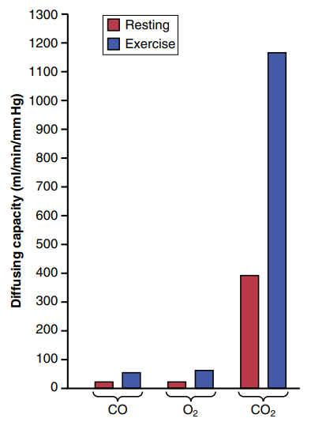
Diffusing Capacity of Respiratory Membrane
Diffusing capacity is defined as; the volume of a gas that will diffuse through the membrane each minute for a partial pressure difference of 1 mm Hg.
1. Oxygen Diffusing Capacity:
  Under resting conditions, averages 21 ml/min per mm Hg.
  Increased during exercise due to factors like increased capillary surface area.
2. Carbon Dioxide Diffusing Capacity:
  Not precisely measured but expected to be higher than oxygen due to higher diffusion coefficient.
  Predicted values show increased diffusing capacity during exercise.
3. Comparison of Gas Diffusing Capacities:
  Carbon dioxide has a much higher diffusing capacity than oxygen.
  Exercise increases diffusing capacity for all gases, aiding respiratory exchange during strenuous activities.

Slide 50
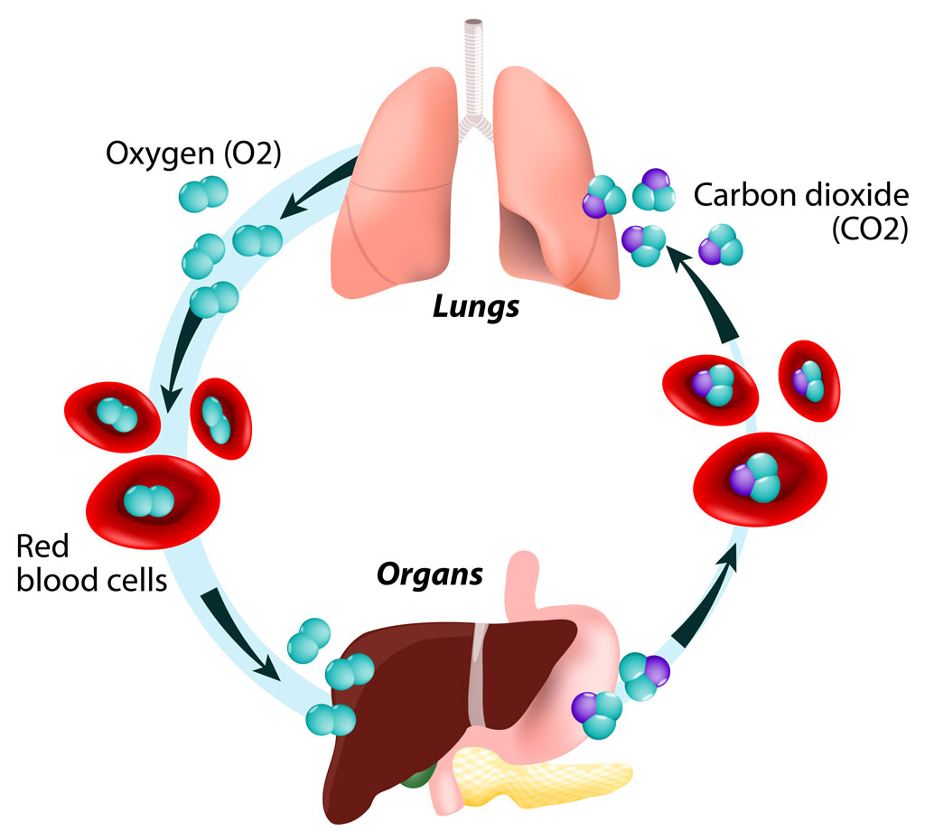
Transport of Respiratory Gases

Slide 51
Transport of Respiratory Gases
Oxygen (O2) moves from the alveoli into pulmonary blood and combines with hemoglobin.
Hemoglobin in red blood cells enables transport of O2 30-100x more than dissolved O2 in blood water.
In tissue cells, O2 reacts with foodstuffs to produce carbon dioxide (CO2).
CO2 enters tissue capillaries and is carried back to the lungs.
CO2, like O2, combines with substances in the blood to increase CO2 transport by 15- to 20-fold.

Slide 52
Transport of Respiratory Gases
The movement of gases from one point to another occurs through diffusion, driven by a difference in partial pressure between these points.
O2 diffuses from the alveoli into pulmonary capillary blood due to higher oxygen partial pressure (Po2) in the alveoli compared to the blood.
In body tissues, higher Po2 in capillary blood compared to tissues causes O2 to diffuse into surrounding cells.
As cells metabolize O2 to form CO2, intracellular CO2 partial pressure (Pco2) increases, causing CO2 to diffuse into tissue capillaries.
After blood flows to the lungs, CO2 diffuses from blood into alveoli as Pco2 in pulmonary capillary blood is higher than in the alveoli.
Transport of O2 and CO2 by blood relies on both diffusion and blood flow.

Slide 53
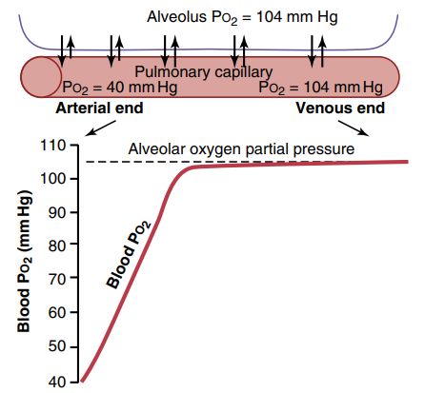
Diffusion of O2 from Alveoli to Pulmonary Capillary Blood
Alveolar O2 Partial Pressure (Po2): Averages 104 mm Hg
Venous Blood O2 Partial Pressure (Po2): Averages 40 mm Hg
Initial Pressure Difference for O2 Diffusion:
Initial pressure difference = Alveolar Po2 - Venous Blood Po2
Initial pressure difference = 104 mm Hg - 40 mm Hg
Initial pressure difference = 64 mm Hg

Slide 54
Transport of O2 in Arterial Blood
Oxygenation in Alveolar Capillaries:
  About 98% of the blood entering the left atrium from the lungs has passed through alveolar capillaries, where it becomes oxygenated up to a Po2 of approx. 104 mm Hg.
Shunt Flow (Bronchial Circulation):
  The remaining 2% of blood has bypassed the gas exchange areas (alveoli) and instead flows through the bronchial circulation, which supplies deep lung tissues and is not exposed to air.
  This blood has a lower Po2 (approx. 40 mm Hg), similar to normal systemic venous blood.
Venous Admixture of Blood:
  Upon leaving the lungs, the oxygenated blood from alveolar capillaries mixes with the deoxygenated "shunt" blood from the bronchial circulation in the pulmonary veins.
  This mixing (venous admixture) causes the overall Po2 of the blood entering the left heart and subsequently pumped into the aorta to decrease to about 95 mm Hg.

Slide 55
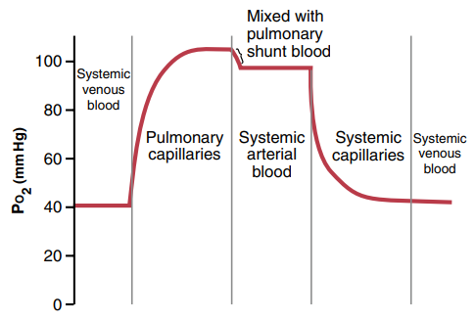
Transport of O2 in Arterial Blood
The presence of shunt flow (deoxygenated blood from bronchial circulation) lowers the overall oxygen content of blood leaving the lungs compared to fully oxygenated blood from alveolar capillaries.
The combined blood in the pulmonary veins results in a reduced Po2 (~95 mm Hg) compared to the Po2 of blood specifically from alveolar capillaries (~104 mm Hg).

Slide 56
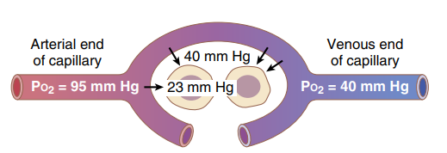
Diffusion of O2 from Peripheral Capillary Blood to Tissues Fluid
Arterial Blood Po2 in Peripheral Capillaries: Po2 of 95 mm Hg
Interstitial Fluid Po2: Po2, averaging around 40 mm Hg
Pressure Difference for Oxygen Diffusion:
  There is a significant pressure difference between the capillary blood (Po2 = 95 mm Hg) and the interstitial fluid (Po2 = 40 mm Hg).
  This large pressure difference drives rapid diffusion of oxygen from the capillary blood into the interstitial fluid.

Slide 57
Diffusion of O2 from Peripheral Capillary Blood to Tissue Cells
The intracellular Po2 (oxygen partial pressure) within peripheral tissues is typically lower than the Po2 in capillaries due to ongoing cellular oxygen consumption.
The intracellular Po2 ranges from as low as 5 mm Hg to as high as 40 mm Hg, with an average of around 23 mm Hg based on direct measurements in experimental animals.
Only 1 to 3 mm Hg of oxygen pressure is typically needed for full support of cellular metabolic activities.
Therefore, an intracellular Po2 of 23 mm Hg provides a considerable safety margin, ensuring that cells receive adequate oxygen for their metabolic needs.

Slide 58
Diffusion of CO2 from Peripheral Tissue to Capillary Blood & from Pul.Cap into Alveoli
CO2 Production and Intracellular Pco2:
  When O2 is used by cells in metabolic processes, it is converted to CO2.
  This transformation increases the intracellular Pco2 ~ around 46 mm Hg.
CO2 Diffusion from Cells to Capillaries:
  Due to ↑ intracellular Pco2, CO2 diffuses from the cells into the nearby capillaries.
CO2 Transport in Blood to Lungs:
  The CO2 carried by the blood in the capillaries is transported to the lungs.
  In the lungs, CO2 diffuses from the pulmonary capillaries into the alveoli and is expelled during expiration.
Comparison of CO2 and O2 Diffusion:
  Unlike oxygen (O2) diffusion, which occurs in the direction opposite to CO2 diffusion, carbon dioxide (CO2) can diffuse much more rapidly—about 20 times faster than O2.

Slide 59
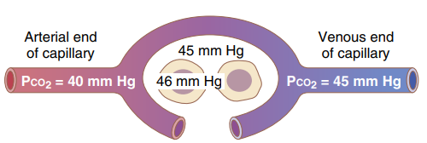
Intracellular Pco2 and Interstitial Pco2:
  Intracellular Pco2: 46 mm Hg
  Interstitial Pco2: 45 mm Hg
  This small pressure differential of 1 mm Hg drives CO2 diffusion from cells into the interstitial fluid.
Pco2 in Tissue Capillary Blood:
  Pco2 of arterial blood entering tissues: 40 mm Hg
  Pco2 of venous blood leaving tissues: 45 mm Hg
  The tissue capillary blood equilibrates with the interstitial Pco2 of 45 mm Hg, maintaining a balance.

Slide 60
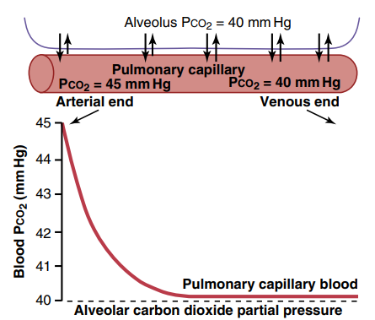
Pco2 in Pulmonary Capillary Blood and Alveolar Air:
  Pco2 of arterial blood entering pulmonary capillaries: 45 mm Hg
  Pco2 of alveolar air: 40 mm Hg
  A small pressure difference of 5 mm Hg drives CO2 diffusion out of the pulmonary capillaries into the alveoli.
  By one-third of the distance through the pulmonary capillaries, the Pco2 of the blood approaches the alveolar Pco2 of 40 mm Hg due to rapid diffusion.

Slide 61
Transport of Respiratory Gases

Slide 62
Transport of Oxygen
Oxygen is transported from alveoli to the tissue by blood in two forms:
  As simple physical solution
  In combination with hemoglobin (30 to 100 times more)

Slide 63
Transport of O2 as simple physical solution
Oxygen dissolves in the water of plasma and is transported in this physical form.
The amount of oxygen transported through dissolution is minimal, only 0.3 mL per 100 mL of plasma.
This dissolved oxygen constitutes approximately 3% of the total oxygen in the blood.
The limited transport through this method is due to the poor solubility of oxygen in the water content of plasma.
However, this form of oxygen transport gains significance during conditions such as muscular exercise when there is an increased demand for oxygen by the tissues.

Slide 64
Transport of O2 in combination with hemoglobin
Oxyhemoglobin Formation:
  Oxygen combines with hemoglobin in blood and is transported as oxyhemoglobin.
  Transport of oxygen in this form is important because, maximum amount (97%) of oxygen is transported by this method.
Oxygenation of Hemoglobin:
  Oxygenation is a physical combination, not oxidation.
  Oxygen combines with the iron in the heme part of hemoglobin, each hemoglobin molecule containing four iron atoms.
  The iron remains in the ferrous (Fe⁺²) form after oxygenation, distinguishing it from oxidation.

Slide 65
Oxygen Carrying Capacity:
  The amount of oxygen transported by 1 gram of hemoglobin.
  Oxygen carrying capacity of hemoglobin is 1.34 mL/g.
Saturation of Hemoglobin:
  Saturation refers to the state when hemoglobin cannot carry more oxygen.
  Saturation depends on the partial pressure of oxygen and is explained by the oxygen-hemoglobin dissociation curve.

Slide 66
Oxygen-Hemoglobin Dissociation Curve
Definition:
  The oxygen-hemoglobin dissociation curve illustrates the relationship between the partial pressure of oxygen and the percentage saturation of hemoglobin with oxygen.
  It elucidates hemoglobin's affinity for oxygen.
  Normally in the blood, hemoglobin is saturated with oxygen only up to 95%.
  Saturation of hemoglobin with oxygen depends upon the partial pressure of oxygen.
  ↑ Partial pressure of oxygen ↑ Saturation of hemoglobin with oxygen
Normal Characteristics:
  Sigmoid Shape:
    Under normal conditions, the curve has an 'S' shape or sigmoid shape.
    Lower part of the curve indicates dissociation of oxygen from hemoglobin.
    Upper part of the curve indicates the uptake of oxygen by hemoglobin depending upon partial pressure of oxygen.

Slide 67
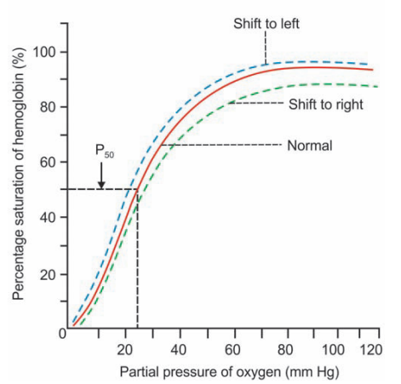
P50
P50 represents the partial pressure of oxygen at which hemoglobin is 50% saturated with oxygen.
At approximately 25-27 mm Hg, hemoglobin is saturated to about 50%.
Saturation increases to 75% at 40 mm Hg and reaches 95% when the partial pressure of oxygen is 100 mm Hg.

Slide 68
Factors Affecting the Curve:
Shift to the Right:
Shift to the Left:
Conditions promoting dissociation of oxygen from hemoglobin.
Factors include;
  Decrease in oxygen partial pressure
  An increase in carbon dioxide pressure (Bohr effect)
  Higher hydrogen ion concentration
  Decreased pH (acidity)
  Elevated body temperature
Conditions favoring association of oxygen with hemoglobin.
Factors include;
  Fetal blood (has a higher affinity for oxygen)
  Decreased hydrogen ion concentration
  Increased pH (alkalinity)

Slide 69
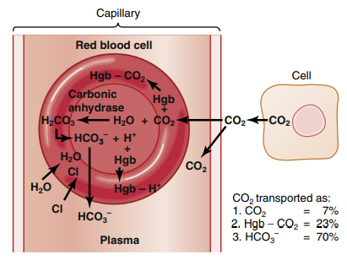
Transport of Carbon dioxide
Carbon dioxide is transported by the blood from cells to the alveoli.
Carbon dioxide is transported in the blood in four ways:
  As dissolved form
  As carbonic acid
  As bicarbonate
  As carbamino compounds

Slide 70
Transport of Dissolved CO2
Co2 diffuses into blood and dissolves in the plasma, forming a simple solution.
Only 3 mL/100 mL of plasma of CO2 is transported as dissolved state.
It is about 7% of total carbon dioxide in the blood.
Transport of CO2 as Carbonic acid
Part of dissolved carbon dioxide in plasma combines with the water to form carbonic acid.
Transport of carbon dioxide in this form is negligible.
Carbonic anhydrase catalyzes CO2 reaction with water in red blood cells.

Slide 71
Transport of CO2 as Bicarbonate
About 63% of carbon dioxide is transported as bicarbonate.
From plasma, carbon dioxide enters the RBCs.
In the RBCs, CO2 combines with water to form carbonic acid.
Carbonic anhydrase catalyzes CO2 reaction with water in red blood cells.
Carbonic acid is very unstable.
Almost all carbonic acid (99.9%) formed in RBC, dissociates into bicarbonate and hydrogen ions.
Concentration of bicarbonate ions in the cell increases more and more.
Due to high concentration, bicarbonate ions diffuse through cell membrane into plasma.

Slide 72
Chloride Shift or Hamburger Phenomenon
Chloride shift or Hamburger phenomenon is the exchange of a chloride ion for a bicarbonate ion across RBC membrane.
It was discovered by Hartog Jakob Hamburger in 1892.
Chloride shift occurs when CO2 enters the blood from tissues.
In plasma, plenty of sodium chloride is present.
It dissociates into sodium and chloride ions.
When the negatively charged bicarbonate ions move out of RBC into the plasma, the negatively charged chloride ions move into the RBC in order to maintain the electrolyte equilibrium (ionic balance).
Anion exchanger 1 (band 3 protein), which acts like Antiport pump in RBC membrane is responsible for the exchange of bicarbonate ions and chloride ions.
Bicarbonate ions combine with sodium ions in the plasma and form sodium bicarbonate.
In this form, it is transported in the blood.
Hydrogen ions dissociated from carbonic acid are buffered by hemoglobin inside the cell.

Slide 73
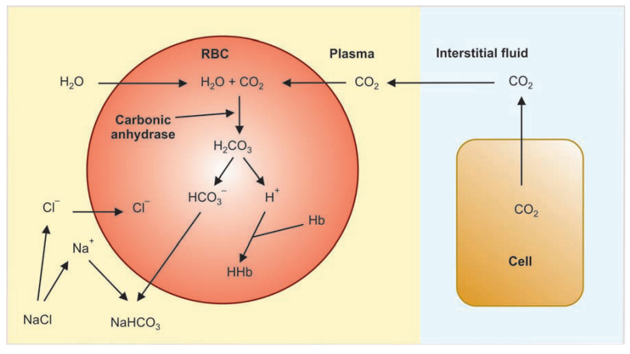

Slide 74
Transport of CO2 in as Carbamino Compounds
About 30% of carbon dioxide is transported as carbamino compounds.
CO2 is transported in blood in combination with hemoglobin and plasma proteins.
CO2 combines with hemoglobin to form carbamino hemoglobin or carbhemoglobin (CO2Hgb).
And it combines with plasma proteins to form carbamino proteins.
Carbamino hemoglobin + carbamino proteins = carbamino compounds.
CO2Hgb, is a reversible compound with a loose bond, allowing easy release of CO2 into the alveoli where Pco2 is lower than in pulmonary capillaries

Slide 75
Thank You

