Slide 1
Pancreas
AIZAZ
Demonstrator Surgical
KMU-IPMS Peshawar

Slide 2
Pancreas
Both exocrine and endocrine gland.
Exocrine portion of the gland produces a secretion that contains enzymes capable of hydrolyzing proteins, fats, and carbohydrates.
Endocrine portion the pancreatic islets (islets of langerhans), produces the hormones insulin and glucagon, which play a key role in carbohydrate metabolism.
An elongated structure lies in the epigastrium and the left upper quadrant.
Soft and lobulated and situated on the posterior abdominal wall behind the peritoneum. It crosses the transpyloric plane.
Divided into a head, neck, body, and tail

Slide 3
Pancreas
Head: Disc shaped and lies within the concavity of the duodenum.
  A part of the head extends to the left behind the superior mesenteric vessels and is called the uncinate process.
Neck: Constricted portion connects the head to the body.
  It lies in front of the beginning of the portal vein and the origin of the superior mesenteric artery from the aorta
Body: Runs upward and to the left across the midline It is somewhat triangular in cross section
Tail: passes forward in the splenicorenal ligament and comes in contact with the hilum of the spleen

Slide 4
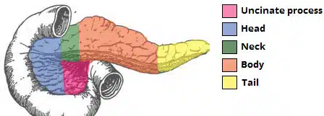

Slide 5
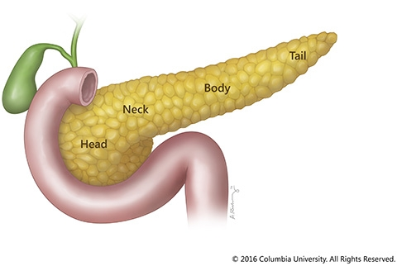

Slide 6
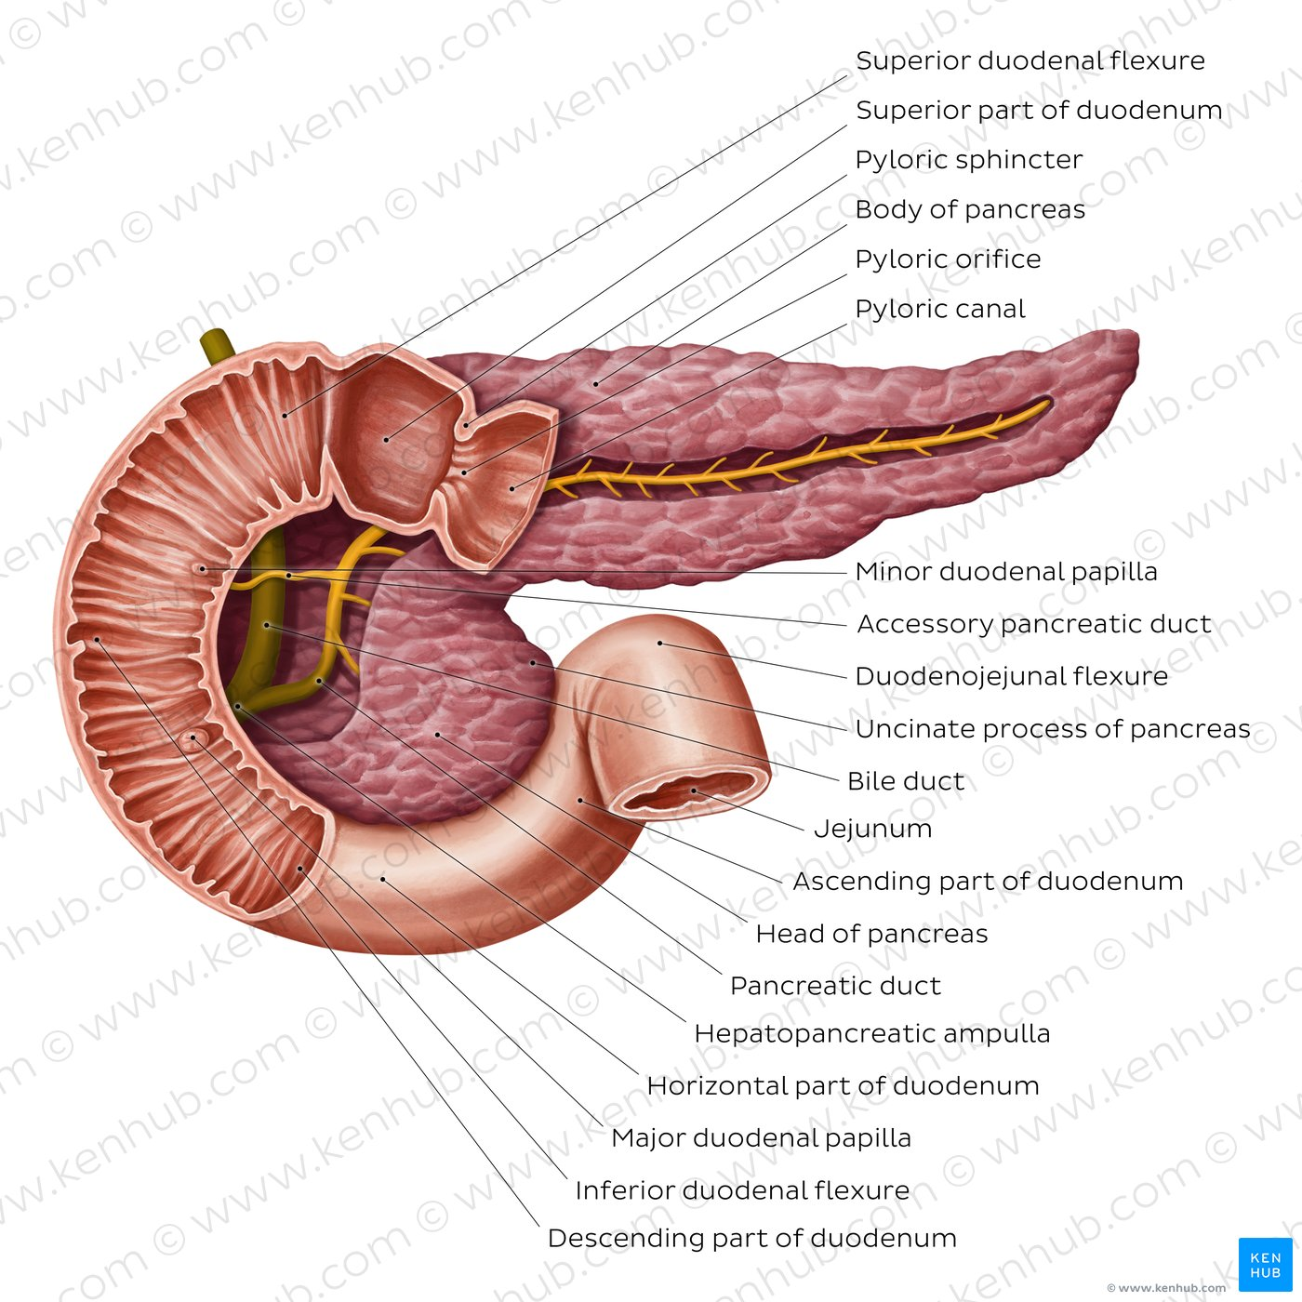

Slide 7
Anatomical relation
ANTERIORLY
POSTERIORLY
From right to left:
Transverse colon and the attachment of the transverse mesocolon, lesser sac, and stomach.
From right to left:
Bile duct, portal and splenic veins, inferior vena cava, aorta, origin of the superior mesenteric artery, left psoas muscle, left suprarenal gland, left kidney, and hilum of the spleen

Slide 8
Pancreatic Ducts
Main duct begins in the tail and runs the length of the gland, receiving numerous tributaries on the way.
It opens into the second part of the duodenum at about its middle with the bile duct on the major duodenal papilla.
Sometimes, the main duct drains separately into the duodenum.
Accessory duct when present, drains into the duodenum a short distance above the main duct on the minor duodenal papilla.

Slide 9
Neurovascular Supply
Arteries:
  Splenic and the superior and inferior pancreaticoduodenal arteries.
Veins:
  Venous drainage of the head of the pancreas is drain into the superior mesenteric branches of the hepatic portal vein. The pancreatic veins draining the rest of the pancreas do so via the splenic vein.
Lymphatics:
  lymphatic vessels that follow the arterial supply that empty into the pancreaticosplenal nodes and the pyloric nodes, which in turn drain into the superior mesenteric and coeliac lymph nodes.
Nerve Supply:
  Sympathetic and parasympathetic (vagal) nerve fibers supply the area.

Slide 10
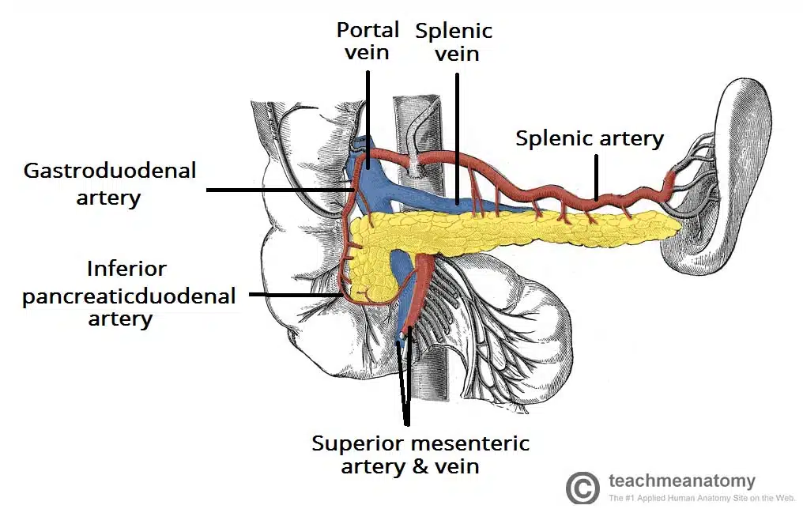

Slide 11
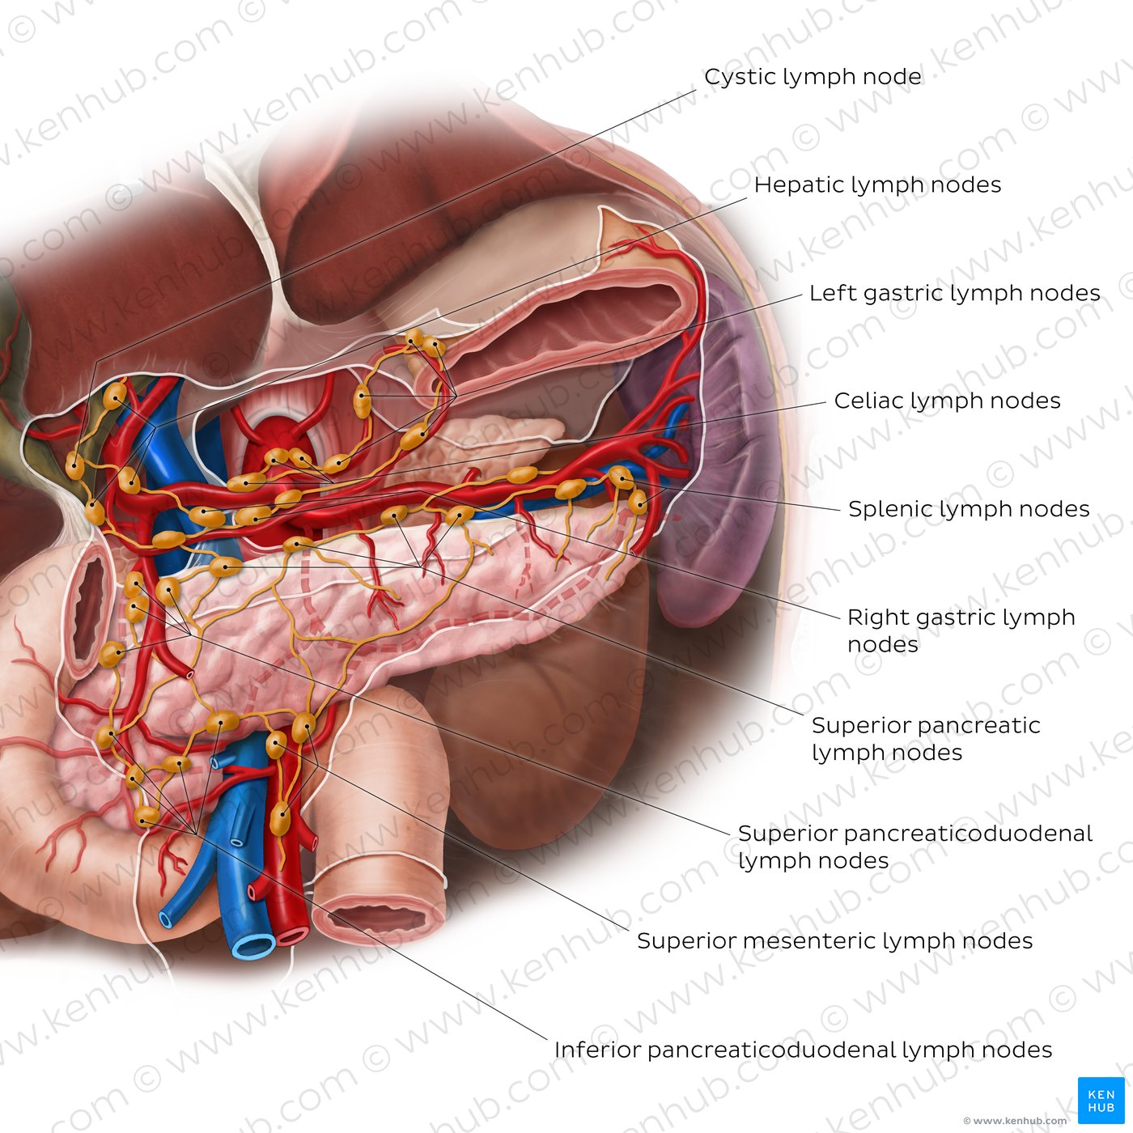

Slide 12
SPLEEN

Slide 13
SPLEEN
Reddish color, oval shaped and largest single mass of lymphoid tissue in the body.
Located in the upper left quadrant of the abdomen, under cover of the diaphragm and the ribcage
Entirely surrounded by peritoneum (except at the splenic hilum).
Lies just beneath the left half of the diaphragm close to the 9th, 10th, and 11th ribs.
Long axis lies along the shaft of the 10th rib, and its lower pole extends forward only as far as the midaxillary line and cannot be palpated on clinical examination

Slide 14
SPLEEN
The spleen is connected to the stomach and kidney by parts of the greater omentum.
  Gastrosplenic ligament: anterior to the splenic hilum, connects the spleen to the greater curvature of the stomach.
  Splenorenal ligament: posterior to the splenic hilum, connects the hilum of the spleen to the left kidney. The splenic vessels and tail of the pancreas lie within this ligament

Slide 15
SPLEEN
Anatomical Relations
Anteriorly: Stomach, tail of the pancreas, and left colic flexure. The left kidney lies along its medial border.
Posteriorly: The diaphragm; left pleura (left costodiaphragmatic recess), left lung, and 9th, 10th, and 11th ribs

Slide 16
SPLEEN
The spleen has a slightly oval shape. It is covered by a weak capsule that protects the organ whilst allowing it to expand in size.
The outer surface of the spleen can be anatomically divided into two:
  Diaphragmatic surface: in contact with diaphragm and ribcage.
  Visceral surface : in contact with the other abdominal viscera.
It has anterior, superior, posteromedial and inferior borders. The posteromedial and inferior borders are smooth, whilst the anterior and superior borders contain notches.

Slide 17
SPLEEN
Arterial Supply
  The large splenic artery is the largest branch of the celiac artery.
  It has a tortuous course as it runs along the upper border of the pancreas.
  The splenic artery then divides into about six branches, which enter the spleen at the hilum.
  These arterial branches do not anastomose with each other – giving rise to vascular segments of the spleen.
Veins
  Venous drainage occurs through the splenic vein. It combines with the superior mesenteric vein to form the hepatic portal vein

Slide 18
SPLEEN
Nerve Supply
  The nerve supply to the spleen is from the coeliac plexus.
Lymph Drainage
  The lymphatic vessels of the spleen follow the splenic vessels and drain into the pancreaticosplenic lymph nodes, and ultimately the coeliac nodes.

Slide 19
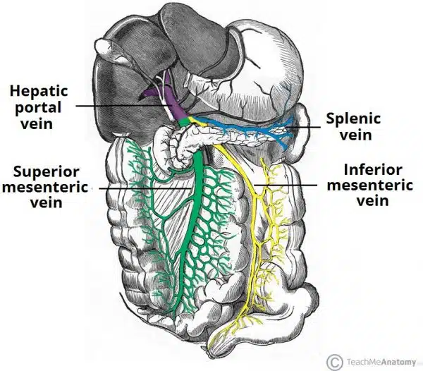

Slide 20


