Slide 1
Liver And Gallbladder
AIZAZ
Demonstrator Surgical
KMU-IPMS Peshawar

Slide 2
LIVER
Largest gland in the body.
Some important functions are
  Production and secretion of bile
  Involvement in many metabolic activities related to carbohydrate, fat, and protein metabolism.
  Filtration of the blood
  Synthesizes heparin.
  An important detoxicating function.
  Produces bile pigments from the hemoglobin of worn-out red blood corpuscles and secretes bile salts; these together are conveyed to the duodenum by the biliary ducts

Slide 3
LIVER
Large organ in the upper right quadrant of the abdomen.
Weighing approximately 1.5 kilograms.
The liver is completely covered by visceral peritoneum, with the exception of the bare area, which is where the liver is in contact with the diaphragm.
Anatomical relation
  Anteriorly: diaphragm, right and left costal margins, right and left pleura and lower margins of both lungs, xiphoid process, and anterior abdominal wall in the subcostal angle
  Posteriorly: diaphragm, right kidney, hepatic flexure of the colon, duodenum, gallbladder, inferior vena

Slide 4
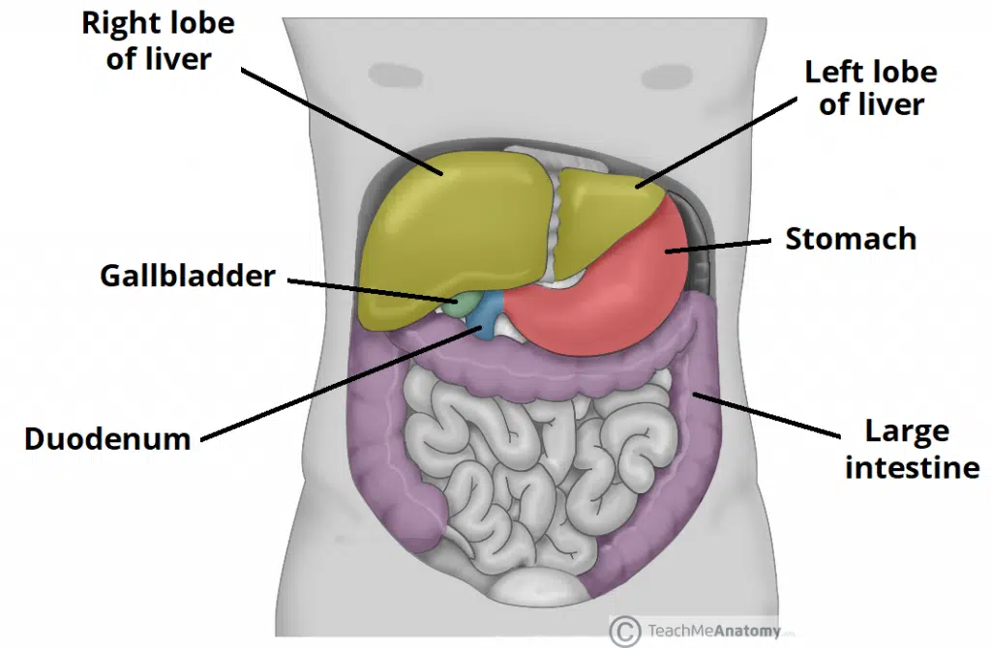

Slide 5
LIVER
Covered by a fibrous layer, known as glisson’s capsule.
Soft and pliable and occupies the upper part of the abdominal cavity just beneath the diaphragm.
The greater part of the liver is situated under cover of the right costal margin. Right hemidiaphragm separates it from the pleura, lungs, pericardium, and heart.
Extends to the left to reach the left hemidiaphragm.

Slide 6
LIVER
Liver has two surfaces i.e. Diaphragmatic and visceral.
Diaphragmatic surface( anterosuperior surface )
  Smooth and convex
  Posterior aspect is not covered by visceral peritoneum but in direct contact with the diaphragm itself called bare area’ of the liver.
Visceral surface (posteroinferior surface)
  With the exception of the fossa of the gallbladder and porta hepatis, it is covered with peritoneum.
  Molded by the shape of the surrounding organs, making it irregular and flat.
  Lies in contact with right kidney, right adrenal gland, right colic flexure, transverse colon, first part of the duodenum, gallbladder, esophagus and the stomach.

Slide 7
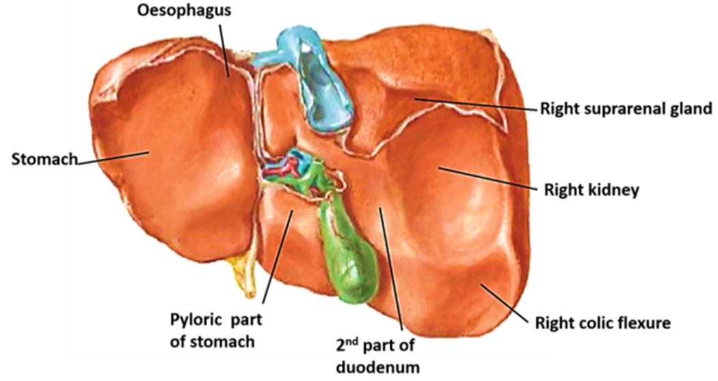

Slide 8
LIVER
Divided into a large right lobe and a small left lobe by of the falciform ligament.
Two accessory lobes arise from the right lobe.
  Quadrate lobe: located on the upper aspect of the visceral surface lies between the inferior vena cava and a fossa produced by the ligamentum venosum (a remnant of the fetal ductus venosus).
  Caudate lobe: located on the lower aspect of the visceral surface. It lies between the gallbladder and a fossa produced by the ligamentum teres (a remnant of the fetal umbilical vein).
Experiments have shown that, in fact, the quadrate and caudate lobes are a functional part of the left lobe of the liver.
Thus, the right and left branches of the hepatic artery and portal vein, and the right and left hepatic ducts, are distributed to the right lobe and the left lobe (plus quadrate plus caudate lobes), respectively.
Separating the caudate and quadrate lobes is a deep, transverse fissure – known as the porta hepatis.

Slide 9
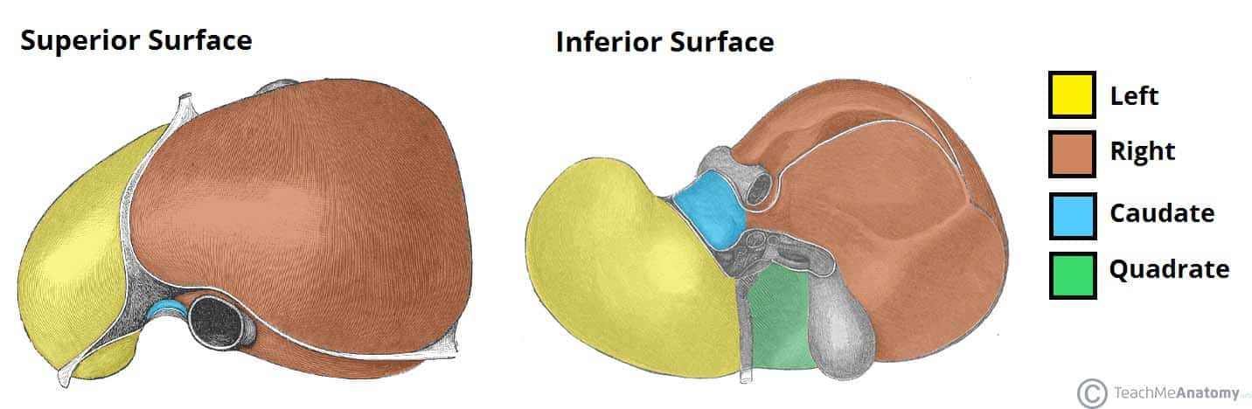

Slide 10
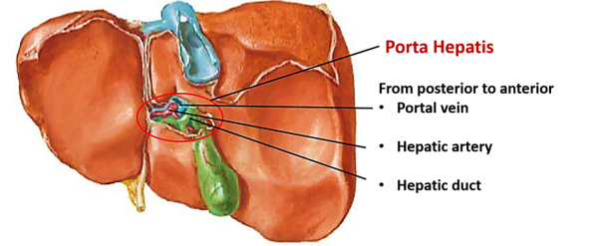

Slide 11
LIVER
The porta hepatis (hilum of the liver) is found on the posteroinferior surface and lies between the caudate and quadrate lobes.
  The upper part of the free edge of the lesser omentum is attached to its margins.
  In it lie the right and left hepatic ducts, the right and left branches of the hepatic artery, the portal vein, and sympathetic and parasympathetic nerve fibers.
  A few hepatic lymph nodes lie here; they drain the liver and gallbladder and send their efferent vessels to the celiac lymph nodes.

Slide 12
LIVER
Peritoneal ligaments: Formed by a double layer of peritoneum.
  Falciform ligament
  Sickle-shaped attaches the anterior surface of the liver to the anterior abdominal wall.
  Free edge contains the ligamentum teres, a remnant of the umbilical vein.
  Coronary ligament
  Has anterior and posterior folds
  Attaches the superior surface of the liver to the inferior surface of the diaphragm and also demarcates the bare area of the liver
  The anterior and posterior folds unite to form the triangular ligaments on the right and left lobes of the liver.

Slide 13
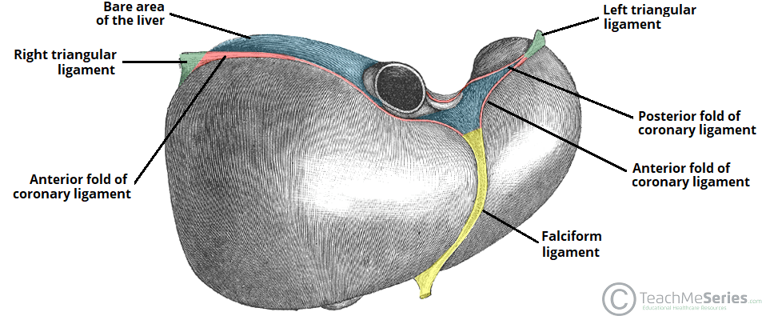

Slide 14
LIVER
  Triangular ligaments (left and right):
    The left one is formed by the union of the anterior and posterior layers of the coronary ligament at the apex of the liver and attaches the left lobe of the liver to the diaphragm.
    The right one is formed in a similar fashion adjacent to the bare area and attaches the right lobe of the liver to the diaphragm.
  Lesser omentum:
    Attaches the liver to the lesser curvature of the stomach and first part of the duodenum.
    It consist of hepatoduodenal ligament (extends from the duodenum to the liver) and the hepatogastric ligament (extends from the stomach to the liver).
    The hepatoduodenal ligament surrounds the portal triad.

Slide 15
LIVER
Hepatic Recess
  Subphrenic spaces:
    Location: between the diaphragm and the anterior and superior aspects of the liver.
    They are divided into a right and left by the falciform ligament.
  Subhepatic space:
    This peritoneal space is located between the inferior surface of the liver and the transverse colon.
  hepatorenal space (Morison's pouch):
    A potential space between the visceral surface of the liver and the right kidney.

Slide 16
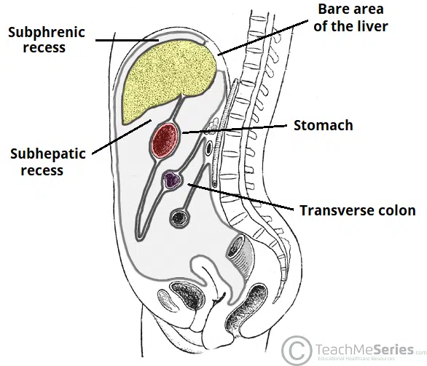
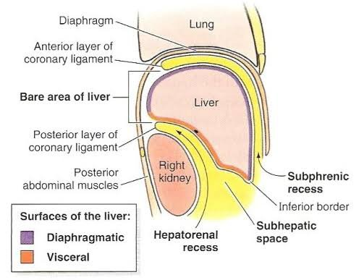

Slide 17
LIVER
The liver is made up of liver lobules.
The central vein of each lobule is a tributary of the hepatic veins.
In the spaces between the lobules are the portal canals, which contain branches of the hepatic artery, portal vein, and a tributary of a bile duct (portal triad).
The arterial and venous blood passes between the liver cells by means of sinusoids and drains into the central vein.

Slide 18
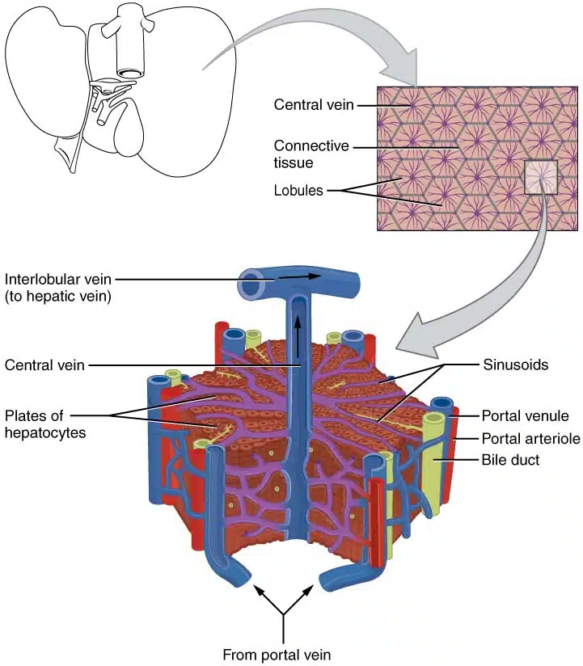

Slide 19
Blood Supply
Arteries
hepatic artery, a branch of the celiac artery, divides into right and left terminal branches that enter the porta hepatis.
Veins
portal vein divides into right and left terminal branches that enter the porta hepatis behind the arteries. The hepatic veins (three or more) emerge from the posterior surface of the liver and drain into the inferior vena cava.

Slide 20
Blood Circulation
The blood vessels conveying blood to the liver are the hepatic artery (30%) and portal vein (70%).
The hepatic artery brings oxygenated blood to the liver.
The portal vein brings venous blood rich in the products of digestion, which have been absorbed from the gastrointestinal tract.
The arterial and venous blood is conducted to the central vein of each liver lobule by the liver sinusoids.
The central veins drain into the right and left hepatic veins, and these leave the posterior surface of the liver and open directly into the inferior vena cava.

Slide 21
Lymph Drainage
The liver produces a large amount of lymph—about one third to one half of all body lymph.
The lymph vessels leave the liver and enter several lymph nodes in the porta hepatis.
The efferent vessels pass to the celiac nodes. A few vessels pass from the bare area of the liver through he diaphragm to the posterior mediastinal lymph nodes.

Slide 22
Nerve Supply
The parenchyma of the liver is innervated by the hepatic plexus, which contains sympathetic (coeliac plexus) and parasympathetic (vagus nerve) nerve fibres. These fibres enter the liver at the porta hepatis and follow the course of branches of the hepatic artery and portal vein.
The fibrous covering of the liver, is innervated by branches of the lower intercostal nerves. Distension of the capsule results in a sharp, well localized pain.

Slide 23
Gallbladder

Slide 24
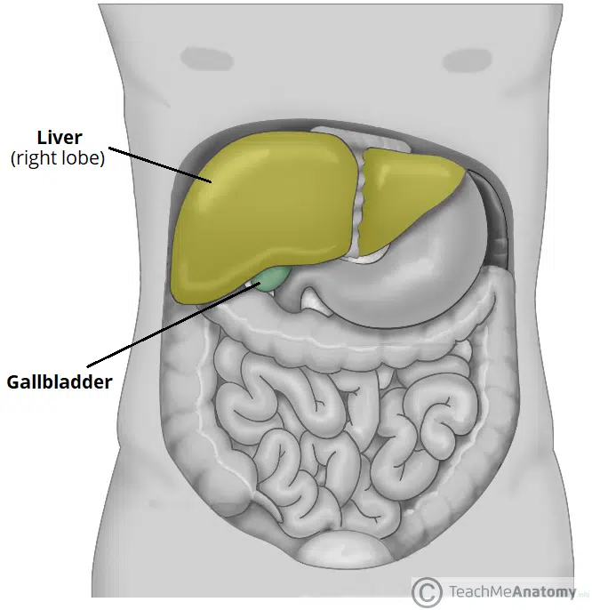

Slide 25
GALLBLADDER
A gastrointestinal pear-shaped organ located within the right hypochondrial region of the abdomen.
Lies within a fossa formed between the inferior aspects of the right and quadrate lobes of the liver.
Entirely surrounded by peritoneum, and is in direct relation to the visceral surface of the liver.
Relation:
  Anteriorly and superiorly: inferior border of the liver and the anterior abdominal wall.
  Posteriorly: transverse colon and the proximal duodenum.
  Inferiorly: biliary tree and remaining parts of the duodenum.

Slide 26
GALLBLADDER
Storage capacity of 30-50ml and typically divided into three parts:
  Fundus: the rounded, distal portion projects into the inferior surface of the liver in the mid-clavicular line.
  Body: largest part lies adjacent to the posteroinferior aspect of the liver, transverse colon and superior part of the duodenum.
  Neck: this part tapers to become continuous with the cystic duct, leading into the biliary tree.
The neck contains a mucosal fold, known as hartmann’s pouch which is common location for gallstones to become lodged, causing cholestasis.

Slide 27
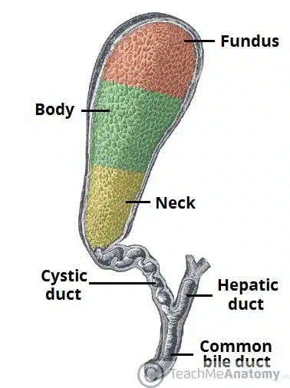

Slide 28
Blood supply
Arterial supply
Cystic artery, a branch of the right hepatic artery.
Venous drainage
Cystic vein drains directly into the portal vein
Venous drainage of the neck of the gallbladder is via the cystic veins, which drain directly into the portal vein. Venous drainage of the fundus and body of the gallbladder flows into the hepatic sinusoids.

Slide 29
Lymphatics
Cystic lymph node situated near the neck of the gallbladder.
From here, the lymph vessels pass to the hepatic nodes along the course of the hepatic artery and then to the celiac nodes.

Slide 30
Innervation
Sympathetic and parasympathetic vagal fibers form the celiac plexus.
The gallbladder contracts in response to the hormone cholecystokinin, which is produced by the mucous membrane of the duodenum on the arrival of fatty food from the stomach.

Slide 31
Biliary Tree
Bile is secreted by the liver cells at a constant rate of about 40 mL per hour.
The biliary tree is a series of gastrointestinal ducts allowing newly synthesized bile from the liver to be concentrated and stored in the gallbladder.
Bile is initially secreted from hepatocytes and drains from both lobes of the liver via canaliculi, intralobular ducts and collecting ducts into the left and right hepatic ducts.
These ducts unite to form the common hepatic duct, which runs alongside the hepatic vein.

Slide 32
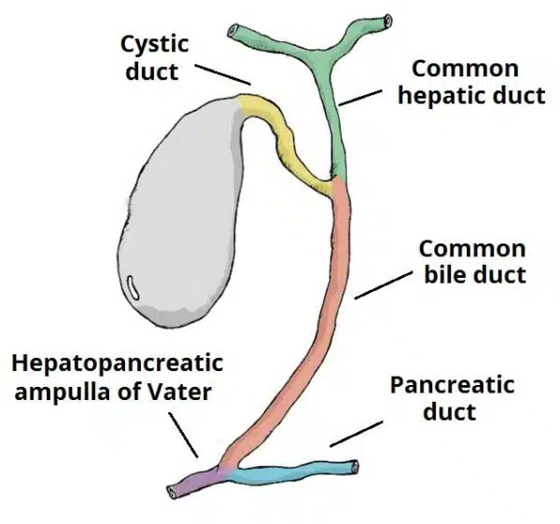

Slide 33
Biliary Tree
As the common hepatic duct (about 1.5 in. (4 cm) long descends and joined by the cystic duct (about 1.5 in. (3.8 cm) long) – which allows bile to flow in and out of the gallbladder for storage and release.
At this point, the common hepatic duct and cystic duct combine to form the common bile duct. (about 3 in. (8 cm) long).
The common bile duct descends and passes posteriorly to the first part of the duodenum and head of the pancreas.
Here, it is joined by the main pancreatic duct, forming the hepatopancreatic ampulla (commonly known as the ampulla of Vater) which then empties into the duodenum via the major duodenal papilla.
This papilla is regulated by a muscular valve, the sphincter of Oddi

Slide 34


