Slide 1


Slide 2


Slide 3
THANKS TO THE AUTHORS
This lecture was prepared using
Textbook of Medical Biochemistry Eighth Edition by Dr (Brig) MN Chatterjea
& different online resources including but not limited to ( PubMed, Google Scholar & Web of Science)
Special thanks to (Sir Noor Ullah (IPMS) & Sir Abdur Rehman (IPMS)) for providing with the basic framework for the lecture

Slide 4
Signals and receptors
Zakir Ahmad

Slide 5
Cell-Cell Communication
The ability of cells to receive and act on signals from beyond the plasma membrane is fundamental to life.
Bacterial cells receive constant input from membrane proteins that act as information receptors. Sampling the surrounding medium for pH, osmotic strength, the availability of food, oxygen, and light, and the presence of noxious chemicals, predators, or competitors for food.

Slide 6
Cell-Cell Communication
These signals elicit appropriate responses, such as motion toward food or away from toxic substances or the formation of dormant spores in a nutrient-depleted medium.
In multicellular organisms, cells with different functions exchange a wide variety of signals.
Plant cells respond to growth hormones and to variations in sunlight.

Slide 7
Cell-Cell Communication
Animal cells exchange information about the concentrations of ions and glucose in extracellular fluids.
And in an embryo, the correct placement of cells during development.
In all these cases, the signal represents information that is detected by specific receptors and converted to a cellular response, which always involves a chemical process.
This conversion of information into a chemical change- signal transduction, is a universal property of living cells.

Slide 8
Cell-Cell Communication
Your cells touch and communicate with one another.
By sending and receiving a variety of chemical signals, they coordinate their behavior so that the body functions as an integrated whole, rather than as a massive collection of individual cells acting independently.
The ability of cells to communicate with one another is the hallmark of multicellular organisms.

Slide 9
Signals
Self-organizing living organisms are so complicated that they must have not only precise structural specifications for each type of biomolecule, but also specifications for how, when, and where each type is to be synthesized, utilized, and degraded
Bacterial cells track down food molecules, plants adapt to changing light levels, and animals seek to avoid predators
Animal cells exchange information about the concentrations of ions and glucose in extracellular fluids

Slide 10
Signals
In an embryo, the correct placement of cells during development
In all these cases, the signal represents information that is detected by specific receptors and converted to a cellular response, which always involves a chemical process
Information, or signals, come in the form of molecules (e.g., nutrients), physical stimuli (e.g., light) and mechanical force

Slide 11
Signal transduction
The process that organisms use to receive and interpret information is referred to as signal transduction or it is a process by which cell convert extracellular signal into intra cellular response
Examples of eukaryotic signal molecules include neurotransmitters (products of neurons), hormones (products of glandular cells), and cytokines (products of mainly immune cells but can be non immune too like fibroblasts and endothelial cells)
The cells of multicellular organisms use a variety of molecules as signals, including not only peptides, but also large proteins, individual amino acids, nucleotides, steroids and other lipids
Even dissolved gases are used as signals. For example, Nitric oxide (NO)

Slide 12
Signal transduction
Any given cell of a multicellular organism is exposed to a constant stream of signals
At any time, hundreds of different chemical signals may be in the environment surrounding the cell
However, each cell responds only to certain signals and ignores the rest like a person following the conversation of one or two individuals in a noisy, crowded room.
How does a cell “choose” which signals to respond to?
Located on or within the cell are receptor proteins, each with a three-dimensional shape that fits the shape of a specific signal molecule

Slide 13
Mechanism of signal transduction
Reception: A signal molecule, called a ligand, binds to and activates a receptor
Transduction: Ligand binding triggers a change in the three-dimensional structure of the receptor, which results in the conversion of a primary message or signal to a secondary message, often across a membrane barrier
Response: Once initiated, the internal signal causes a signaling cascade, a series of reactions that involve covalent modifications (e.g., phosphorylation) of intracellular proteins which cause changes in enzyme activities and/or gene expression, cytoskeletal rearrangements, cell movement, or cell cycle progression (e.g., cell growth or division)

Slide 14
Mechanism of signal transduction
Termination: The efficiency and effectiveness of signal mechanisms require that they be terminated in a timely manner
Signaling molecules may be destroyed or removed (e.g., neurotransmitters such as acetylcholine and serotonin, respectively), activated proteins are inactivated by changes in covalent modification (e.g., removal of phosphate groups), and some signals are degraded by enzymes. (Acetylcholinesterase)

Slide 15
Forms of signaling
Cells communicate through any of four basic mechanisms
Direct Contact: Gap junctions in animals and plasmodesmata in plants are tiny channels that directly connect neighboring cells and are formed from proteins called coonexins
These water-filled channels allow small signaling molecules, called intracellular mediators (2nd Messangers), to diffuse between the two cells
Small molecules and ions are able to move between cells, but large molecules like proteins and DNA cannot fit through the channels.
Many of the important interactions between cells in early development occur by means of direct contact between cell surfaces
In plants, plasmodesmata are ubiquitous, making the entire plant into a giant communication network

Slide 16
Forms of signaling
In autocrine signaling, a cell signals to itself, releasing a ligand that binds to receptors on its own surface or to receptors inside of the cell
In embryological development, this process of stimulating a group of neighboring cells may help to direct the differentiation of identical cells into the same cell type, thus ensuring the proper developmental outcome
Autocrine signaling is important in cancer and is thought to play a key role in metastasis
Autocrine signaling also regulates pain sensation and inflammatory responses
Further, if a cell is infected with a virus, the cell can signal itself to undergo programmed cell death, killing the virus in the process

Slide 17
Forms of signaling
Paracrine signaling: Signal molecules are released by cells and act on other cells in the immediate vicinity of the releasing cell
Signals with such short-lived, local effects are called paracrine signals
Examples are NO, prostaglandins, histamines etc.
Like direct contact, paracrine signaling plays an important role in early development and coordinating the activities of clusters of neighboring cells

Slide 18
Forms of signaling
In endocrine signaling, signals are produced by specialized cells (glands) and released into the bloodstream, which carries them to target cells in distant parts of the body
Endocrine signaling use hormones as ligands
Thyroid, the hypothalamus, and the pituitary, as well as the gonads (testes and ovaries) and the pancreas are examples of endocrine glands

Slide 19
Forms of signaling
Synaptic signaling: One unique example of paracrine signaling is synaptic signaling, in which nerve cells transmit signals
This process is named for the synapse, the junction between two nerve cells where signal transmission occurs
When the sending neuron fires, an electrical impulse moves rapidly through the cell, traveling down an exon
When the impulse reaches the synapse, it triggers the release of ligands called neurotransmitters, which quickly cross the small gap between the nerve cells
When the neurotransmitters arrive at the receiving cell, they bind to receptors and cause a chemical change inside of the cell (often, opening ion channels and changing the electrical potential across the membrane)

Slide 20
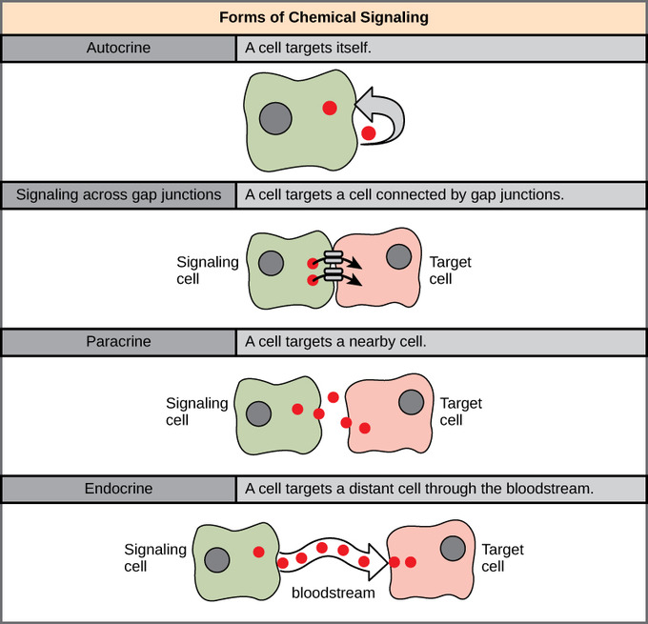

Slide 21
Hormones and their mechanism of action

Slide 22
Hormones
Hormones are conventionally defined as organic substances, produced in small amounts by specific tissues (endocrine glands), secreted into the blood stream to control the metabolic and biological activities in the target cells
Hormones may be regarded as the chemical messengers involved in the transmission of information from one tissue to another and from cell to cell

Slide 23
Hormone actions on target cells
  Alter plasma membrane permeability by opening or closing ion channels and thus control the movement of molecules across the plasma membrane
  Regulating the rate of gene expression (& therefore protein production)
  Altering rates of enzyme mediated reactions
  Induce secretory activity
  Stimulate mitosis

Slide 24
Classification of hormones
Based on the chemical nature
Protein or peptide hormones (Water Soluble by hydrophilic amino acid interaction) e.g. insulin, glucagon, antidiuretic hormone, oxytocin, FSH, LH.
  It works by 2nd messenger system (Gq, Gs, Gi Pathways).
Steroid hormones (Lipid Soluble) e.g. glucocorticoids, mineralocorticoids, sex hormones
Amino acid derivatives e.g. epinephrine, norepinephrine, thyroxine (T₄), triiodothyronine (T₃)

Slide 25
Classification of hormones
Based on the mechanism of action: Hormones are classified into two broad groups I&II (water soluble and lipid soluble) based on the location of the receptors to which they bind, and the signals used to mediate their action.
Group I hormones: These hormones bind to intracellular receptors to form receptor-hormone complexes through which their biochemical functions are mediated
Group I hormones are lipophilic in nature and are mostly derivatives of cholesterol (exception—T3 and T4). e.g. estrogens, androgens, glucocorticoids, calcitriol

Slide 26
Classification of hormones
Group II hormones: These hormones bind to cell surface receptors and stimulate the release of the second messengers which, in turn, perform the biochemical functions
Thus, hormones themselves are the first messengers
Group II hormones are subdivided into three categories based on the chemical nature of the second messengers
The second messenger is cAMP e.g. ACTH, FSH, LH, PTH, glucagon, calcitonin.
The second messenger is phosphatidyl-inositol/calcium e.g. TRH, GnRH, gastrin, CCK
The second messenger is unknown e.g. growth hormone, insulin, oxytocin, prolactin.

Slide 27
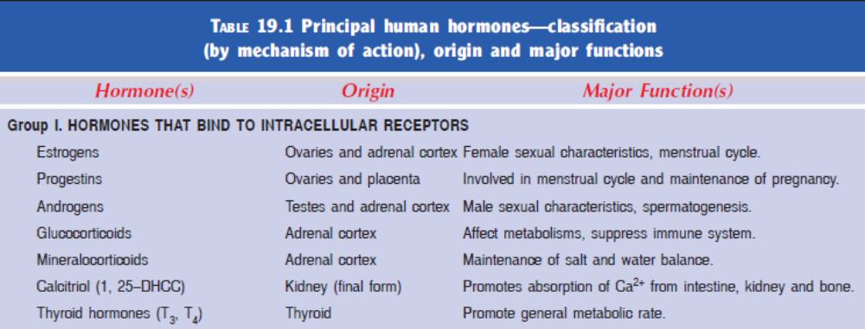

Slide 28
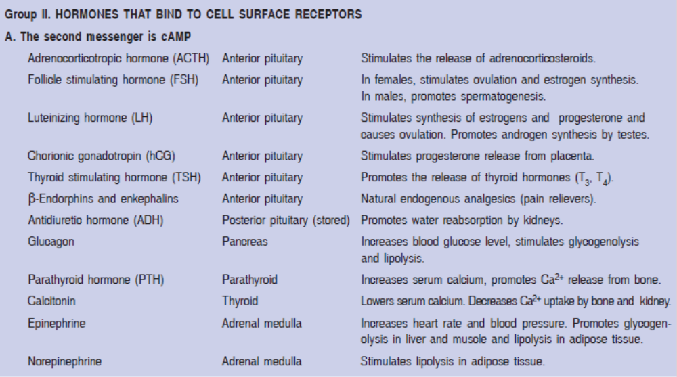

Slide 29
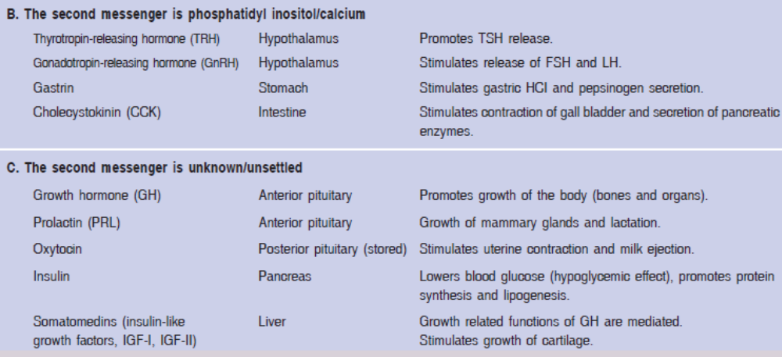

Slide 30
Mechanisms of Hormone Action
Two mechanisms, depending on chemical nature of hormones
  Water-soluble hormones (all amino acid-based hormones except thyroid hormone). Act on cell surface receptors
  Lipid-soluble hormones (steroid and thyroid hormones). Act on intracellular receptors that directly activate or suppress certain processes.

Slide 31
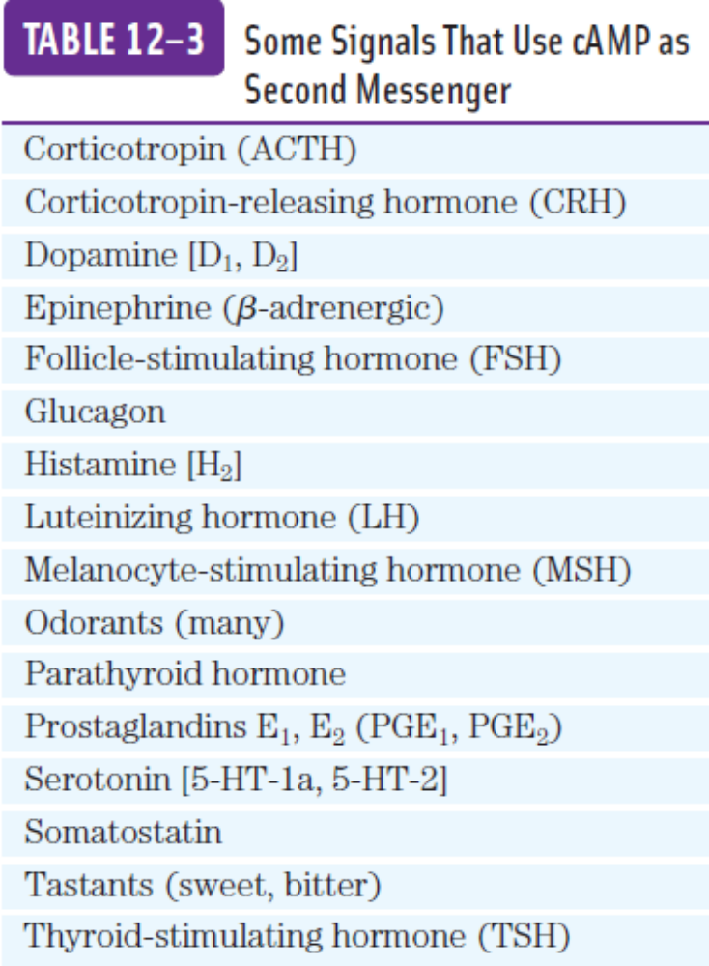

Slide 32
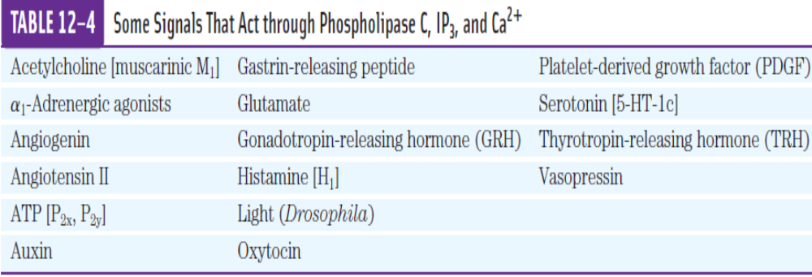

Slide 33


Slide 34
Basic terminologies
Ligands
  Substances which binds with the receptors
    Hormones, Neurotransmitters, Drugs, Toxins other chemical substances
    Receptors
  Receptors are macromolecules to which ligand binds and perform some biological function (if no function is performed so are not receptor i.e plasma proteins)
    Ligand Binding Domain
      Location on receptors where ligand binds

Slide 35
Receptors classification
Based on which molecule they interact receptors are divided into two groups mainly
For molecules which are large in size, polar or lipid insoluble as they can not pass the cell membrane so receptors for such molecules must lie on the membrane such receptors are called Cell surface receptors.
For those molecules which can pass the cell membrane receptors must lie inside the cell such receptors are called Intra cellular receptors.

Slide 36
Cell Surface Receptors
Peptide Hormones
(large Molecules)
Insulin, Growth Hormones, Prolactin’s, FSH, LH, TSH
Catecholamines
(Highly polar)
Epinephrine, Norepinephrine, Dopamine, Prostaglandins, Histamines
Receptors within the cell
Highly lipid soluble
( Steroid Hormones)
Testosterone, Progesterone, Estrogen, Aldosterone, Glucocorticoids, Vit-D
Small Molecular weight
T3, T4, Retinoids

Slide 37
Cell-Surface Receptors
Cell-surface receptors, also known as transmembrane receptors, are cell surface, membrane-anchored, or integral proteins that bind to external ligand molecules
This type of receptor spans the plasma membrane and performs signal transduction, converting an extracellular signal into an intracellular signal
Ligands that interact with cell-surface receptors cannot pass through the cell membrane freely
Each cell-surface receptor has three main components: an extracellular domain, a hydrophobic membrane-spanning region, and an intracellular domain inside the cell

Slide 38
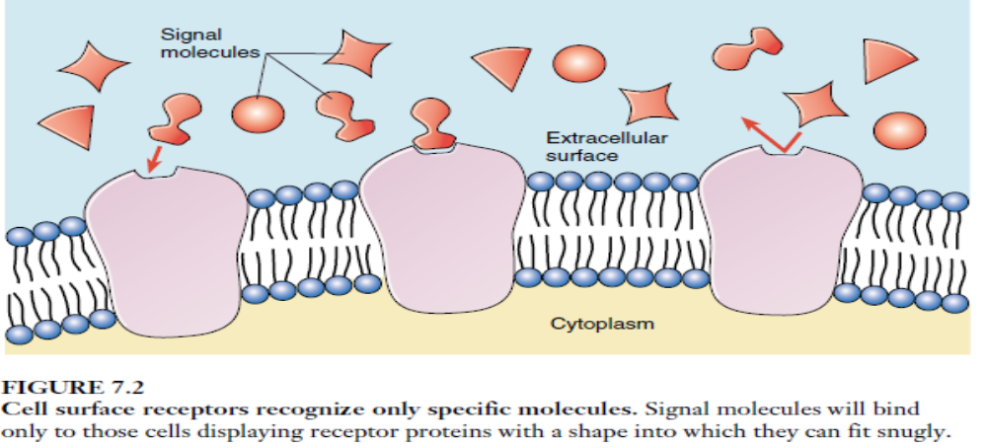
Cell Surface Receptors

Slide 39
Cell-Surface Receptors
Cell-surface receptors are involved in most of the signaling in multicellular organisms
There are three general categories of cell-surface receptors:
  G-protein-linked receptors/Serpentine Receptors/7-Pass receptors
  Enzyme-linked receptors/1-Pass Receptors
  ion channel-linked receptors
    Ligand operated ion channel
    Voltage operated ion channel

Slide 40
Cell-Surface Receptors
  G-protein-linked receptors/Serpentine Receptors/7 Pass receptors
    G Stimulatory System (Gs)
    Gq System (Gq)
    G inhibitory System (Gi)
  Ligands for GPCR
    Catecholamines, Prostaglandins, Histamines, ACH,STH, TSH

Slide 41
G-Protein coupled receptors
G protein–coupled receptors (GPCRs) are receptors that are closely associated with a member of the guanosine nucleotide–binding protein (G protein) family
Three essential components define signal transduction through GPCRs: a plasma membrane receptor with seven transmembrane helical segments, a G protein that cycles between active (GTP-bound) and inactive (GDP-bound) forms, and an effector enzyme (or ion channel) in the plasma membrane that is regulated by the activated G protein

Slide 42
G-Protein coupled receptors
The G protein, stimulated by the activated receptor, exchanges bound GDP for GTP, then dissociates from the occupied receptor and binds to the nearby effector enzyme, altering its activity
The activated enzyme then generates a second messenger that affects downstream targets.
The human genome encodes about 350 GPCRs for detecting hormones, growth factors, and other endogenous ligands, and perhaps 500 that serve as olfactory (smell) and gustatory (taste) receptors

Slide 43
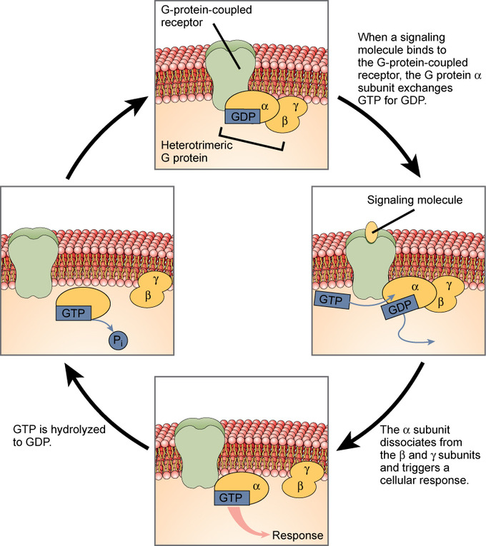
How G-Protein-Linked Receptors Work
G-proteins: Heterotrimeric G proteins have three subunits: α, β, and γ. When a signaling molecule binds to a G-protein-coupled receptor in the plasma membrane, a GDP molecule associated with the α subunit is exchanged for GTP. The β and γ subunits dissociate from the α subunit, and a cellular response is triggered either by the α subunit or the dissociated β pair. Hydrolysis of GTP to GDP terminates the signal.

Slide 44
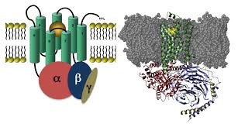
Stimulatory G protein
G proteins are membrane-associated proteins made up of three subunits: alpha (α), beta (β), and gamma (γ). The G alpha subunit is responsible for most of the signaling specificity. The G proteins are heterotrimeric and are sometimes referred to as the "large" G proteins.

Slide 45
Adenylyl cyclase (AC)
Adenylyl cyclase (AC) is an enzyme that catalyzes the production of cyclic-adenosine monophosphate (cAMP) from ATP. The structure of mammalian ACs is made up of two transmembrane regions (M1 and M2) and two cytoplasmic regions (C1 and C2).

Slide 46
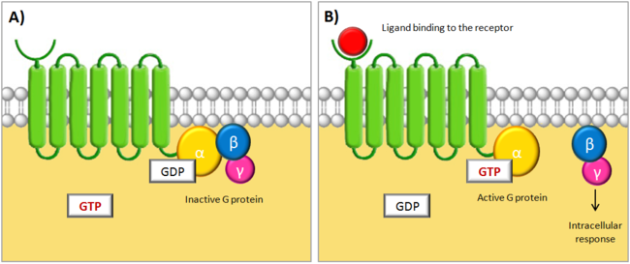
3. G-Protein-Linked Receptors

Slide 47
How G-Protein-Linked Receptors Work
G proteins are mediators that initiate a diffusible signal in the cytoplasm.
They form a transient link between the receptor on the cell surface and the signal pathway within the cytoplasm.
Importantly, this signal has a relatively short life span whose active age is determined by GTP.
Once the signal molecule binds to the receptor, the G-protein-linked receptor changes shape.
This change in receptor shape twists the G protein, causing it to bind GTP.

Slide 48
How G-Protein-Linked Receptors Work
The G protein can now diffuse away from the receptor. The “activated” complex of a G protein with attached GTP is then free to initiate a number of events.
However, this activation is short-lived, because GTP has a relatively short life span (seconds to minutes).
This elegant arrangement allows the G proteins to activate numerous pathways, but only in a transient manner.
In order for a pathway to “stay on,” there must be a continuous source of incoming extracellular signals. When the rate of external signal drops off, the pathway shuts down.

Slide 49
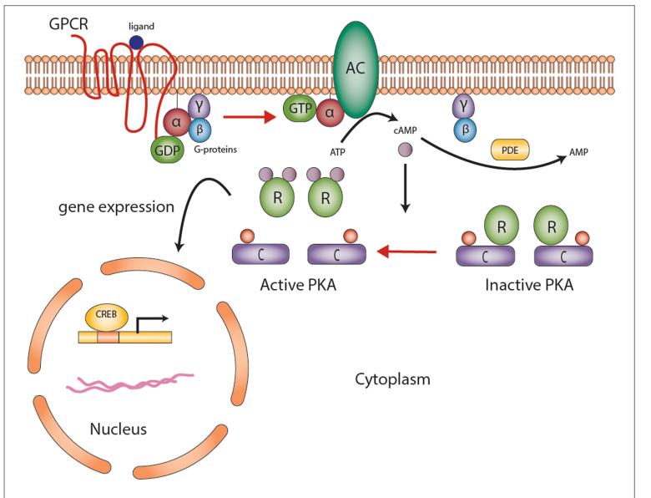

Slide 50
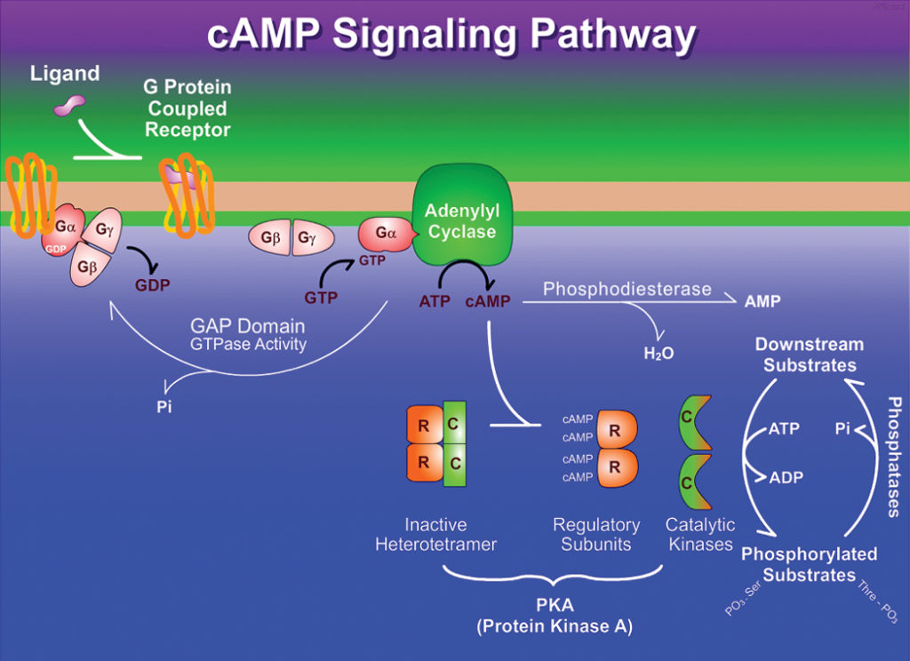

Slide 51
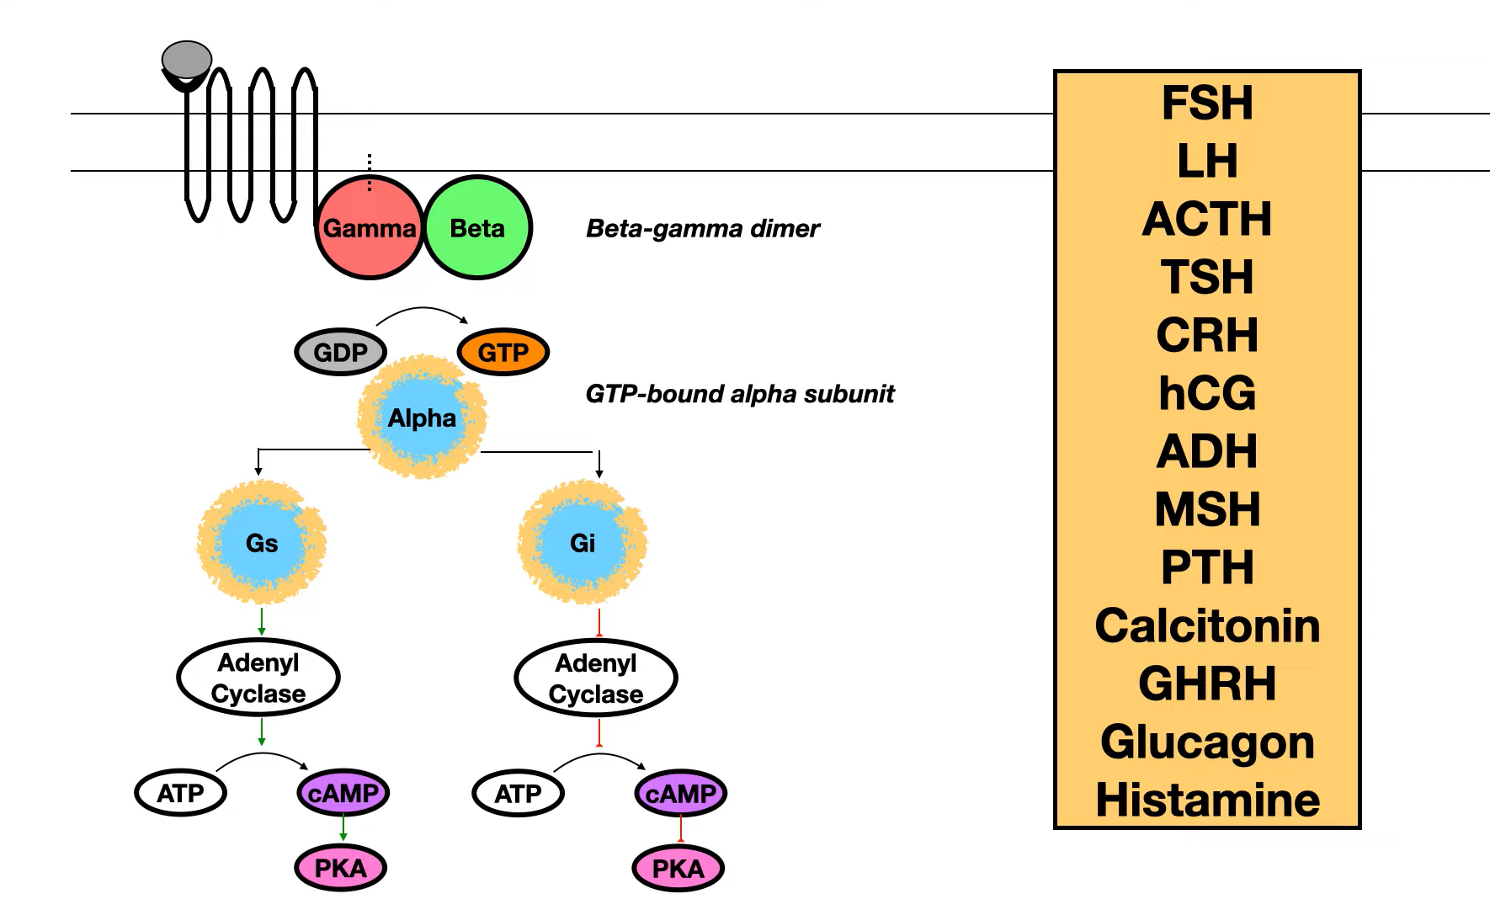

Slide 52
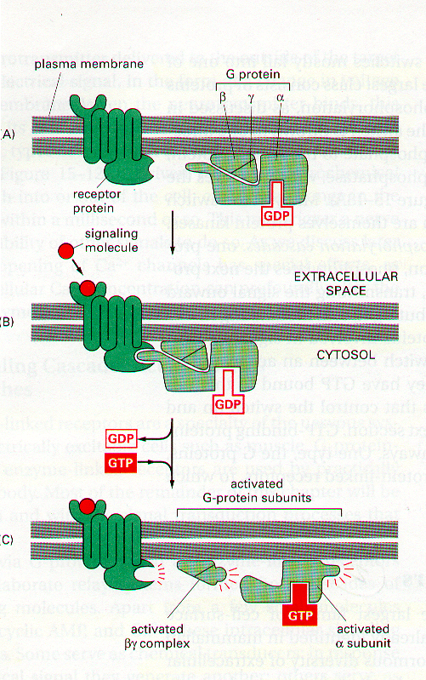
G-protein- a molecular switch
Ligand binds
G-protein associates
GDP-GTP exchange
α-Subunit dissociates
Active G-Protein-GTP
allosteric modulator of target effector enzyme

Slide 53
Initiating the intracellular signal
There are TWO broad subclasses of trimeric G-protein-activated signal transduction pathways.
It depends on their target effector enzymes
A. adenylyl cyclase
B. phospholipase C

Slide 54
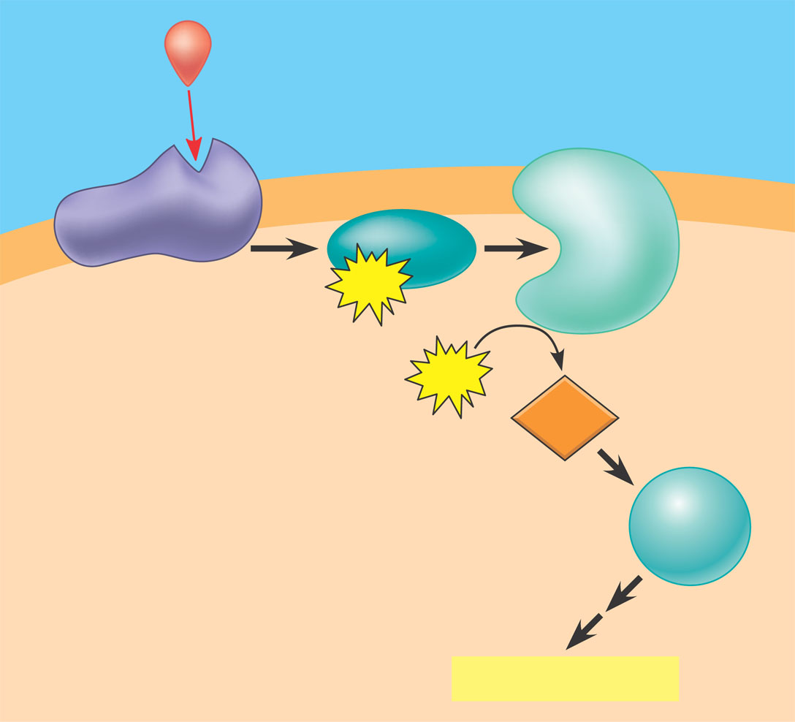
Initiating the intracellular signal
A. adenylyl cyclase pathway: An activated G_{a}-protein-GTP can trigger the formation of cAMP, which then acts as a second messenger in cellular pathways.
First messenger
(signal molecule
such as epinephrine)
Adenylyl
cyclase
G protein
G-protein-linked
receptor
GTP
ATP
cAMP
Protein
kinase A
Cellular responses

Slide 55
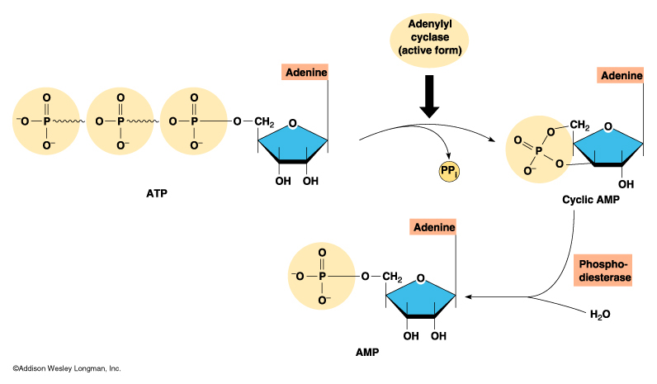
Initiating the intracellular signal
Activated G-protein-GTP act on effector Enzyme adenylyl cyclase which produces the 2nd messenger cAMP

Slide 56
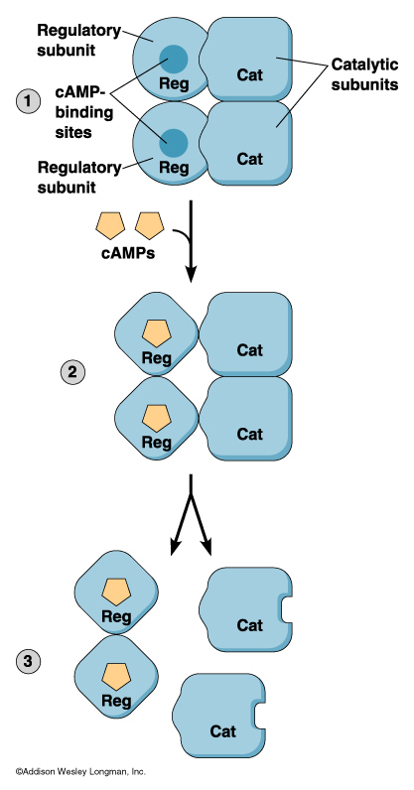
Signal initiation
cAMP activates target enzyme Protein Kinase A (PKA) which phosphorylates target proteins.

Slide 57
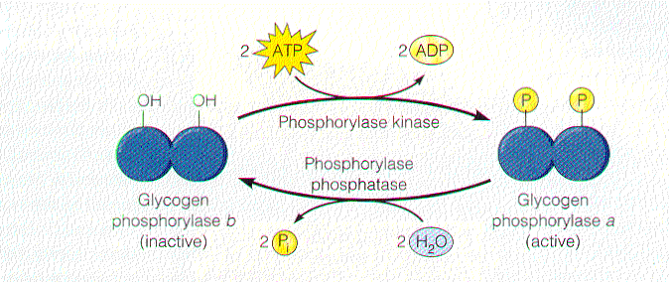
Signal cascade
Protein Kinase A Phosphorylates downstream target enzymes- Phosphorylase kinase- Breaks down Starch Into Glucose.

Slide 58
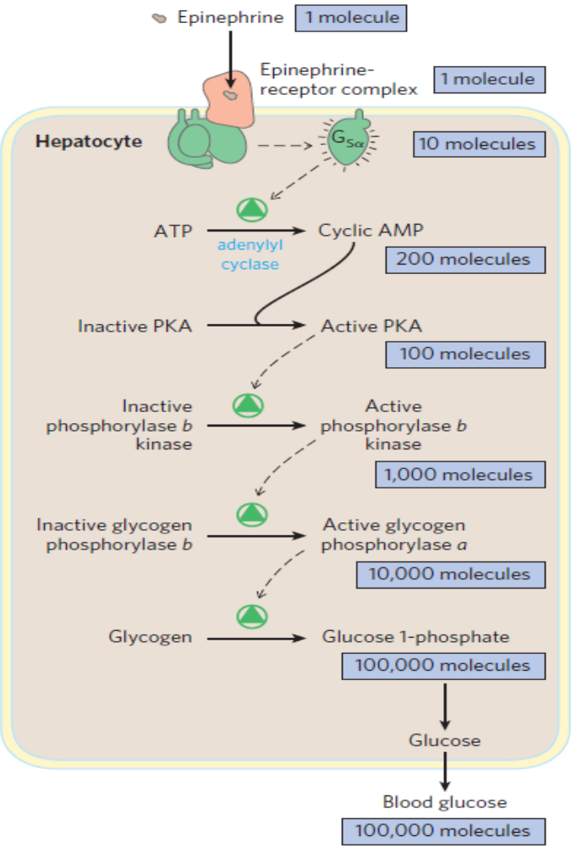
Signal cascade- Amplification

Slide 59
Targets for Protein Kinase A
cAMP regulated pathways
Function Target tissue Signal
Glycogen breakdown muscle, liver epinephrine
Heart rate cardiovascular epinephrine
Water reabsorption kidney antidiuretic
hormone

Slide 60
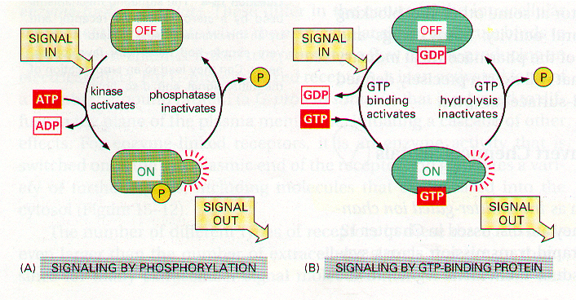
How to switch off molecular switch?

Slide 61
How to switch off molecular switch?
How to switch off this molecular switch?
Another enzyme cAMP-phosphodiesterase rapidly cleaves cAMP and thus switched off.

Slide 62
Switch dysfunction
Normally in gut H₂0, NaCl, NaHCO₃ secretion is controlled by hormones via G protein/cAMP signal pathways.
V. cholera – secretes enterotoxin, chemically modifies αGs – no GTPase activity – switch stays ON
Severe watery diarrhea – dehydration, death

Slide 63
Gq System/Phosphatidylinositol Pathway

Slide 64
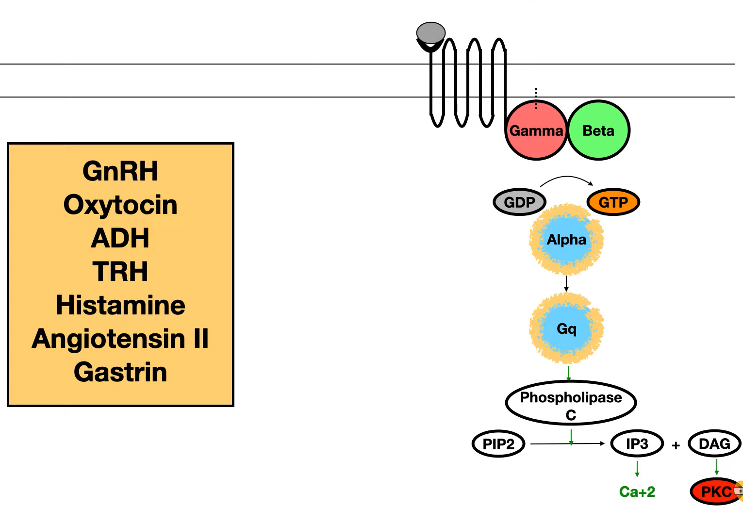

Slide 65
B. Phospholipase C pathway
In this pathway effector enzyme is Phospholipase C.
PLC cleaves a membrane phospholipid (Phoshatidyl inositol) to two 2nd Messengers:
Inositol-1,4,5-Trisphosphate(IP3)
Diacylglycerol (DAG)

Slide 66
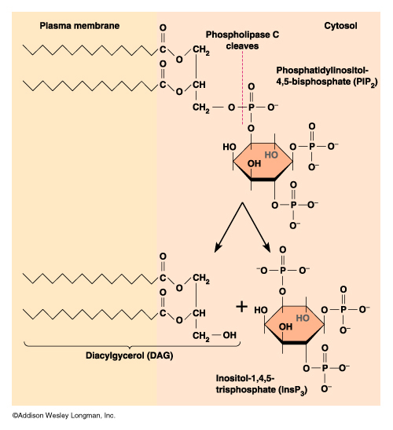
PIP₂
DAG
Lipid
Soluble
I P₃
Water
Soluble

Slide 67
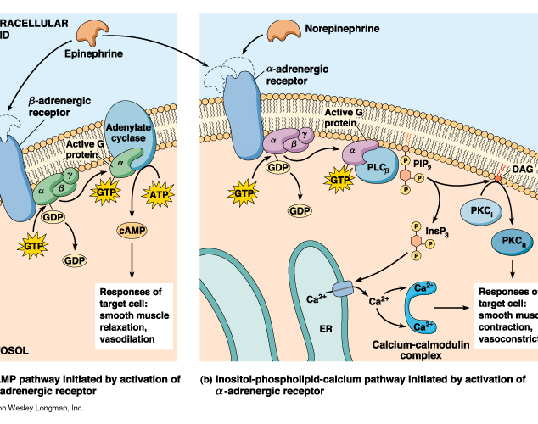
Signal cascade
DAG activates protein kinase C and starts the cascade.
IP3 is ligand for ER- ligand gated Ca⁺⁺ channels- release more and more calcium.

Slide 68
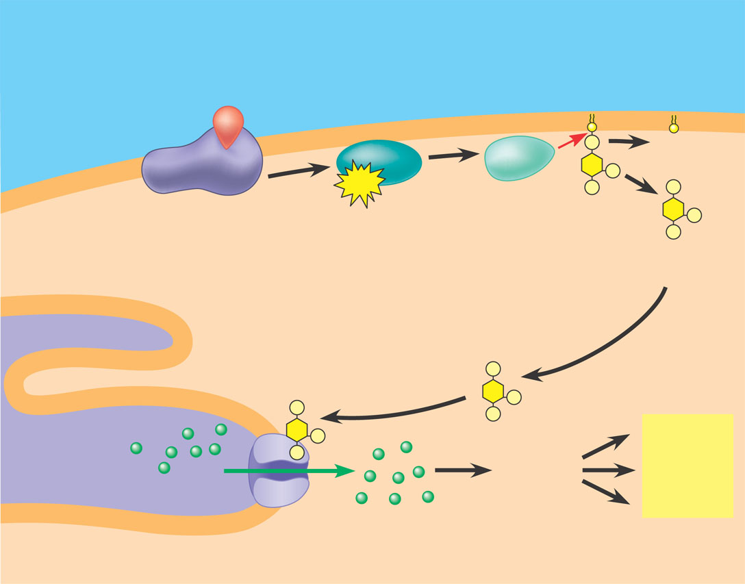
1
2
3
DAG functions as
a second messenger
in other pathways.
A signal molecule binds
to a receptor, leading to
activation of phospholipase C.
Phospholipase C cleaves a
plasma membrane phospholipid
called PIP₂ into DAG and IP₃.
EXTRA-
CELLULAR
FLUID
Signal molecule
(first messenger)
G protein
DAG
GTP
G-protein-linked
receptor
PIP₂
Phospholipase C
IP₃
(second messenger)
IP₃-gated
calcium channel
Endoplasmic
reticulum (ER)
Various
proteins
activated
Cellular
response
Ca²⁺
Ca²⁺
(second
messenger)
4
5
Calcium ions flow out of
the ER (down their con-
centration gradient), raising
the Ca²⁺ level in the cytosol.
6
IP₃ quickly diffuses through
the cytosol and binds to an IP₃–
gated calcium channel in the ER
membrane, causing it to open.
The calcium ions
activate the next
protein in one or more
signaling pathways.

Slide 69
Signal cascade- targets
Protein Kinase C phosphorylates target proteins (ser & thr) which control
cell growth
regulation of ion channels
cytoskeleton
increases cell pH
Protein secretion
Ca++
Binds & activates calmodulin. Calmodulin-binding proteins activate (kinases & phosphatases). The efflux of Ca++ from the endoplasmic reticulum causes skeletal muscle cells to contract and some endocrine cells to secrete hormones.

Slide 70
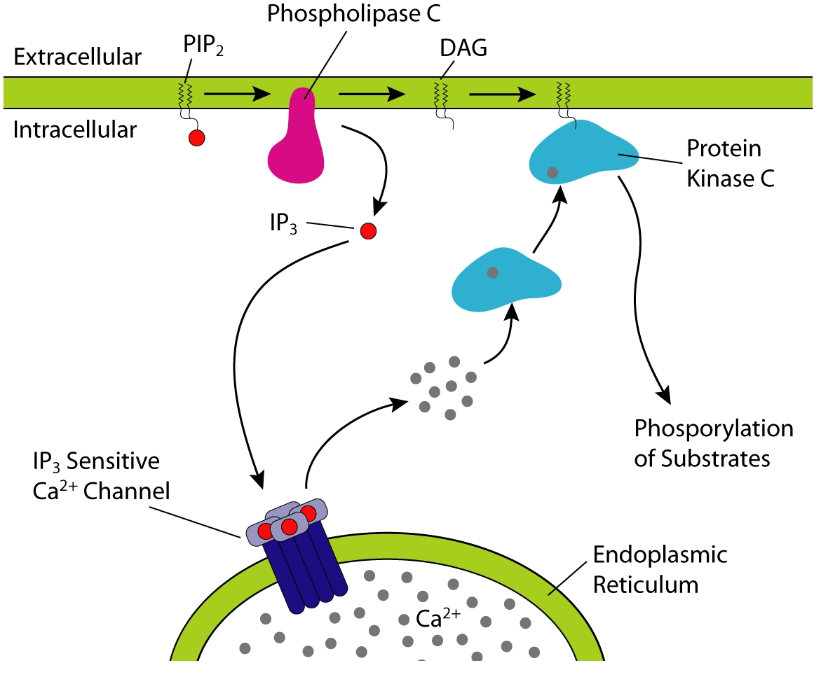

Slide 71
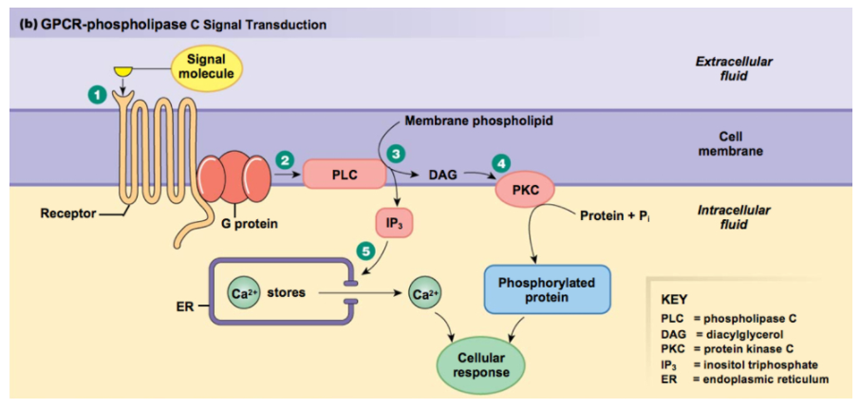

Slide 72
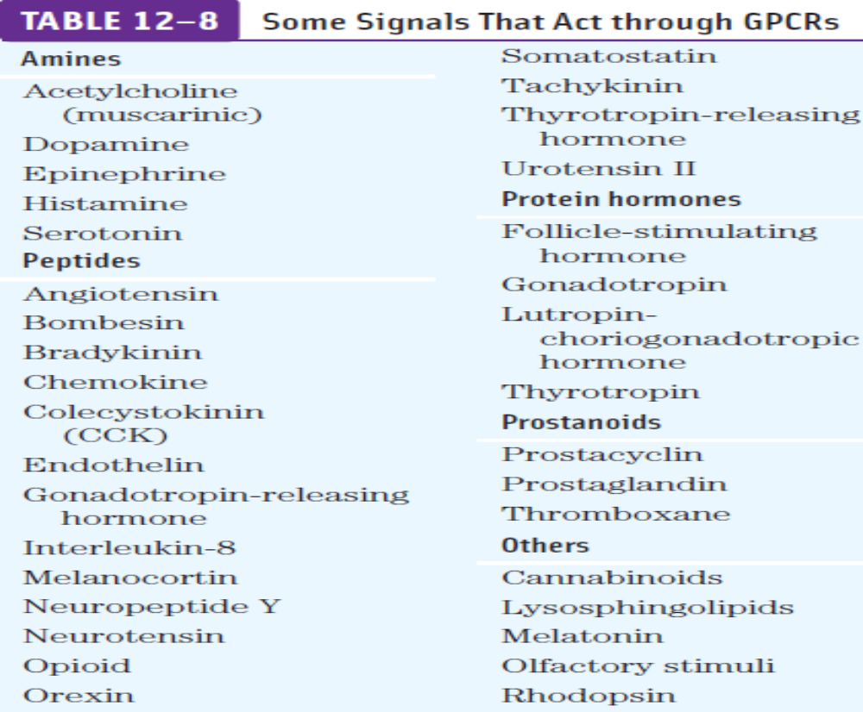

Slide 73
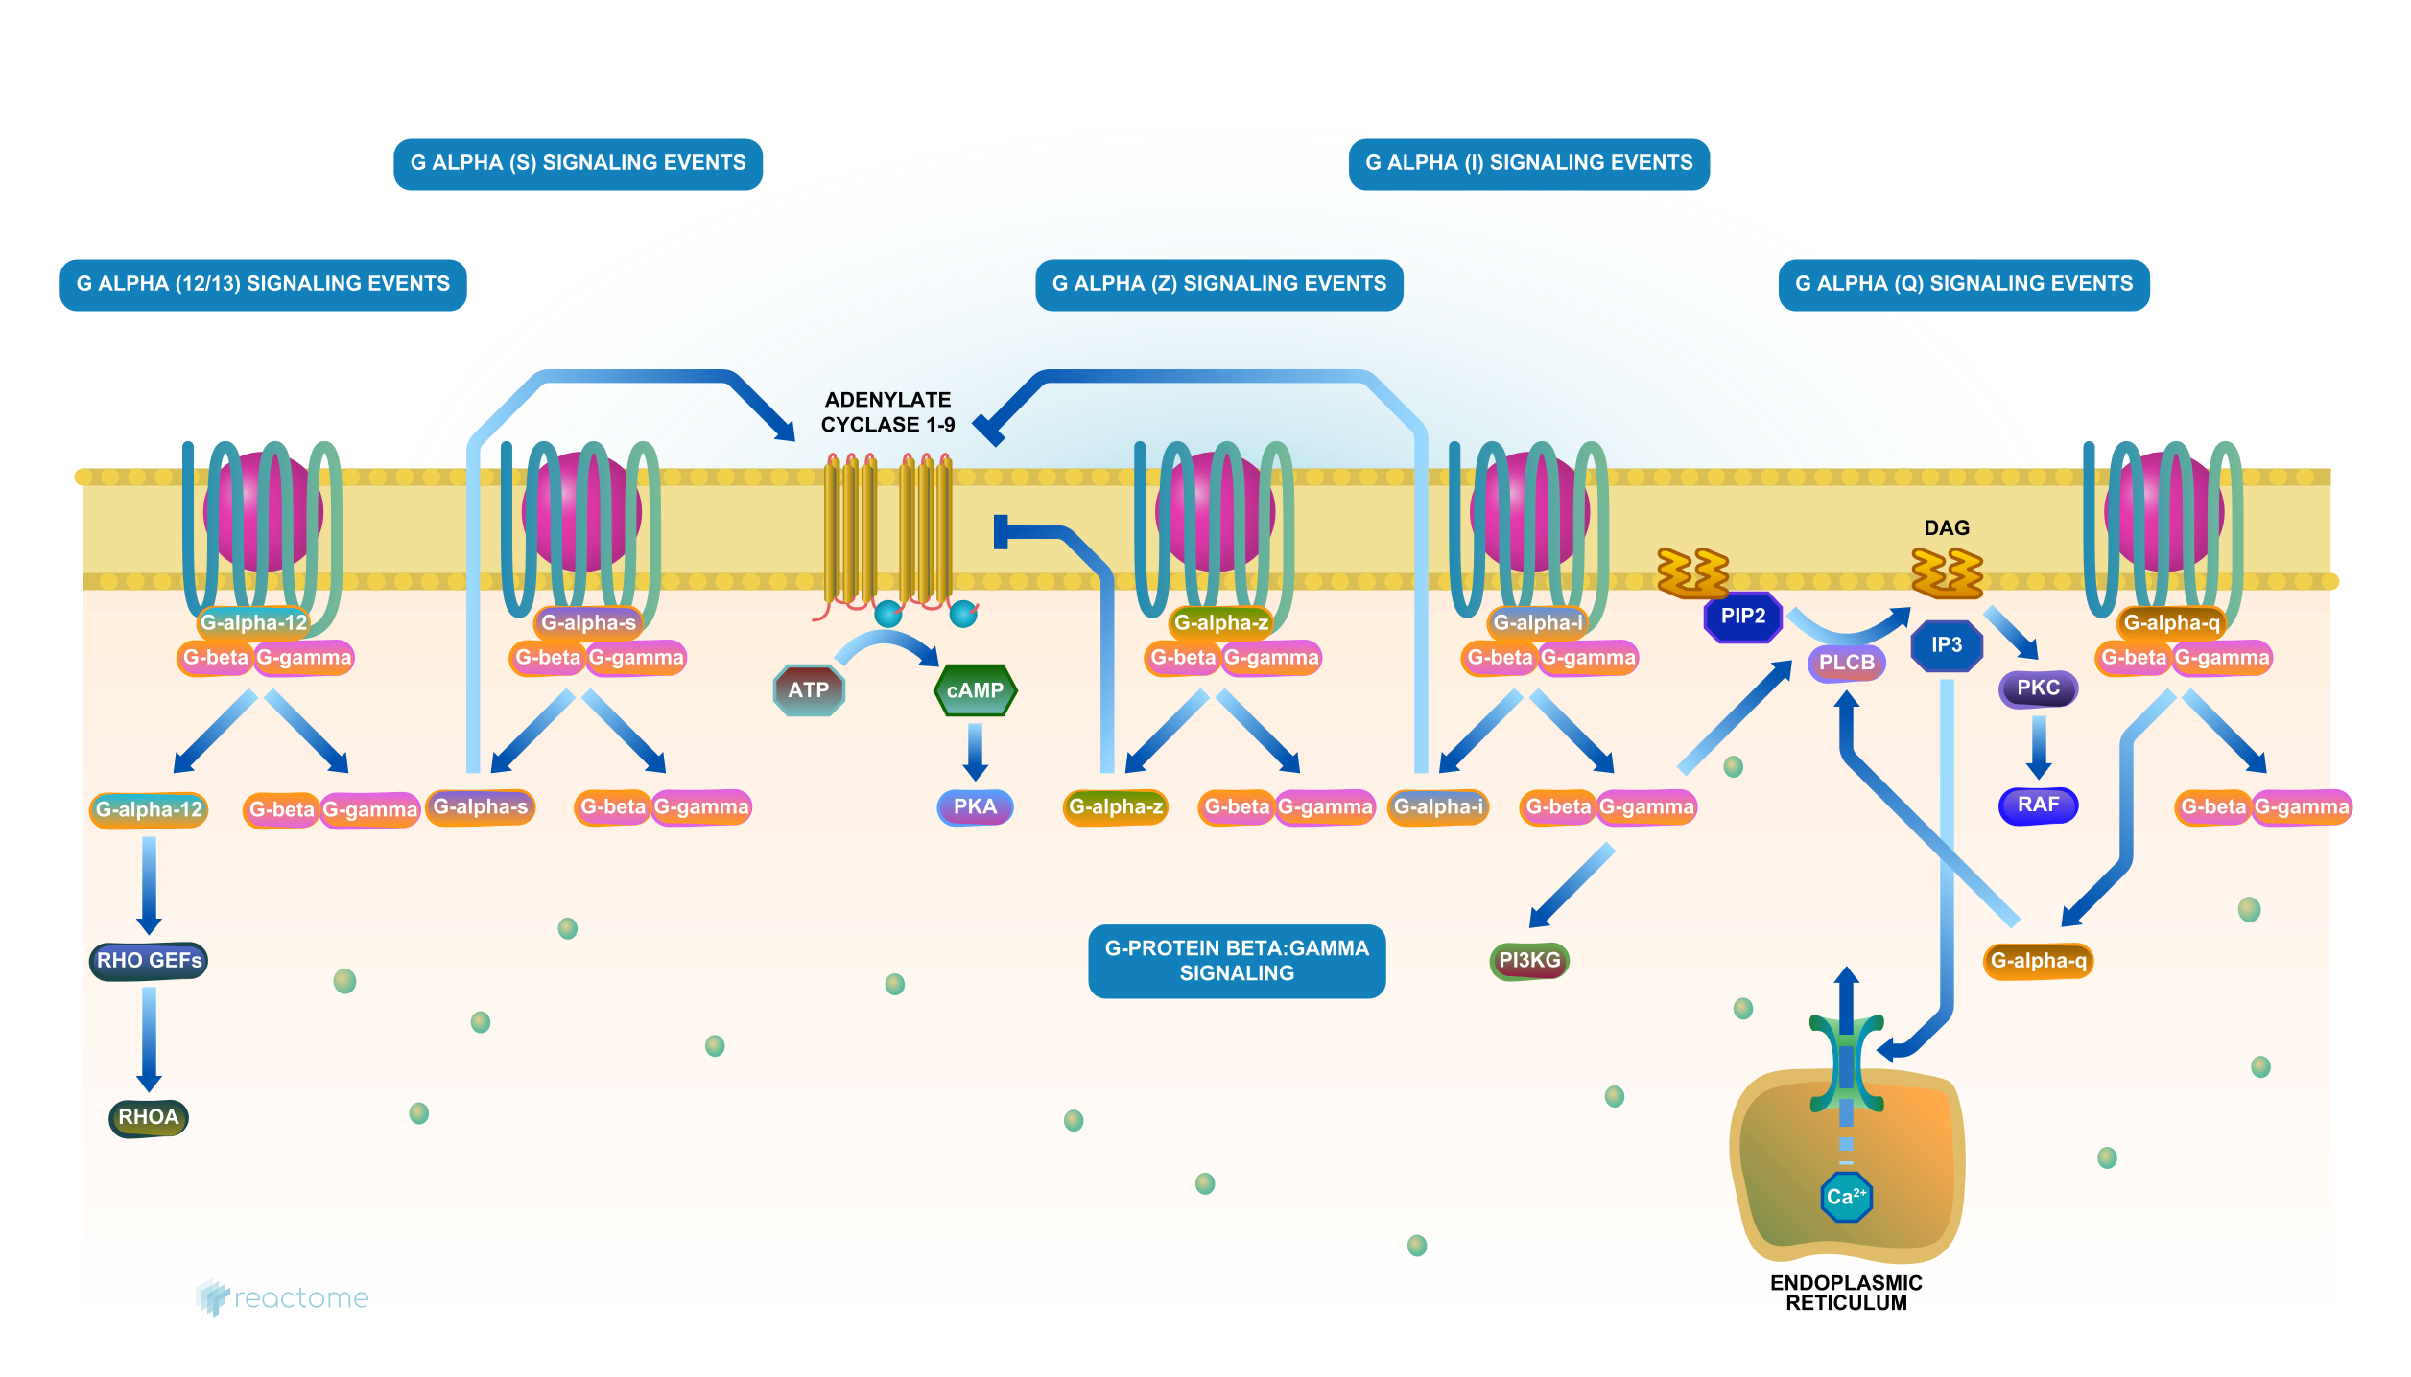

Slide 74
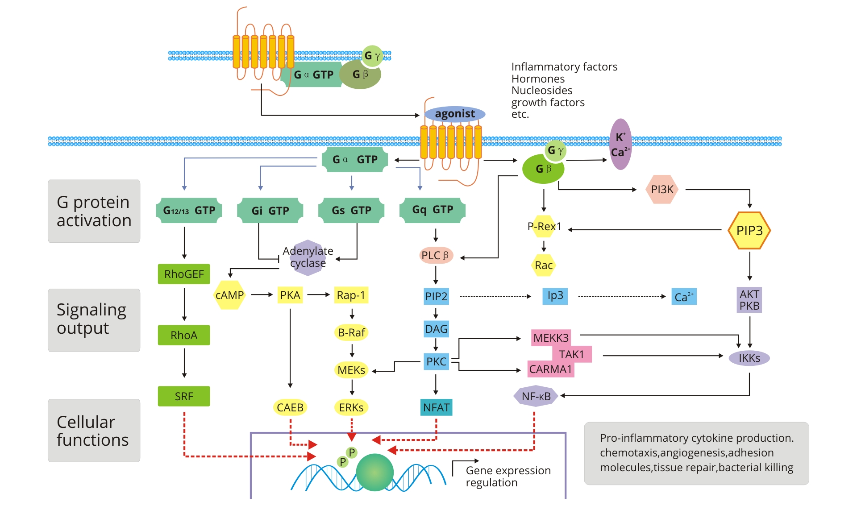

Slide 75
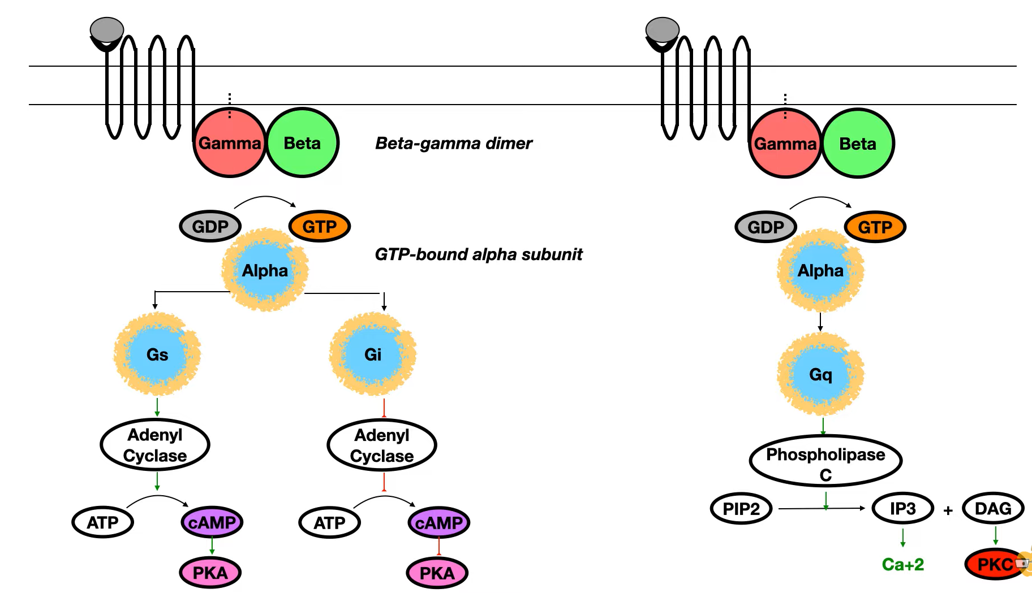

Slide 76
Ligand working through G-Protein Receptors
Cholinergic Receptors
Nicotinic Receptors (Non G-coupled)
Muscarinic Receptors ( Serpentine Receptors)
Adrenergic Receptors
Alpha-1 (Gq System)
Alpha-2 ( G inhibitory System)
Beta-1 ( G Stimulatory System)
Beta-2 ( G Stimulatory System)
Beta-3 ( G Stimulatory System)
Dopaminergic Receptors
D-1 ( G Stimulatory System)
D-2 ( G Inhibitory System)
Purinergic Receptors
A-type (Adenosine)
B-type (ATP)
GABA Receptors
GABA-1 (Chloride Influx)
GABA-2 ( Serpentine Receptors)

Slide 77
Ligand working through G-Protein Receptors
TSH Receptors (G-Protein)
Luteinizing Hormone Receptors (G-Protein)
ACTH Receptors ( Serpentine Receptors)
Rhodopsin Receptors (( Serpentine Receptors)
Vasopressin (ADH)
V-1 (Vascular System- Constriction)
V-2 ( Nephron Last Part)

Slide 78
Ion channels linked Receptors
Ion channels linked Receptors also known as ligand gated channels or inotropic receptors are membrane proteins acting as a receptors for neurotransmitters or other signaling molecules. These receptors alter membrane potential by maintaining the flow of different ions like sodium, potassium, chlorides, and calcium across the membrane leading to changes in neuronal excitability or signaling.
Examples includes
  Nicotinic Cholinergic Receptors
  GABA Receptors

Slide 79
Chemically gated ion channels/ Ion Channel-Linked Receptors
Ion channel-linked receptors bind a ligand and open a channel through the membrane that allows specific ions to pass through
In order to interact with the phospholipid fatty acid tails that form the center of the plasma membrane, many of the amino acids in the membrane-spanning region are hydrophobic in nature
Conversely, the amino acids that line the inside of the channel are hydrophilic to allow for the passage of water or ions
When a ligand binds to the extracellular region of the channel, there is a conformational change in the protein’s structure that allows ions such as sodium, calcium, magnesium, and hydrogen to pass through

Slide 80
Ion channels linked Receptors
These are of the following types
  Ligand operated ion channels
  Voltage operated ion channels
  Mechanical gated ion channels

Slide 81
Ion channels linked Receptors
When cation moves into the cell, it becomes more electropositive and resting membrane potential reaches threshold (-55mv) causing the cell to become excited.
When cell losses more potassium cell become electronegative and hyper polarized.
When more negative ions like chlorides enter cell, it become more electronegative.

Slide 82
Ligand operated ion channels can be stimulated by
  Hormones
  Neurotransmitters
  Chemicals
  These channels can be inhibited by certain substances like
  Tetrodotoxin (Neurotoxin- block Na+ channels)
  Lidocaine (block Na+ preventing action potential generation)

Slide 83
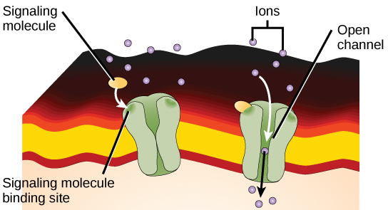
Chemically gated ion channels
Gated-Ion Channels: Gated ion channels form a pore through the plasma membrane that opens when the signaling molecule binds. The open pore then allows ions to flow into or out of the cell

Slide 84
Enzyme-Linked Receptors
Enzyme-linked receptors are cell-surface receptors with intracellular domains that are associated with an enzyme
In some cases, the intracellular domain of the receptor itself is an enzyme or the enzyme-linked receptor has an intracellular domain that interacts directly with an enzyme
The enzyme-linked receptors normally have large extracellular and intracellular domains, but the membrane-spanning region consists of a single alpha-helical region of the peptide strand

Slide 85
Enzyme-Linked Receptors
When a ligand binds to the extracellular domain, a signal is transferred through the membrane and activates the enzyme, which sets off a chain of events within the cell that eventually leads to a response
An example of this type of enzyme-linked receptor is the tyrosine kinase receptor
The tyrosine kinase receptor transfers phosphate groups to tyrosine molecules
Signaling molecules bind to the extracellular domain of two nearby tyrosine kinase receptors, which then dimerize
Phosphates are then added to tyrosine residues on the intracellular domain of the receptors and can then transmit the signal to the next messenger within the cytoplasm

Slide 86
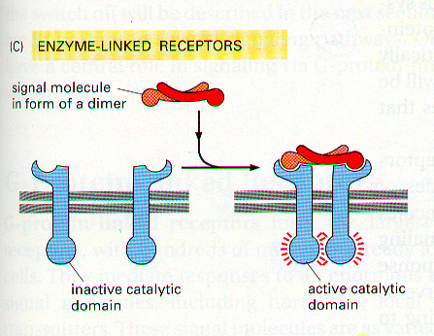
Enzyme-Linked Receptors

Slide 87
Receptor tyrosine Kinase
  Ligand for Receptor Tyrosine Kinase
  Insulin
  Epidermal growth factor
  Nerve growth factor
  Platelet growth factor
  Vascular endothelial growth factor
  Fibroblast growth factor

Slide 88
Receptor tyrosine Kinase
  Phosphorylation of tyrosine residues in tyrosine kinase receptors (RTKs) is a crucial mechanism for signal transduction in cells.
  Ligand Binding and Receptor Dimerization
  Ligand Binding: The process begins when a ligand (such as a growth factor) binds to the extracellular domain of the RTK. Examples of ligands include Epidermal Growth Factor (EGF) and Platelet-Derived Growth Factor (PDGF).
  Receptor Dimerization: Ligand binding induces a conformational change that causes two RTK molecules to come together and form a dimer. Some RTKs can also form oligomers or higher-order structures.

Slide 89
Receptor tyrosine Kinase
  2. Autophosphorylation-
  Activation of Kinase Domain: The dimerization brings the intracellular tyrosine kinase domains of the receptors into proximity. This proximity allows the kinase domains to phosphorylate each other on specific tyrosine residues. This process is known as autophosphorylation.

Slide 90
Receptor tyrosine Kinase
  3. *Signal Transduction
  Docking Sites Creation: The phosphorylated tyrosine residues serve as docking sites for various intracellular signaling proteins. These proteins contain specific domains (e.g., SH2 domains) that recognize and bind to the phosphorylated tyrosine's.
  Recruitment of Signaling Molecules: The binding of signaling proteins to phosphorylated tyrosine's triggers the assembly of signaling complexes at the receptor.
  Propagation of Signal: The activation of these pathways leads to various cellular responses, including changes in gene expression, cell growth, differentiation, and survival.
  Examples of RTKs-Epidermal Growth Factor Receptor (EGFR), Insulin Receptor (IR),Platelet-Derived Growth Factor Receptor (PDGFR)

Slide 91
Receptor tyrosine Kinase
Ligand binding
Receptor dimerization
phosphorylation of tyrosine residues
attachment of Sulfhydryl group with phosphorylated tyrosine
SOS protein
RAF Protein Kinase
DNA expression
RAS Protein (G-Protein)
MAP Kinase

Slide 92
Tyrosine Kinase associated Receptor
  Ligand for Receptor
  Prolactin
  Interlukin-2
  Cytokines
  Platelet growth factor
  T-cell Receptors
  B-cell Receptors

Slide 93
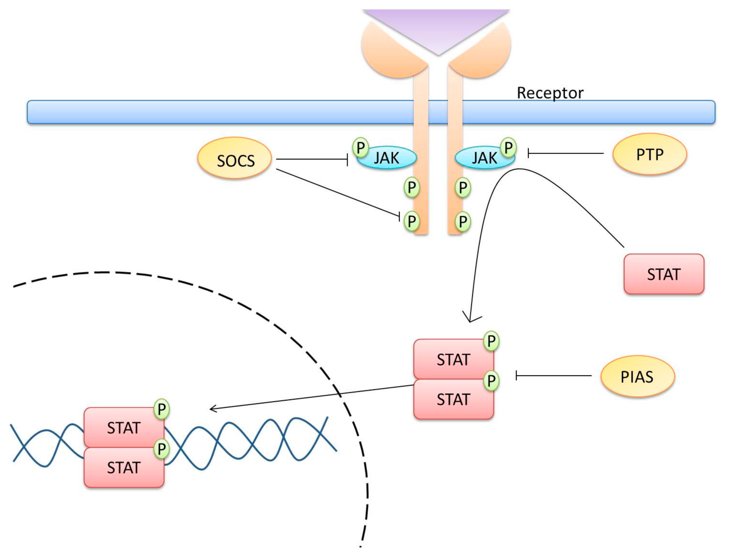

Slide 94
  Tyrosine Phosphatase Receptor
    Receptor Tyrosine Phosphatases (RPTPs) are cell surface receptors that possess intrinsic protein tyrosine phosphatase activity. By dephosphorylating tyrosine residues on target proteins, RPTPs regulate various cellular processes and play important roles in development, immune function, and disease pathology. Understanding the function and regulation of RPTPs provides insights into the complex mechanisms of cellular signaling and potential therapeutic strategies for diseases associated with dysregulated tyrosine phosphorylation.

Slide 95
  Serine Threonine Kinase Receptors
    Beta transforming growth factor binds here (a cytokine)
    Serine/threonine kinase receptors are cell surface receptors that phosphorylate serine and/or threonine residues on target proteins in response to ligand binding. They play critical roles in cellular signaling and regulation of various physiological processes.

Slide 96
One Pass Guanyl cyclase Receptor/Membrane guanylyl cyclase (mGCs)
  When ANP (atrial Natriuretic peptide) bind with this receptor the guanyl cyclase part convert GTP to cGMP. Which in turn activate Protein Kinase G which cause phosphorylation of certain proteins .
  These Receptors are mainly of two types
    Part of 1 pass receptors present in membrane
    Cytosolic Receptor

Slide 97
One Pass Guanyl cyclase Receptor/Membrane guanylyl cyclase (mGCs)
  Atrial natriuretic peptide (ANP) is a hormone secreted primarily by the atria of the heart in response to increased blood volume and pressure.
  It acts as a ligand for one-pass guanylyl cyclase receptors, specifically the natriuretic peptide receptor A (NPR-A), also known as guanylyl cyclase-A (GC-A).
  Ligand Binding: ANP binds specifically to NPR-A receptors located on the surface of target cells, particularly in vascular smooth muscle cells and renal tubular cells.
  Receptor Activation: Binding of ANP induces conformational changes in NPR-A, leading to activation of the intracellular guanylyl cyclase domain. -Activated NPR-A catalyzes the conversion of GTP to cGMP in the cytoplasmic compartment of the cell.
  Cardiac Effects: ANP/NPR-A signaling leads to decreased cardiac contractility and inhibition of renin-angiotensin-aldosterone system (RAAS) activity, contributing to the overall reduction in cardiac workload and blood pressure

Slide 98
One Pass Guanyl cyclase Receptor/Membrane guanylyl cyclase (mGCs)
  cGMP Production: The generation of cGMP serves as a second messenger in intracellular signaling pathways. - Increased levels of cGMP activate downstream effectors, including protein kinases (such as PKG), ion channels, and phosphodiesterases.
  Physiological Effects of ANP/NPR-A Signaling:
    Vasodilation: - Activation of NPR-A by ANP leads to increased production of cGMP, which promotes relaxation of vascular smooth muscle cells. -
    Diuresis and Natriuresis: ANP/NPR-A signaling inhibits sodium reabsorption in the renal tubules, leading to increased urinary sodium excretion (natriuresis) and water loss (diuresis). - This contributes to the reduction of blood volume and pressure.

Slide 99
One Pass Guanyl cyclase Receptor/Membrane guanylyl cyclase (mGCs)
  Atrial natriuretic peptide (ANP) interacts with one-pass guanylyl cyclase receptors, specifically NPR-A, to exert physiological effects such as vasodilation, diuresis, and inhibition of cardiac hypertrophy. Dysregulation of ANP/NPR-A signaling is associated with cardiovascular diseases, making it a potential target for therapeutic intervention in conditions such as heart failure and hypertension. Understanding the mechanisms and effects of ANP/NPR-A signaling provides insights into its role in cardiovascular physiology and disease.

Slide 100
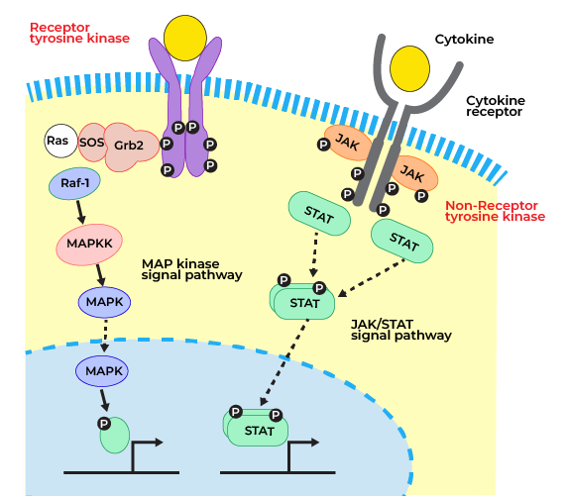

Slide 101
Intracellular receptors
Intracellular or cytoplasmic receptors, are found in the cytoplasm of the cell and respond to hydrophobic ligand molecules that are able to travel across the plasma membrane
Once inside the cell, many of these molecules bind to proteins that act as regulators of mRNA synthesis to mediate gene expression

Slide 102
Intracellular receptors
Ligand for intracellular Receptors
  Steroid hormones (Cytoplasmic)
  T3, T4 (on nucleus)
  Vit-D (Cytoplasmic)
  Retinoids (in nucleus)

Slide 103
Intracellular receptors
The nuclear receptor superfamily consists of a diverse set of transcription factors that were discovered because of a sequence similarity in their DNA-binding domains. This family, now with more than 50 members, includes the nuclear hormone receptors and a number of other receptors whose ligands were discovered after the receptors were identified, and many putative or orphan receptors for which a ligand has yet to be discovered

Slide 104
Intracellular receptors
When steroid hormones enter cell, they have receptors in the cytoplasm
These receptors are basically proteins having an amino and a carboxy terminal.
These receptors having a hormone/ligand binding domain near the carboxy terminal.
While its amine terminal works as a DNA binding domain having zinc fingers (4 cysteine residues linked with zinc).
This terminal in the absence of a ligand is covered by a protein called Heat shock Protein (HSP-90)

Slide 105
Intracellular receptors
Upon ligand attachment to the receptors, the HSP-90 dissociates and the whole complex moves to the nucellus where it binds to a specific region of DNA called DNA Enhancer region resulting in uncooling and later on into mRNA and than proteins

Slide 106
Intracellular receptors act as gene regulators
Some intracellular receptors act as regulators of gene expression
Among them are the receptors for steroid hormones, such as cortisol, estrogen, and progesterone, as well as the receptors for a number of other small, lipid soluble signal molecules, such as vitamin D and thyroid hormone.
Because of their structural similarities, they are all part of the intracellular receptor superfamily

Slide 107
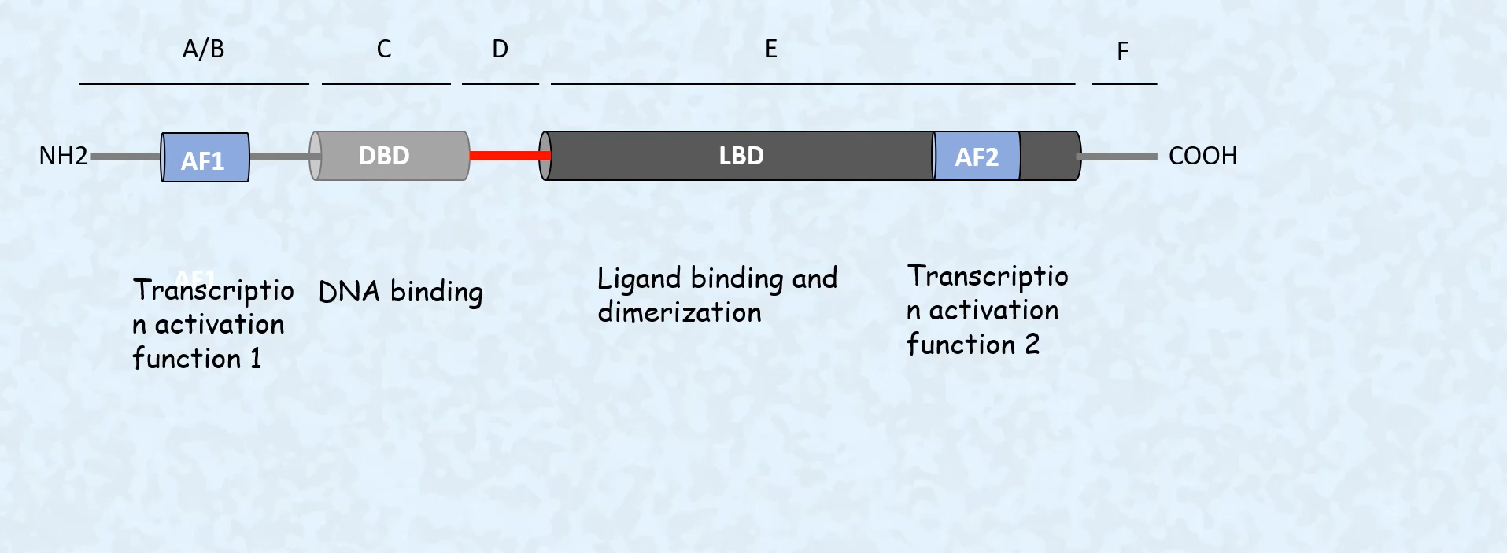

Slide 108
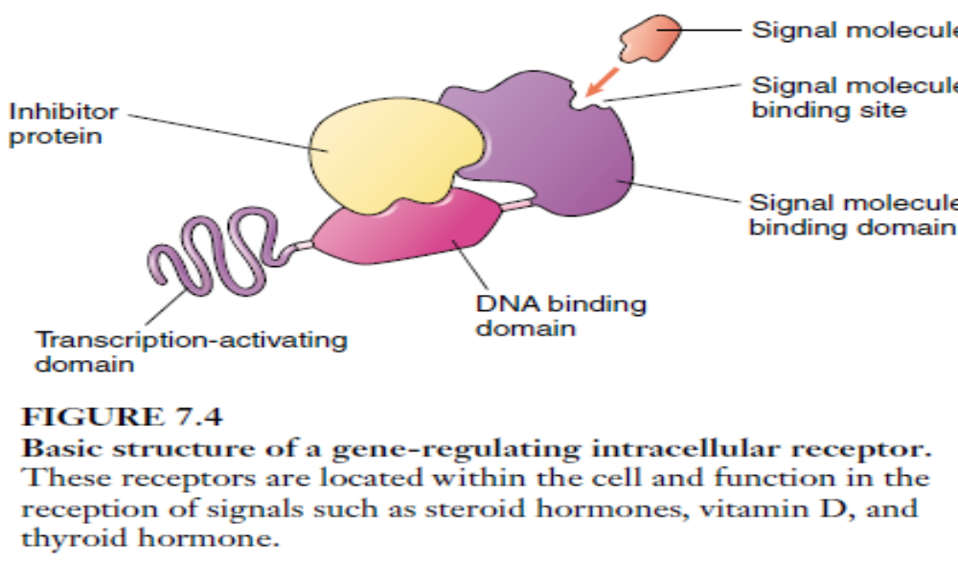
Intracellular receptor

Slide 109
Role of Nitric oxide
Nitric oxide is a gas with a half life of about 5 seconds.
It is mainly produced by
  Macrophages (bactericidal chemical)
  Neurons
    CNS (Short term memory)
    PNS (Penile Erection)
  Endothelial cells ( endothelial derived releasing factor)
  It is produced by the reaction of Nitric oxide Synthase on arginine ( amino acid) forming citrulline and Nitric oxide.

Slide 110
Our body and Nitric oxide
Nitric oxide works on smooth muscles around the deep cavernous artery of Male penis and sinosides of corpora cavernosum of the penis resulting in relaxation of the smooth muscles in the blood vessels which causing an erection and increased blood flow.
Sildenafil belongs to the class of PDE-5 (Phospohdiesterase-5) inhibitors which breaks down cGMP resulting in prolong erection and increase blood flow to the penis.

Slide 111
Mechanism of action of Nitric oxide
Nitric oxide binds to Guanyl cyclase resulting in its activation which result in the conversion of GTP into cGMP (working as a 2nd messenger) . cGMP can be degraded by PDE-5 (Sildenafil works here)
activate Protein Kinase-G
phosphorylation of MLCK (myosin light chain kinase). Results in deactivation of the MLCK .
MLCK unable to phosphorylate contractile proteins of the muscle
Smooth muscles become dilated

Slide 112
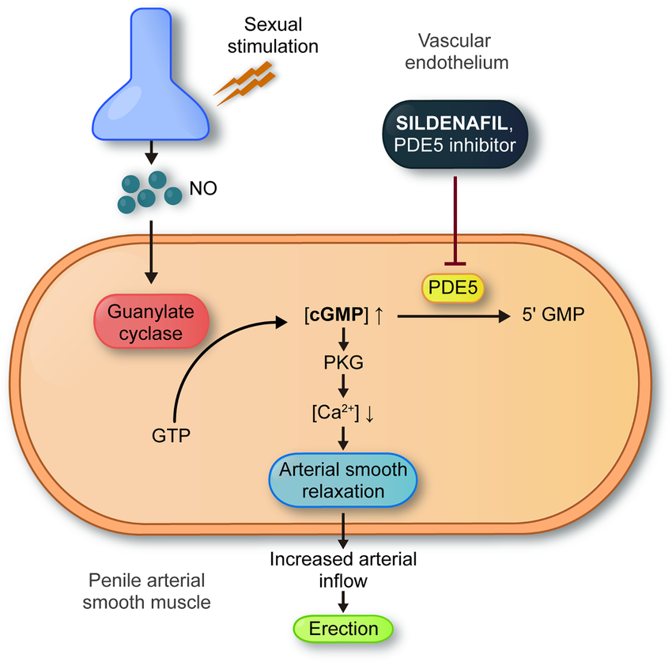

Slide 113
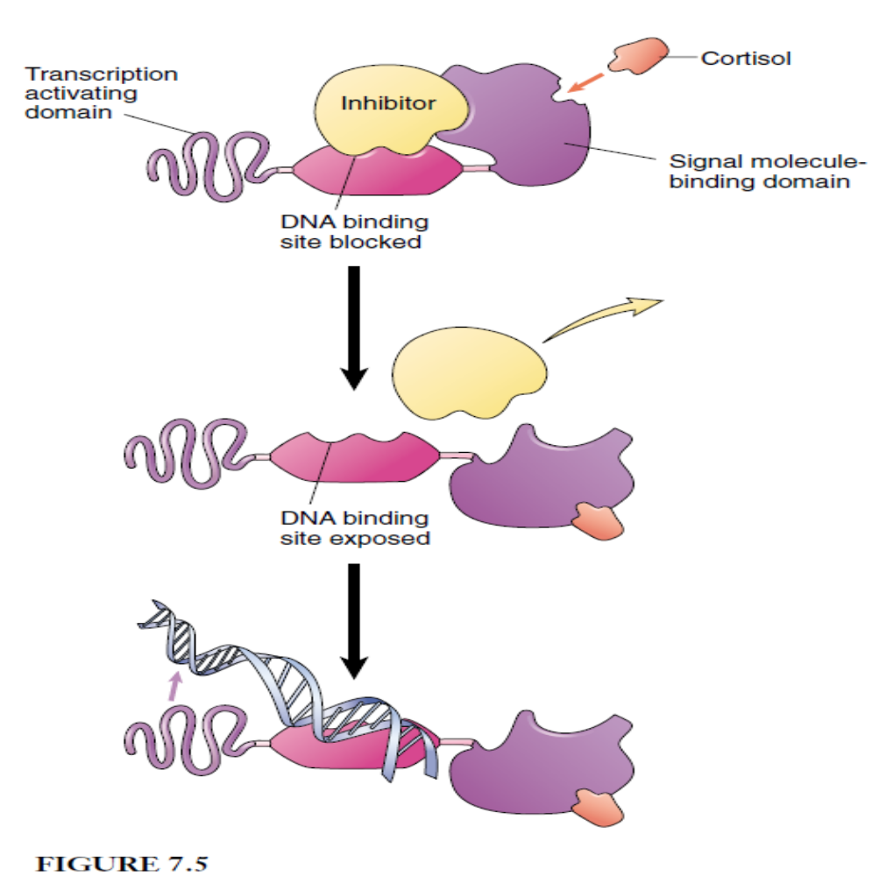

Slide 114
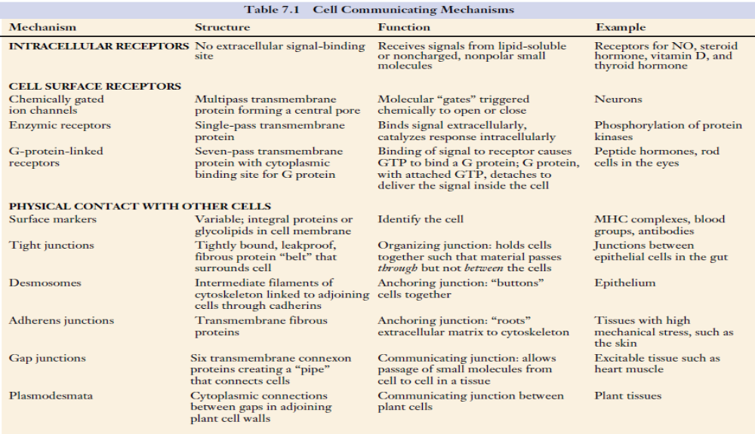

Slide 115


Slide 116


