Slide 1
Human
Digestive System
KHUSHAL KHAN
DEMONSTRATOR CARDIOLOGY
KHYBER MEDICAL UNIVERSITY – INSTITUTE OF PARAMEDICAL SCIENCES

Slide 2
Digestive System
The digestive system consists of;
  Alimentary Canal or Gastrointestinal tract (GIT)
  Accessory organs of digestion
  Alimentary Canal or Gastrointestinal tract (GIT)
  begins at the mouth
  passes through the thorax, abdomen and pelvis
  ends at the anus
Accessory organs of digestion
  They are:
  Teeth
  Tongue
  Salivary glands
  Pancreas
  Liver and biliary tract
  They are ducted organs – connected to the alimentary canal.

Slide 3
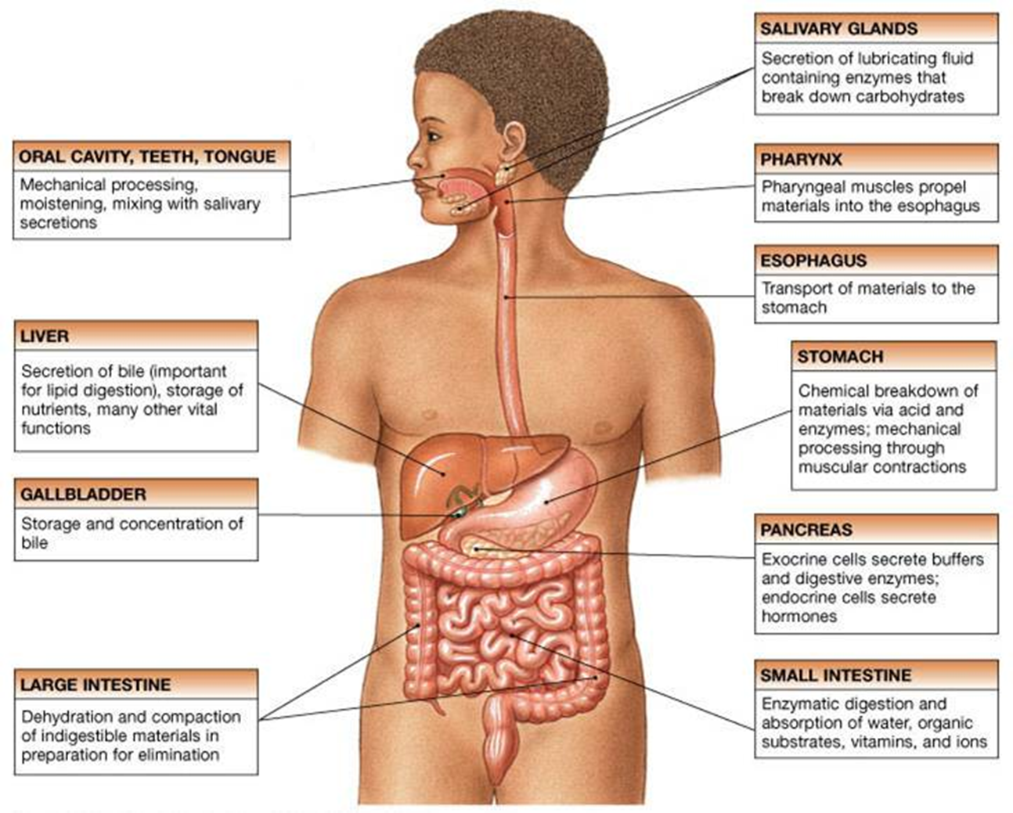

Slide 4
Functions
Ingestion
  Taking of food into the alimentary tract, i.e. eating and drinking.
Secretion
  Secretion of mucous and enzymes i.e. digestive enzymes.
Propulsion (Peristalsis)
  Mixing and movement of food along the alimentary tract.
Digestion
  Mechanical digestion - breakdown of food by, e.g. Mastication (chewing).
  Chemical digestion - conversion of food into small molecules by enzymes.
Absorption
  Passage of digested food substances through the walls of the alimentary canal into the blood and lymph capillaries like alcohol, nutrients, vitamins, water and electrolytes.
Elimination
  The removal of undigested and non absorbable food from the alimentary canal.
  Defaecation - the discharge of faeces from the body.

Slide 5
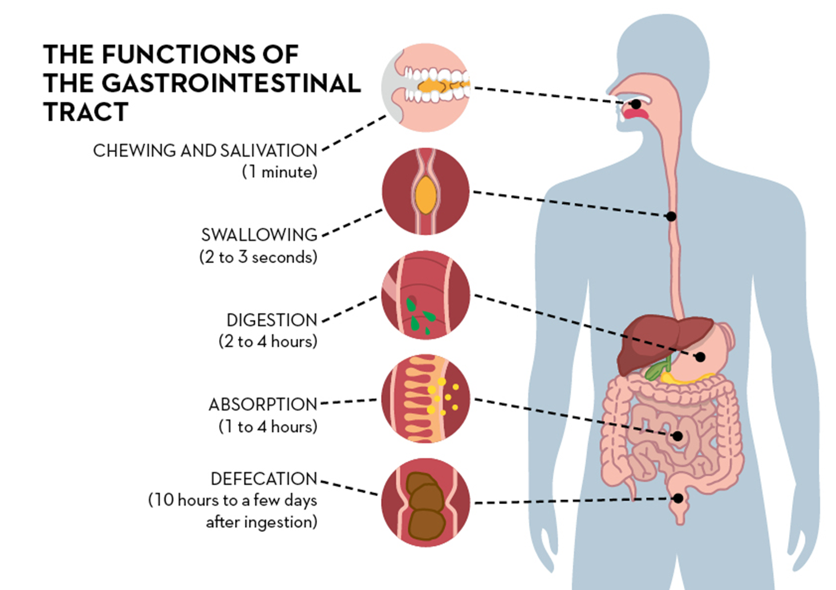

Slide 6
Physiological Anatomy
The digestive system consists of;
  The gastrointestinal tract (GI tract, digestive tract, alimentary canal)
  Accessory organs of digestion
Alimentary canal
  Alimentary canal also known as the gastrointestinal (GI) tract.
  This is a long tube through which food passes (about 9 meters).
  It starts at the mouth and terminates at the anus.
  It consists of;
    Mouth, pharynx, oesophagus, stomach, small intestine, large intestine, rectum and anal canal.

Slide 7
Accessory Organs of digestion
These organs helps primary digestive organs in the process of digestion.
The organs and glands are linked physiologically as well as anatomically to the alimentary canal.
They consist of:
  Teeth
  Tongue
  Three pairs of salivary glands
  Pancreas
  Liver and biliary tract

Slide 8
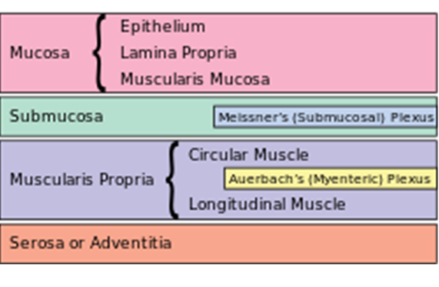
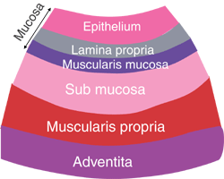
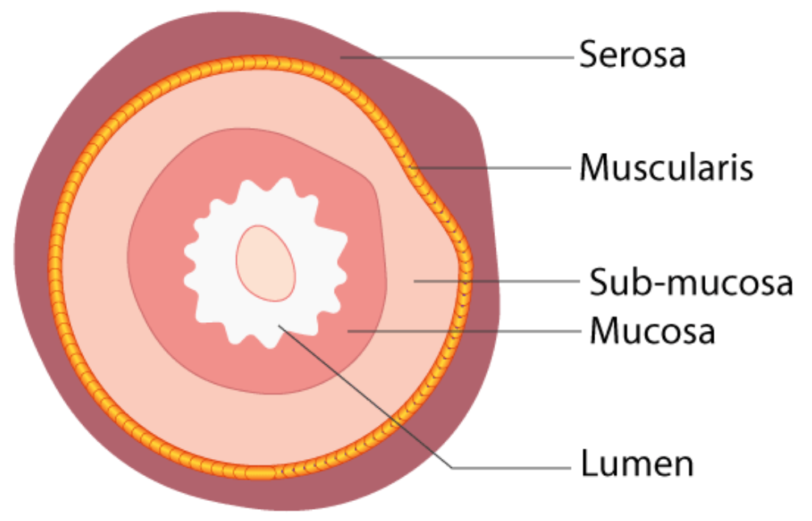
Layers of Gastrointestinal Tract
The basic structure of the walls of the alimentary tract (GIT) are formed by 4 layers of tissue:
Adventitia or The Serosa
The Muscle Layer
The Submucosa
The Mucosa

Slide 9
1- Serosa
This is the outermost layer.
In thorax - it consists of loose fibrous tissue
In the abdomen - the organs are covered by a serous membrane (serosa) called peritoneum.
The peritoneum serves to support the organs of the abdomen and acts as a conduit for the passage of nerves, blood vessels, and lymphatics.

Slide 10
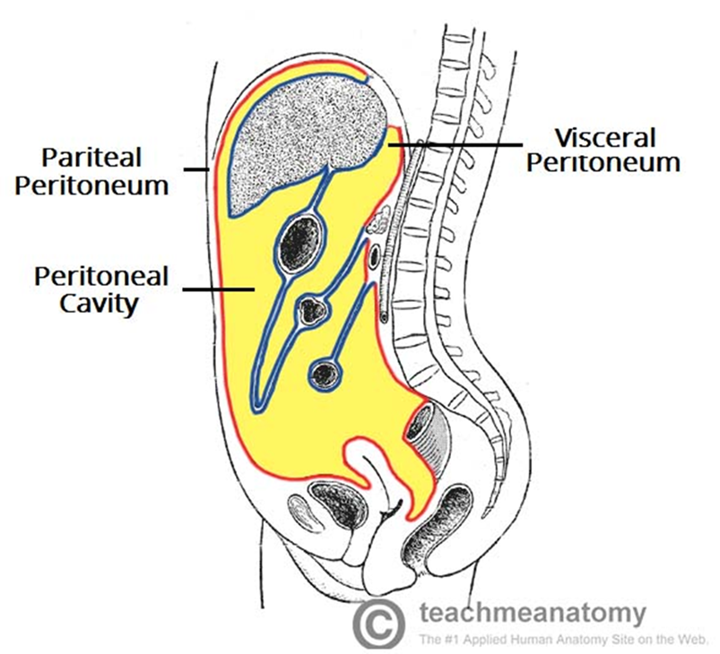
The largest serous membrane of the body.
It is a closed sac, containing a small amount of serous fluid, within the abdominal cavity.
It has two layers:
    Parietal peritoneum - lines the abdominal wall.
    Visceral peritoneum - covers the organs (viscera) within the abdominal and pelvic cavities.
It is richly supplied with blood and lymph vessels, and contains many lymph nodes.
It provides a physical barrier to local spread of infection, and can isolate an infective focus such as appendicitis, preventing involvement of other abdominal structures.
Peritoneal Cavity – space between visceral and parietal peritoneum.
  Contains peritoneal fluid – secreted by peritoneal cells
  Prevent friction between two layers of peritoneum.
Peritoneum

Slide 11
2-Muscle layer
The muscle layer consists of two layers of smooth (involuntary) muscle.
  The muscle fibres of the outer layer are arranged longitudinally.
  The muscle of inner layer encircle the wall of the tube.
Between these two muscle layers are blood vessels, lymph vessels and a plexus (network) of sympathetic and parasympathetic nerves, called the myenteric plexus (Auerbach’s plexus).
The Myenteric Plexus (Auerbach’s Plexus)
  Neurons of this plexus regulate peristaltic waves that move digestive products from the oral to the anal opening.
  Myenteric neurons control local muscular contractions that are responsible for stationary mixing and churning.
  These nerves supply the adjacent smooth muscle and blood vessels.

Slide 12
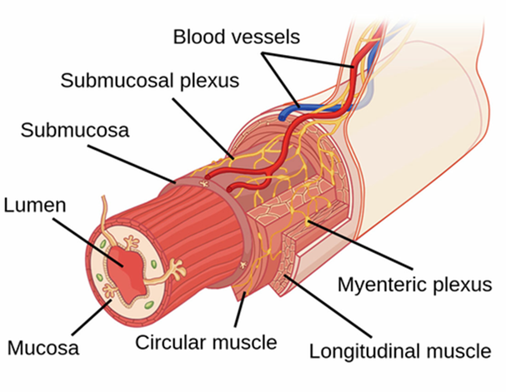
Myenteric Plexus

Slide 13
3-Submucosa
The sub-mucosal layer consists of loose areolar connective tissue.
It contains collagen and elastic fibres, which binds the muscle layer to the mucosa.
The submucosal layer contains;
  blood vessels
  nerves plexuses - Meissner’s plexus
  lymph vessels
  lymphoid tissue
  Meissner’s plexus
  Meissner's plexus, a neural network located within the submucosa.
  It transmits sensory (afferent) stimuli to the central nervous system through both parasympathetic and sympathetic pathways.

Slide 14
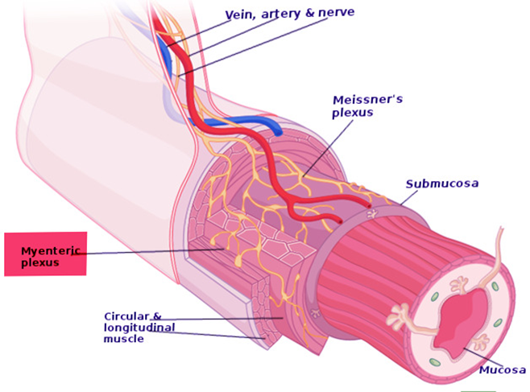
Meissner’s Plexus

Slide 15
4-Mucosa
The mucosa consists of 3 layers of tissue:
Mucous Membrane
  The innermost layer - formed by columnar epithelium
  It has three main functions: protection, secretion and absorption
Lamina Propria
  It consists of loose connective tissue.
  It supports the blood vessels that nourish the inner epithelial layer, and lymphoid tissue that has a protective function.
Muscularis Mucosa
  It is the thin, outer layer of smooth muscle.
  It provides involutions of the mucosa layer, e.g. gastric glands, villi.

Slide 16
Enteric
Nervous System

Slide 17
Enteric
Nervous System
The gastrointestinal tract has a nervous system all its own called the enteric nervous system.
It lies entirely in the wall of the gut, beginning in the esophagus and extending all the way to the anus.
The number of neurons in the enteric system is greater than 100 million.
Its plays a vital role in controlling gastrointestinal movements and secretion.
The enteric nervous system is composed mainly of two plexuses;
  Myenteric plexus or Auerbach’s plexus
  Submucosal plexus or Meissner’s plexus

Slide 18
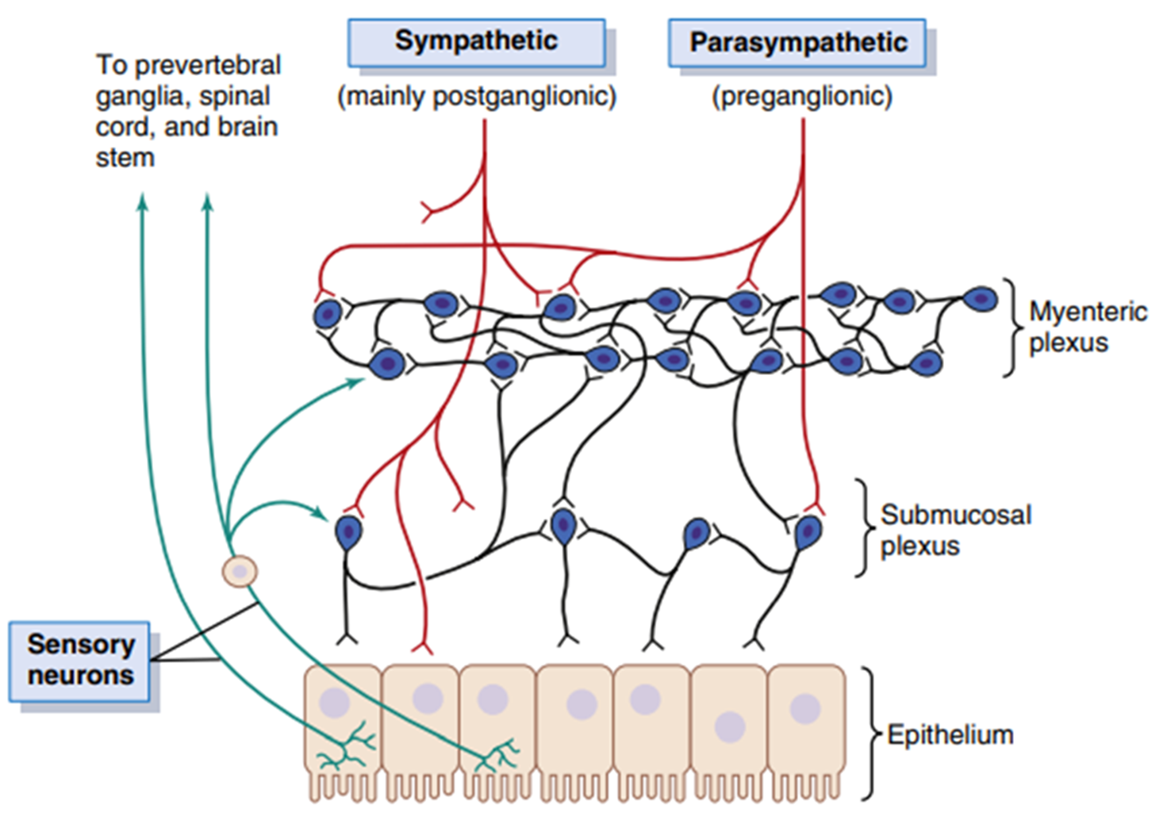
Enteric
Nerve Plexus

Slide 19
Myenteric plexus
Submucosal plexus
also known as Auerbach’s plexus.
It lies between the longitudinal and circular muscle layers.
The myenteric plexus controls mainly the gastrointestinal movements.
also known as Meissner’s plexus.
It lies in the submucosa.
The submucosal plexus controls mainly gastrointestinal secretion and local blood flow.

Slide 20
Sympathetic & Parasympathetic Nerve Supply to GIT
Parasympathetic Supply
Sympathetic Supply
Vagus Nerves
Sacral Nerves
The effects of parasympathetic stimulation are:
  Increased peristalsis - through increased activity of the myenteric plexus
  increased glandular secretion - through increased activity of the submucosal plexus
Celiac Ganglion
Superior Mesenteric Ganglion
Inferior Mesenteric Ganglion
The effects of sympathetic stimulation are:
  decreased peristalsis - because there is less stimulation of the myenteric plexus
  decrease glandular secretion - as stimulation of the submucosal plexus is reduced

Slide 21
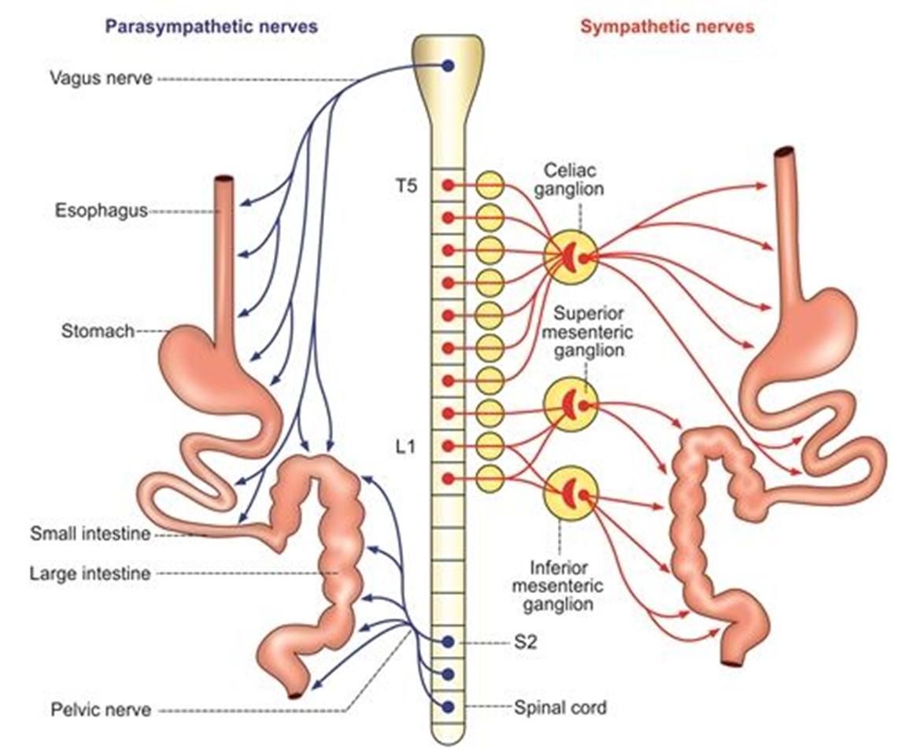

Slide 22
Splanchnic Circulation

Slide 23
Splanchnic Circulation
The term ‘splanchnic circulation’ describes the blood flow to the abdominal gastrointestinal organs including the stomach, liver, spleen, pancreas, small intestine, and large intestine.
It comprises 3 major branches of the abdominal aorta;
  Celiac artery
  Superior mesenteric artery (SMA)
  Inferior mesenteric artery (IMA)
The hepatic portal circulation delivers the majority of the blood flow to the liver.

Slide 24
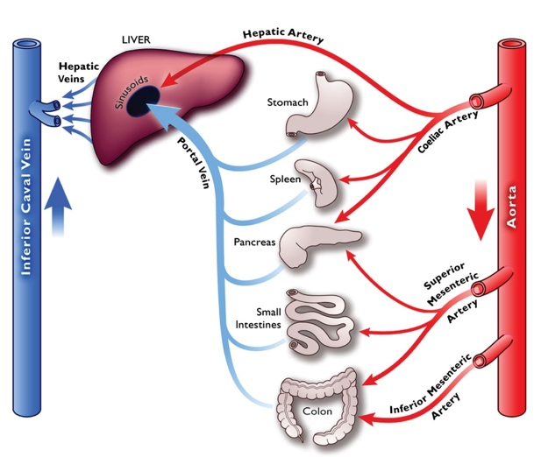

Slide 25
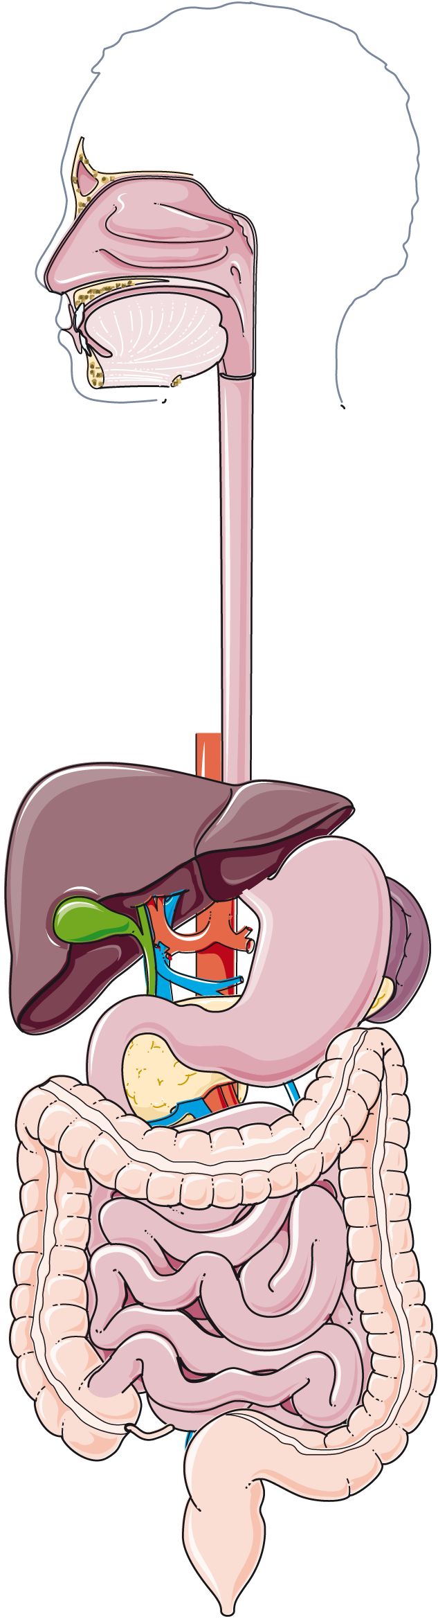
Components of
Digestive System

Slide 26
Mouth
The mouth – also called oral cavity (buccal cavity).
Parts:
  Vestibule - part of the mouth between the gums and the cheeks
  Uvula - curved fold of muscle, hanging down from middle of soft palate
The oral cavity is lined with mucous membrane - stratified squamous epithelium
Borders:
  Anterior – the lips.
  Posterior – it is continuous with the oropharynx.
  Lateral – muscles of the cheeks.
  Superior – bony hard palate and muscular soft palate.
  Inferior – muscular tongue and soft tissues of the floor of the mouth.

Slide 27
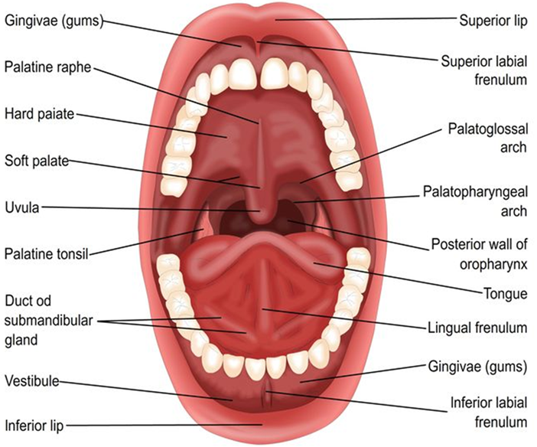

Slide 28
Tongue
The tongue is a voluntary muscular structure.
Occupies the floor of the mouth.
Attachments:
  Hyoid bone
  Frenulum
Superior surface consists - papillae (little projections).
Papillae contain sensory receptors (specialised nerve endings) for the sense of taste in the taste buds.

Slide 29
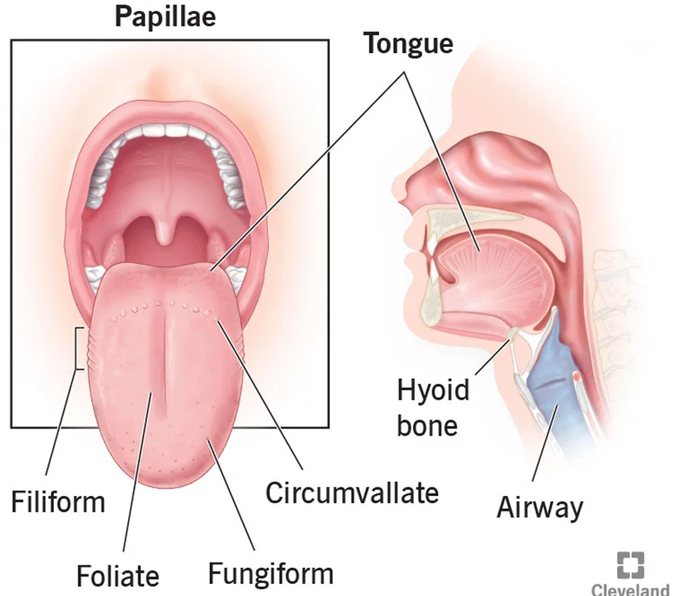

Slide 30
Functions
The tongue plays an important part in:
  Chewing (mastication)
  Swallowing (deglutition)
  Speech
  Taste

Slide 31
Teeth
The teeth are embedded in the alveoli or sockets of the alveolar ridges
  The mandible and the maxilla
Babies are born with two sets of teeth (dentitions)
Temporary teeth (Deciduous teeth)
  There are 20 temporary teeth, 10 in each jaw.
  Begin to erupt about 6 months, and complete by 24 months of age.
Permanent teeth
  The permanent teeth replace the deciduous teeth in the 6th year of age.
  This dentition, consisting of 32 teeth, is usually complete by the 21st year.

Slide 32
Functions
Teeth have different shapes depending on their functions.
  Incisors and canine (cutting teeth) - used for biting off pieces of food.
  Premolar and molar teeth - used for grinding or chewing food.

Slide 33
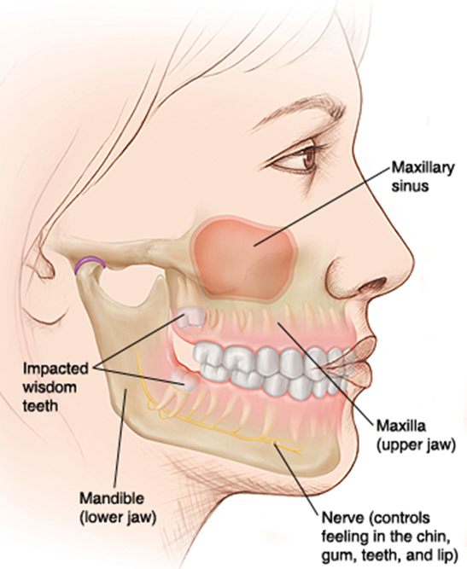
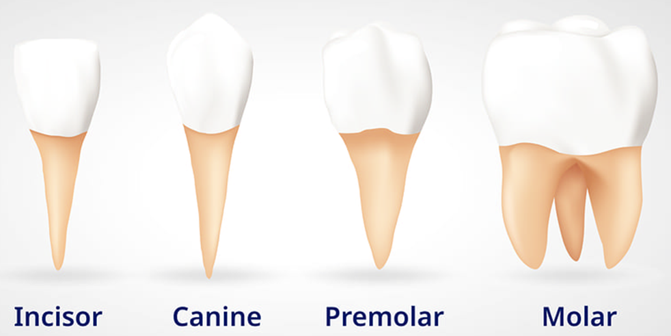

Slide 34
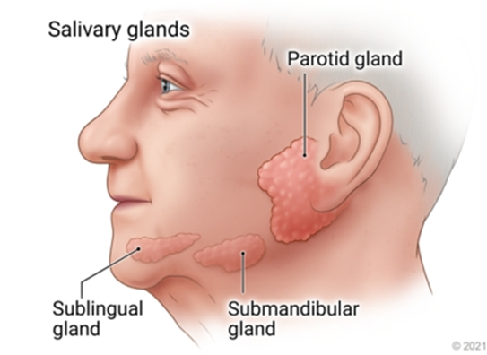
Salivary Glands
Salivary glands make saliva, which aids in digestion.
It keeps the mouth moist and supports healthy teeth.
Salivary glands release their secretions into ducts that lead to the mouth.
There are three main pairs:
  Parotid Glands
  Submandibular Glands
  Sublingual Glands

Slide 35
Functions
Chemical digestion of polysaccharides
  Saliva contains the enzyme amylase that begins the breakdown of complex sugars, including starches, reducing them to the disaccharide maltose.
  The optimum pH for the action of salivary amylase is 6.8 (slightly acid).
  Enzyme action continues during swallowing until terminated by the strongly acidic pH (1.5 to 1.8) of the gastric juices, which degrades the amylase.
Lubrication of food
  The high water content means that dry food entering the mouth is moistened and lubricated by saliva before it can be made into a bolus ready for swallowing.

Slide 36
Cleaning and lubricating the mouth
  An adequate flow of saliva is necessary to clean the mouth, and to keep it soft, moist and pliable.
  It helps to prevent damage to the mucous membrane by rough or abrasive food.
Non-specific defence
  Lysozyme, immunoglobulins and clotting factors present in saliva combat invading microbes.
Taste
  The taste buds are stimulated only by chemical substances in solution and therefore dry foods only stimulate the sense of taste after thorough mixing with saliva.
  The senses of taste and smell are closely linked and involved in the enjoyment of food.

Slide 37
Pharynx
The pharynx is hollow tube inside the neck that starts behind the nose and ends at the top of the trachea (windpipe) and oesophagus.
It is divided into three parts;
  Nasopharynx
  Oropharynx
  Laryngopharynx
The oropharynx and laryngopharynx are passages common to both the respiratory and the digestive systems.
Food passes from the oral cavity into the pharynx then to the oesophagus below, with which it is continuous.

Slide 38
The walls of the pharynx consist of three layers of tissue.
Inner Layer - (mucosa)
  Provide lining of the mouth - stratified squamous epithelium
  Stratified epithelial tissue provides a lining well suited to the wear and tear of swallowing.
Middle layer
  Made of connective tissue
  contains blood and lymph vessels and nerves
Outer Layer
  consists of involuntary muscles - involved in swallowing
When food reaches the pharynx swallowing is no longer under voluntary control.

Slide 39
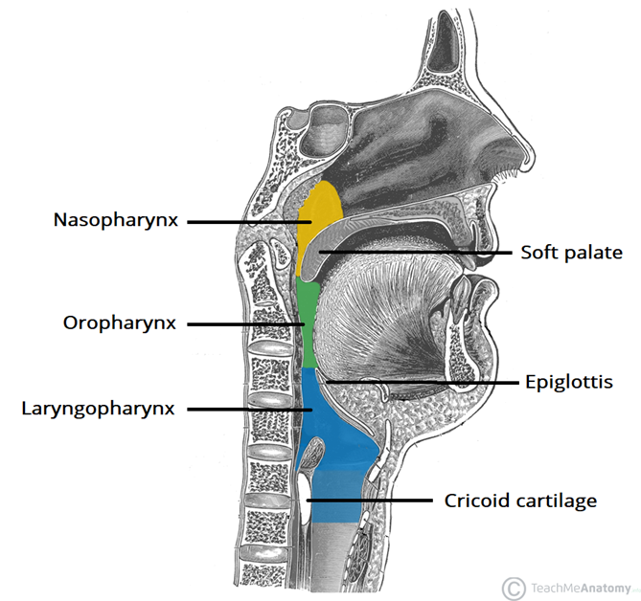

Slide 40
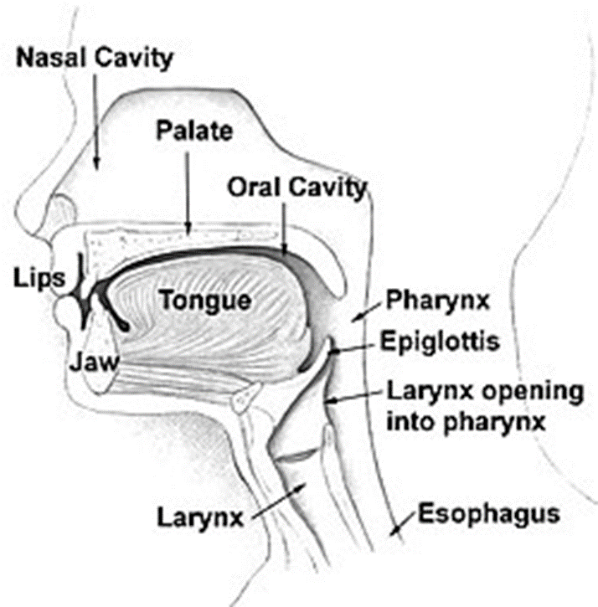

Slide 41
Oesophagus
The oesophagus is a hollow, muscular tube that carries food and liquid from throat to the stomach.
Also called: Food pipe or gullet
It is about 25 cm (10 inch) long and about 2 cm in diameter.
It begins at the back of the mouth, passing downward through the rear part of the mediastinum, through the diaphragm, and into the stomach.
Location:
  It lies in the median plane in the thorax
  in front of the vertebral column
  behind the trachea and the heart
  It is continuous with the pharynx above and just below the diaphragm it joins the stomach.

Slide 42
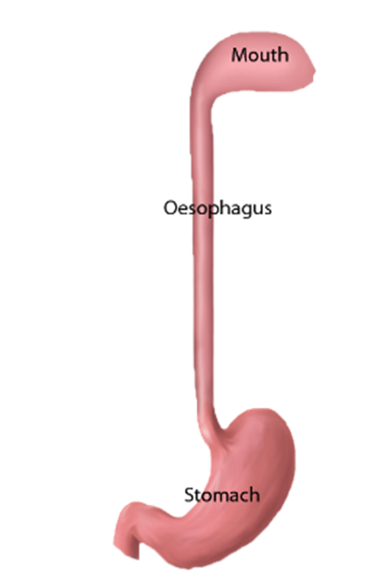
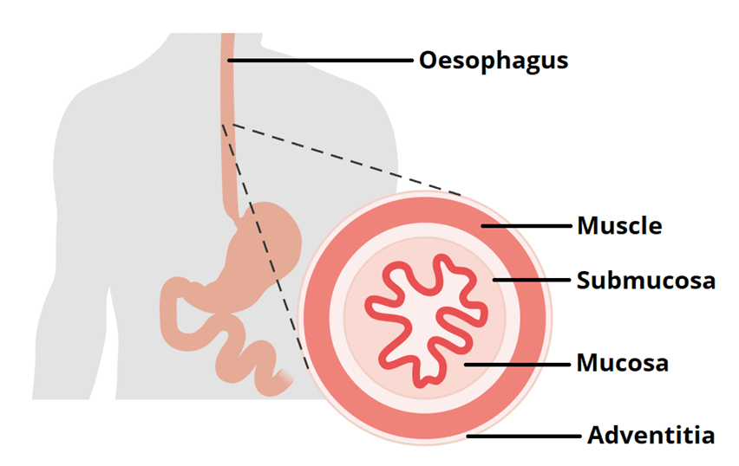
The oesophagus is one of the upper parts of the digestive system.
The oesophagus starts around the level C-6 behind the cricoid cartilage of the trachea, enters the diaphragm at about the level of T-10, and ends at the cardia of the stomach, at the level of T-11.
The wall of the oesophagus consists of;
  Outer layer of connective tissue
  Muscular layer
  Submucosa (connective tissue)
  Mucosa

Slide 43
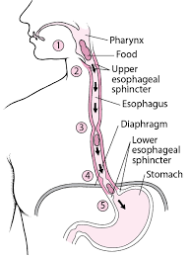
Sphincters:
  The upper and lower ends of the oesophagus are closed by sphincters.
  Upper oesophageal sphincter (cricopharyngeal)
      prevents air passing into the oesophagus during inspiration
      prevents the aspiration of oesophageal contents
  The cardiac or lower oesophageal sphincter
      Physiological – (not anatomical) i.e. no thickening of the circular muscle
      prevents the reflux of acid gastric contents into the oesophagus

Slide 44
Stomach
The stomach is a J-shaped dilated portion of the alimentary tract.
It is situated in the epigastric, umbilical and left hypochondriac regions of the abdominal cavity.
Organs associated with the stomach
  Anteriorly – left lobe of liver and anterior abdominal wall
  Posteriorly – abdominal aorta, pancreas, spleen, left kidney & adrenal gland
  Superiorly – diaphragm, oesophagus and left lobe of liver
  Inferiorly – transverse colon and small intestine
  To the left – diaphragm and spleen
  To the right – liver and duodenum

Slide 45
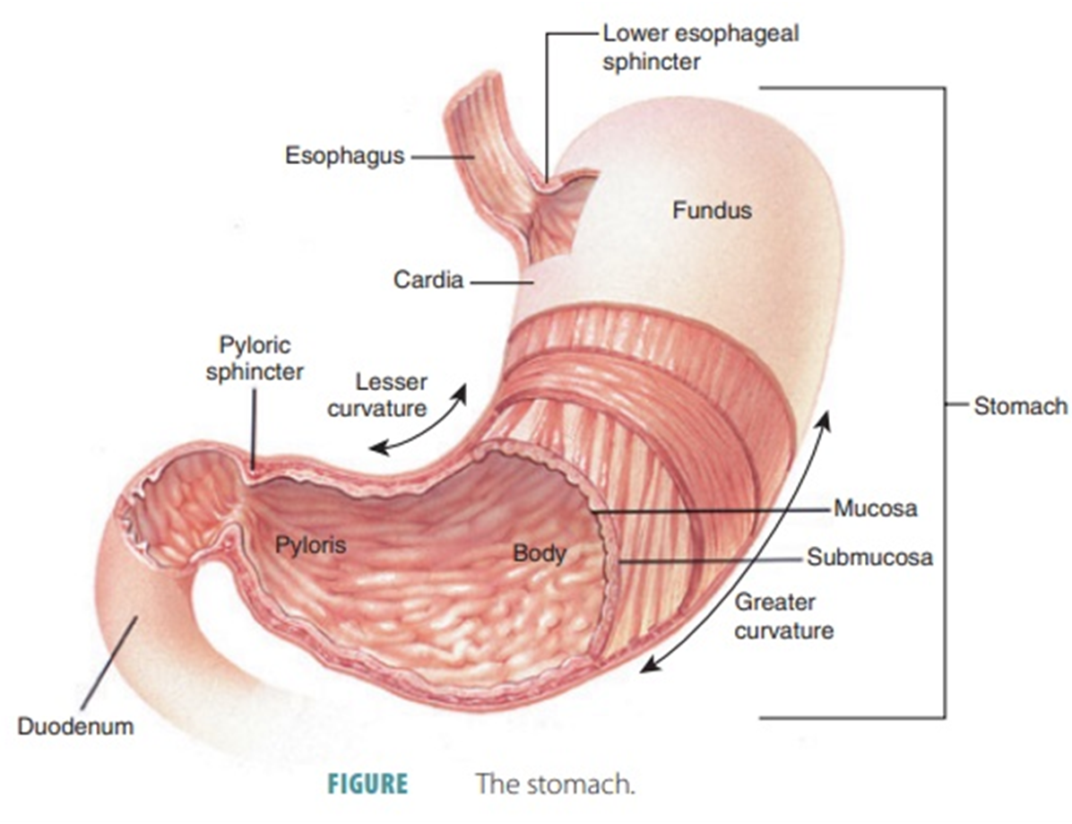
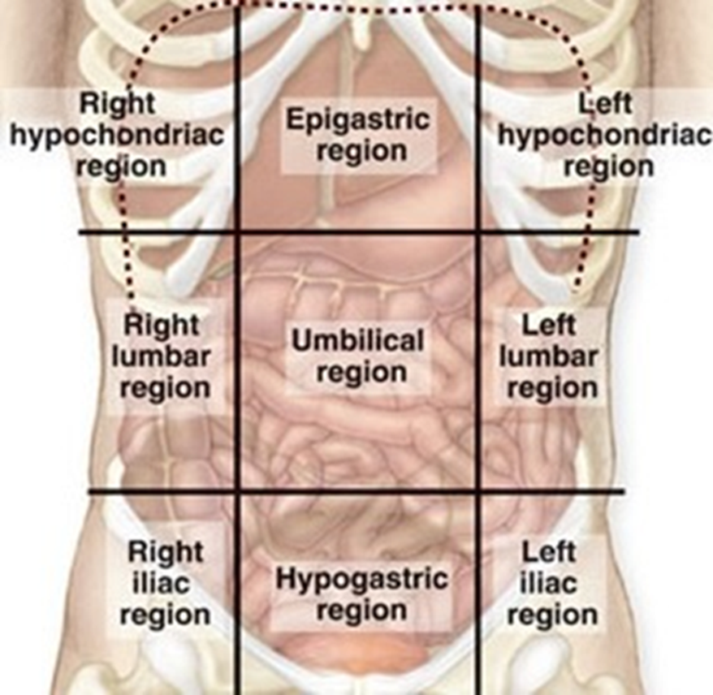

Slide 46
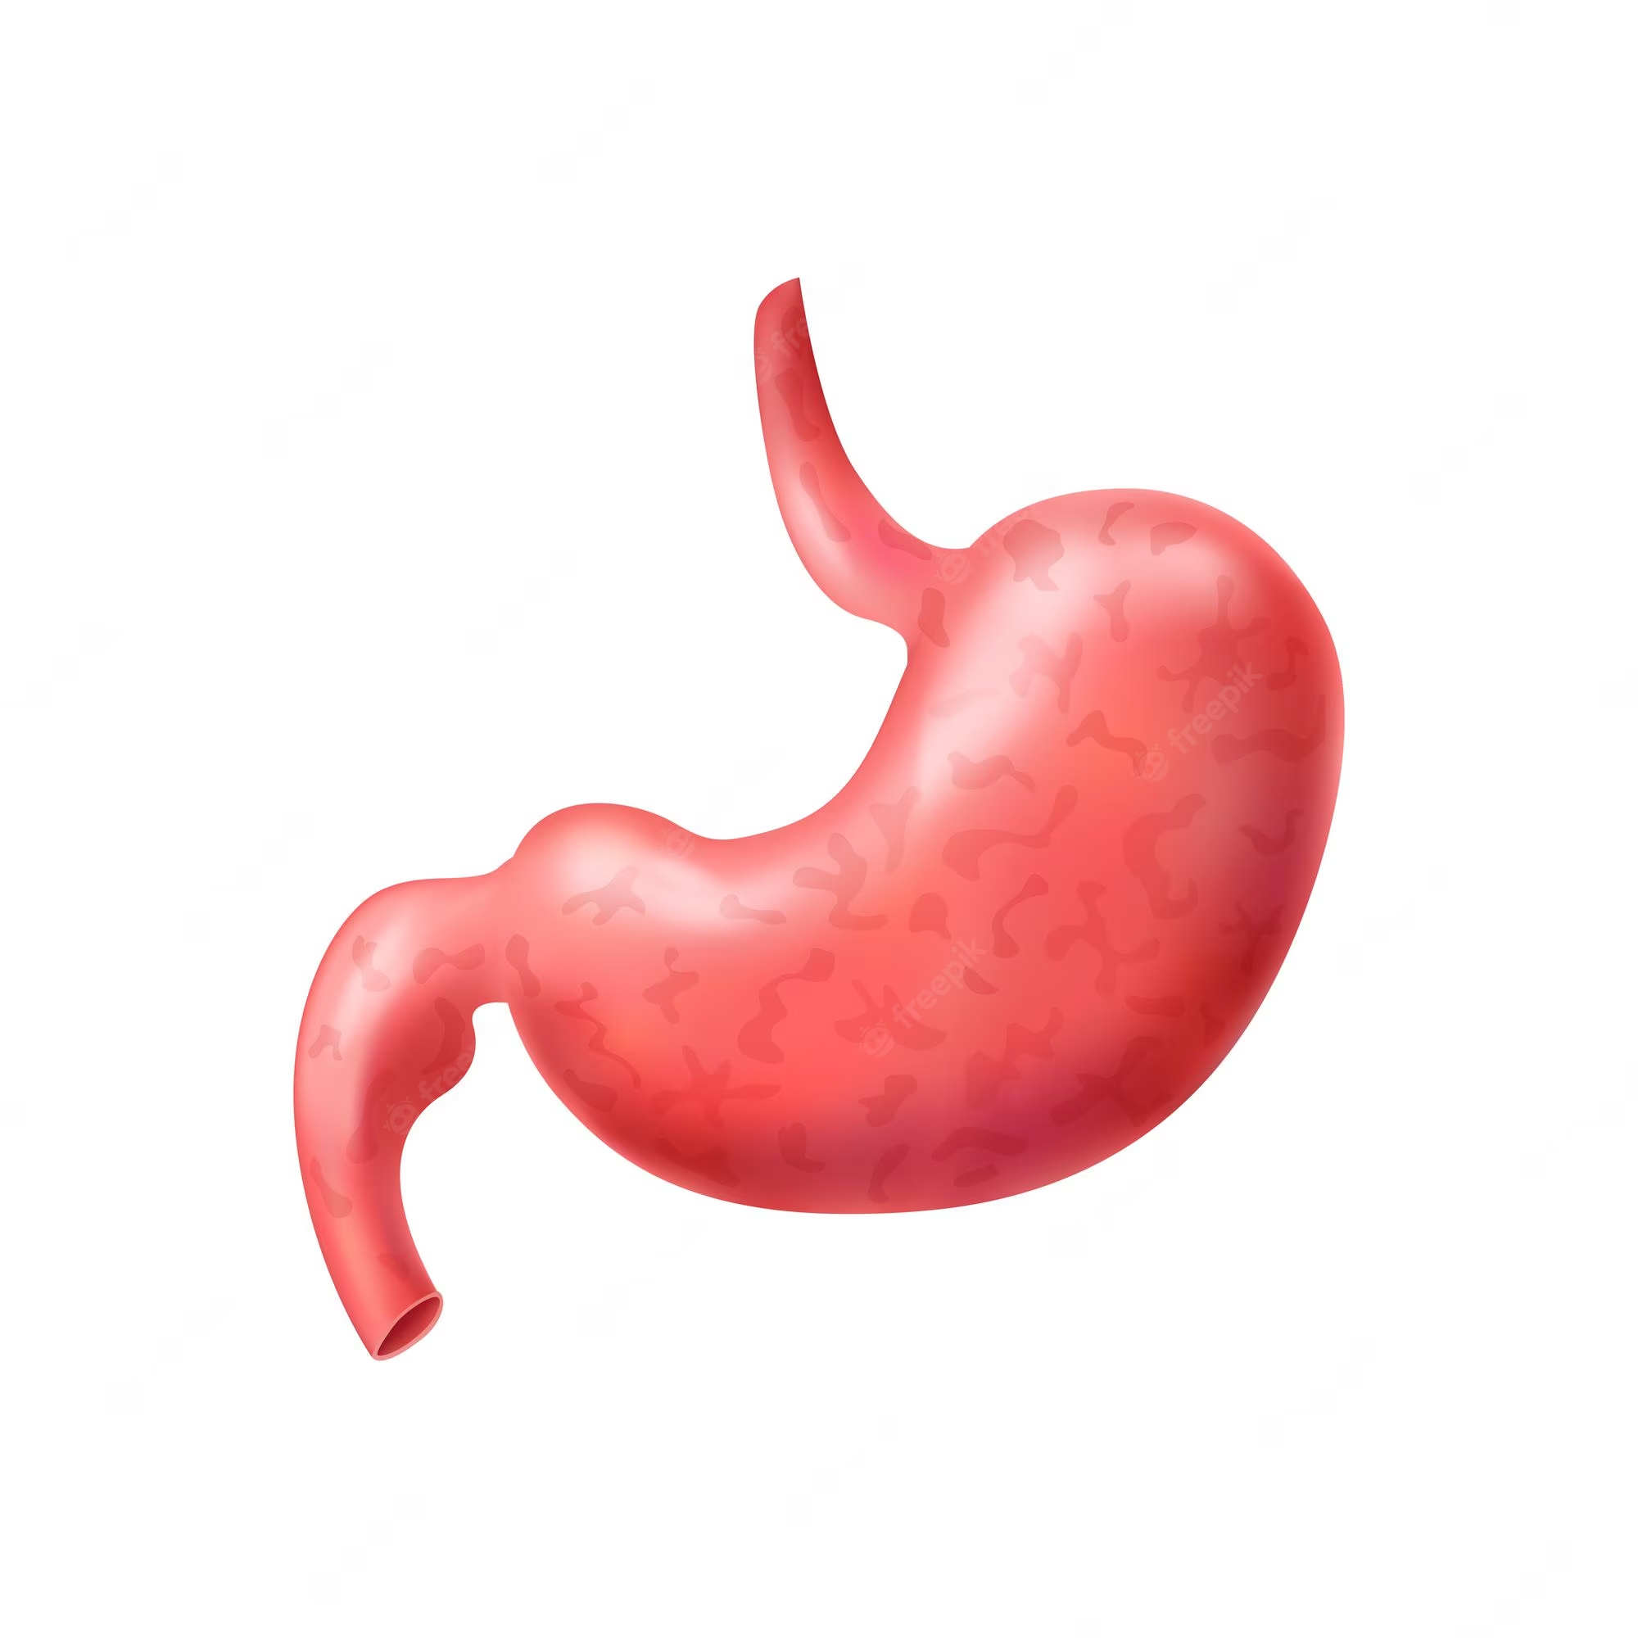
The stomach is continuous with the oesophagus at the cardiac sphincter and with the duodenum at the pyloric sphincter.
Curvatures
  It has two curvatures.
Lesser Curvature
  short, lies on the posterior surface of the stomach
  It is the downward continuation of the posterior wall of the oesophagus.
Greater Curvature
  Where the oesophagus joins the stomach the anterior region angles acutely upwards
  Curves downwards forming the greater curvature and then slightly upwards towards the pyloric sphincter.

Slide 47
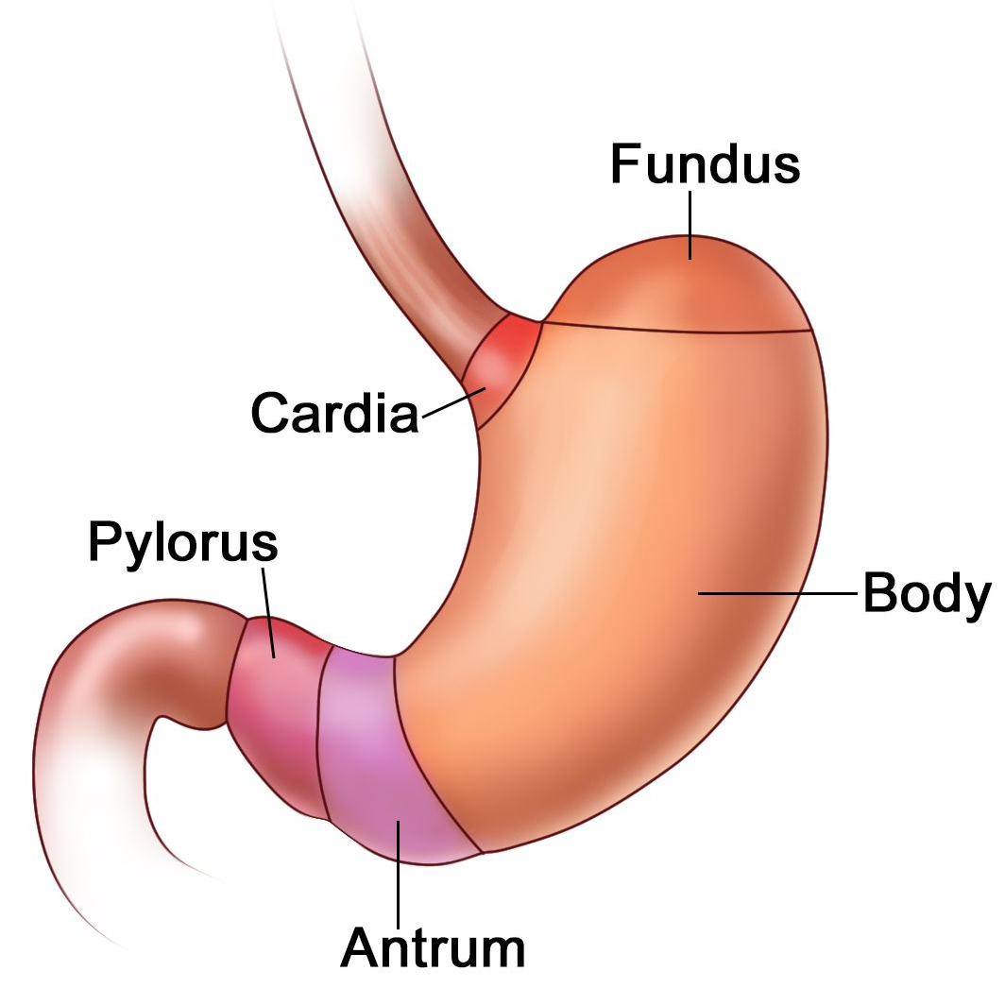
Regions
  The stomach is divided into four regions:
  Cardia – entry of food
  Fundus – storage of food
  Body – chemical digestion + mixing of food
  Pylorus – emptying of food
At the distal end of the pylorus is the pyloric sphincter, guarding the opening between the stomach and the duodenum.
When the stomach is inactive the pyloric sphincter is relaxed and open, and when the stomach contains food the sphincter is closed.

Slide 48
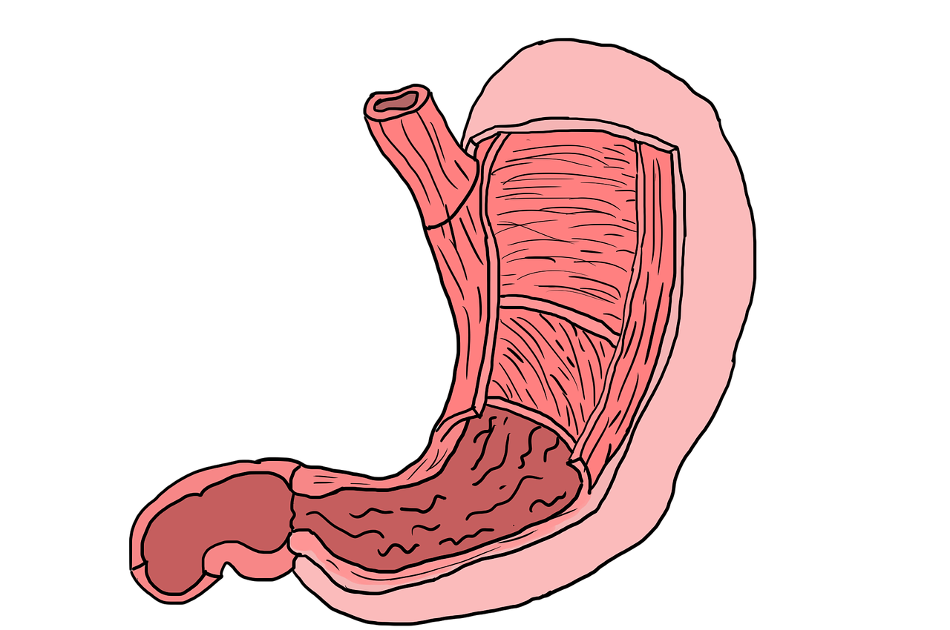
Walls of the Stomach
The four layers of tissue that comprise the basic structure of the alimentary canal are found in the stomach but with some modifications.
Muscle layer
  This consists of 3 layers of smooth muscle fibres:
    an outer layer - longitudinal fibres
    a middle layer - circular fibres
    an inner layer - oblique fibres
This arrangement allows for the churning motion - characteristic of gastric activity, as well as peristaltic movement.
Circular muscle is strongest in the pylorus and pyloric sphincter.

Slide 49
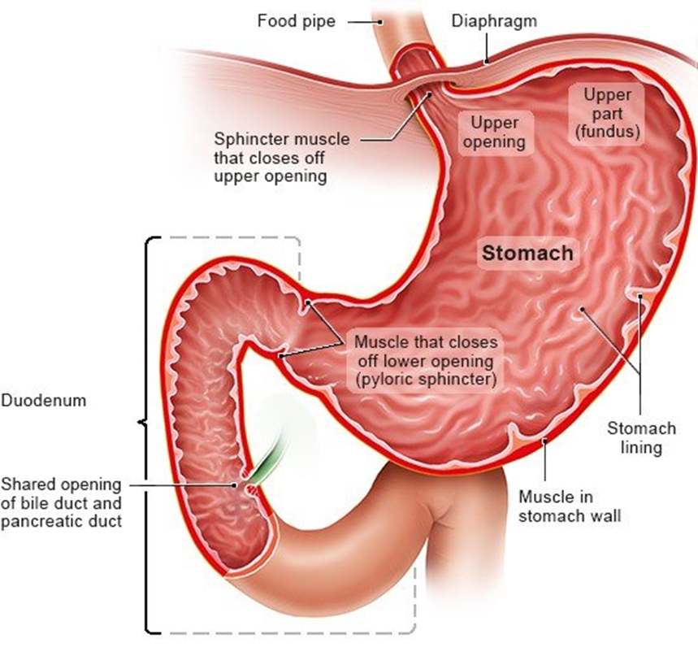
Mucosa of the stomach
  When the stomach is empty the mucous membrane lining is thrown into longitudinal folds or rugae.
  When the stomach is full the rugae are pressed and the surface has a smooth, velvety appearance.
  Numerous gastric glands are situated below the surface in the mucous membrane and open on to it.
  They consist of specialised cells that secrete gastric juice into the stomach.

Slide 50
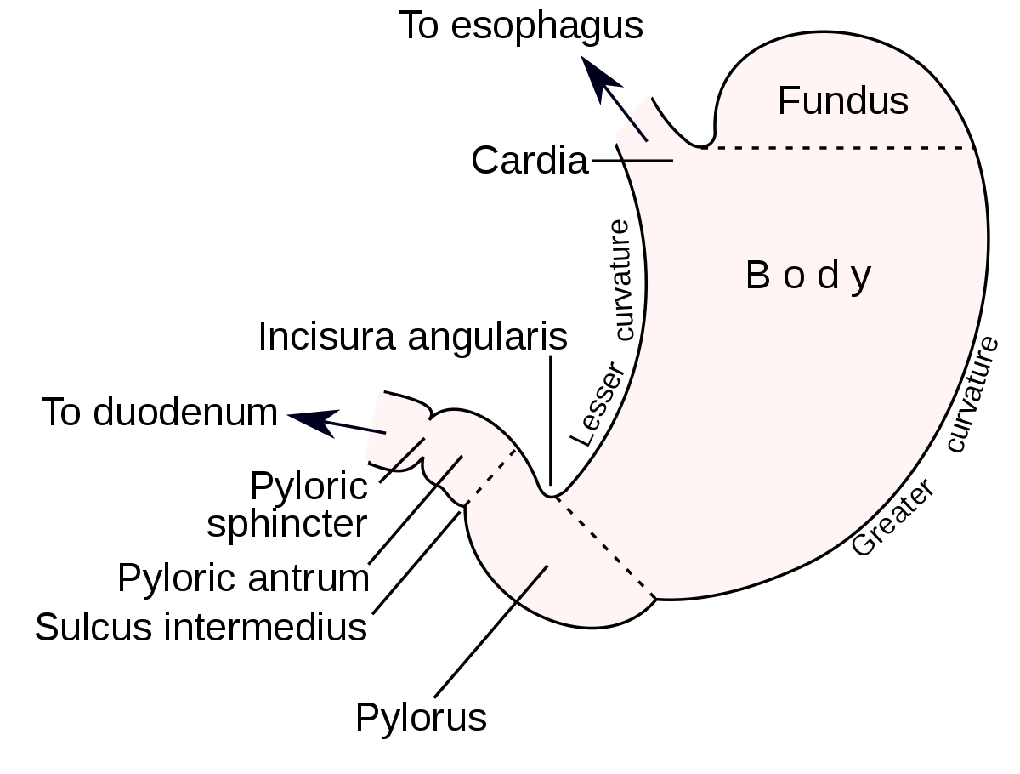

Slide 51
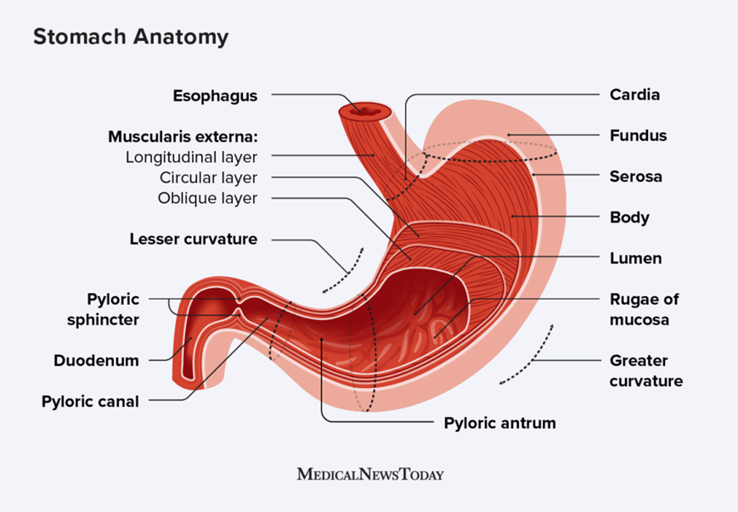

Slide 52
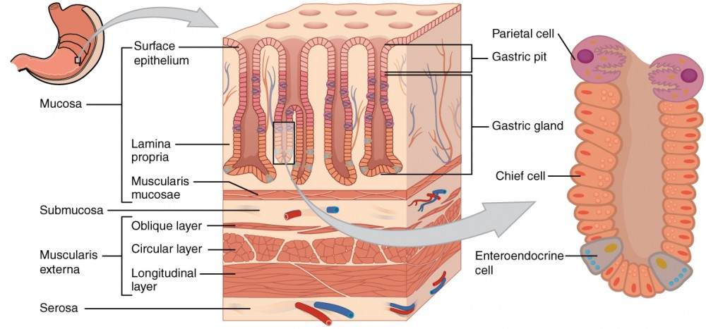

Slide 53
Functions
  Temporary storage of food
    Allowing time for the digestive enzymes, pepsins, to act
  Chemical digestion
    Pepsins convert proteins to polypeptides
  Mechanical breakdown
    The three smooth muscle layers enable the stomach to act as a churn, gastric juice is added and the contents are liquefied to chyme.

Slide 54
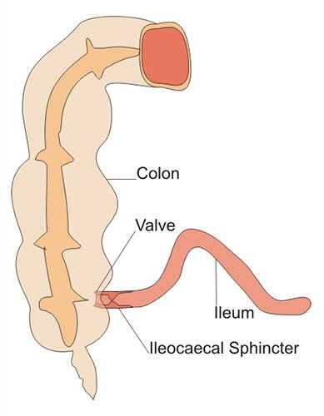
Small Intestine
The small intestine is continuous with the stomach at the pyloric sphincter.
The small intestine is about 5 metres long.
It leads into the large intestine at the ileocaecal valve.
It lies in the abdominal cavity surrounded by the large intestine.
The small intestine comprises three parts:
  Duodenum
  Jejunum
  Ileum

Slide 55
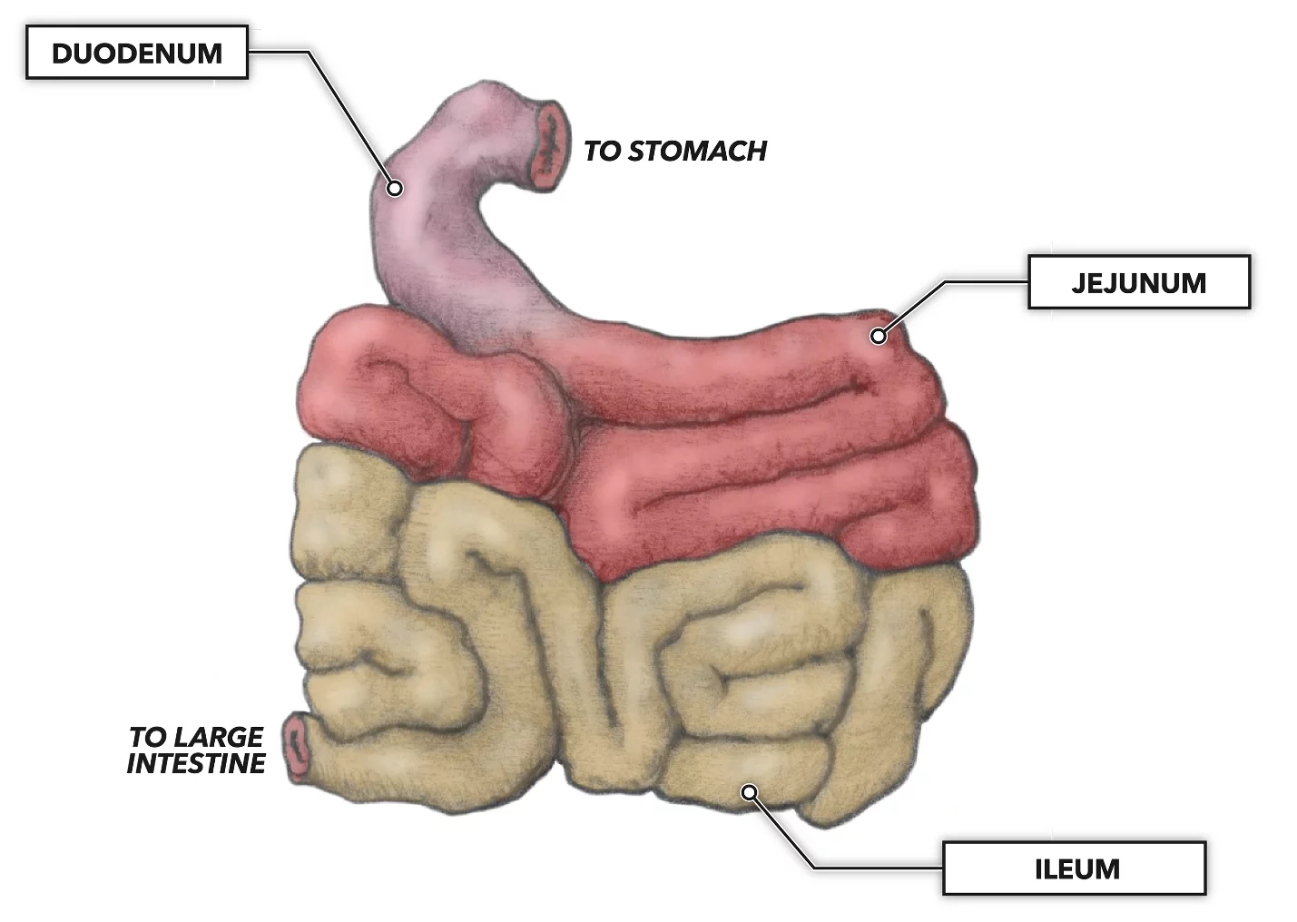
3 Parts of small intestine;
Duodenum
  1st part of small intestine
  about 25 cm long, curves around the head of the pancreas
  Secretions from the gall bladder and pancreas merge in a common structure – the hepatopancreatic ampulla – and enter the duodenum at the duodenal papilla.
  The duodenal papilla is guarded by a ring of smooth muscle, the hepatopancreatic sphincter (of Oddi).
Jejunum
  middle part, about 2 meters long
Ileum
  about 3 metres long, ends at the ileocaecal valve

Slide 56
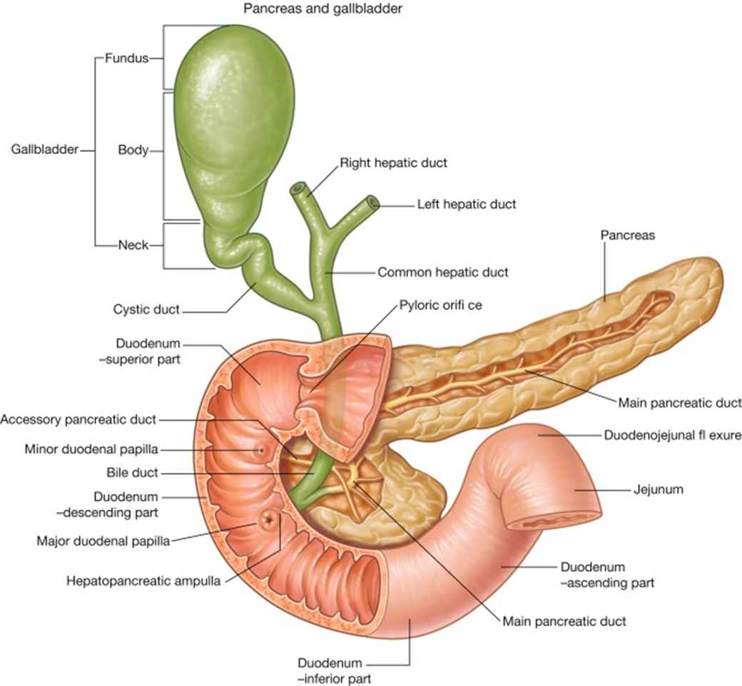

Slide 57
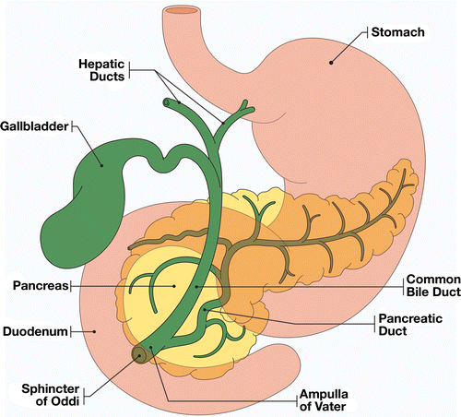

Slide 58
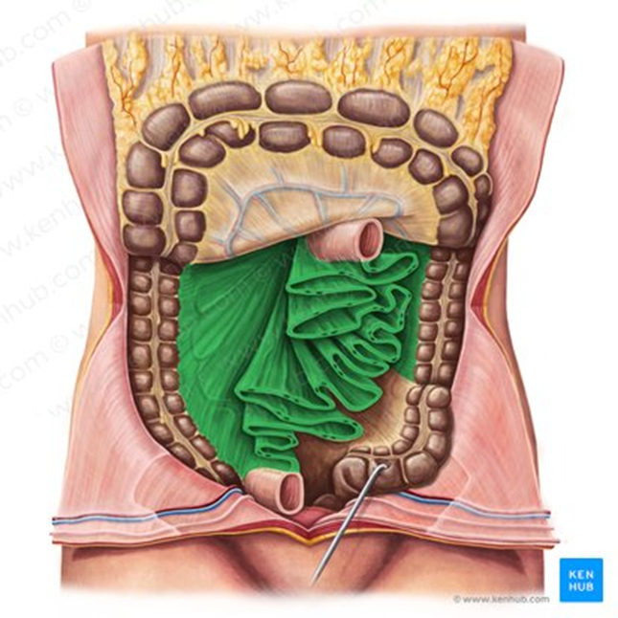
Structure of Small intestine
The walls of the small intestine are composed of the four layers of tissue.
Some modifications occurs at peritoneum and mucosa and described as;
Peritoneum – (Mesentery)
  Short, fan shaped
  A double layer of peritoneum
  Attaches the jejunum and ileum to the posterior abdominal wall.
  The large blood vessels and nerves lie on the posterior abdominal wall and the branches to the small intestine pass between the two layers of the mesentery.

Slide 59
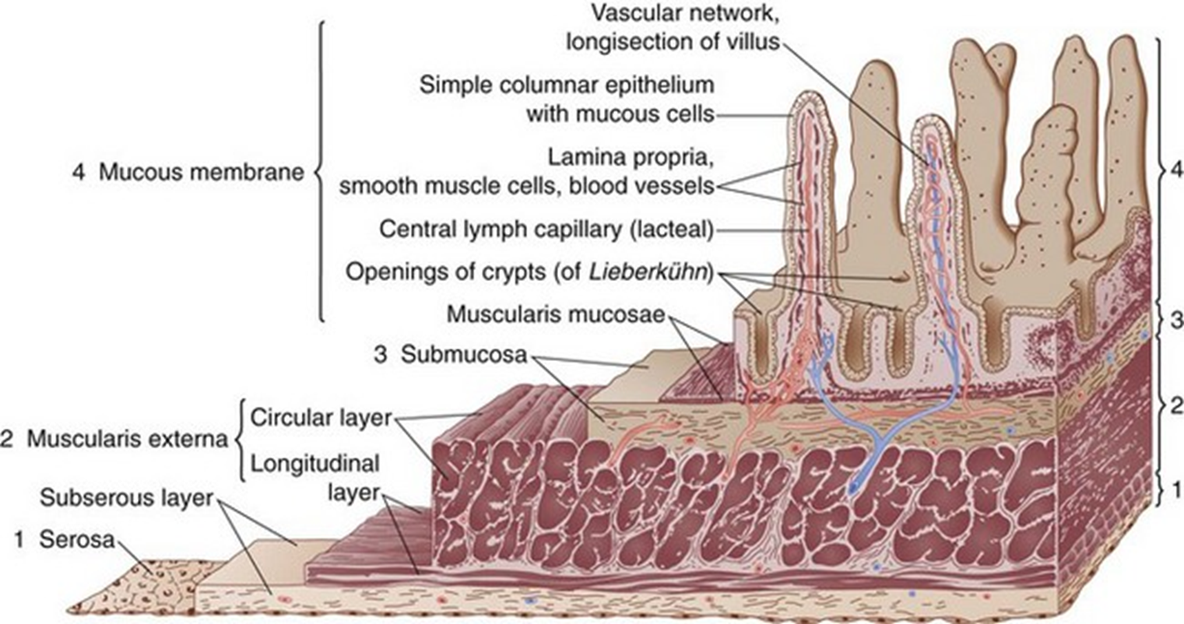
Mucosa
  The surface area of the small intestine mucosa is greatly increased by permanent circular folds, villi and microvilli.
  The permanent circular folds, unlike the rugae of the stomach, are not smoothed out when the small intestine is distended.
  They promote mixing of chyme as it passes along.

Slide 60
Functions
Chemical Digestion
  In the small intestine the chemical digestion of food is completed.
Absorption
  Absorption of most nutrients takes place in small intestine.

Slide 61
Large Intestine
The large intestine is about 1.5 metres long.
It begins at the caecum in the right iliac fossa and terminate at the rectum and anal canal deep in the pelvis.
Its lumen is about 6.5 cm in diameter, larger than that of the small intestine.
It forms an arch round the coiled-up small intestine.
The large intestine is divided into;
  Caecum
  Colon
  Rectum
  Anal canal

Slide 62
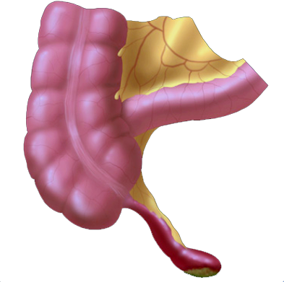
Caecum
Caecum is the first part of the large intestine.
It is a dilated region and is continuous with the ascending colon. Just below the junction of the two the ileocaecal valve opens from the ileum.
Vermiform Appendix
  a fine tube, closed at one end, which leads from the caecum.
  It is usually about 8 to 9 cm long.
  It has the same structure as the walls of the large intestine but contains more lymphoid tissue.

Slide 63
Colon
The colon has four parts;
Ascending colon
  This passes upwards from the caecum to the level of the liver where it curves acutely to the left at the hepatic flexure to become the transverse colon.
Transverse colon
  This is a loop of colon that extends across the abdominal cavity in front of the duodenum and the stomach to the area of the spleen where it forms the splenic flexure and curves acutely downwards to become the descending colon.
Descending colon
  This passes down the left side of the abdominal cavity then curves towards the midline. After it enters the true pelvis it is known as the sigmoid colon.
Sigmoid colon
  This part describes an S-shaped curve in the pelvis that continues downwards to become the rectum.

Slide 64
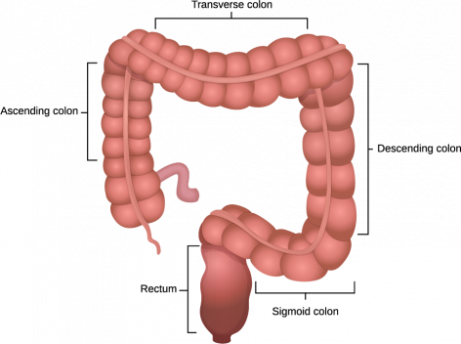

Slide 65
Rectum
This is a slightly dilated section of the large intestine about 13 cm long.
It leads from the sigmoid colon and terminates in the anal canal.

Slide 66
Anal canal
This is a short passage about 3.8 cm long in the adult.
It leads from the rectum to the exterior.
Two sphincter muscles control the anus;
  Internal sphincter
  It consists of smooth muscle.
  It is under the control of the autonomic nervous system.
  External sphincter
  It is formed by skeletal muscle.
  It is under voluntary control.

Slide 67
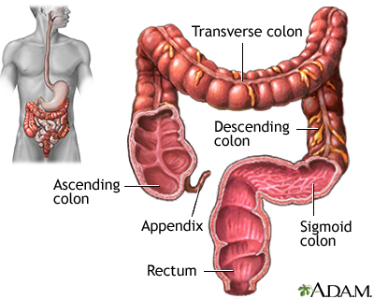

Slide 68
Function
Absorption
  absorption of water - by osmosis, until semisolid consistency of faeces is achieved.
  Mineral salts, vitamins and some drugs are also absorbed.
Microbial activity
  Escherichia coli, Enterobacter aerogenes, Streptococcus faecalis, Clostridium perfringens - synthesise vitamin K and folic acid
Mass movement
  a wave of strong peristalsis sweep along the transverse colon forcing its contents into the descending and sigmoid colons – mass movement
Defaecation
  Thus defaecation involves involuntary contraction of the muscle of the rectum and relaxation of the internal anal sphincter.
  Contraction of the abdominal muscles and lowering of the diaphragm increase the intra-abdominal pressure (Valsalva’s manoeuvre) and so assist the process of defaecation.

Slide 69
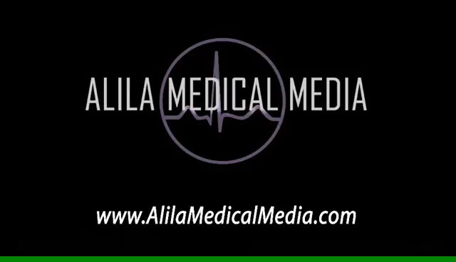

Slide 70
THANK YOU

