Slide 1
Gonads & Their Hormones
KHUSHAL KHAN
Demonstrator cardiology
Khyber medical university – institute of paramedical sciences

Slide 2
Introduction
A gonad is an organ that produces gametes (reproductive cells or sex cells - haploid).
A gonad (sex gland, or reproductive gland) - mixed gland that produces;
  Gametes
  Sex hormones
Male gonad = Testicle, Male gamete = sperm
Female gonad = Ovary, Female gamete = egg cells
Male Sex Hormones = Androgens (primarily Testosterone)
Female Sex Hormones = Estrogen and Progesterone

Slide 3
Male Gonads

Slide 4
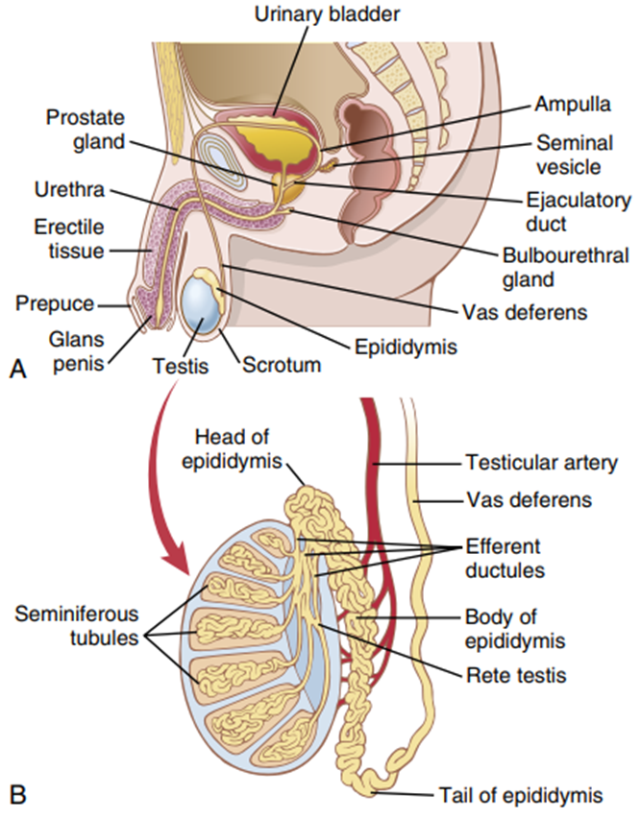
Testes
A testicle or testis (plural testes) is the male reproductive gland or gonad in humans.
It is homologous to the female ovary.
The functions of the testes are to produce;
  Sperm (male gamete)
  Androgens (male sex hormones)
Location:
  Two testicles of similar size
  Contained within the scrotum - extension of the abdominal wall.

Slide 5
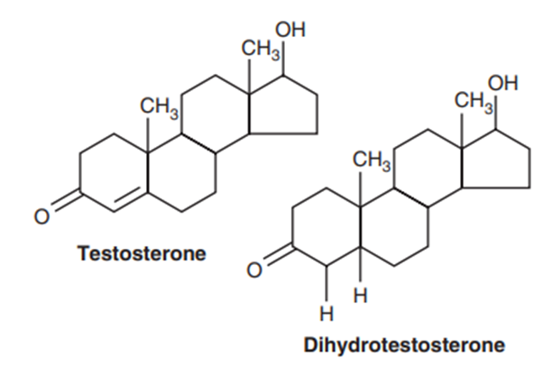
Male Sex Hormones
The testes secrete several male sex hormones; which are collectively called androgens,
  Testosterone
  Dihydrotestosterone
  Androstenedione
Testosterone
  Steroid hormone
  Most abundant - Primary testicular hormone
  Testosterone is converted into the more active hormone dihydrotestosterone in target tissues.

Slide 6
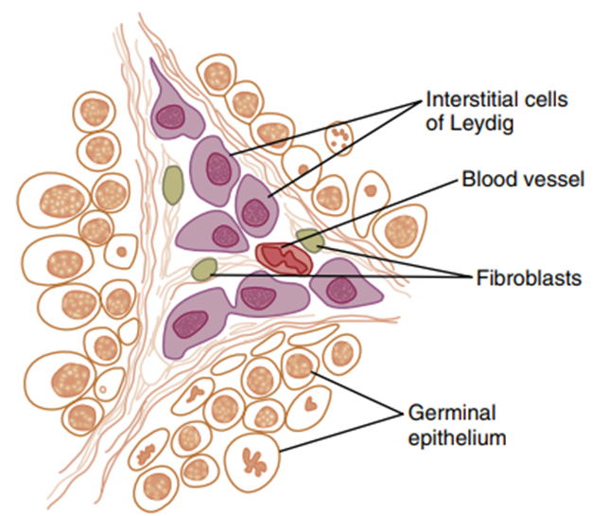
Leydig cells
  Testosterone is formed by the interstitial cells of Leydig
  lie in the interstices between the seminiferous tubules
  constitute about 20% of the mass of the adult testes
  Non-existent in the testes during childhood
  Present in new-born male infant for few months
  Present in adult male after puberty

Slide 7
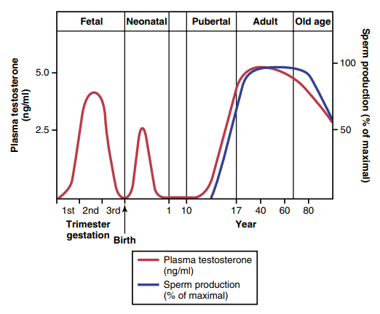
Functions of Testosterone
Testosterone is responsible for the distinguishing characteristics of the masculine body.
Secretion:
  Moderate – during fetal development (stimulated by chorionic gonadotropin from the placenta ).
  Absent – until age of 10-13 years.
  Continuous – from puberty throughout life.

Slide 8
Testosterone secreted by the fetal testes is responsible for development of the male body characteristics; i.e.
  Formation of a penis and a scrotum rather than formation of a clitoris and a vagina.
  Formation of the prostate gland, seminal vesicles, and male genital ducts
  At the same time suppressing formation of female genital organs
Testosterone causes descent of the testes during last 2 to 3 months of gestation.
Effect of testosterone on development of adult primary and secondary sexual characteristics
  After puberty, testosterone secretion cause the enlargement of penis, scrotum, and testes

Slide 9
Testosterone causes the development of secondary sexual characteristics of the male;
  Testosterone causes growth of hair - over the pubis, abdomen, face, chest and back
  Testosterone decreases the growth of hair on the top of the head – Male Baldness
Testosterone causes development typical adult masculine voice.
Testosterone increases;
  The thickness of the skin over the entire body
  Ruggedness of the subcutaneous tissue
  Rate of secretion of sebaceous glands (especially skin – causes acne)

Slide 10
Testosterone increases protein formation and muscle development.
  Development of increasing musculature after puberty, averaging about a 50% increase in muscle mass over that in the female.
  Associated with increased protein in the nonmuscle parts of the body.
  Testosterone or synthetic androgens are also occasionally used in old age as a “youth hormone” to improve muscle strength and vigour.
Testosterone increases bone matrix and causes calcium retention
  Result from the general protein anabolic function of testosterone
  Deposition of calcium salts in response to the increased protein
  It is sometimes used in older men to treat osteoporosis.

Slide 11
Testosterone has a specific effect on the pelvis to;
  Narrow the pelvic outlet
  Lengthen it
  Cause a funnel-like shape instead of the broad ovoid shape of the female pelvis
  Greatly increase the strength of the entire pelvis for load bearing.
Testosterone secretion increases the basal metabolic rate up to 5% to 10%.
  Protein anabolism
  Increased quantity of the enzymes — Increasing activities of all cells.
Testosterone increases red blood cells count.
Testosterone also increase the reabsorption of sodium in the distal tubules of the kidneys like other steroid hormones, but only to a minor degree in comparison with aldosterone.

Slide 12
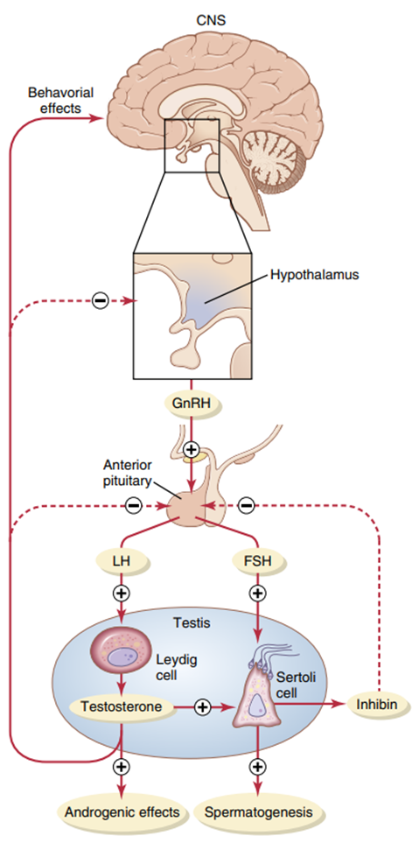
Regulation
Secretion of gonadotropin-releasing hormone (GnRH) by the hypothalamus stimulates the anterior pituitary gland to secrete two other hormones called gonadotropic hormones:
  Luteinizing hormone (LH)
  Follicle-stimulating hormone (FSH)
LH is the primary stimulus for the secretion of testosterone by the testes.
FSH mainly stimulates spermatogenesis.
  Sertoli cells secrete inhibin in the male testes. It inhibits secretion of FSH and, to a lesser extent, LH by the anterior pituitary gland.

Slide 13
Female Gonads

Slide 14
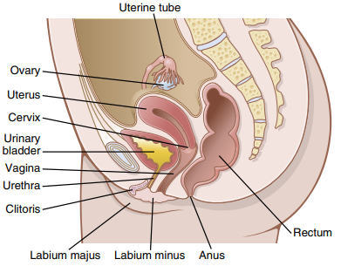
Ovaries
The ovary is female gonad and a major organ in the female reproductive system.
Structure:
  2 in number
  Flattened, oval, almond shape
  2.5 to 3.5 cm long, 2 cm wide and 1 cm thick
  Attached to the upper part of the uterus by the ovarian ligament
  Lie in ovarian fossae - one on each side of the uterus
The ovary produces;
  Produces ovum (egg cells)
  Secrete hormones that play a role in the menstrual cycle and fertility

Slide 15
Female Sex Hormones
The ovaries produces;
    Estrogen
    Progesterone
    Inhibin
    Relaxin
    Androgens
    Estrogen - responsible for development of secondary sexual characteristics of females
    Progesterone - prepare the uterus for pregnancy and the breasts for lactation

Slide 16
Functions of Estrogens
Effect of estrogens on the uterus and external female sex organs
  At puberty, estrogen causes enlargement of the ovaries, fallopian tubes, uterus, and vagina.
  estrogens change the vaginal epithelium from a cuboidal into a stratified type - more resistant to trauma and infection.
  Estrogens cause proliferation of the endometrial stroma and increased development of the endometrial glands, which will later aid in providing nutrition to the implanted ovum.
  During the first few years after puberty estrogen causes increase in the size of the 2 to 3-fold.
The estrogens initiate growth of the breasts and of the milk-producing apparatus.
They are also responsible for the characteristic growth and external appearance of the mature female breast.

Slide 17
Estrogens inhibit osteoclastic activity in the bones and therefore stimulate bone growth.
Estrogens cause a slight increase in total body protein.
Estrogens increase the whole-body metabolic rate slightly, but only about one-third as much as the increase caused by testosterone.
Estrogens also cause deposition of increased quantities of fat in the subcutaneous tissues.
Estrogens do not greatly affect hair distribution - hair develop in the pubic region and in the axillae after puberty due to increased levels of androgens.
Estrogens cause the skin to develop a texture that is soft and usually smooth.
Estrogens cause sodium and water retention by the kidney tubules – insignificant.

Slide 18
Functions of Progesterone
Progesterone promotes secretory changes in the uterus
  Progesterone promote secretory changes in the uterine endometrium during the monthly female sexual cycle, thus preparing the uterus for implantation of the fertilized ovum.
  Progesterone decreases the frequency and intensity of uterine contractions, thereby helping to prevent expulsion of the implanted ovum.
Progesterone promotes secretion by the fallopian tubes
  Progesterone also promotes increased secretion by the mucosal lining of the fallopian tubes.
  These secretions are necessary for nutrition of the fertilized, dividing ovum as it traverses the fallopian tube before implantation.
Progesterone promotes development of the breasts
  Progesterone promotes development of the lobules and alveoli of the breasts, causing the alveolar cells to proliferate, enlarge, and become secretory.
  However, progesterone does not cause milk secretion - milk is secreted only after the prepared breast is further stimulated by prolactin from the anterior pituitary gland.

Slide 19
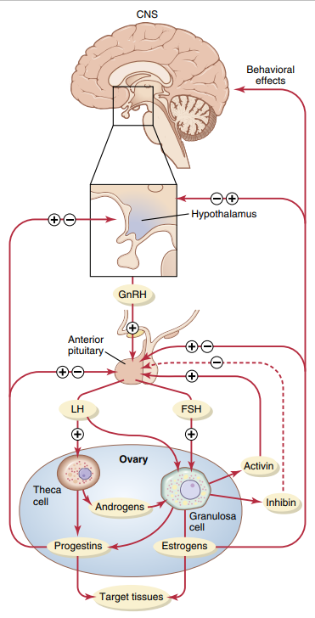
Regulation
Estrogen in small amounts has a strong inhibitory effect on production of LH and FSH.
In the presence of progesterone, the inhibitory effect of estrogen is multiplied.
Inhibin from the corpus luteum inhibits FSH and LH secretion.

Slide 20
THANK YOU

