Slide 1
Adrenal Gland
KHUSHAL KHAN
Demonstrator cardiology
Khyber medical university – institute of paramedical sciences

Slide 2
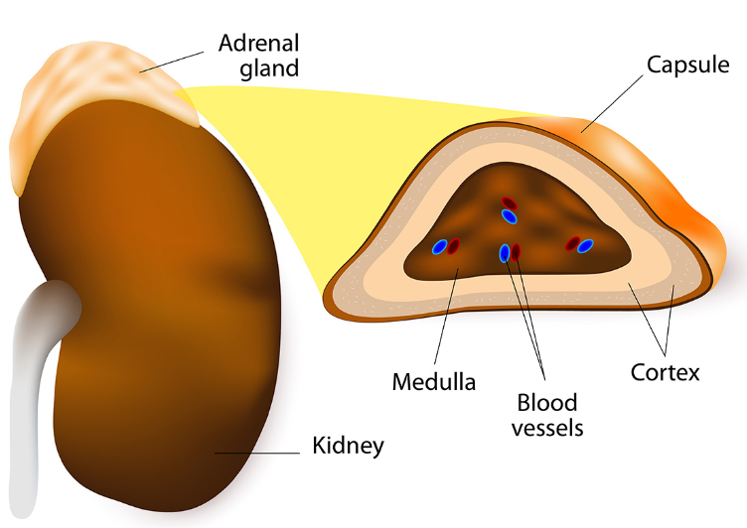
Introduction
Structure:
  Small, triangular-shaped glands
  Enveloped in adipose capsule - protective layer
  Each gland is composed of two parts;
    Adrenal Medulla
    Adrenal Cortex
Weight:
  About 4 grams
Location:
  Located on superior pole of each kidney (supra renal)
Number:
  Two in number – one above each kidney

Slide 3
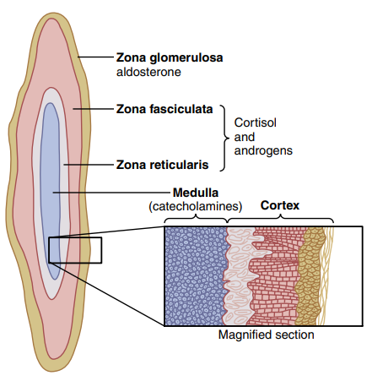
Adrenal Cortex
Outer region
Largest part of adrenal gland (80%)
Divided into three separate zones:
    Zona glomerulosa
    Zona fasciculata
    Zona reticularis
Each zone is responsible for producing specific hormones.

Slide 4
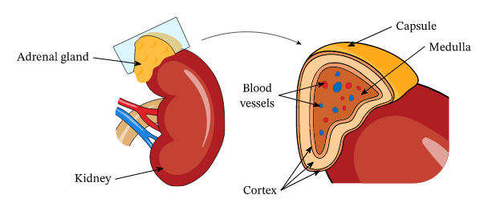
Adrenal Medulla
Central region - surrounded by the adrenal cortex.
Constitute about (20%) of adrenal gland
It produces “stress hormones,” including adrenaline.
It develops from nervous tissue in the embryo and is part of the sympathetic division of the autonomic nervous system.
It is stimulated by its extensive sympathetic nerve supply to produce the hormones adrenaline (epinephrine) and noradrenaline (norepinephrine).

Slide 5
Hormones of Adrenal Gland
Adrenal Cortex produces;
Mineralocorticoids
  Effect electrolytes of ECF (Na+ and K+)
  Aldosterone
Glucocorticoids
  Effect on increasing blood glucose level
  Cortisol
Sex hormones
  Effect on masculinity
  Androgens
Adrenal Medulla produces;
Adrenaline (epinephrine)
Noradrenaline (norepinephrine)

Slide 6
Adrenal Cortex

Slide 7
Mineralocorticoids (Aldosterone)
Aldosterone is the main mineralocorticoid.
Its functions are associated with the maintenance of water and electrolyte balance in the body.
Through a negative feedback system it stimulates the reabsorption of sodium (Na+) by the renal tubules and excretion of potassium (K+) in the urine.
Sodium reabsorption is also accompanied by retention of water and therefore aldosterone is involved in the regulation of blood volume and blood pressure too.
The blood potassium level regulates the amount of aldosterone produced by the adrenal cortex.
When blood potassium levels rise, more aldosterone is secreted.
Low blood potassium has the opposite effect.
Angiotensin also stimulates the release of aldosterone.

Slide 8
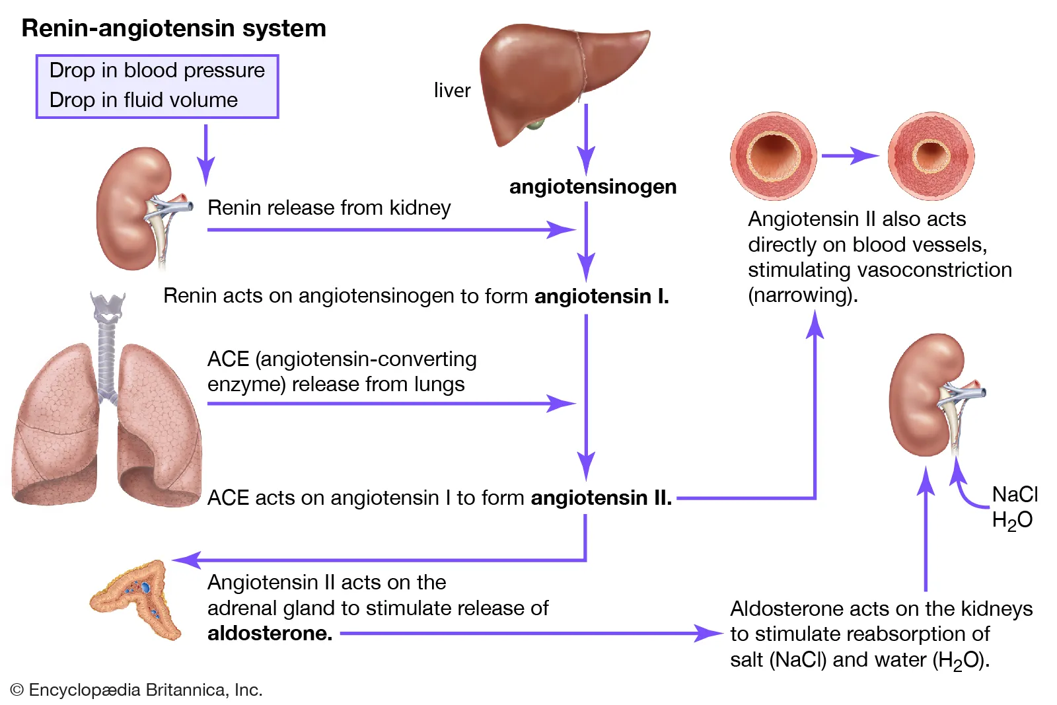

Slide 9
Glucocorticoids (Cortisol)
Cortisol (hydrocortisone) is the main glucocorticoid but small amounts of corticosterone and cortisone are also produced.
They are essential for life, regulating metabolism and responses to stress.
Secretion is controlled through a negative feedback system involving the hypothalamus and anterior pituitary.
It is stimulated by ACTH from the anterior pituitary and by stress.
In normal conditions, secretion shows marked circadian variations.
The highest level of hormone secretion occurs between 4 a.m. and 8 a.m., and the lowest between midnight and 3 a.m.
When the sleeping and waking pattern is changed it takes several days for adjustment of the ACTH/cortisol secretion to take place.

Slide 10
Glucocorticoids have widespread metabolic effects generally concerned with catabolism (breakdown) of protein and fat that makes glucose and other substances available for use.
These include:
  Gluconeogenesis
  Hyperglycaemia
  Lipolysis
  Stimulating breakdown of protein
  Synthesis of proteins, e.g. Enzymes, or for energy (ATP) production.
  Promoting absorption of sodium and water from renal tubules (a weak mineralocorticoid effect).
  Glucocorticoids (steroids) also have other effects including:
    anti-inflammatory actions
    suppression of immune responses
    delayed wound healing.

Slide 11
Sex Hormones
Sex hormones secreted by the adrenal cortex are mainly androgens (male sex hormones).
The amounts produced are insignificant compared with those secreted by the testes and ovaries in late puberty and adulthood.

Slide 12
Adrenal Medulla

Slide 13
Adrenaline and Noradrenaline
Noradrenaline is the postganglionic neurotransmitter of the sympathetic division of the autonomic nervous system.
Adrenaline and some noradrenaline are released into the blood from the adrenal medulla during stimulation of the sympathetic nervous system.
The action of these hormones prolongs and augments stimulation of the sympathetic nervous system.
They are structurally very similar and this explains their similar effects.
Together they potentiate the fight or flight response by:
  Increasing heart rate
  Increasing blood pressure
  Diverting blood to essential organs, including the heart, brain and skeletal muscles,
  By dilating their blood vessels and constricting those of less essential organs, such as the skin
  Increasing metabolic rate dilating the pupils.
Adrenaline has a greater effect on the heart and metabolic processes whereas noradrenaline has more influence on blood vessels.

Slide 14
Stress Response
When the body is under stress homeostasis is disturbed.
To restore it and, in some cases, to maintain life there are immediate and, if necessary, longer-term responses.
Stressors include;
  Exercise
  Fasting
  Fright
  Temperature changes
  Infection
  Disease
  Emotional situations
The immediate response is sometimes described as preparing for ‘fight or flight’.
This is mediated by the sympathetic part of the autonomic nervous system.

Slide 15
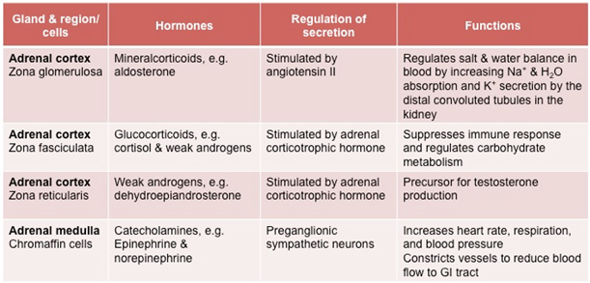

Slide 16
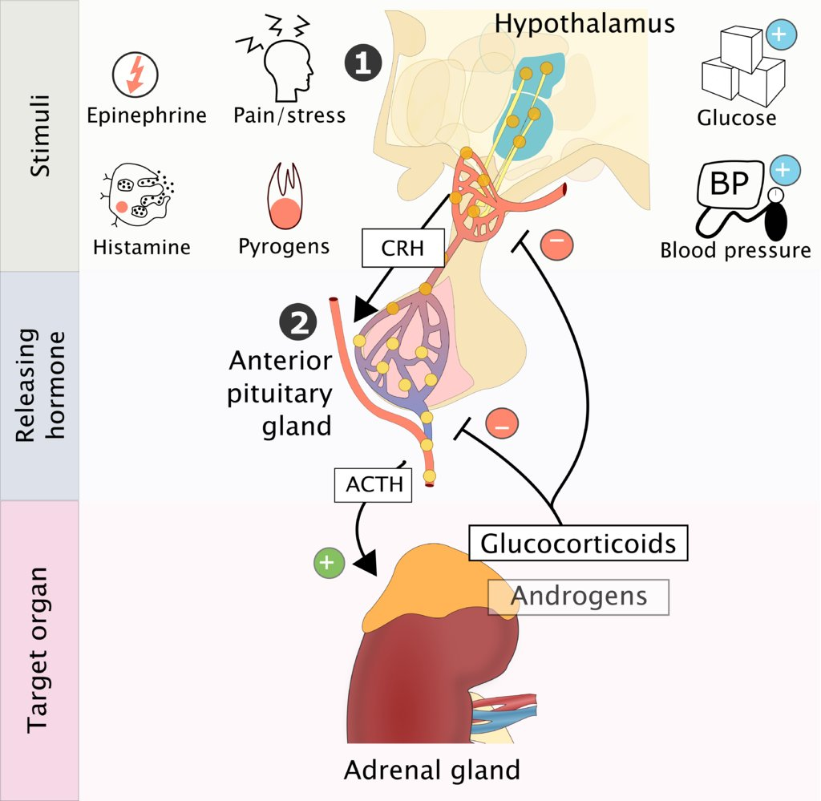
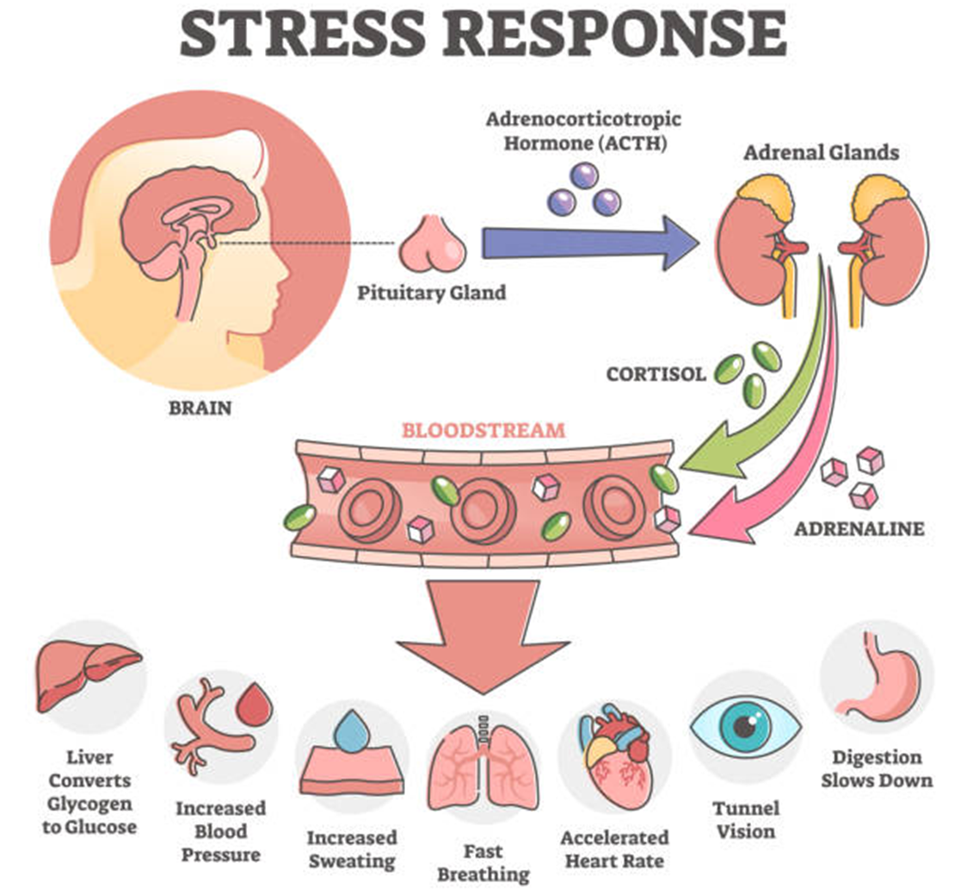

Slide 17
THANK YOU

