Slide 1
Thyroid Gland and
Parathyroid Gland
KHUSHAL KHAN
Demonstrator cardiology
KMU-IPMS

Slide 2
Topic Layout
Thyroid Gland
Physiological anatomy
Synthesis of thyroid hormones
Storage, release, transport of thyroid hormones
Physiological functions of thyroid gland
Regulation of thyroid hormones
Disorders of thyroid gland

Slide 3
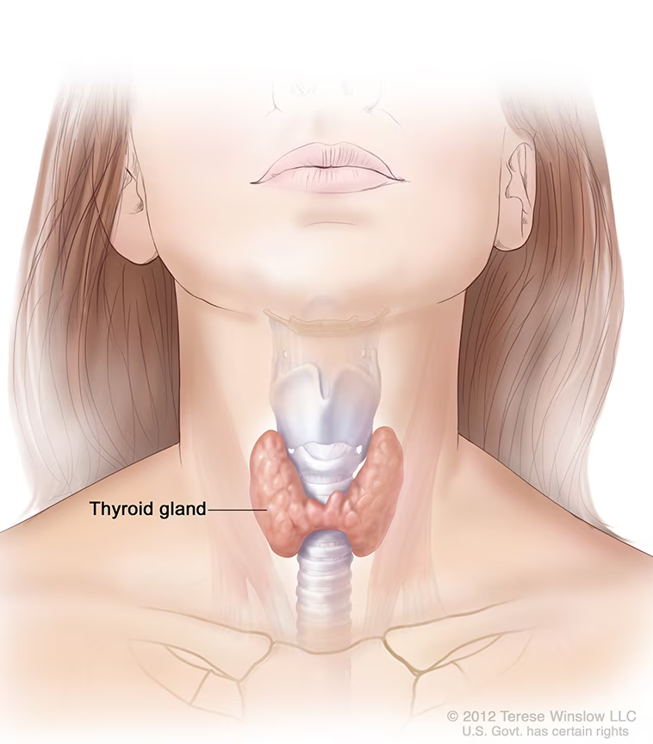
Thyroid Gland

Slide 4
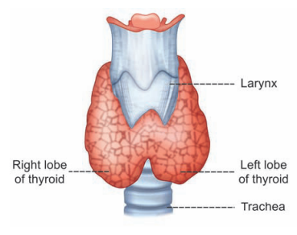
Introduction
Structure:
  Butterfly shape, 2 lobes, Right and Left Lobe connected by isthmus.
  The lobes are cone shaped, about 5 cm long and 3 cm wide.
Location:
  Below larynx, anterior to trachea
  At the level of : C5,C6,C7 and T1
Weight:
  15-20 grams (adults)
Hormones:
  Thyroxine (T4)
  Triiodothyronine (T3)
  Calcitonin
Stimulation of thyroid secretions :
  Thyroid stimulating hormone (TSH) by Anterior Pituitary.

Slide 5
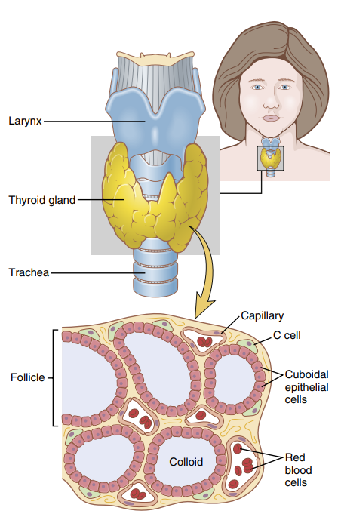
Physiological Anatomy of Thyroid Gland
Thyroid gland is composed of;
Follicles
  Lined with cuboidal epithelial cells – follicular cells
  100-300 micrometer in diameter
  Contains secretary substance – Colloid
  Colloid – consists of glycoprotein Thyroglobulin, contains T3, T4 hormones
C – cells
  Parafollicular cells
  Secretes hormone – Calcitonin (calcium metabolism)

Slide 6
Synthesis of Thyroid Hormones
Tyrosine (amino acid) and Iodine – consumed through diet.
Iodine is converted into iodide – absorbed from GIT into the blood.
Synthesis of thyroid hormones takes place in Thyroglobulin – follicles.
Iodine requirement:
  Approx. 1mg/week, 50mg/year.

Slide 7
Steps in Synthesis of Thyroid Hormones
Synthesis and storage of thyroglobulin
  In follicular cell, ER and Golgi apparatus produces and secretes thyroglobulin (contains 70 tyrosine A.A).
  Thyroglobulin is stored in the follicles of thyroid gland.
Iodide trapping
  Iodide Pump: Sodium-iodide symporter – co-transports 1 iodide (in), 2Na+ (in) into the cell.
  Iodide pump concentrates 30 times iodide more in thyroid gland than in blood.
  Na-K-ATPase – 3Na+(out), 2K+(in) – provides (electrochemical gradient) energy for iodide pump to pump iodide into the cell.

Slide 8
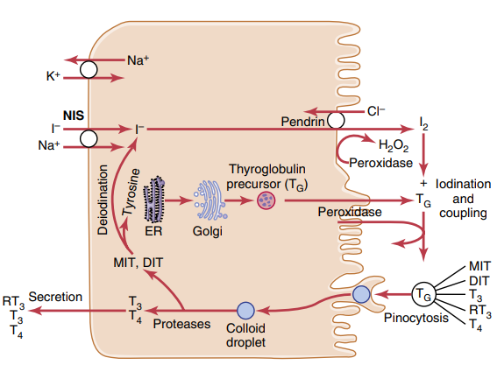
Oxidation of Iodide to Iodine
  Iodide is converted to iodine – b/c only iodine can bind to tyrosine to form thyroid hormones.
  Enzyme: Thyroid peroxidase, hydrogen peroxide

Slide 9
Transport of iodine into follicular cavity
  Iodide- chloride Pump – Pendrin
Iodination of Tyrosine (and Organification of thyroglobulin)
  First, iodine is transported into follicular cavity from follicular cells, where it binds to thyroglobulin.
  The binding of iodine with the thyroglobulin molecule is – organification of the thyroglobulin.
  Iodine + thyroglobulin Organification
  The combination of iodine with tyrosine is called iodination.
  Iodination of tyrosine occurs in several different steps.
  Tyrosine (thyroglobulin) + Iodine Mono-iodo-tyrosine (MIT)
  Enzyme: Iodinase
  MIT + Iodine Di-iodo-tyrosine (DIT)

Slide 10
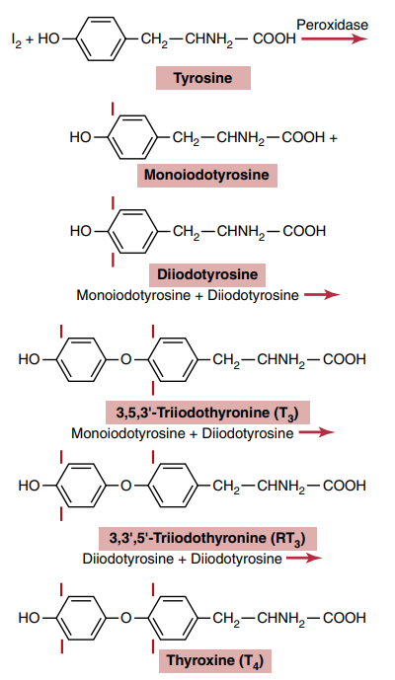
Coupled Reactions
  MIT+DIT Tri-iodo-tyronin (T3)
  DIT+DIT Tetra-iodo-thyronine, thyroxine (T4)
Reverse T3 (RT3)
  Small amounts produced of RT3 by coupling of DIT and MIT.
  DIT+MIT Reverse T3 (RT3)
  Non functional in humans.

Slide 11
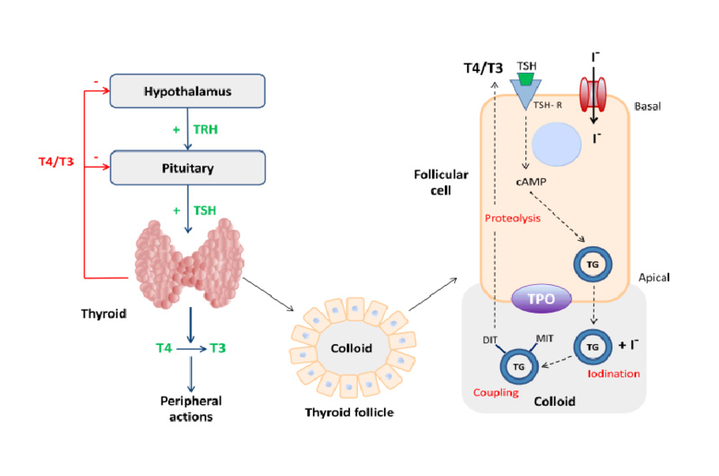

Slide 12
Storage of Thyroid Hormones
The thyroid gland stores large amounts of hormone.
After synthesis of the thyroid hormones, Thyroglobulin molecule contains:
  Up to 30 T4 molecules
  Few T3 molecules
In this form, thyroid hormones stored in follicles in an amount sufficient to supply for body needs for 2-3 months.
When synthesis of thyroid hormone ceases, the physiological effects of deficiency not observed for months after synthesis stops.

Slide 13
Release of Thyroid Hormones
Thyroglobulin remains in the thyroid gland, not entering bloodstream.
T3 and T4 are cleaved from thyroglobulin and then released.
Follicular cells have foot-like extensions called pseudopods that encircle a portion of colloid, forming pinocytic vesicles.
Pinocytic vesicles fuse with lysosomes to form digestive vesicles containing proteases.
Proteases digest thyroglobulin, releasing T3 and T4 into the bloodstream.
Thyroglobulin enters thyroid cells via endocytosis after binding to Megalin.
MIT and DIT (iodotyrosine residues) are not released into the blood; they're de-iodinated, releasing free iodine.
  Iodotyrosine deiodinases enzyme facilitates this process.
Free iodine is reused by follicular cells for further hormone synthesis.

Slide 14
Transport of Thyroid Hormones
Upon entering the blood, more than 99% of the T3 and T4 combines with plasma proteins;
  Thyroxine binding globulin
  Thyroxine-binding pre-albumin or transthyretin
  Albumin

Slide 15
Physiologic Functions of Thyroid Hormones
Activate nuclear transcription of many genes
  Synthesis of protein enzymes, structural proteins, transport proteins
  Thyroid hormone receptors located – in nucleus
  T4 converted to T3, to bind to receptor.
  Thyroid hormone receptor + Retinoid X receptor (RXR) = heterodimer – at specific thyroid hormone response element, located on DNA.
  Once bound to Thyroid hormone receptor – activated – initiates transcription.
Increase basic metabolic rate (BMR)
  Large quantities of thyroid hormone increase BMR by 60-100%
  Accelerated rate of food utilization
  Increased rate of protein synthesis, protein catabolism
  Increase growth rate in young

Slide 16
Carbohydrate Metabolism
  Rapid glucose uptake by cells
  Enhanced glycolysis
  Enhanced gluconeogenesis
  Increased rate of absorption from the gastrointestinal tract
Fat Metabolism
  Mobilization of lipids from fat tissue
  Increases free fatty acid concentration in the plasma
  Accelerates oxidation of free fatty acids by the cells
  Increased thyroid hormone decreases the concentrations of cholesterol, phospholipids, and triglycerides in the plasma
Increased Requirement for Vitamins
Increased Blood Flow and Cardiac Output

Slide 17
Increased Heart Rate
Increased heart strength
  Mild Increase – increase heart strength
  Marked Increase – depressed (due to increase protein catabolism)
Increased Respiration
Increased GIT mobility
Excitation of nervous system

Slide 18
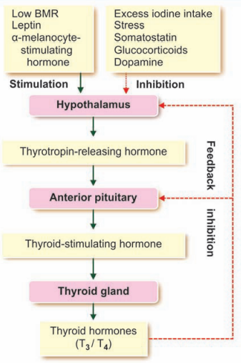
Regulation of Thyroid Hormones
Stimulation of thyroid hormones
  Anterior pituitary secretion : TSH (thyrotropin)
  Low BMR
  Leptin
  Alpha- melanocyte- stimulating hormone
  Decreased temperature
Inhibition of thyroid hormones
  Excess iodine intake
  Stress
  Somatostatin
  Dopamine
  Glucocorticoids

Slide 19
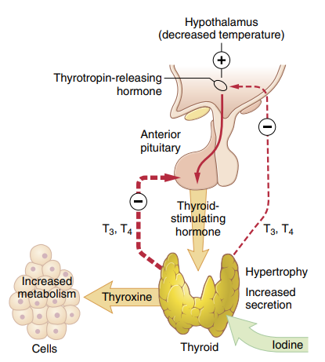
Regulation of Thyroid Hormones
TSH, or thyrotropin, boosts thyroid gland activity.
Anterior pituitary secretes TSH under control of hypothalamic hormone, thyrotropin-releasing hormone (TRH).
Elevated thyroid hormone levels decrease TSH secretion by the anterior pituitary.
Increased thyroid hormone primarily inhibits anterior pituitary TSH secretion directly.
Negative feedback from thyroid hormone inhibits TRH secretion by the hypothalamus.

Slide 20
Disorders of Thyroid Gland
These fall into 3 main categories:
Abnormal secretion of thyroid hormones (T3 and T4).
  Hyperthyroidism
  Hypothyroidism
  Goitre

Slide 21
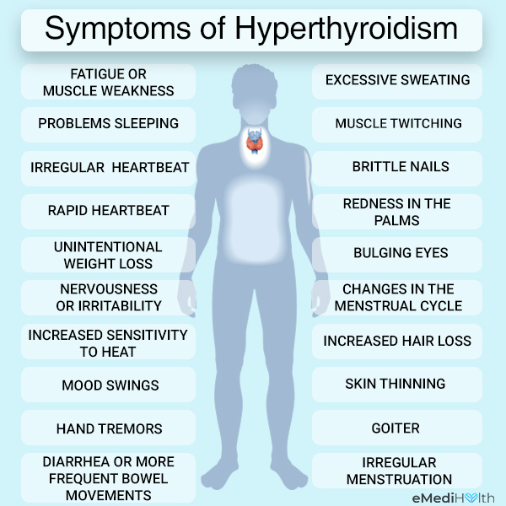
Hyperthyroidism
Also known as thyrotoxicosis.
Develops when the body tissues are exposed to excessive levels of T3 and T4.
The main causes are:
  Graves' disease
  Overactive thyroid nodules
  Thyroiditis - inflammation of the thyroid gland
  Too much iodine
  Too much thyroid hormone medicine
  Benign tumour of the pituitary gland

Slide 22
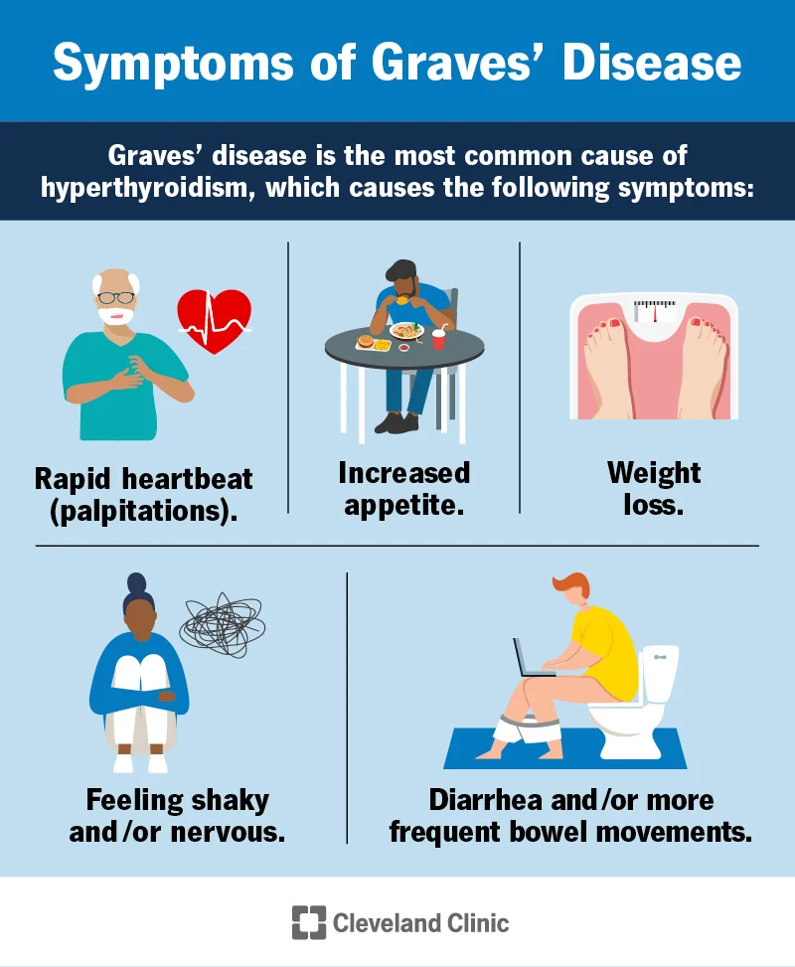
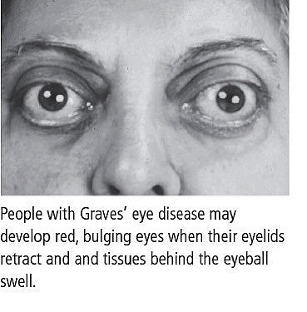
Graves’ Disease

Slide 23
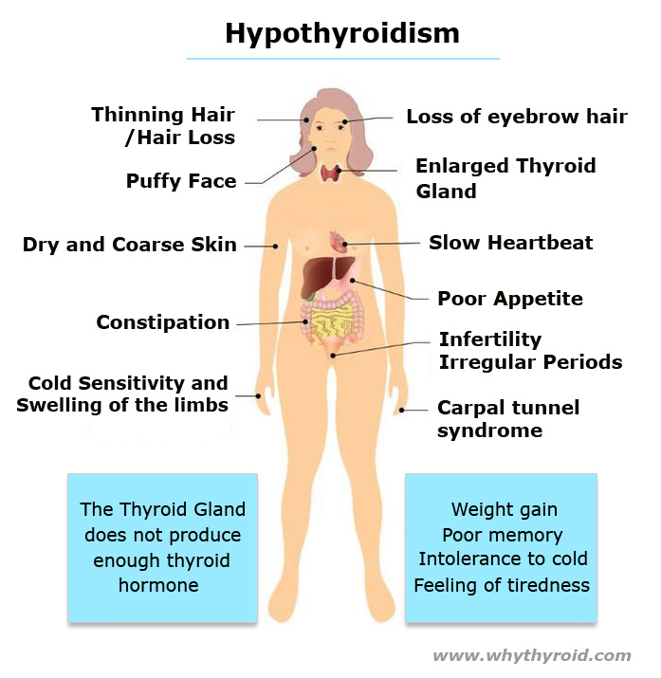
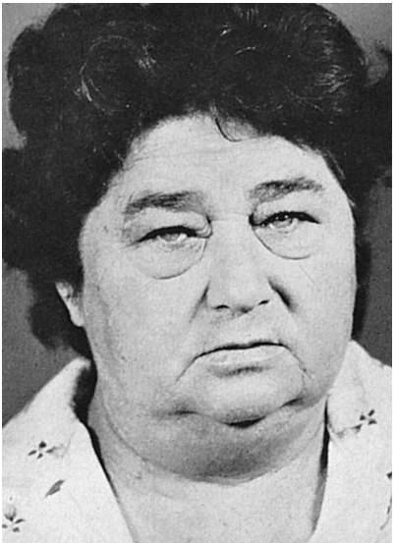
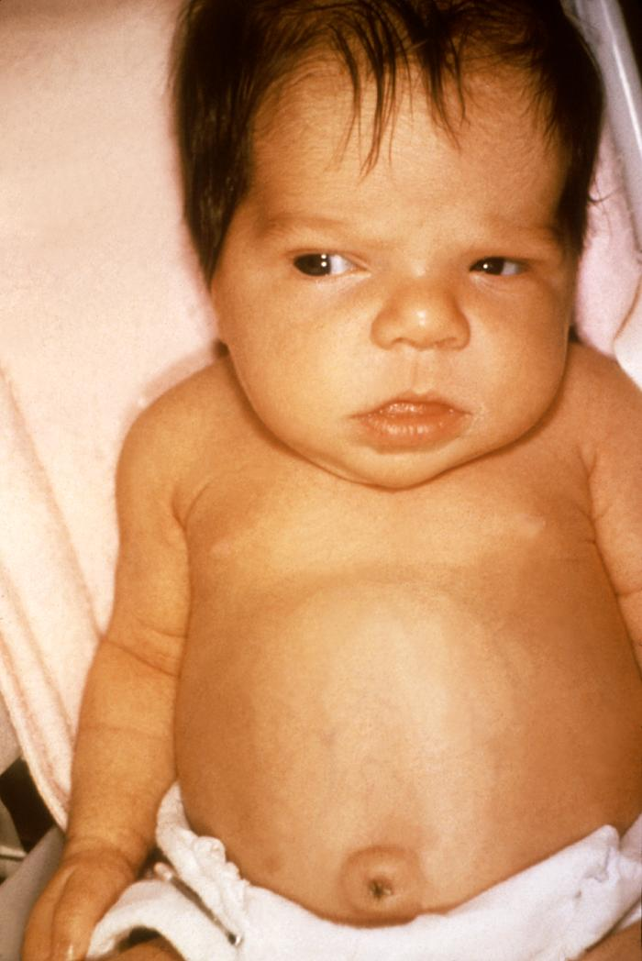
Hypothyroidism
This occurs when there is insufficient T3 and T4 secretion.
Hypothyroidism causes;
  Congenital hypothyroidism in children
  Myxoedema in adults

Slide 24
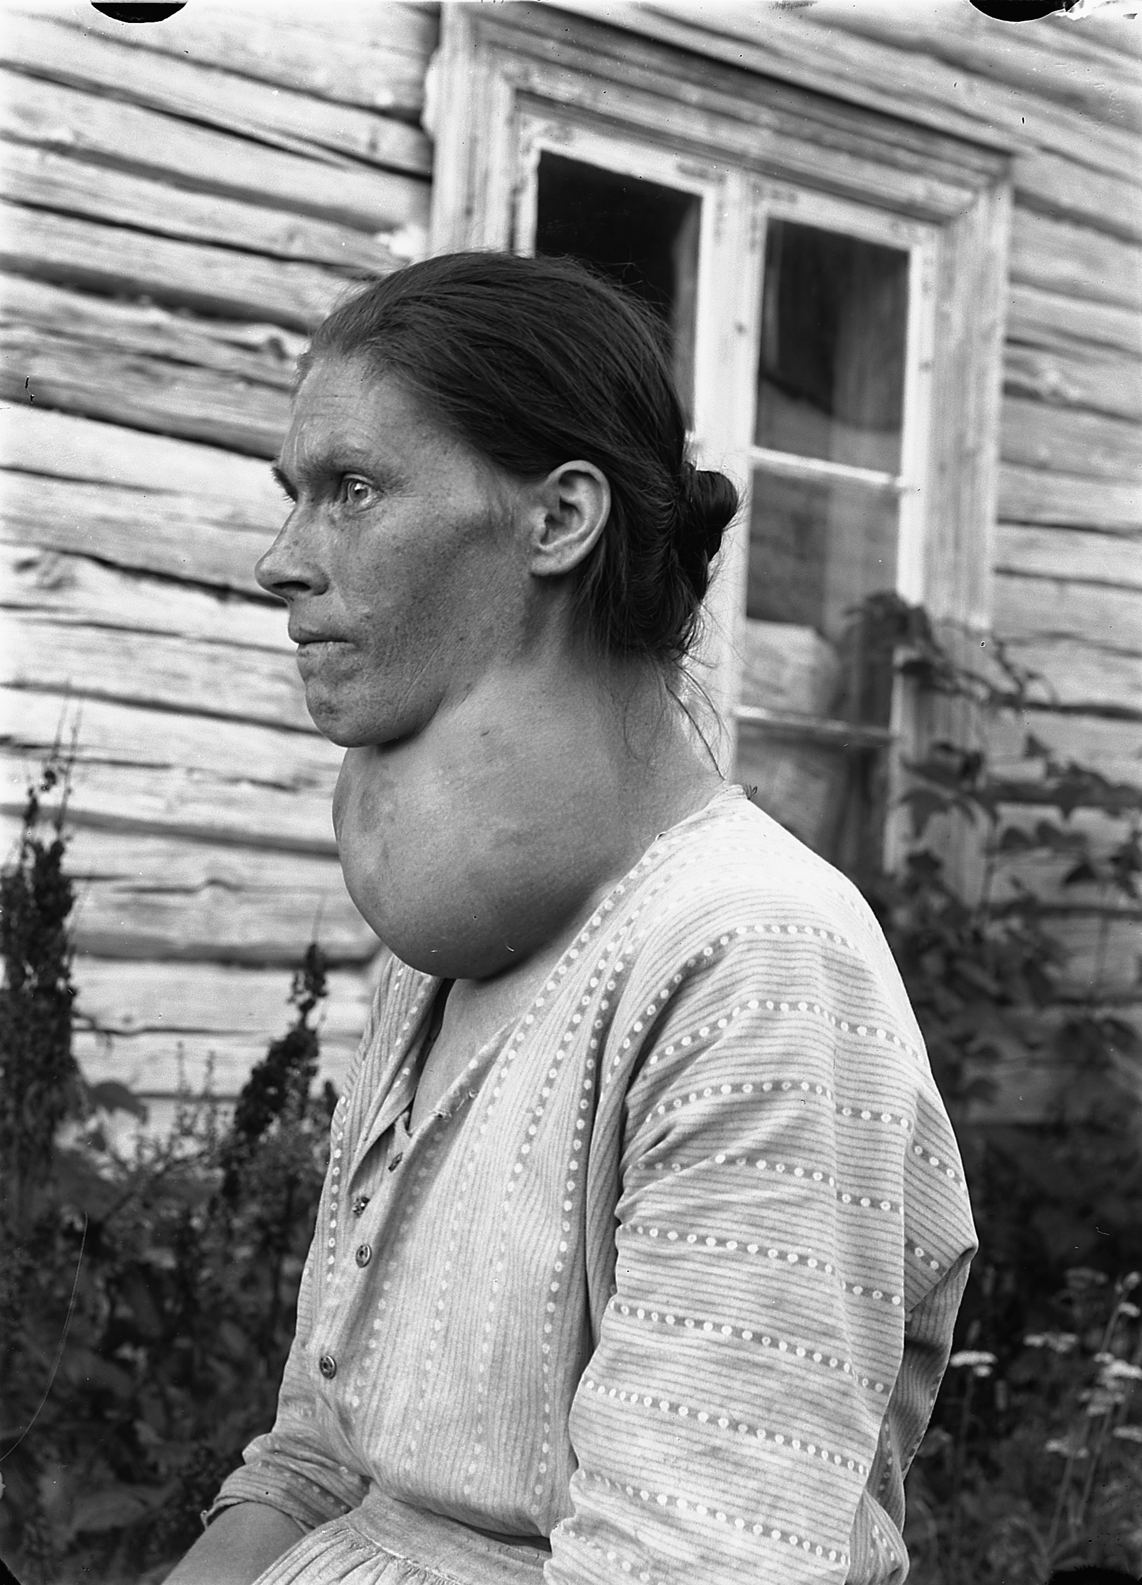
Goitre
A goitre is a swelling in the neck resulting from an enlarged thyroid gland.
A goitre can be associated with a thyroid that is not functioning properly.

Slide 25
Calcitonin
Calcitonin - a peptide hormone (32 amino acids), secreted by the thyroid gland.
Synthesis and secretion – Parafollicular cells, or C cells.
Functions:
  Role of calcitonin in humans is far less than that of PTH in regulating calcium ion concentration.
  Has effects opposite to those of Parathyroid hormone (PTH).
  Calcitonin decreases plasma calcium concentration by;
            Decrease activity of osteoclasts
            Increase activity of osteocytes (deposition of calcium in bone)
            Decrease formation of new osteoclasts
            Has minor effect on calcium handling, in kidney tubules and the intestines.

Slide 26
Parathyroid Gland

Slide 27
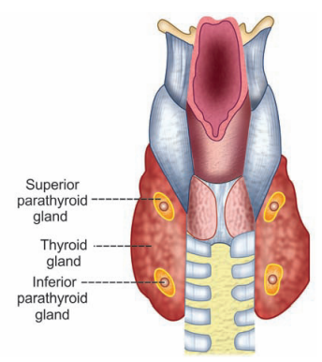
Introduction
Location
  In humans, 4 parathyroid glands – surrounded by connective tissue capsule.
  Located on posterior side of thyroid gland.
Small gland
  6mm long, 3mm wide, 2mm thick - Brown in colour.
Cells
  Chief cells – secrete Parathormone (PTH)
  Oxyphil cells – degenerated chief cells
Hormone
  The parathyroid glands secrete parathyroid hormone (PTH, Parathormone).

Slide 28
Functions & Regulation of Parathormone
Secretion is regulated by blood calcium levels.
When blood Ca⁺² concentration fall, PTH secretion is increased and vice versa.
The main function of PTH is to increase the blood calcium level when it is low.
This is achieved by indirectly increasing the amount of calcium absorbed;
  From the small intestine
  Reabsorbed from the renal tubules
  Stimulates osteoclasts (bone-destroying cells) to release calcium into the blood

Slide 29
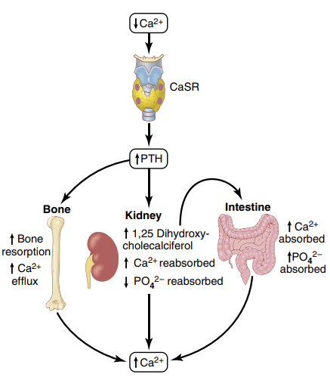
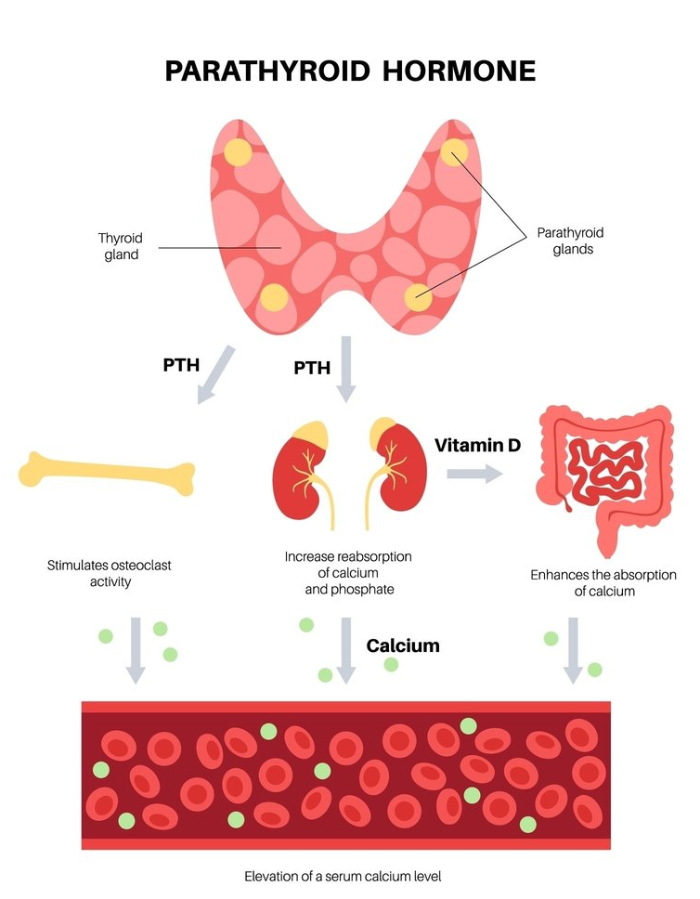
The main effects of increased PTH secretion in response to decreased extracellular fluid calcium ion concentration:
  PTH stimulates bone resorption, causing release of calcium into the extracellular fluid.
  PTH increases calcium reabsorption and decreases phosphate reabsorption by the renal tubules, leading to decreased excretion of calcium and increased excretion of phosphate.
  PTH is necessary for conversion of 25-hydroxycholecalciferol to 1,25-dihydroxycholecalciferol, which, in turn, increases calcium absorption by the intestines.

Slide 30
Disorders of Parathyroid Gland
Disorders of parathyroid gland are of two types. They are;
Hyperparathyroidism
Hyperparathyroidism

Slide 31
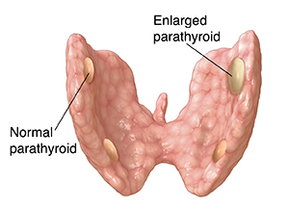
Hyperparathyroidism
Hypersecretion of parathyroid hormone is called Hyperparathyroidism.
It results in hypercalcemia (increased calcium plasma levels).

Slide 32
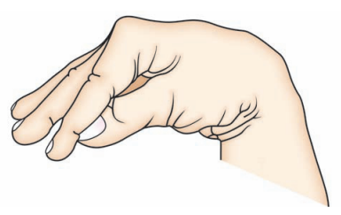
Hypoparathyroidism
Hyposecretion of parathyroid hormone is called Hypoparathyroidism.
It results in hypocalcaemia (decreased calcium plasma levels).
Carpopedal Spasm

Slide 33
THANK YOU

