Slide 1
The Endocrine System
KHUSHAL KHAN
Demonstrator cardiology
Khyber medical university – institute of paramedical sciences

Slide 2
Topic Layout
Introduction to Endocrine system
Cell Signaling
Chemical Messengers
Endocrine Glands
Hormones and their Chemical Structure
Mechanism of Hormones Action

Slide 3
Introduction to Endocrine System
The endocrine system consists of endocrine glands and their secretions, known as hormones.
The endocrine glands are commonly referred to as ductless glands because their hormones diffuse directly into the bloodstream.
Hormones are carried in the bloodstream to target tissues and organs, where they influence cellular growth and metabolism.
All the physiological functions of the body are regulated by Nervous system and Endocrine system.
The homeostasis of the body is maintained by the coordinated functions of both these systems.
The nervous system is concerned with rapid changes, while endocrine system is mainly involved in slower and more precise adjustments.

Slide 4
Cell Signaling or Cell Communication
Cell signaling or cell communication is the ability of a cell to receive, process, and transmit signals with its environment and with itself.
Cell-to-cell signaling refers to the transfer of information from one cell to another.
Signals that originate from outside a cell (or extracellular signals) can be physical agents like mechanical pressure, voltage, temperature, light, or chemical signals (e.g., small molecules, peptides, or gas).
Cell signaling can occur over short or long distances.
The cells of the body communicate with each other through some chemical substances called chemical messengers.

Slide 5
Receptors
Receptors detect chemical signals or physical stimuli.
Receptors are generally proteins located on the cell surface or within the interior of the cell such as the cytoplasm, organelles, and nucleus.
Cell surface receptors usually bind with extracellular signals (or ligands), which causes a conformational change in the receptor that leads it to initiate enzymatic activity, or to open or close ion channel activity.
Some receptors do not contain enzymatic or channel-like domains but are instead linked to enzymes or transporters.
Nuclear receptors have a different mechanism such as changing their DNA binding properties and cellular localization to the nucleus.

Slide 6
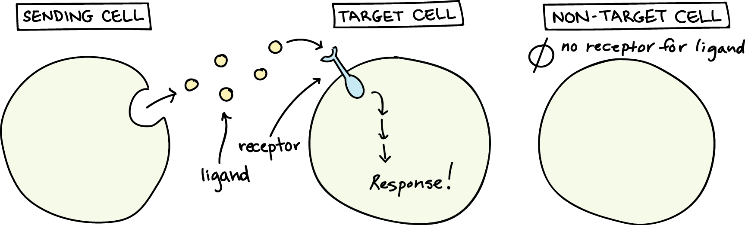

Slide 7
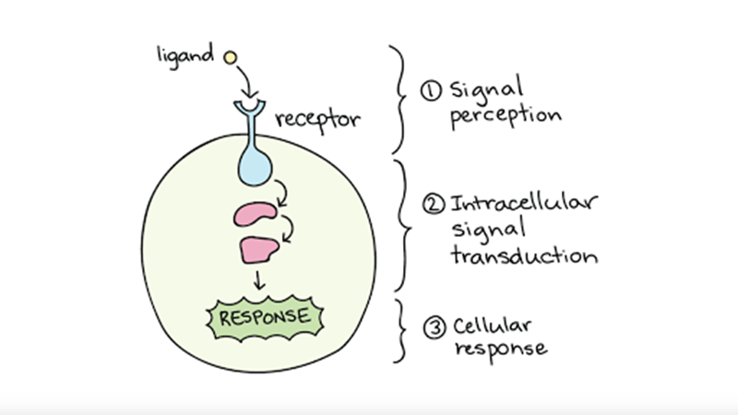

Slide 8
Chemical Messengers
Chemical messengers are the substances involved in cell signaling.
The activities of the cells, tissues, and organs of the body are coordinated by the interplay of several types of chemical messengers.
All chemical messengers carry the message (signal) from the signaling cells (controlling cells) to the target cells.
These messengers are mainly secreted from endocrine glands.
Some chemicals are secreted by nerve endings and the cells of several other tissues also.
The messenger substances may be the hormones or hormone-like substances.

Slide 9
Types of Chemical Messengers
Endocrine Messengers
  Endocrine messengers are released by glands or specialized cells into the circulating blood and influence the function of target cells at another location in the body.
Paracrine Messengers or Juxtacrine Messengers
  Paracrine messengers are secreted by cells into the extracellular fluid and affect neighbouring target cells of a different type.
Autocrine Messengers
  Autocrine messengers are secreted by cells into the extracellular fluid and affect the function of the same cells that produced them.
Neurocrine Messengers
  Neurocrine messengers or neural messengers are neurotransmitter or neuroendocrine hormones.

Slide 10
Neurotransmitter
  Neurotransmitters are released by axon terminals of neurons into the synaptic junctions and act locally to control nerve cell functions.
Neuroendocrine hormone
  Neuroendocrine hormones are secreted by neurons into the circulating blood and influence the function of target cells at another location in the body.
Cytokines
  Cytokines are peptides secreted by cells into the extracellular fluid and can function as autocrines, paracrines, or endocrine hormones.
  Examples of cytokines include the interleukins and other lymphokines that are secreted by helper cells and act on other cells of the immune system.
  Cytokine hormones (e.g., leptin) produced by adipocytes are sometimes called adipokin.

Slide 11
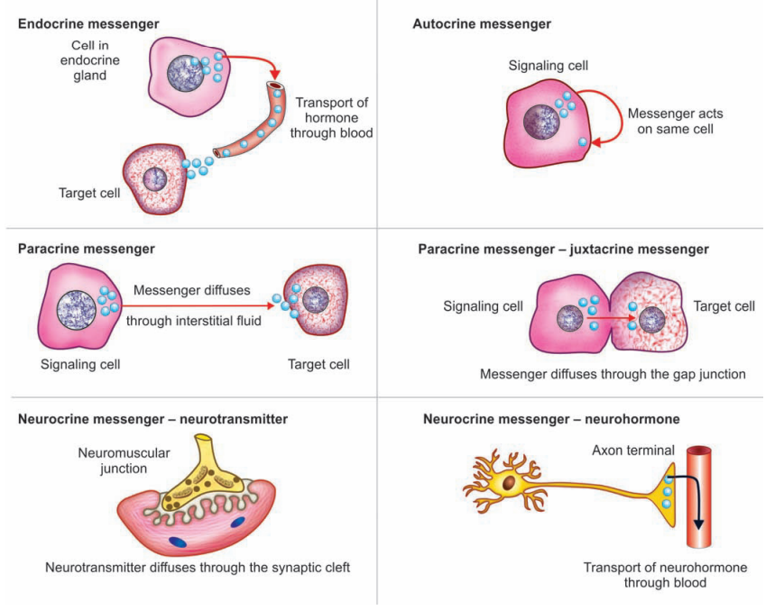

Slide 12
Glands
Glands are groups of epithelial cells that produce specialised secretions.
There are two major types of glands. They are;
Exocrine glands
  Exocrine glands release the substances into a duct or opening to the inside or outside of the body.
  Exocrine glands vary considerably in size, shape and complexity.
  Secretions of exocrine glands include mucus, saliva, digestive juices and earwax.
Endocrine glands
  Endocrine glands release the substances directly into the bloodstream.
  Secretions of exocrine glands include Growth hormone, hormones of thyroid gland, etc.

Slide 13
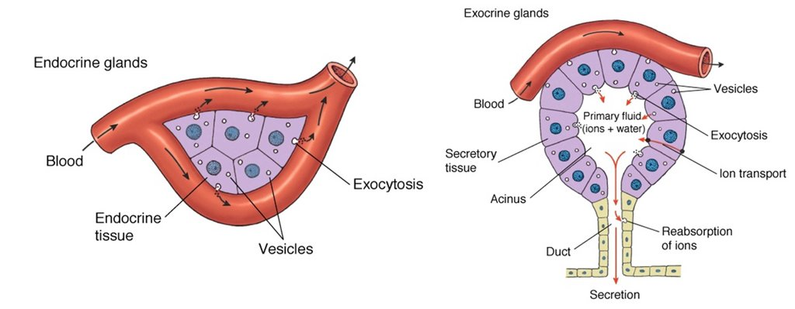

Slide 14
Major Endocrine Glands of Human Body
Endocrine glands are the glands which synthesize and release the classical hormones into the blood.
Endocrine glands are also called ductless glands because the hormones secreted by them are released directly into blood without any duct.
Endocrine glands play an important role in homeostasis and control of various activities in the body through their hormones.
Hormones are transported by blood to target organs or tissues in different parts of the body, where the actions are executed.

Slide 15
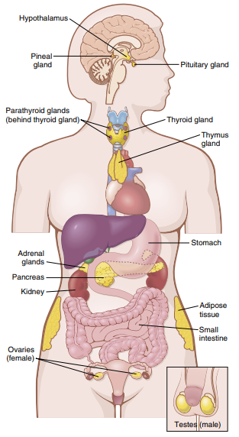
The major endocrine glands of human body include;
Hypothalamus
Pituitary Gland
Pineal Gland
Thyroid Gland
Parathyroid Gland
Adrenal Gland
Gonads (testes, ovaries)
Pancreas
Kidney
Placenta, etc.

Slide 16
Hormones
Hormones are chemical messengers, synthesized by endocrine glands.
Hormones are classified into three major classes. They are;
Protein (or Polypeptide) Hormones
  Hormones secreted by the anterior and posterior pituitary gland, the pancreas (insulin and glucagon), the parathyroid gland (parathyroid hormone) are protein hormones.
Steroid Hormones
  Hormones secreted by the adrenal cortex (cortisol and aldosterone), the ovaries (estrogen and progesterone), the testes (testosterone), and the placenta (estrogen and progesterone) are steroid hormones.
Derivatives of the amino acid tyrosine
  Hormones secreted by the thyroid (thyroxine and triiodothyronine) and the adrenal medullae (epinephrine and norepinephrine) are derivatives of tyrosine.

Slide 17
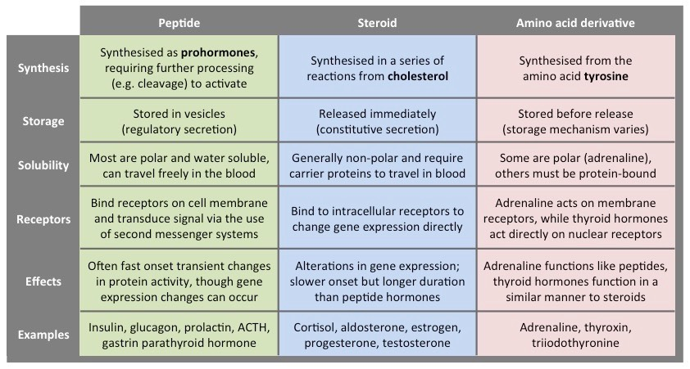

Slide 18
Mechanism of Hormone Action
Hormone does not act directly on target cells.
First it combines with receptor present on the target cells and forms a hormone-receptor complex.
This hormone-receptor complex induces various changes or reactions in the target cells.
Hormone-receptor complex enters the target cell by means of endocytosis and execute the actions.
After this, some receptors are recycled, whereas many of them are degraded and new receptors are formed.

Slide 19
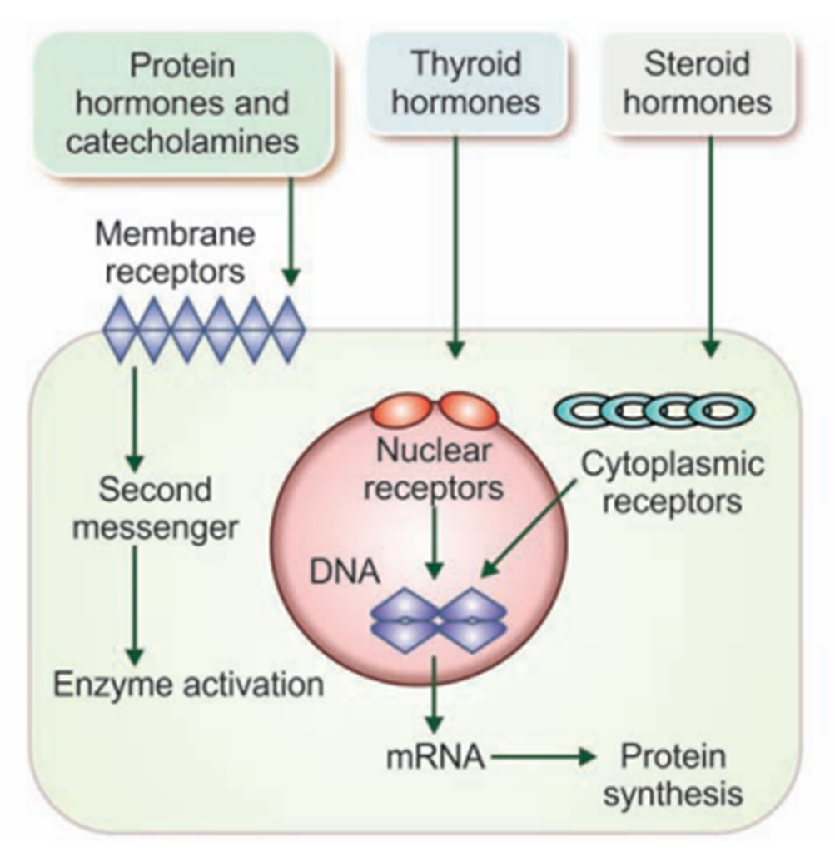
These hormone receptors are proteins that are present in the target cells.
These receptors are highly specific in nature.
Without the presence of a specific receptor a hormone cannot act or induce change in the target cell.
These receptors can be found in;
Cell membrane (e.g. receptors of protein hormones, receptors for hormones of adrenal medulla)
Cytoplasm (e.g. receptors for steroid hormones)
Nucleus (e.g. receptors for thyroid hormones)

Slide 20
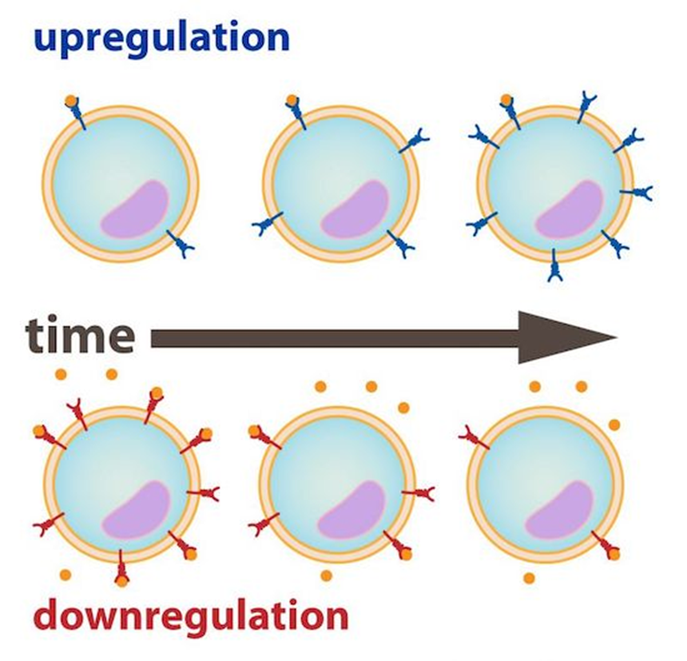
Regulation of Hormone Receptors
Receptor proteins are not static components of the cell.
Their number increases or decreases in various conditions.
Down Regulation
  When a hormone is released in excess, the number of receptors in the target cell decreases due to binding of hormone to the receptors.
  This process is known as down regulation.
Up Regulation
  When a hormone is deficient, the number of receptors in the target cell increases.
  This process is known as up regulation.

Slide 21
A hormone affects its target tissues by first forming a hormone-receptor complex.
Formation of this complex alters the function of the receptor, and the activated receptor initiates the hormonal effects.
The hormone-receptor complex execute hormonal action by one of the following mechanisms;
By altering permeability of cell membrane
By activating intracellular enzymes
By acting on genes

Slide 22
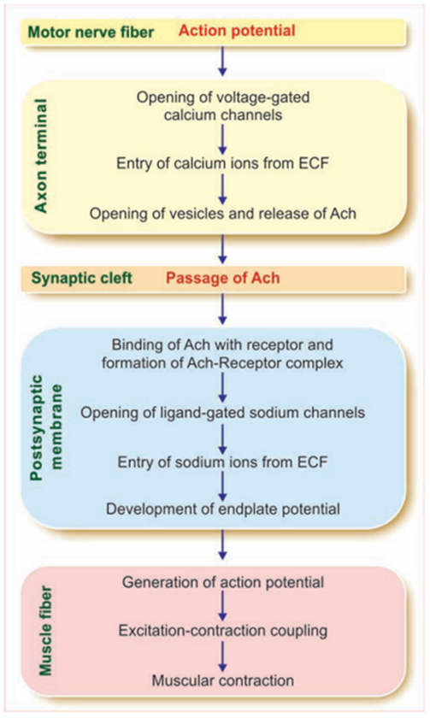
By Altering Permeability Of Cell Membrane
Neurotransmitters in synapse or neuromuscular junction act by changing the permeability of post-synaptic membrane.
For example, in a neuromuscular junction, when an impulse (action potential) reaches the axon terminal of the motor nerve, acetylcholine is released from the vesicles.
Acetylcholine increases the permeability of the postsynaptic membrane for sodium, by opening the ligand-gated sodium channels.
Sodium ions enter the neuromuscular junction from ECF through the channels and cause the development of endplate potential.

Slide 23
By Activating Intracellular Enzymes
Protein hormones and the catecholamines act by activating the intracellular enzymes.
First Messenger (Chemical mediator)
  The hormone which act on target cell, is called first messenger or chemical mediator.
  It combines with receptor and forms hormone-receptor complex.
Second messenger (Intracellular hormonal mediator)
  Hormone- receptor complex activates the enzymes of the cell and causes the formation of other substance, called second messenger or intracellular hormonal mediator.
  Second messenger produces the effects of the hormone inside the cells.
  Protein hormones and the catecholamines act through second messenger.
  Most common second messenger is cyclic AMP (cyclic adenosine 3’5’-monophosphate).

Slide 24
Formation of cAMP & Role of G-proteins
G proteins (guanosine nucleotide-binding proteins) are membrane proteins present on the inner surface of cell membrane.
These proteins play a vital role in the formation of cAMP.
Each G-protein is made up of three subunits called α , β, and Ὑ subunits.
α- subunit is responsible for most of the biological actions.
It is bound to guanosine diphosphate (GDP) and forms α-GDP unit.
The α-subunit possesses enzymatic activity called GTPase activity.
The β and Ὑ subunits combines to form β-Ὑ dimer.
In the in-activated form both α-GDP unit and β-Ὑ dimer are united.

Slide 25
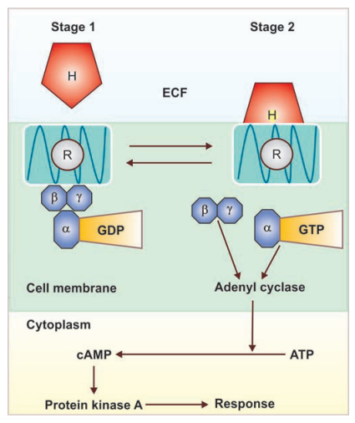
Sequence of Events in cAMP Formation
Formation of Hormone-Receptor Complex
Activation of G-protein
G-protein releases GDP from α-GDP unit
α-subunit binds with a new molecule of GTP
This exchange triggers disassociation of α-GTP and β-Ὑ dimer from receptor
Both α-GTP unit activates the enzyme Adenyl Cyclase
Activated Adenyl cyclase converts ATP into cAMP
cAMP activates Protein Kinase A
Response

Slide 26
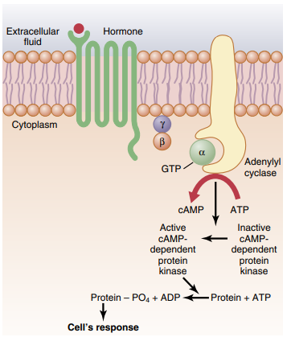
cAMP produces one of the following cell responses;
  Contraction and relaxation of muscle fibers.
  Alterations in cell membrane permeability.
  Synthesis of substances inside the cell.
  Secretions or release of substances by target cells.
  Other physiological activates of target cells.

Slide 27
By Acting on Genes
Thyroid hormones and steroid hormones execute their actions by acting on the genes in target cells.
Steroid hormones binds with receptor in cytoplasm while thyroid hormone binds with receptor in the nucleus and forms hormone-receptor complex.

Slide 28
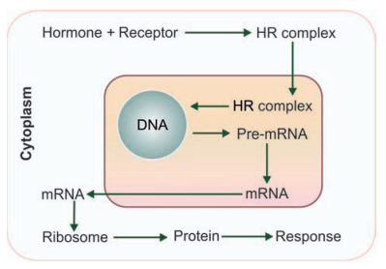
Sequence of Events in Gene Activation
Formation of Hormone-Receptor complex
Hormone-Receptor Complex binds with DNA
Enhances the formation of mRNA
mRNA moves out of the nucleus and reaches to ribosome and activates them
Activated ribosomes produces large quantities of proteins
These proteins produces physiological responses in target cells

Slide 29
THANK YOU

