Slide 1
Neuromuscular Junction
KHUSHAL KHAN
Demonstrator cardiology
Khyber medical university – institute of paramedical sciences

Slide 2
Topic Layout
Neuromuscular Junction
Physiological Anatomy of Neuromuscular Junction
Synthesis & Degradation of Acetylcholine
Neuromuscular Blockers
Neuromuscular Stimulants

Slide 3
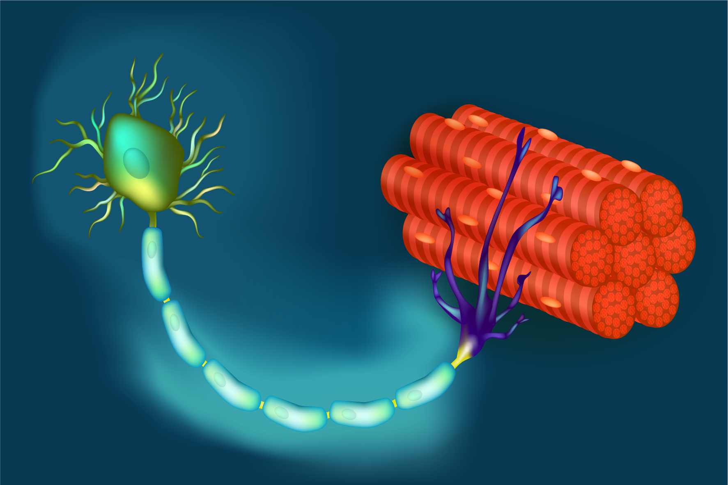
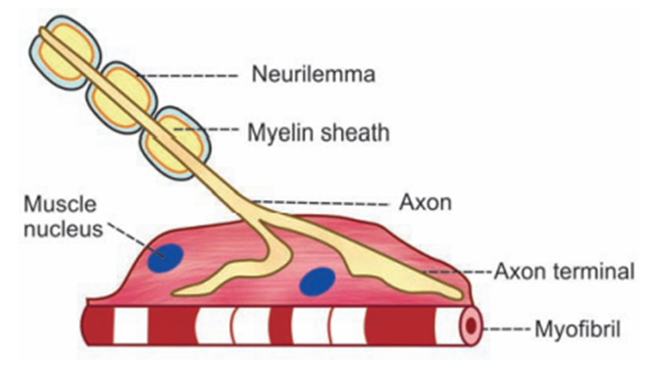
Neuromuscular Junction
Neuromuscular junction is the junction between the terminal branch of nerve fiber and muscle fiber.
Skeletal muscle fibers are innervated by large myelinated nerve fibers that originate from large motor neurons in the anterior horns of the spinal cord.
Each nerve fiber, after entering the muscle belly, normally branches and stimulates from three to several hundred skeletal muscle fibers.
Each nerve ending makes a junction with the muscle fiber, called the neuromuscular junction.
The action potential initiated in the muscle fiber by the nerve signal travels toward the muscle fiber ends.

Slide 4
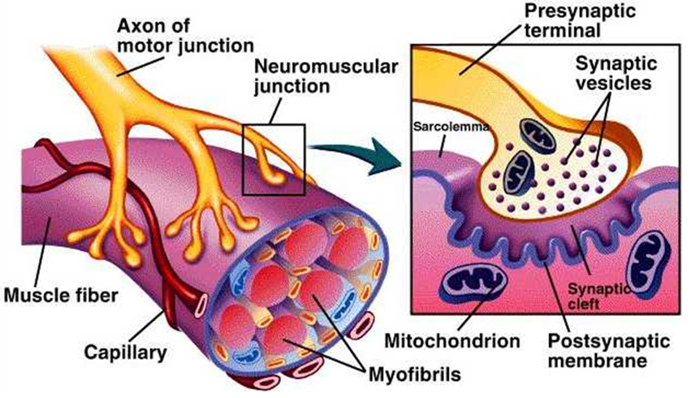
Physiological Anatomy of NMJ
Axon Terminal
  Terminal branch of nerve fiber is called axon terminal.
  When axon comes close to muscle fiber, it looses its myelin sheath, in such a way that axis cylinder is exposed.
  This portion of axis cylinder is expanded like a bulb and is known as motor end plate.
  Axon terminals contain mitochondria and synaptic vesicles.
  Synaptic vesicles contains neurotransmitter – Acetylcholine.
  Ach is synthesized by mitochondria of axon terminals and is stored in synaptic vesicles.
  Mitochondria contains ATP – source of energy for Ach synthesis.

Slide 5
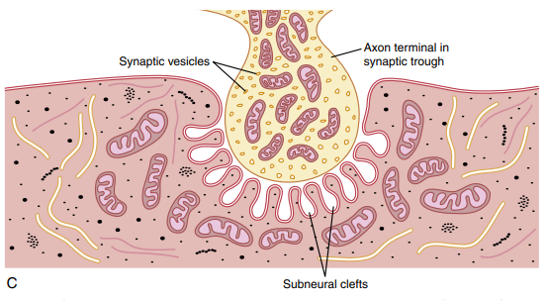
Motor End Plate
  The nerve fiber forms a complex of branching nerve terminals that invaginate into the surface of the muscle fiber but lie outside the muscle fiber plasma membrane.
  The entire structure is called the motor end plate.
  It is covered by one or more Schwann cells that insulate it from the surrounding fluids.
Synaptic Gutter / Synaptic Trough
  The invaginated membrane is called the synaptic gutter or synaptic trough.

Slide 6
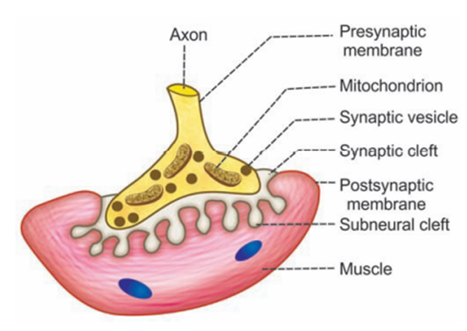
Synaptic Cleft
  The space between the terminal and the fiber membrane is called the synaptic space or synaptic cleft.
  It is 20 to 30 nanometers wide.
Pre-synaptic Membrane
  Membrane of nerve ending is called presynaptic membrane.
Post-synaptic Membrane
  Membrane of muscle fiber is called postsynaptic membrane.
Basal Lamina
  It is a thin layer of spongy reticular matrix, through which ECF diffuses.
  It is present in synaptic cleft.
  An enzyme Acetylcholinesterase is present in large quantities in the matrix of basal lamina.

Slide 7
Subneural Clefts
  At the bottom of the gutter are numerous smaller folds of the muscle membrane (postsynaptic membrane) called subneural clefts, which greatly increase the surface area at which the synaptic transmitter can act.
  In the axon terminal are many mitochondria that supply adenosine triphosphate (ATP).
  ATP is the energy source used for synthesis of a transmitter, acetylcholine, which excites the muscle fiber membrane.
  Postsynaptic membrane contains receptors called – Nicotinic Acetylcholine Receptors.

Slide 8
Acetylcholine (Ach)
  Acetylcholine is used at the neuromuscular junctions, triggering the firing of motor neurons and affecting voluntary movements.
  Acetylcholine is synthesized in the cytoplasm of the terminal.
  It is absorbed rapidly into many small synaptic vesicles.
  There are about 300,000 of synaptic vesicles present normally in the terminals of a single end plate.
Acetylcholinesterase (AchE)
  Acetylcholinesterase, also known as acetyl-hydrolase, is the primary cholinesterase in the body.
  It is an enzyme that catalyzes the breakdown of acetylcholine and some other choline esters that function as neurotransmitters.
  It is found at mainly neuromuscular junctions and in chemical synapses of the cholinergic type, where its activity serves to terminate synaptic transmission.

Slide 9
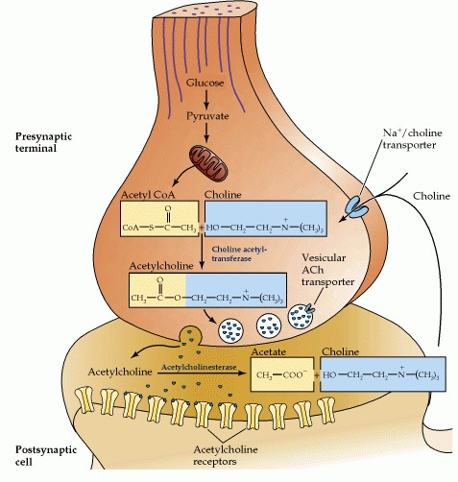
Synthesis & Degradation of Acetylcholine
Acetylcholine is synthesized in nerve terminals from acetyl coenzyme A (acetyl CoA, which is synthesized from glucose) and choline, in a reaction catalysed by choline acetyltransferase (CAT).
In the synaptic space or synaptic cleft are large quantities of the enzyme acetylcholinesterase (AchE), which destroys acetylcholine a few milliseconds after it has been released from the synaptic vesicles.

Slide 10
Neuromuscular Blockers
Neuromuscular blockers are drugs which prevent transmission of impulses from nerve fiber to the muscle fiber through NMJ.
Neuromuscular blockers are used in anaesthesia during surgery to relax skeletal muscles and cause paralysis for proper performance of a surgical procedure.
They are;
  Curare
  Bungarotoxin (snake’s venom)
  Succinylcholine
  Carbamylcholine
  Botulinum Toxin (Clostridium botulinum)

Slide 11
Neuromuscular Stimulants
Some drugs cause stimulation of NMJ.
They inhibit acetylcholinesterase so that acetylcholine is not hydrolysed.
It leads to repeated stimulation of continuous contraction of muscles.
They are;
  Neostigmine
  Physostigmine
  Di-iso-propyl-fluro-phosphate

Slide 12
THANK YOU

