Slide 1
The Skin and
Integumentary System
KHUSHAL KHAN
Demonstrator cardiology
Khyber medical university – institute of paramedical sciences

Slide 2
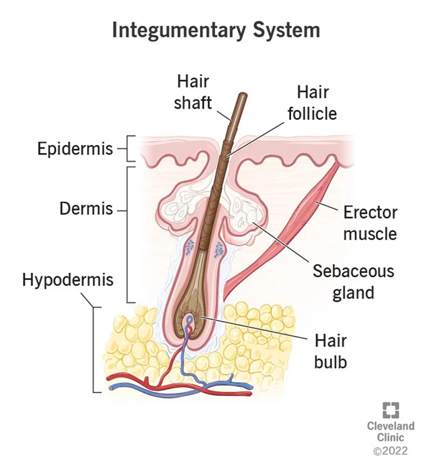
Integumentary System
The integumentary system is the body’s outer layer.
It’s made up of skin, nails, hair and the glands and nerves on the skin.
The integumentary system acts as a physical barrier — protecting the body from bacteria, infection, injury and sunlight.
It also helps regulate your body temperature and allows to feel skin sensations like hot and cold.

Slide 3
Structure of the skin
The skin is the largest organ in the body.
Skin has a surface area of about 1.5 to 2 square. Meter in adults.
It includes glands, hair and nails.
There are three main layers:
The Epidermis
The Dermis
The Hypodermis (subcutaneous layer)

Slide 4
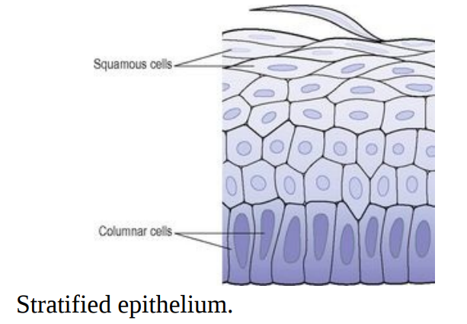
A- Epidermis
The epidermis is the most superficial layer of the skin.
It is composed of stratified keratinised squamous epithelium, which varies in thickness in different parts of the body.
It is thickest on the palms of the hands and soles of the feet.
There are no blood vessels or nerve endings in the epidermis, but its deeper layers are bathed in interstitial fluid from the dermis, which provides oxygen and nutrients, and drains away as lymph.

Slide 5
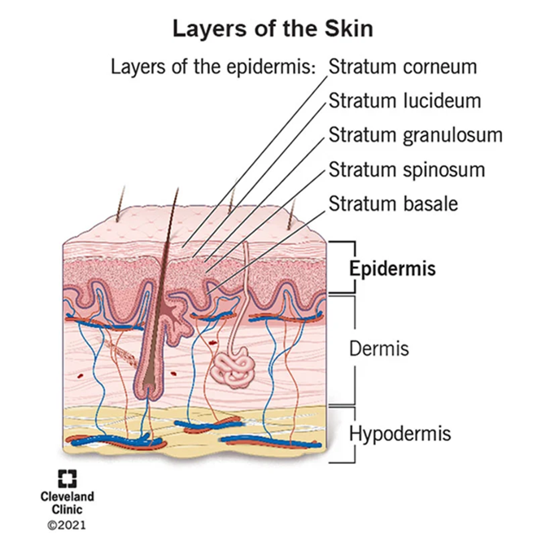
There are several layers (strata) of cells in the epidermis which extend from the deepest germinative layer (stratum basale) to the most superficial (stratum corneum).
The cells on the surface are flat, thin, non-nucleated, dead cells, or squamous, in which the cytoplasm has been replaced by the fibrous protein keratin.
These cells are constantly being rubbed off and replaced by cells that originated in the germinative layer and have undergone gradual change as they progressed towards the surface.
Complete replacement of the epidermis takes about a month.

Slide 6
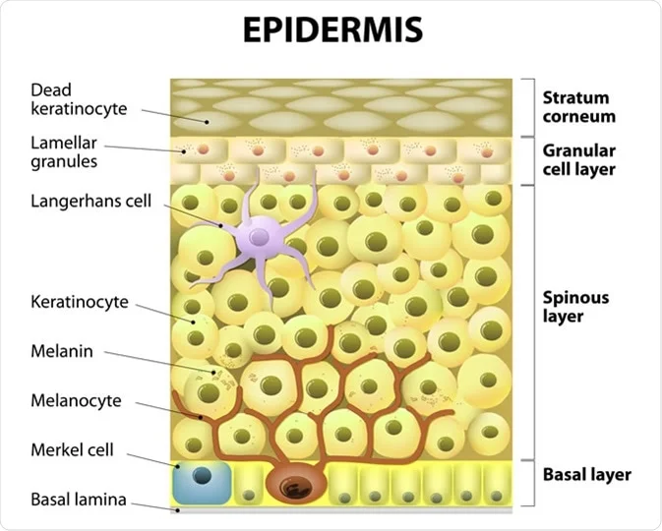
Melanin, a dark pigment derived from the amino acid tyrosine and secreted by melanocytes in the deep germinative layer, is absorbed by surrounding epithelial cells.
  It protects the skin from the harmful effects of sunlight.
  Exposure to sunlight promotes synthesis of melanin.
Normal saturation of haemoglobin and the amount of blood circulating in the dermis give white skin its pink colour.
Excessive levels of bile pigments in blood and carotenes in subcutaneous fat give the skin a yellowish colour.
Langerhans Cells – Tissue Macrophages – they play a key role in immunity.

Slide 7
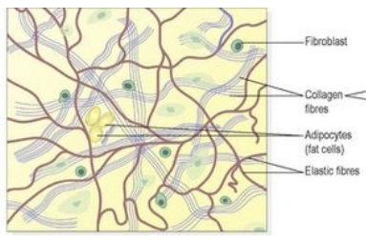
B- Dermis
The dermis lies underneath epidermis and is tough and elastic.
It is formed from connective tissue and the matrix contains collagen fibres interlaced with elastic fibres.
Rupture of elastic fibres occurs when the skin is overstretched, resulting in permanent striae, or stretch marks, that may be found in pregnancy and obesity.
Collagen fibres bind water and give the skin its tensile strength, but as this ability declines with age, wrinkles develop.
Fibroblasts, macrophages and mast cells are the main cells found in the dermis.

Slide 8
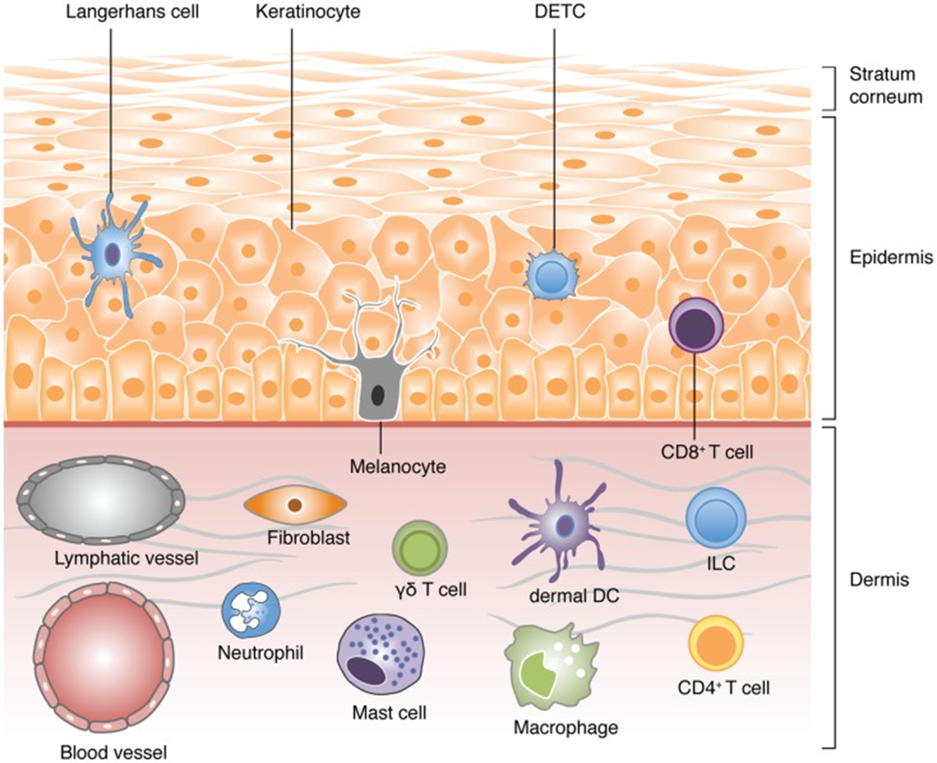
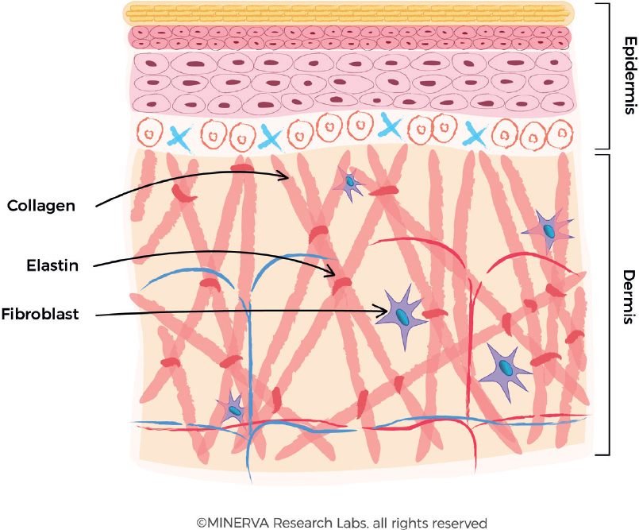

Slide 9
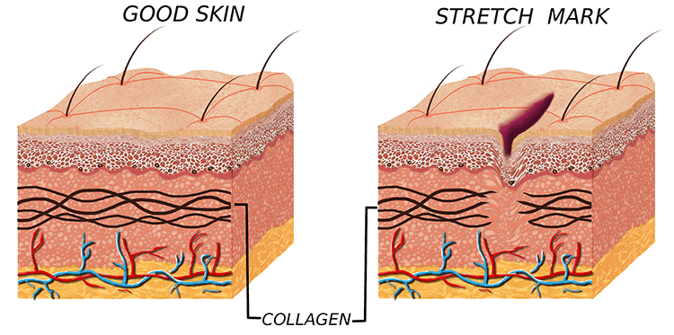
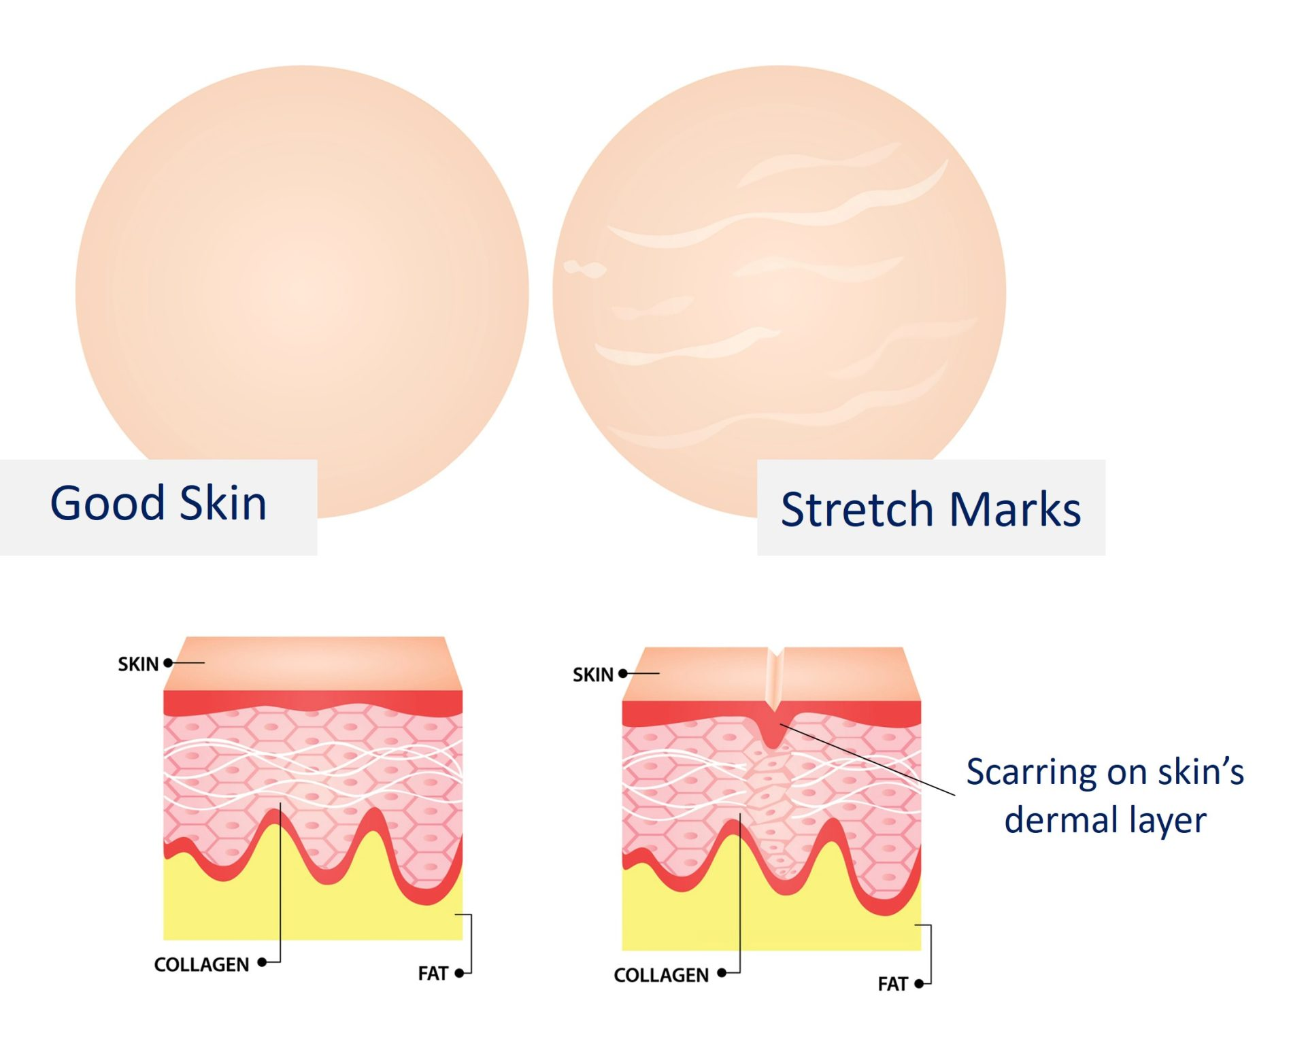

Slide 10
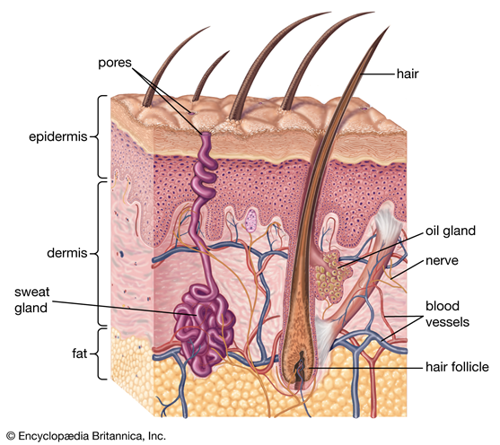
The structures in the dermis are:
Blood vessels
Lymph vessels
Sensory (somatic) nerve endings
Sweat glands and their ducts
Hairs
Arrector pili muscles
Sebaceous glands.

Slide 11

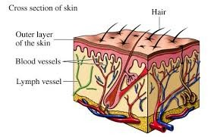
Blood and lymph vessels
Arterioles form a fine network with capillary branches supplying sweat glands, sebaceous glands, hair follicles and the dermis.
Lymph vessels form a network throughout the dermis.

Slide 12
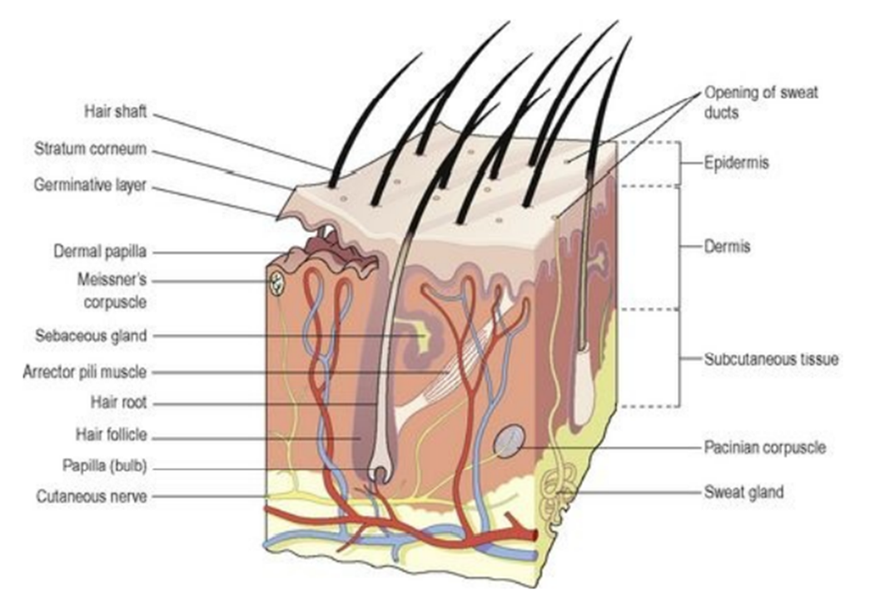
Sensory (Somatic) Nerve Endings
Sensory receptors (specialised nerve endings) sensitive to touch, temperature, pressure and pain are widely distributed in the dermis.
Incoming stimuli activate different types of sensory receptors.
The skin is an important sensory organ through which individuals receive information about their environment.
Nerve impulses, generated in the sensory receptors in the dermis, are conveyed to the spinal cord by sensory nerves, then to the sensory area of the cerebrum where the sensations are perceived.

Slide 13
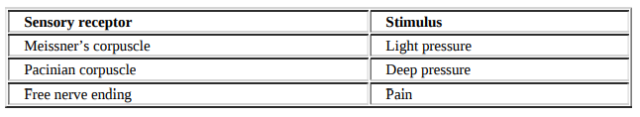

Slide 14
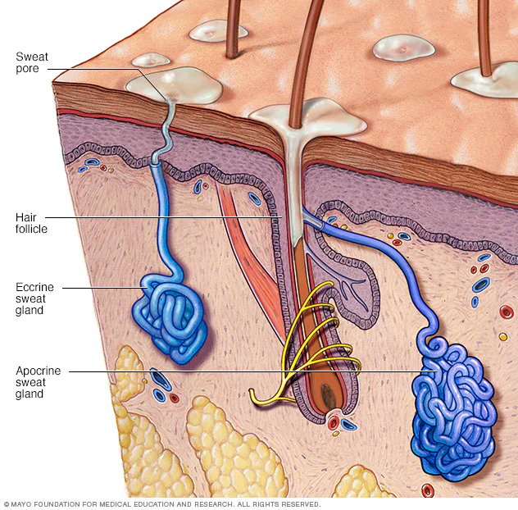
Sweat Glands
These are widely distributed throughout the skin and are most numerous in the palms of the hands, soles of the feet, axillae and groins.
They are formed from epithelial cells.
The bodies of the glands lie coiled in the subcutaneous tissue.
The most important function of sweat is in the regulation of body temperature.
Excessive sweating may lead to dehydration and serious depletion of sodium chloride unless intake of water and salt is appropriately increased.
There are two types of sweat glands. They are;

Slide 15
Types of Sweat Glands
1- Eccrine Sweat Glands:
The commonest type of sweat glands and are distributed almost all over the human body, in varying densities, with the highest density in palms and soles, then on the head, but much less on the trunk and the extremities.
They opens onto the skin surface through tiny pores.
The sweat produced is a clear, watery fluid.
It is important in regulating body temperature.
2- Apocrine Sweat Glands:
The second type is apocrine sweat glands.
They opens into hair follicles.
They are found in the axilla and perineal areas in humans.
They are not significant for cooling in humans.
Bacterial decomposition of these secretions causes an unpleasant odour.
Specialised examples of this type of gland are; Ceruminous glands (which produce ear wax), Ciliary glands in the eyelids are modified apocrine sweat glands.

Slide 16
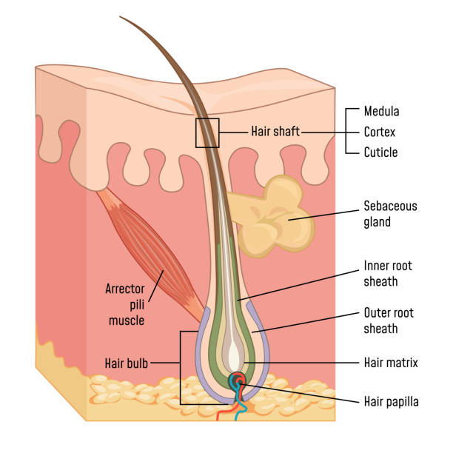
Hairs
These are formed by a down growth of epidermal cells into the dermis or subcutaneous tissue, called hair follicles.
At the base of the follicle is a cluster of cells called the papilla or bulb.
The hair is formed by multiplication of cells of the bulb and as they are pushed upwards, away from their source of nutrition, the cells die and become keratinised.
The part of the hair above the skin is the shaft and the remainder, the root.
Desquamation at the surface provides a haven for micro-organisms.

Slide 17
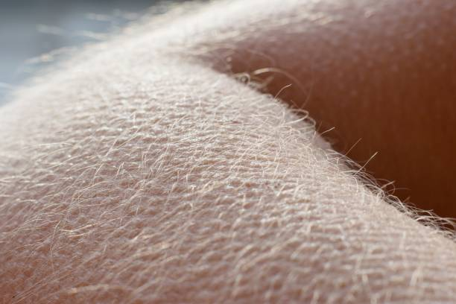
Arrector Pili
These are little bundles of smooth muscle fibres attached to the hair follicles.
Contraction makes the hair stand erect and raises the skin around the hair, causing ‘goose flesh’.
The muscles are stimulated by sympathetic nerve fibres in response to fear and cold.
Erect hairs trap air, which acts as an insulating layer.
This is an efficient warming mechanism, especially when accompanied by shivering, i.e. involuntary contraction of skeletal muscles.

Slide 18
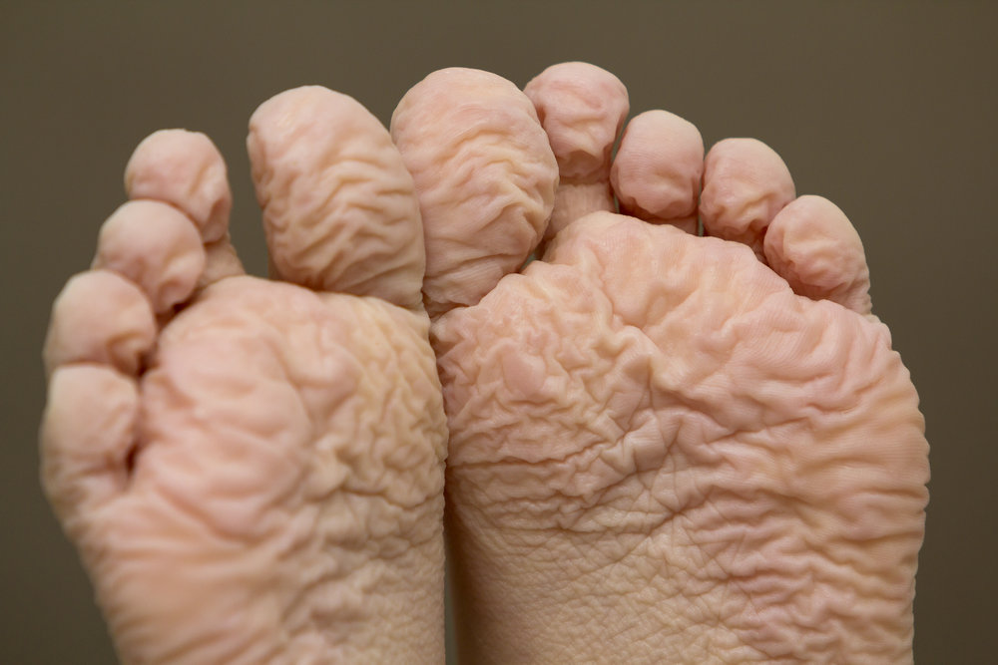
Sebaceous Glands
These consist of secretory epithelial cells derived from the same tissue as the hair follicles.
They secrete an oily substance called sebum, into the hair follicles.
They are present in the skin of all parts of the body except the palms of the hands and the soles of the feet.
They are most numerous in the skin of the scalp, face, axillae and groins.
Sebum keeps the hair soft and pliable and gives it a shiny appearance.
On the skin it provides some waterproofing and acts as a bactericidal and fungicidal agent, preventing infection.
It also prevents drying and cracking of skin, especially on exposure to heat and sunshine.
The activity of these glands increases at puberty and is less at the extremes of age.
Macerated Skin

Slide 19
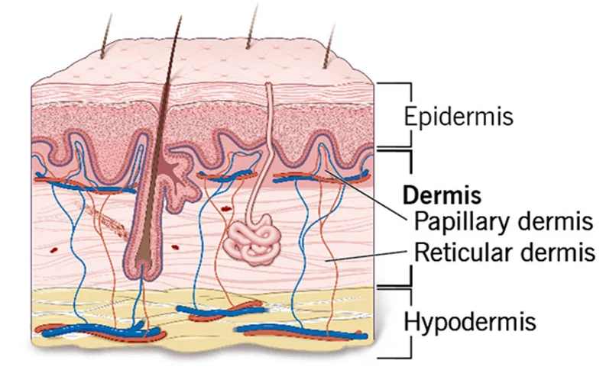
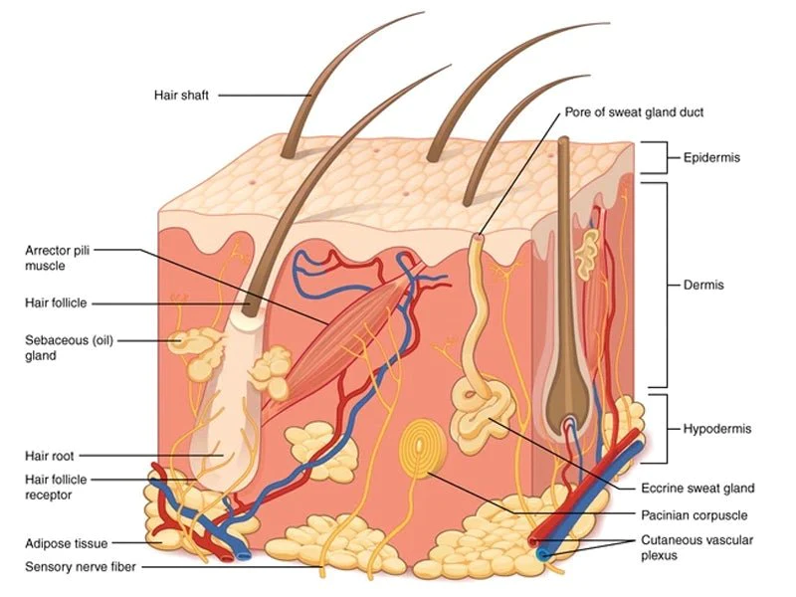
C- Hypodermis (subcutaneous layer)
Between the skin and underlying structures is the subcutaneous layer composed of areolar tissue and adipose (fat) tissue.

Slide 20
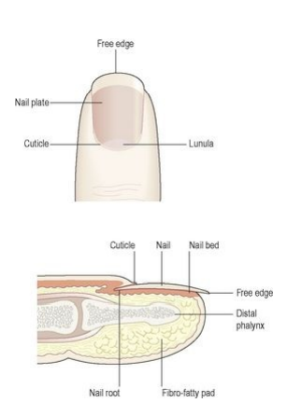
Nails
Human nails are equivalent to the claws, horns and hoofs of animals.
They are derived from the same cells as epidermis and hair and consist of hard, keratin plates.
They protect the tips of the fingers and toes.
The root of the nail is embedded in the skin and covered by the cuticle, which forms the hemispherical pale area called the lunula.
The nail plate is the exposed part that has grown out from the germinative zone of the epidermis called the nail bed.
Finger nails grow more quickly than toe nails and growth is quicker when the environmental temperature is high.

Slide 21
Functions of the skin
Protection
The skin forms a relatively waterproof layer, provided mainly by its keratinised epithelium, which protects the deeper and more delicate structures.
As an important non-specific defence mechanism it acts as a barrier against:
  Invasion by micro-organisms, chemicals, physical agents, e.g. mild trauma, ultraviolet light dehydration.
  The epidermis contains specialised immune cells called Langerhans cells, which are a type of microphage. They phagocytose intruding antigens and travel to lymphoid tissue, where they present antigen to T-lymphocytes, thus stimulating an immune response.

Slide 22
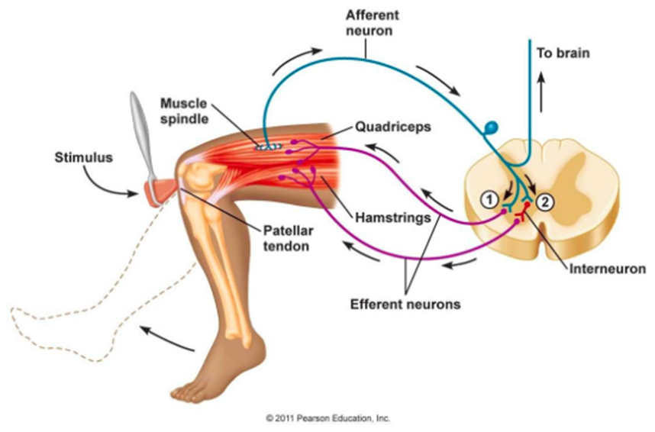
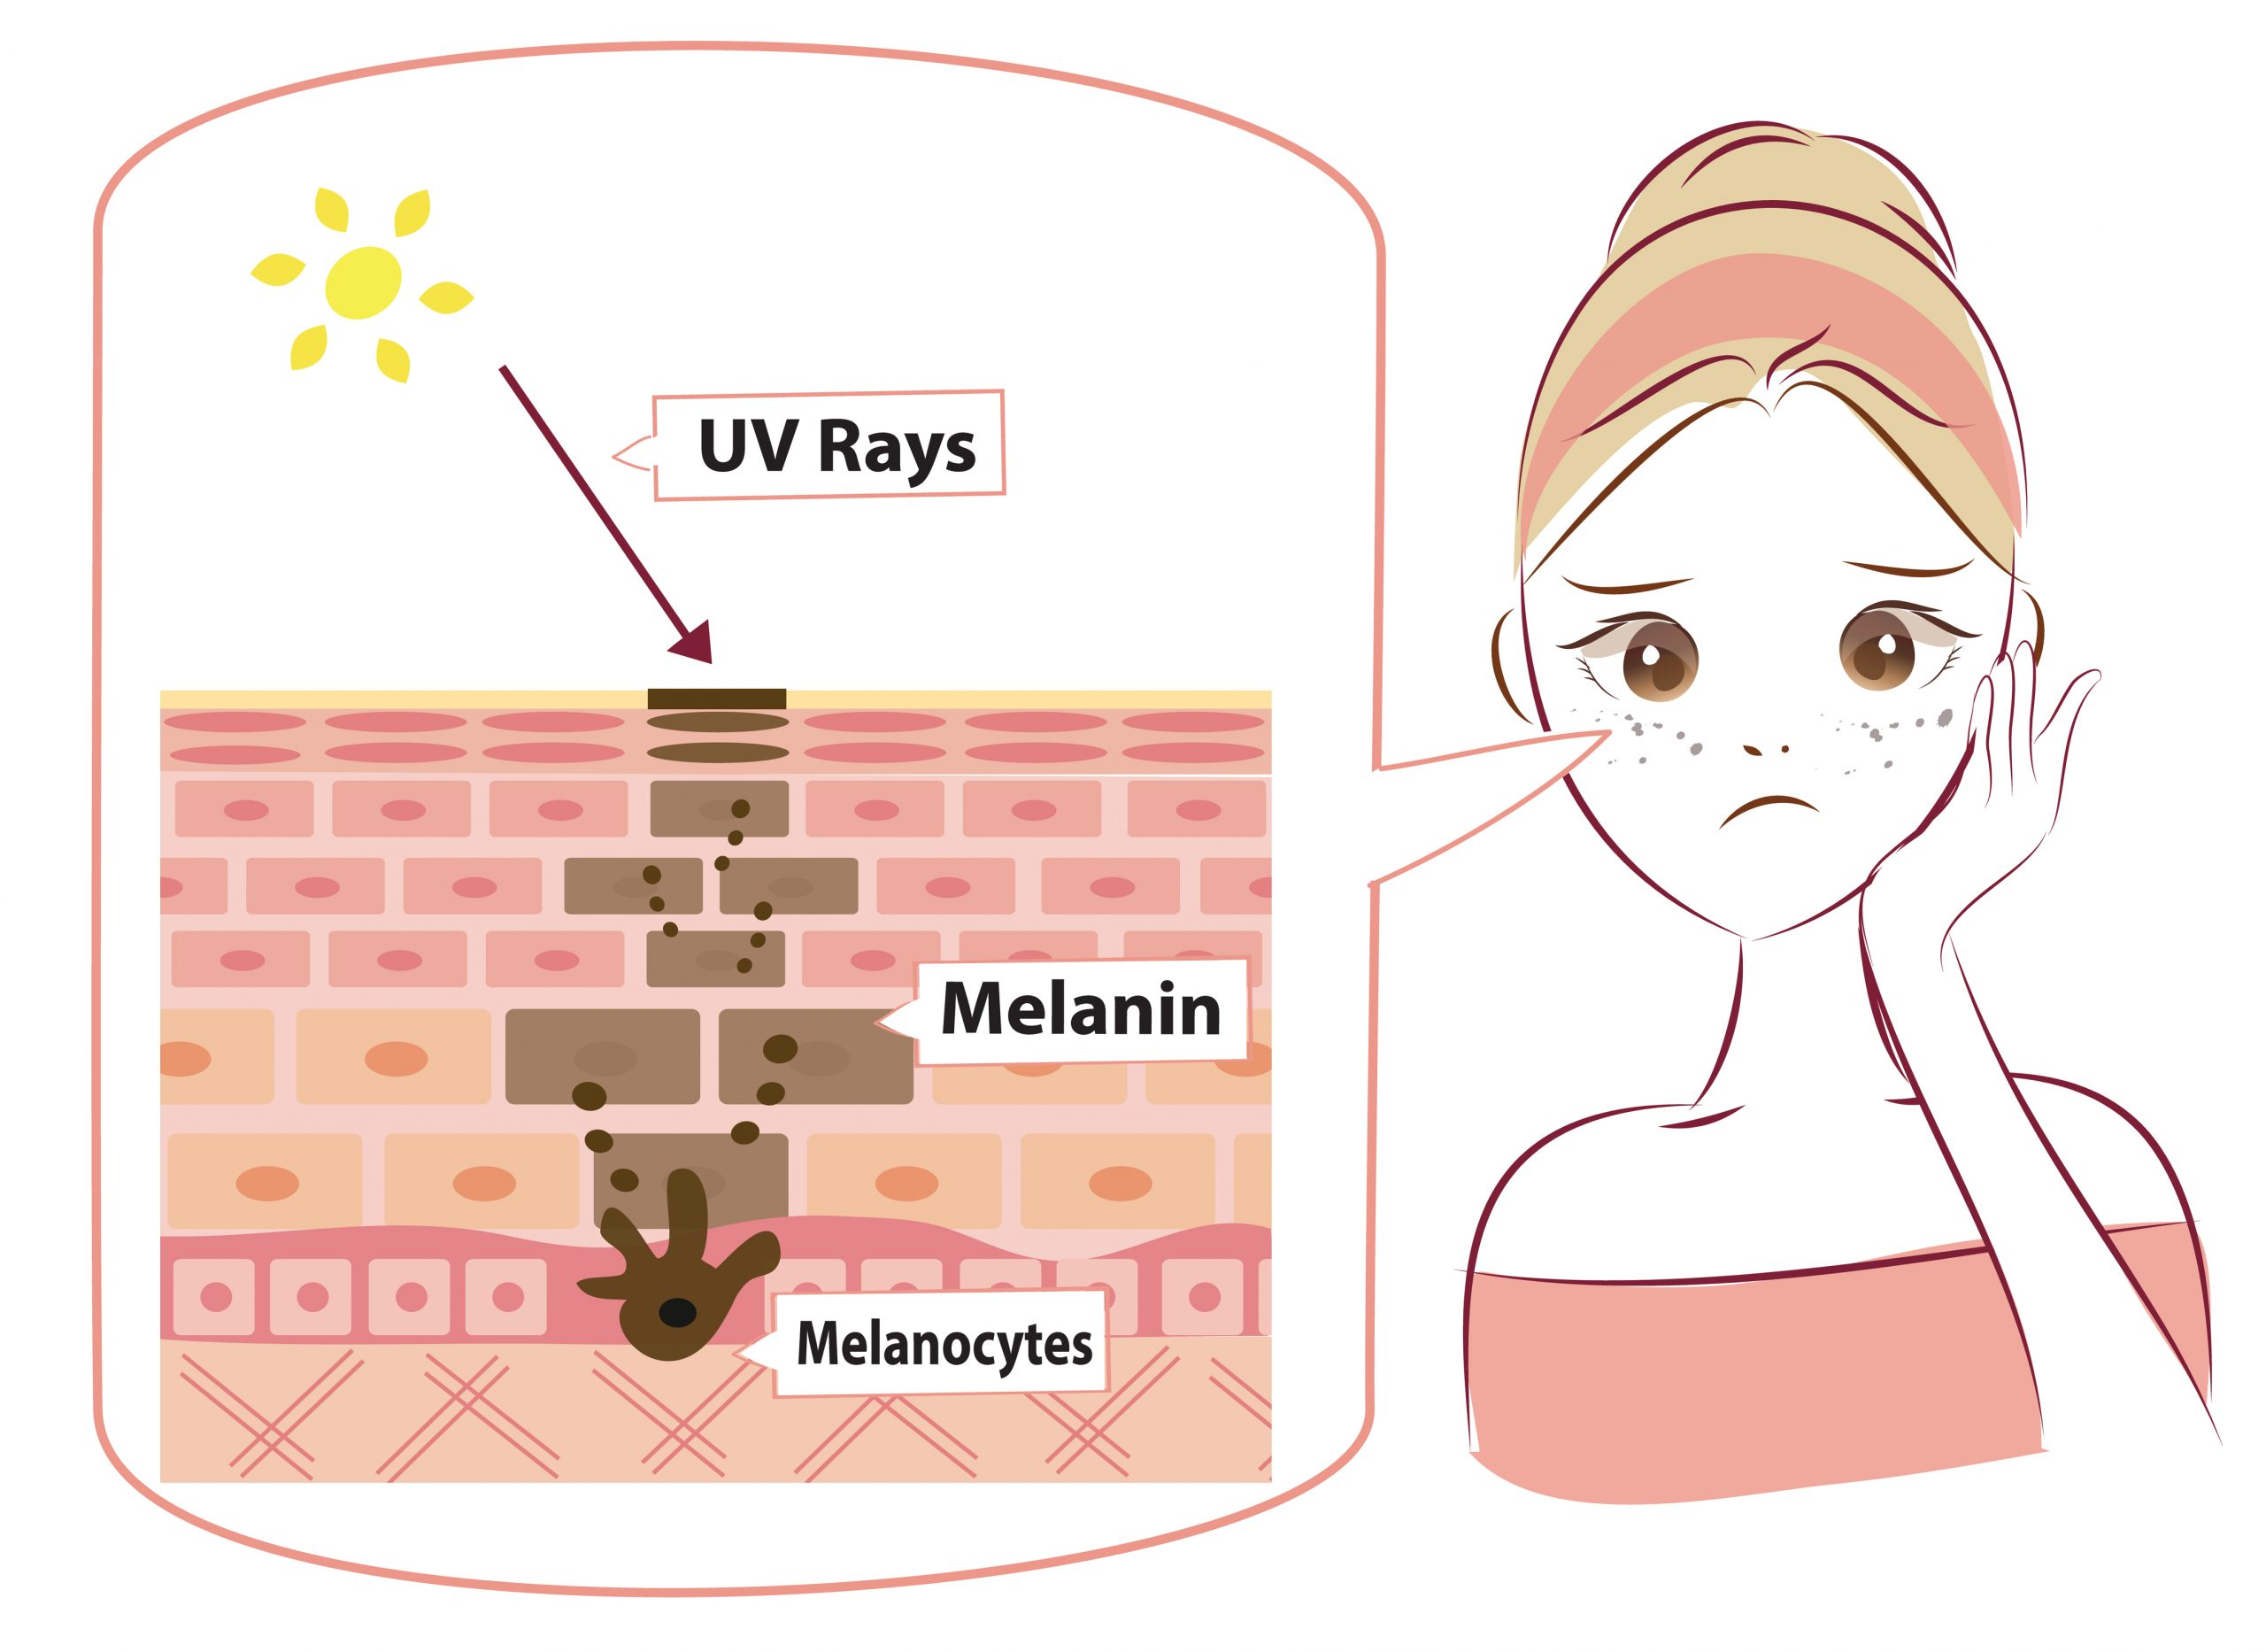
  Due to the presence of the sensory nerve endings in the skin the body reacts by reflex action (withdrawal) to unpleasant or painful stimuli, protecting it from further injury.
  The pigment melanin affords some protection against harmful ultraviolet rays in sunlight.

Slide 23
2- Regulation of Body Temperature
Body temperature remains fairly constant at about 36.8°C across a wide range of environmental temperatures ensuring that the optimal range for enzyme activity required for metabolism is maintained.
In health, variations in temperature are usually limited to between 0.5 and 0.75°C.
  it rises slightly in the evening, during exercise and in women just after ovulation.
To ensure this constant temperature, a negative feedback system maintains the balance between heat produced in the body and heat lost to the environment.

Slide 24
Heat Loss
Most heat loss from the body occurs through the skin.
Small amounts are lost in expired air, urine and faeces.
Only heat loss through the skin can be regulated; heat lost by the other routes cannot be controlled.
Heat loss through the skin is affected by the difference between body and environmental temperatures, the amount of the body surface exposed and the type of clothes worn.
Air insulates against heat loss when trapped in layers of clothing and between the skin and clothing.
For this reason several layers of lightweight clothes provide more effective insulation against low environmental temperatures than one heavy garment.

Slide 25
Mechanisms of heat loss
Evaporation
  In evaporation, the body is cooled as heat converts the water in sweat to water vapour.
Radiation
  In radiation, exposed parts of the body radiate heat away from the body.
Conduction
  In conduction, clothes and other objects in direct contact with the skin take up heat.
Convection
  In convection, air passing over the exposed parts of the body is heated and rises, cool air replaces it and convection currents are set up.

Slide 26
Control of body temperature
The temperature regulating centre in the hypothalamus is sensitive to the temperature of circulating blood.
This centre responds to decreasing temperature by sending nerve impulses to: arterioles in the dermis, which constrict decreasing blood flow to the skin and skeletal muscles stimulating shivering.
As heat is conserved, body temperature rises and when it returns to the normal range again the negative feedback mechanism is switched off.
Conversely when body temperature rises, heat loss is increased by dilation of arterioles in the dermis, increasing blood flow to the skin, and stimulation of the sweat glands causing sweating, until it falls into the normal range again when the negative feedback mechanism is switched off.

Slide 27
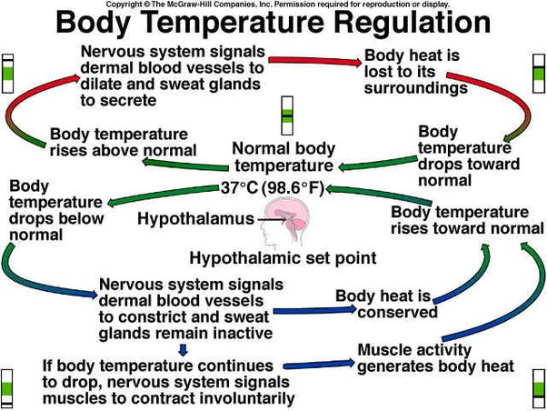

Slide 28
Activity of the sweat glands
When body temperature is increased by 0.25 to 0.5°C the sweat glands secrete sweat onto the skin surface.
Evaporation of sweat cools the body, but is slower in humid conditions.
Loss of heat from the body by evaporation of water through the skin and expired air still occurs even when the environmental temperature is low.
This is called insensible water loss (around 500 ml per day) and is accompanied by insensible heat loss.

Slide 29
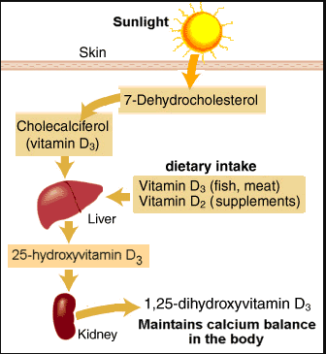
3- Formation of vitamin D
7-dehydrocholesterol is a lipid-based substance in the skin, and ultraviolet rays in sunlight convert it to vitamin D.
This circulates in the blood and is used, with calcium and phosphate, in the formation and maintenance of bone.

Slide 30
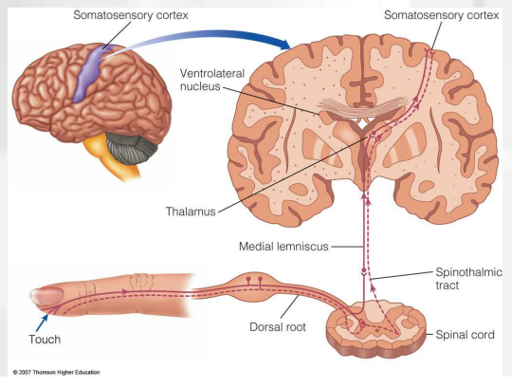
4- Cutaneous Sensation
Sensory receptors are nerve endings in the dermis that are sensitive to touch, pressure, temperature or pain.
Stimulation generates nerve impulses in sensory nerves that are transmitted to the cerebral cortex.
Some areas have more sensory receptors than others causing them to be especially sensitive, e.g. the lips and fingertips.

Slide 31
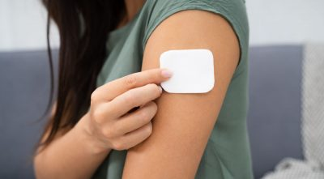
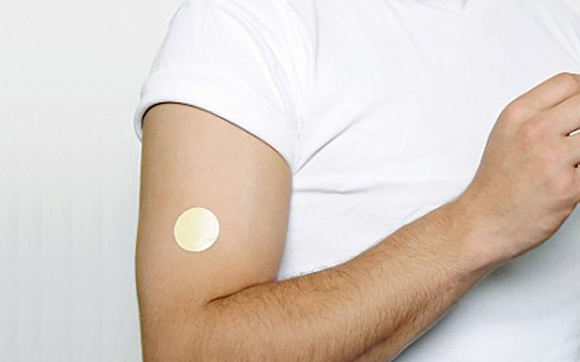
5- Absorption
This property is limited but substances that can be absorbed include: some drugs, in transdermal patches. E.g.;
Hormone replacement therapy during the menopause.
Nicotine as an aid to stopping smoking some toxic chemicals, e.g. Mercury.

Slide 32
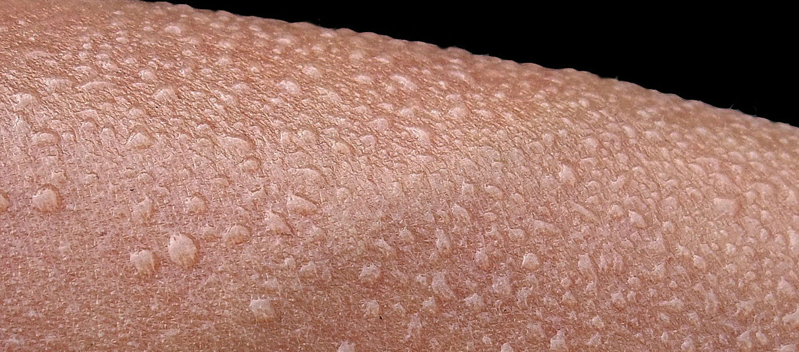
6-Excretion
The skin is a minor excretory organ for some substances including:
Sodium chloride in sweat
  Excess sweating may lead to low blood sodium levels (hyponatraemia)
Urea - when kidney function is impaired
Aromatic substances, e.g. Garlic and other spices.

Slide 33
THANK YOU

