Slide 1
Cell Cycle
KHUSHAL KHAN
Demonstrator cardiology
Khyber medical university – institute of paramedical sciences

Slide 2
Topic Layout
Cell cycle
Stages of cell cycle
Mitosis and its phases
Meiosis and its phases
Differences between meiosis I and meiosis II
Purpose of Meiosis
Differences between mitosis and meiosis

Slide 3
Cell cycle
A cell cycle is a series of events that takes place in a cell as it grows and divides.
Cell cycle is the process through which cells replicate and make two new cells.
Many damaged, dead, and worn out cells can be replaced by growth and division of other similar cells.
Most body cells have 46 chromosomes and divide by mitosis, a process that results in two new genetically identical daughter cells.
The only exception to this is the formation of gametes (sex cells), i.e. ova and spermatozoa, which takes place by meiosis.
The period between two cell divisions is known as the cell cycle, which has two phases that can be seen on light microscopy:
  Interphase
  Mitosis (M phase)

Slide 4
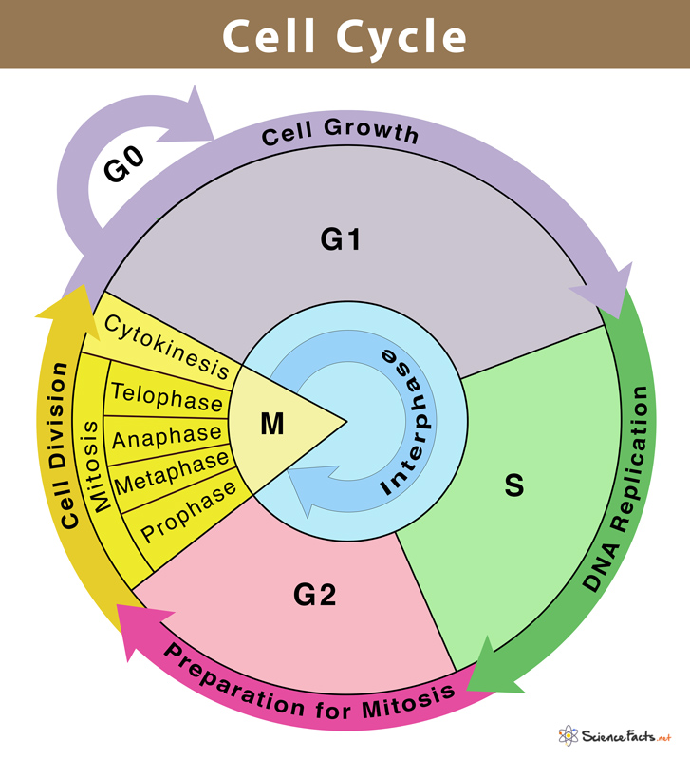

Slide 5
Interphase
A cell spends most of its time in interphase, and during this time it grows, replicates its chromosomes, and prepares for cell division.
The cell then leaves interphase, undergoes mitosis, and completes its division.
The resulting cells, known as daughter cells, each enter their own interphase and begin a new round of the cell cycle.
This is the longer phase and three separate stages are recognised:
First gap phase (G1)
Synthesis of DNA (S phase)
Second gap phase – (G2)

Slide 6
First Gap Phase (G1)
The cell grows in size and volume.
This is usually the longest phase and most variable in length.
Sometimes cells do not continue the cell cycle but enter a resting phase instead (g0).

Slide 7
Synthesis Of DNA (S Phase)
The chromosomes replicate forming two identical copies of DNA.
Therefore, after the S phase, the cell now has 92 chromosomes;
i.e. enough DNA for two cells and is nearly ready to divide by mitosis.

Slide 8
Second Gap Phase – (G2)
After S phase the cell enters G2 phase.
There is further growth and preparation for cell division in G2 phase.

Slide 9
Mitosis
After G2 phase the cell is ready to be divided and the mitosis begins.
Mitosis is a continuous process involving four distinct stages and can be seen by light microscopy only.
Prophase
Metaphase
Anaphase
Telophase

Slide 10
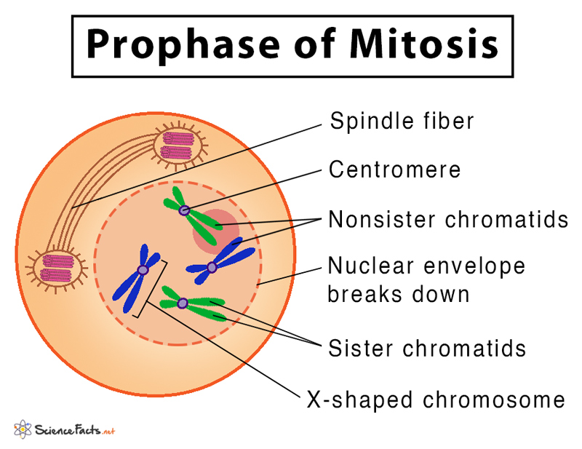
1- Prophase
During this stage the replicated chromatin becomes tightly coiled and easier to see under the microscope.
Each of the original 46 chromosomes (called a chromatid at this stage) is paired with its copy in a double chromosome unit.
The two chromatids are joined to each other at the centromere.
The mitotic apparatus appears; this consists of two centrioles separated by the mitotic spindle, which is formed from microtubules.
The centrioles migrate, one to each end of the cell, and the nuclear envelope disappears.

Slide 11
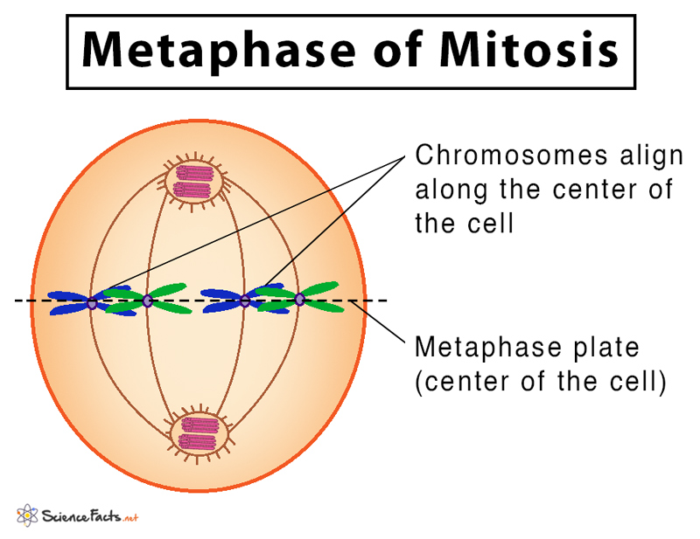
2-Metaphase
The chromatids align on the centre of the spindle, attached by their centromeres.

Slide 12
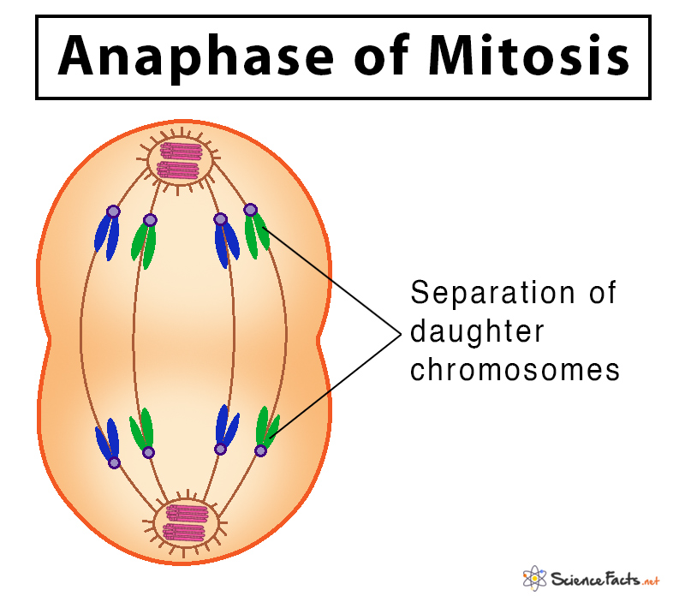
3-Anaphase
The centromeres separate, and one of each pair of sister chromatids (now called chromosomes again) migrates to each end of the spindle as the microtubules that form the mitotic spindle contract.

Slide 13
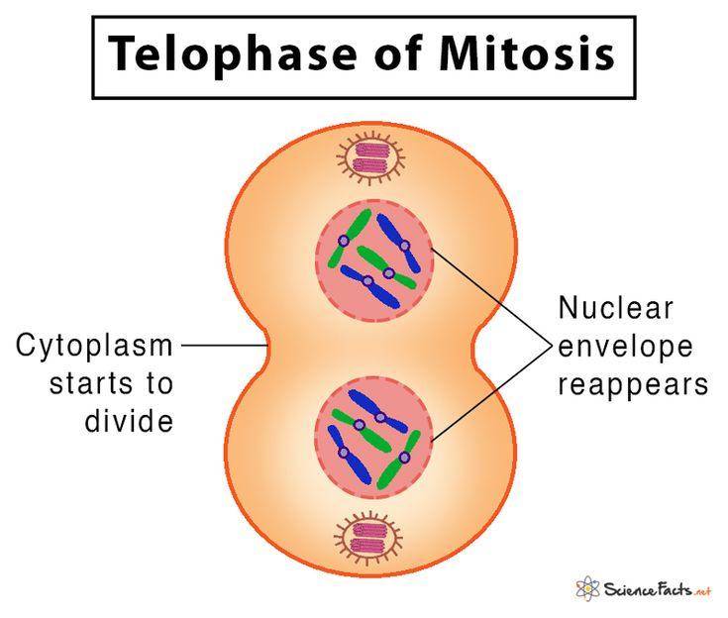
4-Telophase
The mitotic spindle disappears, the chromosomes uncoil and the nuclear envelope reforms.

Slide 14
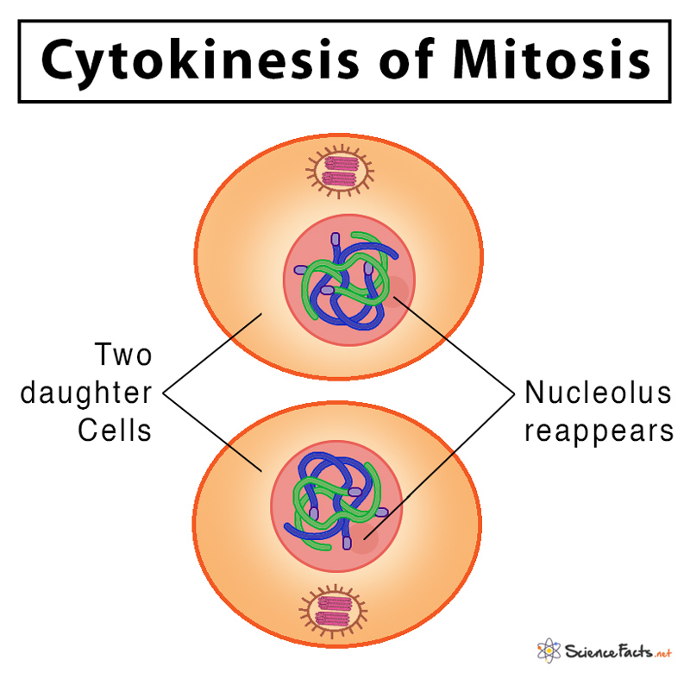
Cytokinesis
Following telophase, cytokinesis occurs:
The cytoplasm, intracellular organelles and plasma membrane split forming two identical daughter cells.
The organelles of the daughter cells are incomplete at the end of cell division but they develop during interphase.
The frequency with which cell division occurs varies with different types of cell.

Slide 15
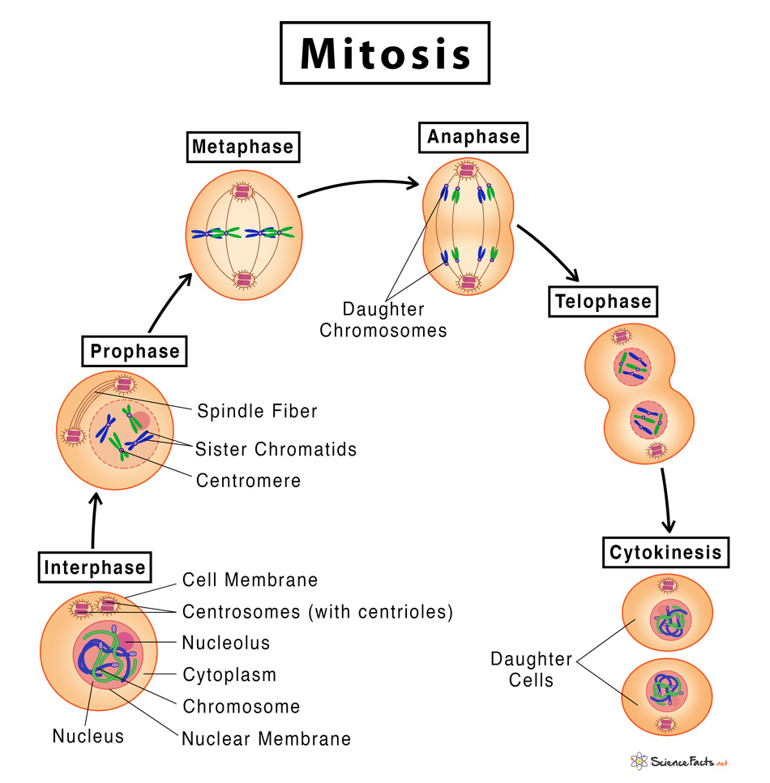

Slide 16
Meiosis

Slide 17
Meiosis
Meiosis is a cell division process where a single (parent) cell divides twice to produce four independent (daughter) cells, each having half the chromosomes as the original cell.
The term ‘meiosis’ came from the Greek, meaning ‘lessening’.
Meiosis produces gametes.
On fertilisation, when the male gamete (sperm cell) and the female gamete (ovum) unite, the resulting zygote is diploid, because each gamete was haploid.
Unlike mitosis, meiosis involves two distinct cell divisions rather than one.
Meiosis produces four daughter cells, not two, all different from the parent cells and from each other.
This is the basis of genetic diversity and the uniqueness of each human individual.

Slide 18
Meiosis involves two successive stages or phases of cell division, meiosis I and meiosis II.
Each stage includes a period of nuclear division or karyokinesis and a cytoplasmic division or cytokinesis.
The cells before entering meiosis I undergo a compulsory growth period called interphase.

Slide 19
Interphase
During this phase, the nuclear envelope remains intact. The chromosomes exist in the form of long, slender, and coiled chromatin fibers.
G1 phase:
  The first gap phase or the preparatory phase of cell division.
  During this phase, the cell increase in size by absorbing water from the cytoplasm and synthesize different types of RNA and proteins.

Slide 20
S phase:
  The period of DNA synthesis during which the genetic material present within the nucleus gets copied.
  Each chromosome duplicates to become two identical sister chromatids attached at a specific point, called the centromere.
  The centrioles get duplicated as well.
G2 phase:
  The second gap phase that happens after the DNA synthesis, but before prophase.
  During this phase, the cell continues to increase in size with the synthesis of RNA and proteins.

Slide 21
First Meiotic Division (Meiosis-I)
This stage produces two genetically different daughter cells.
DNA replication occurred beforehand, so each pair of chromosomes is now four chromatids, and they gather together into a tight bundle.
Because the chromosomes are so tightly associated, it is possible for them to exchange genes.
This process is called crossing over, and results in the four chromatids acquiring different combinations of genes.
Following crossing over, the pairs of chromosomes then separate in preparation for the first meiotic division, and transfer of maternal and paternal chromosomes to either daughter cell is random.
This means that the two daughter cells have an unpredictable assortment of maternal and paternal DNA, giving rise to a huge number of possible combinations of chromosomes in them.

Slide 22
This explains why a child inherits a combination of its mother’s and father’s characteristics.
Each pair of chromosomes separates and one travels to each end of the cell, guided by a spindle as in mitosis, and the cytoplasm divides, producing two genetically unique diploid daughter cells.

Slide 23
1- Prophase I
It is the longest phase of meiotic division involving a series of events and is divided into the following steps:
The duplicated chromosomes condense, resembling an X-shaped structure with two sister chromatids that become distinctly visible within the nucleus.
The homologous chromosome pair (one inherited from each parent) comes closer and associate along the entire chromosome length, forming a tetrad. Each tetrad is composed of four chromatids.
The homologous chromosomes exchange parts of DNA with each other; this process is known as crossing over. The points of physical contact from which the genetic materials are exchanged are known as chiasmata.
Spindle fibers originate from the centrioles on either side of the cell, getting attached to each chromosome’s centromere.
The last step of prophase involves the breakdown of the nuclear envelope.
The chromosomes then start moving towards the middle of the cell.

Slide 24
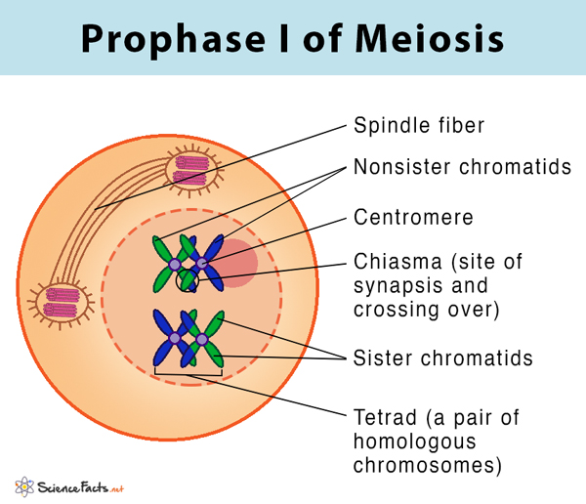

Slide 25
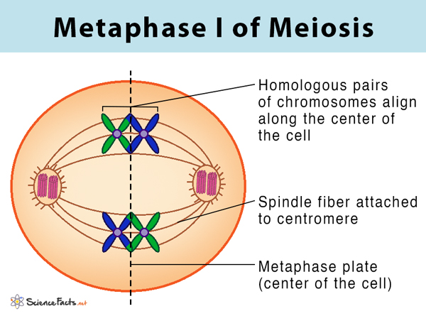
2- Metaphase I
Homologous chromosomes align along the center of the cell.
The centrioles reach the opposite poles of the cell with the spindle fibers extending from them.
The centromeres orient themselves towards the opposite poles of the cell.

Slide 26
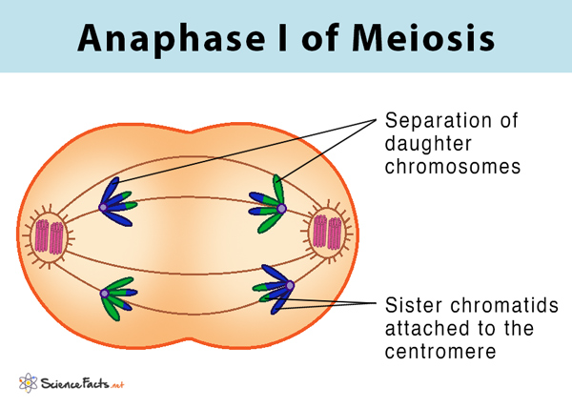
3- Anaphase I
The chromosomes with two sister chromatids are separated, and they begin to migrate to the opposite poles.
This separation is achieved because of the contraction of the spindle fibers attached to each chromosome’s centromere.
The homologous chromosomes start to migrate to the opposite poles.

Slide 27
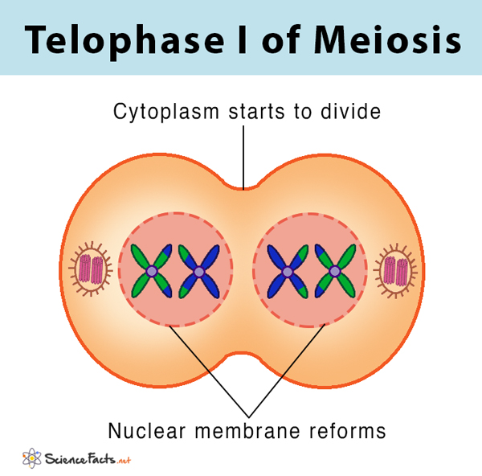
4- Telophase I
The chromosomes stop migrating with each pole containing a haploid number of chromosomes.
The nuclear envelope is formed around the chromosome, and the spindle fibers disappear.
The chromosomes uncoil and become less dense with the nucleolus appearing within the nucleus.

Slide 28
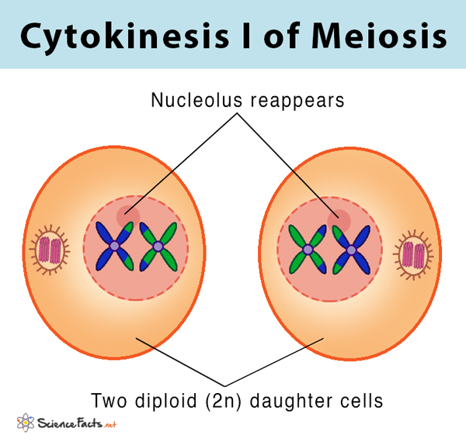
Cytokinesis I
It involves the division of the cytoplasm to produce two individual daughter cells.
In animals, cytokinesis occurs by constriction of the cell membrane, while in plants, it happens through the formation of a cell plate.
In most cells, cytokinesis occurs at the same time as telophase.

Slide 29
Second Meiotic Division (Meiosis-II)
At the end of cytokinesis I, two different daughter cells are formed, each with half the number of chromosomes as the parent cell (having 23 chromosomes having 23 pairs of chromatids).
Meiosis is thus also called the reduction division.
For a gamete to be produced, the amount of genetic material present in the two daughter cells following the first meiotic division must be halved.
This is accomplished by a second division.
The centromeres separate and the two sister chromatids travel to opposite ends of the cell, which then divides.
Each of the four haploid daughter cells now has only one chromosome from each original pair.
Fusion with another gamete creates a zygote (fertilised ovum), a diploid cell which can then go on to grow and develop into a human being by mitosis.

Slide 30
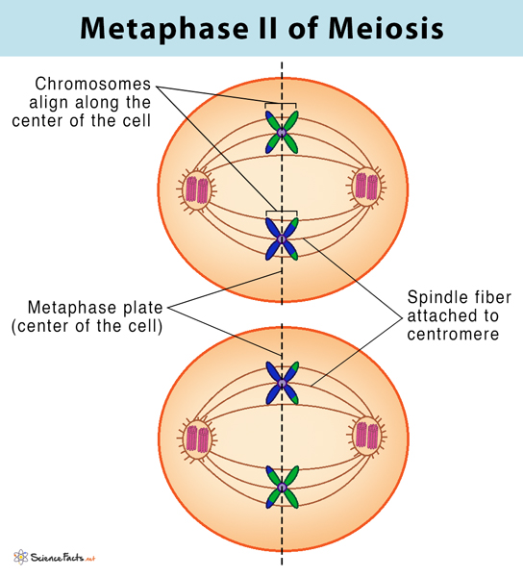
1- Prophase II
The nuclear membrane initiates to break down, and the spindle fibers appear again.
Each centriole divides, forming two pairs of centrioles.
Chromosomes do not replicate any further in this phase of meiosis and begin migration towards the center of the cell.

Slide 31
2- Metaphase II
Chromosomes arrange on the equator of the cell with the help of the spindle fibers.
The centrioles are now at opposite poles in each of the daughter cells.
Centromere divides, producing two sister chromatids, now known as daughter chromosomes, with the spindle fibers attached to each chromosome.

Slide 32
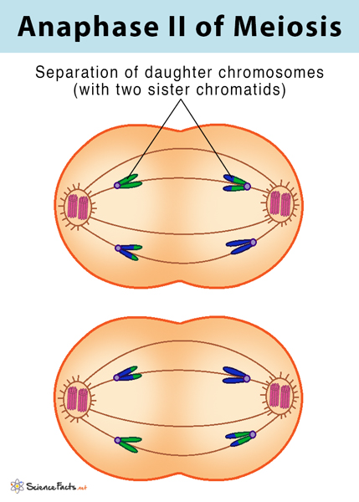
3- Anaphase II
The daughter chromosomes are pulled towards the opposite poles of the cells with the help of the spindle fibers.
At the end of anaphase II, each end of the cell contains a complete set of chromosomes.

Slide 33
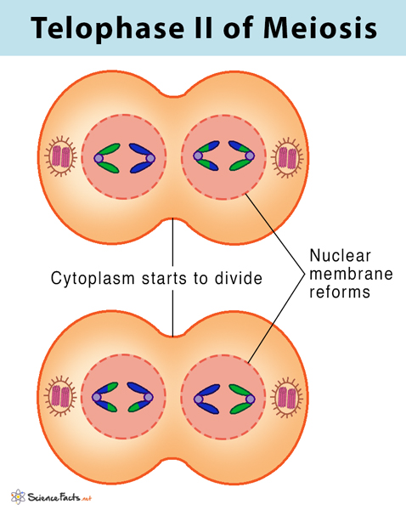
4- Telophase II
The nuclear membrane forms around each chromosome with the disappearance of the spindle fibers.
Nucleolus reappears as the cell prepares for the second round of cytoplasmic division.

Slide 34
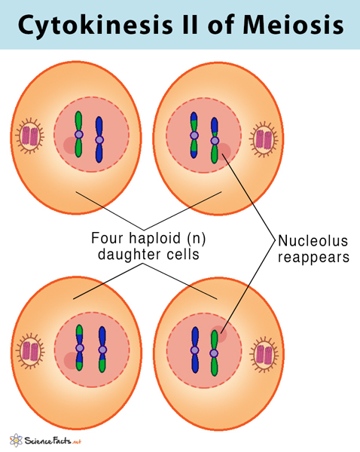
Cytokinesis II
This step is identical to cytokinesis I, involving the second cytoplasm division, resulting in the formation of two individual daughter cells.
Thus at the end of meiosis II, four non-identical, haploid daughter cells are formed, each having half chromosome number as the original parent cell.

Slide 35
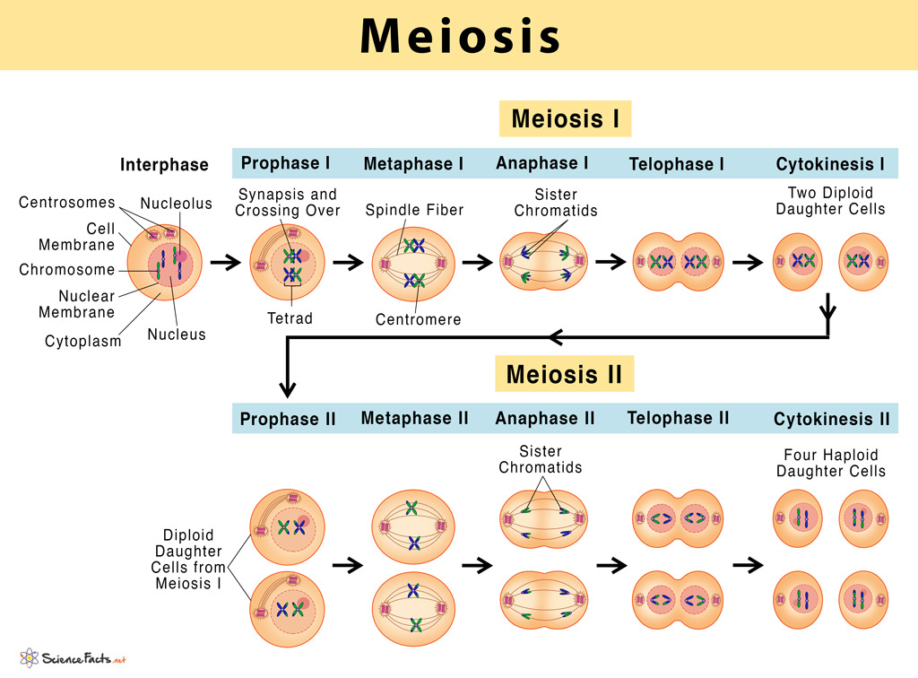

Slide 36
Differences Between Meiosis I and Meiosis II
In meiosis I, a pair of homologous chromosomes separate to produce two diploid daughter cells, each having half the number of chromosomes as the parent cell.
In contrast, during meiosis II, sister chromatids separate to produce four haploid daughter cells.
Also, unlike meiosis I, no genetic recombination by crossing over occurs in meiosis II.

Slide 37
Purpose of Meiosis
Maintaining chromosome number in organisms:
  In humans, each cell typically contains 46 chromosomes organized into 23 pairs. To maintain the chromosome number generation after generation, the gametes formed from the meiotic division should contain half the number of chromosomes (23 chromosomes) as the parent cell. When the sex cells fuse to form a zygote, the usual chromosome number of 46 chromosomes is restored in the new individual. If the chromosomal reduction process is not maintained, it could cause genetic abnormality in the child.
Creates genetic diversity:
  The exchange of genetic information between the pair of homologous chromosomes allows genetic variation among the population. These variations form the basis of the evolutionary process.
Repairs genetic defects:
  The process of mixing chromosomes in meiosis, commonly known as recombination, helps repair genetic abnormalities in individuals produced through meiosis. When one of the parents has a genetic defect, recombination through meiosis can replace that abnormality in the next generation, allowing the formation of a healthy individual.

Slide 38
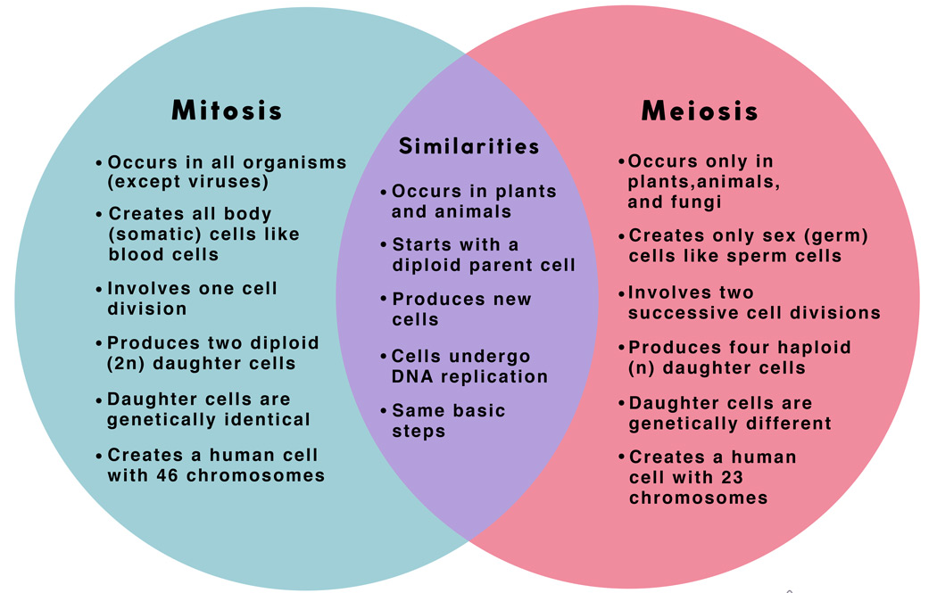
Differences Between Mitosis & Meiosis

Slide 39
THANK YOU

