Slide 1
Cell and its Organelles
KHUSHAL KHAN
Demonstrator cardiology
Khyber medical university – institute of paramedical sciences

Slide 2
Topic Layout
Cell
Organization of the cell
Cell organelles, their structures and functions
Transport across the cell membrane
Functional systems of the cell - Endocytosis
Locomotion of the cell

Slide 3
Cell
Cell is the basic structural and functional unit of all living organisms.
A cell is a mass of cytoplasm that is bound externally by a cell membrane.
Usually microscopic in size, cells are the smallest structural units of living matter and compose all living things.
Cells are the building blocks of the body, providing structure for the body’s tissues and organs, ingesting nutrients and converting them to energy, and performing specialized functions.
Cells also contain the body’s hereditary code, which controls the substances synthesized by the cells and permits them to make copies of themselves.
Each cell in a human being is a living structure that can survive for months or years, provided its surrounding fluids contain appropriate nutrients.

Slide 4
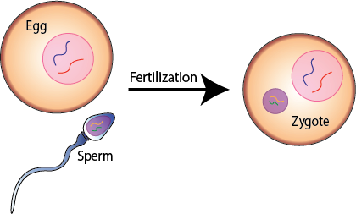
The human body develops from a single cell called the zygote, which results from the fusion of the ovum (female egg cell) and the spermatozoon (male sex cell).
Cell division follows and, as the fetus grows, cells with different structural and functional specialisations develop, all with the same genetic makeup as the zygote.
A cell consists of a plasma membrane inside which are a number of organelles suspended in a watery fluid called cytoplasm.
Organelles, also called ‘small organs’, have individual and highly specialised functions, and are often enclosed in their own membrane within the cytoplasm.

Slide 5
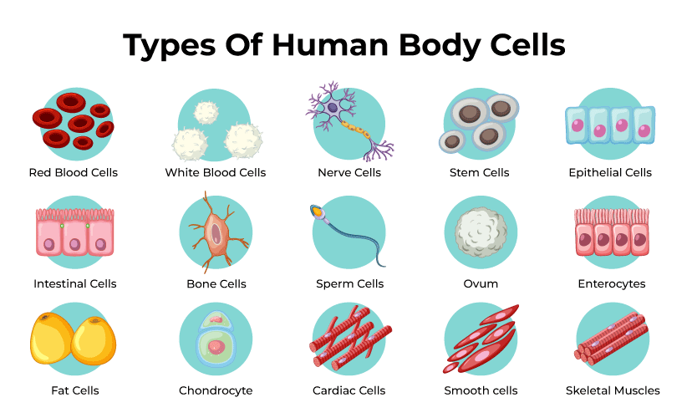
Examples

Slide 6
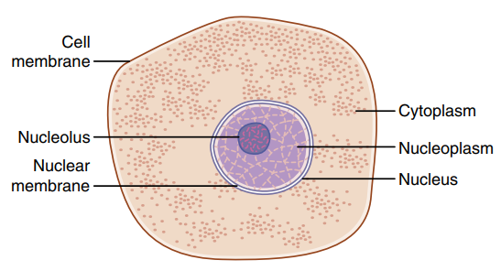
Organization of the cell
The two major parts of the cell are the nucleus and the cytoplasm.
The nucleus is separated from the cytoplasm by a nuclear membrane.
The cytoplasm is separated from the surrounding fluids by a cell membrane or plasma membrane.
Protoplasm
  The different substances that make up the cell are collectively called protoplasm.
  Protoplasm is composed mainly of five basic substances—water, electrolytes, proteins, lipids, and carbohydrates.

Slide 7
Water
  Most cells, except fat cells, are comprised mainly of water in a concentration of 70% to 85%.
Electrolytes
  Important ions in the cell include potassium, magnesium, phosphate, sulphate, bicarbonate, and smaller quantities of sodium, chloride, and calcium.
  The ions provide inorganic chemicals for cellular reactions and are necessary for the operation of some cellular control mechanisms.
  For example; ions acting at the cell membrane are required for the transmission of electrochemical impulses in nerve and muscle fibers.

Slide 8
Proteins
  After water, the most abundant substances in most cells are proteins, which normally constitute 10% to 20% of the cell mass.
  These proteins can be divided into two types, structural proteins and functional proteins.
Structural proteins
  Structural proteins are present in the cell mainly in the form of long filaments.
  They are structural components of microtubules, which provide the cytoskeletons of cellular organelles such as; cilia, nerve axons, the mitotic spindles, and thin filamentous tubules in cytoplasm and nucleoplasm.
  Fibrillar proteins are found outside the cell, especially in the collagen and elastin fibers of connective tissue, and in blood vessel walls, tendons, and ligaments.
Functional proteins
  The functional proteins are usually composed of combinations of a few molecules in tubular-globular form.
  These proteins are mainly the enzymes of the cell and are often mobile in the cell fluid.
  Many of them are adherent to membranous structures inside the cell and catalyze specific intracellular chemical reactions.

Slide 9
Lipids
  Lipids are molecules that contain hydrocarbons and make up the building blocks of the structure and function of living cells.
  Especially important lipids are phospholipids and cholesterol, which together constitute only about 2% of the total cell mass.
  Phospholipids and cholesterol are mainly insoluble in water and therefore are used to form the cell membrane and intracellular membrane barriers that separate the different cell compartments.
  In addition to phospholipids and cholesterol, some cells contain large quantities of triglycerides, also called neutral fats.
  In fat cells (adipocytes), triglycerides often account for as much as 95% of the cell mass.
  The fat stored in these cells represents the body’s main storehouse of energy-giving nutrients that can later be used to provide energy wherever it is needed in the body.

Slide 10
Carbohydrates
  Carbohydrates play a major role in cell nutrition and, as parts of glycoprotein molecules, have structural functions.
  Most human cells do not maintain large stores of carbohydrates; they constitute about 1% of their total mass but 3% in muscle cells and up to 6% in liver cells.
  Also, a small amount of carbohydrate is stored in cells as glycogen, an insoluble polymer of glucose that can be depolymerized and used rapidly to supply the cell’s energy needs.

Slide 11
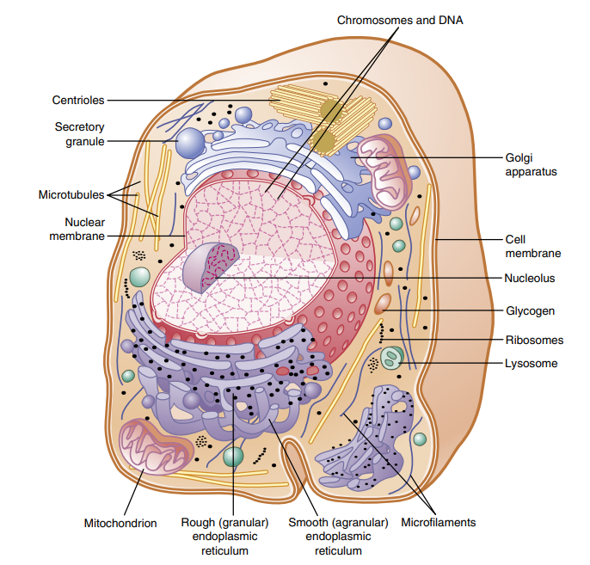
Cell Structure
The cell contains highly organized physical structures called intracellular organelles, which are critical for cell function.
For example, without one of the organelles, the mitochondria, more than 95% of the cell’s energy release from nutrients would cease immediately.

Slide 12
Membranous Structures Of The Cell
Most organelles of the cell are covered by membranes composed primarily of lipids and proteins.
These membranes include the cell membrane, nuclear membrane, membrane of the endoplasmic reticulum, and membranes of the mitochondria, lysosomes, and Golgi apparatus.
The lipids in membranes provide a barrier that impedes movement of water and water-soluble substances from one cell compartment to another because water is not soluble in lipids.
However, protein molecules often penetrate all the way through membranes, thus providing specialized pathways, often organized into actual pores, for passage of specific substances through membranes.
Also, many membrane proteins are enzymes, which catalyze a multitude of different chemical reactions.

Slide 13
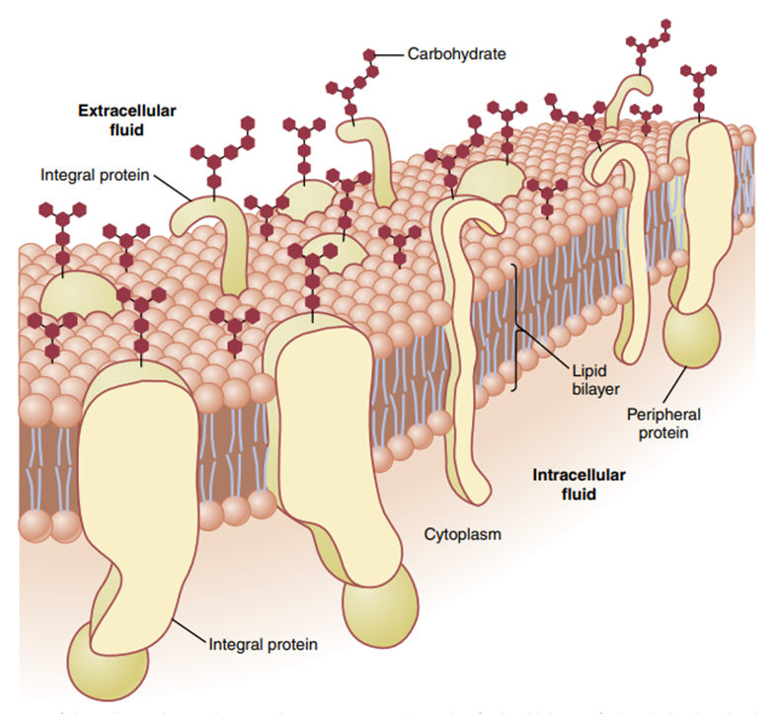
Cell Membrane
The cell membrane (also called the plasma membrane) envelops the cell.
It is a thin, pliable, elastic structure.
The cell membrane is 7.5 to 10 nanometres thick.
It is composed almost entirely of proteins and lipids.
The cell membrane is composed of;
  55% proteins
  25% phospholipids
  13% cholesterol
  4% other lipids
  3% carbohydrates

Slide 14
  The cell membrane lipid barrier impedes penetration by water-soluble substances.
  Its basic structure is a lipid bilayer, which is a thin, double-layered film of lipids—each layer only one molecule thick—that is continuous over the entire cell surface.
  Interspersed in this lipid film are large globular proteins.
  The basic lipid bilayer is composed of three main types of lipids;
  Phospholipids
  Sphingolipids
  Cholesterol

Slide 15
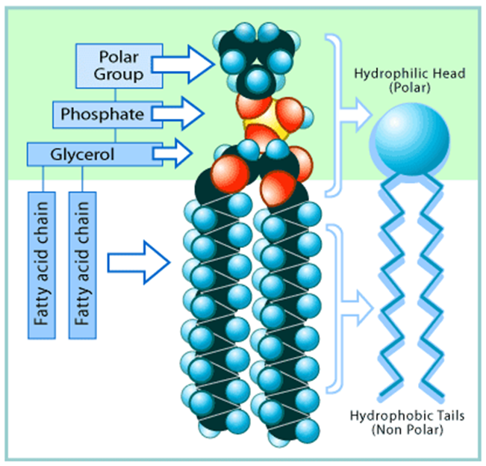
Phospholipids
  Phospholipids are the most abundant cell membrane lipids.
The phosphate end of the phospholipid is hydrophilic, and the fatty acid portion is hydrophobic.
Because the hydrophobic portions of the phospholipid molecules are repelled by water but are mutually attracted to one another, they have a natural tendency to attach to one another in the middle of the membrane.
The hydrophilic phosphate portions then constitute the two surfaces of the complete cell membrane, in contact with intracellular water on the inside of the membrane and extracellular water on the outside surface.
The lipid layer in the middle of the membrane is impermeable to the usual water-soluble substances, such as ions, glucose, and urea.
Conversely, fat-soluble substances, such as oxygen, carbon dioxide, and alcohol, can penetrate this portion of the membrane with ease.

Slide 16
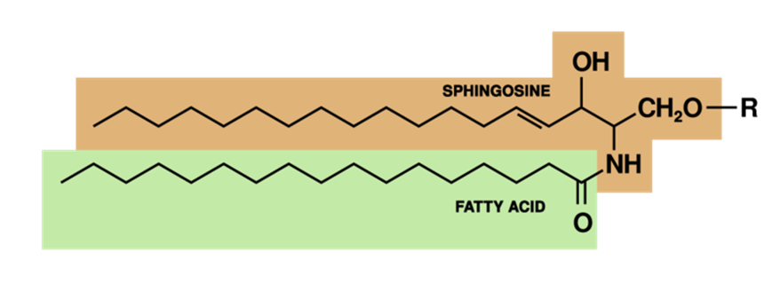
Sphingolipids
Sphingolipids, derived from the amino alcohol sphingosine.
They also have hydrophobic and hydrophilic groups and are present in small amounts in the cell membranes, especially nerve cells.
Complex sphingolipids in cell membranes are thought to serve several functions;
Protection from harmful environmental factors
Signal transmission
Adhesion sites for extracellular proteins

Slide 17
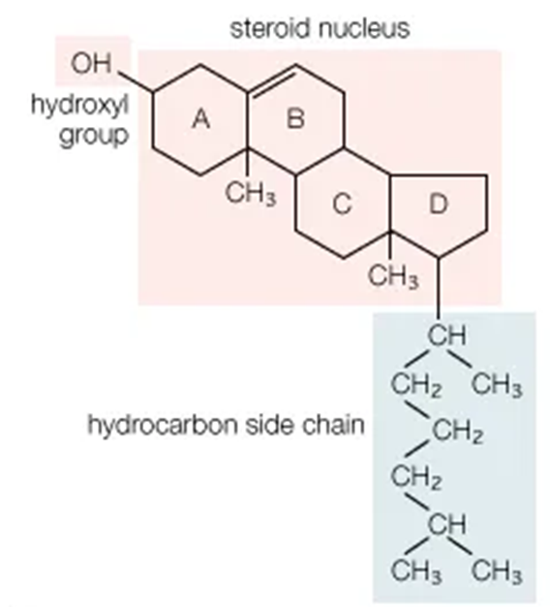
Cholesterol
Cholesterol molecules in membranes are also lipids because their steroid nuclei are highly fat-soluble.
These molecules are dissolved in the bilayer of the membrane.
They mainly help determine the degree of permeability (or impermeability) of the bilayer to watersoluble constituents of body fluids.
Cholesterol controls much of the fluidity of the membrane as well.

Slide 18
Cell Membrane Proteins
These membrane proteins are mainly glycoproteins.
There are two types of cell membrane proteins,
Integral proteins - which protrude all the way through the membrane.
Peripheral proteins - which are attached only to one surface of the membrane
Many of the integral proteins provide structural channels (or pores) through which water molecules and water-soluble substances, especially ions, can diffuse between extracellular and intracellular fluids.
These protein channels also have selective properties that allow preferential diffusion of some substances over others.

Slide 19
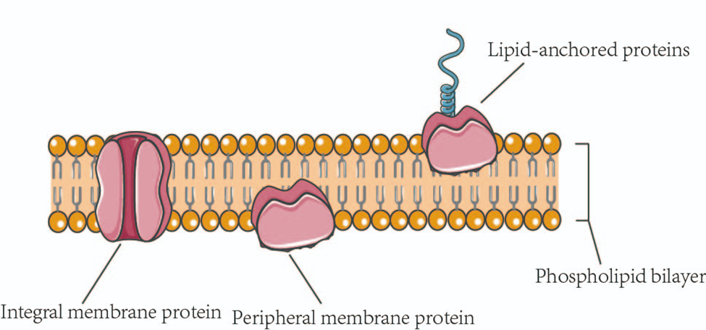
Carrier Proteins
  Some integral proteins act as carrier proteins for transporting substances that otherwise could not penetrate the lipid bilayer.
Active Transport
  Sometimes, these carrier proteins even transport substances in the direction opposite to their electrochemical gradients for diffusion, which is called active transport.
Enzymes
  Some proteins act as enzymes.

Slide 20
Receptors
  Integral membrane proteins can also serve as receptors for water-soluble chemicals, such as peptide hormones, that do not easily penetrate the cell membrane.
  Interaction of cell membrane receptors with specific ligands that bind to the receptor causes conformational changes in the receptor protein.
  This process, in turn, enzymatically activates the intracellular part of the protein or induces interactions between the receptor and proteins in the cytoplasm that act as second messengers, relaying the signal from the extracellular part of the receptor to the interior of the cell.
  In this way, integral proteins spanning the cell membrane provide a means of conveying information about the environment to the cell interior.

Slide 21
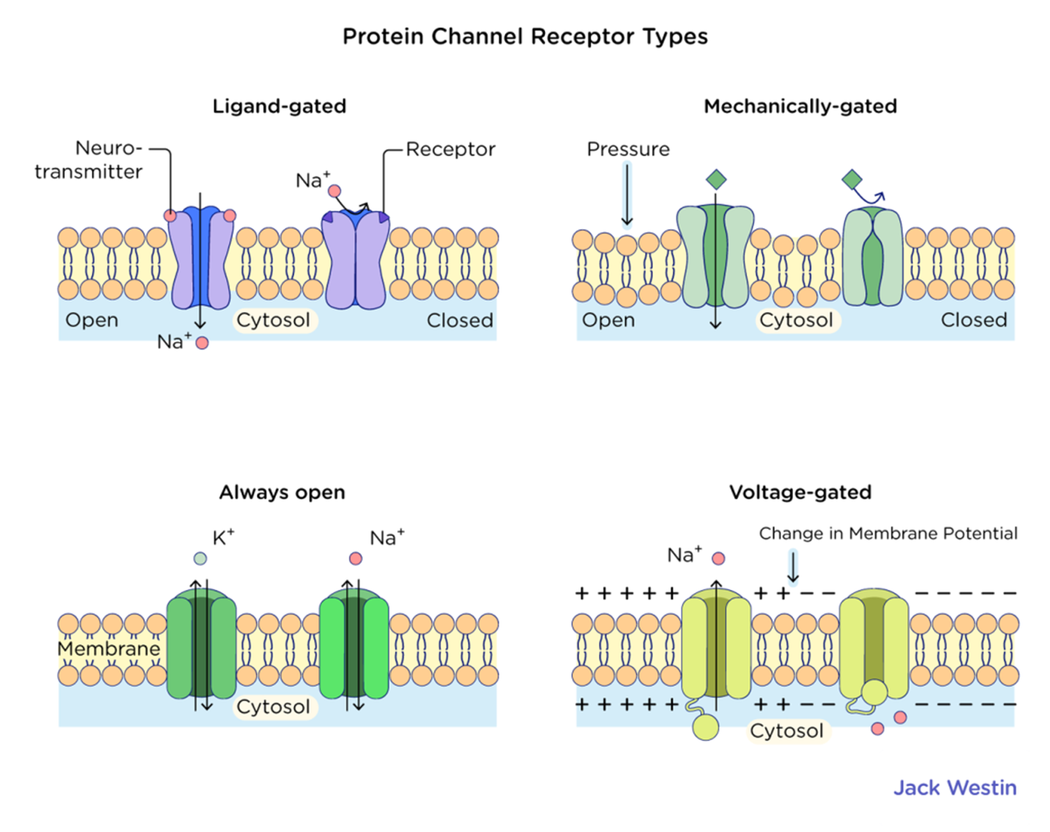

Slide 22
Membrane Carbohydrates - “Glycocalyx”
Membrane carbohydrates occur almost in combination with proteins or lipids in the form of glycoproteins or glycolipids.
Most of the integral proteins are glycoproteins, and about one-tenth of the membrane lipid molecules are glycolipids.
The glyco - portions of these molecules almost protrude to the outside of the cell, dangling outward from the cell surface.
Many other carbohydrate compounds, called proteoglycans— which are mainly carbohydrates bound to small protein cores—are loosely attached to the outer surface of the cell as well.
The entire outside surface of the cell often has a loose carbohydrate coat called the glycocalyx.

Slide 23
The carbohydrate moieties attached to the outer surface of the cell have several important functions:
Many of them have a negative electrical charge, which gives most cells an overall negative surface charge that repels other negatively charged objects.
The glycocalyx of some cells attaches to the glycocalyx of other cells, thus attaching cells to one another.
Many of the carbohydrates act as receptors for binding hormones, such as insulin. When bound, this combination activates attached internal proteins that in turn activate a cascade of intracellular enzymes.
Some carbohydrate moieties enter into immune reactions.

Slide 24
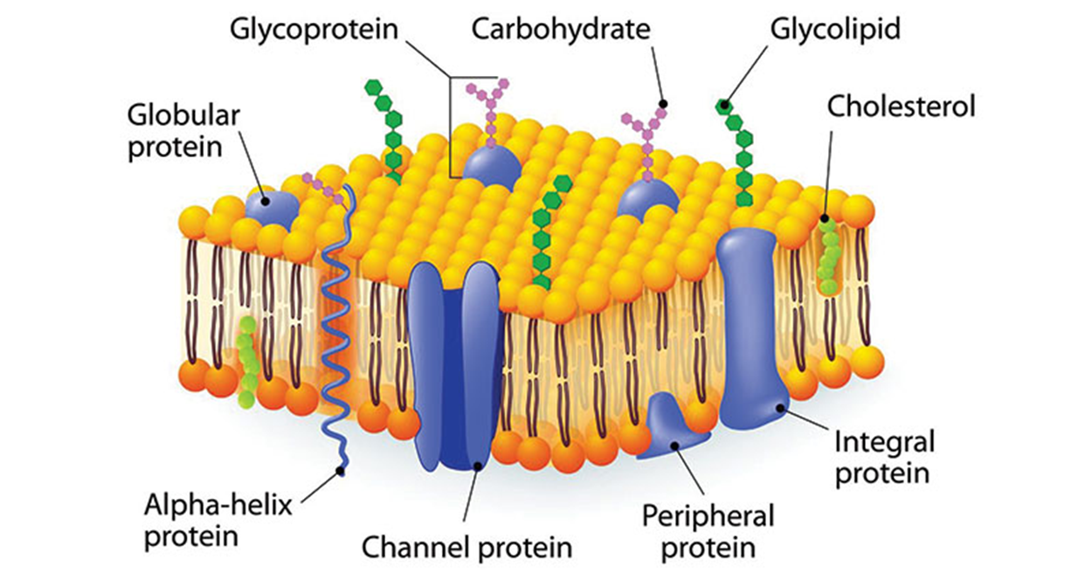

Slide 25
Transport across cell membrane
The cell membrane consists of a lipid bilayer with large numbers of protein molecules in the lipid, many of which penetrate all the way through the membrane.
The lipid bilayer is not soluble with the extracellular fluid or the intracellular fluid. Therefore, it acts as a barrier for movement of water molecules and water soluble substances between the extracellular and intracellular fluid compartments.
However, lipid-soluble substances can diffuse directly through the lipid substance.
The membrane protein molecules interrupt the continuity of the lipid bilayer, constituting an alternative pathway through the cell membrane.
Many of these penetrating proteins can function as transport proteins.

Slide 26
Channel proteins
  Some proteins have watery spaces all the way through the molecule and allow free movement of water, as well as selected ions or molecules; these proteins are called channel proteins.
Carrier proteins
  Bind with molecules or ions that are to be transported, and conformational changes in the protein molecules then move the substances through the interstices of the protein to the other side of the membrane.
Channel proteins and carrier proteins are usually selective for the types of molecules or ions that are allowed to cross the membrane.

Slide 27
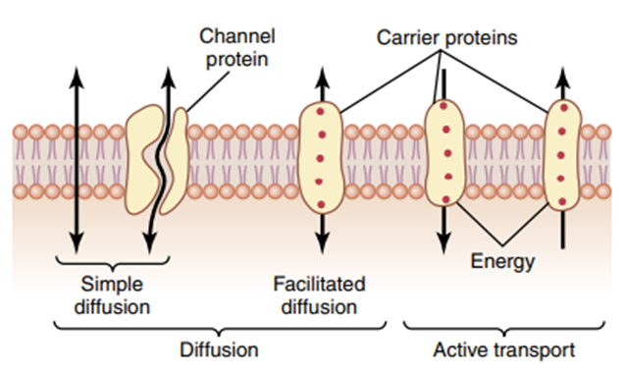
Transport through the cell membrane, either directly through the lipid bilayer or through the proteins, occurs via one of two basic processes;
Passive transport (or Diffusion)
Active transport

Slide 28
1- Passive Transport
Diffusion means random molecular movement of substances molecule by molecule, either through intermolecular spaces in the membrane or in combination with a carrier protein.
The energy that causes diffusion is the energy of the normal kinetic motion of matter.
Diffusion through the cell membrane is divided into two subtypes, called;
Simple diffusion
Facilitated diffusion

Slide 29
Simple Diffusion
Simple diffusion means that kinetic movement of molecules or ions occurs through a membrane opening or through intermolecular spaces without interaction with carrier proteins in the membrane.
The rate of diffusion is determined by;
The amount of substance available.
The velocity of kinetic motion.
The number and sizes of openings in the membrane through which the molecules or ions can move.
Simple diffusion can occur through the cell membrane by two pathways:
Through the interstices of the lipid bilayer if the diffusing substance is lipid-soluble.
Through watery channels that penetrate all the way through some of the large transport proteins.

Slide 30
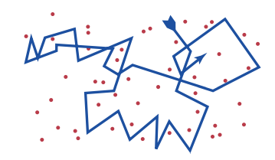
The lipid solubility of a substance is an important factor for determining how rapidly it diffuses through the lipid bilayer.
For example, the lipid solubilities of oxygen, nitrogen, carbon dioxide, and alcohols are high, and all these substances can dissolve directly in the lipid bilayer and diffuse through the cell membrane in the same manner that diffusion of water solutes occurs in a watery solution.
The rate of diffusion of each of these substances through the membrane is directly proportional to its lipid solubility.

Slide 31
Facilitated Diffusion
Facilitated diffusion requires interaction of a carrier protein.
The carrier protein aids passage of molecules or ions through the membrane by binding chemically with them and shuttling them through the membrane in this form.
Water is highly insoluble in the membrane lipids, it readily passes through channels in protein molecules that penetrate all the way through the membrane.
Many of the body’s cell membranes contain protein “pores” called aquaporins that selectively permit rapid passage of water through the membrane.
Other lipid-insoluble molecules can pass through the protein pore channels in the same way as water molecules if they are water-soluble and small enough.
However, as the size of molecules become larger, their penetration falls off rapidly.

Slide 32
For example, the diameter of the urea molecule is only 20% greater than that of water, and its penetration through the cell membrane pores is about 1000 times less than that of water.
The protein channels are distinguished by two important characteristics:
They are often selectively permeable to certain substances.
Many of the channels can be opened or closed by gates that are regulated by electrical signals (voltage-gated channels) or chemicals that bind to the channel proteins (ligand-gated channels).
Ion channels are flexible dynamic structures, and subtle conformational changes influence gating and ion selectivity.

Slide 33
Osmosis
The process by which molecules of a solvent tend to pass through a semipermeable membrane from a less concentrated solution into a more concentrated one.
The process of net movement of water caused by a concentration difference of water is called osmosis.
The most abundant substance that diffuses through the cell membrane is water.
Enough water diffuses in each direction through the red blood cell membrane per second to equal about 100 times the volume of the cell itself.
But, the amount that normally diffuses in the two directions is balanced so precisely that zero net movement of water occurs.
Therefore, the volume of the cell remains constant.
Under certain conditions, concentration difference for water develops, net movement of water does occur across the cell membrane, causing the cell to swell or shrink, depending on the direction of the water movement.

Slide 34
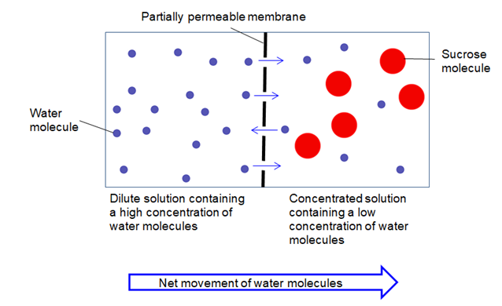

Slide 35
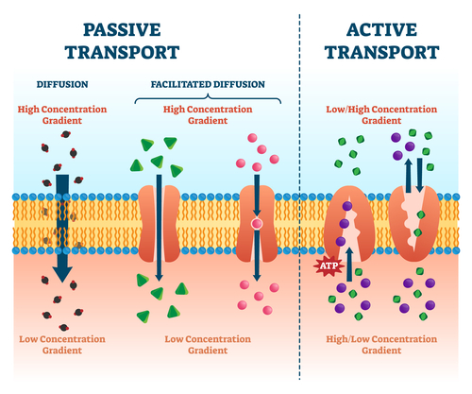

Slide 36
2- Active Transport
The movement of ions or molecules across a cell membrane into a region of higher concentration, assisted by enzymes and requiring energy is known as active transport.
When a cell membrane moves molecules or ions uphill against a concentration gradient (or uphill against an electrical or pressure gradient), the process is called active transport.
Some substances that are actively transported through at least some cell membranes include sodium, potassium, calcium, iron, hydrogen, chloride, iodide, and urate ions, several different sugars, and most of the amino acids.
Active transport is divided into two types according to the source of the energy used to facilitate the transport. They are;
Primary Active Transport
Secondary Active Transport

Slide 37
Primary Active Transport
  In primary active transport, the energy is derived directly from the breakdown of adenosine triphosphate (ATP) or some other high-energy phosphate compound.
  Example;
  Sodium-Potassium Pump Transports Sodium Ions Out of Cells and Potassium Ions into Cells
  Transport of Calcium Ions
  Transport of Hydrogen Ions

Slide 38
Secondary Active Transport
  In secondary active transport, the energy is derived secondarily from energy that has been stored in the form of ionic concentration differences of ionic substances between the two sides of a cell membrane.
  There are two kinds of secondary active transport;
  Antiport or Counter-transport
  Symport or Co-transport

Slide 39
Antiport or Counter-transport
Antiport or Counter-transport means that two different molecules or ions are being transported at the same time but opposite directions.
One of the species is allowed to flow from high concentration to a lower concentration (often Sodium) while the other species is transported simultaneously to the other side.
Example;
Na⁺-Ca²⁺ counter-transport where Na⁺ binds to the transport carrier protein on its exterior side, and Ca²⁺ bound to the same protein on the membranes interior side. Once both are bound, a conformational change occurs which releases energy and the sodium ion is transported to the interior and calcium to the exterior. This transporter is situated on almost all cell membranes.
Na⁺-H⁺ counter-transport. The mechanism is the same as the Na⁺-Ca²⁺ counter-transport. However it plays a key role in H⁺ homeostasis in the body, present in proximal tubules of the kidneys.

Slide 40
Symport or Co-transport
Symport or "Co-transport" means that a molecule is allowed to be transported from high to low concentration region while moving another molecule with it from low to high concentration.
It in fact is pulling the other molecule with it into the cell.
Examples:
Sodium-Glucose co-transport mechanism. On its exterior side the transport protein has 2 binding sites, one for sodium and one for glucose. When both of these bind to the protein there is a conformational change allowing the electrochemical gradient to provide the energy needed to transport both of these molecules into the cell.
Sodium-Amino acid co-transport occurs in the same manner as for glucose, except that uses a different set of transport proteins, however its mechanism is the same.

Slide 41
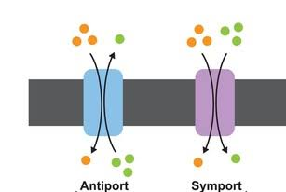

Slide 42
Functions of Plasma Membrane
Functions of Plasma membrane include;
Protection
Selective permeability
Absorption
Excretion
Gaseous exchange
Maintenance of cell size and shape

Slide 43
Cytoplasm and its organelles
The cytoplasm is filled with minute and large dispersed particles and organelles.
The jelly-like fluid portion of the cytoplasm in which the particles are dispersed is called cytosol and contains mainly dissolved proteins, electrolytes, and glucose.
Dispersed in the cytoplasm are neutral fat globules, glycogen granules, ribosomes, secretory vesicles, and five especially important organelles;
  Endoplasmic reticulum
  Golgi apparatus
  Mitochondria
  Lysosomes
  Peroxisomes

Slide 44
Endoplasmic Reticulum
The endoplasmic reticulum is a network of tubular structures called cisternae and flat vesicular structures in the cytoplasm.
This organelle helps process molecules made by the cell and transports them to their specific destinations inside or outside the cell.
The tubules and vesicles are interconnected.
The total surface area of this structure in the liver cells can be as much as 30 to 40 times the cell membrane area.
The space inside the tubules and vesicles is filled with endoplasmic matrix.
  a watery medium that is different from fluid in the cytosol.
The space inside the endoplasmic reticulum is connected with the space between the two membrane surfaces of the nuclear membrane.

Slide 45
Substances formed in some parts of the cell enter the space of the endoplasmic reticulum and are then directed to other parts of the cell.
Also, the vast surface area of this reticulum and the multiple enzyme systems attached to its membranes provide the mechanisms for a major share of the cell’s metabolic functions.
Ribosomes and the Rough (Granular) Endoplasmic Reticulum
Attached to the outer surfaces of many parts of the endoplasmic reticulum are large numbers of minute granular particles called ribosomes.
Where these particles are present, the reticulum is called the rough (granular) endoplasmic reticulum (RER).
The ribosomes are composed of a mixture of RNA and proteins; they function to synthesize new protein molecules in the cell.

Slide 46
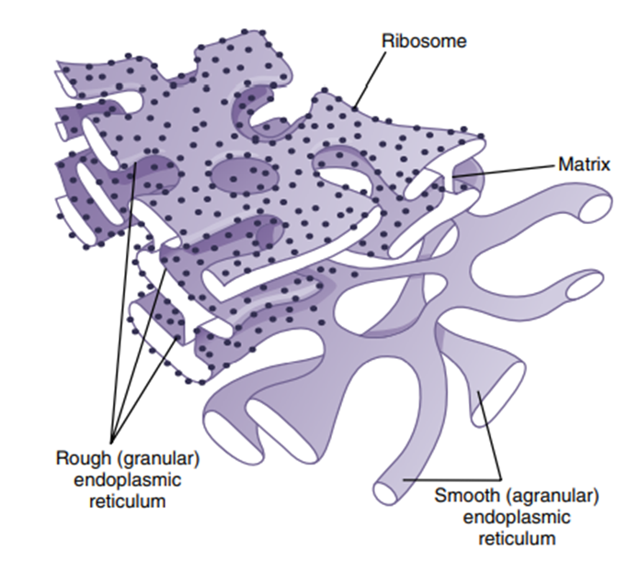
Smooth (A granular) Endoplasmic Reticulum
Part of the endoplasmic reticulum has no attached ribosomes.
This part is called the smooth, or agranular, endoplasmic reticulum (SER).
The smooth reticulum functions for the synthesis of lipid substances and for other processes of the cells promoted by intrareticular enzymes.

Slide 47
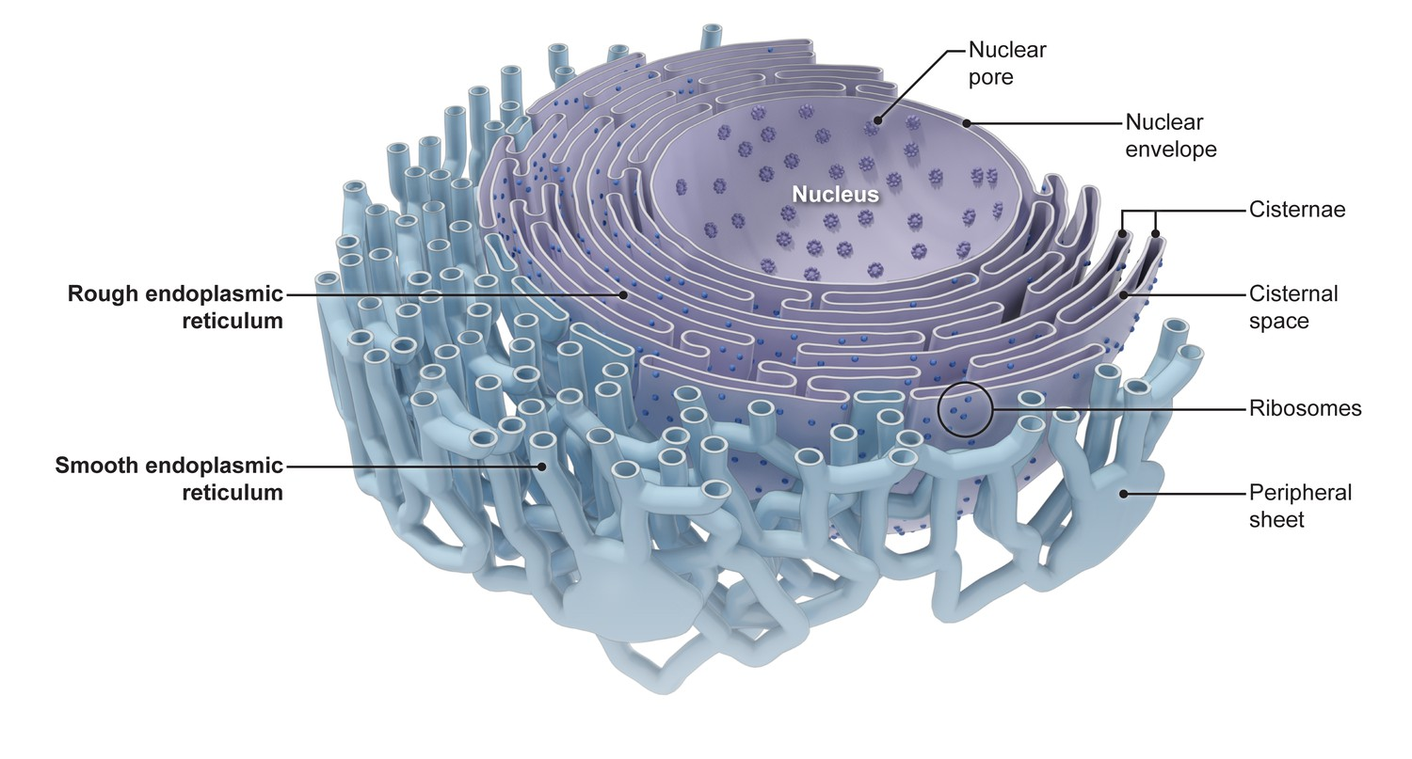

Slide 48
Golgi Apparatus
The Golgi apparatus is closely related to the endoplasmic reticulum.
It has membranes similar to those of the smooth endoplasmic reticulum.
The Golgi apparatus is usually composed of four or more stacked layers of thin, flat, enclosed vesicles lying near one side of the nucleus.
This apparatus is prominent in secretory cells, where it is located on the side of the cell from which secretory substances are extruded.
The Golgi apparatus functions in association with the endoplasmic reticulum.
Small transport vesicles (also called endoplasmic reticulum vesicles [ER vesicles]) continually pinch off from the endoplasmic reticulum and shortly thereafter fuse with the Golgi apparatus.
In this way, substances entrapped in ER vesicles are transported from the endoplasmic reticulum to the Golgi apparatus.
The transported substances are then processed in the Golgi apparatus to form lysosomes, secretory vesicles, and other cytoplasmic components.

Slide 49
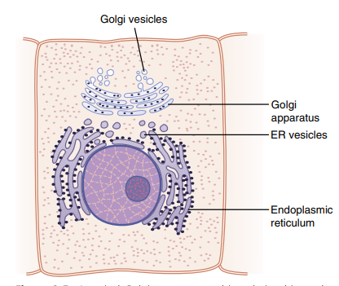
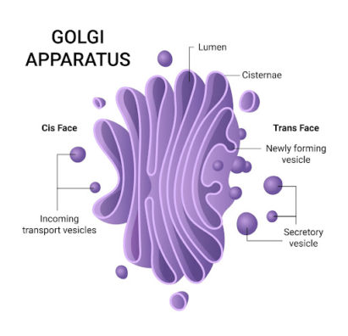

Slide 50
Lysosomes
Lysosomes are vesicular organelles that form by breaking off from the Golgi apparatus.
The lysosomes provide an intracellular digestive system that allows the cell to digest the following:
Damaged cellular structures
Food particles that have been ingested by the cell
Unwanted matter such as bacteria
Lysosome are different in various cell types but are usually 250 to 750 nanometres in diameter.
They are membrane bounded and are contains large numbers of small granules, 5 to 8 nanometres in diameter, which are protein aggregates of as many as 40 different hydrolase (digestive) enzymes.
A hydrolytic enzyme is capable of splitting an organic compound into two or more parts by combining hydrogen from a water molecule with one part of the compound and combining the hydroxyl portion of the water molecule with the other part of the compound.

Slide 51
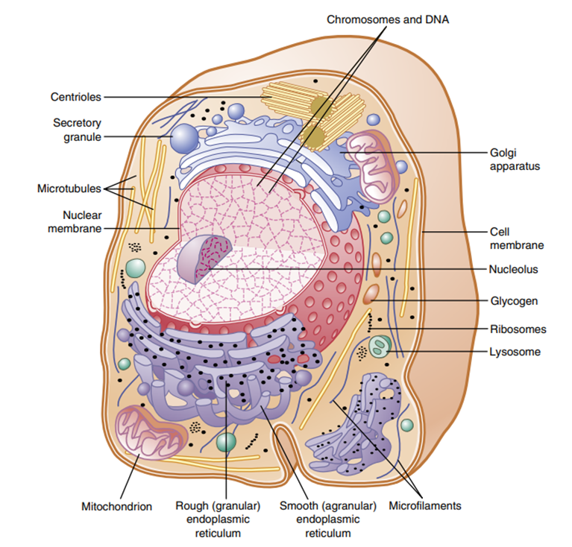
For example, protein is hydrolyzed to form amino acids, glycogen is hydrolyzed to form glucose, and lipids are hydrolyzed to form fatty acids and glycerol.
Hydrolytic enzymes are highly concentrated in lysosomes.
The membrane surrounding the lysosome prevents the enclosed hydrolytic enzymes from coming into contact with other substances in the cell and therefore prevents their digestive actions.
Some conditions of the cell break the membranes of lysosomes, allowing release of the digestive enzymes.
These enzymes then split the organic substances with which they come in contact into small, highly diffusible substances such as amino acids and glucose.

Slide 52
Peroxisomes
Peroxisomes are physically similar to lysosomes, but they are different in two important ways.
First, they are believed to be formed by self-replication (or perhaps by budding off from the smooth endoplasmic reticulum) rather than from the Golgi apparatus.
Second, they contain oxidases rather than hydrolases.
Several of the oxidases are capable of combining oxygen with hydrogen ions derived from different intracellular chemicals to form hydrogen peroxide (H2O2).
Hydrogen peroxide is a highly oxidizing substance and is used in association with catalase, another oxidase enzyme present in large quantities in peroxisomes, to oxidize many substances that might otherwise be poisonous to the cell.
  For example, about half the alcohol that a person drinks is detoxified into acetaldehyde by the peroxisomes of the liver cells in this manner.
A major function of peroxisomes is to catabolize long-chain fatty acids.

Slide 53
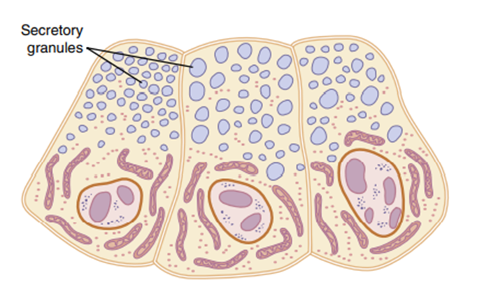
Secretory Vesicles
One of the important functions of many cells is secretion of special chemical substances.
Almost all such secretory substances are formed by the endoplasmic reticulum– Golgi apparatus system.
And are then released from the Golgi apparatus into the cytoplasm in the form of storage vesicles called secretory vesicles or secretory granules.
Example;
  Typical secretory vesicles inside pancreatic acinar cells; these vesicles store protein proenzymes (enzymes that are not yet activated).
  The proenzymes are secreted later through the outer cell membrane into the pancreatic duct and then into the duodenum, where they become activated and perform digestive functions on the food in the intestinal tract.

Slide 54
Mitochondria
The mitochondria are called the powerhouses of the cell.
Without them, cells would be unable to extract enough energy from the nutrients, and essentially all cellular functions would cease.
Mitochondria are present in all areas of each cell’s cytoplasm, but the total number per cell varies from less than 100 up to several thousand, depending on the energy requirements of the cell.
For example;
  Cardiac muscle cells (cardiomyocytes), use large amounts of energy and have far more mitochondria than fat cells (adipocytes), which are much less active and use less energy.
Furthermore, the mitochondria are concentrated in those portions of the cell responsible for the major share of its energy metabolism.
They are also variable in size and shape.
Some mitochondria are only a few hundred manometers in diameter and are globular in shape, whereas others are elongated and are as large as 1 micrometer in diameter and 7 micrometers long.

Slide 55
Some are branched and filamentous.
The basic structure of the mitochondrion is composed mainly of two lipid bilayer protein membranes, an outer membrane and an inner membrane.
Many infoldings of the inner membrane form shelves or tubules called cristae onto which oxidative enzymes are attached.
The cristae provide a large surface area for chemical reactions to occur.
In addition, the inner cavity of the mitochondrion is filled with a matrix that contains large quantities of dissolved enzymes necessary for extracting energy from nutrients.
These enzymes operate in association with oxidative enzymes on the cristae to cause oxidation of nutrients, thereby forming carbon dioxide and water and, at the same time, releasing energy.
The liberated energy is used to synthesize a high-energy substance called adenosine triphosphate (ATP).

Slide 56
ATP is then transported out of the mitochondrion and diffuses throughout the cell to release its own energy wherever it is needed for performing cellular functions.
Mitochondria are self-replicative, which means that one mitochondrion can form a second one, a third one, and so on whenever the cell needs increased amounts of ATP.
Indeed, the mitochondria contain DNA similar to that found in the cell nucleus.
The DNA of the mitochondrion plays a similar role, controlling replication of the mitochondrion.
Cells that are faced with increased energy demands—for example;
  in skeletal muscles subjected to chronic exercise training—may increase the density of mitochondria to supply the additional energy required.

Slide 57
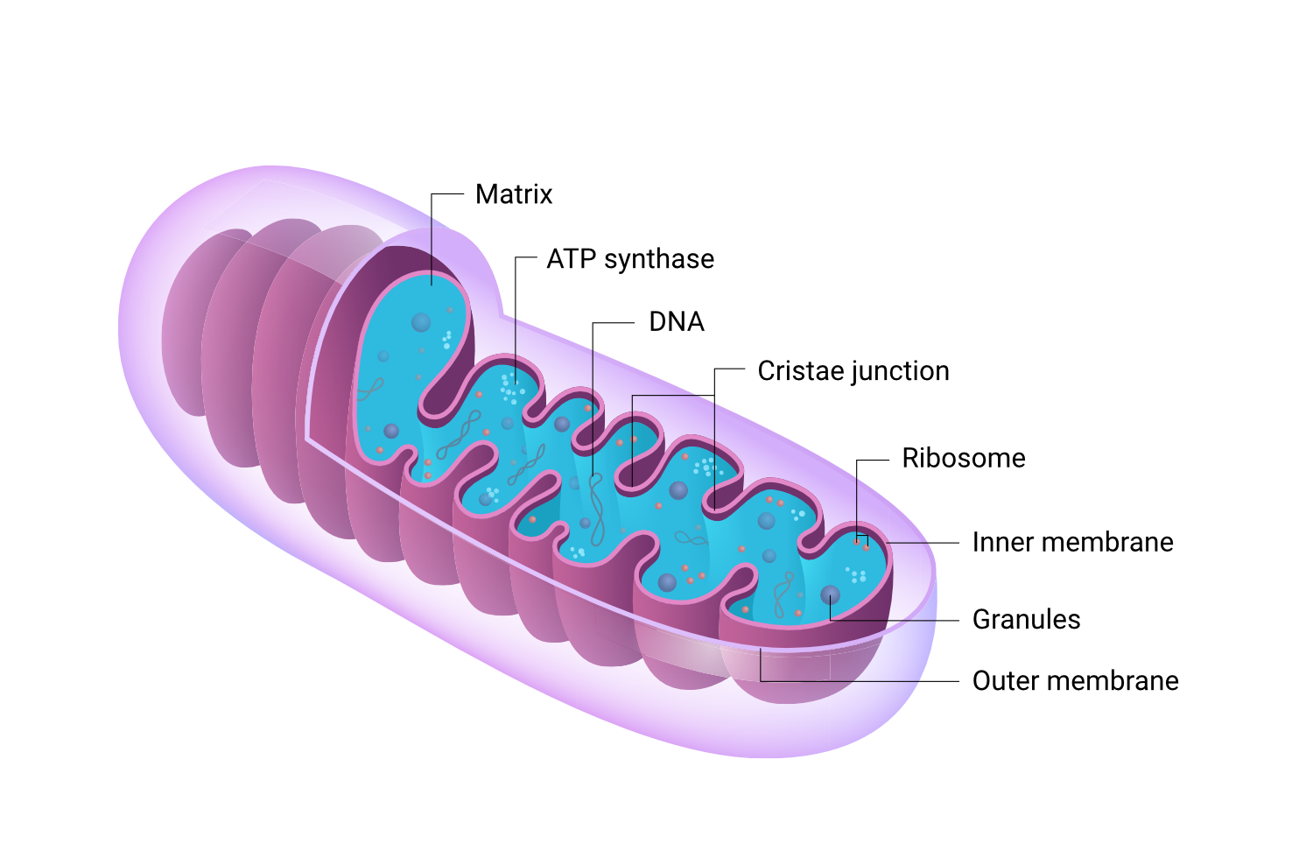
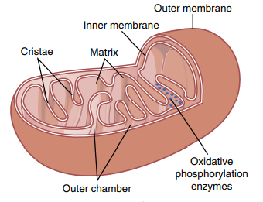

Slide 58
Cell Cytoskeleton
The cell cytoskeleton is a network of fibrillar proteins organized into filaments or tubules.
These originate as precursor proteins synthesized by ribosomes in the cytoplasm.
The precursor molecules then polymerize to form filaments.
The functions of cell cytoskeleton are;
Determines cell shape.
Participates in cell division.
Allows cells to move.
Provides a track-like system that directs the movement of organelles in the cells.

Slide 59
1- Microfilaments
These are the smallest fibres.
Large numbers of actin microfilaments present in the outer zone of the cytoplasm, called the ectoplasm, to form an elastic support for the cell membrane.
Also, in muscle cells, actin and myosin filaments are organized into a special contractile machine that is the basis for muscle contraction.
They provide structural support, maintain the characteristic shape of the cell and permit contraction, e.g. in muscle cells.

Slide 60
2- Intermediate Filaments
Intermediate filaments are generally strong rope-like filaments that often work together with microtubules, providing strength and support for the fragile tubulin structures.
They are called intermediate because their average diameter is between that of narrower actin microfilaments and wider myosin filaments found in muscle cells.
Their functions are mainly mechanical, and they are less dynamic than actin microfilaments or microtubules.
All cells have intermediate filaments, although the protein subunits of these structures vary, depending on the cell type.
Specific intermediate filaments found in various cells include Desmin filaments in muscle cells, neurofilaments in neurons, and keratins in epithelial cells.

Slide 61
3- Microtubules
The microtubules are special type of stiff filaments composed of polymerized tubulin molecules and used in all cells to construct strong tubular structures.
These are larger contractile protein fibres that are involved in movement of organelles within the cell chromosomes during cell division cell extensions.
A major function of microtubules is to act as a cytoskeleton, providing rigid physical structures for certain parts of cells.
Microtubules serve as the conveyor belts for the intracellular transport of vesicles, granules, and organelles such as mitochondria.

Slide 62
Centrosome
This directs organisation of microtubules within the cell.
It consists of a pair of centrioles (small clusters of microtubules) and plays an important role during cell division.
Centrioles form the nucleation sites for microtubules and are arranged in a 9+0 configuration.
Cell Extensions
These project from the plasma membrane in some types of cell and their main components are microtubules, which allow movement.
They include;
  Microvilli
  Cilia
  Flagella

Slide 63
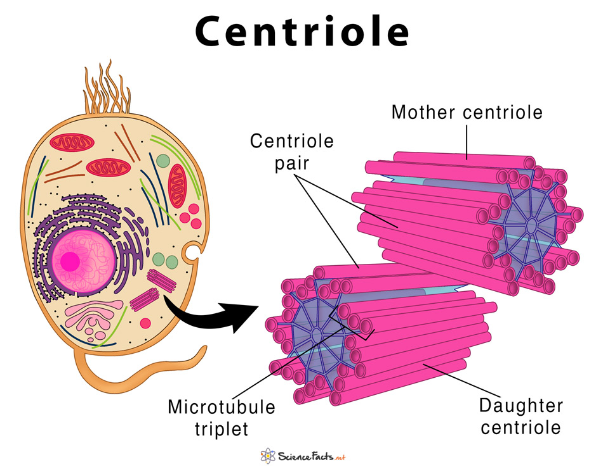

Slide 64
II- Cell Extensions
Microvilli
  Tiny projections that contain microfilaments.
  They cover the surface of certain types of cell, e.g. Absorptive cells that line the small intestine.
  By greatly increasing the surface area, microvilli make the structure of these cells ideal for their function – maximising absorption of nutrients from the small intestine.
Cilia
  Microscopic hair-like projections containing microtubules that lie along the free borders of some cells.
  They beat in union, moving substances along the surface, e.g. mucus upwards in the respiratory tract.
  Cilia have a 9+2 arrangement of microtubules.
Flagella
  Single, long whip-like projections, containing microtubules, which form the ‘tails’ of spermatozoa that enable their movement along the female reproductive tract.
  Flagella also have a 9+2 microtubule arrangement.

Slide 65
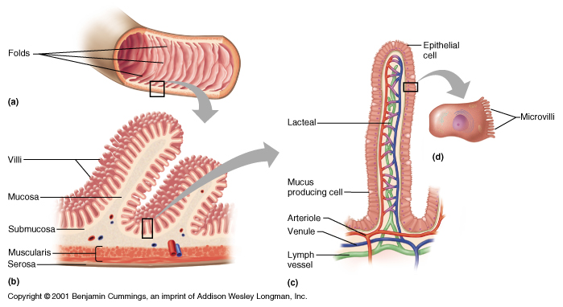
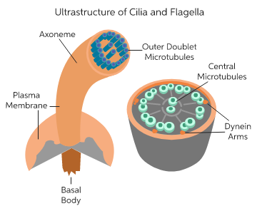

Slide 66
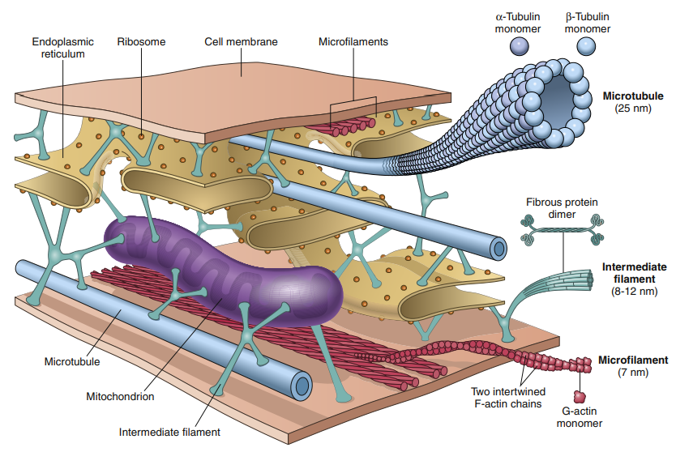

Slide 67
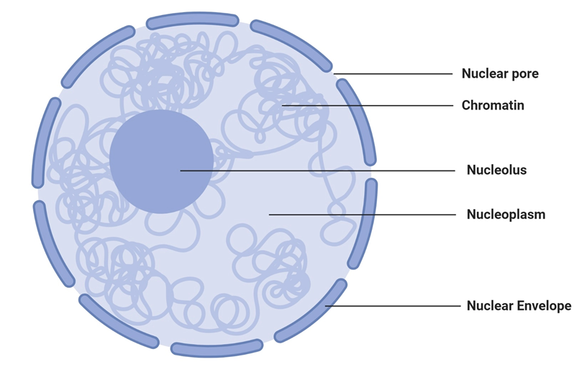
Nucleus
The nucleus is the control centre of the cell and sends messages to the cell to grow and mature, replicate, or die.
The nucleus contains large quantities of DNA, which comprise the genes.
The genes determine the characteristics of the cell’s proteins, including the structural proteins, as well as the intracellular enzymes that control cytoplasmic and nuclear activities.
The genes also control and promote cell reproduction.
The genes first reproduce to create two identical sets of genes; then the cell splits by a special process called mitosis to form two daughter cells, each of which receives one of the two sets of DNA genes.
The appearance of the nucleus reveals darkly stained chromatin material throughout the nucleoplasm.

Slide 68
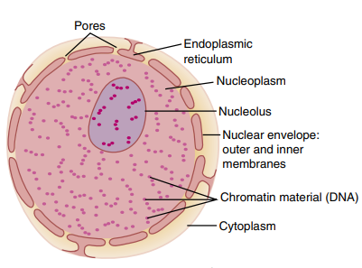
Nuclear Membrane
The nuclear membrane, also called the nuclear envelope, is actually two separate bilayer membranes.
The outer membrane is continuous with the endoplasmic reticulum of the cell cytoplasm, and the space between the two nuclear membranes is also continuous with the space inside the endoplasmic reticulum.
The nuclear membrane is penetrated by several thousand nuclear pores.
The central area of each pore is only about 9 nanometres in diameter.

Slide 69
Nucleoli and Formation of Ribosomes
The nuclei of most cells contain one or more highly staining structures called nucleoli.
The nucleolus does not have a limiting membrane. It is simply an accumulation of large amounts of RNA and proteins found in ribosomes.
The nucleolus enlarges considerably when the cell is actively synthesizing proteins.
Formation of the nucleoli (and of the ribosomes in the cytoplasm outside the nucleus) begins in the nucleus.
First, specific DNA genes in the chromosomes cause RNA to be synthesized.
Some of this synthesized RNA is stored in the nucleoli, but most of it is transported outward through the nuclear pores into the cytoplasm.
Here it is used in conjunction with specific proteins to assemble “mature” ribosomes that play an essential role in forming cytoplasmic proteins.

Slide 70
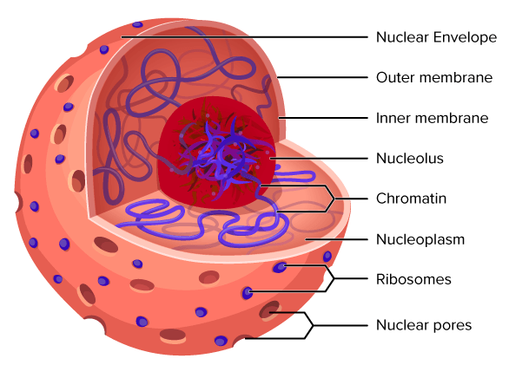

Slide 71
Functional systems of the cell
If a cell is to live and grow and reproduce, it must obtain nutrients and other substances from the surrounding fluids.
Most substances pass through the cell membrane by the processes of diffusion and active transport.
Large particles enter the cell by a specialized function of the cell membrane called endocytosis.
The principal forms of endocytosis are pinocytosis and phagocytosis.
Pinocytosis means the ingestion of minute particles that form vesicles of extracellular fluid and particulate constituents inside the cell cytoplasm.
Phagocytosis means the ingestion of large particles, such as bacteria, whole cells, or portions of degenerating tissue.

Slide 72
1- Endocytosis
Endocytosis is the process by which cells take in substances from outside of the cell by engulfing them in a vesicle.
These can include things like nutrients to support the cell or pathogens that immune cells engulf and destroy.
Endocytosis occurs when a portion of the cell membrane folds in on itself, encircling extracellular fluid and various molecules or microorganisms.
The resulting vesicle breaks off and is transported within the cell.

Slide 73
Phagocytosis
Phagocytosis, also known as cell eating, is the process by which cells internalize large particles or cells, like damaged cells and bacteria.
Within the human body, and in other mammals, phagocytosis is how immune cells engulf and destroy dangerous microorganisms or toxic compounds.
Macrophages and neutrophils, types of white blood cells, are the two primary phagocytes.
These white blood cells are responsible for clearing out aged and damaged cells, as well as disposing of infectious microorganisms.

Slide 74
Pinocytosis
Pinocytosis, also known as cell drinking, is common in plant and animal cells.
During pinocytosis, the cell takes in substances from the extracellular fluid that it needs to function.
These include things like water and nutrients.
Receptor-mediated endocytosis is a specialized type of pinocytosis.
During receptor-mediated endocytosis, macromolecules bind to receptors along the surface of the cell’s plasma membrane.
Cholesterol uptake is an example of receptor-mediated endocytosis.

Slide 75
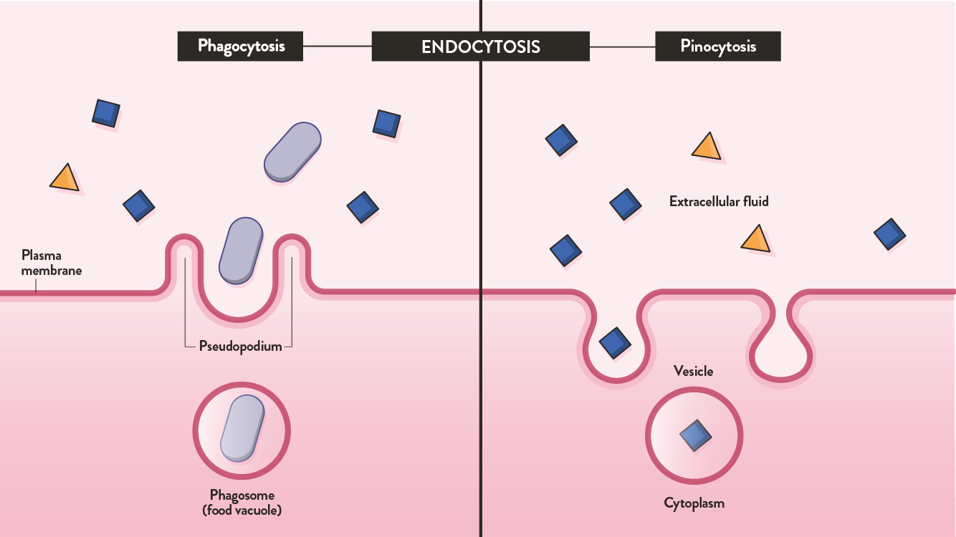

Slide 76
2- Exocytosis
Exocytosis is the process by which cells move materials from within the cell into the extracellular fluid.
Exocytosis occurs when a vesicle fuses with the plasma membrane, allowing its contents to be released outside the cell.

Slide 77
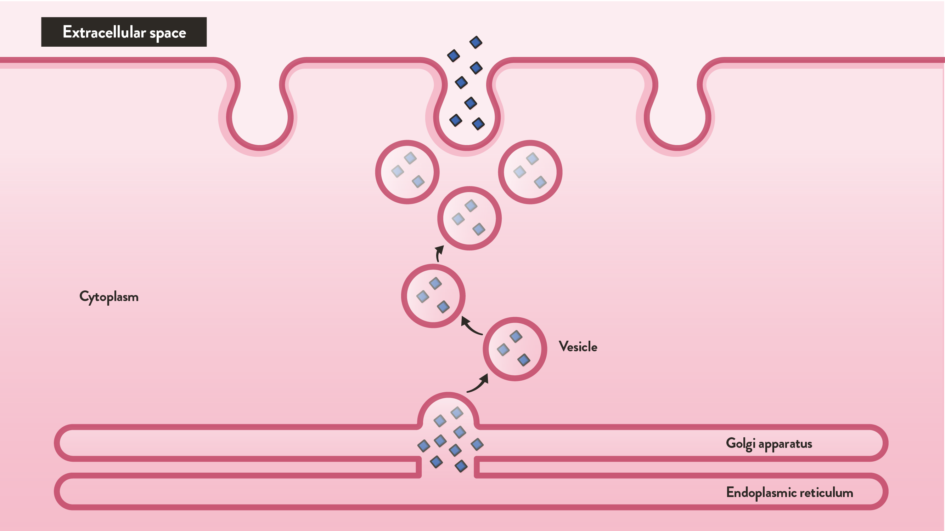

Slide 78
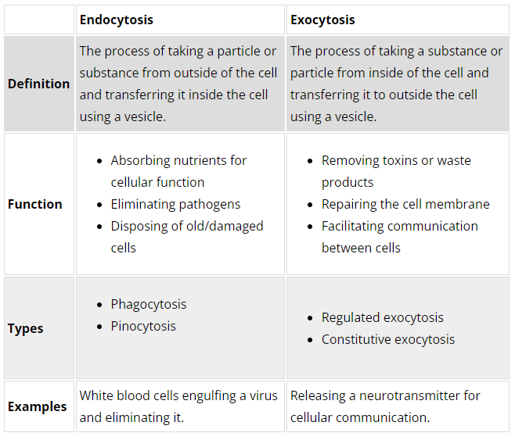
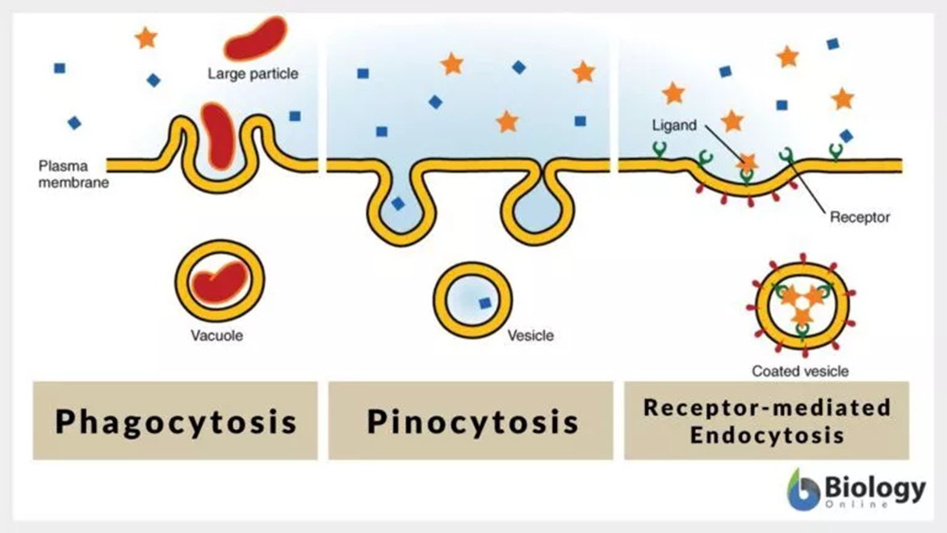

Slide 79
Locomotion Of Cells
The most obvious type of movement in the body is that which occurs in skeletal, cardiac, and smooth muscle cells, which constitute almost 50% of the entire body mass.
Two other types of cell movements are;
Amoeboid Movement
Ciliary Movement

Slide 80
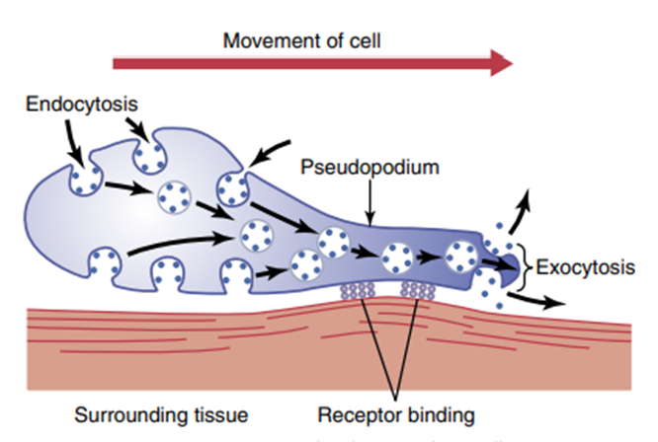
1) Amoeboid Movement
Amoeboid movement is a crawling-like movement of an entire cell in relation to its surroundings, such as movement of white blood cells through tissues.
This type of movement gets its name from the fact that amoebae move in this manner.
Typically, amoeboid locomotion begins with the protrusion of a pseudopodium from one end of the cell.
The pseudopodium projects away from the cell body and partially secures itself in a new tissue area; then the remainder of the cell is pulled toward the pseudopodium.

Slide 81
2) Cilia And Ciliary Movements
There are two types of cilia;
  Motile
  Nonmotile, or primary cilia.
Motile cilia can undergo a whip-like movement on the surfaces of cells.
This movement occurs mainly in two places in the human body;
  on the surfaces of the respiratory airways
  on the inside surfaces of the uterine tubes (fallopian tubes) of the reproductive tract.

Slide 82
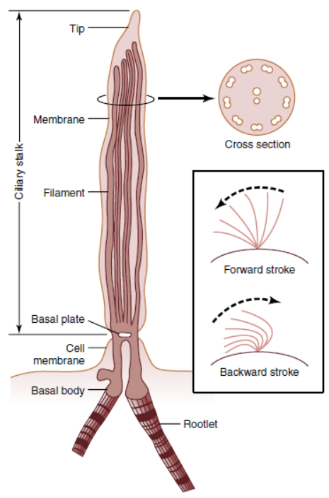
  Cilia are small, slender, hair-like structures present on the surface of all mammalian cells.
  A cilium has the appearance of a sharp-pointed straight or curved hair that projects 2 to 4 micrometres from the surface of the cell.
  Many motile cilia project from a single cell—for example, as many as 200 cilia on the surface of each epithelial cell inside the respiratory passageways.
  The cilium is covered by an outcropping of the cell membrane, and it is supported by 11 microtubules—nine double tubules located around the periphery of the cilium and two single tubules down the center.
  Each cilium is an outgrowth of a structure that lies immediately beneath the cell membrane, called the basal body of the cilium.

Slide 83
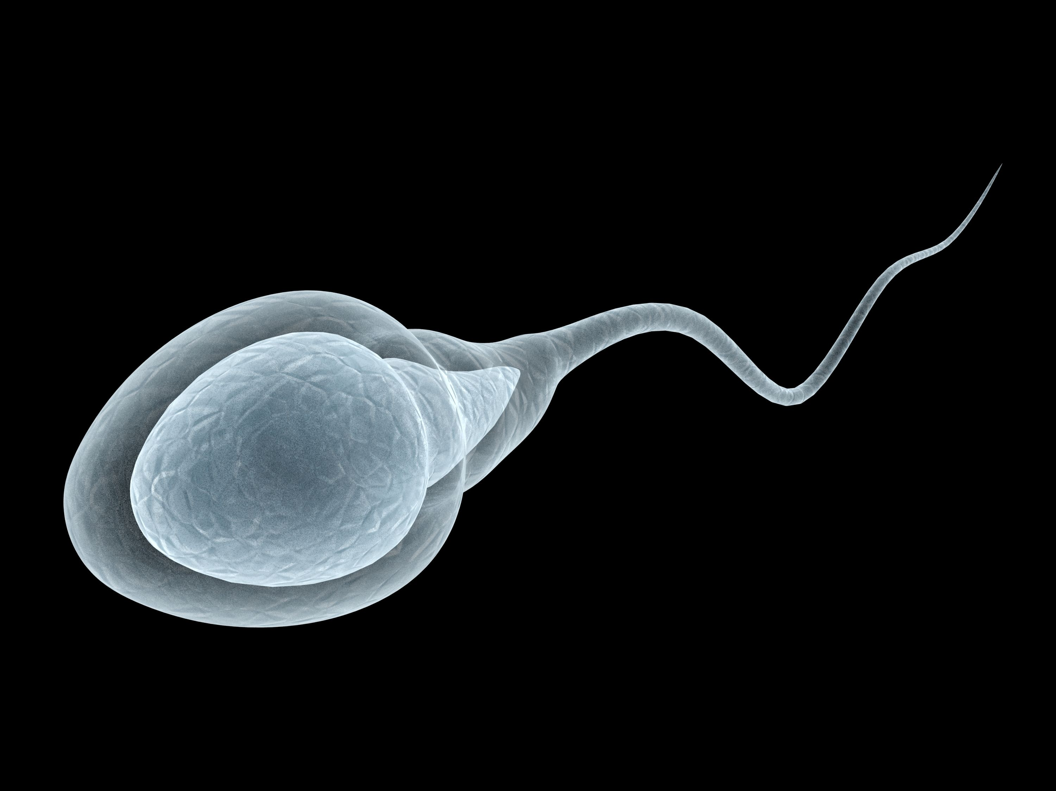
Flagella
  The flagellum of a sperm is similar to a motile cilium.
  It has much the same type of structure and same type of contractile mechanism.
  The flagellum, however, is much longer and moves in quasisinusoidal waves instead of whip like movements.

Slide 84
THANK YOU

