Slide 1
Prokaryotic & Eukaryotic Cells
KHUSHAL KHAN
Demonstrator cardiology
Khyber medical university – institute of paramedical sciences

Slide 2
Introduction
Every living organism falls into one of two groups:
  Eukaryotes
  Prokaryotes
Cellular structure determines which group an organism belongs to.
All life on Earth consists of either eukaryotic cells or prokaryotic cells.
Prokaryotes were the first form of life.
Scientists believe that eukaryotes evolved from prokaryotes around 2.7 billion years ago.

Slide 3
The primary distinction between these two types of organisms is that eukaryotic cells have a membrane-bound nucleus and prokaryotic cells do not.
The nucleus is where eukaryotes store their genetic information.
In prokaryotes, DNA is bundled together in the nucleoid region, but it is not stored within a membrane-bound nucleus.
Eukaryote DNA consists of multiple molecules of double-stranded linear DNA, while that of prokaryotes is double-stranded and circular.

Slide 4
Prokaryotes
Prokaryotes are unicellular organisms that lack membrane-bound structures, the most noteworthy of which is the nucleus.
Prokaryotic cells tend to be small, simple cells, measuring around 0.1-5 μm in diameter.
While prokaryotic cells do not have membrane-bound structures, they do have distinct cellular regions.
In prokaryotic cells, DNA bundles together in a region called the nucleoid.
Prokaryotes can be split into two domains, bacteria and archaea.
In prokaryotes, molecules of protein, DNA and metabolites are all found together, floating in the cytoplasm.

Slide 5
Prokaryotic Cell Features
Nucleoid: A central region of the cell that contains its DNA.
Ribosome: Ribosomes are responsible for protein synthesis.
Cell wall: The cell wall provides structure and protection from the outside environment. Most bacteria have a rigid cell wall made from carbohydrates and proteins called peptidoglycans.
Cell membrane: Every prokaryote has a cell membrane, also known as the plasma membrane, that separates the cell from the outside environment.
Capsule: Some bacteria have a layer of carbohydrates that surrounds the cell wall called the capsule. The capsule helps the bacterium attach to surfaces.
Fimbriae: Fimbriae are thin, hair-like structures that help with cellular attachment.
Pili: Pili are rod-shaped structures involved in multiple roles, including attachment and DNA transfer.
Flagella: Flagella are thin, tail-like structures that assist in movement.

Slide 6
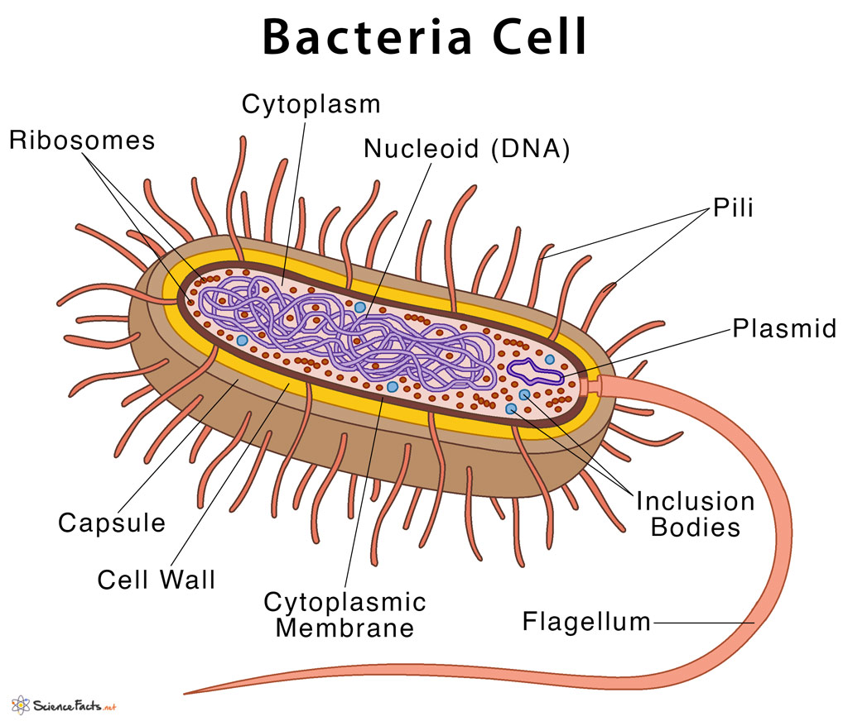
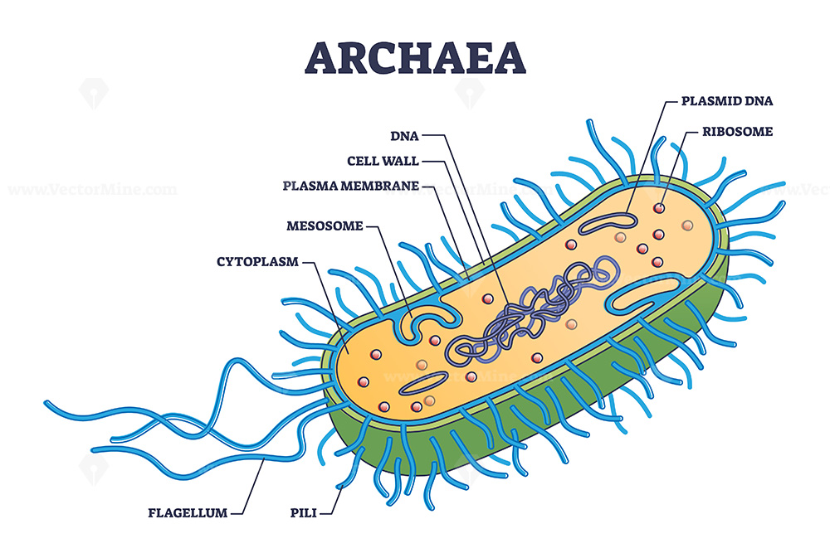
Examples
Bacteria and archaea are the two types of prokaryotes.

Slide 7
Eukaryotes
Eukaryotes are organisms whose cells have a nucleus and other organelles enclosed by a plasma membrane.
Organelles are internal structures responsible for a variety of functions, such as energy production and protein synthesis.
Eukaryotic cells are large (around 10-100 μm) and complex.
While most eukaryotes are multicellular organisms, there are some single-cell eukaryotes.

Slide 8
Eukaryotic Cell Features
Nucleus: The nucleus stores the genetic information in chromatin form.
Nucleolus: Found inside of the nucleus, the nucleolus is the part of eukaryotic cells where ribosomal RNA is produced.
Plasma membrane: The plasma membrane is a phospholipid bilayer that surrounds the entire cell and encompasses the organelles within.
Cytoskeleton or cell wall: The cytoskeleton or cell wall provides structure, allows for cell movement, and plays a role in cell division.
Ribosomes: Ribosomes are responsible for protein synthesis.
Mitochondria: Mitochondria, also known as the powerhouses of the cell, are responsible for energy production.
Cytoplasm: The cytoplasm is the region of the cell between the nuclear envelope and plasma membrane.
Cytosol: Cytosol is a gel-like substance within the cell that contains the organelles.

Slide 9
Endoplasmic reticulum: The endoplasmic reticulum is an organelle dedicated to protein maturation and transportation.
Vesicles and vacuoles: Vesicles and vacuoles are membrane-bound sacs involved in transportation and storage.
Other common organelles found in many, but not all, eukaryotes include the Golgi apparatus, chloroplasts and lysosomes.

Slide 10
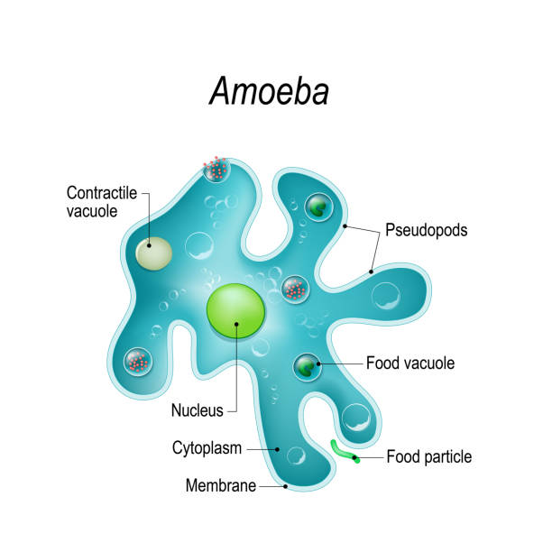
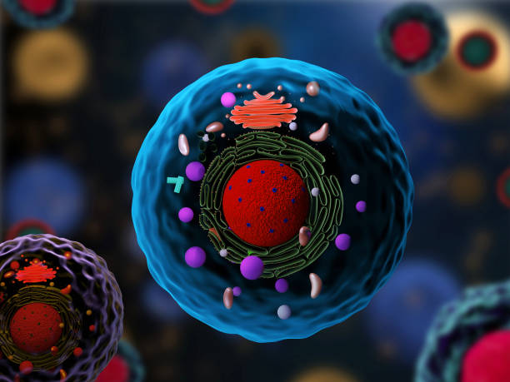
Examples
Animals, plants, fungi, algae and protozoans are all eukaryotes.

Slide 11
Key Similarities Between Prokaryotes And Eukaryotes
All cells, whether prokaryotic or eukaryotic, share these four features:
DNA
Plasma membrane
Cytoplasm
Ribosomes

Slide 12
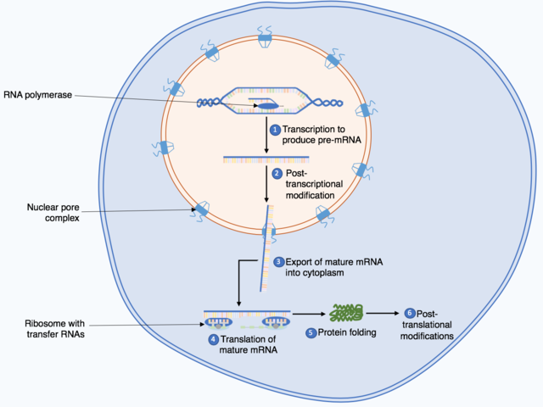
Transcription And Translation In Prokaryotes Vs Eukaryotes
  Transcription
  Transcription is the process of making an RNA copy of a gene's DNA sequence.
  Translation
  Translation is the process by which a cell makes proteins using the genetic information carried in messenger RNA (mRNA).
In prokaryotic cells, transcription and translation are coupled, meaning translation begins during mRNA synthesis.
In eukaryotic cells, transcription and translation are not coupled.
  Transcription occurs in the nucleus, producing mRNA.
  The mRNA then exits the nucleus, and translation occurs in the cell’s cytoplasm.

Slide 13
Key Differences Between Prokaryotes And Eukaryotes
Prokaryotes and eukaryotes vary in several important ways, these differences include;
Structural variation
  Whether a nucleus is present or absent
  Whether the cell has membrane-bound organelles
Molecular variation
  Whether the DNA is in a circular or linear form.
The differences are summarized in the table below.

Slide 14
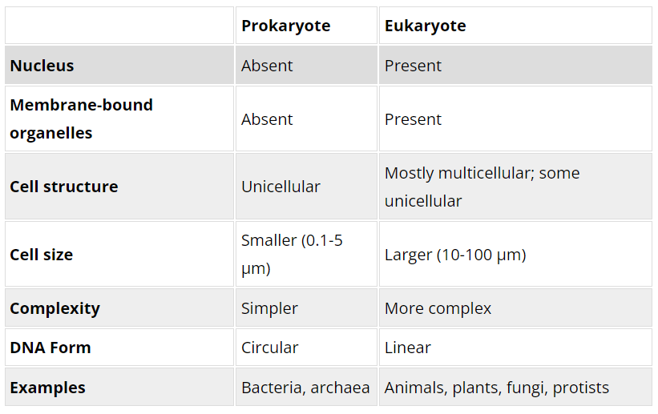

Slide 15
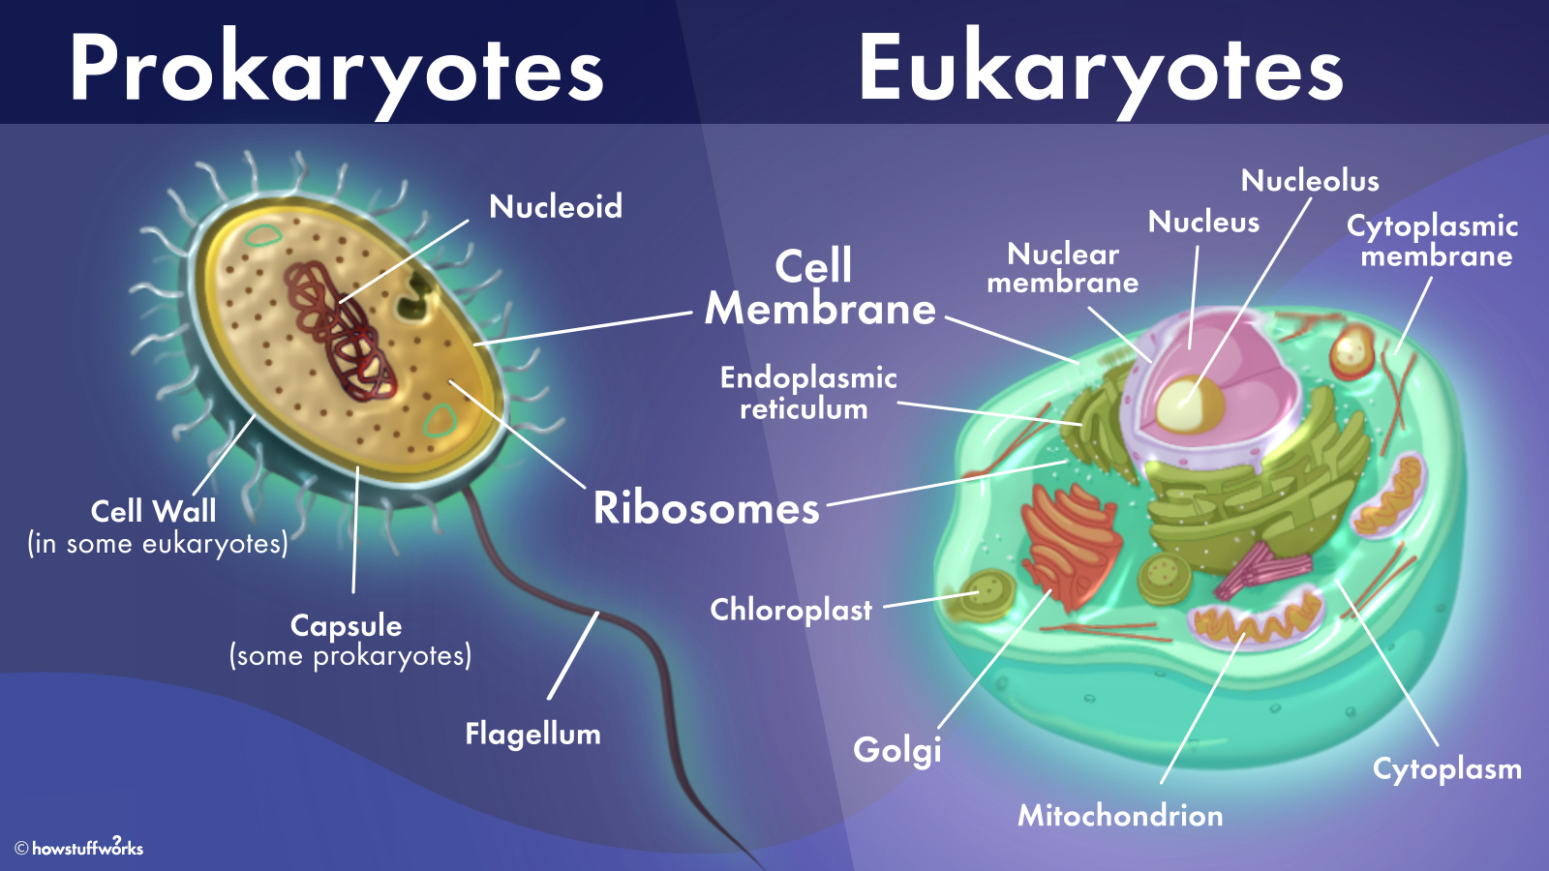

Slide 16
THANK YOU

