Slide 1
Homeostasis
KHUSHAL KHAN
Demonstrator cardiology
Khyber medical university – institute of paramedical sciences

Slide 2
Title Layout
External environment
Internal environment
Differences between ICF & ECF
Homeostasis
Mechanism of homeostasis
Blood circulatory system
Origin and removal of nutrients and wastes
Regulation of body systems
Control systems of the body
Survival of the body

Slide 3
External Environment
The external environment surrounds the body and is the source of oxygen and nutrients required by all body cells.
Waste products of cellular activity are eventually excreted into the external environment.
The skin provides a barrier between the dry external environment (the atmosphere) and the aqueous (water based) environment of most body cells.

Slide 4
Internal Environment
The internal environment is the water-based medium in which body cells exist.
Cells are bathed in fluid called interstitial or tissue fluid.
Oxygen and other substances they require must travel from the internal transport systems through the interstitial fluid to reach the cells.
Similarly, cellular waste products must move through the interstitial fluid and transport systems to the excretory organs to be excreted.
About 50% to 70% of the adult human body is fluid, mainly a water solution of ions and other substances.
Although most of this fluid is inside the cells and is called intracellular fluid, about one-third is in the spaces outside the cells and is called extracellular fluid.

Slide 5
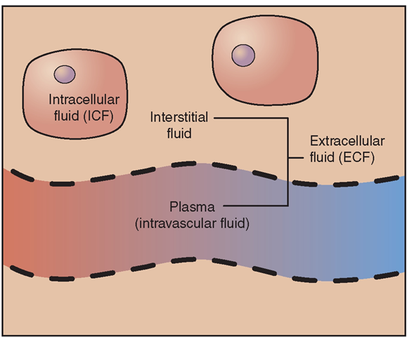
This extracellular fluid is in constant motion throughout the body.
It is transported rapidly in the circulating blood and then mixed between the blood and tissue fluids by diffusion through the capillary walls.
In the extracellular fluid are the ions and nutrients needed by the cells to maintain life.
Thus, all cells live in essentially the same environment—the extracellular fluid.

Slide 6
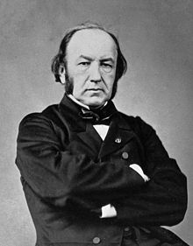
The extracellular fluid is also called the internal environment of the body, or the milieu intérieur, a term introduced by the great 19th-century French physiologist Claude Bernard – Father of Physiology.
Claude Bernard is known as the Father of Physiology.

Slide 7
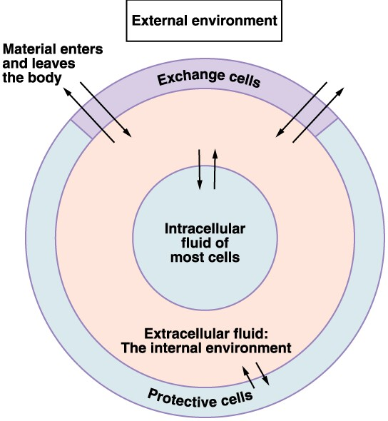
Cells are capable of living and performing their special functions as long as the proper concentrations of oxygen, glucose, different ions, amino acids, fatty substances, and other constituents are available in this internal environment.

Slide 8
Differences between ECF and ICF
The extracellular fluid contains large amounts of sodium, chloride, and bicarbonate ions as well as nutrients for the cells, such as oxygen, glucose, fatty acids, and amino acids.
It also contains carbon dioxide that is being transported from the cells to the lungs to be excreted, plus other cellular waste products that are being transported to the kidneys for excretion.
The intracellular fluid contains large amounts of potassium, magnesium, and phosphate ions instead of the sodium and chloride ions found in the extracellular fluid.
Special mechanisms for transporting ions through the cell membranes maintain the ion concentration differences between the extracellular and intracellular fluids.

Slide 9
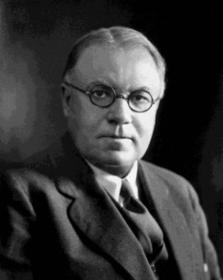
Homeostasis
An American physiologist Walter Cannon, coined the term homeostasis to describe the maintenance of nearly constant conditions in the internal environment.
The ability of an organism to maintain internal stability - Homeostasis
All organs and tissues of the body perform functions that help maintain these relatively constant conditions.
For example;
Lungs provide oxygen to the extracellular fluid to replenish the oxygen used by the cells.
Kidneys maintain constant ion concentrations.
Gastrointestinal system provides nutrients while eliminating waste from the body.

Slide 10
Homeostatic Compensations in Diseases
Disease is considered to be a state of disrupted homeostasis.
However, even in the presence of disease, homeostatic mechanisms continue to operate and maintain vital functions through multiple compensations.
In some cases, these compensations may lead to major deviations of the body’s functions from the normal range, making it difficult to distinguish the primary cause of the disease from the compensatory responses.
For example, diseases that impair the kidneys’ ability to excrete salt and water may lead to high blood pressure, which initially helps return excretion to normal so that a balance between intake and renal excretion can be maintained. This balance is needed to maintain life, but, over long periods of time, the high blood pressure can damage various organs, including the kidneys, causing even greater increases in blood pressure and more renal damage.

Slide 11
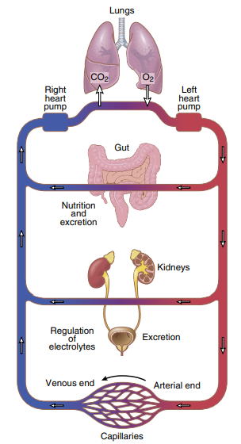
The Blood Circulatory System
Extracellular fluid is transported through the body in two stages.
The first stage is movement of blood through the body in the blood vessels.
The second is movement of fluid between the blood capillaries and the intercellular spaces between the tissue cells.
All the blood in the circulation traverses the entire circuit an average of once each minute when the body is at rest and as many as six times each minute when a person is extremely active.

Slide 12
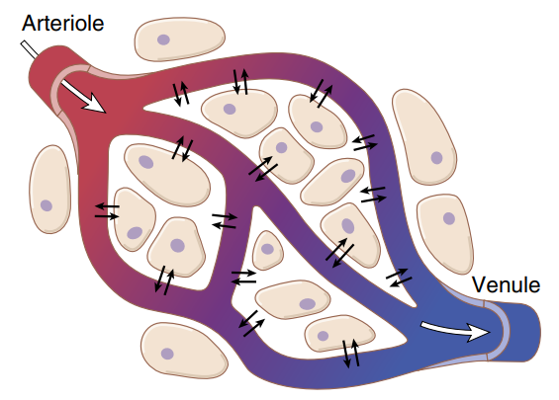
As blood passes through blood capillaries, continual exchange of extracellular fluid occurs between the plasma of the blood and the interstitial fluid that fills the intercellular spaces.
The capillary walls are permeable to most molecules in the blood plasma, with the exception of plasma proteins, which are too large to pass through capillaries.
Therefore, large amounts of fluid and its dissolved constituents diffuse back and forth between the blood and the tissue spaces.
This process of diffusion is caused by kinetic motion of the molecules in the plasma and the interstitial fluid.

Slide 13
Thus, the extracellular fluid everywhere in the body both that of the plasma and that of the interstitial fluid, is continually being mixed, thereby maintaining homogeneity of extracellular fluid throughout the body.

Slide 14
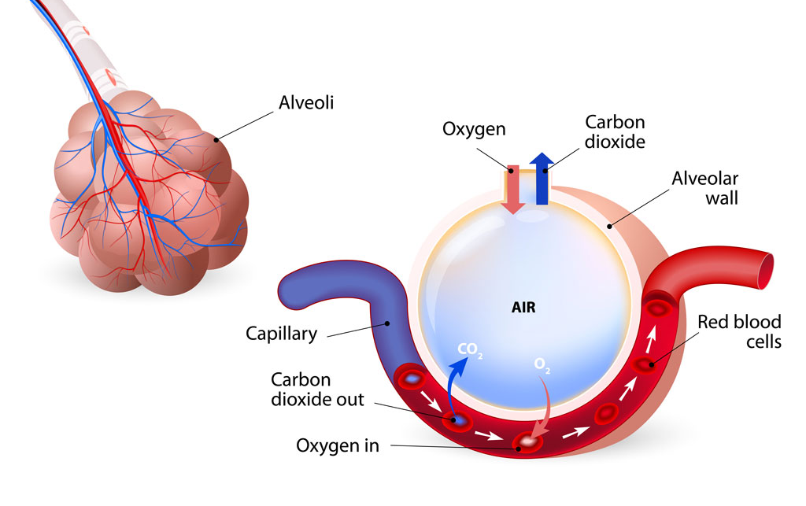
Origin Of Nutrients In The ECF
1- Respiratory System
Respiratory System provides oxygen to the blood.
As the blood flows through the lungs, the blood picks up oxygen in the alveoli and transported to the cells.
The membrane between the alveoli and the lumen of the pulmonary capillaries, the alveolar membrane, is only 0.4 to 2.0 micrometres thick, and oxygen rapidly diffuses by molecular motion through this membrane into the blood.

Slide 15
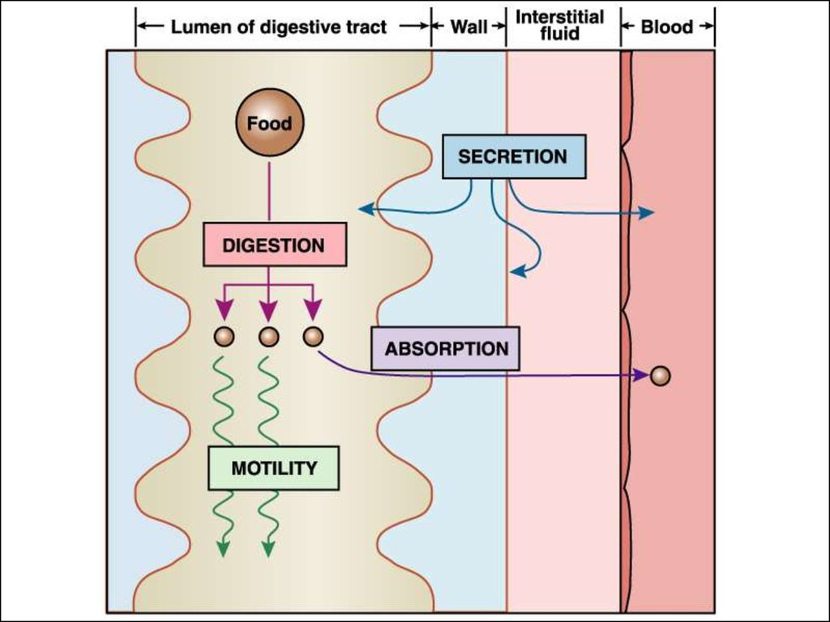
2- Gastrointestinal Tract
A large portion of the blood pumped by the heart also passes through the walls of the gastrointestinal tract.
Here different dissolved nutrients, including carbohydrates, fatty acids, and amino acids, are absorbed from ingested food into the extracellular fluid of the blood.

Slide 16
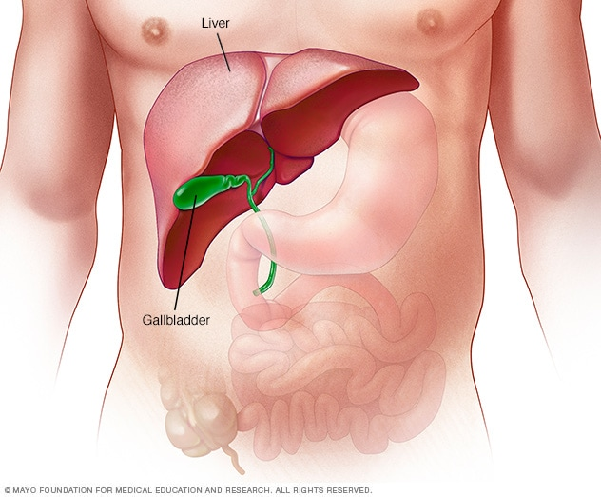
3- Liver and Other Organs with Metabolic Functions
The liver changes the chemical compositions of many of these substances to more usable forms.
The liver also eliminates certain waste products produced in the body and toxic substances that are ingested.
Fat cells, gastrointestinal mucosa, kidneys, and endocrine glands—help modify the absorbed substances or store them until they are needed.

Slide 17
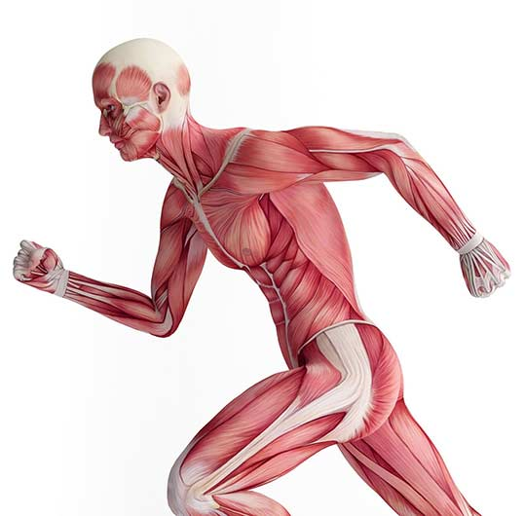
4- Musculoskeletal System
The body move to obtain the foods required for nutrition with the help of muscles.
The musculoskeletal system also provides motility for protection against adverse surroundings, without which the entire body, along with its homeostatic mechanisms, could be destroyed.

Slide 18
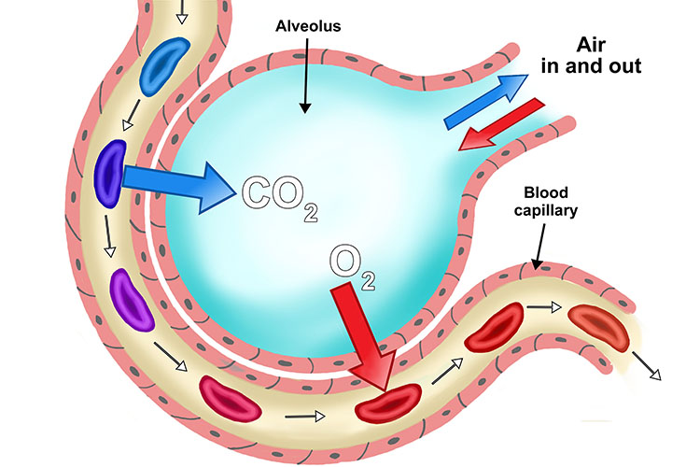
Removal of Metabolic End Products
1- Respiratory System
At the same time when blood picks up oxygen in the lungs, carbon dioxide is released from the blood into lung alveoli; the respiratory movement of air into and out of the lungs carries carbon dioxide to the atmosphere.
Carbon dioxide is the most abundant of all the metabolism products.

Slide 19
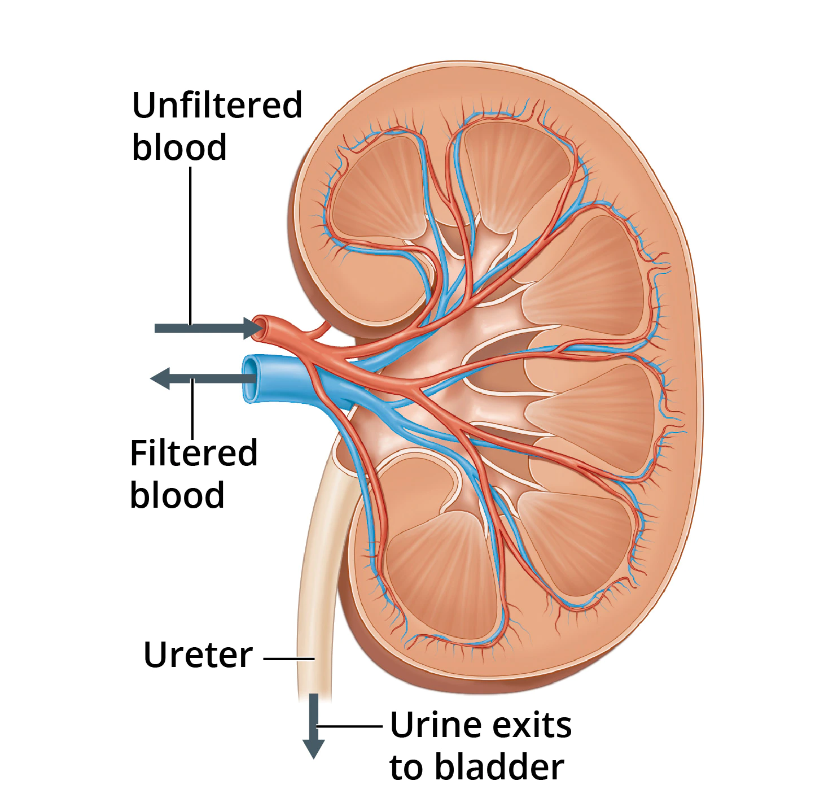
2- Kidneys
The different end products of cellular metabolism, such as urea and uric acid are not needed by the body are removed by the kidneys.
The kidneys perform their function first by filtering large quantities of plasma through the glomerular capillaries into the tubules and then reabsorbing into the blood substances needed by the body, such as glucose, amino acids, appropriate amounts of water, and many of the ions.

Slide 20
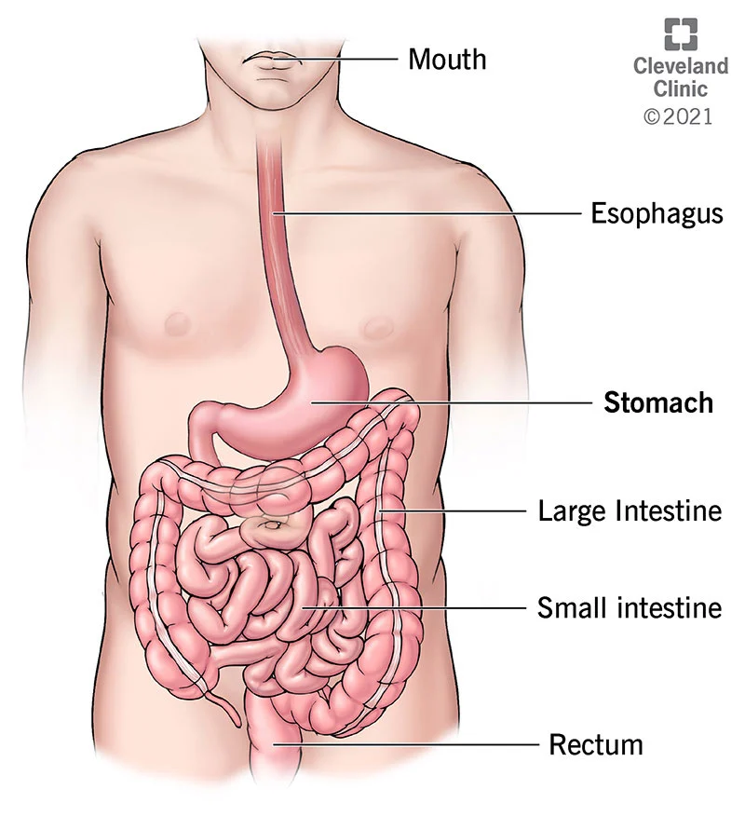
3- Gastrointestinal Tract
Undigested material that enters the gastrointestinal tract and some waste products of metabolism are eliminated in the feces.
Liver plays a vital role in detoxification or removal of ingested drugs and chemicals.
The liver secretes many of these wastes into the bile to be eventually eliminated in the feces.

Slide 21
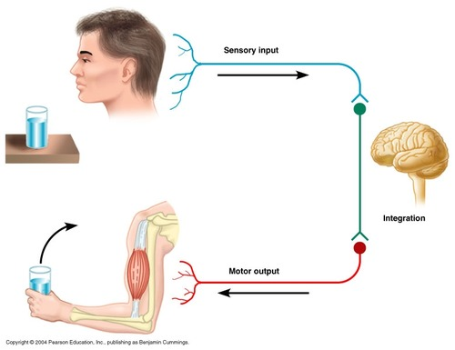
Regulation Of Body Functions
1- Nervous System
The nervous system is composed of three major parts;
  The sensory input portion
  The central nervous system (or integrative portion)
  The motor output portion

Slide 22
Sensory receptors detect the state of the body and its surroundings.
  For example, receptors in the skin alert us whenever an object touches the skin.
  The eyes are sensory organs that give us a visual image of the surrounding area.
  The ears are also sensory organs.
The central nervous system is composed of the brain and spinal cord.
  The brain stores information, generates thoughts, creates ambition, and determines reactions that the body performs in response to the sensations.
Appropriate signals are then transmitted through the motor output portion of the nervous system to carry out one’s desires.
Autonomic nervous system
  It operates at a subconscious level and controls many functions of internal organs, including the pumping activity by the heart, movements of the gastrointestinal tract, and secretion by many of the body’s glands.

Slide 23
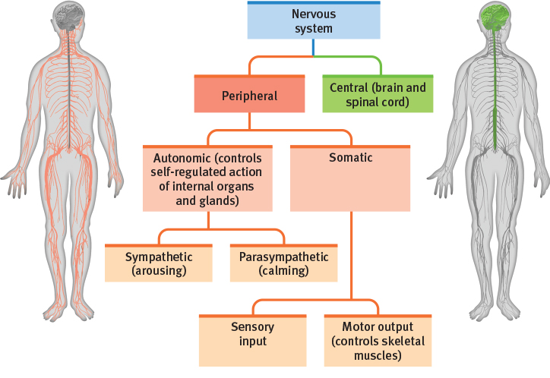

Slide 24
2- Hormone Systems
The hormonal system - also called the endocrine system.
It is a network of glands and organs in the body that produces hormones.
Gland: An organ that makes one or more substances, such as hormones, digestive juices, sweat, tears, saliva, or milk.
Several glands make hormones, including the hypothalamus, the pituitary gland, the pineal gland, the thyroid gland, the parathyroid glands, the adrenal glands, the pancreas, ovaries and testes.
Hormones are transported in the extracellular fluid to other parts of the body to help regulate cellular function.

Slide 25
For example,
  Thyroid hormone increases the rates of most chemical reactions in all cells.
  Insulin controls glucose metabolism.
  Adrenocortical hormones control sodium and potassium ions and protein metabolism.
  Parathyroid hormone controls bone calcium and phosphate.
The hormones provide a regulatory system that complements the nervous system.
The nervous system controls many muscular and secretory activities of the body, whereas the hormonal system regulates many metabolic functions.
The nervous and hormonal systems normally work together in a coordinated manner to control essentially all the organ systems of the body.

Slide 26
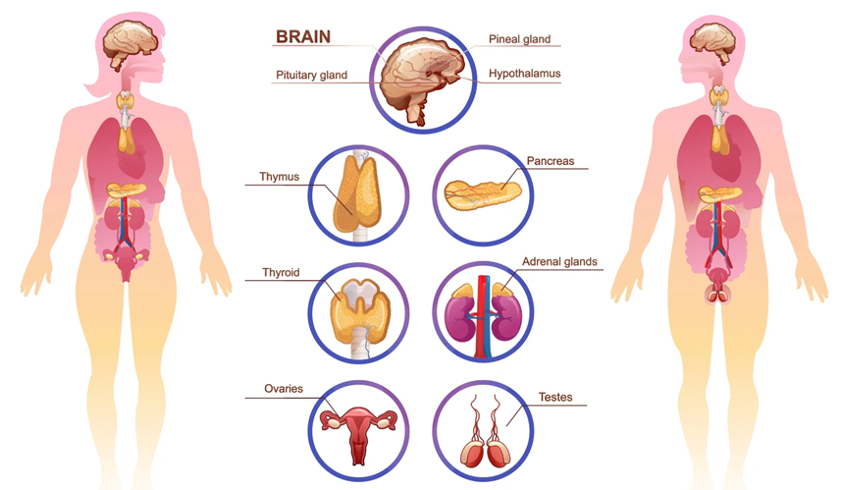

Slide 27
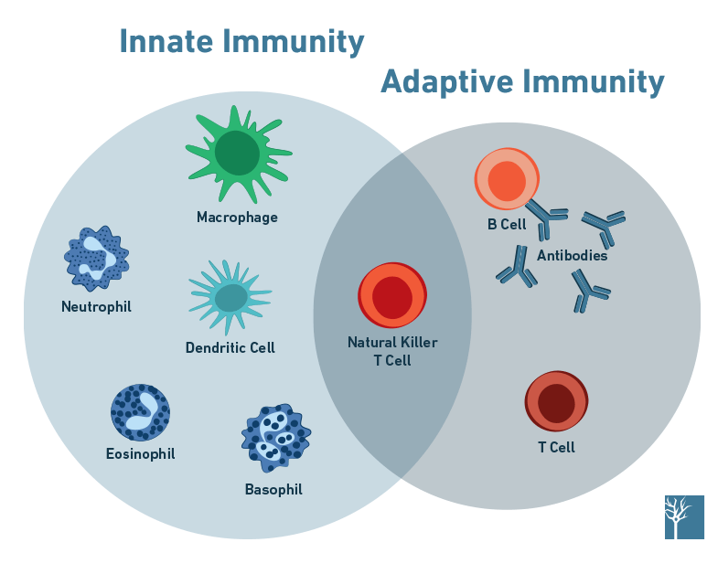
Protection Of The Body
1- Immune System
The immune system includes white blood cells, tissue cells derived from white blood cells, the thymus, lymph nodes, and lymph vessels that protect the body from pathogens such as bacteria, viruses, parasites, and fungi.
The immune system provides a mechanism for the body to carry out the following:
Distinguish its own cells from harmful foreign cells and substances.
Destroy the invader by phagocytosis or by producing sensitized lymphocytes or specialized proteins (e.g., Antibodies) that destroy or neutralize the invader.

Slide 28
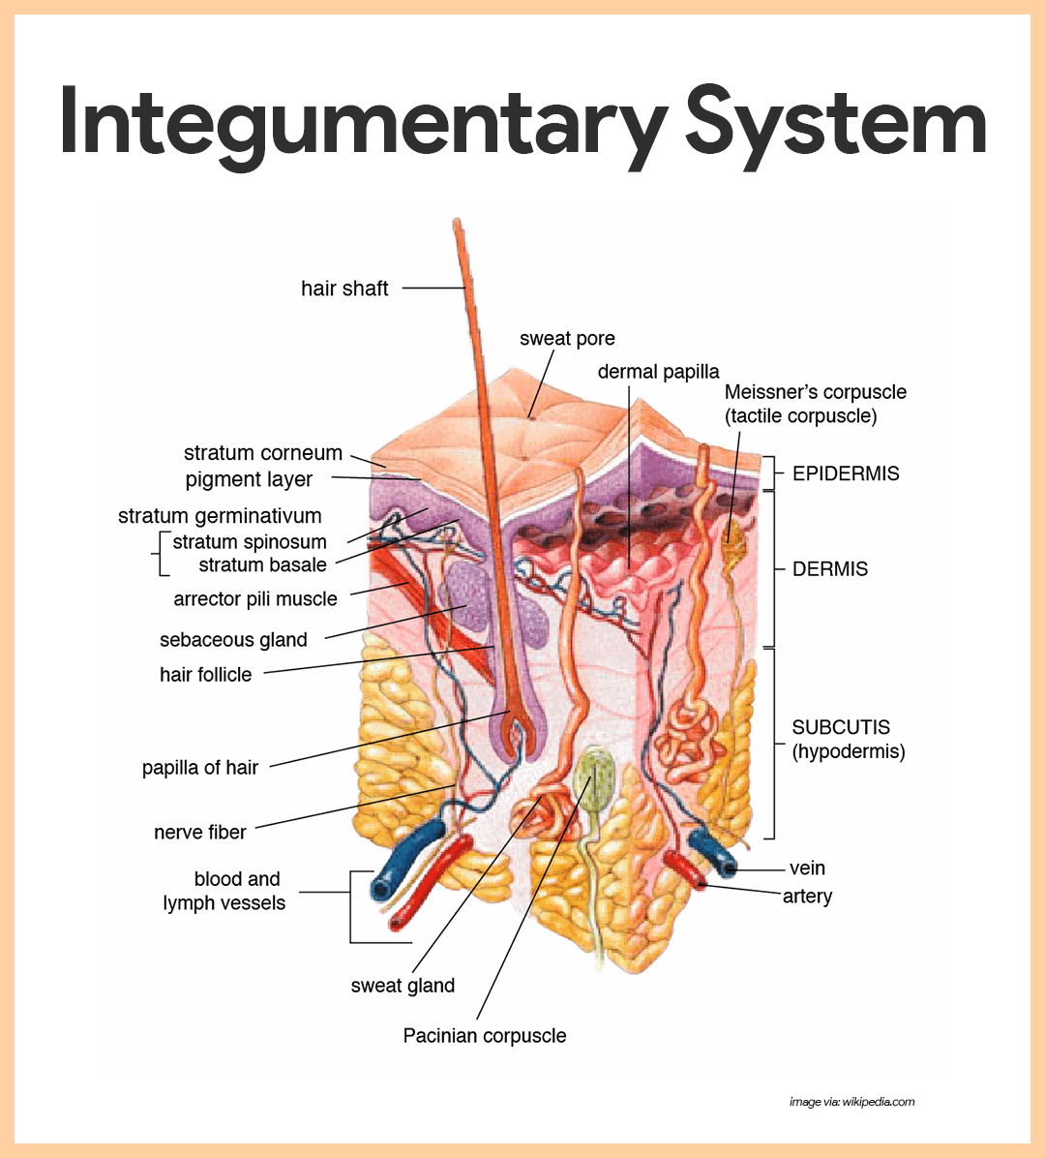
2- Integumentary System
The skin and its various appendages (including the hair, nails, glands, and other structures) cover, cushion, and protect the deeper tissues and organs of the body.
It provides a boundary between the body’s internal environment and the outside world.
The integumentary system is also important for temperature regulation and excretion of wastes.
It provides a sensory interface between the body and the external environment.
The skin generally comprises about 12% to 15% of body weight.

Slide 29
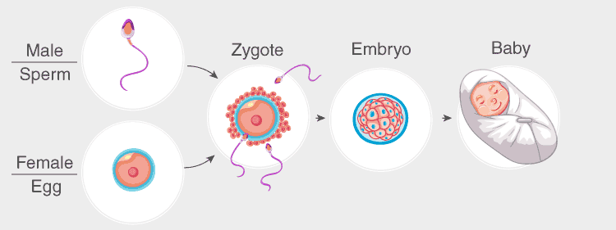
3- Reproduction
Although reproduction is sometimes not considered a homeostatic function, it helps maintain homeostasis by generating new beings to take the place of those that are dying.
Reproduction illustrates that essentially all body structures are organized to help maintain the automaticity and continuity of life.

Slide 30
Control Systems Of The Body
The human body has thousands of control systems.
Some of the most complex of these systems are genetic control systems that operate in all cells to help regulate intracellular and extracellular functions.
Many other control systems operate within the organs to regulate functions of the individual parts of the organs.
Some operate throughout the entire body to control the interrelationships between the organs.
For example;
The respiratory system, operating in association with the nervous system, regulates the concentration of carbon dioxide in the extracellular fluid.
The liver and pancreas control glucose concentration in the extracellular fluid.
The kidneys regulate concentrations of hydrogen, sodium, potassium, phosphate, and other ions in the extracellular fluid.

Slide 31
1- Feedback Mechanism
A feedback mechanism is a physiological regulation system in a living body that works to return the body to its normal internal state, or commonly known as homeostasis.
In nature, feedback mechanisms can be found in a variety of environments and animal types.
In a living system, the feedback mechanism takes the shape of a loop, which aids in maintaining homeostasis.
The feedback mechanism is triggered when the system undergoes a change that causes an output.
The biochemical control system in living beings is made up of a variety of components, including chemicals, genes, and their regulatory connections.

Slide 32
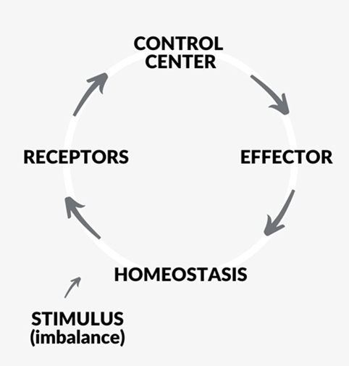
Feedback mechanism is a loop system in which the system responds to changes either in the same direction (positive feedback) or in the opposite direction (negative feedback).
In a biological sense, a feedback mechanism involves a biological process, a signal, or a mechanism that tends to initiate (or accelerate) or to inhibit (or slow down) a process.

Slide 33
Negative Feedback Mechanism
A negative feedback mechanism, often known as negative feedback homeostasis, is a pathway that is triggered by a deviation in output and produces changes in output in the opposite direction of the initial deviation.
After the control unit analyses the magnitude of the deviation, the negative feedback mechanism drives the variable factors towards a stable state or homeostasis.
Positive feedback loops are less prevalent than negative feedback loops because negative feedback loops tend to stabilize the system.

Slide 34
Steps in a negative feedback mechanism
Stimulation
  The development of stimuli as a result of physiological parameter deviations from the normal value is the initial stage in the negative feedback loop.
  Physiological parameters can deviate from the norm in either direction.
Reception
  The control unit receives changes in physiological parameters through a variety of receptors located throughout the body.
  Nerves and other thermoreceptors are examples of common receptors engaged in stimulus transmission.
Processing
  The brain serves as the loop’s control unit, determining whether a change in a physiological parameter necessitates loop activation or inhibition.
  The brain sends out signals to erase the alterations in different ways depending on the direction of departure.
Counteract on the stimulus
  The control unit sends out signals at the end of the loop to cancel out the impacts that cause changes in physiological variables.
  Changes can take several forms and be directed at different sections of the body.

Slide 35
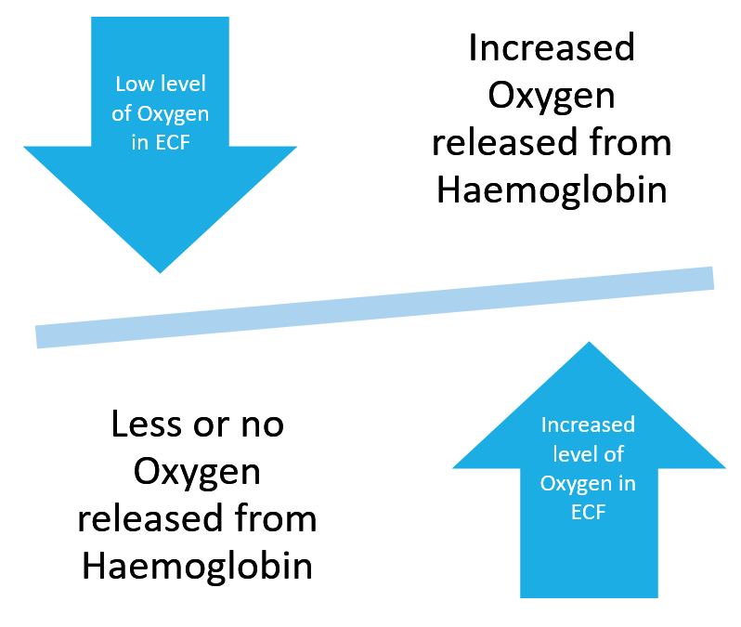
Regulation of O2 Concentrations in ECF
Oxygen is one of the major substances required for chemical reactions in cells, the body has a special control mechanism to maintain an almost exact and constant oxygen concentration in the extracellular fluid.
This mechanism depends principally on the chemical characteristics of haemoglobin, which is present in red blood cells.
This regulation is called the oxygen-buffering function of haemoglobin.

Slide 36
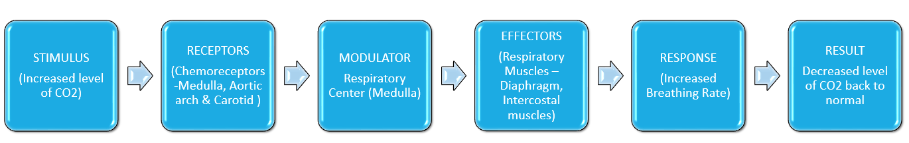
Regulation of CO2 Concentrations in ECF
Carbon dioxide is a major end product of oxidative reactions in cells.
If all the carbon dioxide formed in the cells continued to accumulate in the tissue fluids, all energy-giving reactions of the cells would cease.

Slide 37
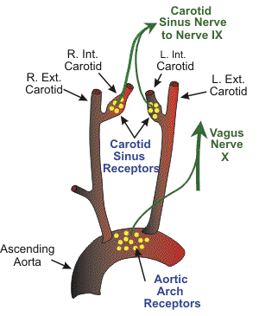
Regulation of Arterial Blood Pressure
Several systems contribute to arterial blood pressure regulation. One of these, the baroreceptor system.
When arterial pressure rises too high, the baroreceptors send barrages of nerve impulses to the medulla of the brain.
Here, these impulses inhibit the vasomotor center, which in turn decreases the number of impulses transmitted from the vasomotor center through the sympathetic nervous system to the heart and blood vessels.
Lack of these impulses causes diminished pumping activity by the heart and dilation of peripheral blood vessels, allowing increased blood flow through the vessels.
Both these effects decrease the arterial pressure, moving it back toward normal.
Conversely, a decrease in arterial pressure below normal relaxes the stretch receptors, allowing the vasomotor center to become more active than usual, thereby causing vasoconstriction and increased heart pumping.
The initial decrease in arterial pressure thus initiates negative feedback mechanisms that raise arterial pressure back toward normal.

Slide 38
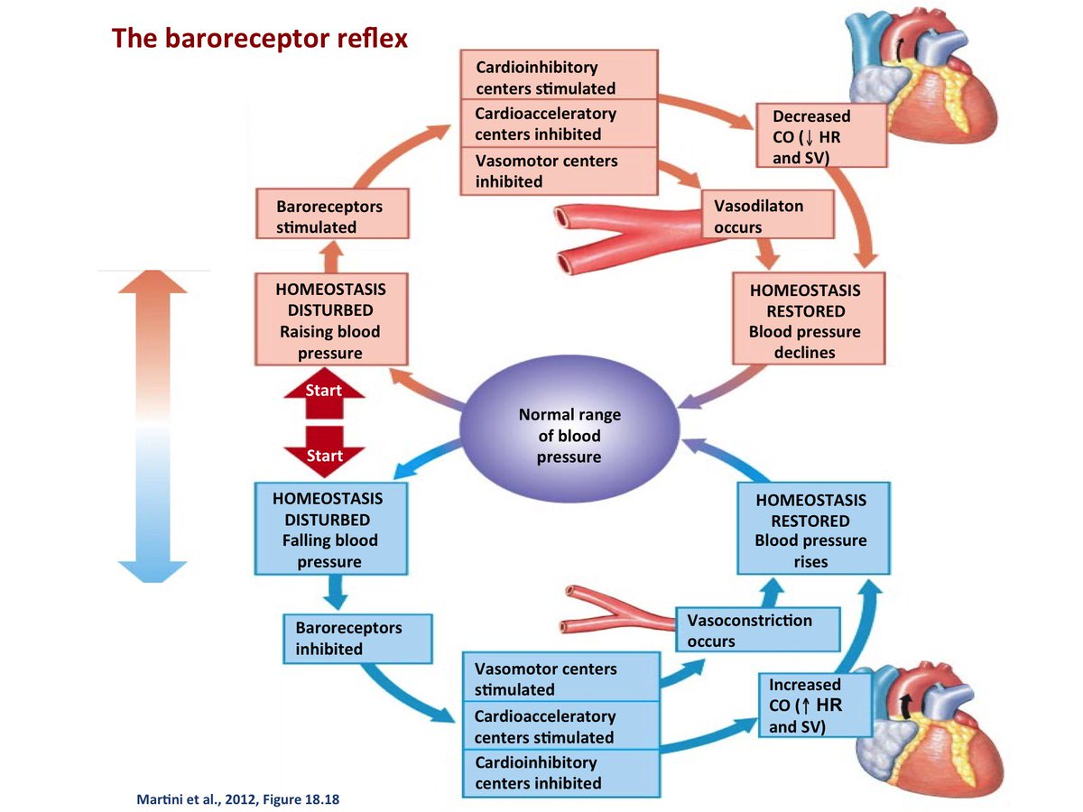

Slide 39
Regulating Temperature
When the body’s temperature rises above normal, the brain sends signals to various organs, including the skin, to release heat in the form of sweat.
These physiological actions cause the temperature to drop to the point where the negative feedback mechanism’s pathways are shut down.
When the body temperature rises above its typical level in order to preserve homeostasis, a similar mechanism happens.

Slide 40
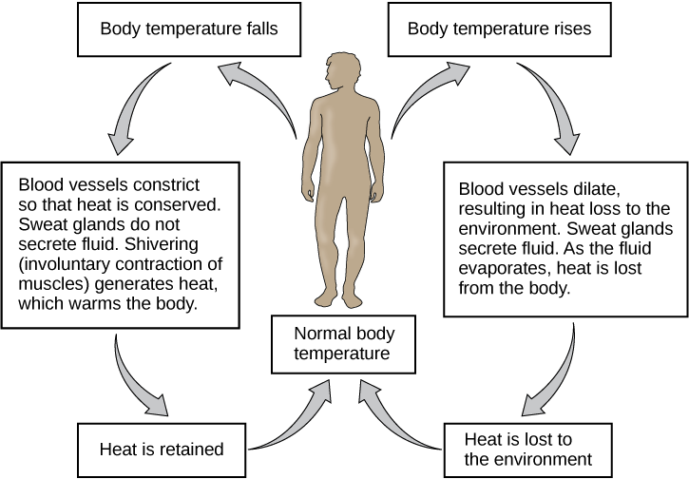

Slide 41
Regulating Blood Glucose Level
A negative feedback mechanism regulates the concentration of glucose in the blood.
More glucose is absorbed in the gut and stored in the form of glycogen in the liver when blood glucose levels rise above the usual range.
Insulin secretion from the pancreas is in charge of conversion and conservation.
Insulin encourages glucose absorption in the muscles and liver.
When blood glucose levels drop and more glucose is needed in the blood, insulin release is suppressed, which reduces blood glucose absorption.

Slide 42
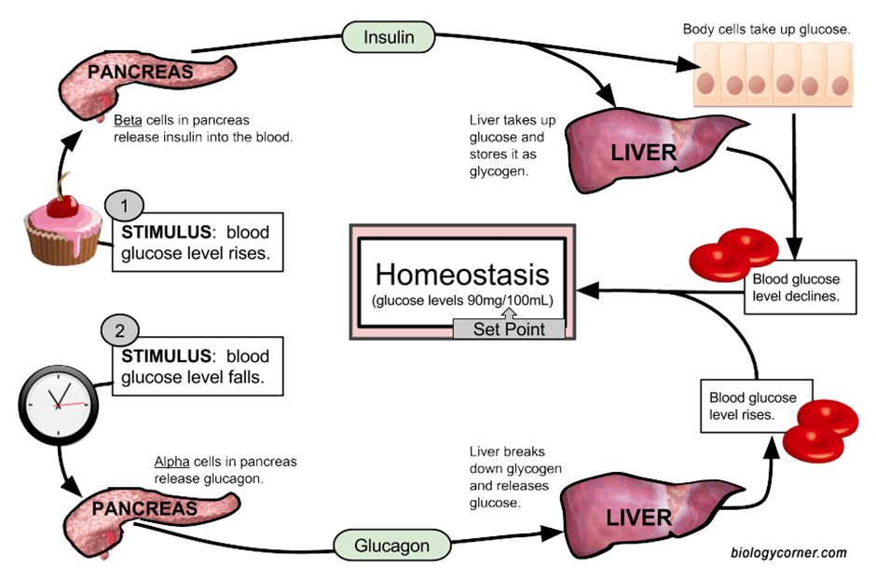

Slide 43
Positive Feedback Mechanism
A positive feedback mechanism or positive feedback homeostasis is a pathway that, in response to an output variation, causes the output to vary even more in the direction of the initial deviation.
A positive feedback system amplifies deviations and causes output state changes.
Because it moves the body away from homeostasis, positive feedback mechanisms are significantly less common than negative feedback mechanisms.
As long as the stimulus (example: the presence of the stimulant) is maintained, the positive feedback system gradually increases the reaction.
A single component that activates its own activity or numerous components with direct and indirect interactions might make up a positive feedback loop.
Positive feedback loops in biological processes are common in processes that need to happen fast and efficiently, as the output tends to magnify the stimulus’ influence.

Slide 44
Steps of Positive Feedback Mechanism
Stimulation
  The stimulation that initiates the positive feedback loop in order to complete a process is the initial step.
  Hormones released by various organs as a result of the start of a process are the most common stimuli in the human body.
Reception
  The second step in the loop is the reception of stimuli via various sensors, which provide data to the control unit.
  These receptors are mostly nerves that transmit signals from the stimulus location to the control unit, which is the brain in humans.
Processing
  The processing of information supplied to the control unit by the receptors is the next phase in the loop.
  The control unit tallies the data and displays an output if the stimulus is outside the typical range of the value.
Stimuli are activated even more
  In order to induce an output in response to the stimulus, information from the brain is conveyed to the location of action via several nerves.
  The brain’s messages tend to activate the stimulus even more in the direction of deviation in the case of a positive feedback loop.

Slide 45
Positive Feedback May Cause Vicious Cycles and Death
Positive feedback leads to instability rather than stability and, in some cases, can cause death.
The heart of a healthy human pumps about 5 liters of blood per minute.
If the person suddenly bleeds a total of 2 liters, the amount of blood in the body is decreased to such a low level that not enough blood is available for the heart to pump effectively.
As a result, the arterial pressure falls, and blood flow to the heart muscle through the coronary vessels diminishes.
This results in weakening of the heart, further diminished pumping, a further decrease in coronary blood flow, and still more weakness of the heart; the cycle repeats itself again and again until death occurs.
Positive feedback is sometimes known as a “vicious cycle”.

Slide 46
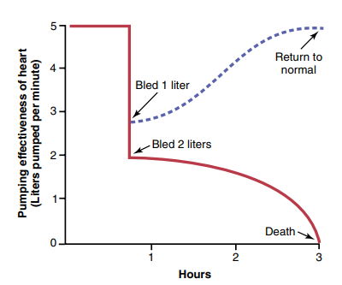
A mild degree of positive feedback can be overcome by the negative feedback control mechanisms of the body, and the vicious cycle then fails to develop.
For example, if the person in the aforementioned example bleeds only 1 liter instead of 2 liters, the normal negative feedback mechanisms for controlling cardiac output and arterial pressure can counterbalance the positive feedback and the person can recover.

Slide 47
Positive Feedback Can Sometimes Be Useful
The body sometimes uses positive feedback to its advantage.
Some examples of positive feed back mechanism are as follows;

Slide 48
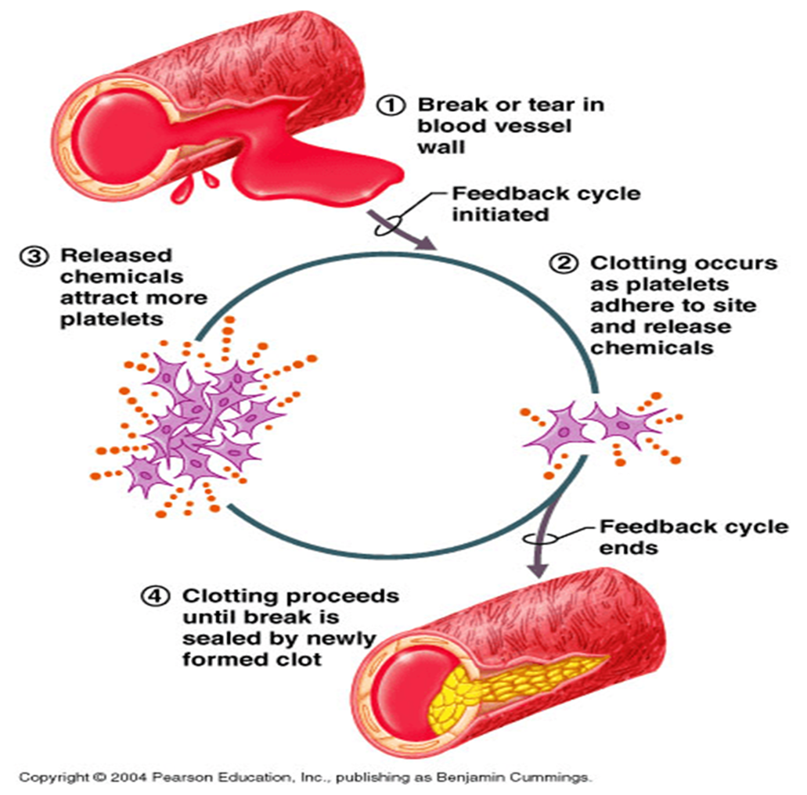
Blood Clotting
Blood clotting is an example of a valuable use of positive feedback.
When a blood vessel is ruptured, and a clot begins to form, multiple enzymes called clotting factors are activated within the clot.
Some of these enzymes act on other inactivated enzymes of the immediately adjacent blood, thus causing more blood clotting.
This process continues until the hole in the vessel is plugged and bleeding no longer occurs.
On occasion, this mechanism can get out of hand and cause formation of unwanted clots.
In fact, this is what initiates most acute heart attacks, which can be caused by a clot beginning on the inside surface of an atherosclerotic plaque in a coronary artery and then growing until the artery is blocked.

Slide 49
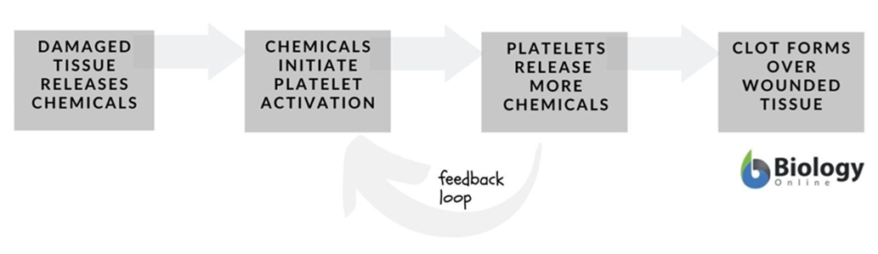

Slide 50
Childbirth
Childbirth is another situation in which positive feedback is valuable.
When uterine contractions become strong enough for the baby’s head to begin pushing through the cervix, stretching of the cervix sends signals through the uterine muscle back to the body of the uterus, causing even more powerful contractions.
Thus, the uterine contractions stretch the cervix, and cervical stretch causes stronger contractions.
When this process becomes powerful enough, the baby is born.
If they are not powerful enough, the contractions usually die out, and a few days pass before they begin again.

Slide 51
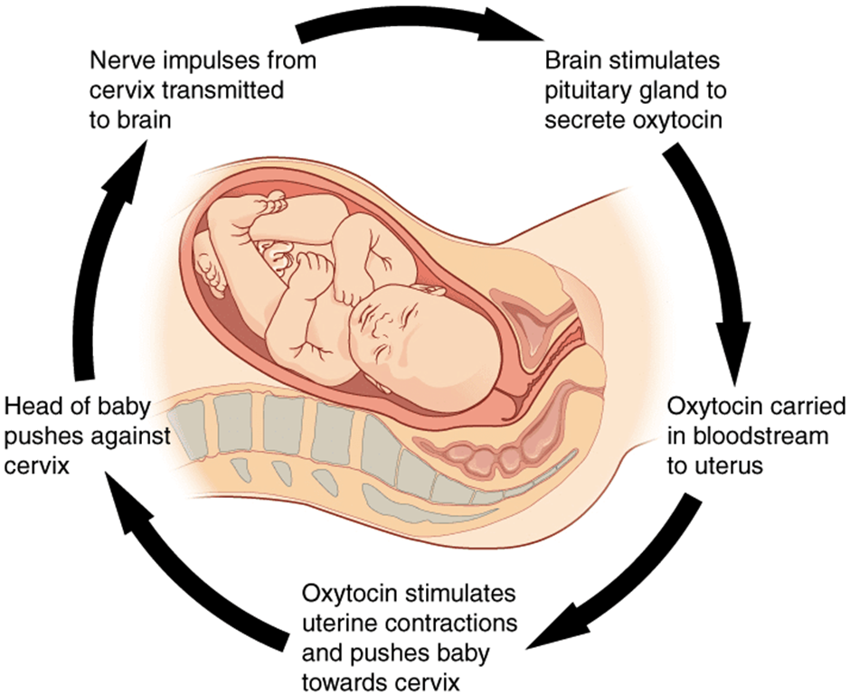
3
2
4
1
5

Slide 52
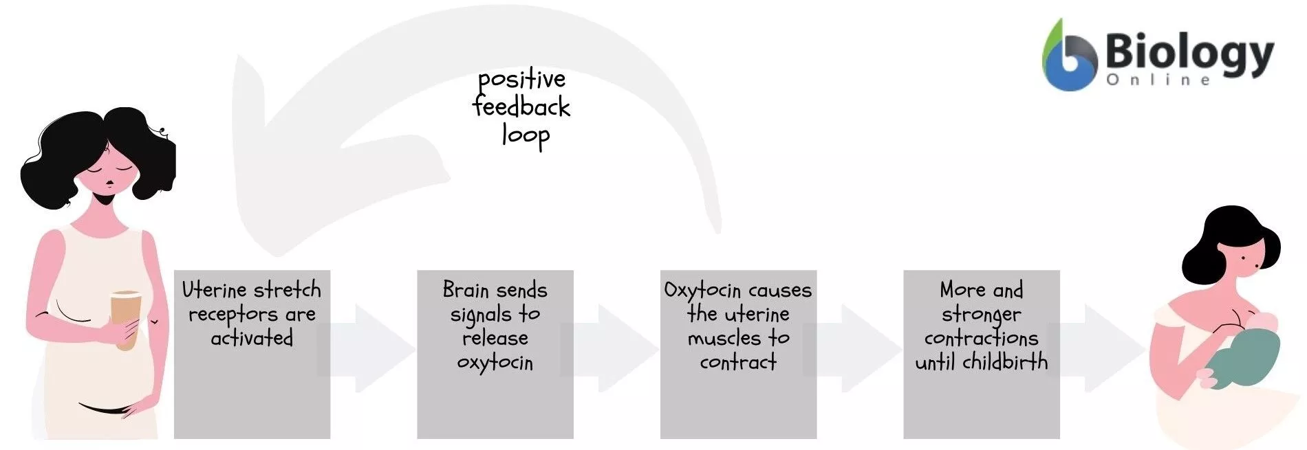

Slide 53
Generation Of Nerve Signals
Another important use of positive feedback is for the generation of nerve signals.
Stimulation of the membrane of a nerve fiber causes slight leakage of sodium ions through sodium channels in the nerve membrane to the fiber’s interior.
The sodium ions entering the fiber then change the membrane potential, which, in turn, causes more opening of channels, more change of potential, still more opening of channels, and so forth.
Thus, a slight leak becomes an explosion of sodium entering the interior of the nerve fiber, which creates the nerve action potential.
This action potential, in turn, causes electrical current to flow along the outside and inside of the fiber and initiates additional action potentials.
This process continues until the nerve signal goes all the way to the end of the fiber.

Slide 54
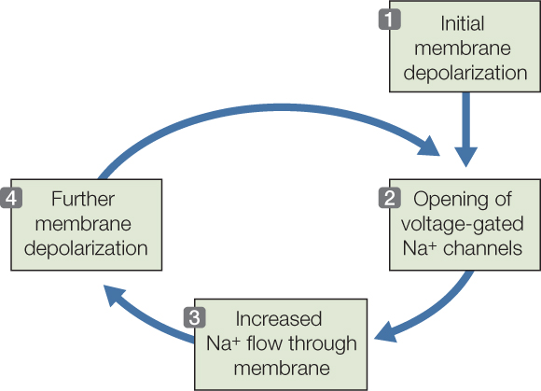

Slide 55
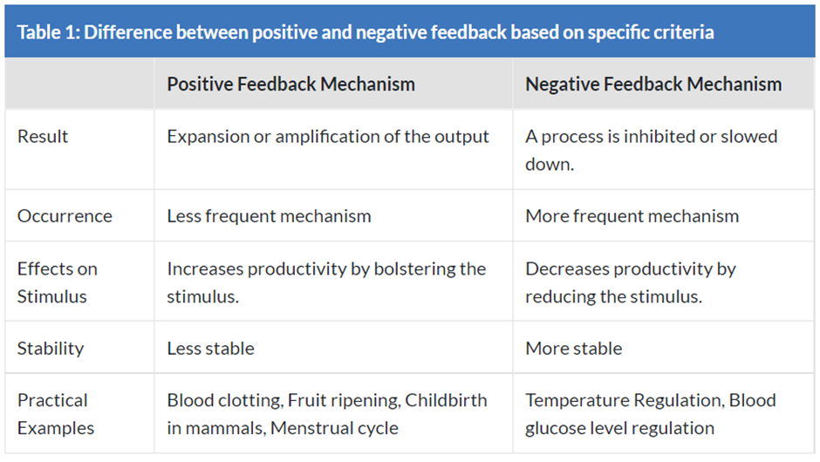
Positive vs. Negative Feedback Mechanism

Slide 56
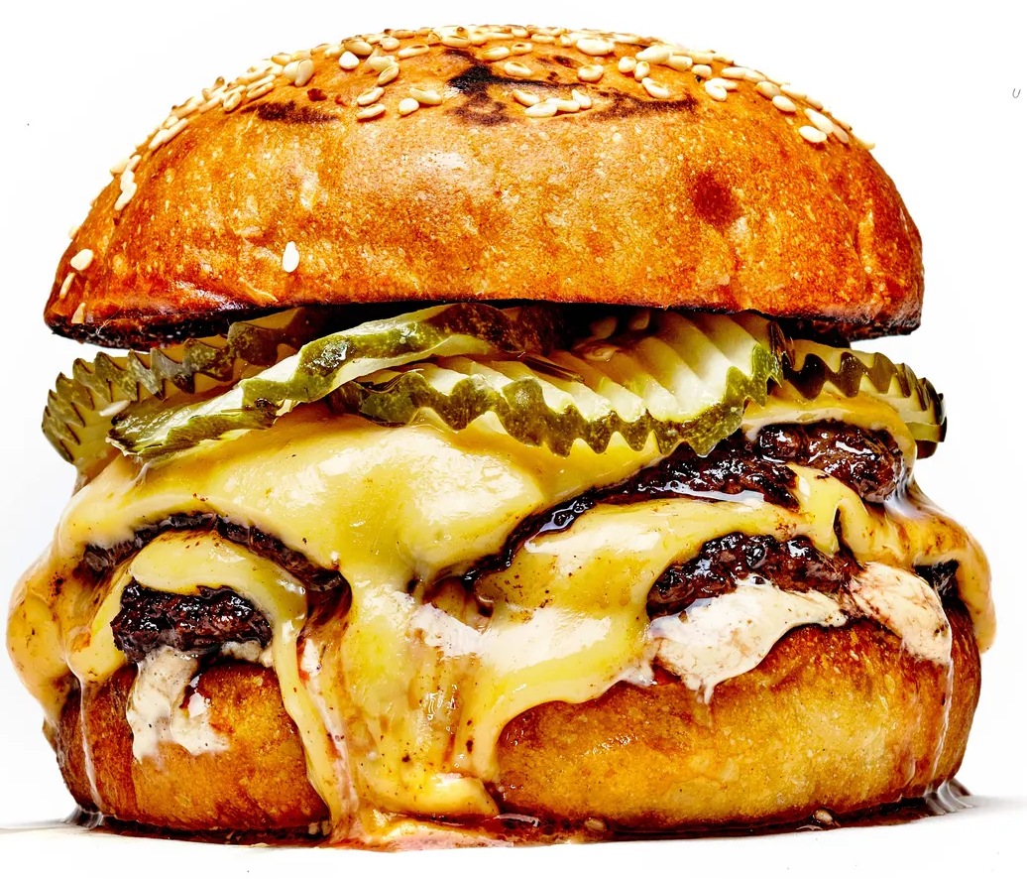
3- Feed-Forward Control
Feed-Forward control is a homeostatic control system in which the body anticipates and acts before the change occurs.
Feed-Forward control allows the body to anticipate change and bring stability.
Examples;
Salvation as a result of sight, smell or thought about food.
Rise in respiratory rate before exercise.
Increased release of insulin as a result of food in digestive tract - avoids excessive rise of glucose in blood after meal.

Slide 57
4- Adaptive Control
Adaptive Homeostasis has been defined as, “The transient expansion or contraction of the homeostatic range in response to exposure to sub-toxic, non-damaging, signaling molecules or events, or the removal or cessation of such molecules or events.”
It is when the body tries to bring homeostasis. For example, during hypertension, the heart has difficulty pushing blood out to the body. It needs a lot of pressure to do. So you know what happens? The heart muscle cells get bigger in size so they could more work to compensate for what a normal heart would do.

Slide 58
A few examples of above type of control system are —
Exercise
Oxidative stress
Body response mechanism to hypoxia
The changes that take place under food deprivation (glycogenolysis, ketone body synthesis in starvation, etc.)

Slide 59
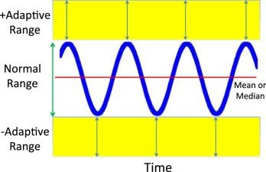

Slide 60
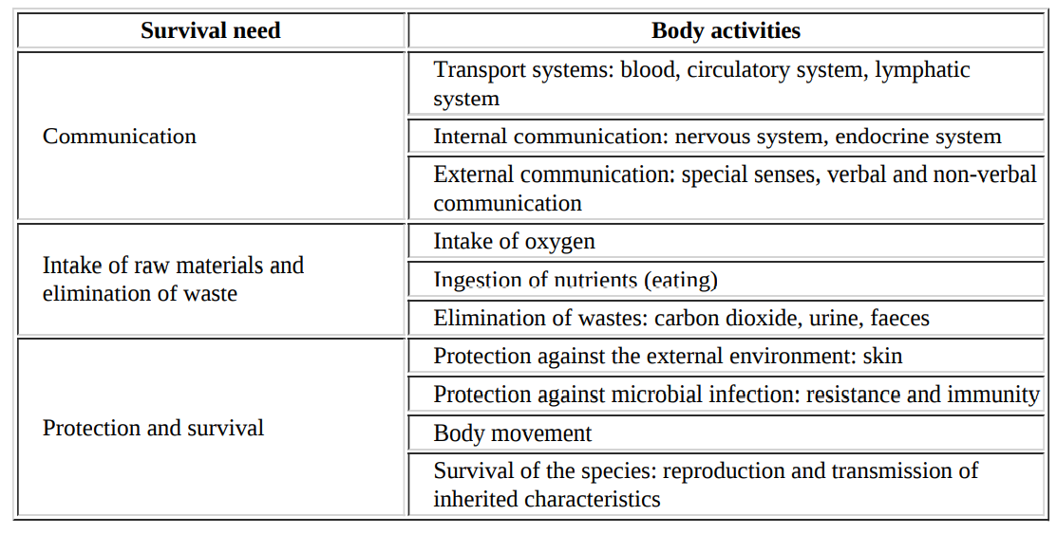
Survival of the Body

Slide 61
THANK YOU

