Slide 1
KIDNEY
AIZAZ
Demonstrator Surgical
KMU-IPMS Peshawar

Slide 2
KIDNEYS
The kidneys are bilateral bean-shaped organs, reddish-brown in color and located in the posterior abdomen.
Their main function is to filter and excrete waste products from the blood. They are also responsible for water and electrolyte balance in the body.
Metabolic waste and excess electrolytes are excreted by the kidneys to form urine. Urine is transported from the kidneys to the bladder by the ureters. It leaves the body via the urethra, which opens out into the perineum in the female and passes through the penis in the male.

Slide 3
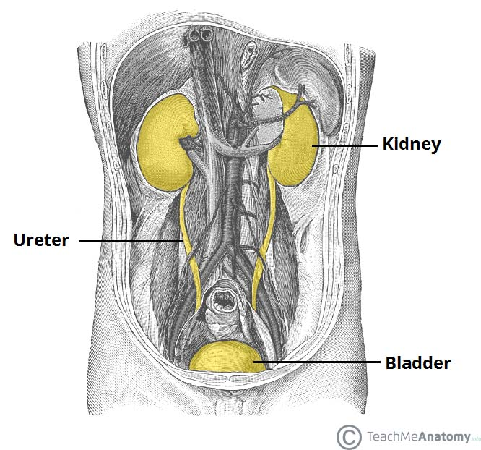

Slide 4
Anatomical Position
lie retroperitoneally in the abdomen, either side of the vertebral column.
They typically extend from T12 to L3, although the right kidney is often situated slightly lower due to the presence of the liver. Each kidney is approximately three vertebrae in length.
The adrenal glands sit immediately superior to the kidneys within a separate envelope of the renal fascia.

Slide 5
Structure
The kidneys are encased in complex layers of fascia and fat. They are arranged as follows (deep to superficial):
  Renal capsule – tough fibrous capsule.
  Perirenal fat – collection of extraperitoneal fat.
  Renal fascia (also known as Gerota’s fascia or perirenal fascia) – encloses the kidneys and the suprarenal glands.
  Pararenal fat – mainly located on the posterolateral aspect of the kidney.

Slide 6
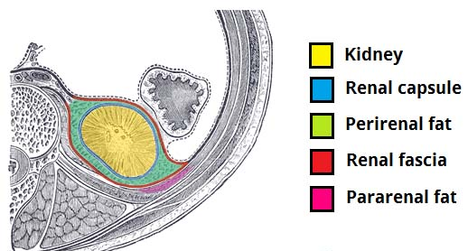

Slide 7
Structure
Internally, the kidneys have an complex and unique structure.
The renal parenchyma can be divided into two main areas – the outer cortex and inner medulla.
The cortex extends into the medulla, dividing it into triangular shapes known as renal pyramids.
The apex of a renal pyramid is called a renal papilla.
Each renal papilla is associated with a structure known as the minor calyx, which collects urine from the pyramids.
Several minor calices merge to form a major calyx.

Slide 8
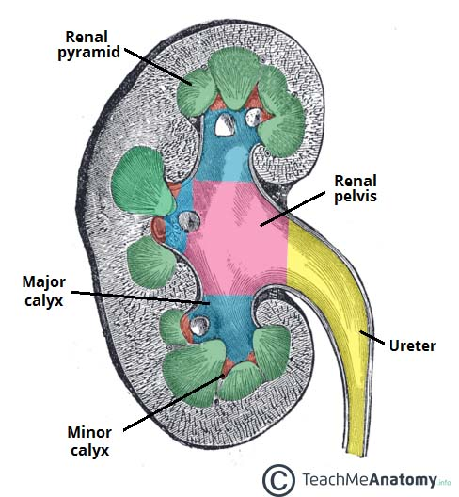

Slide 9
Structure
Urine passes through the major calices into the renal pelvis, a flattened and funnel-shaped structure.
From the renal pelvis, urine drains into the ureter, which transports it to the bladder for storage.
The medial margin of each kidney is marked by a deep fissure, known as the renal hilum. This acts as a gateway to the kidney –
Normally the renal vessels and ureter enter/exit the kidney via this structure.

Slide 10
Kidney | Anterior | Posterior
Left | Suprarenal gland Spleen Stomach Pancreas Left colic flexure Jejunum | Diaphragm 11th and 12th ribs Psoas major, quadratus lumborum and transversus abdominis Subcostal, iliohypogastric and ilioinguinal nerves
Right | Suprarenal gland Liver Duodenum Right colic flexure | Diaphragm 12th rib Psoas major, quadratus lumborum and transversus abdominis Subcostal, iliohypogastric and ilioinguinal nerves

Slide 11
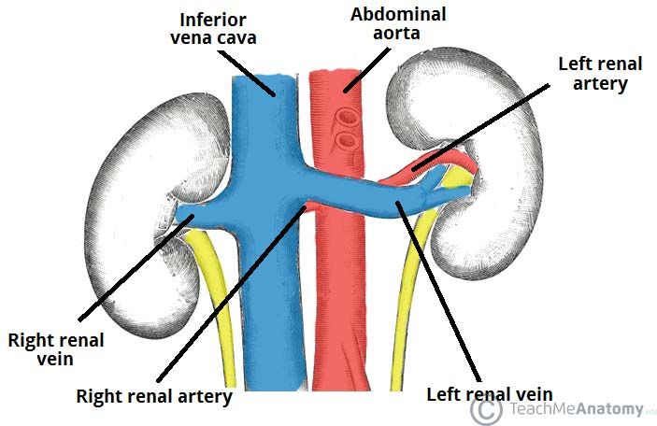

Slide 12
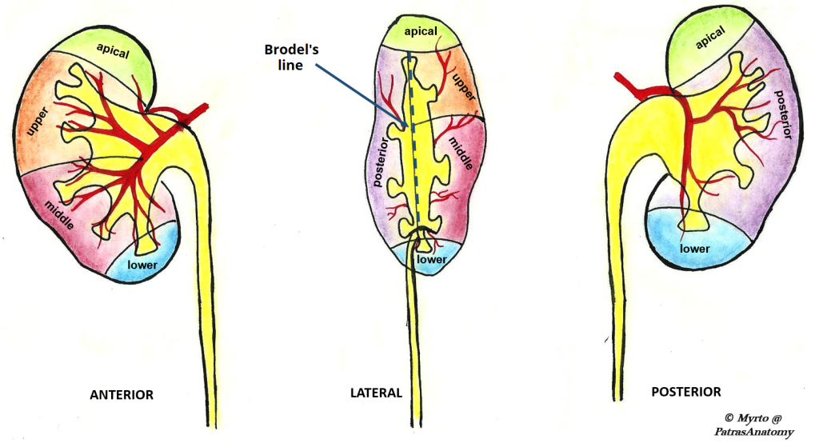

Slide 13
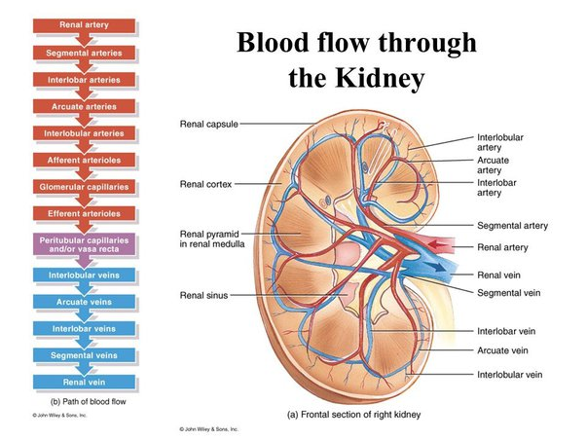

Slide 14


