Slide 1
Classification of Joints
AIZAZ
Demonstrator Surgical
KMU-IPMS Peshawar

Slide 2
JOINTS
The union between two or more bones or cartilage is called joints or articulation.
Derived from Greek word Arthron.
The chief function of the joint is to provide a stable union or to permit free movement.

Slide 3
Classification of joints
Joints are classify into 4 main groups.
  A: Structural classification.
  B: Functional classification.
  C: Regional classification.
  D: According to number of articulating bones.

Slide 4
JOINTS Classification
Structural
Functional
Regional
No. Of Articulating bones
Fibrous
Cartilaginous
Synovial
Synarthrosis
Amphiarthrosis
Diarthrosis
Skull type
Vertebral type
Limb type
Simple
Compound
Complex
Suture
Gomphosis
Syndesmosis
Primary Cartilaginous
Secondary Cartilaginous
Ball and Socket
Saddle
Condylar
Ellipsoid
Hinge
Pivot
Plane
Immovable joints
Slightly Movable Joints
Freely Movable Joints

Slide 5
A: Structural classification
3. Synovial joints
Ball-and-socket or spheroidal
Sellar or saddle joints
Condylar or bicondylar joints
Ellipsoid joints
Hinge joints
Pivot or trochoid joints
Plane joints
1. Fibrous joints
(a) Sutures
(b) Gomphosis
(c) Syndesmosis
2. Cartilaginous joints
(a) Primary cartilaginous joints or synchondrosis
(b) Secondary cartilaginous joints or symphysis

Slide 6
B. Functional Classification (according to the degree of mobility)
1. Synarthrosis (immovable), like fibrous joints.
Synarthroses are fixed joints at which there is no movement. The articular surfaces are joined by tough fibrous tissue. Often the edges of the bones are fit together into one another as in the sutures of the skull.
2. Amphiarthrosis (slightly movable), like cartilaginous joints.
Amphiarthroses are joints at which slight movement is possible. A pad of cartilage lies between the bone surfaces, and there are fibrous ligaments to hold the bones and cartilage in place. The cartilages of such joints also act as shock absorbers, e.g. the intervertebral discs between the bodies of the vertebrae, where the cartilage is strengthened by extra collagen fibers.

Slide 7
Continue…..
3. Diarthrosis (freely movable), like synovial joints.
  Freely movable joints,
  Some of them the movement is restricted by the shape of the articulating surfaces and by the ligaments which hold the bones together.
  Ligaments are of elastic connective tissue.
  Fluid-filled cavity between articular surfaces which are covered by articular cartilage.
  The fluid, known as synovial fluid, produced by the synovial membrane.
  Synovial fluid acts as a lubricant.

Slide 8
C. Regional Classification
1. Skull type: Immovable.
2. Vertebral type: Slightly movable.
3. Limb type: Freely moveable .

Slide 9
D. According to number of articulating bones
1. Simple joint: When two bones articulate, e.g. interphalangeal joints.
2. Compound joint: More than two bones articulate within one capsule, e.g. elbow joint, wrist joint.
3. Complex joint: When joint cavity is divided by an intra-articular
disc, e.g., temporomandibular joint and sternoclavicular joint.

Slide 10
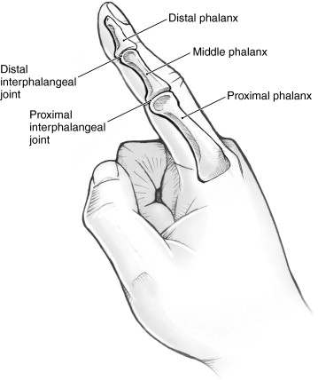
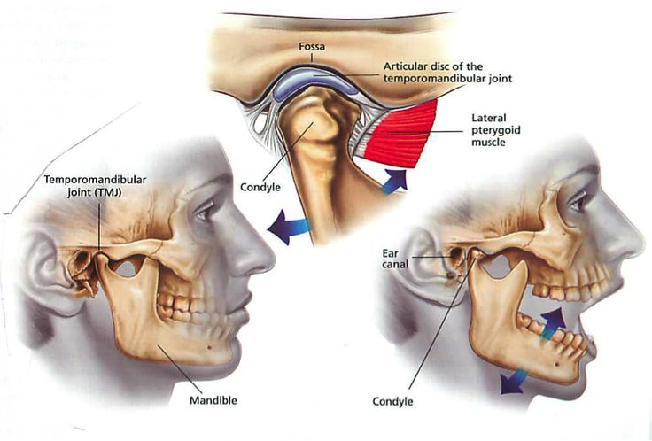
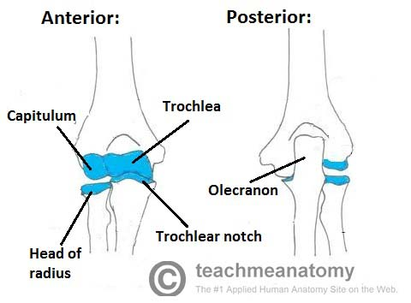

Slide 11
Fibrous joints
A fibrous joint is where the bones are bound by a tough, fibrous tissue. These are typically joints that require strength and stability over range of movement.
These are either immovable or permit a slight degree of movement.
Fibrous joints can be further sub-classified into sutures, gomphoses and syndesmoses.
1: SUTURAL
  Sutures are immovable joints (synarthrosis), and are only found between the flat, plate-like bones of the skull.
  Movement occur in fetuses and young children (necessary to allow normal growth of brain) In adults the fibrous connective tissue is gradually replaced by bone and bones became permanently fused. Such a union between adjacent bones by osseous material is called a synostosis

Slide 12
Fibrous joints
According to the shape of bony margins, the sutures can be:
Plane.
e.g. internasal suture
Serrate
e.g. interparietal suture
Squamous
e.g. temporo-parietal suture
Denticulate
e.g. lambdoid suture
Schindylesis type
e.g. between rostrum of sphenoid and upper border of vomer.

Slide 13
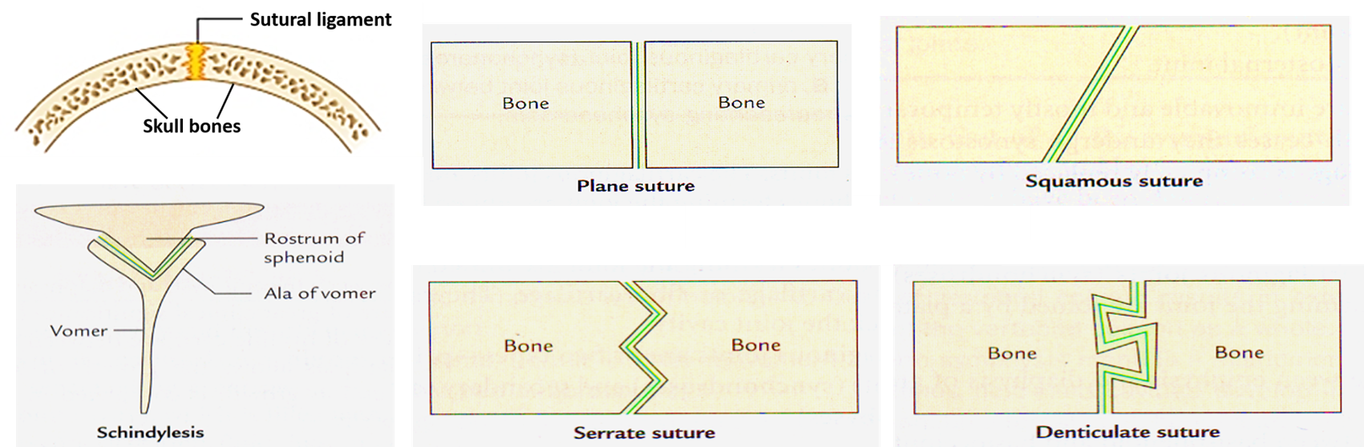

Slide 14
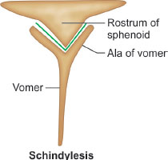
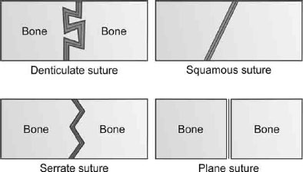

Slide 15
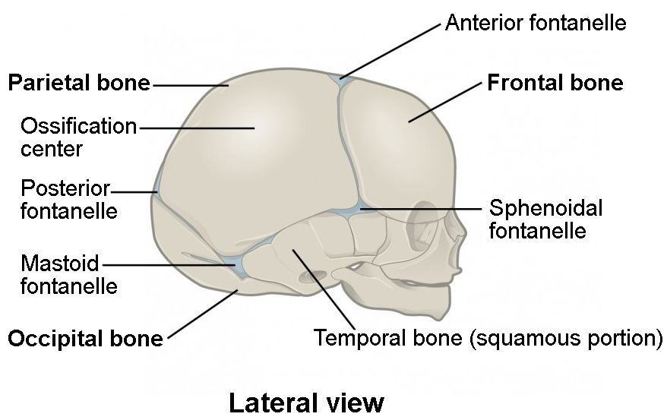
Fibrous joints
Neonatal skull reveals fontanelles which are temporary in nature.
At six specific points on the sutures in new born skull are membrane filled gaps called "fontanelles". (These allow the underlying brain to increase in size)
Anterior fontanelle is used to judge the hydration of the infant.
All these fontanelles become bone by 18 months

Slide 16
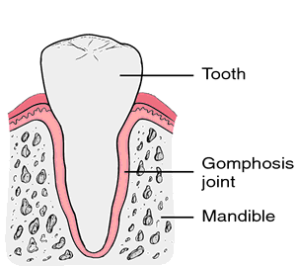
Fibrous joints
3: GOMPHOSES
A specialized fibrous joint in which a conical process or peg of one bone fits into a hole or socket in another bone. No movement is possible.
E.g. the joints between the roots of teeth and alveolar sockets of the jaw bones.

Slide 17
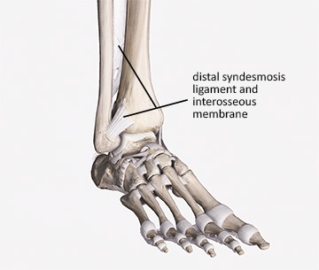
Fibrous joints
2: SYNDESMOSES
Syndesmoses are slightly movable joints (amphiarthroses).
The bones are connected by interosseous ligament.
E.g. inferior tibiofibular joint,

Slide 18
Cartilaginous joints
When two bones are united to each other by cartilage(fibrocartilage or hyaline cartilage). Further classified into two subtypes.
1: SYNCHONDROSIS: (Primary cartilaginous joints or hyaline cartilage joints).
  In a synchondrosis, the bones are connected by hyaline cartilage. These joints are immovable (synarthrosis).
  These joints are temporary in nature because after a certain age
  the cartilaginous plate is replaced by bone.
  Examples:
  Joint between epiphysis and diaphysis of a growing long bone.
  Spheno-occipital joint
  First chondrosternal joint
  Costochondral joints.

Slide 19
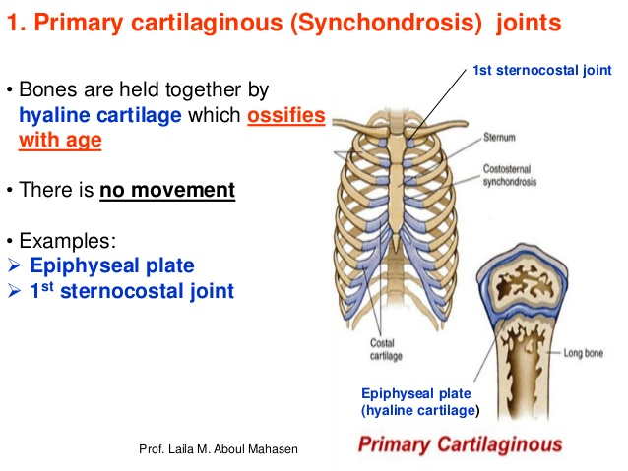
Cartilaginous joints

Slide 20
Cartilaginous joints
2:SYMPHYSES: (Secondary cartilaginous joints or fibrocartilaginous joints)
  The articular surfaces are covered by a thin layer of hyaline cartilage, and united by .a disc of fibrocartilage.
  These joints are permanent and persist throughout life.
  Typically the secondary cartilaginous joints occur in the median plane of the body
  permit limited movements due to compressible pad of fibro-cartilage
  Examples: Symphysis pubis, Manubriosternal joint and Intervertebral joints between the vertebral bodies

Slide 21
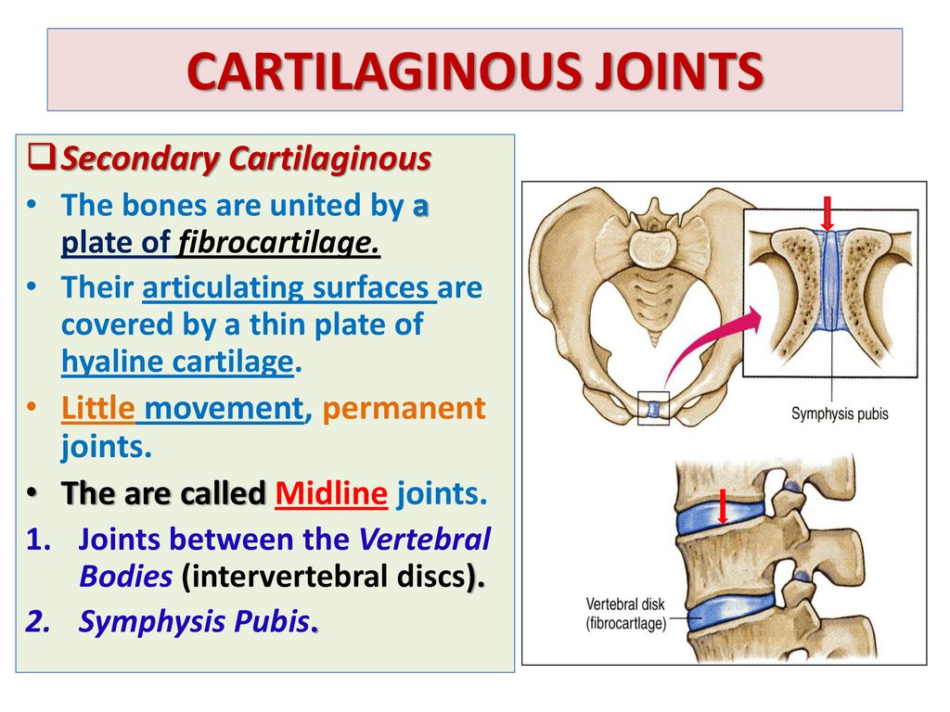

Slide 22


