Slide 1
BLOOD VESSELS OF BONES
AIZAZ
Demonstrator Surgical
KMU-IPMS Peshawar

Slide 2
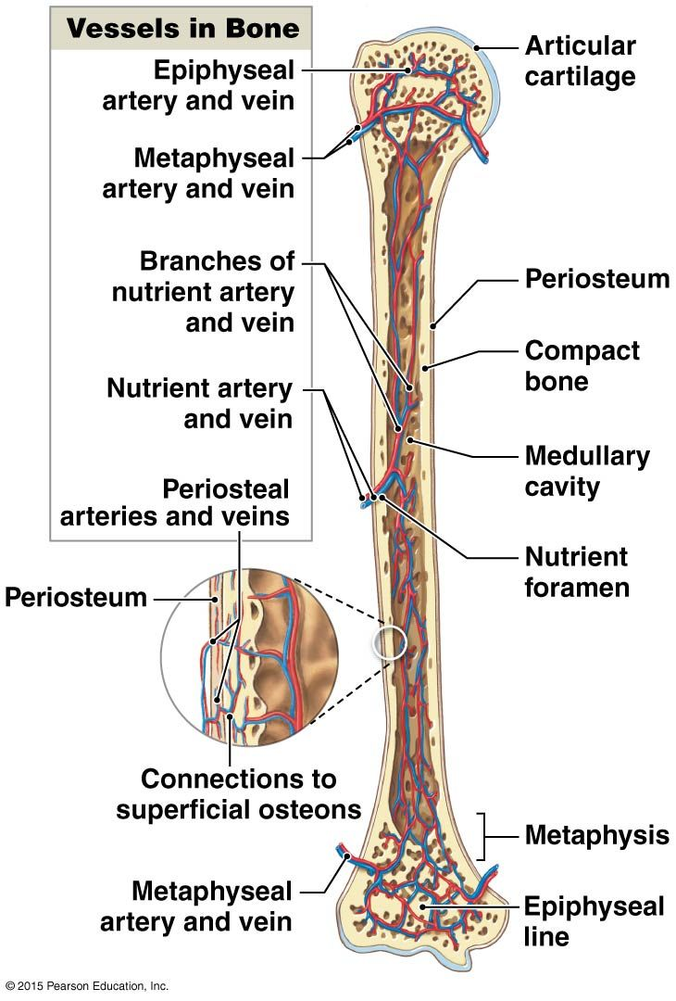

Slide 3
Blood supply of long bone
ARTERIAL SUPPLY
  Each long bone has at least one nutrient artery, which is derived from the main artery of the region. Nutrient artery enter the bone by nutrient foramen near the middle of the bone shaft.
  In addition to nutrient arteries long bone receives blood from three others sets of arteries which are metaphyseal arteries, epiphyseal arteries, and periosteal arteries.

Slide 4
Blood supply of long bone
  Nutrient artery enters the bone through Nutrient Foramen , through the cortex obliquely the artery passes to the medullary cavity. So their the branches referred to as medullary arteries. The medullary arteries runs towards bones ends .
  As approaches to epiphyses medullary arteries rise to numerous terminal branches which drain into venous capillaries which open into a large central part of medullary cavity.
  The central branches deliver blood into a meshwork of medullary sinusoid which lie in bone marrow. These sinusoids drain into central venous sinus.
  The cortical branches of medullary arteries' give rise to capillaries that pass into bone cortex to run in the haversian canals.
Notes:
1: Sinusoid, irregular tubular space for the passage of blood, taking the place of capillaries and venules in the liver, spleen, and bone marrow.
2: Haversian canals are microscopic tubes or tunnels in cortical bone that house nerve fibers and a few capillaries. This allows bone to get oxygen and nutrition without being highly vascular. These canals also communicate with bone cells using special connections, or canaliculi.

Slide 5
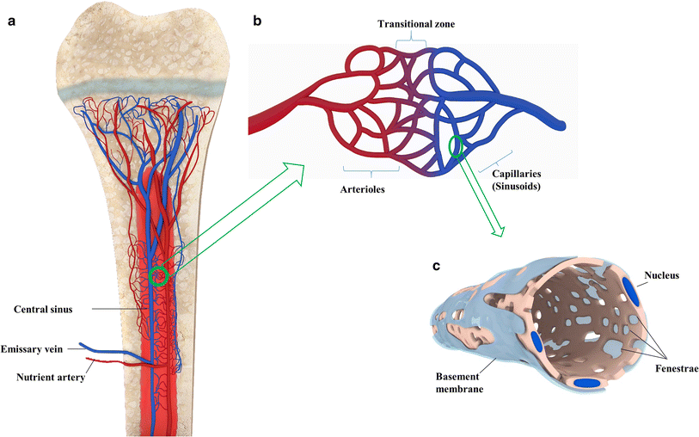

Slide 6
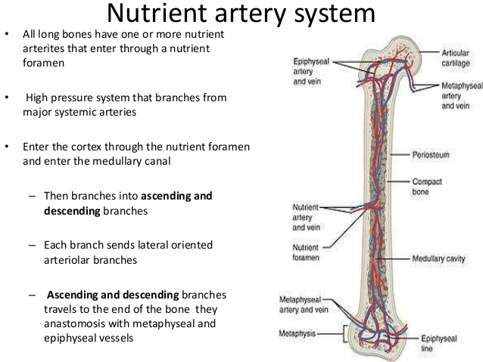
Notes:
Anastomosis is a connection or opening between two things that are normally diverging or branching, such as between blood vessels, leaf veins, or streams.

Slide 7
Blood supply of long bones
  The metaphyseal arteries are numerous vessels which are direct branches of major regional arteries. They passes into the bone through many vascular foramina situated just inner to the epiphyseal line. Inside the bone the metaphyseal arteries divide into branches which anastomose with the terminal branches of the epiphyseal arteries.

Slide 8
Blood supply of long bones
    The epiphyseal arteries are derived from arterial anastomoses , which are formed around the joints by the branches of neighboring major arteries.
    At each bone end many epiphyseal arteries enter the bone through many vascular foramina located outer to the epiphyseal line within the spongy bone of epiphyses.
Notes:
The arterial arcades are a series of anastomosing arterial arches between the arterial branches

Slide 9
Blood supply of long bones
    The epiphyseal arteries divide into branches , which anastomose with each other to form many arterial arcades. From these arcades arise end arterial loops most of which return blood to the epiphyseal venous drainage.
Notes:
The arterial arcades (intermesenteric arterial anastomoses or Riolan arcades) are a series of anastomosing arterial arches between the arterial branches of the jejunum and ileum. Arterial arcades. Loop of small intestine showing distribution of intestinal arteries. Anatomical terminology.

Slide 10
Blood supply of long bone
  The periosteal arteries are derived from the arteries of those muscles which are attached to the bone.
  Branches arises from muscular arteries form plexuses over and within the periosteum.
  In addition to providing nutrition of the periosteum the periosteal arteries aid in the blood supply of the outer part of the cortex.
Notes:
A plexus (from the Latin for "braid") is a branching network of vessels or nerves

Slide 11
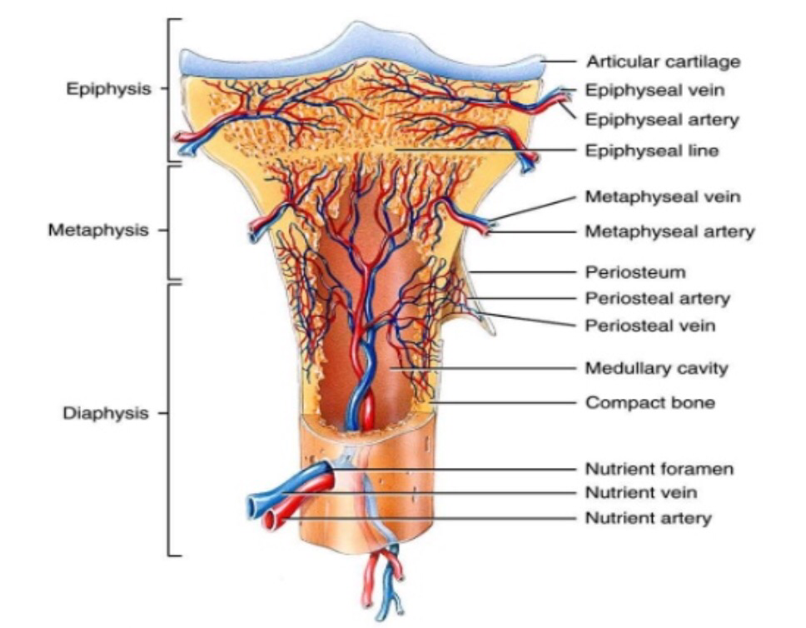

Slide 12
Blood supply of long bone
Venous drainage of long bone
  A large Venus sinuses located in the center of the medullary cavity. Which receive blood from the meshwork of medullary sinusoids. This Venus sinuses also receive blood from terminal branches of the medullary arteries.
  The center venous sinuses drains the blood through the nutrient foramen by means of diaphyseal vein.

Slide 13
Blood supply of long bone
  In the periosteum Venus plexus also exist which drains into the vennules of the muscles attached to bone.
  The spongy bone of the ends is drained by many metaphyseal and epiphyseal veins, which pass out through numerous vascular foramina to join the neighboring veins.

Slide 14
Blood supply of short bones
  A short bone receive numerous fine blood vessels from the periosteum which enter through the non articular surface of the bone.
  Vessels supply to compact bone spongy bone, and bone marrow.
  The venous drainage occurs by one or two veins, which leave through vascular foramina on the non-articular surfaces of the bone.

Slide 15
Blood supply of flat bone
  The flat bone of the skull receive arterial blood by numerous fine vessels which originates from the periosteal plexuses.
  The veins are large and thin walled they run in tortuous canals in diploe.
  A rib receive blood from periosteal arteries and a nutrient artery that enters the bone just beyond tubercle.
Notes:
In the flat bone outer and inner bone are called tables, while the spongy bone between them is called diploe.

Slide 16
Blood supply of irregular bones
  Receive vessels from periosteal plexus. Provided with large nutrient arteries.
  A vertebra receives arterial supply by two arteries entering the bone close to the base of each transverse process. The spongy bone drains via two large vessels called basivertebral veins. Which converge to the foramen on the posterior surface of the vertebral body.

Slide 17
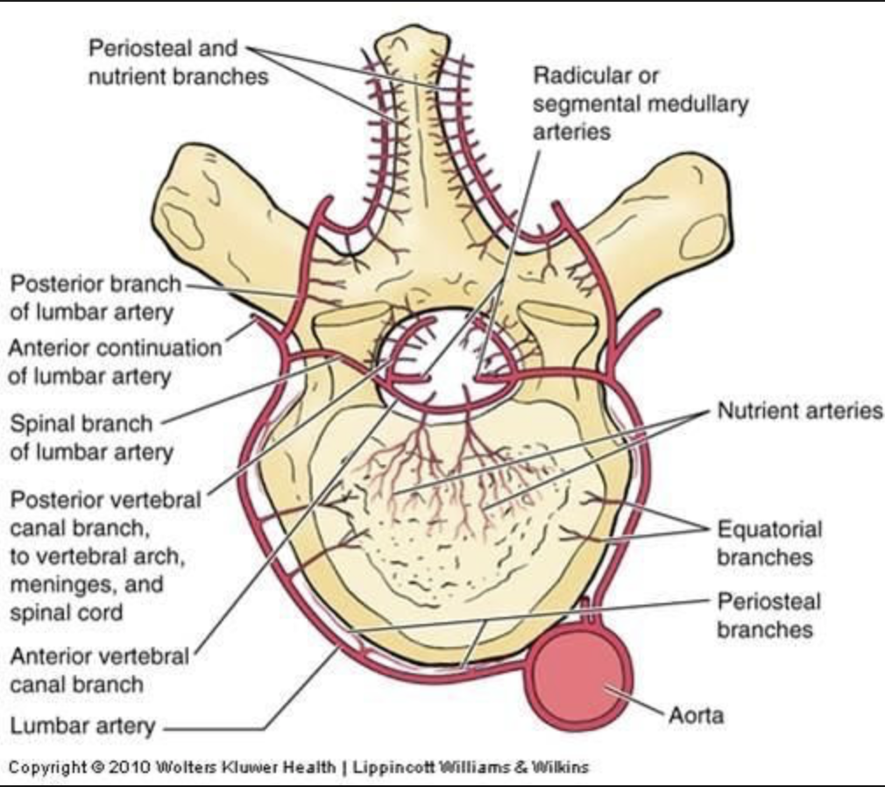
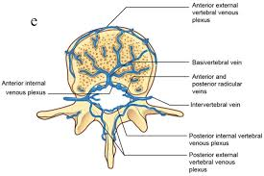

Slide 18


