Slide 1
Male Genital organs
AIZAZ
Demonstrator Surgical
KMU-IPMS Peshawar

Slide 2
MALE GENITAL ORGANS
The male sex organs comprise a complex arrangement of internal and external genital organs.
Their function is concerned with reproduction and sexual pleasure.
The internal genital organs are the male gonads (testis), epididymis, a series of ducts and the accessory glands.
The penis and scrotum compose the external sexual organs.

Slide 3
SCROTUM
Out pouching of the lower part of the anterior abdominal wall.
Contains the testes, the epididymides, and the lower ends of the spermatic cords
The wall of the scrotum has the following layers:
    Skin
    Superficial fascia
    Spermatic fasciae
    Tunica vaginalis

Slide 4
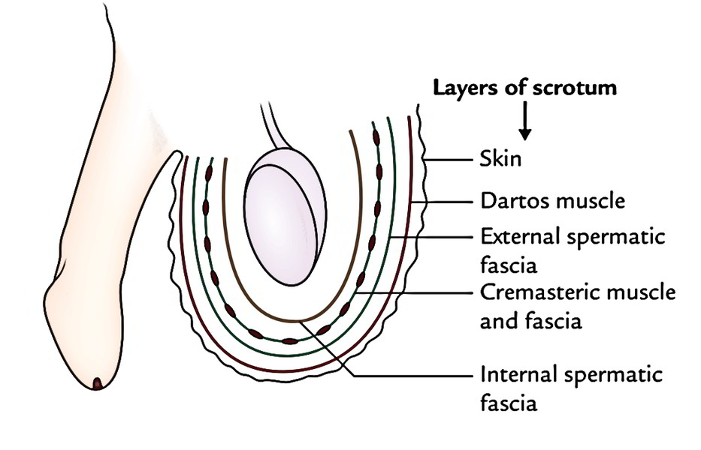

Slide 5
SCROTUM
Skin
The skin of the scrotum is thin, wrinkled, and pigmented and forms a single pouch.
A slightly raised ridge in the midline indicates the line of fusion of the two lateral labioscrotal swellings. (In the female, the swellings remain separate and form the labia majora.)

Slide 6
SCROTUM
Superficial fascia
Continuous with the fatty and membranous layers of the anterior abdominal wall.
Fat is replaced by smooth muscle called the dartos muscle. This is innervated by sympathetic nerve fibers and is responsible for the wrinkling of the overlying skin.
The membranous layer of the superficial fascia (often referred to as colles’ fascia) is continuous in front with the membranous layer of the anterior abdominal wall (scarpa’s fascia), and behind it is attached to the perineal body and the posterior edge of the perineal membrane.
At the sides, it is attached to the ischiopubic rami. Both layers of superficial fascia contribute to a median partition that crosses the scrotum and separates the testes from each other.

Slide 7
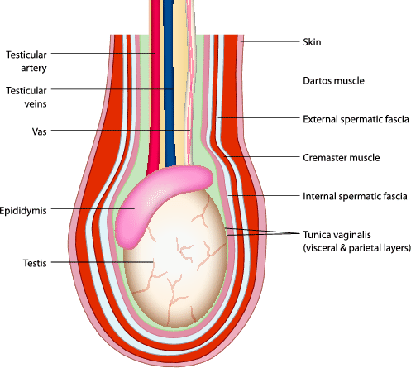

Slide 8
SCROTUM
Spermatic fasciae
Three layers lie beneath the superficial fascia
Derived from the three layers of the anterior abdominal wall on each side.
  External spermatic fascia is derived from the aponeurosis of the external oblique muscle.
  Cremasteric fascia is derived from the internal oblique muscle.
  Internal spermatic fascia is derived from the fascia transversalis.
Cremaster muscle supplied by the genital branch of the genitofemoral nerve which can be made to contract by stroking the skin on the medial aspect of the thigh. This is called the cremasteric reflex.
The function of the cremaster muscle is to raise the testis and the scrotum upward for warmth and for protection against injury.

Slide 9
SCROTUM
Tunica vaginalis
Lies within the spermatic fasciae and covers the anterior, medial, and lateral surfaces of each testis.
It is the lower extended part of the processus vaginalis
Normally, just before birth, it becomes shut off from the upper part of the processus and the peritoneal cavity.
The tunica vaginalis is thus a closed sac, invaginated from behind by the testis.

Slide 10
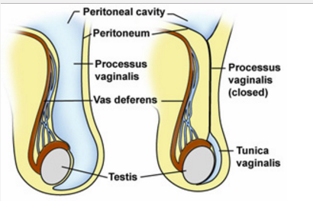

Slide 11
SCROTUM
Vessels
The anterior and posterior scrotal arteries. The anterior scrotal artery arises from the external pudendal artery, while the posterior is derived from the internal pudendal artery.
The scrotal veins follow the major arteries, draining into the external pudendal veins.
Lymphatic's
The lymphatic fluid from the scrotum drains to the nearby superficial inguinal nodes.

Slide 12
SCROTUM
Nerves
Cutaneous innervation to the scrotum is supplied via several nerves, according to the topography:
Anterior and anterolateral aspect: anterior scrotal nerves derived from the genital branch of genitofemoral nerve and ilioinguinal nerve
Posterior aspect: posterior scrotal nerves derived from the perineal branches of the pudendal nerve and posterior femoral cutaneous nerve.

Slide 13
TESTIS
The testis is a firm, mobile organ lying within the scrotum.
Left testis usually lies at a lower level than the right.
Each testis is surrounded by a tough fibrous capsule, the tunica albuginea.
The testes have an ellipsoid shape. They consist of a series of lobules, each containing seminiferous tubules supported by interstitial tissue.
The tubules open into a network of channels called the rete testis. Small efferent ductules connect the rete testis to the upper end of the epididymis
Normal spermatogenesis occur at lower temperature. 3 C lower than abdominal temperature.

Slide 14
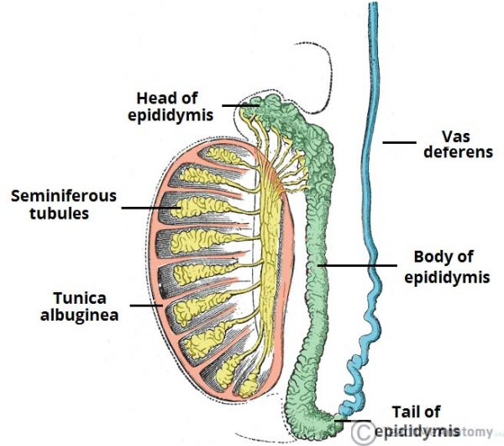

Slide 15
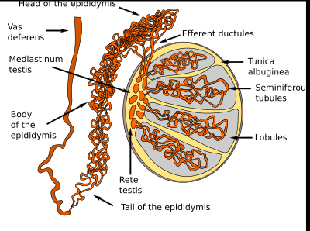
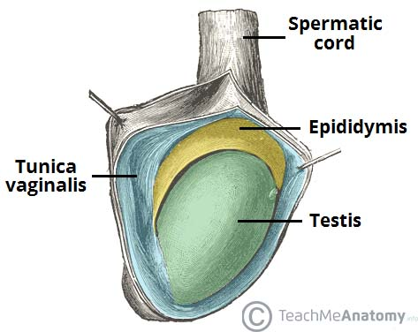

Slide 16
EPIDIDYMIS
Firm structure lying posterior to the testis, with the vas deferens lying on its medial side
The epididymis is a much coiled tube nearly 20 ft (6 m) long embedded in connective tissue.
The tube emerges from the tail of the epididymis as the vas deferens, which enters the spermatic cord.

Slide 17
EPIDIDYMIS
The epididymis consists of a single heavily coiled duct. It can be divided into three parts; head, body and tail.
  Head: most proximal part of the epididymis, formed by the efferent tubules of the testes, which transport sperm from the testes to the epididymis.
  Body: Medial part formed by the heavily coiled duct of the epididymis.
  Tail: most distal part of the epididymis. It marks the origin of the vas deferens, which transports sperm to the prostatic portion of the urethra for ejaculation.

Slide 18
EPIDIDYMIS
Function
  Provides storage space for the spermatozoa and allows them to mature
  Absorption of fluid.
  nourish the maturing sperm

Slide 19
EPIDIDYMIS
Vascular Supply
The main arterial supply to the testes and epididymis is via the paired testicular arteries, which arise directly from the abdominal aorta. They descend down the abdomen, and pass into the scrotum via the inguinal canal.
However, the testes are also supplied by branches of the cremasteric artery (from the inferior epigastric artery) and the artery of the vas deferens (from the inferior vesical artery). These branches give anastomoses to the main testicular artery.
Venous drainage is achieved via the paired testicular veins. They are formed from the pampiniform plexus in the scrotum In the retroperitoneal space of the abdomen, the left testicular vein drains into the left renal vein, while the right testicular vein drains directly into the inferior vena cava.

Slide 20
  EPIDIDYMIS
Innervation
  The testes and epididymis receive innervation from the testicular plexus – a network of nerves derived from the renal and aortic plexi.
Lymphatic's
Since the testes are originally retroperitoneal organs, the lymphatic drainage is to the lumbar and para-aortic nodes, along the lumbar vertebrae.
This is in contrast to the scrotum, which drains into the nearby superficial inguinal nodes.

Slide 21
VAS DEFERENS
A thick-walled tube about 18 in. (45 cm) long that conveys mature sperm from the epididymis to the ejaculatory duct and the urethra.
Arises from the lower end or tail of the epididymis and passes through the inguinal canal.
Emerges from the deep inguinal ring and passes around the lateral margin of the inferior epigastric artery then passes downward and backward on the lateral wall of the pelvis and crosses the ureter in the region of the ischial spine.
The vas deferens then runs medially and downward on the posterior surface of the bladder.
The terminal part of the vas deferens is dilated to form the ampulla of the vas deferens.
The inferior end of the ampulla narrows down and joins the duct of the seminal vesicle to form the ejaculatory duct.

Slide 22
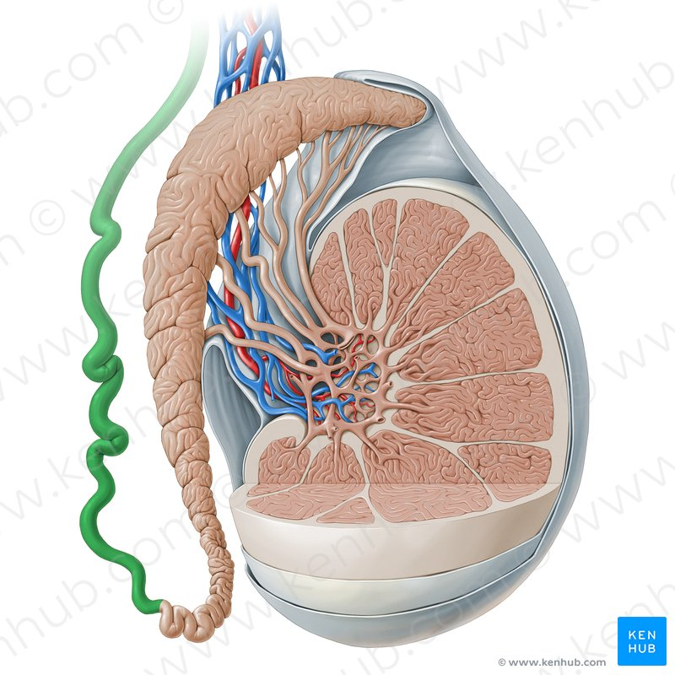
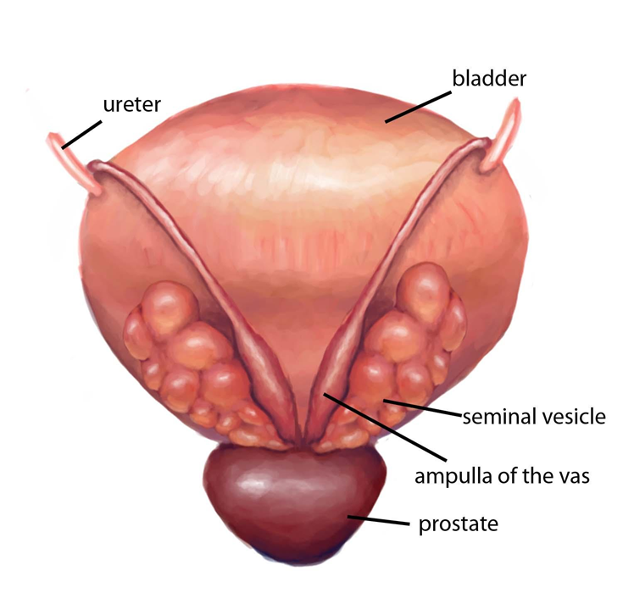

Slide 23
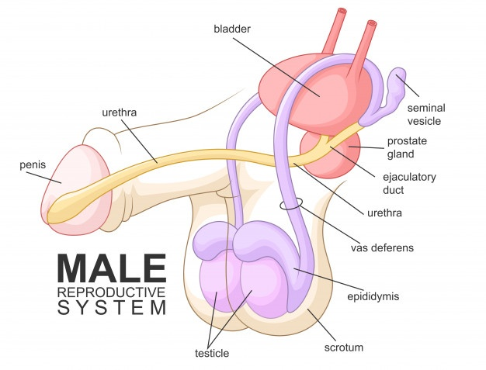
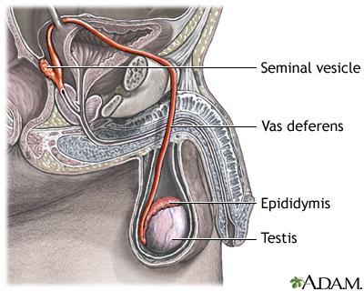

Slide 24
SEMINAL VESICLES
Two lobulated organs about 2 in. (5 cm) long lying on the posterior surface of the bladder
On the medial side of each vesicle lies the terminal part of the vas deferens.
Posteriorly, the seminal vesicles are related to the rectum.
Inferiorly, each seminal vesicle narrows and joins the vas deferens of the same side to form the ejaculatory duct.
Each seminal vesicle consists of a much-coiled tube embedded in connective tissue.

Slide 25
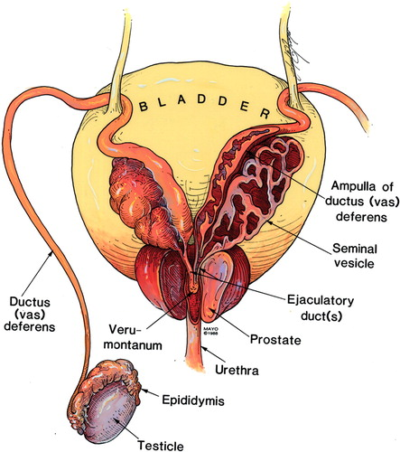

Slide 26
SEMINAL VESICLES
Function
  Produce a secretion that is added to the seminal fluid which nourish the spermatozoa.
  During ejaculation, the seminal vesicles contract and expel their contents into the ejaculatory ducts, thus washing the spermatozoa out of the urethra.

Slide 27
SEMINAL VESICLES
Blood Supply
Arteries
  The inferior vesicle and middle rectal arteries.
Veins
  The veins drain into the internal iliac veins.
Lymph Drainage
  The internal iliac nodes.

Slide 28
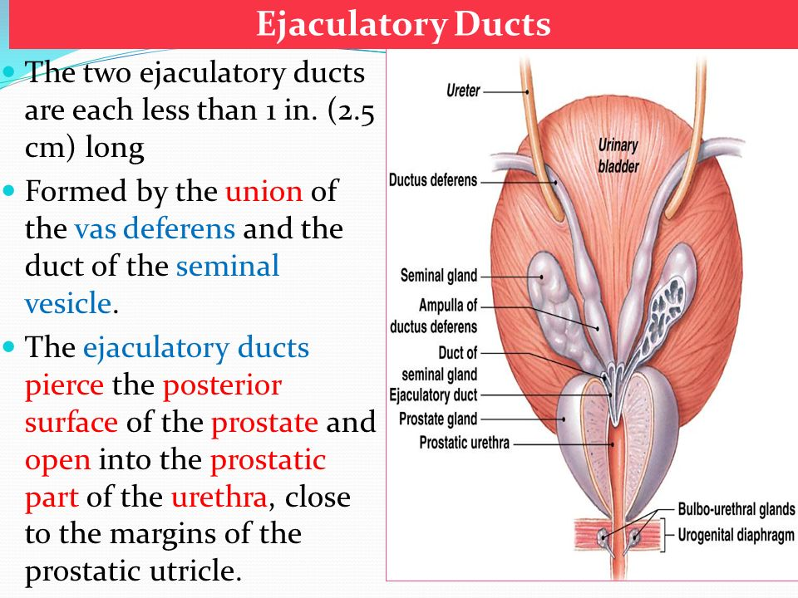

Slide 29
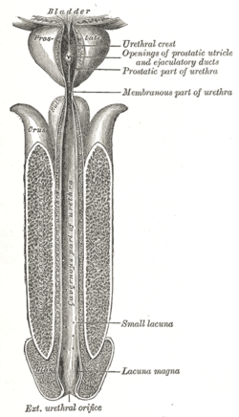

Slide 30
PROSTATE
Fibromuscular glandular organ surrounds the prostatic urethra.
About 1.25 in. (3 cm) long.
Lies between the neck of the bladder above and the urogenital diaphragm below.
Surrounded by a fibrous capsule.
Conical prostate has a base, which lies against the bladder neck above, and an apex, which lies against the urogenital diaphragm below.
The two ejaculatory ducts pierce the upper part of the posterior surface of the prostate to open into the prostatic urethra at the lateral margins of the prostatic utricle

Slide 31
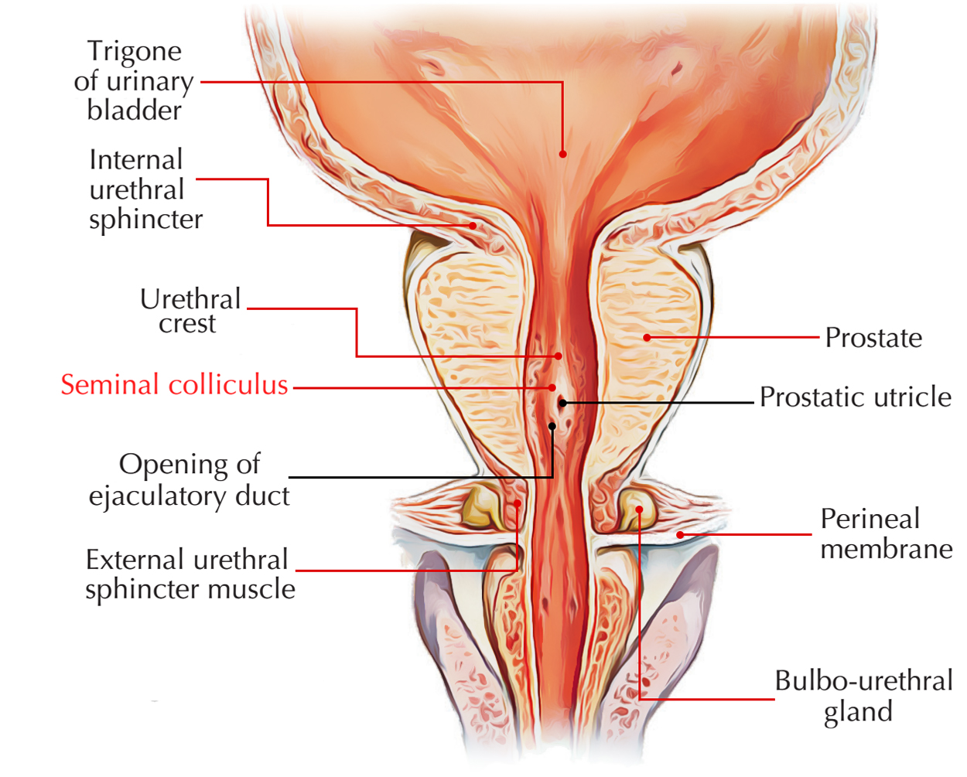

Slide 32
PROSTATE
Relations
  Superiorly: continues with bladder neck
  Inferiorly: urogenital diaphragm.
  Anteriorly: the prostate is related to the symphysis pubis, the prostate is connected to the posterior aspect of the pubic bones by the fascial puboprostatic ligaments.
  Posteriorly: anterior surface of the rectal ampulla and is separated from it by the rectovesical septum (fascia of denonvilliers).
  Laterally: anterior fibers of the Levator ani

Slide 33
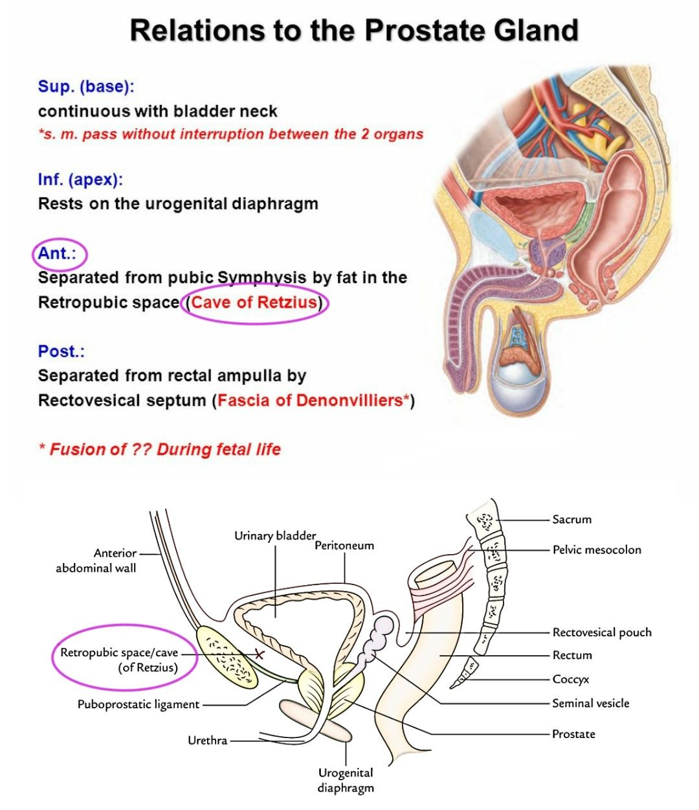

Slide 34
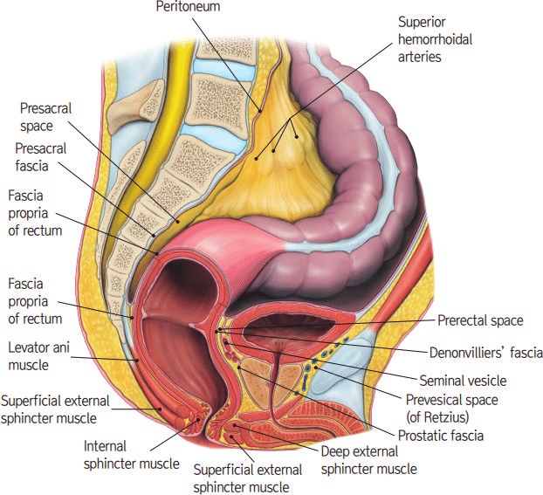

Slide 35
PROSTATE
Structure of the Prostate
The numerous glands of the prostate are embedded in a mixture of smooth muscle and connective tissue, and their ducts open into the prostatic urethra.
The prostate is incompletely divided into five lobes.
The anterior lobe lies in front of the urethra and is lacking of glandular tissue.
The median, or middle lobe is the wedge of gland situated between the urethra and the ejaculatory ducts. Its upper surface is related to the trigone of the bladder; it is rich in glands.

Slide 36
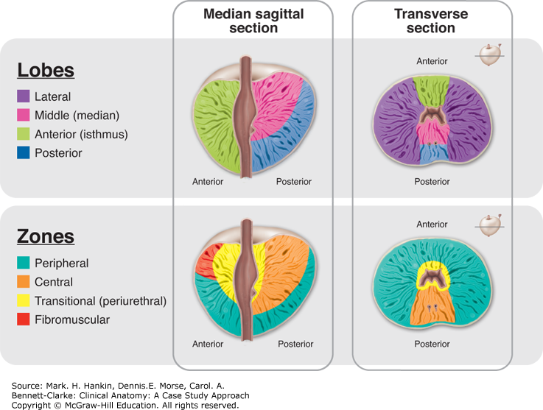

Slide 37
PROSTATE
The posterior lobe is situated behind the urethra and below the ejaculatory ducts and also contains glandular tissue.
The right and left lateral lobes lie on either side of the urethra and are separated from one another by a shallow vertical groove on the posterior surface of the prostate.
The lateral lobes contain many glands.

Slide 38
PROSTATE
Function of the Prostate
  Produces a thin, milky fluid containing citric acid and acid phosphatase that is added to the seminal fluid at the time of ejaculation.
  The prostatic secretion is alkaline and helps neutralize the acidity in the vagina.
  It secretes proteolytic enzymes into the semen, which act to break down clotting factors in the ejaculate

Slide 39
PROSTATE
Blood Supply
Arteries
  Branches of the inferior vesical and middle rectal arteries.
Veins
  The veins form the prostatic venous plexus, which lies outside the capsule of the prostate. The prostatic plexus receives the deep dorsal vein of the penis and numerous vesical veins and drains into the internal iliac veins.
Lymph Drainage
  Internal iliac nodes.
Nerve Supply
  Inferior hypogastric plexuses. The sympathetic nerves stimulate the smooth muscle of the prostate during ejaculation.

Slide 40
PENIS
The penis is an external organ of the male reproductive system. It has two main functions:
  Sexual intercourse
  Micturition
Structure of the Penis:
The penis can be anatomically divided into three parts:
  Root
  Body
  glans

Slide 41
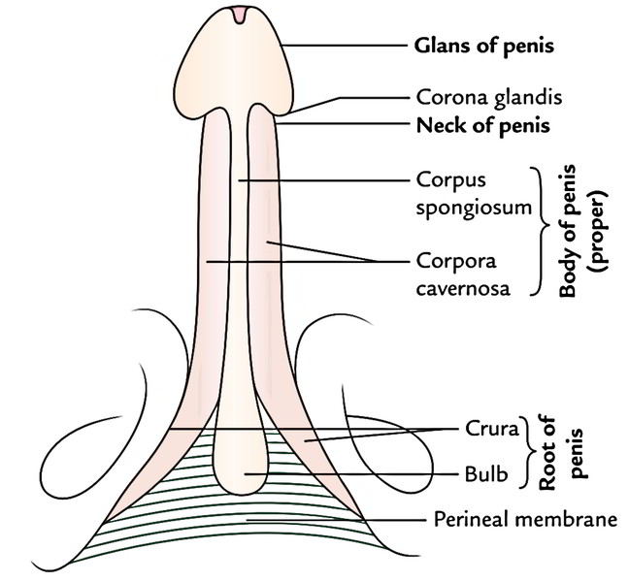

Slide 42
PENIS
Root: the most proximal, fixed part of the penis. It is located in the superficial perineal pouch of the pelvic floor, and is not visible externally. The root contains three erectile tissues (two crura and bulb of the penis), and two muscles (ischiocavernosus and bulbospongiosus).
Body: the free part of the penis, located between the root and glans. It is suspended from the pubic symphysis. It is composed of three cylinders of erectile tissue – two corpora cavernosa, and the corpus spongiosum.
Glans: the most distal part of the of penis. It is conical in shape, and is formed by the distal expansion of the corpus spongiosum. This contains the opening of the urethra, termed the external urethral orifice.

Slide 43
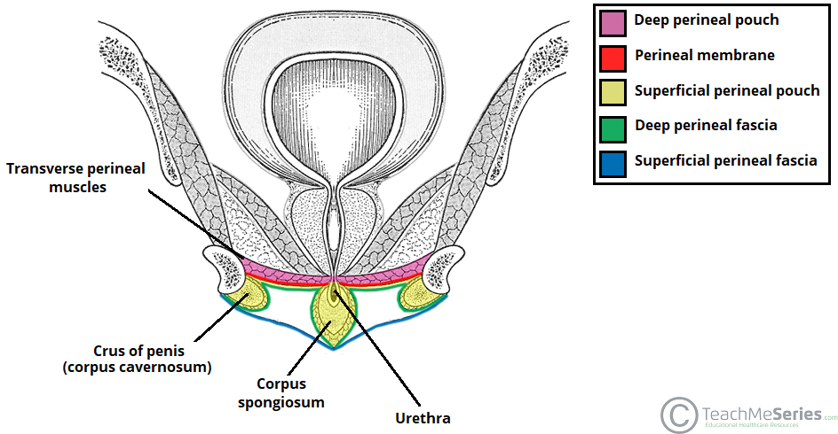

Slide 44
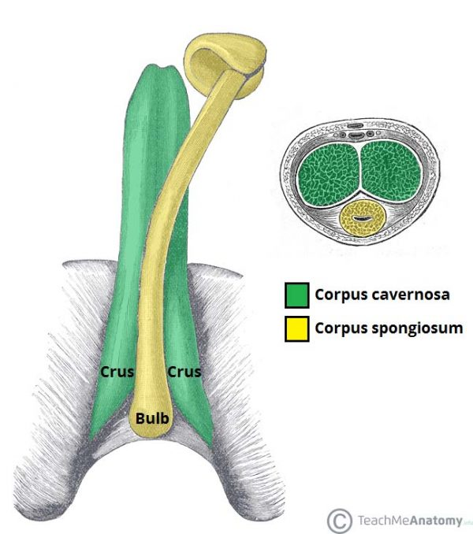

Slide 45
PENIS
Erectile Tissues
The erectile tissues fill with blood during sexual arousal, producing an erection. The root and body of the penis are covered by three masses of erectile tissue.
In the root, these tissues are known as the left and right crura, and the bulb of the penis. The bulb is situated in the midline of the penile root, and is go over the urethra. The left and right crura are located laterally; attached to the ipsilateral ischial ramus, and covered by the paired ischiocavernosal muscles.

Slide 46
PENIS
The erectile tissues continue into the body of the penis.
The left and right crura continue anteriorly into the dorsal part of the penis – they form the two corpora cavernosa. They are separated by the septum of the penis, although often incompletely.
The bulb forms the corpus spongiosum, which lies ventrally.
The male urethra runs through the corpus spongiosum – to prevent it becoming occluded during erection the corpus spongiosum fills to a reduced pressure.
Distally, the corpus spongiosum expands to form the glans penis.

Slide 47
PENIS
Muscles
There are four muscles located in the root of the penis:
Bulbospongiosus (x2): associated with the bulb of the penis. It contracts to empty the spongy urethra of any residual semen and urine. The anterior fibres also aid in maintaining erection by increasing the pressure in the bulb of the penis.
Ischiocavernosus (x2): surrounds the left and right crura of the penis. It contracts to force blood from the cavernous spaces in the crura into the corpus cavernosa – this helps maintain erection.

Slide 48
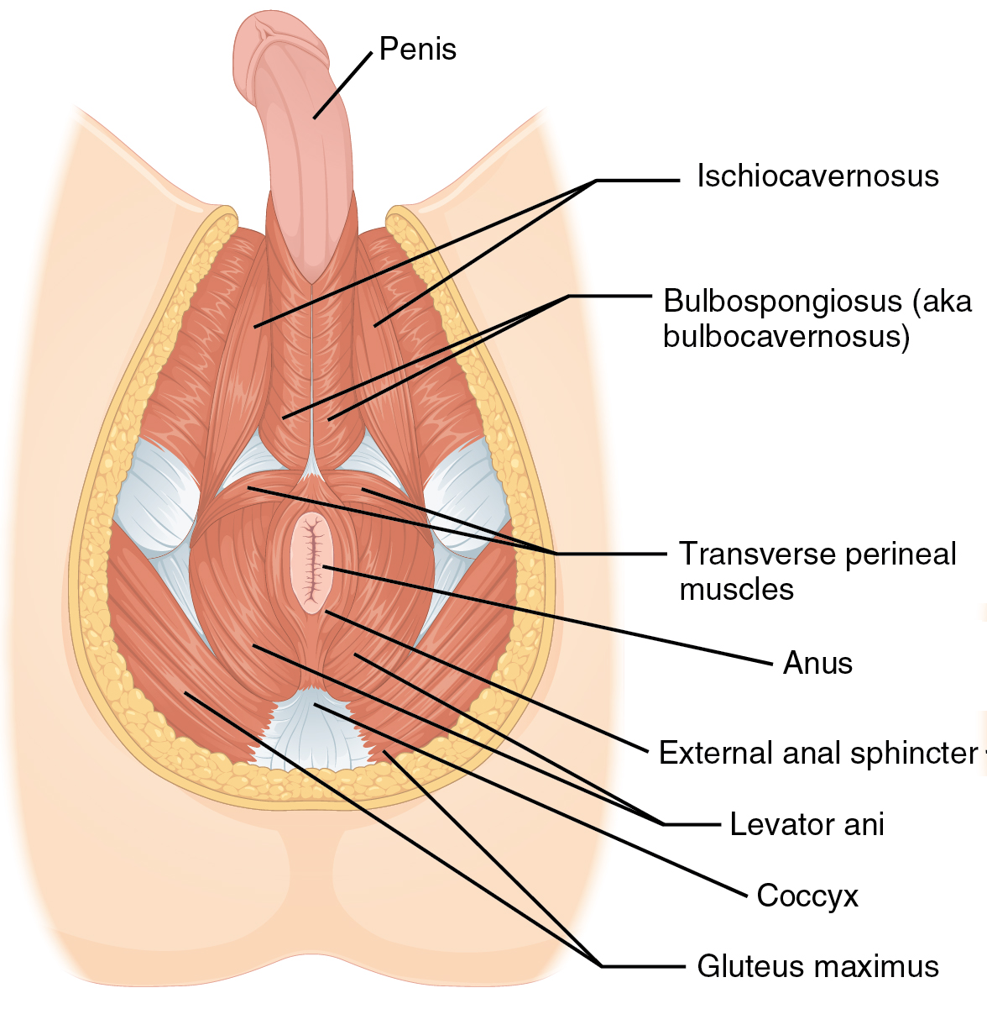
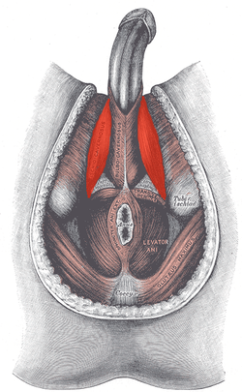
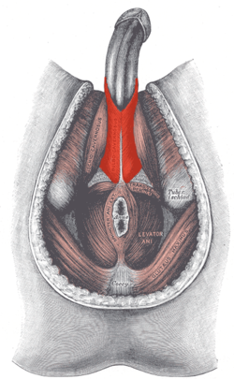

Slide 49
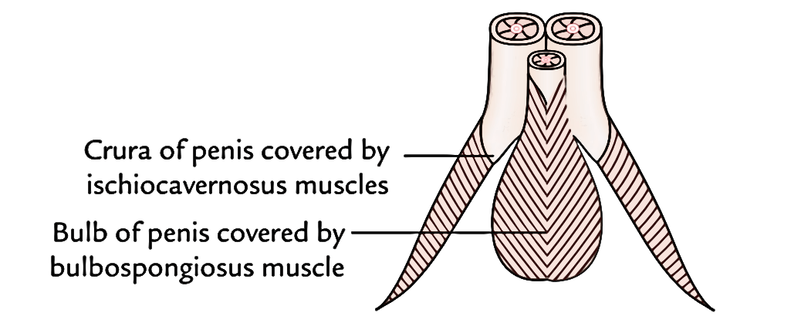

Slide 50
PENIS
Fascial Coverings
Each mass of erectile tissue has two fascial coverings. The most superficial layer, immediately under the skin, is the external fascia of Colles.
A deeper stratum is the deep fascia of the penis (also known as Buck’s fascia). This is a continuation of the deep perineal fascia, and forms a strong membranous covering which holds all three erectile tissues together.
Underneath the deep fascia is the strong fascia called tunica albuginea, forming an individual capsule around each cavernous body and fused in the midline. The incomplete septum between the two corpora is comprised of tunica albuginea.

Slide 51
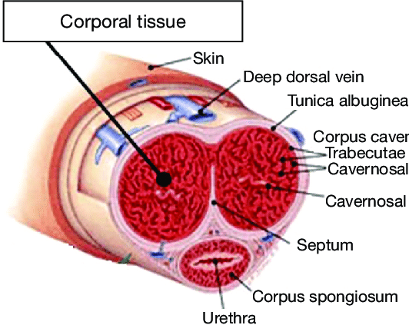
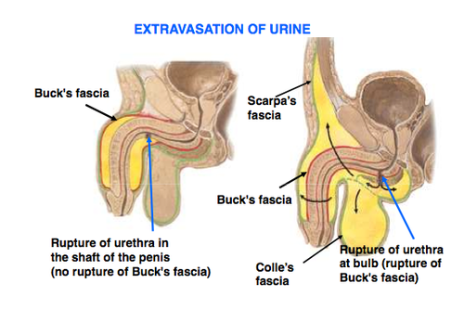

Slide 52
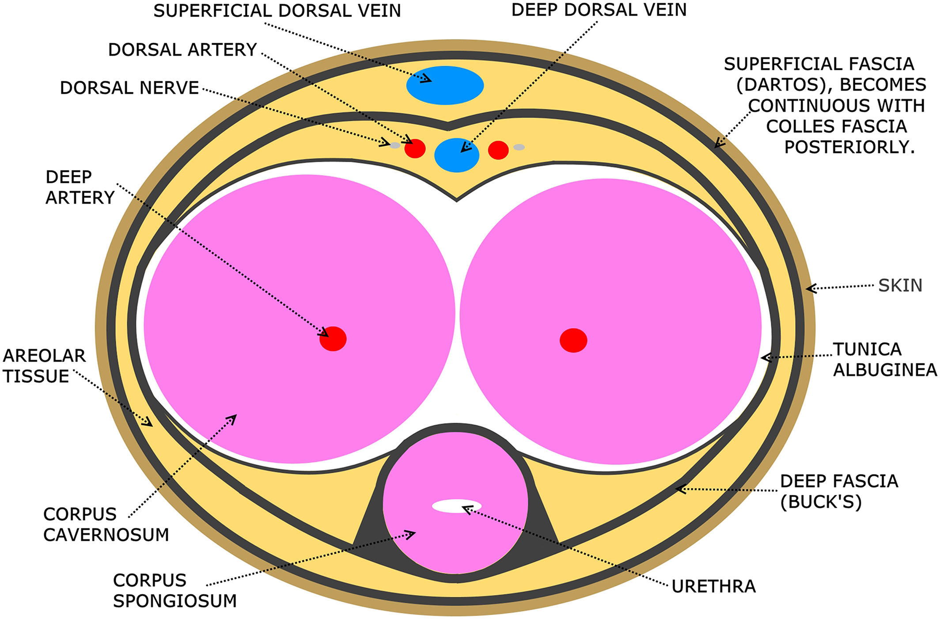

Slide 53
PENIS
Ligaments
The root of the penis is supported by two ligaments, which attach it to the surrounding structures:
  Suspensory ligament: a condensation of deep fascia. It connects the erectile bodies of the penis to the pubic symphysis.
  Fundiform ligament: a condensation of abdominal subcutaneous tissue. It runs down from the linea alba, surrounding the penis like a sling, and attaching to the pubic symphysis.

Slide 54
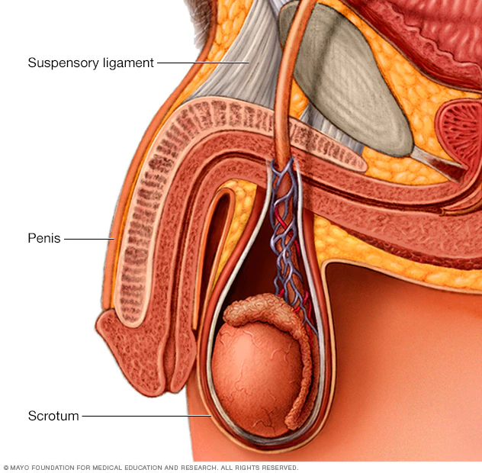
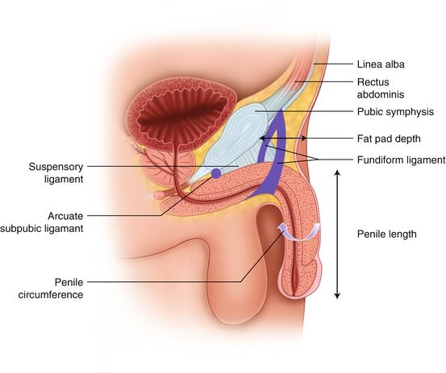

Slide 55
PENIS
Skin
More heavily pigmented than the rest of the body.
Connected to the underlying fascias by loose connective tissue.
Prepuce (foreskin) is a double layer of skin and fascia, located at the neck of the glans which covers the glans to a variable extent.
Prepuce is connected to the surface of the glans by the frenulum, a median fold of skin on the ventral surface of the penis.
The potential space between the glans and prepuce is termed the preputial sac.

Slide 56
PENIS
Vascular supply
The penis receives arterial supply from three sources:
  Dorsal arteries of the penis
  Deep arteries of the penis
  Bulbourethral artery
These arteries are all branches of the internal pudendal artery. This vessel arises from the anterior division of the internal iliac artery.
The cavernous spaces are drained by the deep dorsal vein of the penis – this empties into the prostatic venous plexus. The superficial dorsal veins drain the superficial structures of the penis.

Slide 57
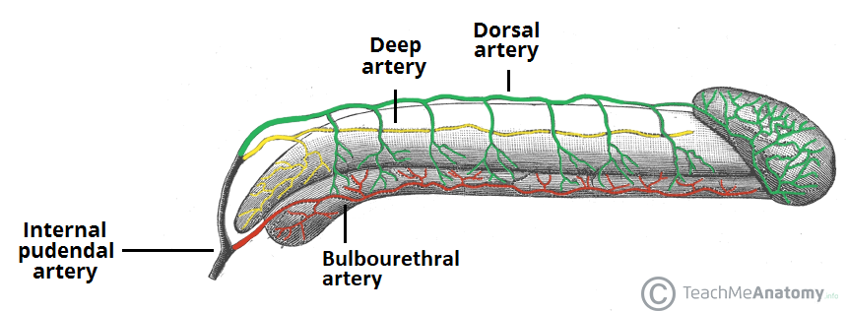

Slide 58
PENIS
Innervation
  The penis is supplied by S2-S4 spinal cord segments.
  Sensory and sympathetic innervation to the skin and glans penis is supplied by the, dorsal nerve of the penis a branch of the pudendal nerve.
  Parasympathetic innervation is carried by cavernous nerves from the peri-prostatic nerve plexus, and is responsible for the vascular changes which cause erection.

Slide 59


