Slide 1
PELVIC WALL
AIZAZ
Demonstrator Surgical
KMU-IPMS Peshawar

Slide 2
THE PELVIS
The PELVIS is a ring-like bony structure, located in the lower part of the trunk and connects the axial skeleton to the lower limbs.
Functions of the Pelvis
  Transfer of weight from the upper axial skeleton to the lower appendicular components of the skeleton, especially during movement.
  Provides attachment for a number of muscles and ligaments used in locomotion.
  Contains and protects the abdominopelvic and pelvic viscera.
The bony pelvis is composed of four bones: the two hip bones, which form the lateral and anterior walls, and the sacrum and the coccyx, which are part of the vertebral column and form the back wall

Slide 3
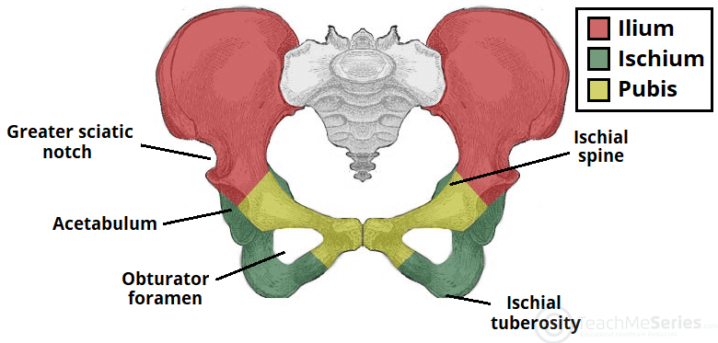

Slide 4
THE PELVIS
Structure of the Pelvic Girdle
The bony pelvis consists of 4 Bones the two hip bones ( pelvic bones), the sacrum and the coccyx.
There are four articulations within the pelvis:
  Sacroiliac joints (x2) – between the ilium of the hip bones, and the sacrum
  Sacrococcygeal symphysis – between the sacrum and the coccyx.
  Pubic symphysis – between the pubis bodies of the two hip bones.
Ligaments attach the lateral border of the sacrum to various bony landmarks on the bony pelvis to aid stability.
The bony pelvis thus forms a strong basin-shaped structure that contains and protects the lower parts of the intestinal and urinary tracts and the internal organs of reproduction.

Slide 5
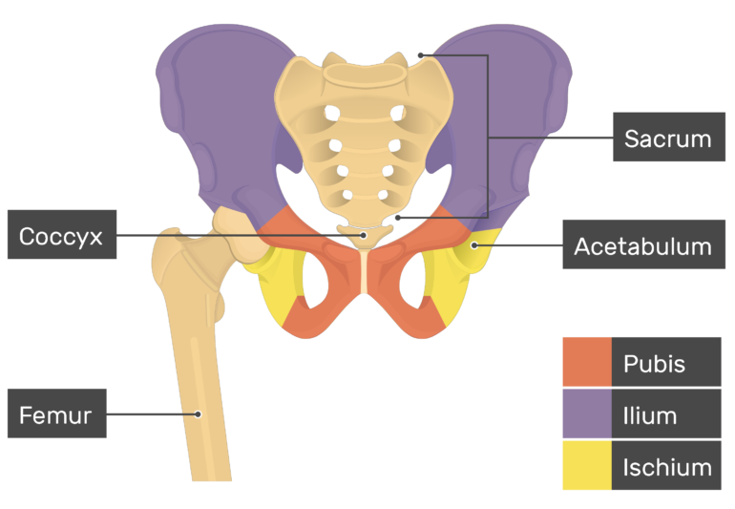

Slide 6
THE PELVIS
The Greater and Lesser Pelvis
The osteology of the pelvic girdle allows the pelvic region to be divided into two:
Greater pelvis (false pelvis): located superiorly, it provides support of the lower abdominal viscera (such as a ileum and sigmoid colon). It supports the abdominal contents and after the 3rd month of pregnancy helps support the gravid uterus
Lesser pelvis (true pelvis): located inferiorly. Within the lesser pelvis reside the pelvic cavity and pelvic viscera. it is the bony canal through which the child passes during birth. The true pelvis has an inlet, an outlet, and a cavity.
The junction between the greater and lesser pelvis is known as the pelvic inlet. The outer bony edges of the pelvic inlet are called the pelvic brim.

Slide 7
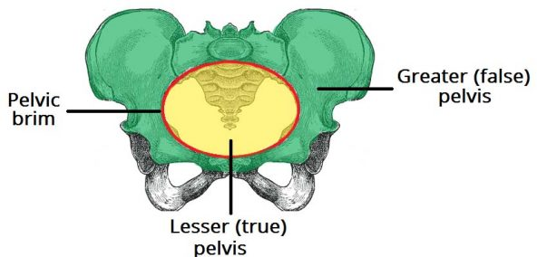

Slide 8
THE PELVIS
Pelvic Inlet
The pelvic inlet marks the boundary between the greater pelvis and lesser pelvis. Its size is defined by its edge, the pelvic brim.
The borders of the pelvic inlet:
  Posterior: sacral promontory (the superior portion of the sacrum) and sacral wings (ala).
  Lateral: arcuate line on the inner surface of the ilium, and the pectineal line on the superior pubic ramus.
  Anterior: pubic symphysis.
The pelvic inlet determines the size and shape of the birth canal, with the prominent ridges key areas of muscle and ligament attachment.

Slide 9
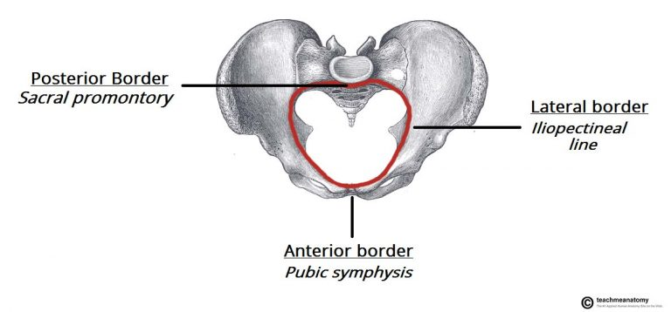

Slide 10
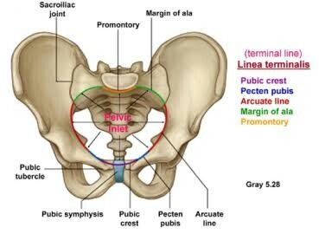
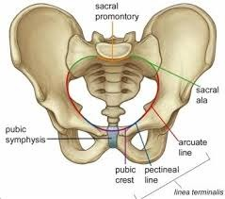
THE PELVIS
Some alternative descriptive terminology can be used in describing the pelvic inlet:
  Linea terminalis – the combined pectineal line, arcuate line and sacral promontory.
  Iliopectineal line – the combined arcuate and pectineal lines. This represents the lateral border of the pelvic inlet.

Slide 11
THE PELVIS
Pelvic Outlet
The pelvic outlet is located at the end of the lesser pelvis, and the beginning of the pelvic wall.
Its borders are:
  Posterior: The tip of the coccyx
  Lateral: The ischial tuberosities and the inferior margin of the sacrotuberous ligament
  Anterior: The pubic arch (the inferior border of the ischiopubic rami).
The angle beneath the pubic arch is known as the sub-pubic angle and is of a greater size in women.

Slide 12
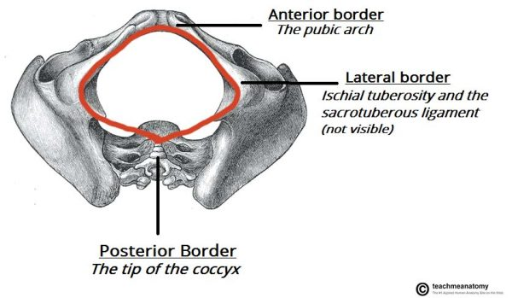

Slide 13
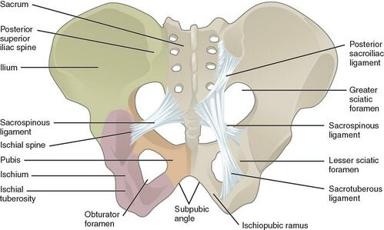

Slide 14
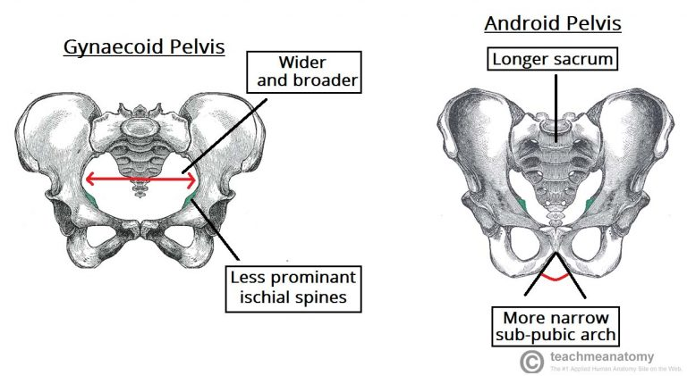

Slide 15
STRUCTURE OF THE PELVIC WALLS
The walls of the pelvis are formed by bones and ligaments that are partly lined with muscles covered with fascia and parietal peritoneum.
The pelvis has
  Anterior
  Posterior,
  Lateral walls
  Inferior wall or floor

Slide 16
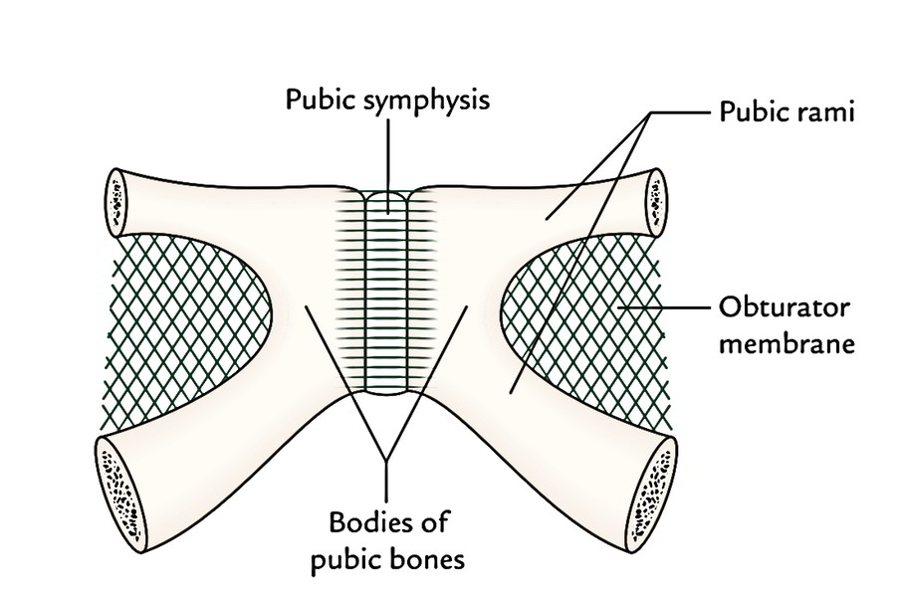
ANTERIOR PELVIC WALL
The anterior pelvic wall is the shallowest wall and is formed by the
  BODIES OF THE PUBIC BONES
  PUBIC RAMI
  SYMPHYSIS PUBIS

Slide 17
POSTERIOR PELVIC WALL
The posterior pelvic wall is wide and is formed by the
  SACRUM
  COCCYX
  PIRIFORMIS MUSCLES and their covering of parietal pelvic fascia

Slide 18
SACRUM
The sacrum consists of five vertebrae fused together to form a single wedge-shaped bone with a forward concavity.
The upper border or base of the bone articulates with the fifth lumbar vertebra
The narrow inferior border articulates with the coccyx
Laterally, the sacrum articulates with the two iliac bones to form the sacroiliac joints.
The anterior and upper margins of the first sacral vertebra bulge forward as the posterior margin of the pelvic inlet called sacral promontory which is an important obstetric landmark used when measuring the size of the pelvis.

Slide 19
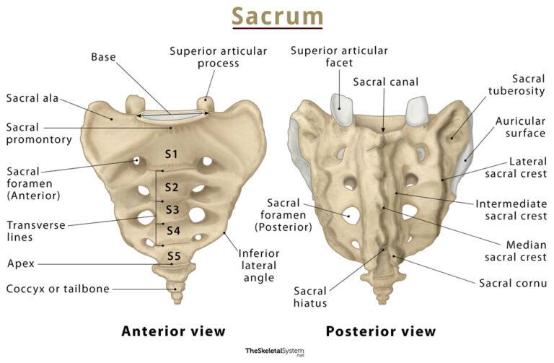

Slide 20
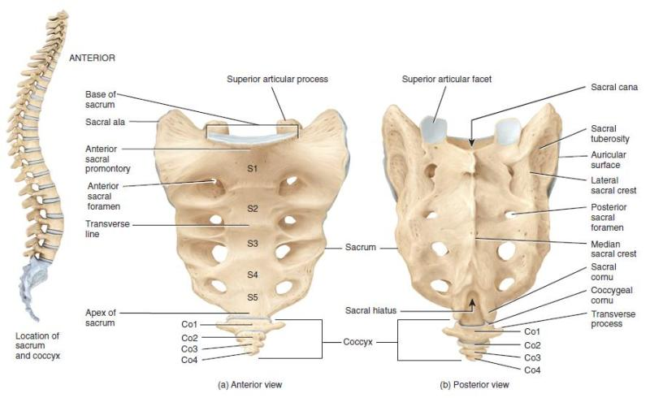

Slide 21
SACRUM
The vertebral foramina together form the sacral canal.
The laminae of the 5th sacral vertebra, and sometimes those of the 4th, fail to meet in the midline, forming the sacral hiatus.
The sacral canal contains the anterior and posterior roots of the lumbar, sacral, and coccygeal spinal nerves; the filum terminale; and fibro fatty material.
It also contains the lower part of the subarachnoid space down as far as the lower border of the 2nd sacral vertebra

Slide 22
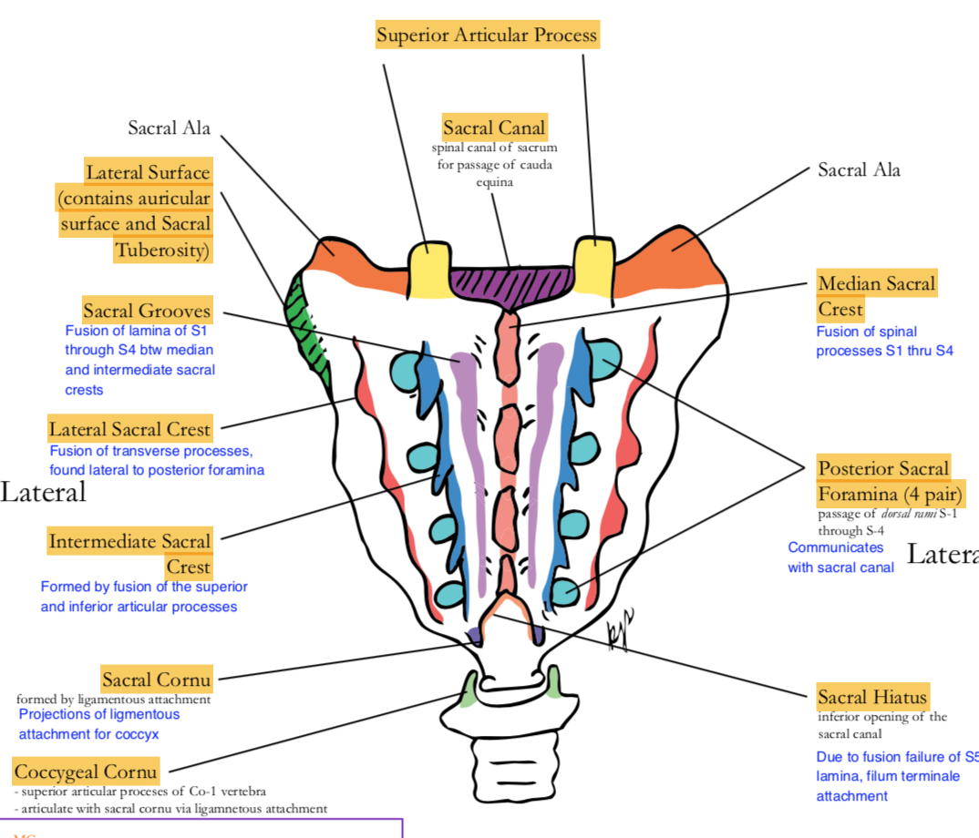
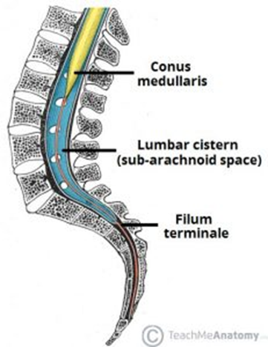

Slide 23
SACRUM
The anterior and posterior surfaces of the sacrum possess on each side four foramina for the passage of the anterior and posterior rami of the upper four sacral nerves
The sacrum is usually wider in proportion to its length in the female than in the male.
The sacrum is tilted forward so that it forms an angle with the fifth lumbar vertebra, called the lumbosacral angle.

Slide 24
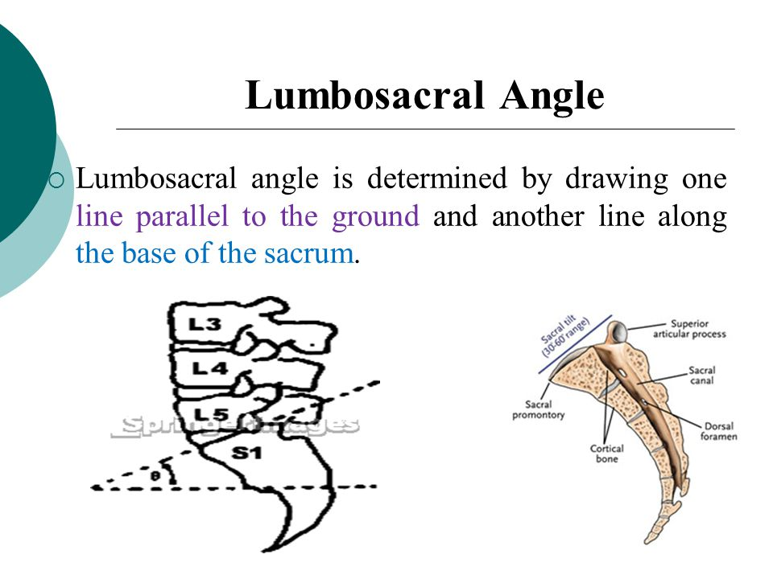

Slide 25
COCCYX
The coccyx consists of four vertebrae fused together to form a small triangular bone, which
articulates at its base with the lower end of the sacrum.
The coccygeal vertebrae consist of bodies only, but the first vertebra possesses a rudimentary transverse process and cornua.
The cornua are the remains of the pedicles and superior articular processes and project upward to articulate with the sacral cornua

Slide 26
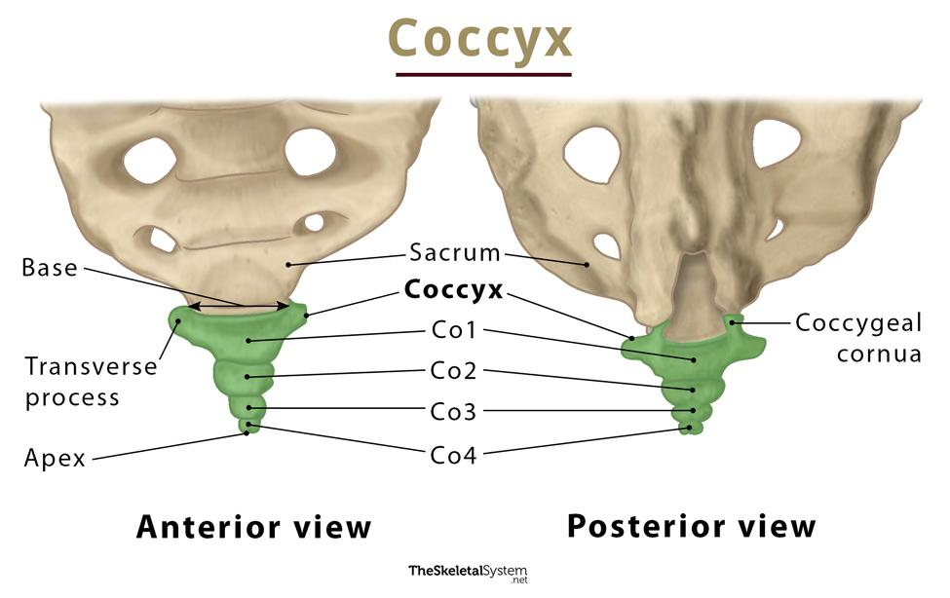
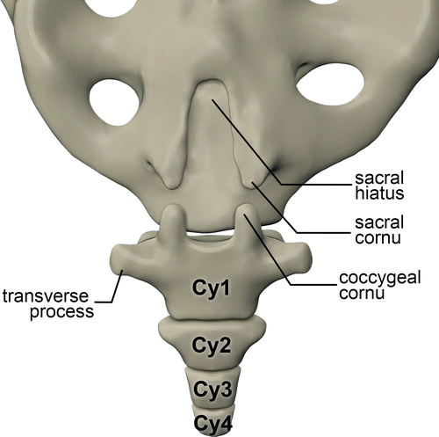

Slide 27
PIRIFORMIS MUSCLE
Arises from the front of the lateral mass of the sacrum and leaves the pelvis to enter the gluteal region by passing laterally through the greater sciatic foramen.
Inserted into the upper border of the greater trochanter of the femur.
Action: it is a lateral rotator of the femur at the hip joint.
Nerve supply: from the sacral plexus.

Slide 28
LATERAL PELVIC WALL
FORMED BY
  Part of the hip bone
  Pelvic inlet
  Obturator membrane
  Sacrotuberous and sacrospinous ligaments
  Obturator internus muscle and its covering fascia

Slide 29
THE HIP BONE
The left and right hip bones (pelvic bones) are two irregularly shaped bones that form part of the pelvic girdle – the bony structure that attaches the axial skeleton to the lower limbs.
The hip bones have three main articulations:
  Sacroiliac joint: articulation with the sacrum.
  Pubic symphysis: articulation between the left and right hip bones.
  Hip joint: articulation with the head of femur.

Slide 31
THE HIP BONE
The hip bone is comprised of the three parts, ilium, pubis and ischium. Prior to puberty, the triradiate cartilage separates these parts – and fusion only begins at the age of 15-17.
Together, the ilium, pubis and ischium form a cup-shaped socket known as the acetabulum (literal meaning in Latin is ‘vinegar cup‘). The head of the femur articulates with the acetabulum to form the hip joint.
a large bony indentation situated along the posterior border of hip bone the greater sciatic notch, which is separated from the lesser sciatic notch by the spine of the ischium.
The sciatic notches are converted into the greater and lesser sciatic foramina by the presence of the sacrotuberous and sacrospinous ligaments

Slide 32
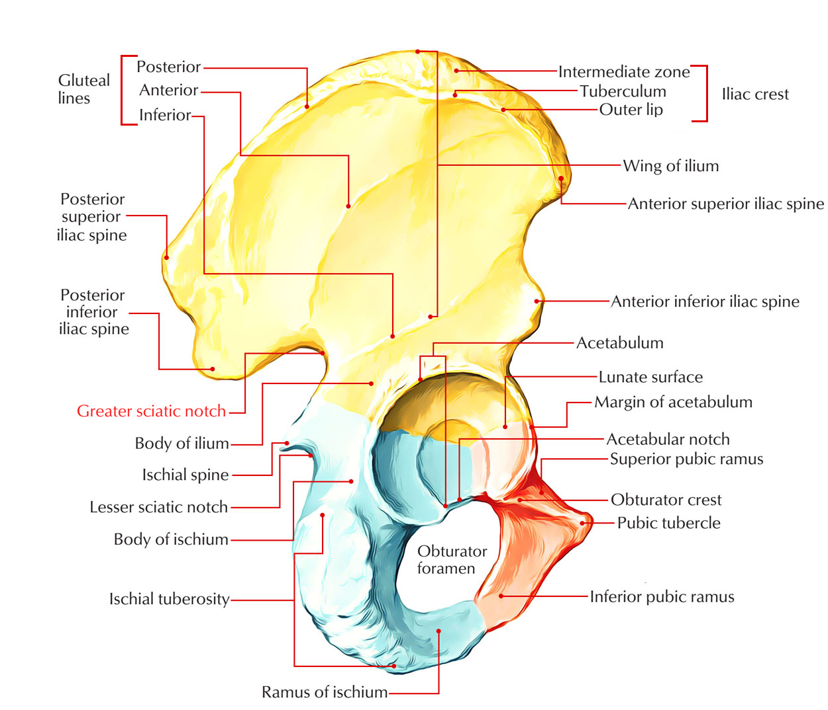

Slide 34
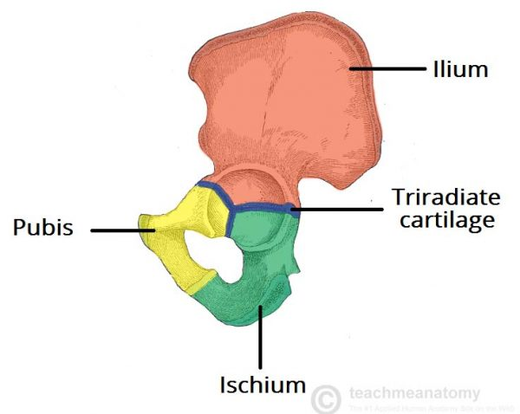

Slide 35
THE HIP BONE
Ilium
Upper flattened part of the hip bone, possesses the iliac crest.
The iliac crest runs between the anterior and posterior superior iliac spines. Below these spines are the corresponding anterior and posterior inferior iliac spines.
On the inner surface of the ilium is the large auricular surface for articulation with the sacrum.
The iliopectineal line runs downward and forward around the inner surface of the ilium and serves to divide the false from the true pelvis.

Slide 36
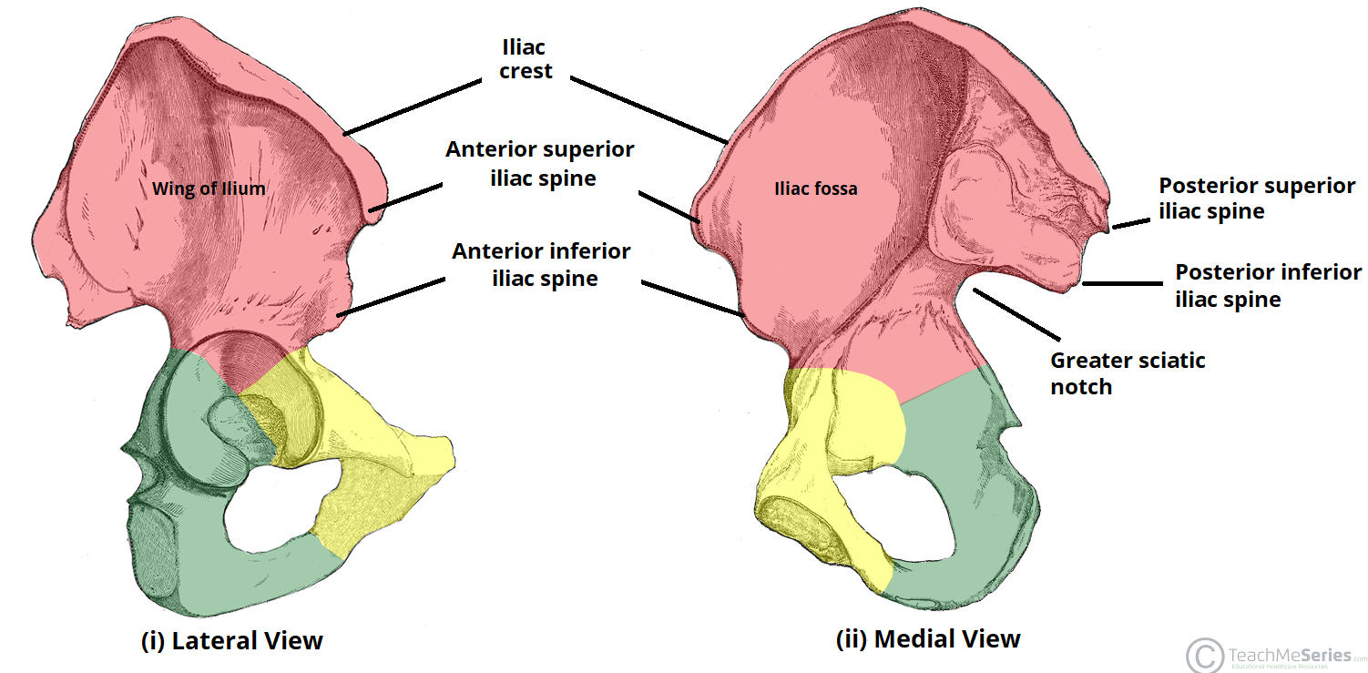

Slide 37
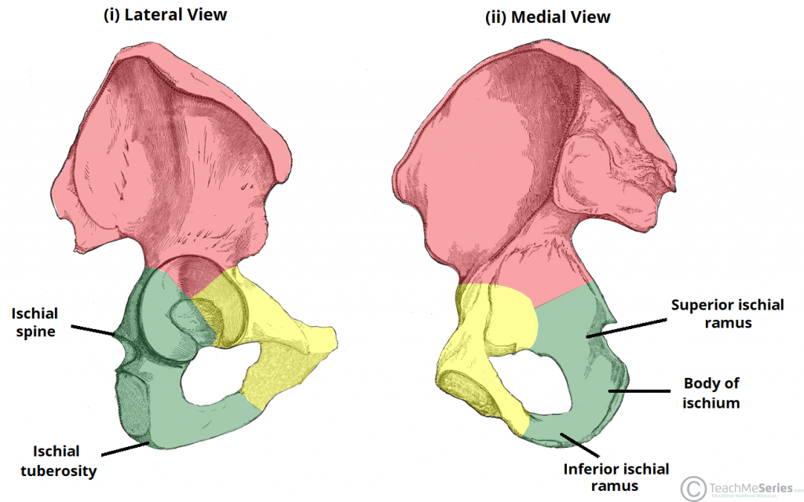
THE HIP BONE
ISCHIUM
The ischium is the inferior and posterior part of the hip bone and possesses an ischial spine and an ischial tuberosity

Slide 38
THE HIP BONE
PUBIS
anterior part has a body and superior and inferior pubic rami.
Body of the pubis bears the pubic crest and pubic tubercle and articulates with the pubic bone of the opposite side at the symphysis pubis.
In the lower part of the hip bone is a large opening, the obturator foramen, which is bounded by the parts of the ischium and pubis. The obturator foramen is filled in by the obturator membrane

Slide 39
OBTURATOR MEMBRANE
Fibrous sheet that almost completely closes the obturator foramen,
Leaving a small gap, the obturator canal, for the passage of the obturator nerve and vessels as they leave the pelvis to enter the thigh

Slide 40
SACROTUBEROUS LIGAMENT
The sacrotuberous ligament is strong and extends from the lateral part of the sacrum and coccyx and the posterior inferior iliac spine to the ischial tuberosity.

Slide 41
SACROSPINOUS LIGAMENT
Is strong and triangle shaped. It is attached by its base to the lateral part of the sacrum and coccyx and by its apex to the spine of the ischium

Slide 42
OBTURATOR INTERNUS MUSCLE
Arises from the pelvic surface of the obturator membrane and the adjoining part of the hip bone.
The muscle fibers converge to a tendon, which leaves the pelvis through the lesser sciatic foramen and is inserted into the greater trochanter of the femur.
Action:
  It laterally rotates the femur at the hip joint.
Nerve supply:
  The nerve to the obturator internus, a branch from the sacral plexus

Slide 43
INFERIOR PELVIC WALL OR PELVIC FLOOR
The floor of the pelvis supports the pelvic viscera and is formed by the pelvic diaphragm.
It divide the pelvic cavity above and perineum below.
The pelvic diaphragm is formed by the levatores ani muscles and the small coccygeus muscles and their covering fasciae.
It is incomplete anteriorly to allow passage of the urethra in males and the urethra and the vagina in females.

Slide 44
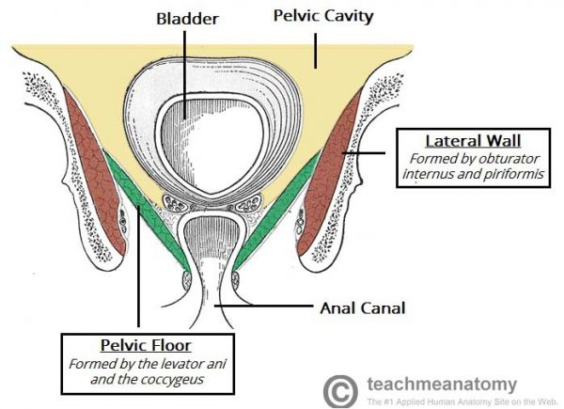

Slide 45
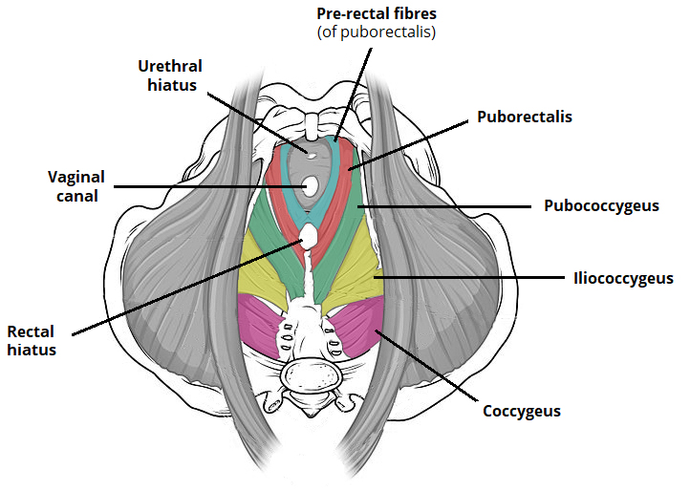

Slide 46
LEVATOR ANI MUSCLE
The levator ani is a broad sheet of muscle. It is composed of three separate paired muscles; pubococcygeus, puborectalis and iliococcygeus.
These muscles have attachments to the pelvis as follows:
  Anterior: pubic bodies of the pelvic bones.
  Laterally: thickened fascia of the obturator internus muscle, known as the tendinous arch.
  Posteriorly: ischial spines of the pevlic bones

Slide 47
LEVATOR ANI MUSCLE
Action:
The levatores ani muscles of the two sides form an efficient muscular sling that supports and maintains the pelvic viscera in position.
They resist the rise in intrapelvic pressure during the straining and expulsive efforts of the abdominal muscles (as occurs in coughing).
They also have an important sphincter action on the anorectal junction, and in the female they serve also as a sphincter of the vagina.
Nerve supply:
The perineal branch of the fourth sacral nerve and from the perineal branch of the pudendal nerve

Slide 48
COCCYGEUS MUSCLE
This small triangular muscle arises from the spine of the ischium and is inserted into the lower end of the sacrum and into the coccyx
Action:
The two muscles assist the levatores ani in supporting the pelvic viscera.
Nerve supply:
A branch of the 4th and 5th sacral nerves

Slide 49


