Slide 1
Small intestine
AIZAZ
Demonstrator Surgical
KMU-IPMS Peshawar

Slide 2
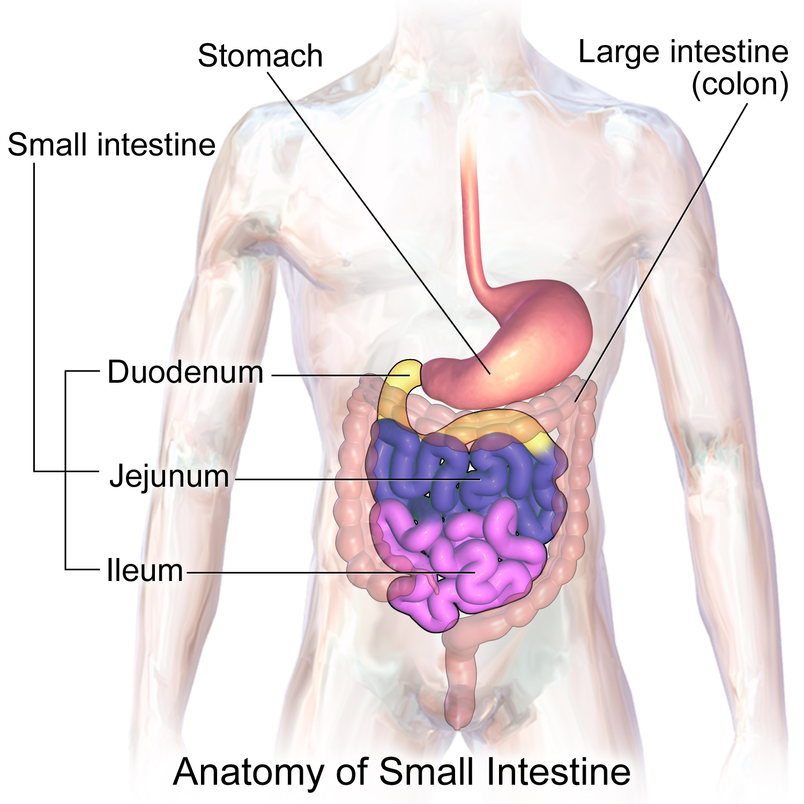
Small intestine
Longest part of the alimentary canal and extends from the pylorus of the stomach to the ileocecal junction.
Divided into three parts:
  Duodenum,
  Jejunum,
  The ileum.

Slide 3
Duodenum
C-shaped tube, about 10 in. (25 cm)
Joins the stomach to the jejunum.
Receives the openings of the bile and pancreatic ducts
Curves around the head of the pancreas
The 1st inch resemble the stomach.
  Covered on its anterior and posterior surfaces with peritoneum and
  Has the lesser omentum attached to upper border and the
  Greater omentum attached to its lower border;
  Lesser sac lies behind this short segment
The remainder of the duodenum is retroperitoneal, being only partially covered by peritoneum

Slide 4
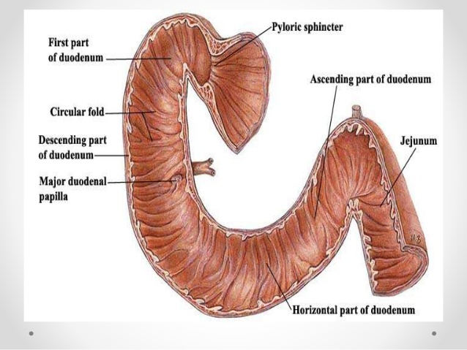

Slide 5
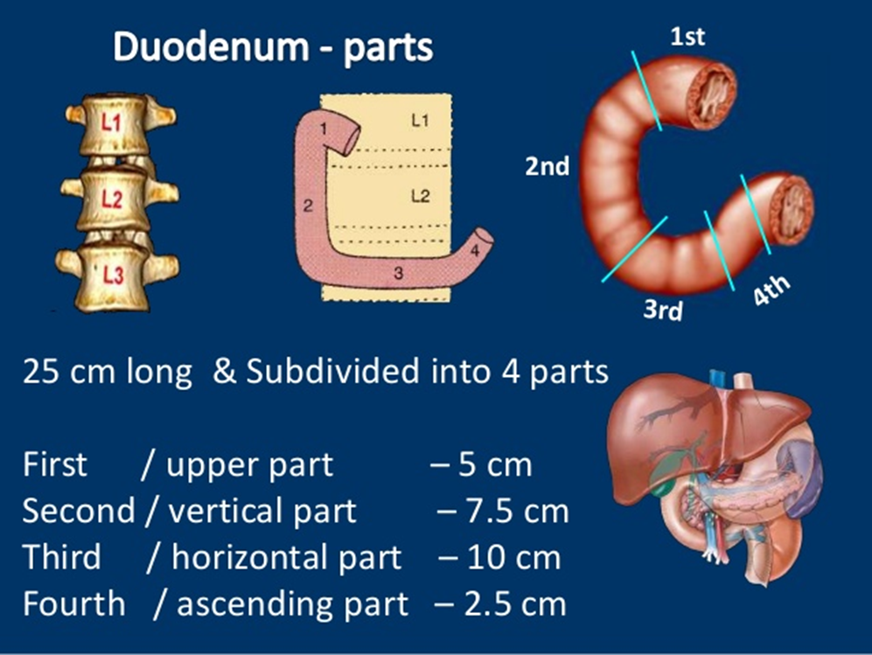

Slide 6
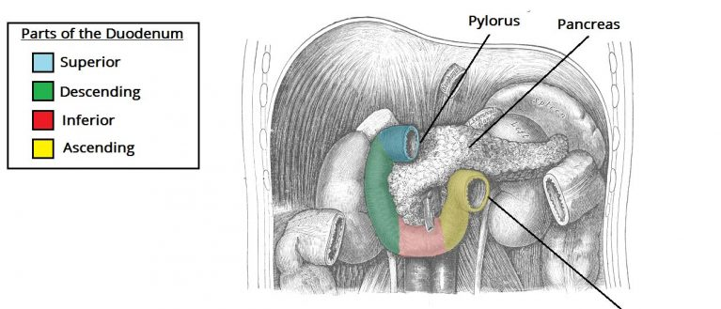

Slide 7
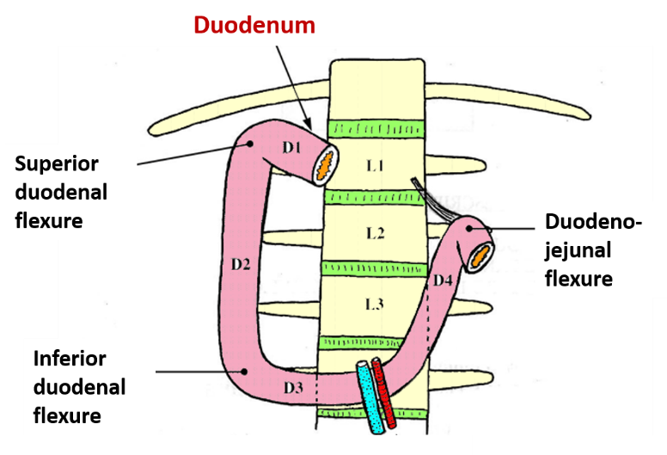

Slide 8
PARTS OF DUEDENUM
First Part of the Duodenum :
The first part of the duodenum begins at the pylorus and runs upward and backward on the transpyloric plane at the level of the 1st lumbar vertebra.
Anatomical relation
  Anteriorly: The quadrate lobe of the liver and the gallbladder.
  Posteriorly: The lesser sac, gastroduodenal
  artery, bile duct, portal vein, and the inferior vena cava
  Superiorly: The entrance into the lesser sac (the epiploic foramen)
  Inferiorly: The head of the pancreas

Slide 9
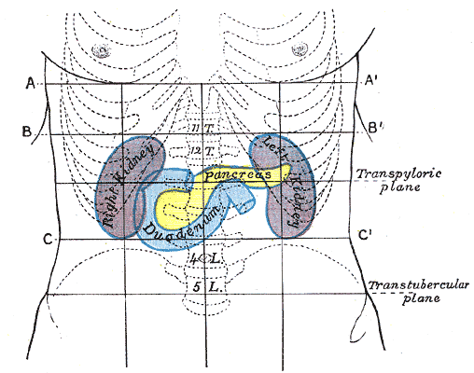

Slide 10
PARTS OF DUEDENUM
SECOND PART OF THE DUODENUM :
The second part of the duodenum runs vertically downward in front of the hilum of the right kidney on the right side of the 2nd and 3rd lumbar vertebrae.
  About halfway down its medial border, the bile duct and the main pancreatic duct pierce the duodenal wall. They unite to form the ampulla
  that opens on the summit of the major duodenal papilla.
  The accessory pancreatic duct, if present, opens into the duodenum a little higher up on the minor duodenal papilla

Slide 11
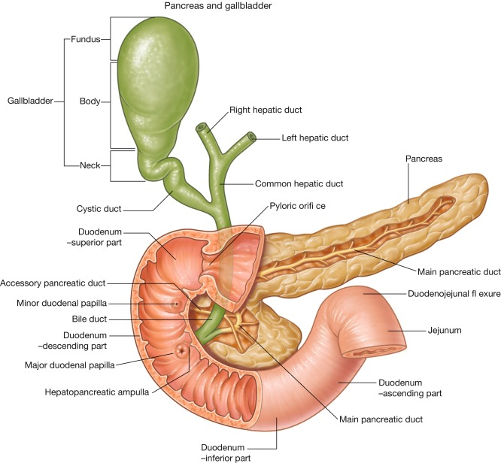
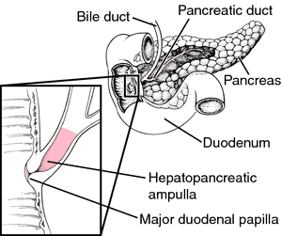

Slide 12
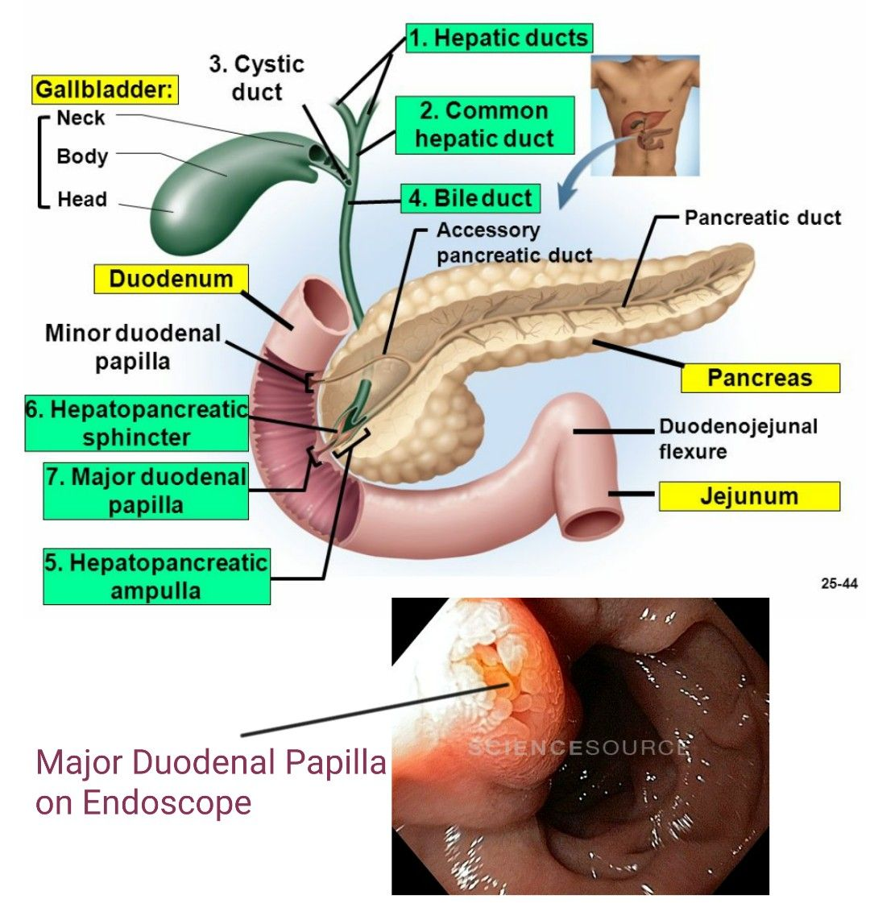
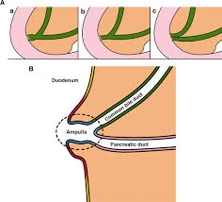

Slide 13
PARTS OF DUEDENUM
Anatomical relation of descending duodenum
  Anteriorly: fundus of the gallbladder and right lobe of the liver, transverse colon, and the coils of the small intestine.
  Posteriorly: hilum of the right kidney and the right Ureter.
  Laterally: ascending colon, right colic flexure, and right lobe of the liver.
  Medially: head of the pancreas, bile duct, and main pancreatic duct

Slide 14
PARTS OF DUEDENUM
THIRD PART OF THE DUODENUM :
Runs horizontally to the left on the subcostal plane, passing in front of the vertebral column and following the lower margin of the head of the pancreas.
Anatomical relation
  Anteriorly: The root of the mesentery of the small intestine, the superior mesenteric vessels, and coils of jejunum
  Posteriorly: Right ureter, right psoas muscle, inferior vena cava, and aorta.
  Superiorly: The head of pancreas.
  Inferiorly: Coils of jejunum

Slide 15
PARTS OF DUEDENUM
FOURTH PART OF THE DUODENUM :
The fourth part of the duodenum runs upward and to the left to the duodenojejunal flexure.
The flexure is held in position by a peritoneal fold, the ligament of Treitz, which is attached to the right crus of the diaphragm.
Anatomical relation
  Anteriorly: The beginning of the root of the mesentery and coils of jejunum
  Posteriorly: The left margin of the aorta and the medial border of the left psoas muscle

Slide 16
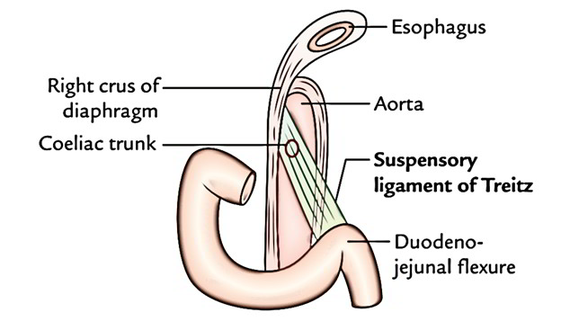

Slide 17
MUCOUS MEMBRANE AND DUODENAL PAPILLAE
Mucous membrane: is thick. , Smooth, present in 1st part. In the remaining it is thrown into numerous circular folds called the plicae circulares.
At the site where the bile duct and the main pancreatic duct pierce the medial wall of the second part is a small, rounded elevation called the major duodenal papilla.
The accessory pancreatic duct, if present, opens into the duodenum on a smaller papilla about 0.75 in. (1.9 cm) above the major duodenal papilla.

Slide 18
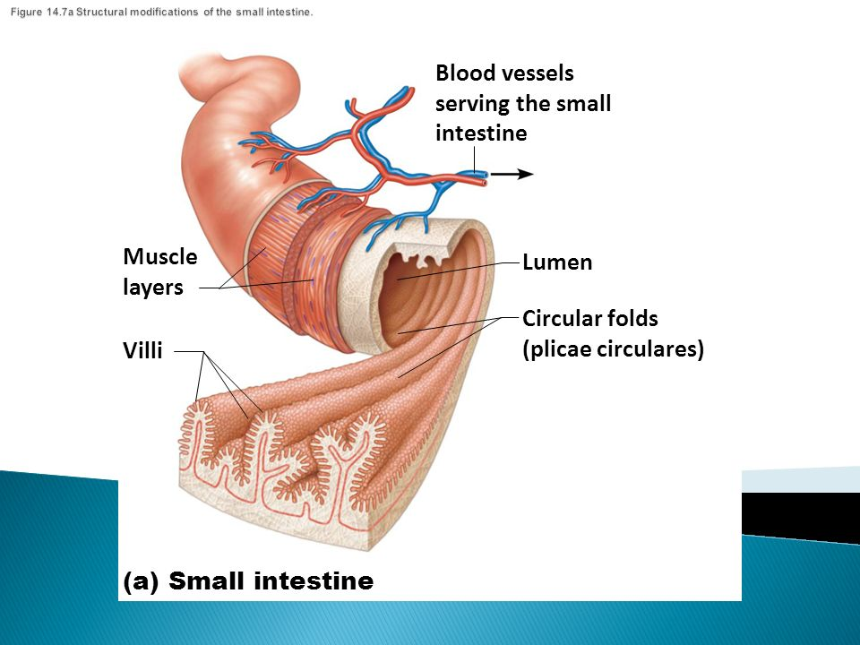
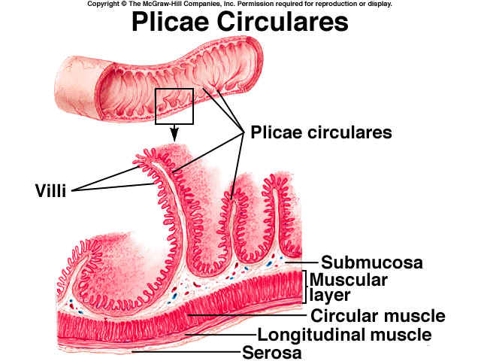

Slide 19
Blood Supply of duodenum
Arteries
The upper half is supplied by the superior pancreaticoduodenal artery, a branch of the gastroduodenal artery.
The lower half is supplied by the inferior pancreaticoduodenal artery, a branch of the superior mesenteric artery.
Veins
The superior pancreaticoduodenal vein drains into the portal vein the inferior vein joins the superior mesenteric vein.

Slide 20
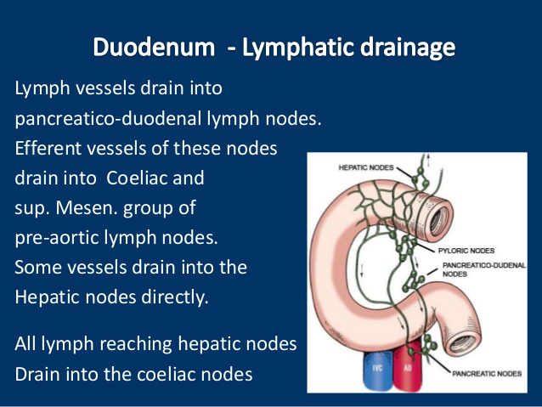
Lymph Drainage of Duodenum

Slide 21
Nerve Supply
The duodenum receives both sympathetic and parasympathetic innervation. The vagus nerve (CN X), provides parasympathetic fibers via the anterior and posterior vagal trunks, while the greater sphlanchnic nerves (T5-T9) gives fibers to the celiac plexus that subsequently travel along the pancreaticoduodenal arteries.

Slide 22
Jejunum and Ileum
The jejunum and ileum measure about 20 Ft. (6 m) long.
The upper two fifths of this length make up the jejunum.
The jejunum begins at the duodenojejunal flexure, and the ileum ends at the ileocecal junction.
The coils are freely mobile and attached to the posterior abdominal wall by a fan-shaped fold of peritoneum known as the mesentery of the small intestine

Slide 23
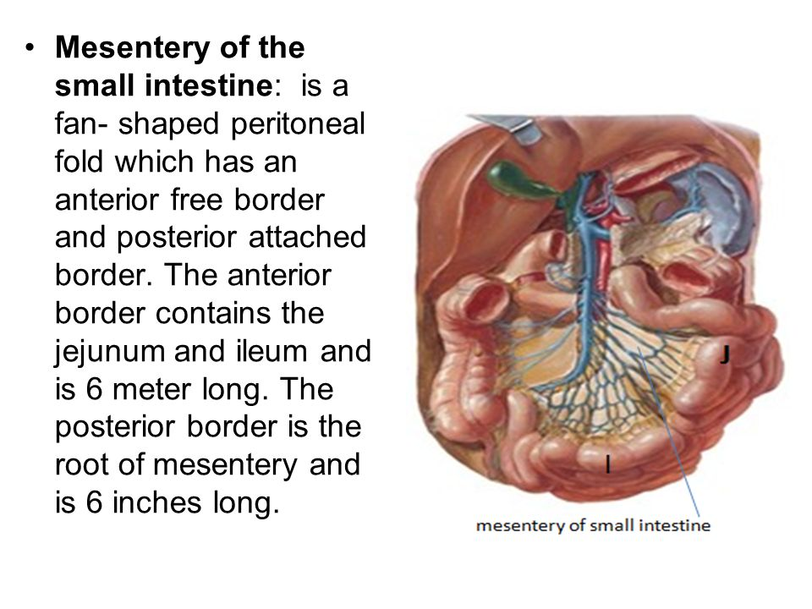
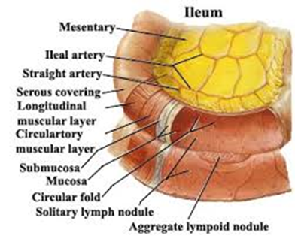
Jejunum and Ileum

Slide 24
Jejunum and Ileum
The long free edge of the fold encloses the mobile intestine.
The short root of the fold is continuous with the parietal peritoneum on the posterior abdominal wall .
extends from the left side of L2 at duedenojejunal flexure to the right sacroiliac joint at the ileocaecal junction.
The root of the mesentery permits the entrance and exit of the branches of the superior mesenteric artery and vein, lymph vessels, and nerves into the space between the two layers of peritoneum forming the mesentery.

Slide 25
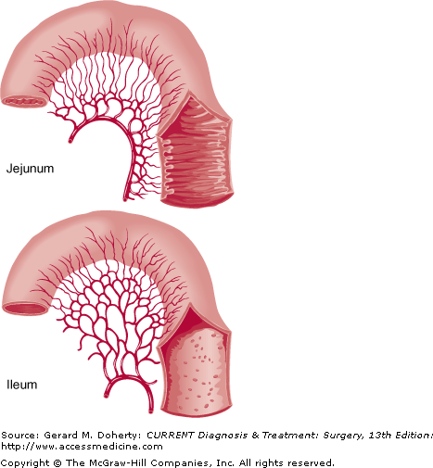
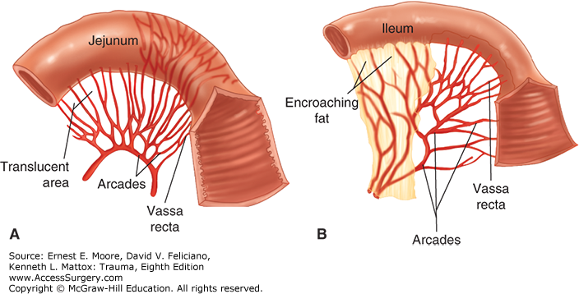

Slide 26
Different features of jejunum and ileum
JEJUNUM
ILEUM
The ileum receives numerous short terminal vessels that arise from a series of three or four or even more arcades
end of the mesentery, the fat is deposited throughout
lower and right part of abdomen
Jejunal mesenteric vessels form only one or two arcades
End of the mesentery, the fat is deposited near the root
Upper and left part of abdominal area

Slide 27
Different features of jejunum and ileum
JEJUNUM
ILEUM
Wall feels thicker because the permanent infoldings of the mucous membrane, the plicae circulares, are larger, more numerous, and closely set
Mesentery is attached to the posterior abdominal wall above and to the left of the aorta,
Whereas in the upper part of the ileum they are smaller and more widely separated and in the lower part they are absent
Mesentery is attached below and to the right of the aorta

Slide 28
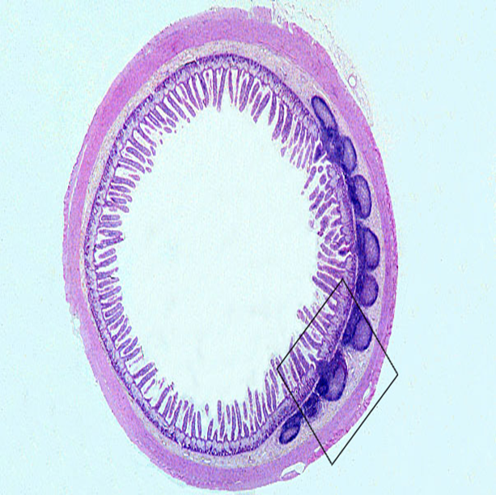
Different features of jejunum and ileum
JEJUNUM
ILEUM
peyer’s patches absent
Wider bored, thicker walled, and redder
Peyer’s patches present.

Slide 29
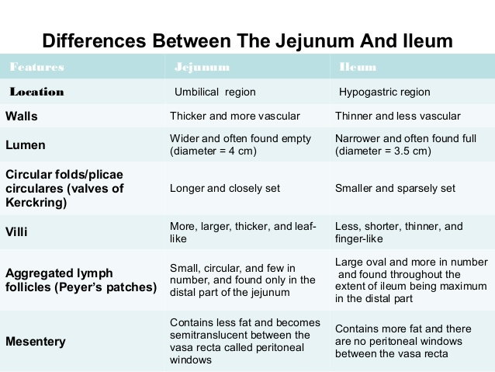

Slide 30
Blood Supply
Arteries
The arterial supply is from branches of the superior mesenteric artery.
The lowest part of the ileum is supplied by the ileocolic artery.
Veins
The veins correspond to the branches of the superior mesenteric artery and drain into the superior mesenteric vein.

Slide 31
Lymph Drainage
  The lymph vessels pass through many intermediate mesenteric nodes and finally reach the superior mesenteric nodes, which are situated around the origin of the superior mesenteric artery.

Slide 32
Nerve Supply
The nerves are derived from the sympathetic and parasympathetic (vagus) nerves from the superior mesenteric plexus.

Slide 33


