Slide 1
STOMACH
AIZAZ
Demonstrator Surgical
KMU-IPMS Peshawar

Slide 2
ESOPHAGUS
The esophagus is a 10 inch (25 cm) long fibromuscular tube extending from the pharynx (C6 level) to the stomach (T11 level).
It passes through the diaphragm at the level of the 10th thoracic vertebra to join the stomach.
It is part of the digestive system facilitates the passage of the food into the stomach.
Anatomical relation in the neck
  Lies in front of the vertebral column.
  Laterally, related to the lobes of the thyroid gland.
  Anteriorly, in contact with the trachea and the recurrent laryngeal nerves.
In the thorax, it passes downward and to the left through the superior and then the posterior mediastinum.
At the level of the sternal angle, the aortic arch pushes the esophagus over to the midline.

Slide 3
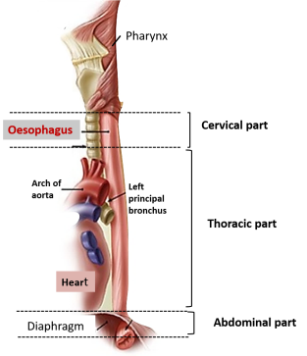
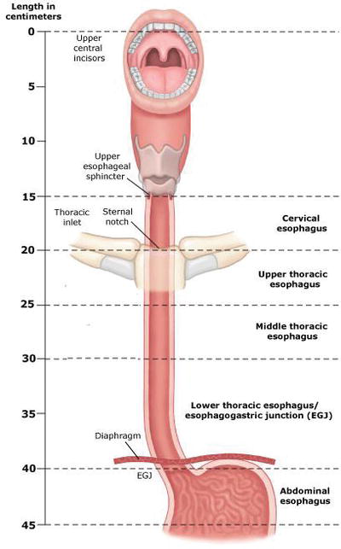

Slide 4
ESOPHAGUS
The relations of the thoracic part of the esophagus from above downward are as follows:
  Anteriorly: trachea, left recurrent laryngeal nerve, left principal bronchus, and pericardium
  Posteriorly: bodies of thoracic vertebrae, thoracic duct, azygos veins, right posterior intercostal arteries and , the descending thoracic aorta.
  Right side: mediastinal pleura and terminal part of the azygos vein.
  Left side: left subclavian artery, aortic arch, thoracic duct, and mediastinal pleura

Slide 5
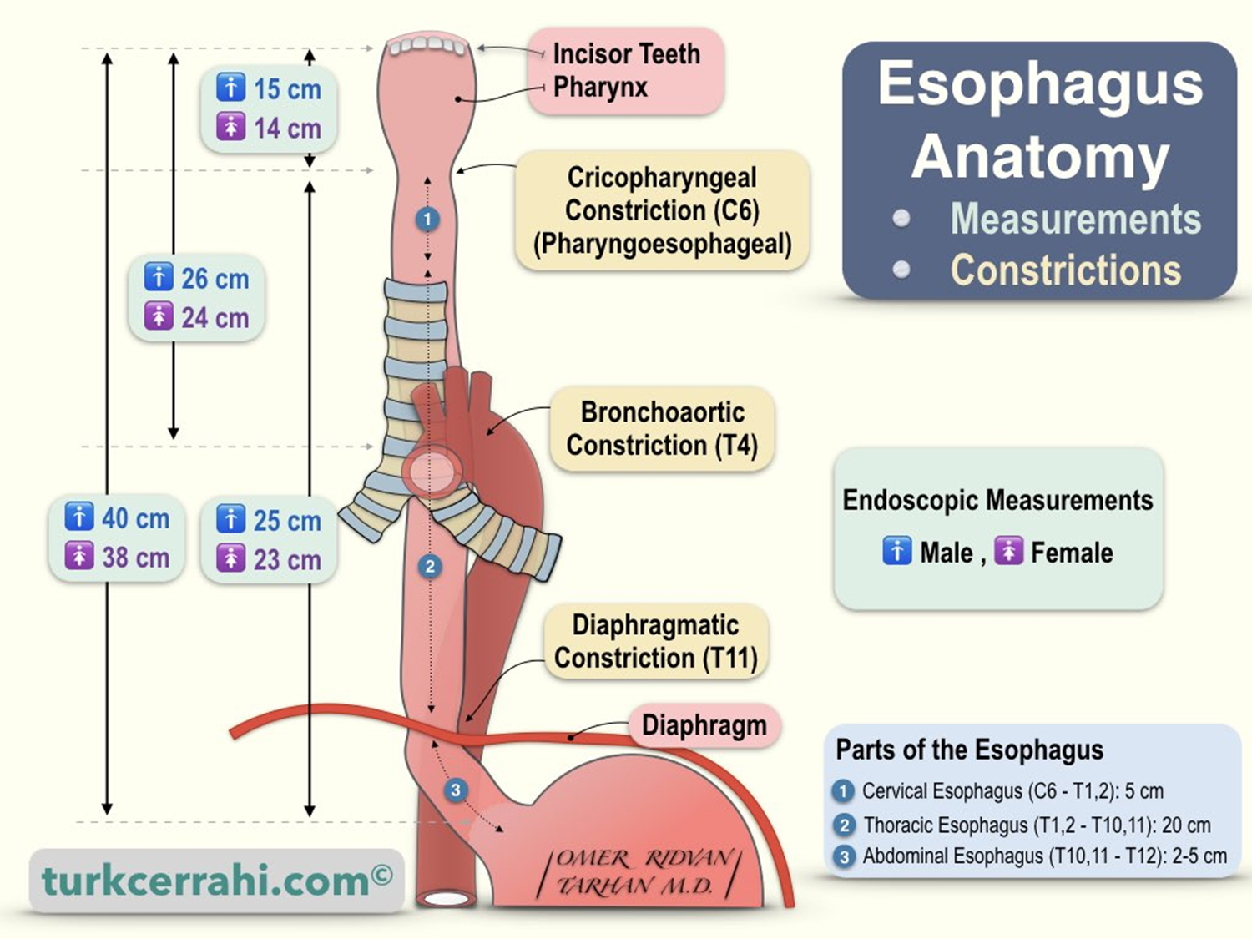

Slide 6
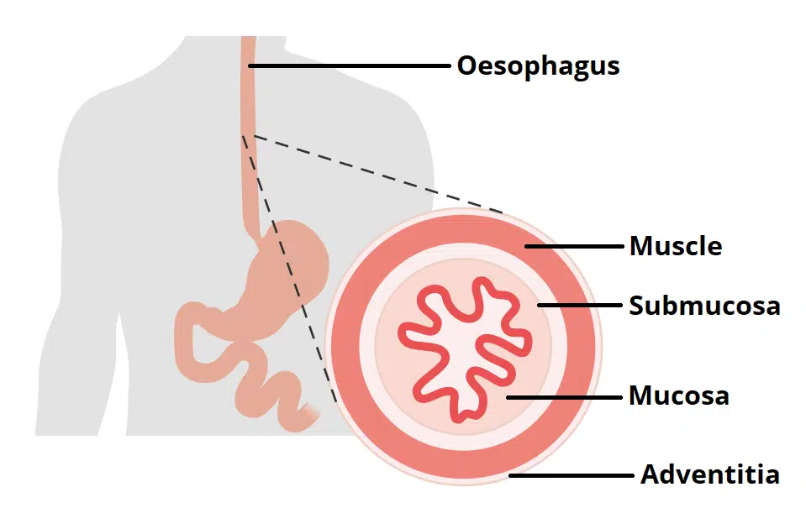

Slide 7
ESOPHAGUS
Inferiorly to the level of the roots of the lungs, the vagus nerves leave the pulmonary plexus and join with sympathetic nerves to form the esophageal plexus.
The left vagus lies anterior to the esophagus, and the right vagus lies posterior.
At the opening in the diaphragm, the esophagus is accompanied by the two vagi, branches of the left gastric blood vessels, and lymphatic vessels.
Fibers from the right crus of the diaphragm pass around the esophagus in the form of a sling.
The abdominal portion of the oesophagus is approximately 0.5 (1.3cm) long – it terminates by joining the cardiac orifice of the stomach at level of T11.
It is related to the left lobe of the liver anteriorly and to the left crus of the diaphragm posteriorly.

Slide 8
Blood supply of esophagus
Arterial supply
  The upper third is supplied by the inferior thyroid artery.
  Middle third by branches from the descending thoracic aorta.
  Lower third by branches from the left gastric artery.
Venous return
  Upper third drain into the inferior thyroid veins
  Middle third into the azygos veins
  Lower third into the left gastric vein, a tributary of the portal vein.

Slide 9
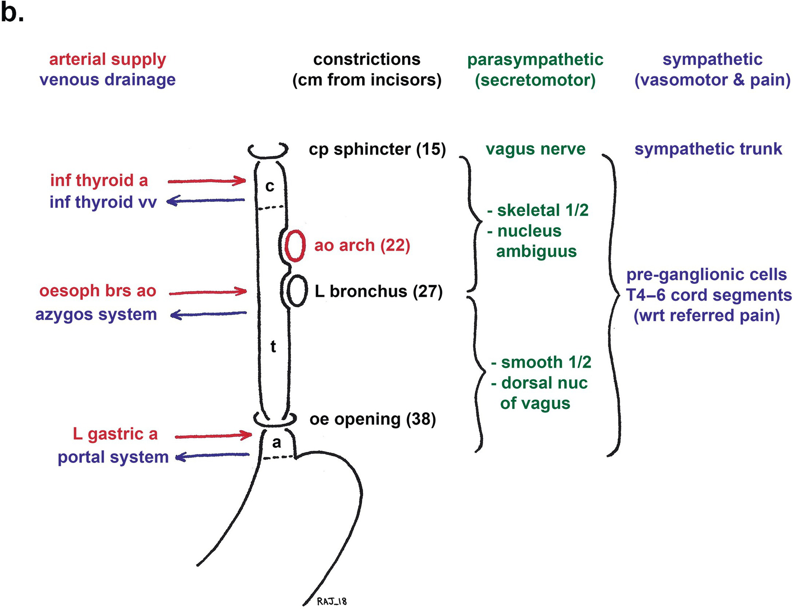

Slide 10
Nerve Supply to Esophagus
The esophagus is supplied by parasympathetic and sympathetic efferent and afferent fibers via the vagi and sympathetic trunks.
In the lower part of its thoracic course, the esophagus is surrounded by the esophageal nerve plexus.

Slide 11
Lymph Drainage of the Esophagus
Lymph vessels from the
  Upper third drain into the deep cervical nodes.
  Middle third into the superior and posterior mediastinal nodes.
  Lower third into nodes along the left gastric blood vessels and the celiac nodes.

Slide 12
SPHINCTERS
There are two sphincters present in the esophagus, known as the upper and lower esophageal sphincters. They act to prevent the entry of air and the reflux of gastric contents respectively.
Upper Esophageal Sphincter
  The upper sphincter is an anatomical, striated muscle sphincter at the junction between the pharynx and esophagus. It is produced by the cricopharyngeus muscle. Normally, it is constricted to prevent the entrance of air into the esophagus.
Lower Esophageal Sphincters (GASTROESOPHAGEAL SPHINCTER)
  No anatomic sphincter exists at the lower end of the esophagus.
  However, the circular layer of smooth muscle in this region serves as a physiologic sphincter.
  As the food descends through the esophagus, relaxation of the muscle at the lower end occurs ahead of the peristaltic wave so that the food enters the stomach.
  The tonic contraction of this sphincter prevents the stomach contents from regurgitating into the esophagus.
  The closure of the sphincter is under vagal control, and this can be augmented by the hormone gastrin and reduced in response to secretin, cholecystokinin, and glucagon.

Slide 13
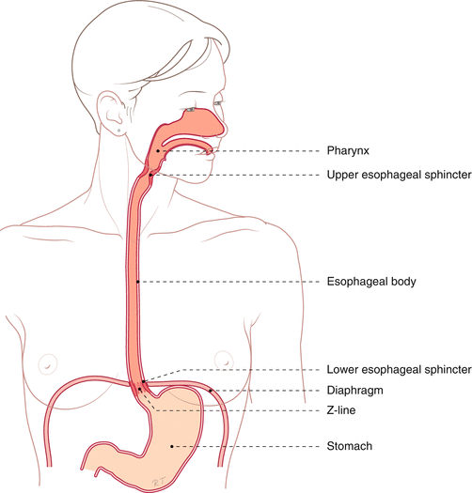
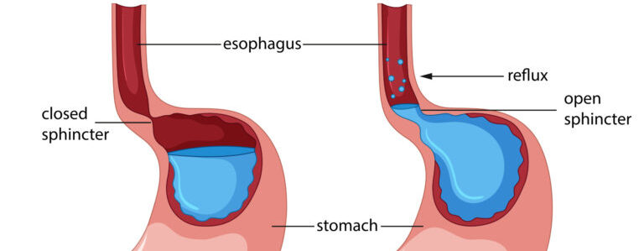

Slide 14
STOMACH
  Dilated portion of the alimentary canal, situated in the upper part of the abdomen, extending from beneath the left costal margin region into the epigastric and umbilical regions
  Roughly j-shaped
  Capacity of about 1500 ml
  Two openings, the cardiac and pyloric orifices
  Two curvatures, the greater and lesser curvature
  Two surfaces, an anterior and a posterior surface
  Fixed at both ends but is very mobile in between.

Slide 15
STOMACH
High and transversely arranged in the short, obese person (steer-horn stomach)
Elongated vertically in the tall, thin person (j-shaped stomach)
Shape variation depends on the volume of the contents.
Has three main function
  Stores food
  Mixes the food with gastric secretions to form a semifluid chyme
  Controls the rate of delivery of the chyme to the small intestine so that efficient digestion and absorption can take place.

Slide 16
STOMACH
The stomach is divided into the following parts
  Fundus: Dome-shaped and projects upward and to the left of the cardiac orifice. It is usually full of gas.
  Body: Extends from the level of the cardiac orifice to the level of the incisura angularis, a constant notch in the lower part of the lesser curvature.
  Pyloric antrum: Extends from the incisura angularis to the pylorus.
  Pylorus: The most tubular part of the stomach. The thick muscular wall is called the pyloric sphincter, and the cavity of the pylorus is the pyloric canal

Slide 17
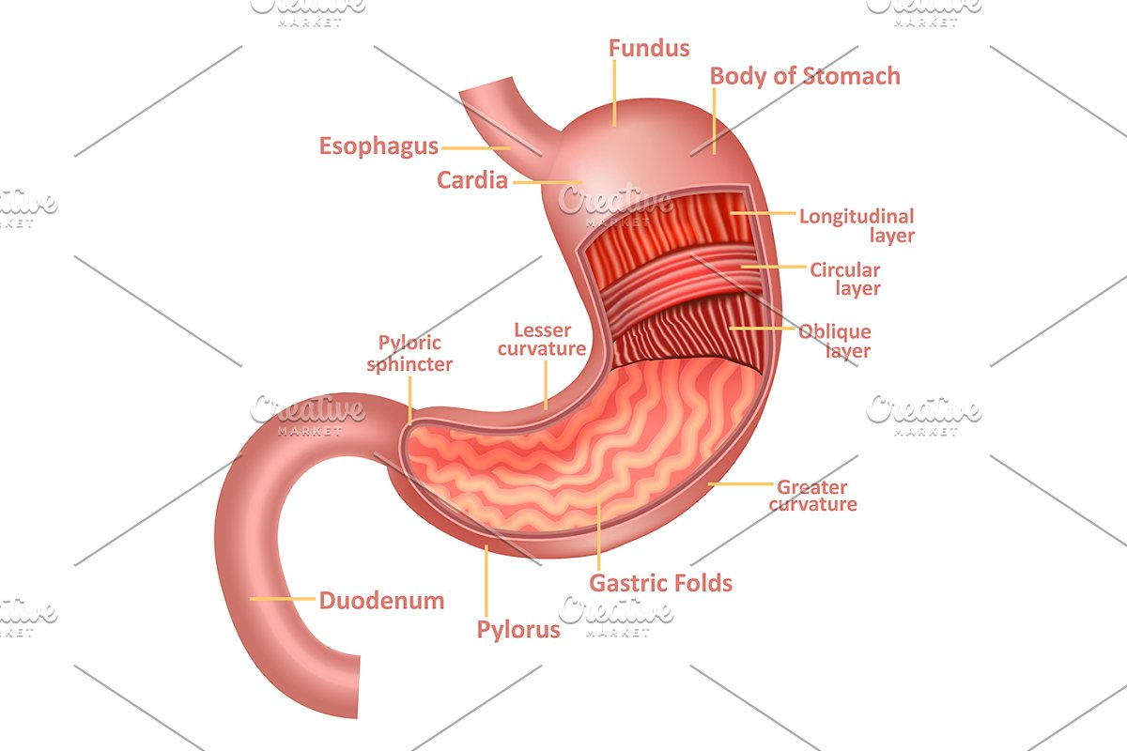

Slide 18
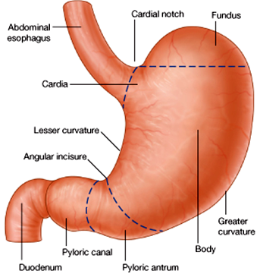
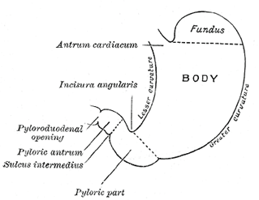

Slide 19
STOMACH
Lesser curvature forms the right border and extends from the cardiac orifice to the pylorus suspended from the liver by the lesser omentum.
Greater curvature is much longer and extends from the left of the cardiac orifice, over the dome of the fundus, and along the left border of the stomach to the pylorus.
Here gastrosplenic Omentum extends from the upper part to the spleen.
The greater omentum extends from the lower part of the greater curvature to the transverse colon.

Slide 20
STOMACH
Cardiac orifice is where the esophagus enters the stomach has no sphincter a physiologic mechanism exists that prevents regurgitation to esophagus.
Pyloric orifice is formed by the pyloric canal, which is about 1 in. (2.5 cm) long here present a circular muscle called pyloric sphincter.
Pyloric sphincter controls the outflow of gastric contents into the duodenum
Mucous membrane of the stomach is thick and vascular and is thrown into numerous folds, or rugae longitudinal in direction, folds flatten out when the stomach is distended.

Slide 21
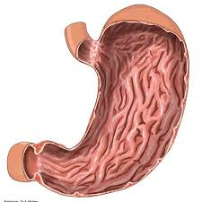

Slide 22
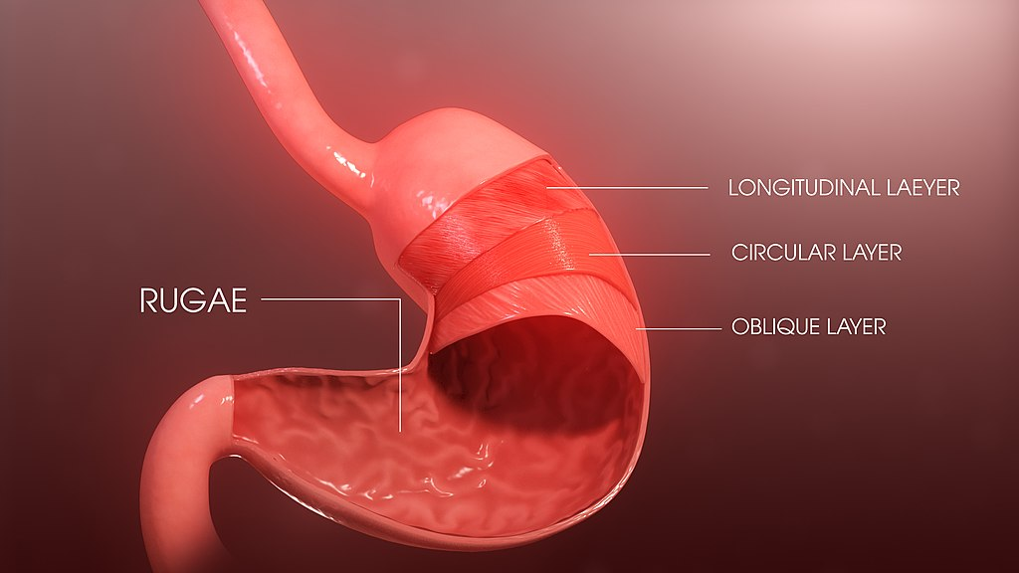

Slide 23
STOMACH
The muscular wall of the stomach contains longitudinal fibers, circular fibers, and oblique fibers.
The peritoneum completely surrounds the stomach.
  It leaves the lesser curvature as the lesser omentum and the greater curvature as the gastrosplenic omentum and the greater omentum.

Slide 24
Anatomical relation | Structures
Superior | Oesophagus and left dome of the diaphragm
Anterior | The anterior abdominal wall, the left costal margin, the left pleura and lung, the diaphragm, and the left lobe of the liver
Posterior | The lesser sac, diaphragm, spleen, left suprarenal gland, upper part of the left kidney, splenic artery, pancreas, the transverse mesocolon, and the transverse colon

Slide 25
Arterial supply of stomach
Left gastric artery arises from the celiac artery supplies the lower third of the esophagus and the upper right part of the stomach
Right gastric artery arises from the hepatic artery supplies the lower right part of the stomach.
Short gastric arteries arise from the splenic artery supply the fundus
Left gastroepiploic artery arises from the splenic artery supply upper part of the greater curvature
Right gastroepiploic artery arises from the gastroduodenal branch of the hepatic artery supplies the stomach along the lower part of the greater curvature.

Slide 26
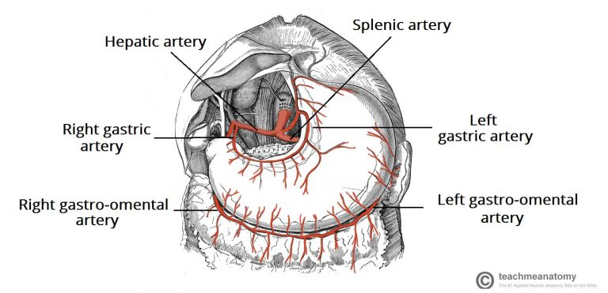

Slide 27
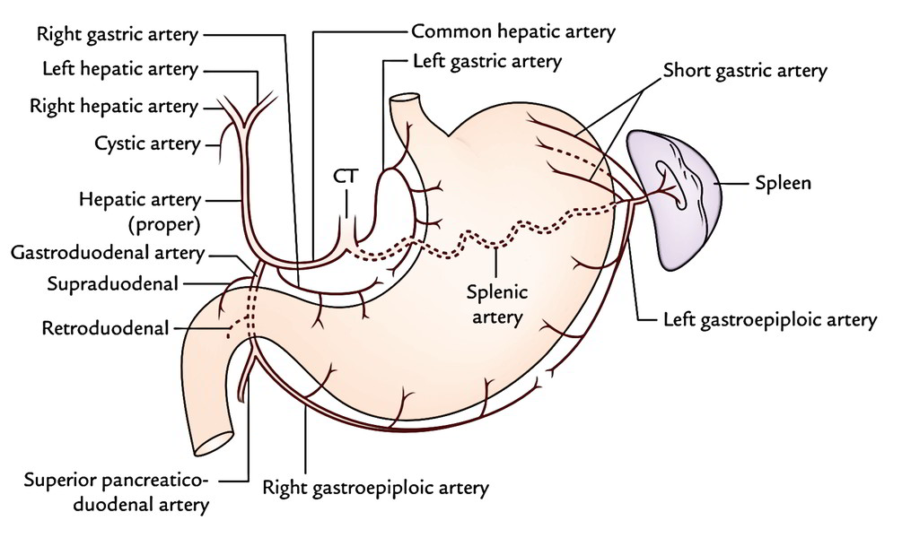

Slide 28
Veins of stomach
The veins drain into the portal circulation.
The left and right gastric veins drain directly into the portal vein.
The short gastric veins and the left gastroepiploic veins join the splenic vein.
The right gastroepiploic vein joins the superior mesenteric vein.

Slide 29
Lymphatic's
The gastric lymphatic vessels travel with the arteries along the greater and lesser curvatures of the stomach.
Lymph fluid drains into the gastric and gastro-omental lymph nodes found at the curvatures.
Efferent lymphatic vessels from these nodes connect to the coeliac lymph nodes, located on the posterior abdominal wall

Slide 30
Nerve supply
The nerve supply includes sympathetic fibers derived from the celiac plexus and parasympathetic fibers from the right and left vagus nerves
Anterior vagal trunk, supply the anterior surface of the stomach
Posterior vagal trunk supply mainly the posterior surface of the stomach.
The pyloric sphincter receives motor fibers from the sympathetic system and inhibitory fibers from the vagi.

Slide 31
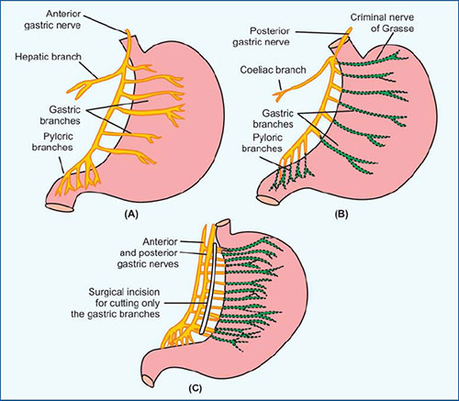

Slide 32


