Slide 1
Peritoneum
AIZAZ
Demonstrator Surgical
KMU-IPMS Peshawar

Slide 2
ABDOMINAL CAVITY
The abdominal cavity is a large body cavity.
It is a part of the abdominopelvic cavity.
It is located below the thoracic cavity, and above the pelvic cavity
Its dome-shaped roof is the thoracic diaphragm.
Its floor is the pelvic inlet, opening into the pelvis.
Organs of the abdominal cavity include:
  the stomach, liver, gallbladder, spleen, pancreas, small intestine, kidneys, large intestine, and adrenal glands

Slide 3
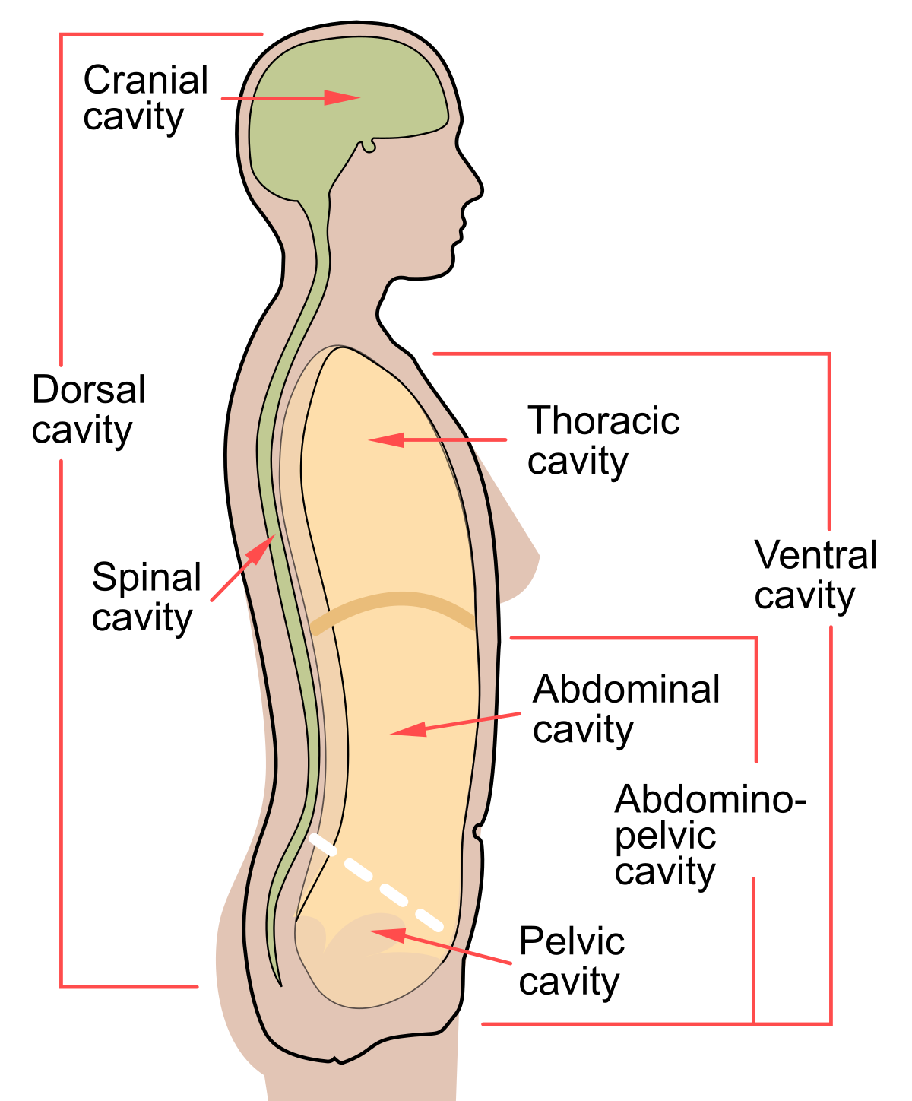

Slide 4
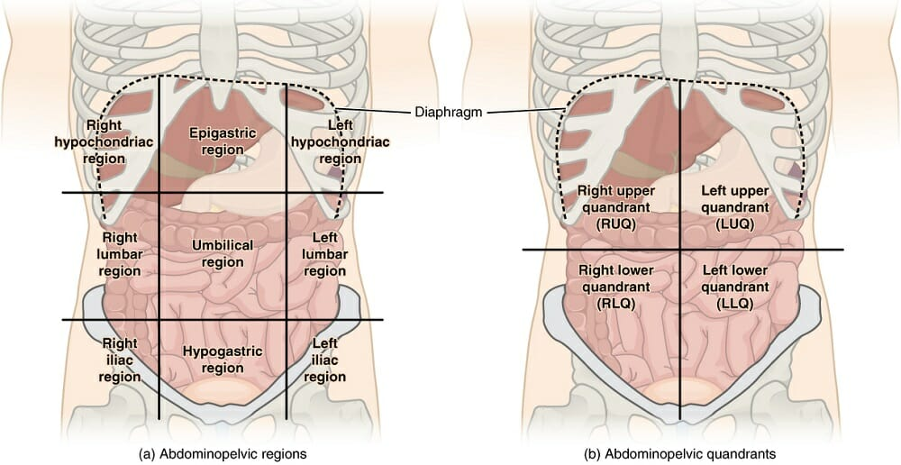

Slide 5
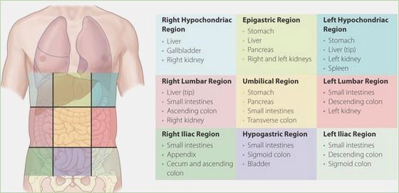

Slide 6
PERITONEUM
General Arrangement
Thin serous membrane that lines the walls of the abdominal and pelvic cavities and clothes the viscera .
The peritoneum can be regarded as a balloon against which organs are pressed from outside.
The peritoneum consists of two layers that are continuous with each other: the parietal peritoneum and the visceral peritoneum. Both types are made up of simple squamous epithelial cells called mesothelium.
The parietal peritoneum lines the walls of the abdominal and pelvic cavities.
Visceral peritoneum covers the organs.

Slide 7
PERITONEUM
The potential space between the parietal and visceral layers, is called the peritoneal cavity.
In males, the cavity is closed , but in females, there is communication with the exterior through the uterine tubes, the uterus, and the vagina.
Between the parietal peritoneum and the fascial lining of the abdominal and pelvic walls is a layer of connective tissue called the extraperitoneal tissue; in the area of the kidneys, this tissue contains a large amount of fat, which supports the kidneys.
The peritoneal cavity is the largest cavity in the body and is divided into two parts: the greater sac and the lesser sac.

Slide 8
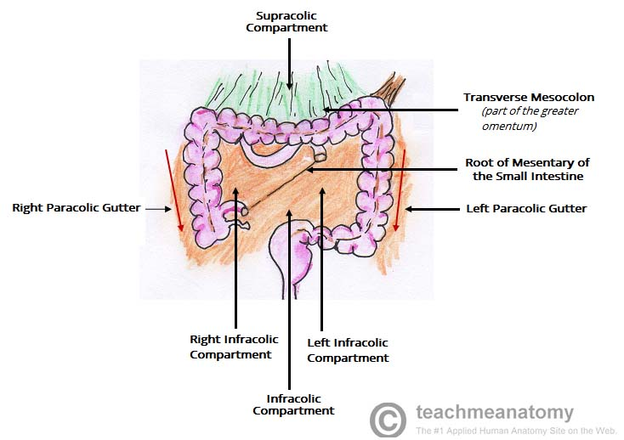

Slide 9
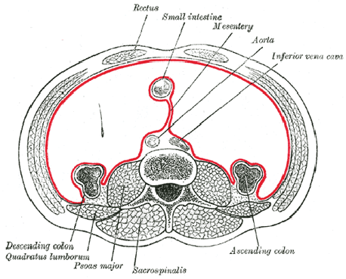
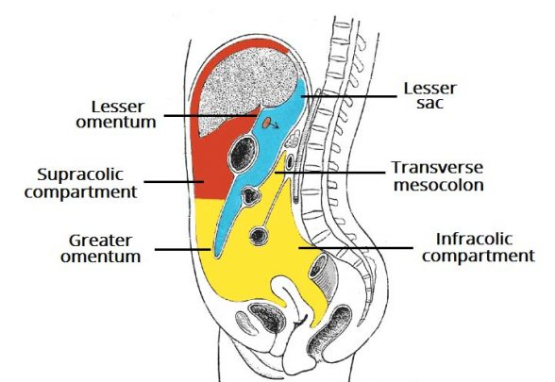

Slide 10
PERITONEUM
The greater sac is the main compartment and extends from the diaphragm down into the pelvis
The lesser sac is smaller and lies behind the stomach
The greater and lesser sacs are in free communication with one another through an oval window called the opening of the lesser sac, or the epiploic foramen.
The peritoneum secretes a small amount of serous fluid, the peritoneal fluid, which lubricates the surfaces of the peritoneum and allows free movement between the viscera.

Slide 11
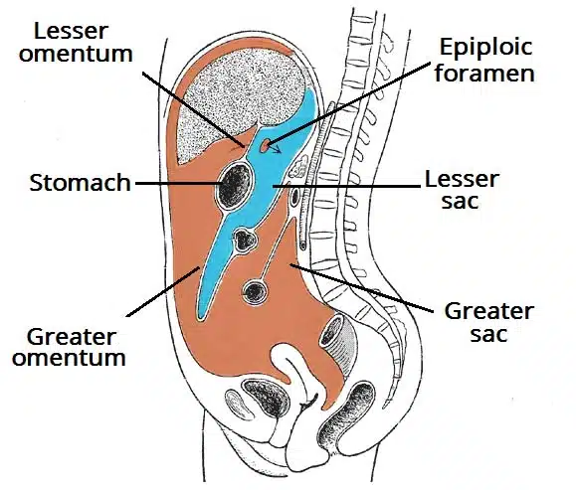

Slide 12
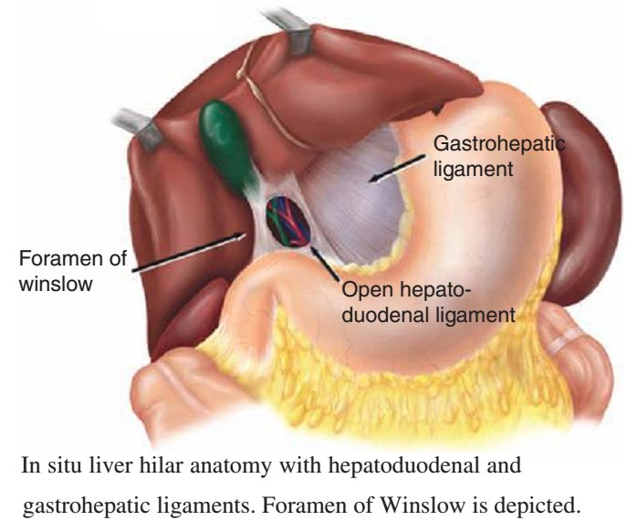

Slide 13
PERITONEUM
Intraperitoneal VS retroperitoneal
Describe the relationship of various organs to their peritoneal covering.
An organ is said to be intraperitoneal when it is almost totally covered with visceral peritoneum. E.G. The stomach, jejunum, ileum, and spleen.
Retroperitoneal organs lie behind the peritoneum and are only partially covered with visceral peritoneum. E.G. Pancreas, the ascending and descending parts of the colon are examples of retroperitoneal organs.

Slide 14
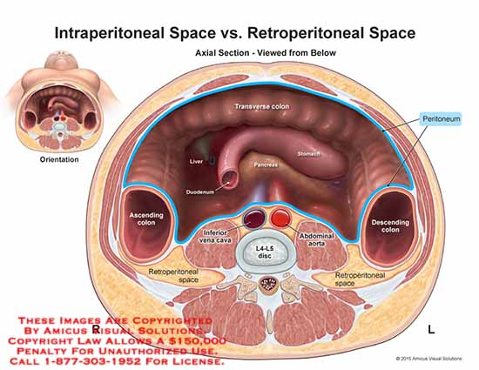

Slide 15
PERITONEUM
Peritoneal Ligaments
Peritoneal ligaments are two-layered folds of peritoneum that connect solid viscera to the abdominal walls.
The liver, is connected to the diaphragm by the falciform ligament, the coronary ligament, and the right and left triangular ligaments.

Slide 16
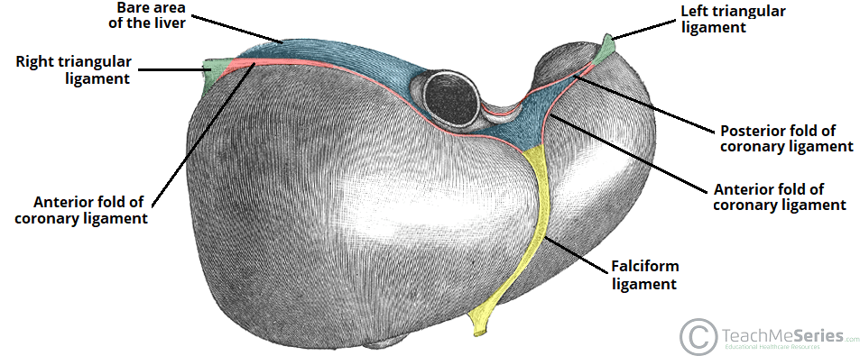

Slide 17
OMENTA
Omenta are two-layered folds of peritoneum that connect the stomach to another viscera.
The greater omentum connects the greater curvature of the stomach to the transverse colon. It hangs down like an apron in front of the coils of the small intestine and is folded back on itself to be attached to the transverse colon.
The lesser omentum suspends the lesser curvature of the stomach from the fissure of the ligamentum venosum and the porta hepatis on the undersurface of the liver.
The gastrosplenic omentum (ligament) connects the stomach to the hilum of the spleen.

Slide 18
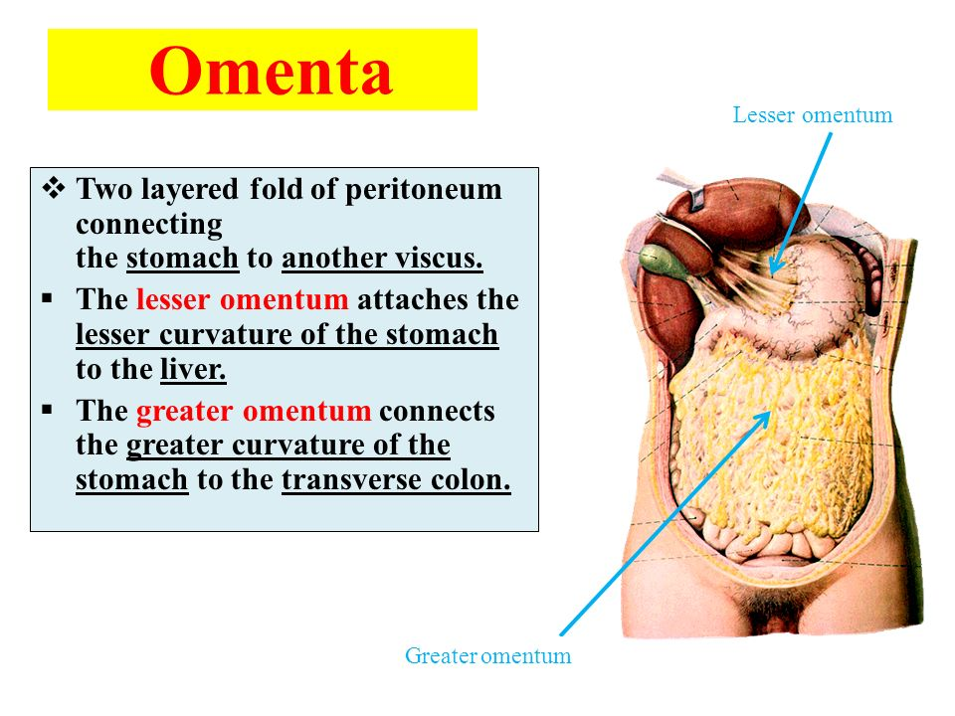
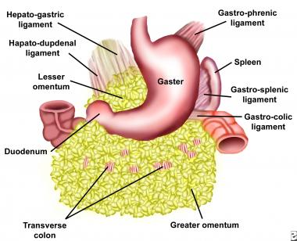

Slide 19
MESENTERIES
Mesenteries are two-layered folds of peritoneum connecting parts of the intestines to the posterior abdominal wall, E.g. the mesentery of the small intestine, the transverse mesocolon, and the sigmoid mesocolon
  The peritoneal ligaments, omenta, and mesenteries permit blood, lymph vessels, and nerves to reach the viscera.

Slide 20
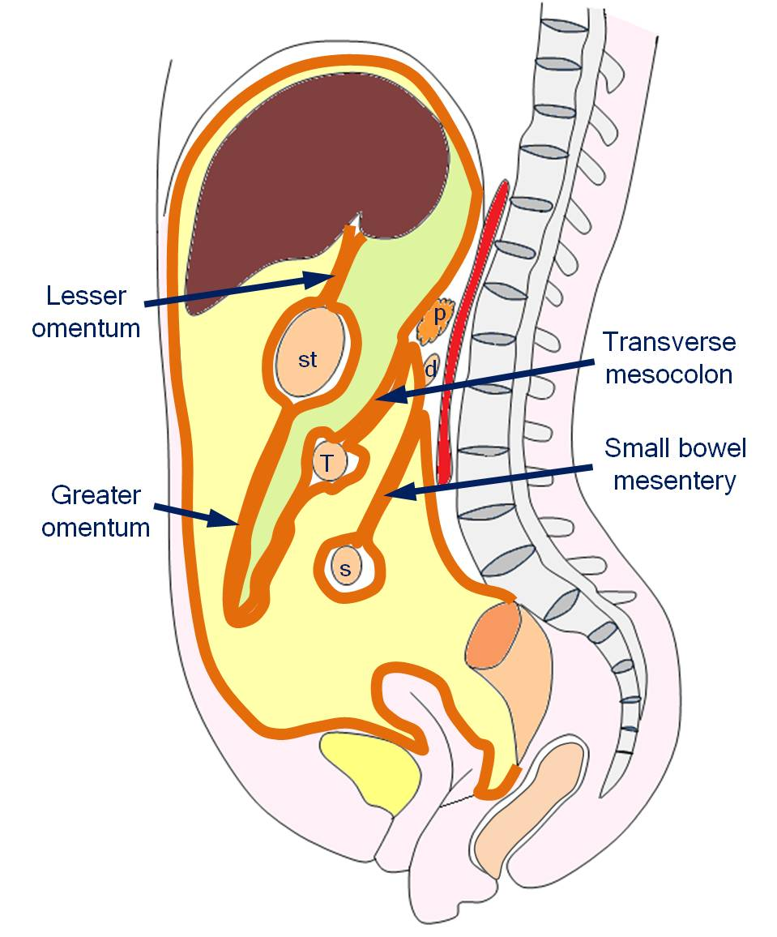
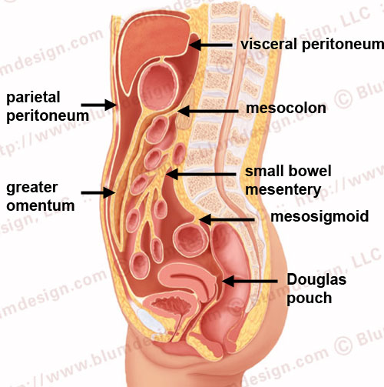

Slide 21
NERVE SUPPLY OF THE PERITONEUM
The parietal peritoneum is sensitive to pain, temperature, touch, and pressure supplied by the lower six thoracic and 1st lumbar nerves.
The diaphragmatic peritoneum is supplied in center by the phrenic nerves; peripherally, by the lower six thoracic nerves
The parietal peritoneum in pelvis is supplied by obturator nerve.
The visceral peritoneum is sensitive only to stretch and tearing and is not sensitive to touch, pressure, or temperature. supplied by autonomic afferent nerves that supply the viscera or are traveling in the mesenteries.

Slide 22


