Slide 1
Posterior Abdominal wall
AIZAZ
Demonstrator Surgical
KMU-IPMS Peshawar

Slide 2
POSTERIOR ABDOMINAL WALL
Formed in the midline by
  Five lumbar vertebrae and their intervertebral discs.
Laterally by
  The 12th ribs,
  The upper part of the bony pelvis
  The psoas muscles
  The quadratus lumborum muscles,
  Iliacus Muscles
  And the aponeuroses of origin of the transversus abdominis muscles.

Slide 3
Lumber Vertebra
The lumbar vertebrae are five in number and designated as vertebrae L1-L5
The body of each vertebra is Large and kidney shaped, and it has to bear the greater part of the body weight.
They lack the characteristic features of other vertebrae, with no transverse foramina, costal facets, or bifid spinous processes
However, like the cervical vertebrae, they have a triangular-shaped vertebral foramen. Their spinous processes are shorter than those of thoracic vertebrae and do not extend inferiorly below the level of the vertebral body.
The 5th lumbar vertebra articulates with the base of the sacrum at the lumbosacral joint.
The intervertebral discs in the lumbar region are thicker than in other regions of the vertebral column.
They are wedge shaped and are responsible for the normal posterior concavity in the curvature of the vertebral column in the lumbar region.

Slide 4
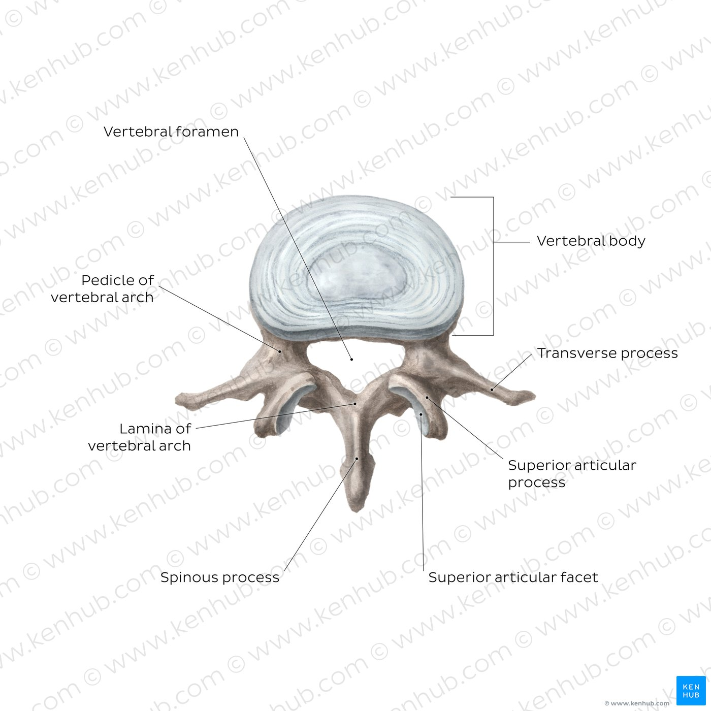

Slide 5
MUSCLES OF THE POSTERIOR ABDOMINAL WALL
  Psoas Major
  Quadratus Lumborum
  Iliacus

Slide 6
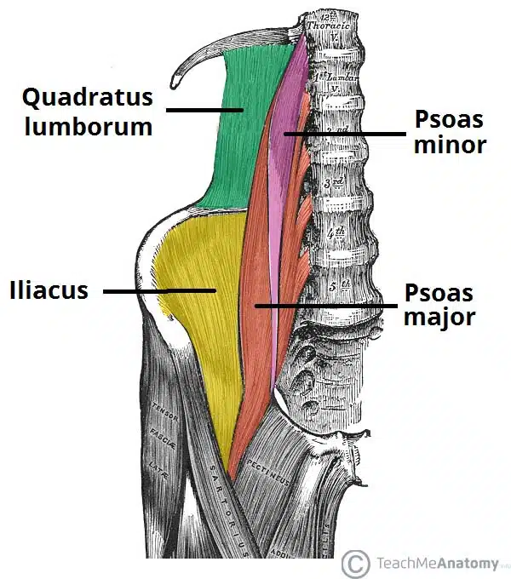

Slide 7
PSOAS MAJOR
Origin: Transverse processes, bodies, and intervertebral discs of 12th thoracic and five lumbar vertebrae
Insertion: With iliacus into lesser trochanter of femur
  The psoas is enclosed in a fibrous sheath that is derived from the lumbar fascia.
  The sheath is thickened above to form the medial arcuate ligament.
Nerve supply: lumbar plexus.
Action: The psoas flexes the thigh at the hip joint on the trunk, or if the thigh is fixed, it flexes the trunk on the thigh, as in sitting up from a lying position.

Slide 8
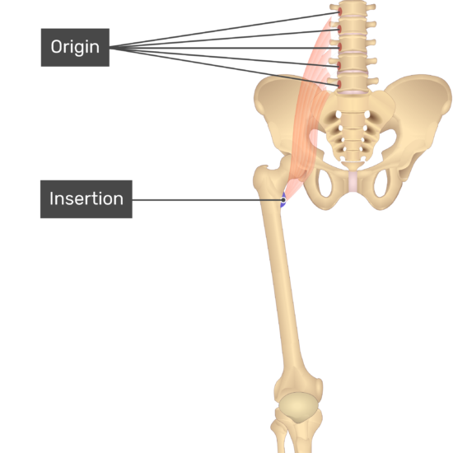
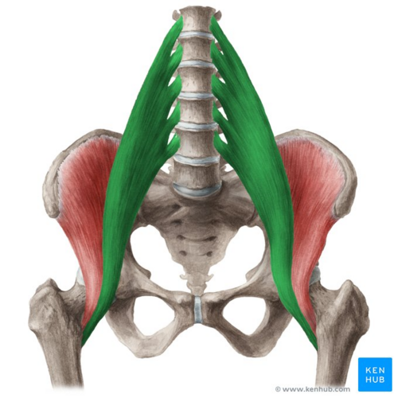

Slide 9
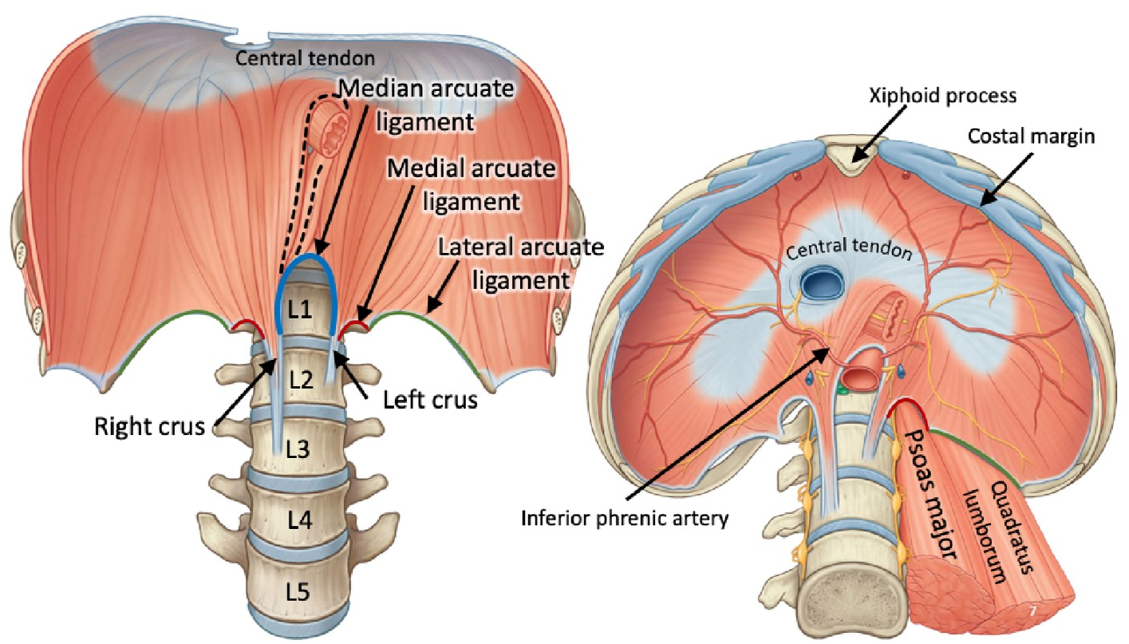

Slide 10
QUATRADUS LUMBORUM
A flat, quadrilateral-shaped muscle that lies alongside the vertebral column.
Origin: iliolumbar ligament, iliac crest, tips of transverse processes of lower lumbar vertebrae
Insertion: inserted into the lower border of the 12th rib and the transverse processes of the upper four lumbar vertebrae.
  The anterior surface of the muscle is covered by lumbar fascia, which is thickened above to form the lateral arcuate ligament and below to form the iliolumbar ligament.
Nerve supply: lumbar plexus.
Action: it fixes or depresses the 12th rib during respiration and laterally flexes the vertebral column to the same side.

Slide 11
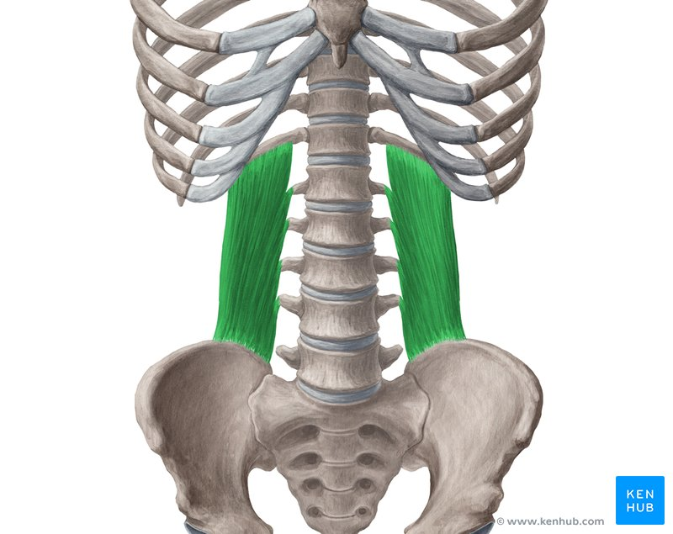
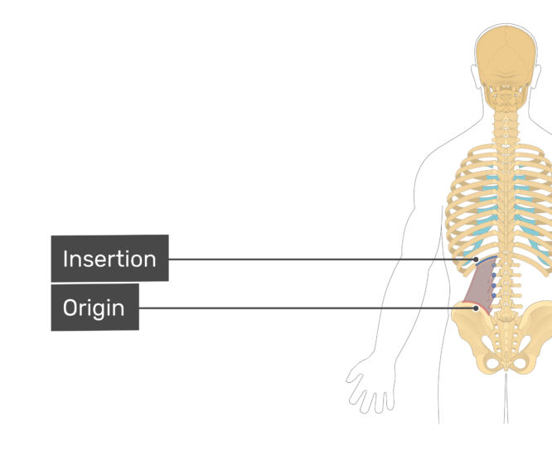

Slide 12
ILIACUS
Origin: fan shaped and arises from the upper part of the iliac fossa
Insertion: fibers join the lateral side of the psoas tendon to be inserted into the lesser trochanter of the femur.
  The combined muscles are often referred to as the iliopsoas.
Nerve supply: femoral nerve, a branch of the lumbar plexus.
Action: The iliopsoas flexes the thigh on the trunk at the hip joint, or if the thigh is fixed, it flexes the trunk on the thigh.

Slide 13
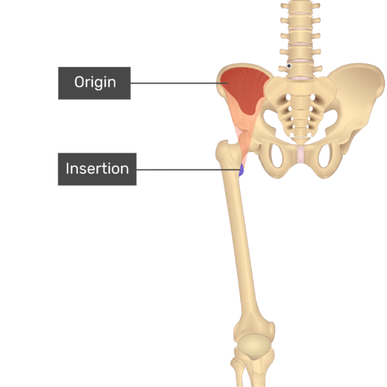
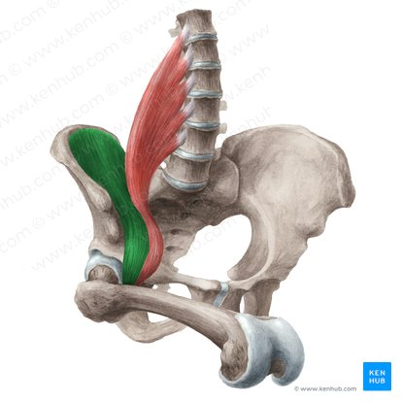

Slide 14
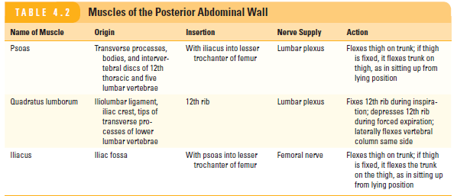

Slide 15


