Slide 1
lungs
AIZAZ
Demonstrator Surgical
KMU-IPMS Peshawar

Slide 2
Lungs
Lungs are soft , spongy and very elastic .
Conical in shape.
In the child, they are pink, but with age, they become dark and mottled.
Two in number situated on each side of mediastinum.
Covered with visceral pleura.
Each lung has a blunt apex, which projects upward into the neck for about 1 in. (2.5 cm) above the clavicle.
a concave base that sits on the diaphragm
a convex costal surface, which corresponds to the concave chest wall

Slide 3
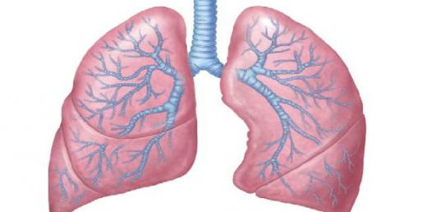
Lungs
Concave mediastinal surface, which is molded to the pericardium and other mediastinal structures.
At about the middle of this surface is the hilum, a depression in which the bronchi, vessels, and nerves that form the root enter and leave the lung.
The anterior border is thin and overlaps the heart; it is here on the left lung that the cardiac notch is found. The posterior border is thick and lies beside the vertebral column.

Slide 4
LOBES AND FISSURES
Right Lung
The right lung is slightly larger than the left and is divided by the oblique and horizontal fissures into three lobes: the upper, middle, and lower lobes.
The oblique fissure runs from the inferior border upward and backward across the medial and costal surfaces until it cuts the posterior border about 2.5 in. (6.25 cm) below the apex.
The horizontal fissure runs horizontally across the costal surface at the level of the 4th costal cartilage to meet the oblique fissure in the midaxillary line. The middle lobe is thus a small triangular lobe bounded by the horizontal and oblique fissures.

Slide 5
LOBES AND FISSURES
Left Lung
The left lung is divided by a similar oblique fissure into two lobes: the upper and lower lobes. There is no horizontal fissure in the left lung.

Slide 6
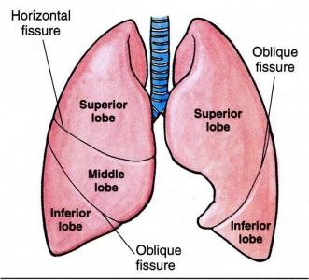
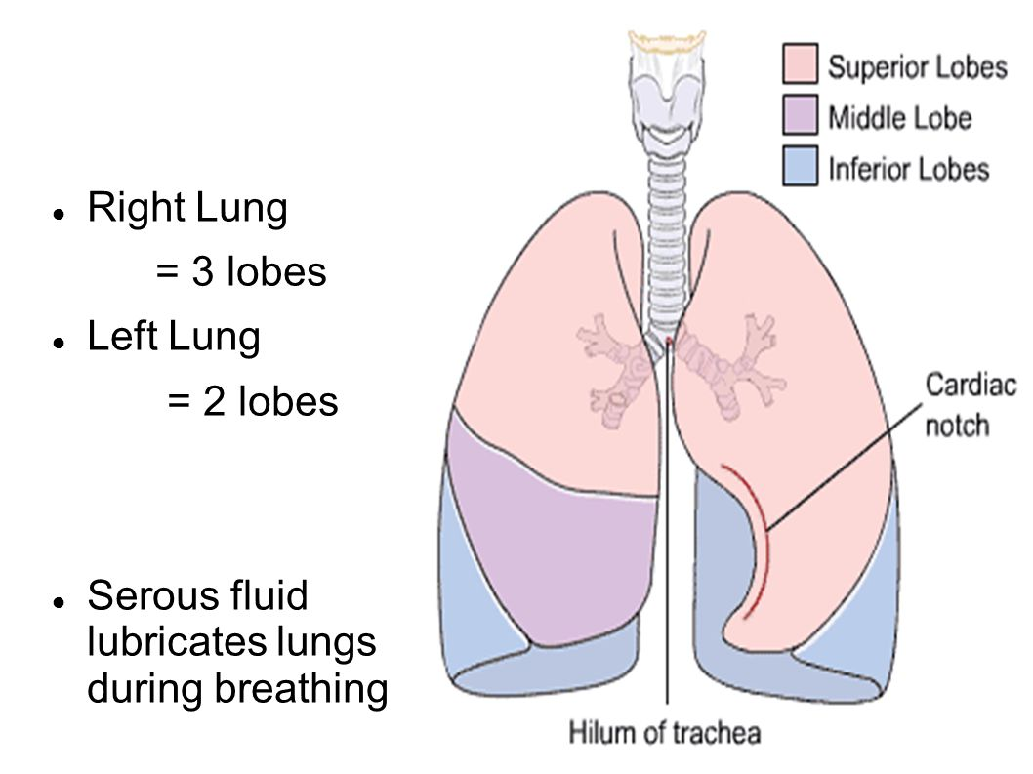

Slide 7
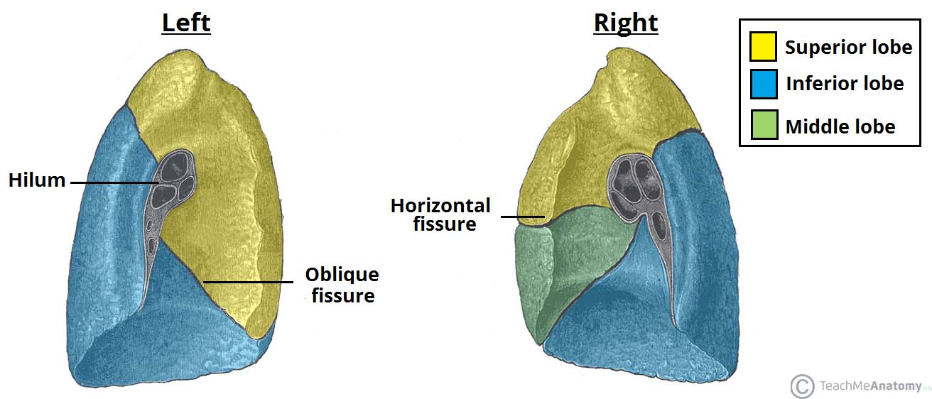

Slide 8
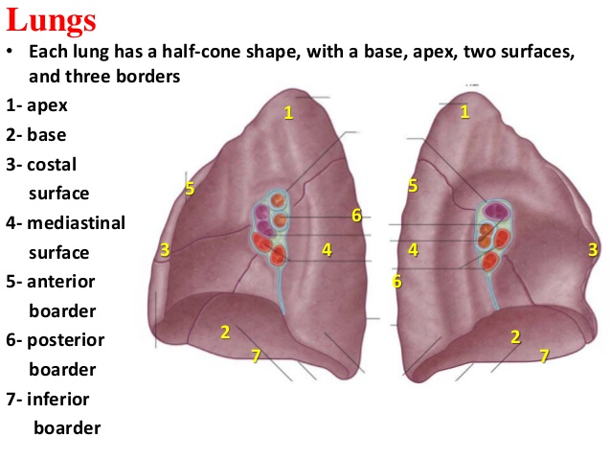
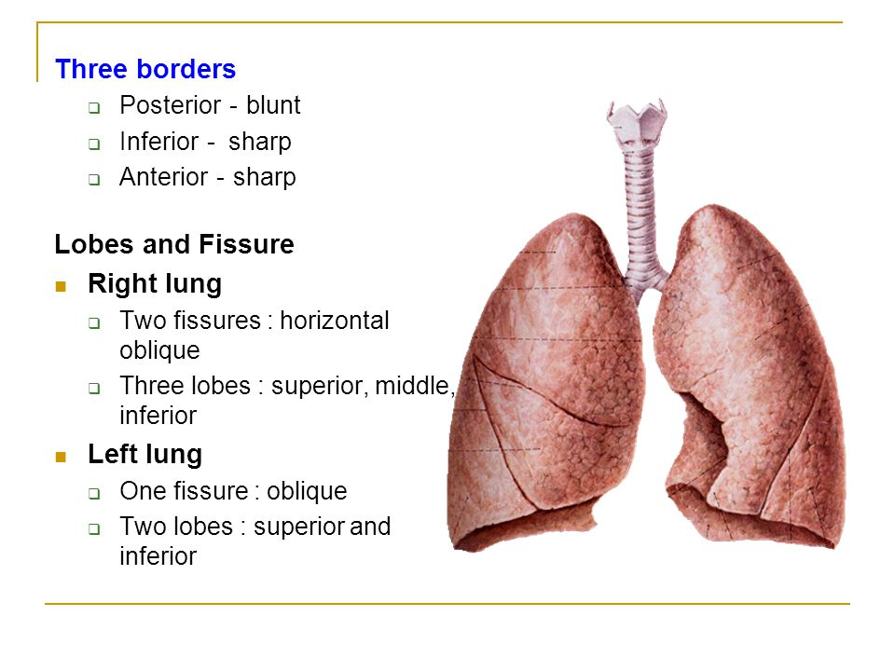

Slide 9
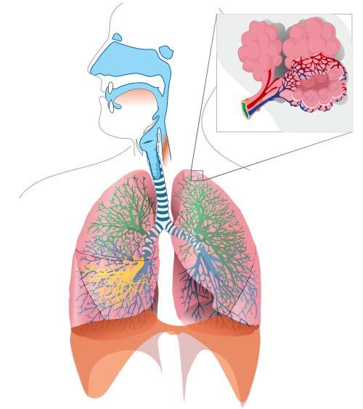

Slide 10
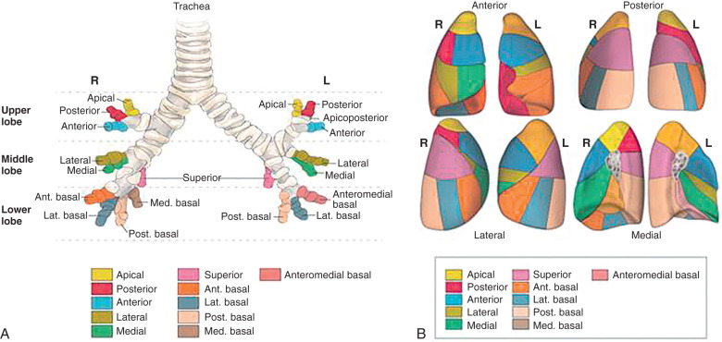

Slide 11
Bronchopulmonary Segments
Each lobar bronchus, which passes to a lobe of the lung, gives off branches called segmental (tertiary) bronchi each segmental bronchus passes to a structurally and functionally independent unit of a lung lobe called a bronchopulmonary segment.
Surrounded by connective tissue
The segmental bronchus is accompanied by a branch of the pulmonary artery.
But the tributaries of the pulmonary veins run in the connective tissue between adjacent bronchopulmonary segments.
Each segment has its own lymphatic vessels and autonomic nerve supply.

Slide 12
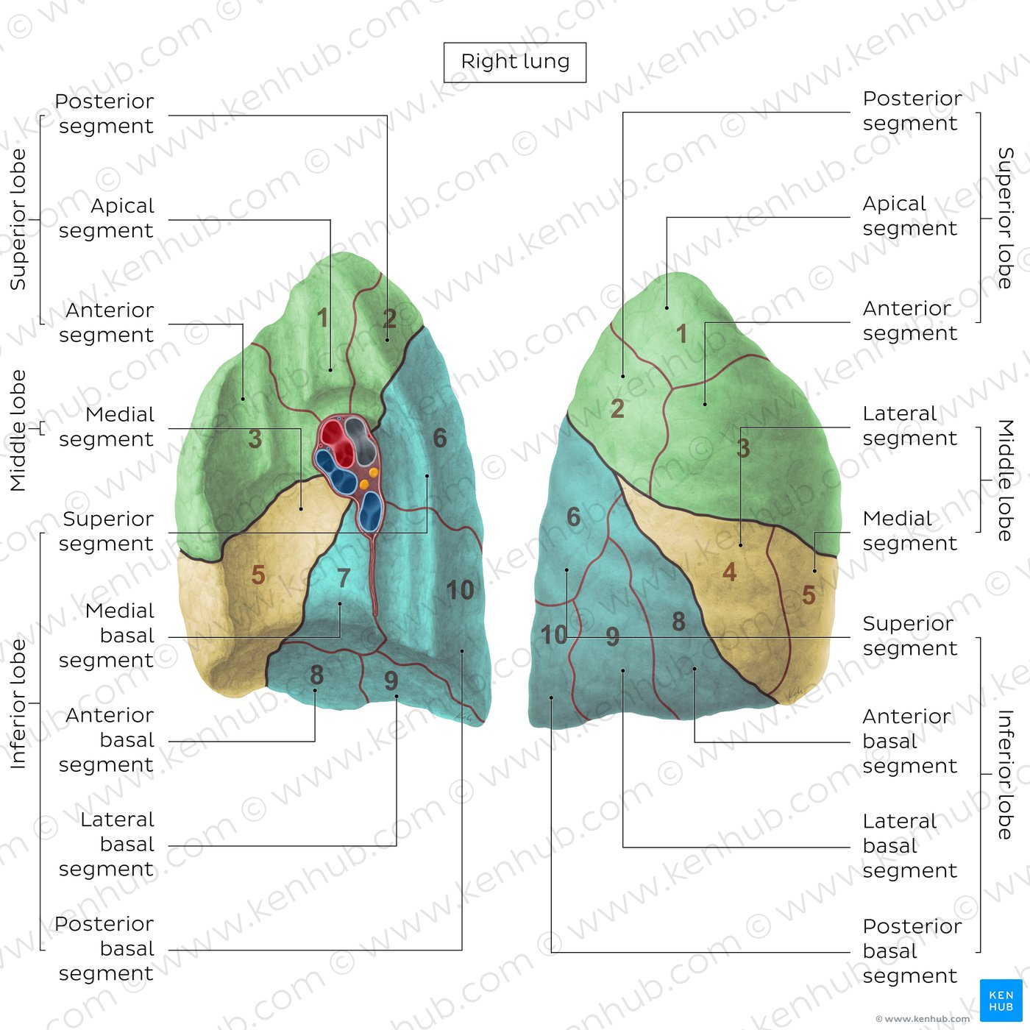

Slide 13
Bronchopulmonary Segments
On entering a bronchopulmonary segment, each segmental bronchus divides repeatedly .
As the bronchi become smaller, the U-shaped bars of cartilage found in the trachea are gradually replaced by irregular plates of cartilage, which become smaller and fewer in number.
The smallest bronchi divide and give rise to bronchioles, which are <1 mm in diameter.
Bronchioles possess no cartilage in their walls and are lined with columnar ciliated epithelium. The submucosa possesses a complete layer of circularly arranged smooth muscle fibers.

Slide 14
Bronchopulmonary Segments
The bronchioles then divide and give rise to terminal bronchioles which show delicate outpunching's from their walls.
Gaseous exchange between blood and air takes place in the walls of these outpunching's, which explains the name respiratory bronchiole.
The diameter of a respiratory bronchiole is about 0.5 mm.
The respiratory bronchioles end by branching into alveolar ducts, which lead into tubular passages with numerous thin-walled outpunching's called alveolar sacs.
The alveolar sacs consist of several alveoli opening into a single chamber. Each alveolus is surrounded by a rich network of blood capillaries.
Gaseous exchange takes place between the air in the alveolar lumen through the alveolar wall into the blood within the surrounding capillaries.

Slide 15
Characteristics of a bronchopulmonary segment
It is a subdivision of a lung lobe.
It is pyramid shaped, with its apex toward the lung root.
It is surrounded by connective tissue.
It has a segmental bronchus, a segmental artery, lymph vessels, and autonomic nerves.
The segmental vein lies in the connective tissue between adjacent bronchopulmonary segments.
Because it is a structural unit, a diseased segment can be removed surgically.

Slide 16
Characteristics of a bronchopulmonary segment
The main bronchopulmonary segments are as follows:
Right lung
  Superior lobe: Apical, posterior, anterior
  Middle lobe: Lateral, medial
  Inferior lobe: Superior (apical), medial basal, anterior basal, lateral basal, posterior basal
Left lung
  Superior lobe: Apical, posterior, anterior, superior lingular, inferior lingular
  Inferior lobe: Superior (apical), medial basal, anterior basal, lateral basal, posterior basal

Slide 17
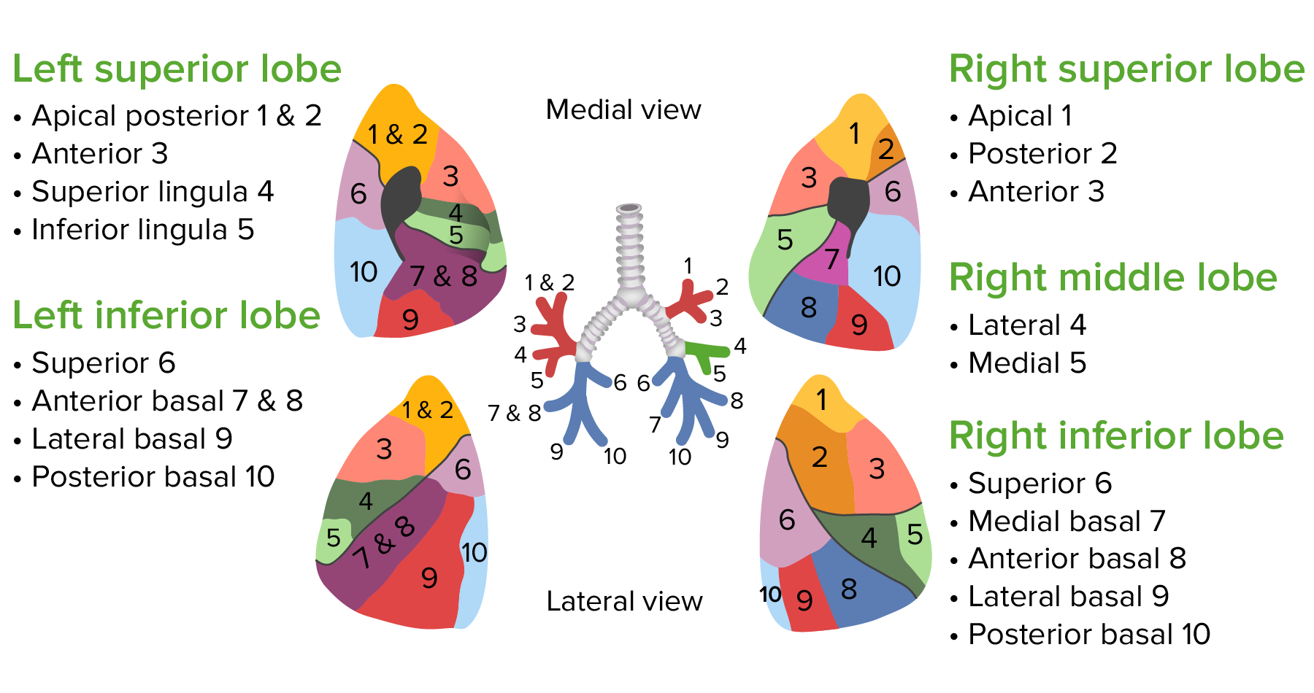

Slide 18
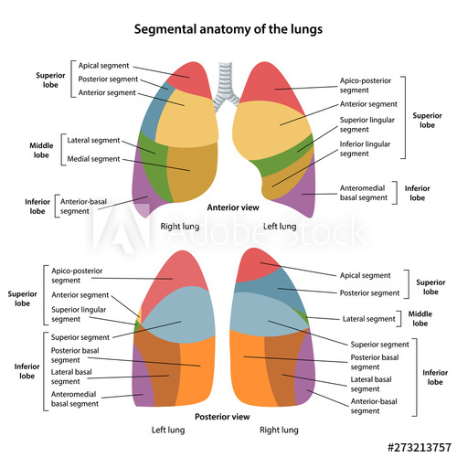
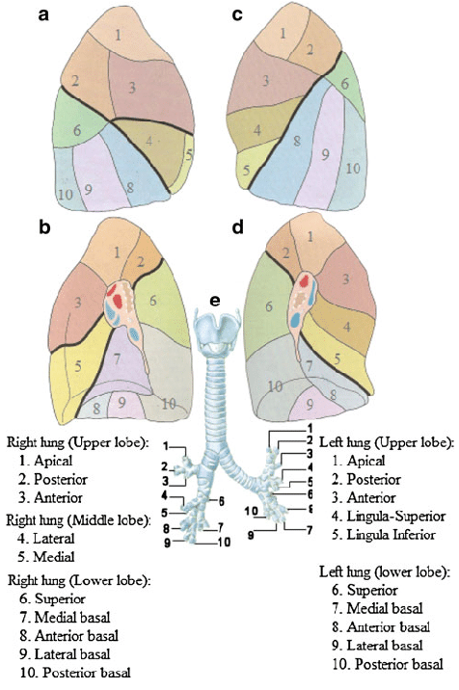

Slide 19
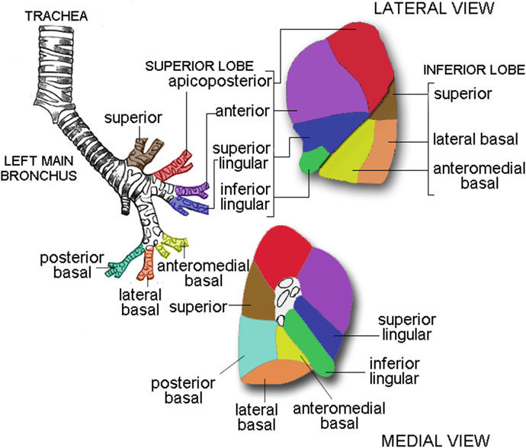

Slide 20
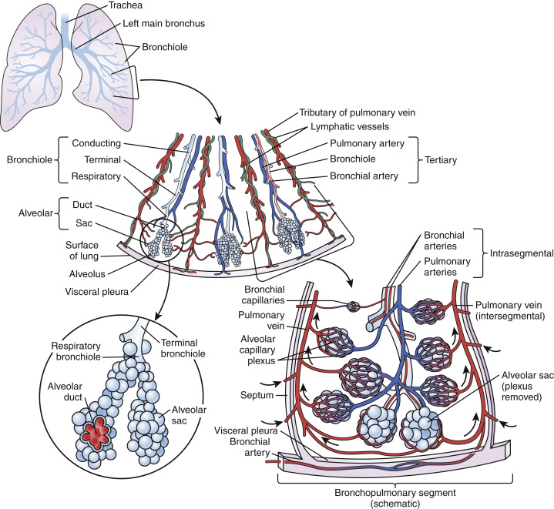

Slide 21


Slide 22
Blood Supply of the Lungs
The bronchi, the connective tissue of the lung, and the visceral pleura receive their blood supply from the bronchial arteries, which are branches of the descending aorta.
The bronchial veins drain into the azygos and hemiazygos veins.
The alveoli receive deoxygenated blood from the terminal branches of the pulmonary arteries.
The oxygenated blood leaving the alveolar capillaries drains into the tributaries of the pulmonary veins, which follow the intersegmental connective tissue septa to the lung root. Two pulmonary veins leave each lung root to empty into the left atrium of the heart.

Slide 23
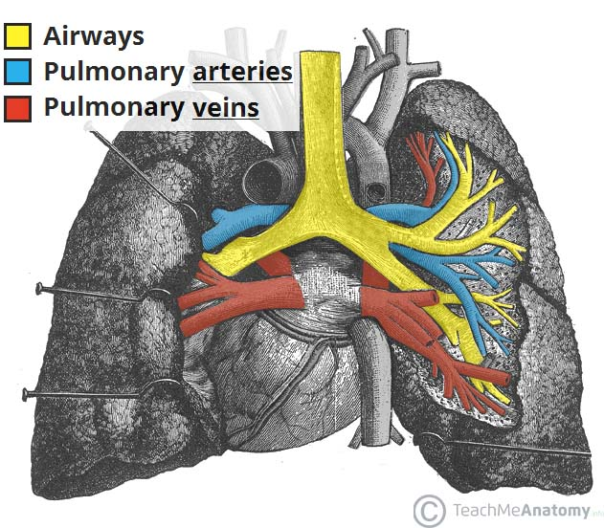

Slide 24
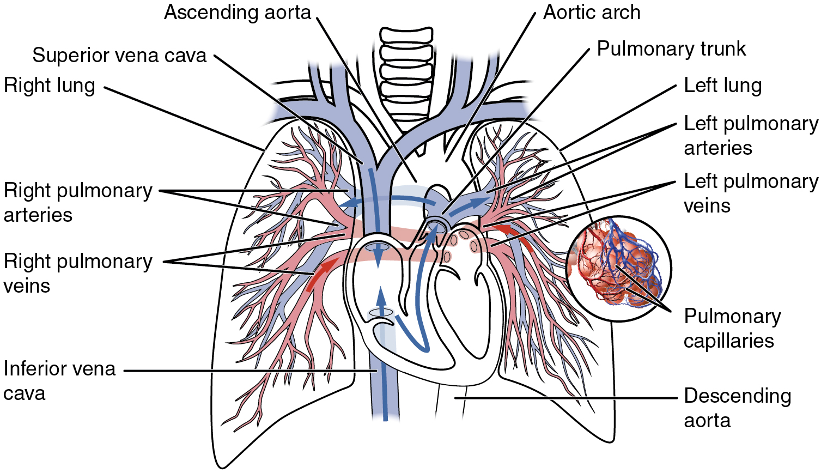
Blood Supply of the Lungs

Slide 25
Lymph Drainage of the Lungs
  The lymph vessels originate in superficial and deep plexuses they are not present in the alveolar walls.
  The superficial (subpleural) plexus lies beneath the visceral pleura and drains over the surface of the lung toward the hilum, where the lymph vessels enter the bronchopulmonary nodes.
  The deep plexus travels along the bronchi and pulmonary vessels toward the hilum of the lung, passing through pulmonary nodes located within the lung substance;
  The lymph then enters the bronchopulmonary nodes in the hilum of the lung.
  All the lymph from the lung leaves the hilum and drains into the tracheobronchial nodes and then into the bronchomediastinal lymph trunks

Slide 26
Nerve Supply of the Lungs
At the root of each lung is a pulmonary plexus composed of efferent and afferent autonomic nerve fibers.
The plexus is formed from branches of the sympathetic trunk and receives parasympathetic fibers from the vagus nerve.
The sympathetic efferent fibers produce bronchodilatation and vasoconstriction
The parasympathetic efferent fibers produce bronchoconstriction, vasodilatation, and increased glandular secretion.
Afferent impulses derived from the bronchial mucous membrane and from stretch receptors in the alveolar walls pass to the central nervous system in both sympathetic and parasympathetic nerves

Slide 27
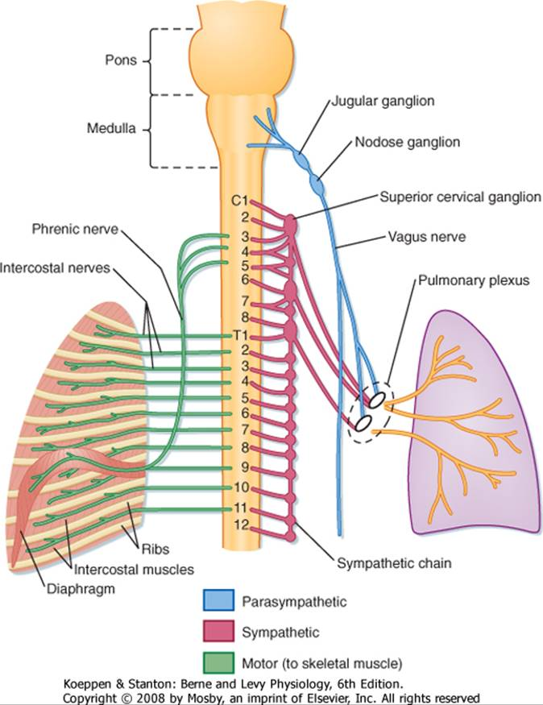
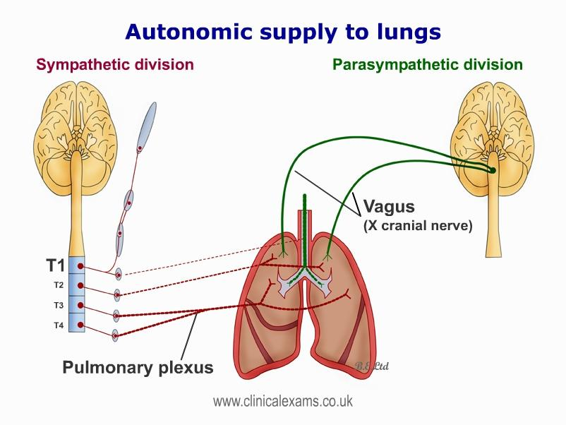

Slide 28


