Slide 1
Chest cavity
AIZAZ
Demonstrator Surgical
KMU-IPMS Peshawar

Slide 2
CHEST CAVITY
Bounded by the chest wall and below by the diaphragm.
Extends upward into the root of the neck about one fingerbreadth above the clavicle on each side.
Diaphragm, is the only structure that apart the chest cavity from the abdomen
Chest cavity can be divided into a median partition, called the mediastinum, and the laterally placed pleurae and lungs

Slide 3
MEDIASTINUM
Mediastinum, though thick, is a movable partition that extends
Superiorly to the thoracic outlet and the root of the neck and inferiorly to the diaphragm. It extends anteriorly to the sternum and posteriorly to the vertebral column.
It Contains thymus, heart, large blood vessels, trachea and esophagus, thoracic duct, lymph nodes, the vagus and phrenic nerves, and the sympathetic trunks.

Slide 4
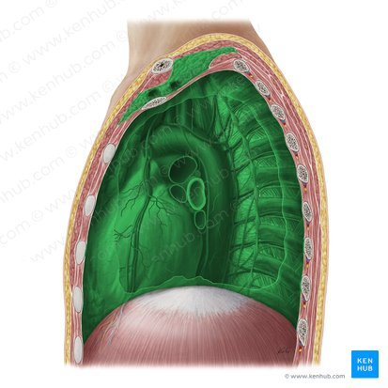

Slide 5
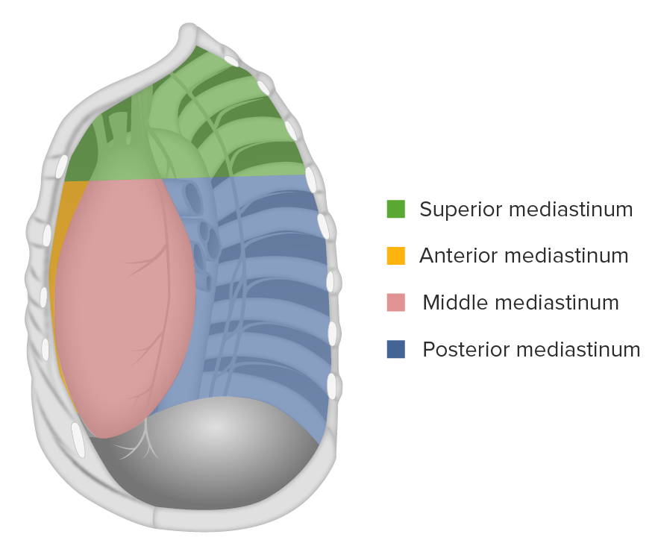

Slide 6
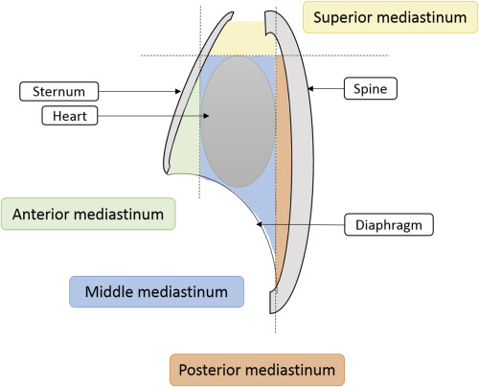

Slide 7
MEDIASTINUM
The mediastinum is divided into superior and inferior mediastina by an imaginary plane passing from the sternal angle anteriorly to the lower border of the body of the 4th thoracic vertebra posteriorly
Inferior mediastinum is further subdivided into
  Middle mediastinum: which consists of the pericardium and heart
  Anterior mediastinum: which is a space between the pericardium and the sternum
  Posterior mediastinum: which lies between the pericardium and the vertebral column.

Slide 8
MEDIASTINUM
Superior Mediastinum
  (a) Thymus, (b) large veins, (c) large arteries, (d) trachea, (e) esophagus and thoracic duct, and (f) sympathetic trunks.
  The superior mediastinum is bounded in front by the manubrium sterni and behind by the first four thoracic vertebrae
Inferior Mediastinum
  (a) Thymus, (b) heart within the pericardium with the phrenic nerves on each side, (c) esophagus and thoracic duct, (d) descending aorta, and (e) sympathetic trunks.
  The inferior mediastinum is bounded in front by the body of the sternum and behind by the lower eight thoracic vertebrae

Slide 9
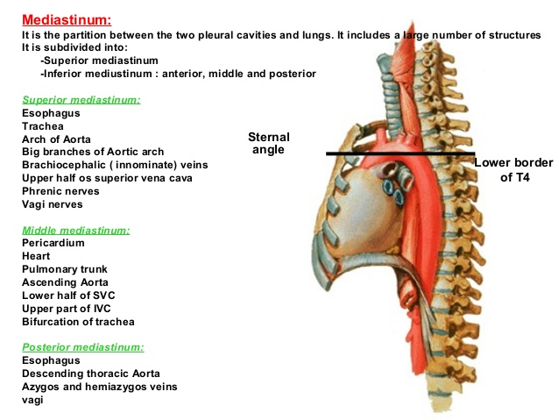
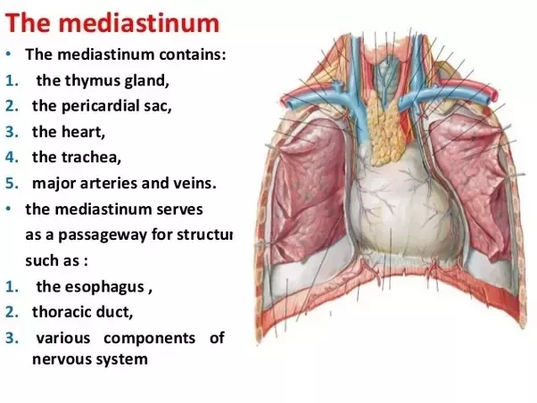

Slide 10
PLEURA
The pleurae and lungs lie on either side of the mediastinum within the chest cavity.
Each pleura has two parts: a parietal layer, and visceral layer.
  Parietal layer: Lines the thoracic wall, covers the thoracic surface of the diaphragm and the lateral aspect of the mediastinum and extends into the root of the neck. Further divided into
    Mediastinal pleura: Covers the lateral aspect of the mediastinum
    Cervical pleura: Lines the extension of the pleural cavity into the neck.
    Costal pleura: Covers the inner aspect of the ribs, costal cartilages, and intercostal muscles.
    Diaphragmatic pleura: Covers the thoracic (superior) surface of the diaphragm.
  Visceral layer: Completely covers the outer surfaces of the lungs and extends into the depths of the interlobar fissures.
The two layers become continuous with one another by means of a cuff of pleura that surrounds the structures entering and leaving the lung at the hilum of each lung.

Slide 11
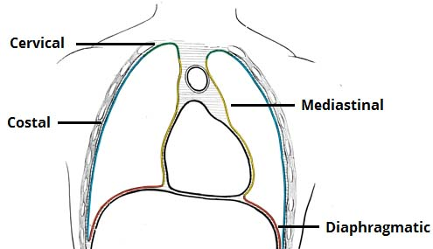

Slide 12
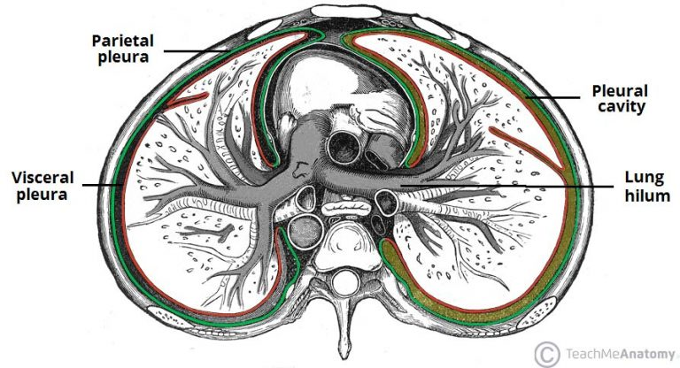

Slide 13
PLEURA
The hilum (root) is a depressed surface at the center of the medial surface of the lung.
lies anteriorly to fifth through seventh thoracic vertebrae.
It is the point at which various structures enter and exit the lung.
The hilum is surrounded by pleura, which extends inferiorly and forms a pulmonary ligament.

Slide 14
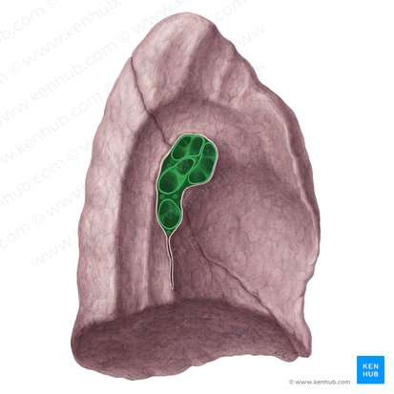
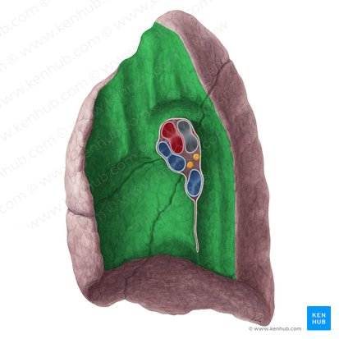

Slide 15
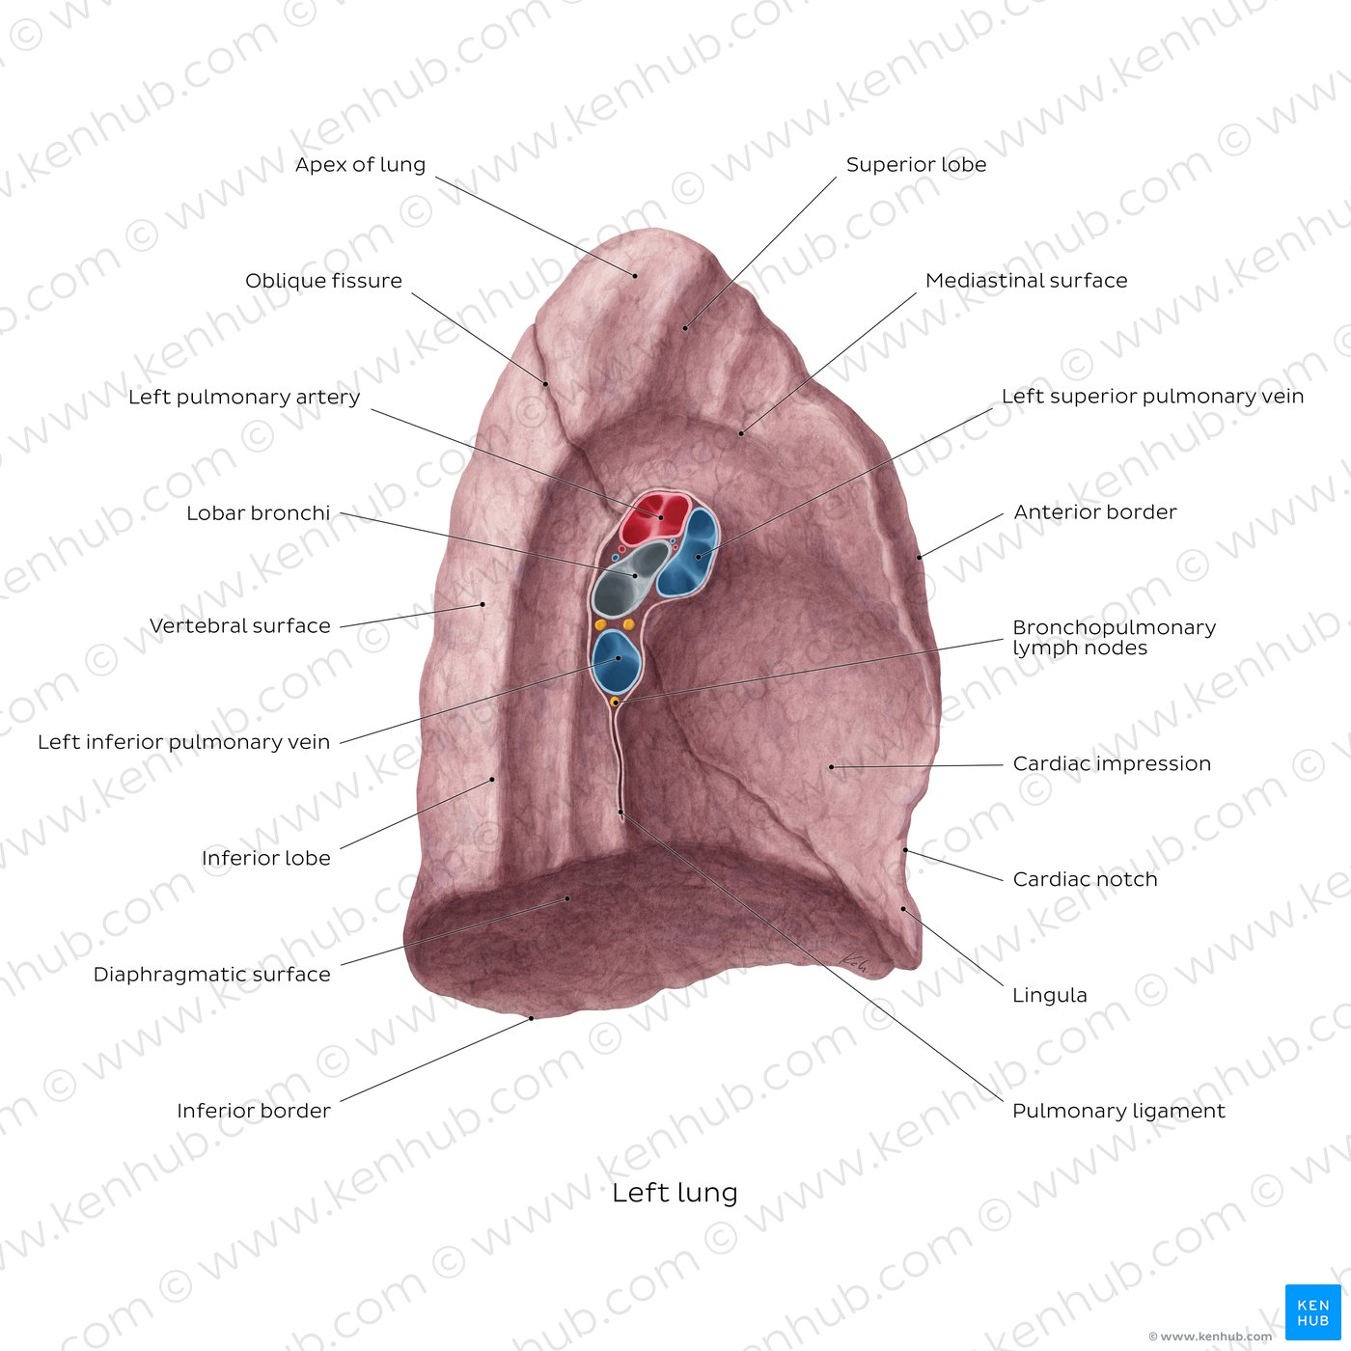

Slide 16
PLEURA
To allow for movement of the pulmonary vessels and large bronchi during respiration, the pleural cuff hangs down as a loose fold called the pulmonary ligament.
The parietal and visceral layers of pleura are separated from one another by pleural space, called pleural cavity.
The pleural cavity normally contains a small amount of tissue fluid, the pleural fluid.
The cervical pleura extend up into the nick lining. lining the undersurface of the suprapleural membrane. It reaches a level 1 to 1.5 in above the medial third of the clavicle.
The costal pleura lines the inner surfaces of the ribs, the costal cartilages, the intercostal spaces, the sides of the vertebral bodies, and the back of the sternum.

Slide 17
PLEURA
The diaphragmatic pleura covers the thoracic surface of the diaphragm.
In quiet respiration, the costal and diaphragmatic pleurae are in apposition to each other below the lower border of the lung.
In deep inspiration, the margins of the base of the lung descend, and the costal and diaphragmatic pleurae separate.
This lower area of the pleural cavity into which the lung expands on inspiration is referred to as the costodiaphragmatic recess.

Slide 18
PLEURA
The mediastinal pleura covers and forms the lateral boundary of the mediastinum. At the hilum of the lung, it is reflected as a cuff around the vessels and bronchi and here becomes continuous with the visceral pleura.
The costomediastinal recesses are situated along the anterior margins of the pleura. During inspiration and expiration, the anterior borders of the lungs slide in and out of the recesses.

Slide 19
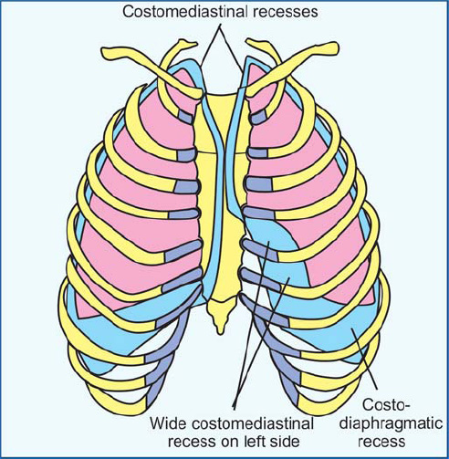
Anteriorly and posteroinferiorly, the pleural cavity is not completely filled by the lungs. This gives rise to pleural recesses – where the opposing surfaces of the parietal pleura touch.
There are two recesses present in each pleural cavity:
Costodiaphragmatic: located between the costal pleurae and the diaphragmatic pleura.
Costomediastinal: located between the costal pleurae and the mediastinal pleurae, behind the sternum

Slide 20
PLEURA
Nerve Supply of the Pleura
The parietal pleura is sensitive to pain, temperature, touch, and pressure and is supplied as follows:
  The costal pleura is segmentally supplied by the intercostal nerves.
  The mediastinal pleura is supplied by the phrenic nerve.
  The diaphragmatic pleura is supplied over the domes by the phrenic nerve and around the periphery by the lower six intercostal nerves.
The visceral pleura covering the lungs is sensitive to stretch but is insensitive to common sensations such as pain and touch. It receives an autonomic nerve supply from the pulmonary plexus.

Slide 21
TRACHEA
Mobile cartilaginous and membranous tube.
Begins in the neck as a continuation of the larynx at the lower border of the cricoid cartilage at the level of the 6th cervical vertebra.
It descends in the midline of the neck. In the thorax, the trachea ends below at the carina by dividing into right and left principal (main) bronchi at the level of the sternal angle.
During expiration, the bifurcation rises by about one vertebral level, and during deep inspiration may be lowered as far as the 6th thoracic vertebra.
In adults, the trachea is about 4 1/2 in. (11.25 cm) long and 1 in. (2.5 cm) in diameter.

Slide 22
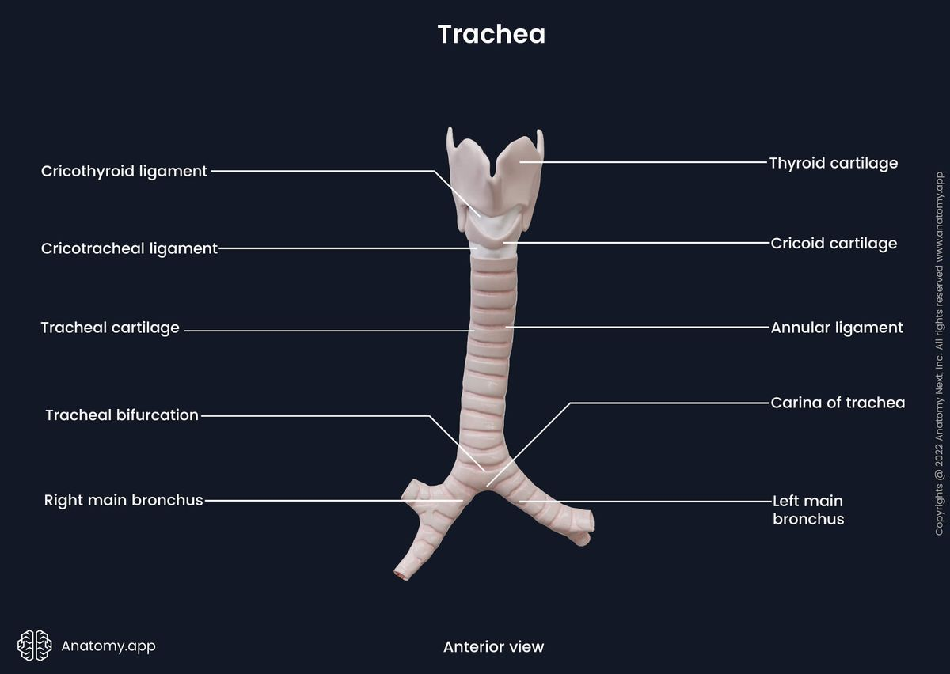

Slide 23
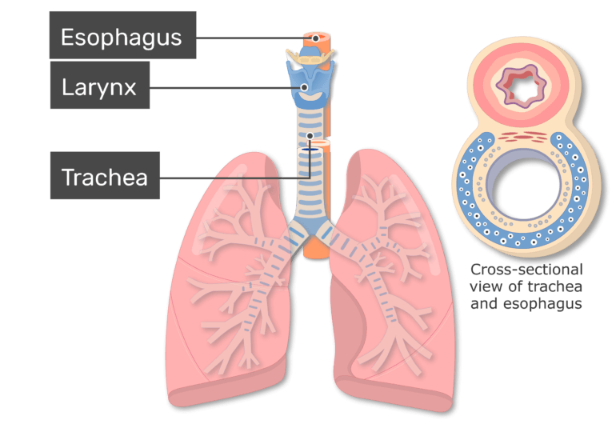

Slide 24
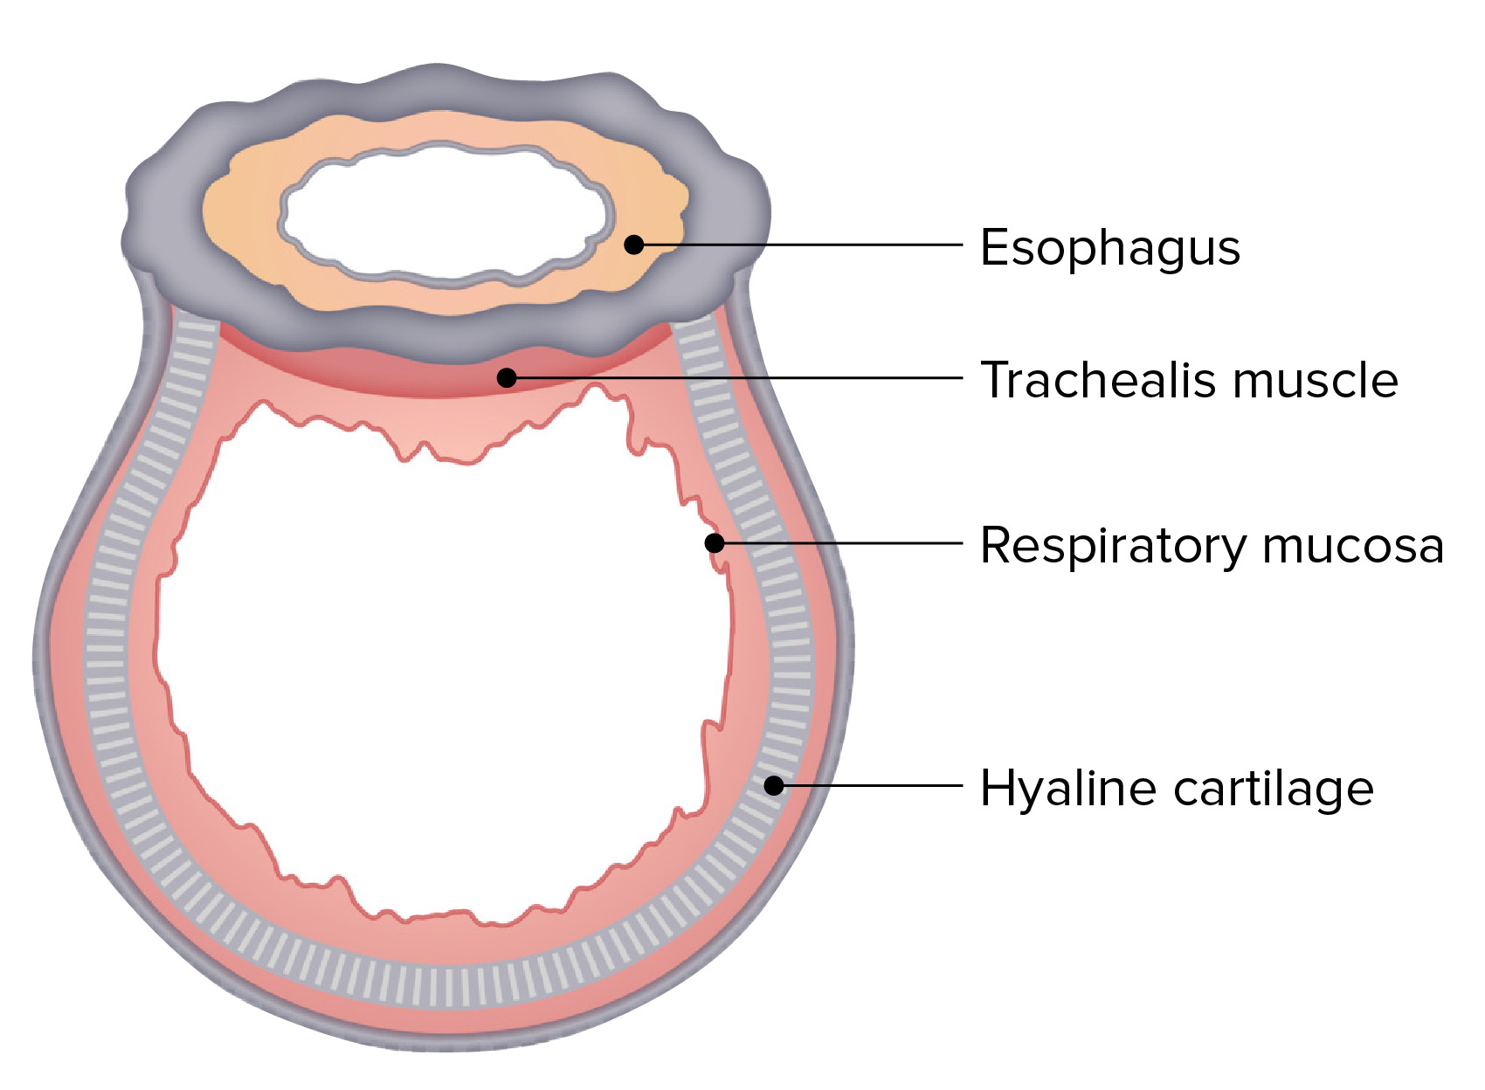

Slide 25
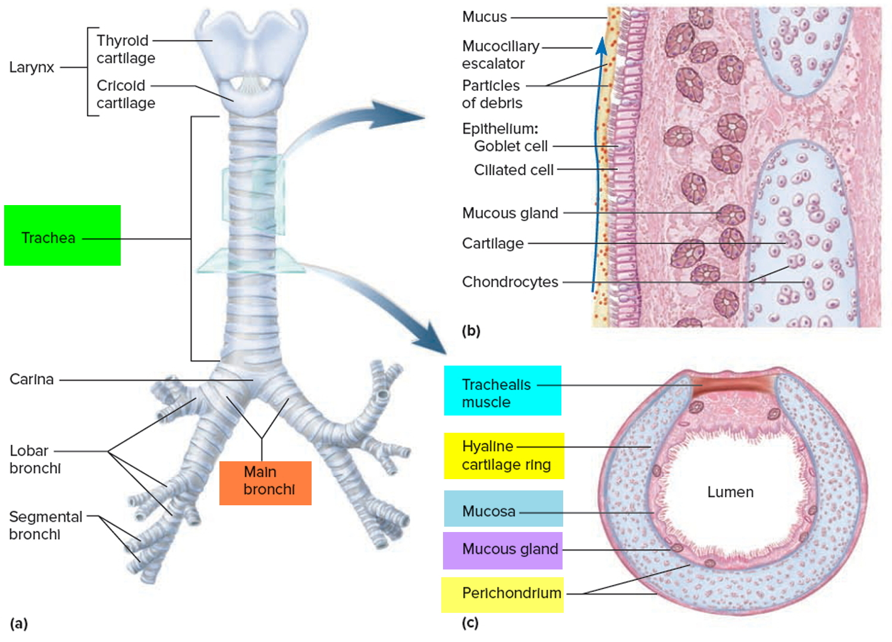

Slide 26
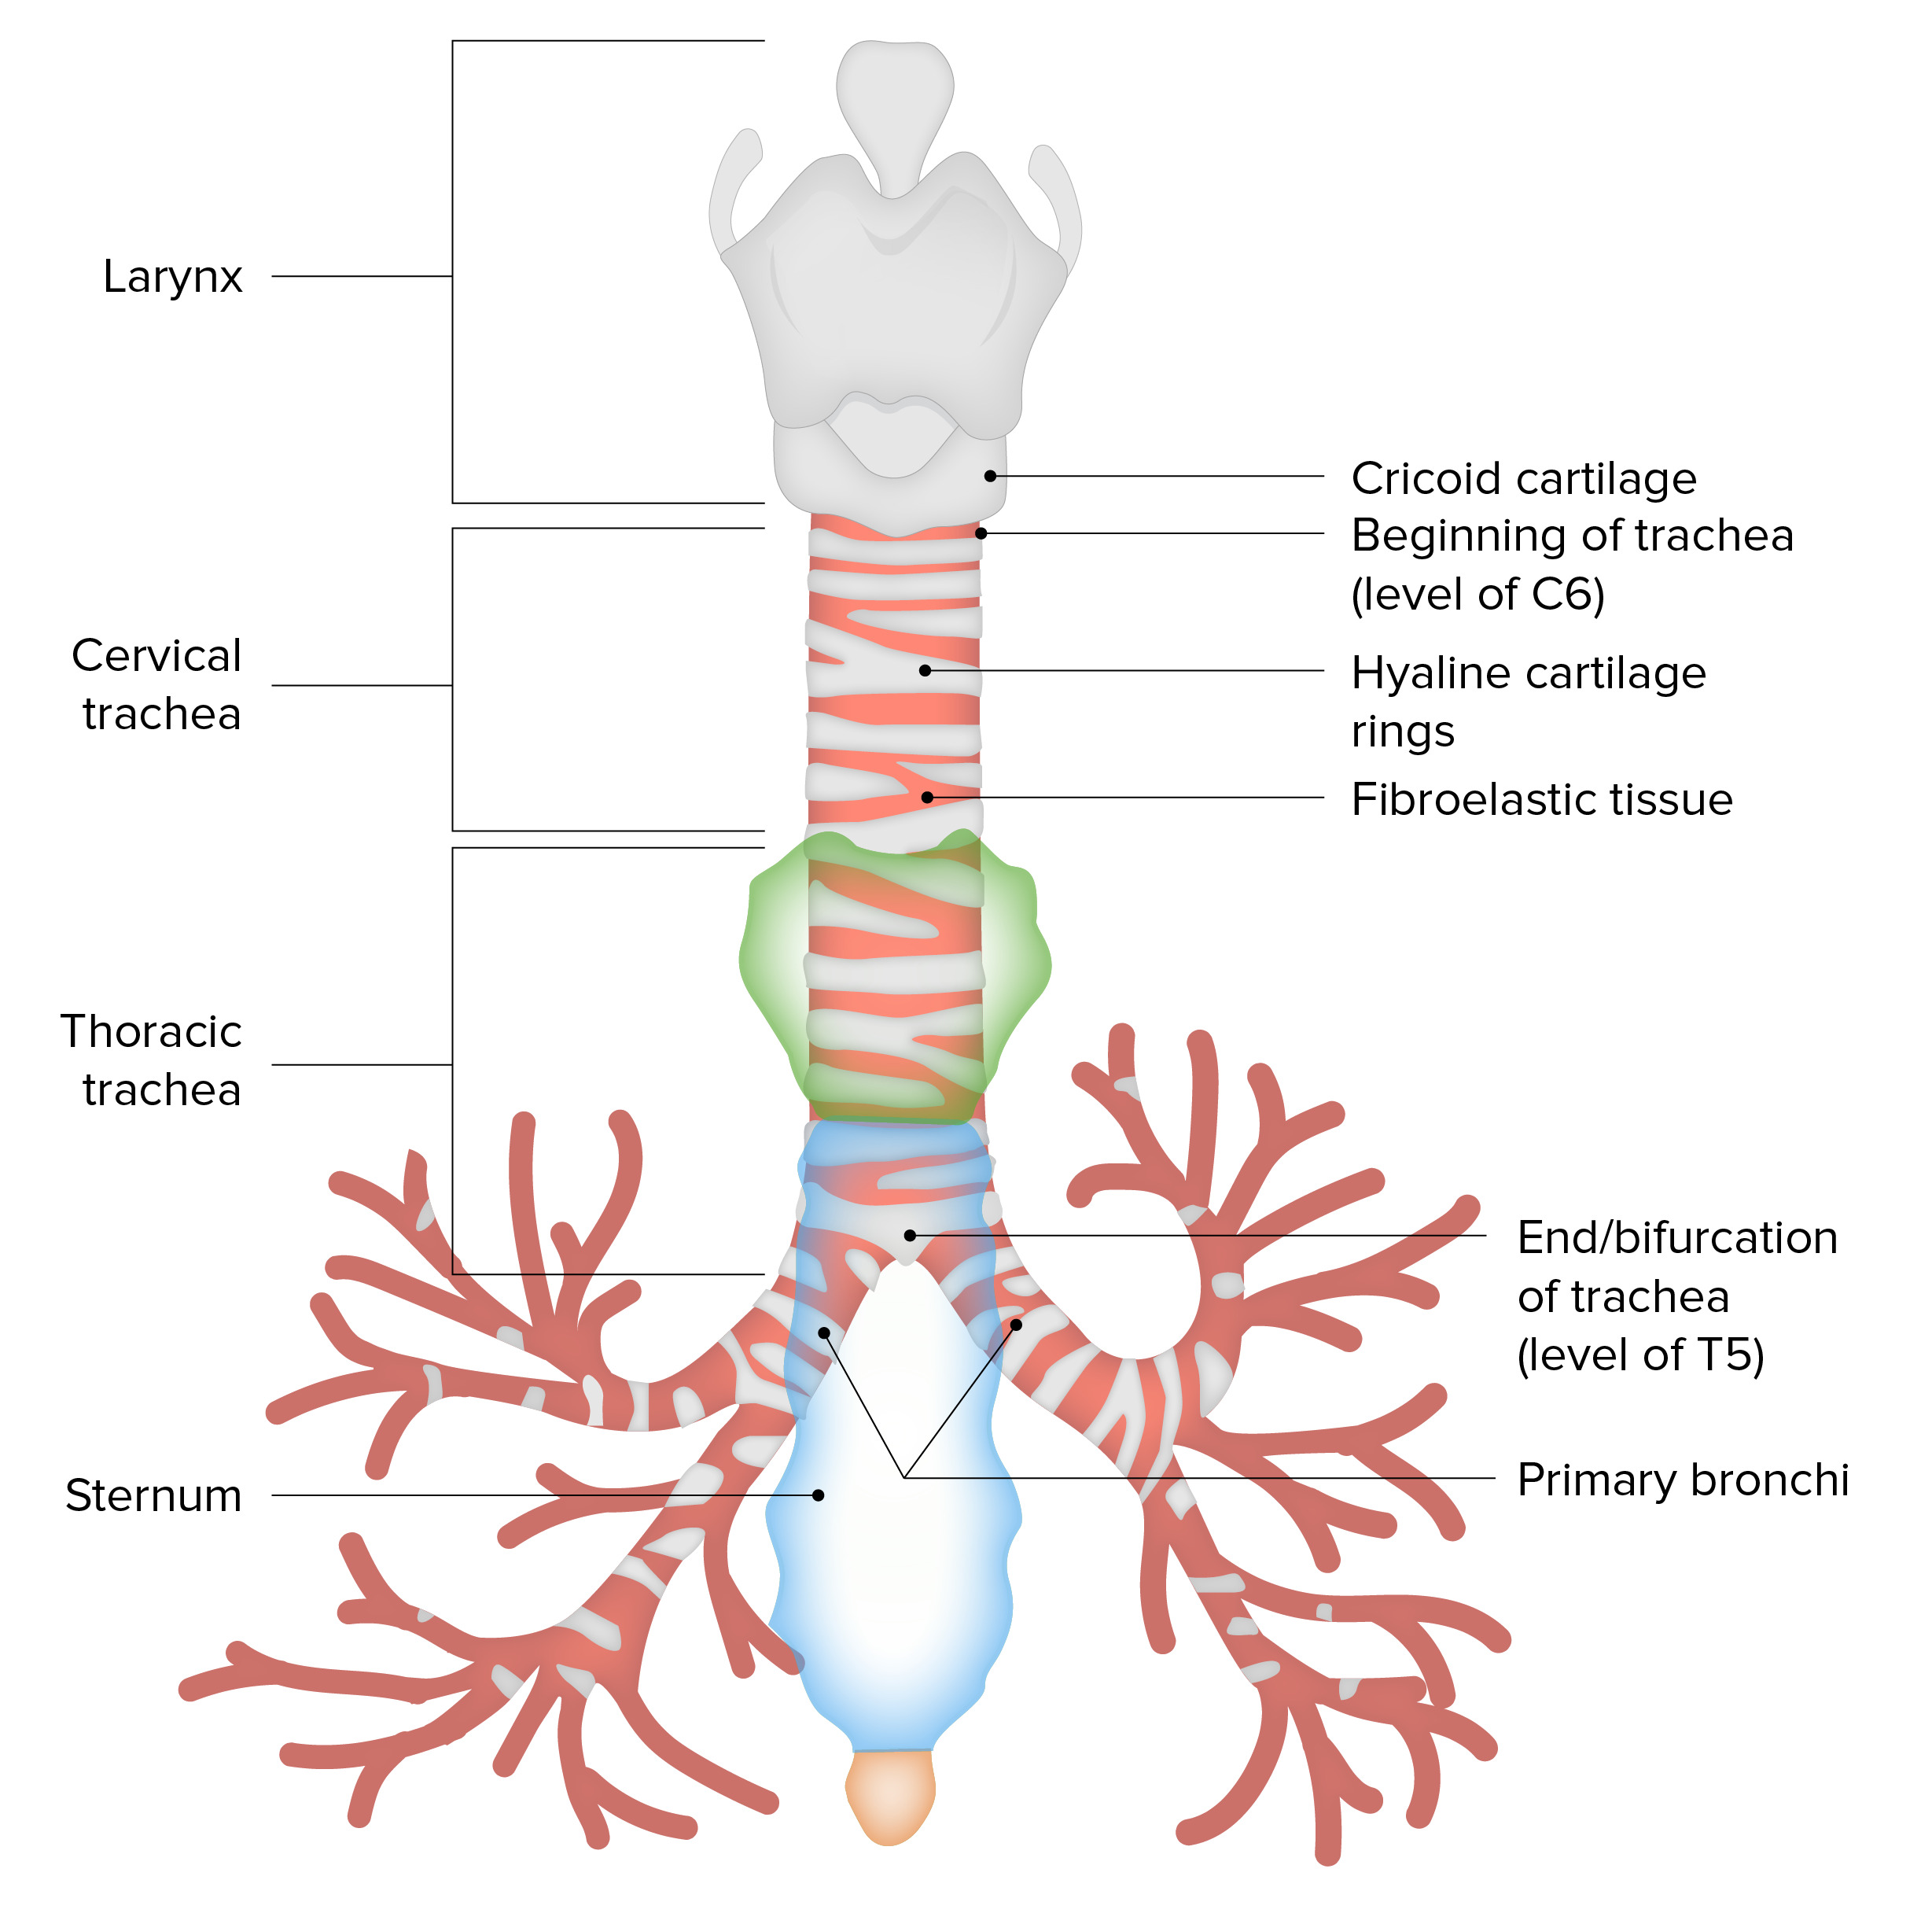
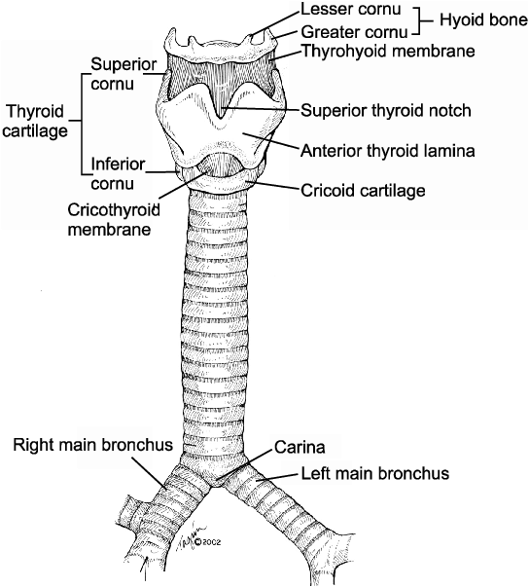

Slide 27
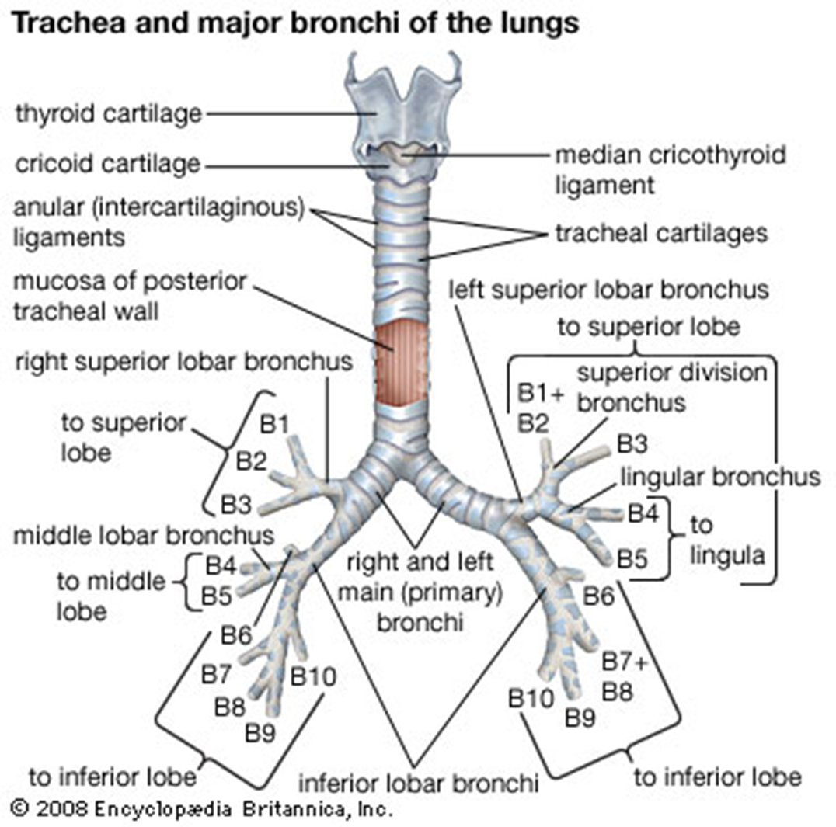

Slide 28
TRACHEA
The fibro elastic tube is kept patent by the presence of U-shaped bars (rings) of hyaline cartilage embedded in its wall. The posterior free ends of the cartilage are connected by smooth muscle, the trachealis muscle.
Anatomical relation
  Anteriorly: The sternum, the thymus, the left brachiocephalic vein, the origins of the brachiocephalic and left common carotid arteries, and the arch of the aorta.
  Posteriorly: The esophagus and the left recurrent laryngeal nerve.
  Right side: The azygos vein, the right vagus nerve, and the pleura.
  Left side: The arch of the aorta, the left common carotid and left subclavian arteries, the left vagus and left phrenic nerves, and the pleura.

Slide 29
TRACHEA
Blood Supply of the Trachea
  The upper two thirds are supplied by the inferior thyroid arteries and the lower third is supplied by the bronchial arteries.
Lymph Drainage of the Trachea
  The lymph drains into the pretracheal and paratracheal lymph nodes and the deep cervical nodes.
Nerve Supply of the Trachea
  The sensory nerve supply is from the vagi and the recurrent laryngeal nerves. Sympathetic nerves supply from the Sympathetic trunk.

Slide 30
THE BRONCHI
The trachea bifurcates behind the arch of the aorta into the right and left principal (primary or main) bronchi.
The bronchi divide dichotomously, giving rise to several million terminal bronchioles that terminate in one or more respiratory bronchioles.
Each respiratory bronchiole divides into 2 to 11 alveolar ducts that enter the alveolar sacs.
The alveoli arise from the walls of the sacs as diverticula

Slide 31
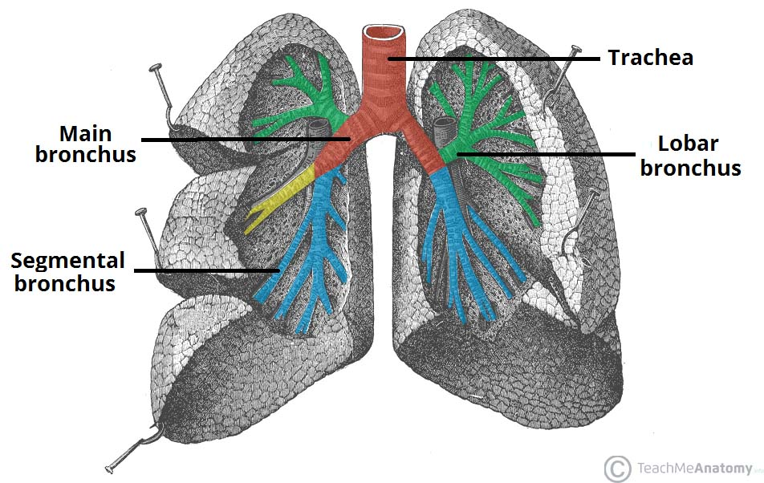

Slide 32
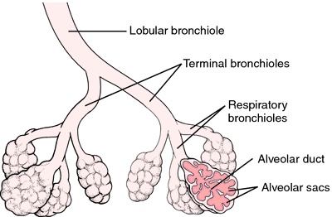
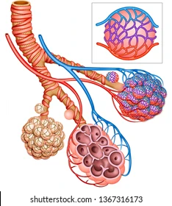

Slide 33
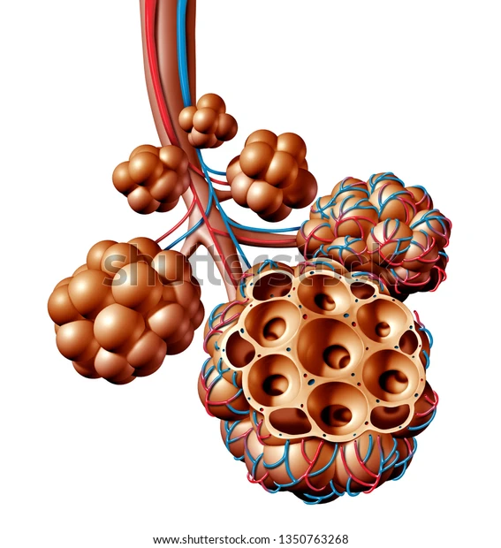

Slide 34
THE BRONCHI
Principal Bronchi
  The right principal (main) bronchus is wider, shorter, and more vertical than the left and is about 1 in. (2.5 cm) long.
    Enters the right lung at roughly the level of the fifth thoracic vertebra.
    3 subdivisions, superior lobar bronchus, middle and an inferior lobar bronchus. which become secondary bronchi also known as lobar bronchi, which deliver air to the 3 lobes of the right lung.
  The left principal (main) bronchus is narrower, longer, and more horizontal than the right and is about 2 in. (5 cm) long.
    The left main bronchus enters the root of the left lung opposite to the sixth thoracic vertebra
    It passes to the left below the arch of the aorta and in front of the esophagus.
    On entering the hilum of the left lung, the principal bronchus divides into a superior and an inferior lobar bronchus.

Slide 35
THE BRONCHI
The first bronchi branch from trachea, and they are the right and left main bronchi. These bronchi are the widest and they enter the lung.
After entering the lungs, the bronchi continue to branch further into the secondary bronchi, known as lobar bronchi, which then branch into tertiary (segmental) bronchi.
Segmental bronchi continue their branching until they reach the final, sixth generation of bronchi.
Every generation, starting from primary, is supported by cartilage in its wall. After sixth generation, the passageways are too narrow to be supported by the cartilage, and thus are called bronchioles (small bronchi)

Slide 36
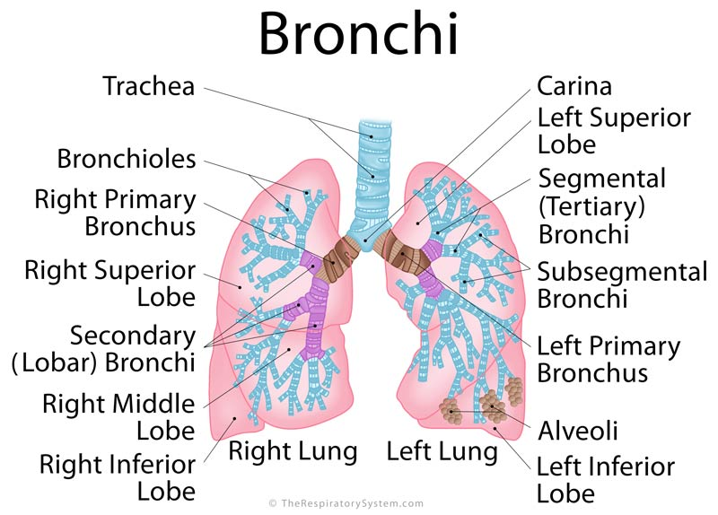

Slide 37
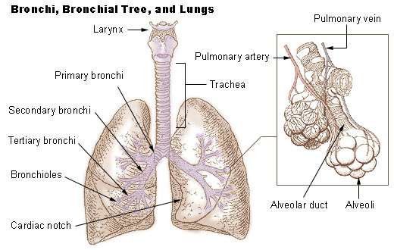
Trachea -> bifurcation -> main bronchi -> lobar bronchi -> segmental bronchi -> -> bronchi of sixth generation -> terminal bronchioles -> respiratory bronchioles -> alevolar duct -> alveolar sac -> alveolus

Slide 38


