Slide 1
THORAX: Thoracic wall
AIZAZ
Demonstrator Surgical
KMU-IPMS Peshawar

Slide 2
INTRODUCTION
Region of the body between the neck and the abdomen.
Flattened in front and behind but rounded at the sides.
Framework of the walls of the thorax, is referred to as the thoracic cage, is formed by the vertebral column behind, the ribs and intercostal spaces on either side, and the sternum and costal cartilages in front.
Superiorly, thorax communicates with the neck, and inferiorly separated from the abdomen by the diaphragm.
Thoracic cage protects the lungs and heart and affords attachment for the muscles of the thorax, upper extremity, abdomen, and back.

Slide 3
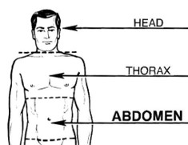
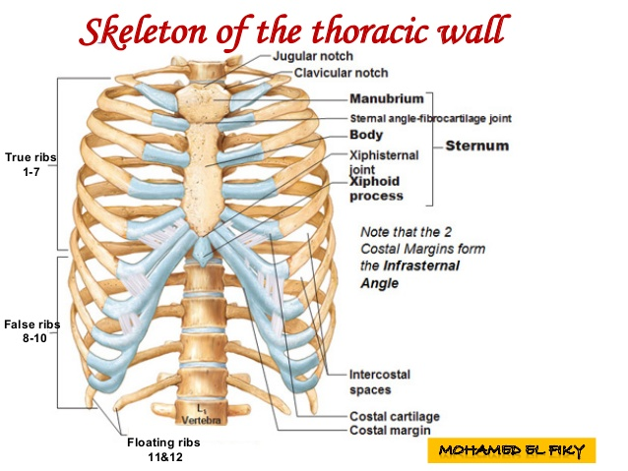
INTRODUCTION

Slide 4
INTRODUCTION
Thoracic cavity can be divided into a median partition, called the mediastinum, and the laterally placed pleurae and lungs
lungs are covered by a thin membrane called the visceral pleura the inner surface of the chest wall, where it is called the parietal pleura.
In this manner, two membranous sacs called the pleural cavities are formed, one on each side of the thorax, between the lungs and the thoracic walls.

Slide 5
THORACIC WALL
Covered on the outside by skin and muscles attaching the shoulder girdle to the trunk.
Formed posteriorly by the thoracic part of the vertebral column.
Anteriorly by the sternum and costal cartilages
Laterally by the ribs and intercostal spaces
Superiorly by the suprapleural membrane
Inferiorly by the diaphragm which separates the thoracic cavity from the abdominal cavity.

Slide 6
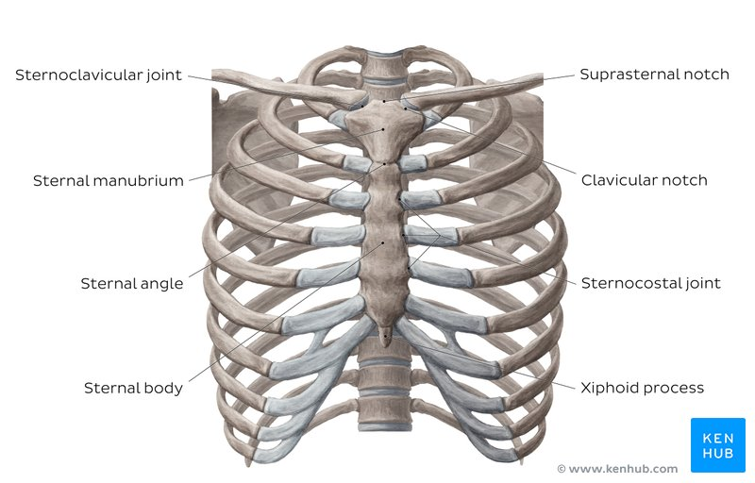

Slide 7
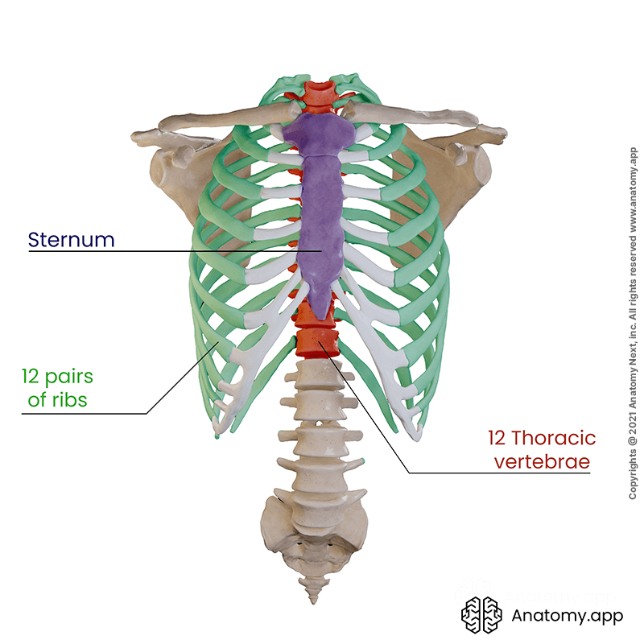

Slide 8
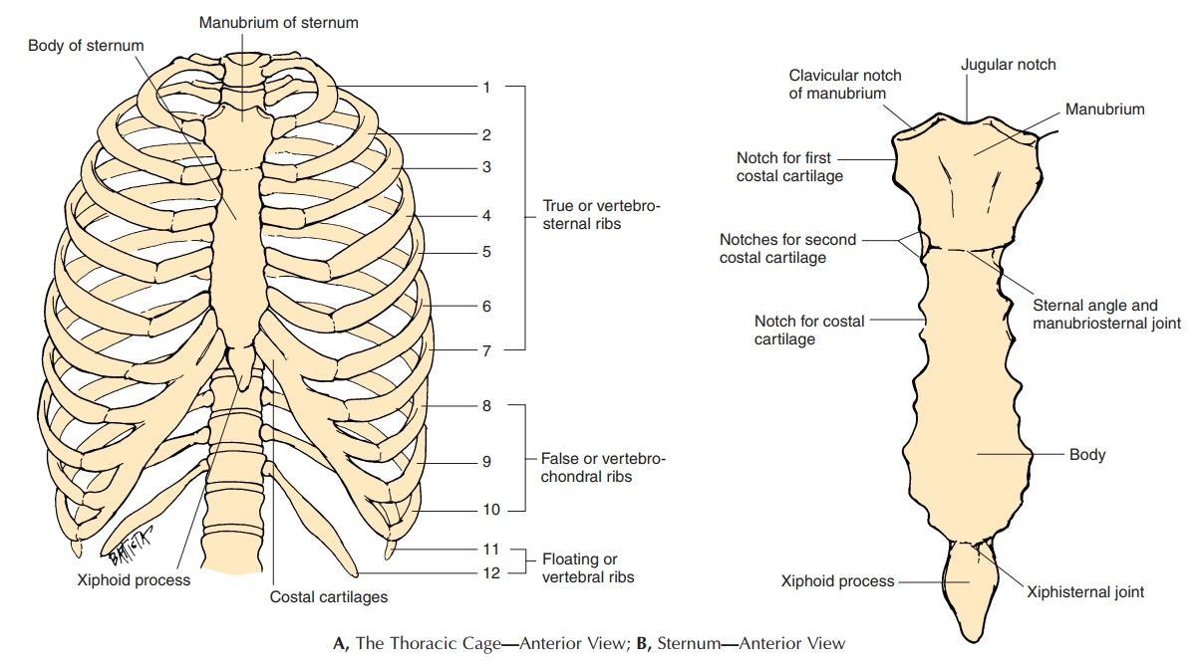

Slide 9
STERNUM
A flat bone lies in the midline of the anterior chest wall
Three parts: manubrium sterni, body of the sternum, and xiphoid process.
  1) Manubrium: is the upper part of the sternum. It articulates with the body of the sternum at the manubriosternal joint, and it also articulates with the clavicles and with the 1st costal cartilage and the upper part of the 2nd costal cartilages on each side It lies opposite the 3rd and 4th thoracic vertebrae.

Slide 10
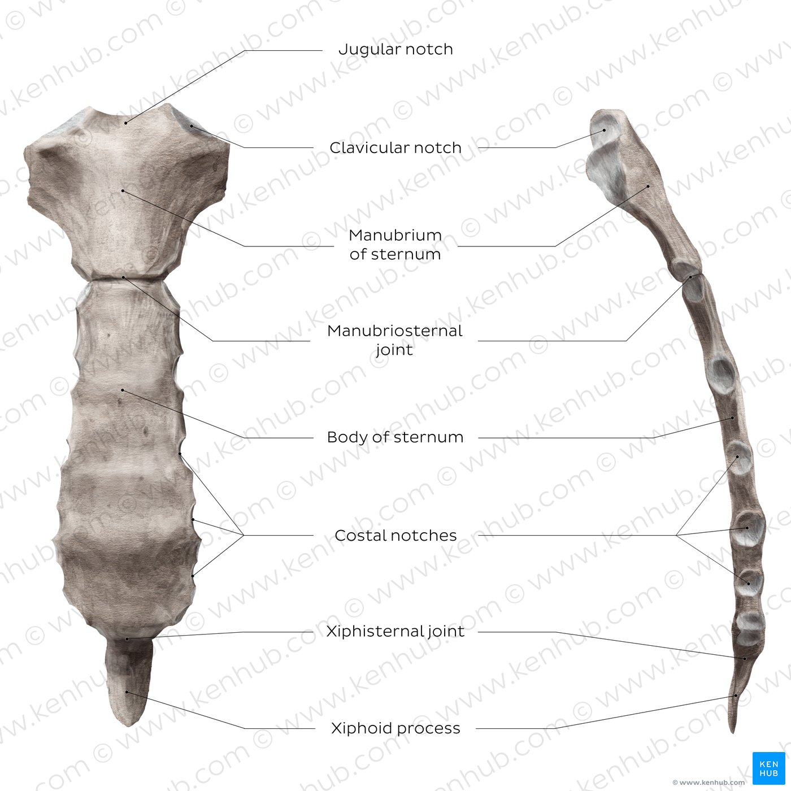
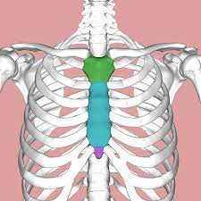

Slide 11
STERNUM
  2) body of the sternum: articulates above with the manubrium at the manubriosternal joint and below with the xiphoid process at the xiphisternal joint. On each side, it articulates with the 2nd to the 7th costal cartilages.
  3) xiphoid process: A thin plate of cartilage that becomes ossified at its proximal end during adult life. No ribs or costal cartilages are attached to it.

Slide 12
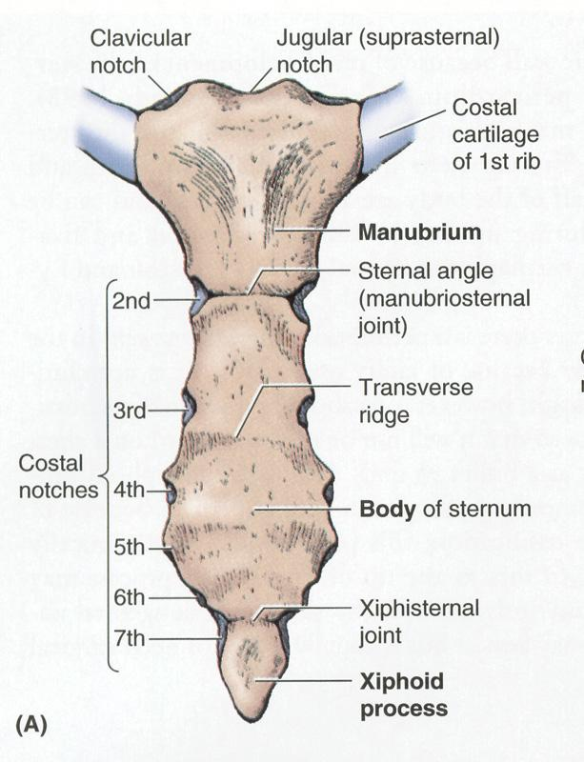

Slide 13
STERNUM
Sternal angle (angle of Louis), formed by the articulation of the manubrium with the body of the sternum. The sternal angle lies opposite the intervertebral disc between the 4th and 5th thoracic vertebrae.
The xiphisternal joint lies opposite the body of the ninth thoracic vertebra.

Slide 14
RIBS
There are 12 pairs of ribs, all of which are attached posteriorly to the thoracic vertebrae. The ribs are divided into three categories:
True ribs: The upper seven pairs are attached anteriorly to the sternum by their costal cartilages.
False ribs: The 8th, 9th, and 10th pairs of ribs are attached anteriorly to each other and to the 7th rib by means of their costal cartilages and small synovial joints.
Floating ribs: The 11th and 12th pairs have no anterior attachment.

Slide 15
Rib Structure
There are two classifications of ribs –
  Typical
  Atypical
The typical ribs have a generalized structure, while the atypical ribs have variations on their structure.

Slide 16
RIBS
Typical rib
A typical rib is a long, twisted, flat bone having a rounded, smooth superior border and a sharp, thin inferior border.
The anterior end of each rib is attached to the corresponding costal cartilage.
A rib has a head, neck, tubercle, shaft, and angle.
The typical rib consists of a head, neck and body:
The head is wedge shaped, and has two articular facets separated by a wedge of bone. One facet articulates with the numerically corresponding vertebrae, and the other articulates with the vertebrae above.

Slide 17
RIBS
The neck contains no bony prominences, but simply connects the head with the body.
Where the neck meets the body there is a roughed tubercle, with a facet for articulation with the transverse process of the corresponding vertebrae.
The body, or shaft of the rib is flat and curved.
The internal surface of the shaft has a groove for the neurovascular supply of the thorax, protecting the vessels and nerves from damage

Slide 18
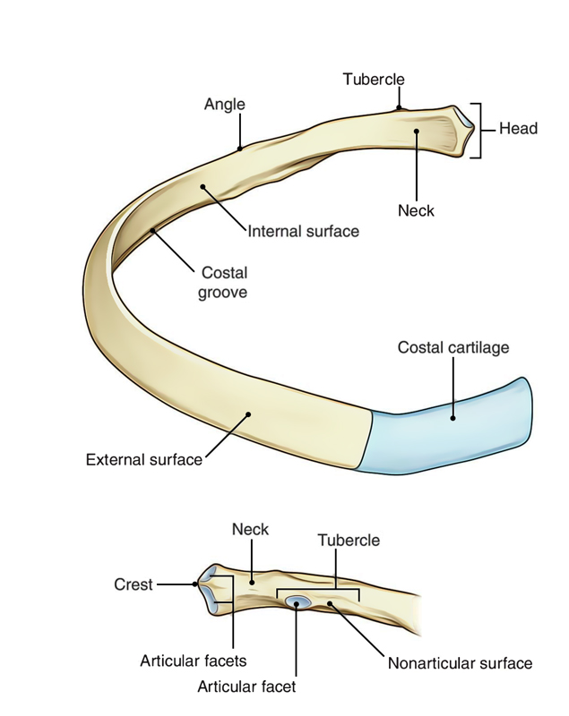
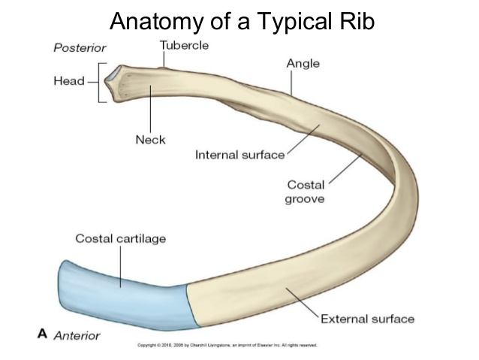

Slide 19
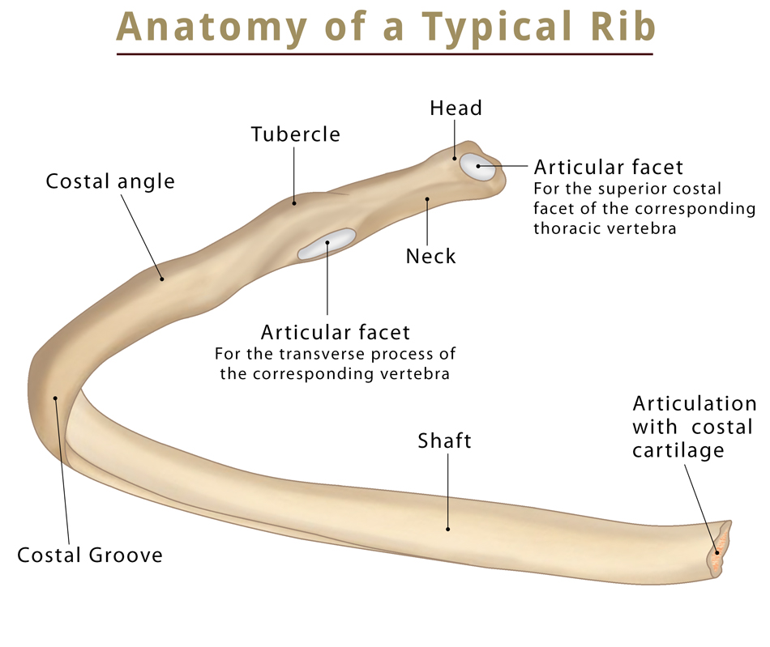

Slide 20
RIBS
Atypical Rib
Ribs 1, 2, 10 11 and 12 can be described as ‘atypical’ – they have features that are not common to all the ribs.
  Rib 1 is shorter and wider than the other ribs. It only has one facet on its head for articulation with its corresponding vertebrae (there isn’t a thoracic vertebra above it). The superior surface is marked by two grooves, which make way for the subclavian vessels.

Slide 21
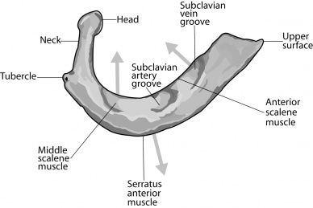

Slide 22
RIBS
  Rib 2 is thinner and longer than rib 1, and has two articular facets on the head as normal. It has a roughened area on its upper surface, from which the serratus anterior muscle originates.
  Rib 10 only has one facet – for articulation with its numerically corresponding vertebrae.
  Ribs 11 and 12 have no neck, and only contain one facet, which is for articulation with their corresponding vertebrae

Slide 23
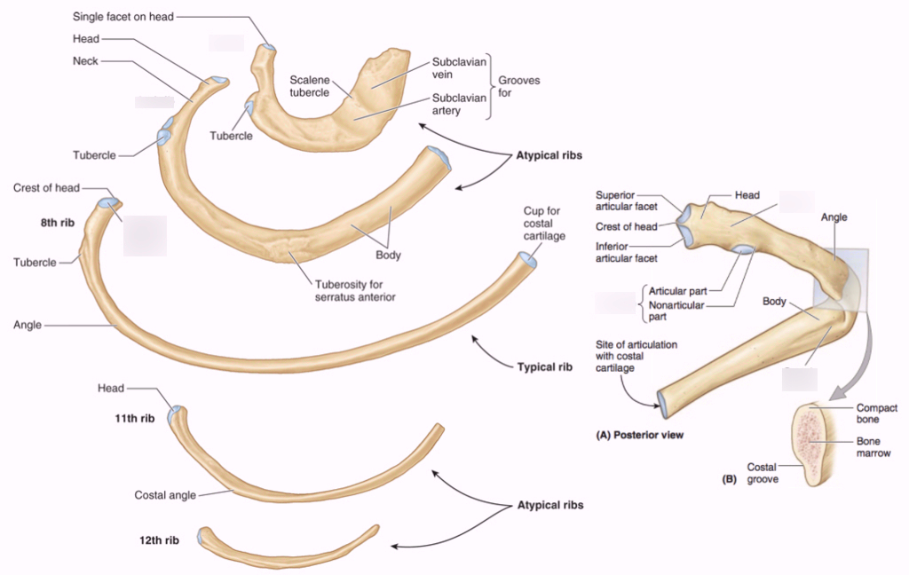

Slide 24
Thoracic Spine
Second segment of the vertebral column.
Located between the cervical and lumbar vertebral segments.
Consists of twelve vertebrae, which are separated by intervertebral discs.
Forms the posterior part of the thoracic cage.
The thoracic vertebrae have four features which distinguish them from other vertebrae:
  Vertebral body is heart shaped
  Presence of demi-facets on the sides of each vertebral body
  Presence of costal facets on the transverse processes (T1 to T10 only)
  The spinous processes are long and slant inferiorly.

Slide 25
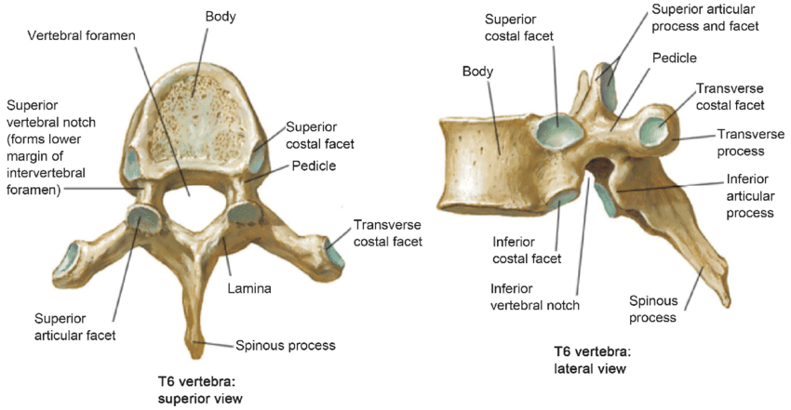

Slide 26
Thoracic Spine
Body: heart-shaped massive that increase in size as descending to the lumbar vertebrae
Spinous process: dorsal bony prominence
Costal facets (superior, inferior, transverse): articulation surfaces for head of the rib
Transverse process: bony process that arises from the vertebral arch, intended for the attaching of the rib tubercle
Superior and inferior articular facets: articulation surfaces for adjacent (superior and inferior) vertebrae
Lamina: bony imbrication that covers the subjacent vertebrae and connect with pedicles to protect the spinal cord
Intervertebral foramen: paired foramina (one left, one right) intended for the exiting nerve roots
Vertebral foramen: large opening posterior to the body that forms spinal canal through which the spinal cord passes

Slide 27
COSTAL CARTILAGES
Costal cartilages are bars of cartilage connecting the upper seven ribs to the lateral edge of the sternum and the 8th, 9th, and 10th ribs to the cartilage immediately above.
11th and 12th ribs end in the abdominal musculature .
The costal cartilages contribute significantly to the elasticity and mobility of the thoracic walls. In old age, the costal cartilages tend to lose some of their flexibility as the result of superficial calcification.

Slide 28
JOINTS OF THE RIBS
Posterior
All the twelve ribs articulate posteriorly with the vertebrae of the spine. Two type of costovertebral joints form posteriorly.
  Costotransverse joint: Between the tubercle of the rib, and the transverse costal facet of the corresponding vertebrae.
  Costovertebral joint: Between the head of the rib, superior costal facet of the corresponding vertebrae, and the inferior costal facet of the vertebrae above.

Slide 29
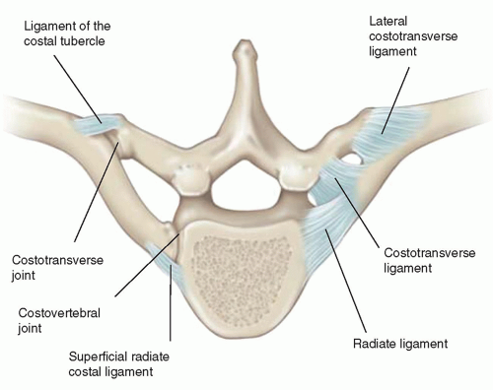

Slide 30
JOINTS OF THE RIBS
Anterior
The anterior attachment of the ribs vary:
Ribs 1-7 attach independently to the sternum.
Ribs 8 – 10 attach to the costal cartilages superior to them.
Ribs 11 and 12 do not have an anterior attachment and end in the abdominal musculature. Because of this, they called ‘floating ribs’.

Slide 31
JOINTS OF THE RIBS
Joints of the Heads of the Ribs
The 1st rib and the three lowest ribs have a single synovial joint with their corresponding vertebral body.
For the 2nd to 9th ribs, the head articulates by means of a synovial joint with the corresponding vertebral body and that of the vertebra above it.
There is a strong intraarticular ligament that connects the head to the intervertebral disc

Slide 32
JOINTS OF THE RIBS
Joints of the Costal Cartilages with the Sternum
The 1st costal cartilages articulate with the manubrium, by cartilaginous joints that permit no movement.
The 2nd to 7th costal cartilages articulate with the lateral border of the sternum by synovial joints.
In addition, the 6th, 7th, 8th, 9th, and 10th costal cartilages articulate with one another along their borders by small synovial joints.
The cartilages of the 11th and 12th ribs are embedded in the abdominal musculature.

Slide 33
OPENINGS OF THE THORAX
The chest cavity communicates with the root of the neck through an oblique opening called the thoracic outlet.
It is called an outlet because important vessels and nerves emerge from the thorax here to enter the neck and upper limbs.
The opening is bounded
  Posteriorly by the 1st thoracic vertebra
  Laterally by the medial borders of the 1st ribs and their costal cartilages
  Anteriorly by the superior border of the manubrium sterni.

Slide 34
INTERCOSTAL SPACES
The spaces between the ribs contain three muscles of respiration:
  The external intercostal muscle
  The internal intercostal muscle
  Innermost intercostal muscle

Slide 35
INTERCOSTAL MUSCLES
The external intercostal muscle forms the most superficial layer.
Its fibers are directed downward and forward from the inferior border of the rib above to the superior border of the rib below.
The muscle extends forward to the costal cartilage where it is replaced by an aponeurosis, the anterior (external) intercostal membrane

Slide 36
INTERCOSTAL MUSCLES
The internal intercostal muscle forms the intermediate layer.
Its fibers are directed downward and backward from the subcostal groove of the rib above to the upper border of the rib below.
The muscle extends backward from the sternum in front to the angles of the ribs behind, where the muscle is replaced by an aponeurosis, the posterior (internal) intercostal membrane

Slide 37
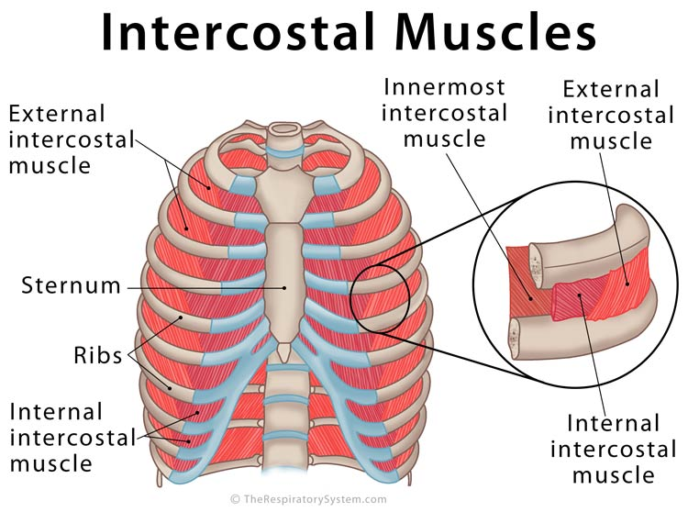
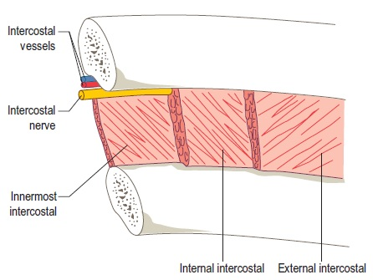
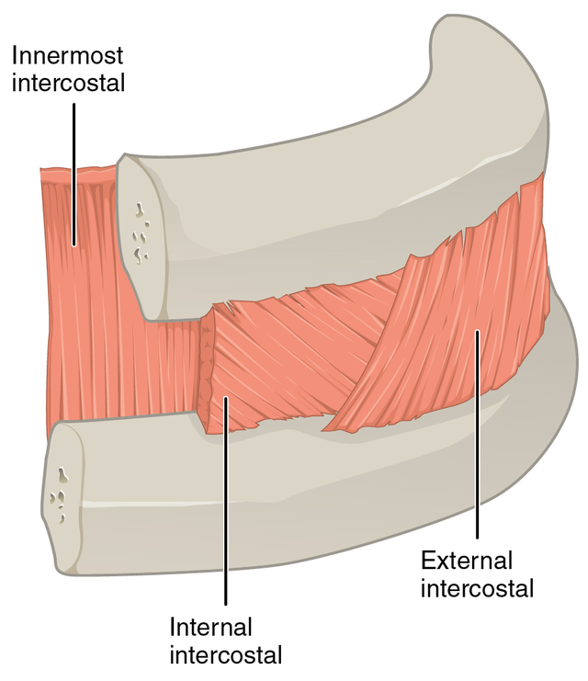

Slide 38
INTERCOSTAL MUSCLES
The innermost intercostal muscle forms the deepest layer and corresponds to the transversus abdominis muscle in the anterior abdominal wall.
It is an incomplete muscle layer and crosses more than one intercostal space within the ribs. It is related internally to fascia (endothoracic fascia) and parietal pleura and externally to the intercostal nerves and vessels.
  The endothoracic fascia is a thin layer of loose connective tissue that separates the parietal pleura from the thoracic wall.

Slide 39
INTERCOSTAL VESSELS
Each intercostal space contains a large single posterior intercostal artery and two small anterior intercostal arteries.
The posterior intercostal arteries of the first two spaces are branches from the superior intercostal artery, a branch of the subclavian artery.
The posterior intercostal arteries of the lower nine spaces are branches of the descending thoracic aorta .

Slide 40
INTERCOSTAL VESSELS
The anterior intercostal arteries of the first six spaces are branches of the internal thoracic artery , which arises from the first part of the subclavian artery.
The anterior intercostal arteries of the lower spaces are branches of the musculophrenic artery, one of the terminal branches of the internal thoracic artery.
Each intercostal artery gives off branches to the muscles, skin, and parietal pleura. In the region of the breast in the female, the branches to the superficial structures are particularly large.

Slide 41
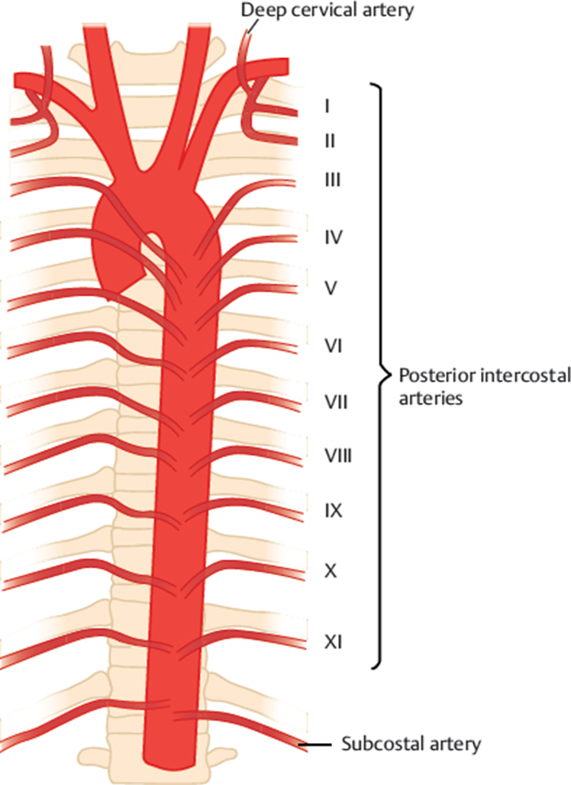
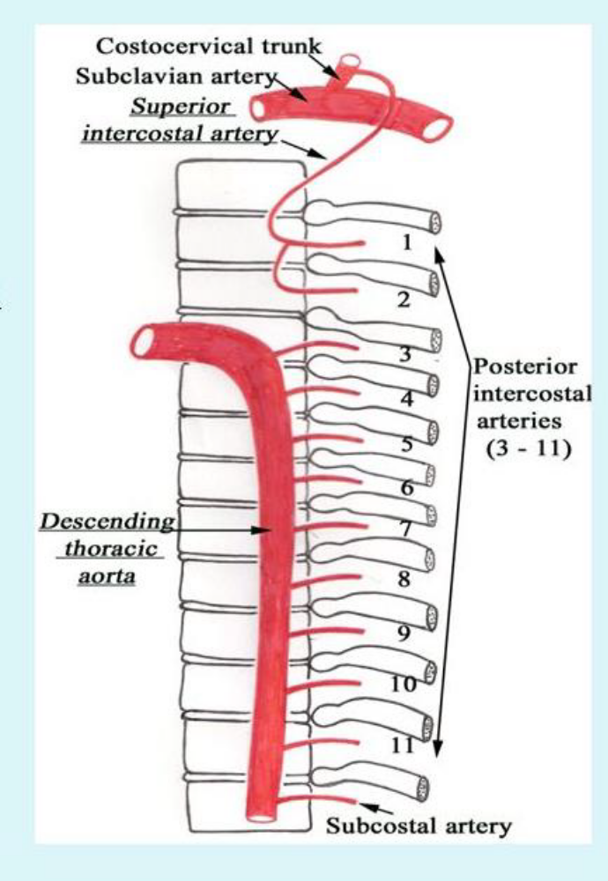
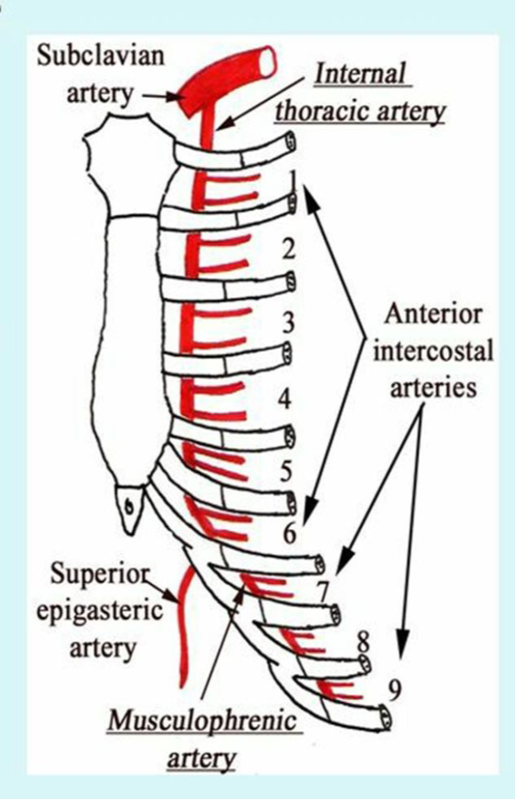

Slide 42
INTERCOSTAL NERVES
The intercostal nerves are the anterior rami of the first 11 thoracic spinal nerves.
The anterior ramus of the 12th thoracic nerve lies in the abdomen and runs forward in the abdominal wall as the subcostal nerve.
Each intercostal nerve enters an intercostal space between the parietal pleura and the posterior intercostal membrane.
It then runs forward inferiorly to the intercostal vessels in the subcostal groove of the corresponding rib, between the innermost intercostal and internal intercostal muscle.

Slide 43
INTERCOSTAL NERVES
The first six nerves are distributed within their intercostal spaces.
The 7th to 9th intercostal nerves leave the anterior ends of their intercostal spaces by passing deep to the costal cartilages, to enter the anterior abdominal wall.
The 10th and 11th nerves, since the corresponding ribs are floating, pass directly into the abdominal wall.

Slide 44
INTERCOSTAL NERVES
The intercostal nerves have many branches:
  Rami communicantes: These branches connect the intercostal nerves to ganglia of the sympathetic trunk, the string of interconnected sympathetic ganglia along each side of the vertebral column.
  Collateral branches: These branches run just below the main nerve, on the rib below.
  Lateral cutaneous branches: These nerve branches innervate the skin of the side of the chest.

Slide 45
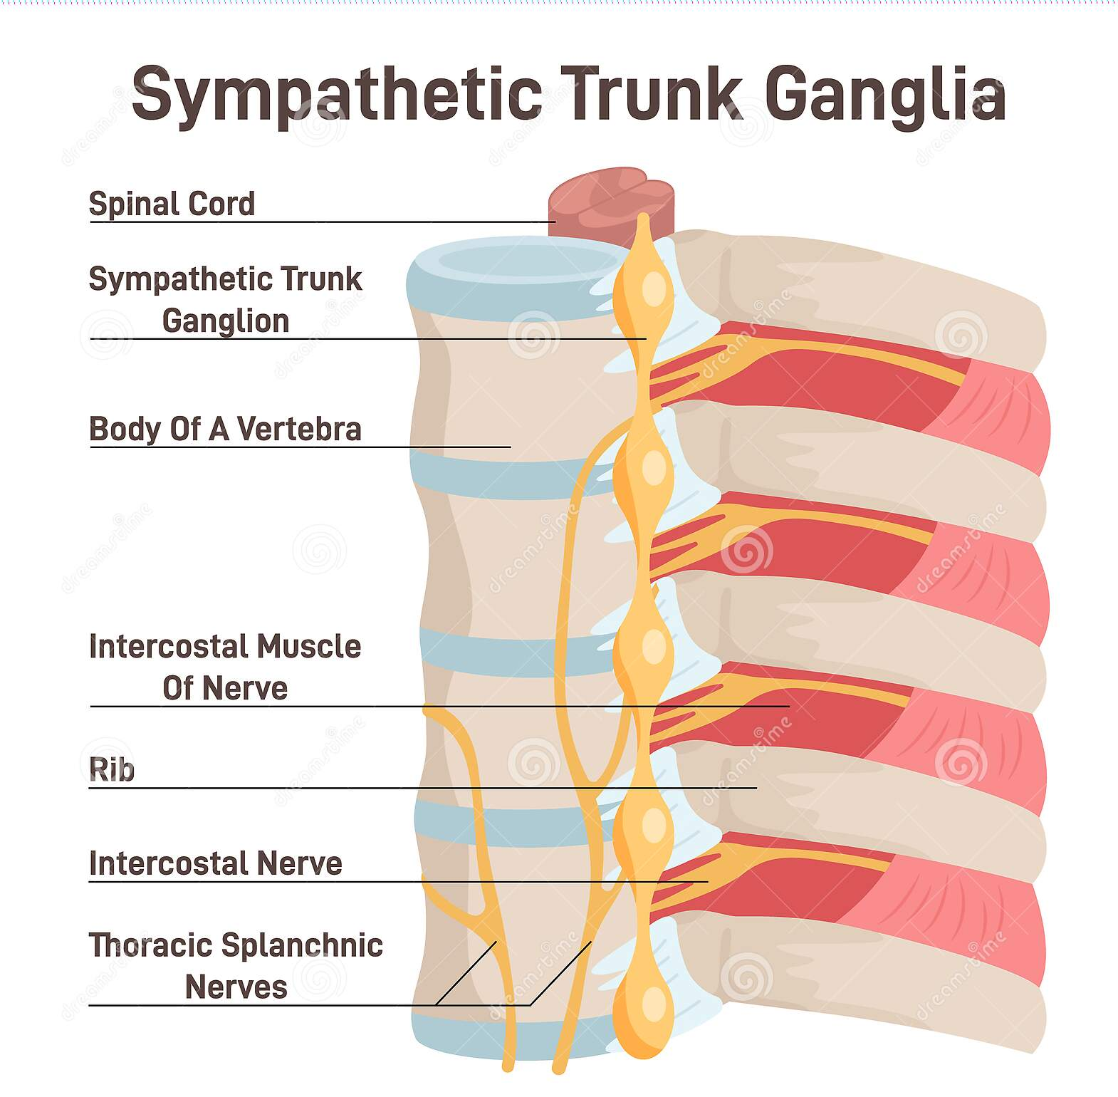

Slide 46
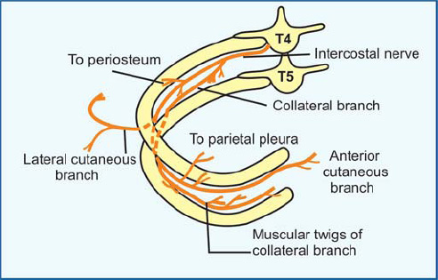

Slide 47
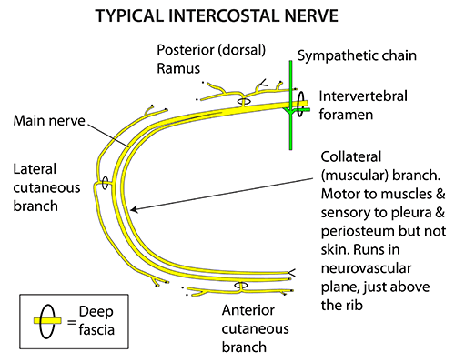

Slide 48
INTERCOSTAL NERVES
  Anterior cutaneous branches: These branches are the terminal portions of the anterior rami that innervate the skin of the anterior thorax.
  Muscular branches: These branches innervate the intercostal muscles.
  Pleural sensory branches: These branches innervate the parietal pleura.
  Peritoneal sensory branches: These branches run to the parietal peritoneum (thin serous membrane lining the abdominal wall) on the 7th through 11th intercostal nerves.

Slide 49
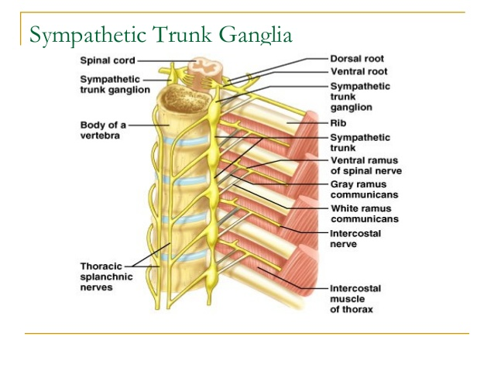

Slide 50
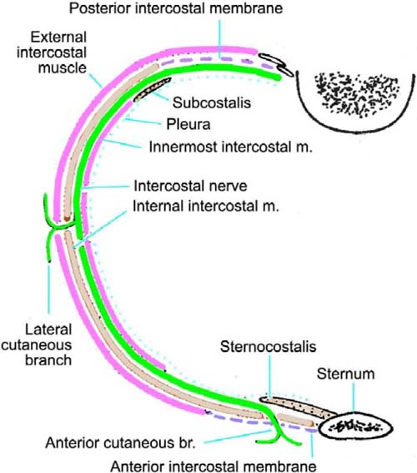

Slide 51


