Slide 1
Presentation Skills
Amir khysro

Slide 2
Definition
Presentation skills are the skills you need in delivering effective and engaging presentations to a variety of audiences. These skills cover a variety of areas such as the structure of your presentation, the design of your slides, the tone of your voice and the body language you convey.

Slide 3
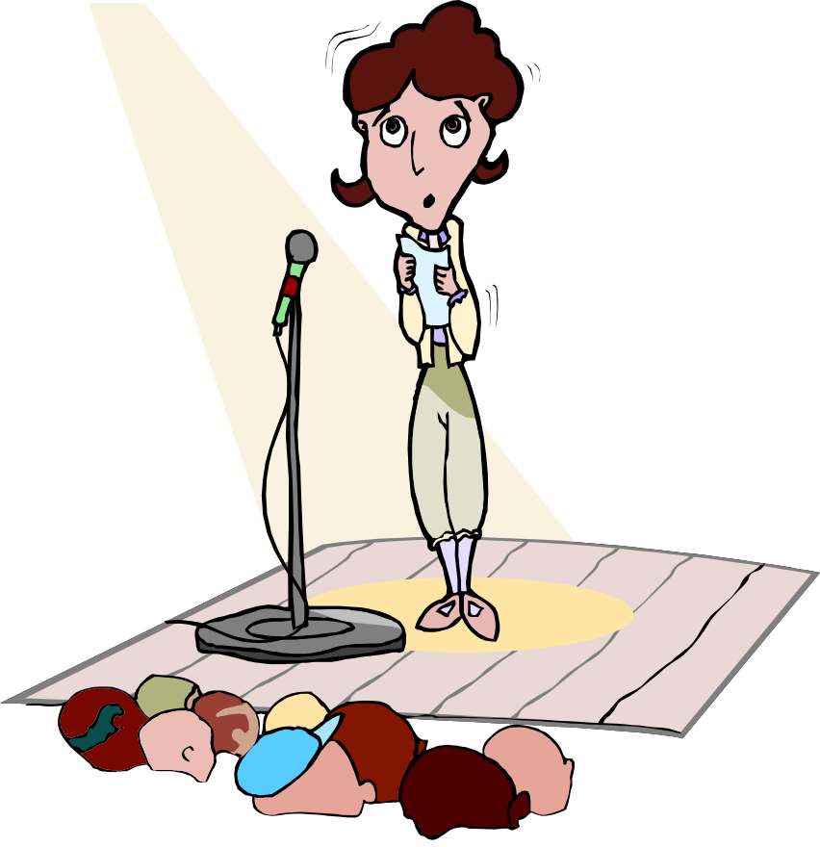
“After violent death, most people fear public speaking more than anything else in life”
People Management
April 2002

Slide 4
Planning
Why are you doing the talk? Be clear about your purpose
Find out how big your audience is likely to be & what sort of group
Make notes about your subject
Don’t write your talk word for word
Use small pieces of paper and number them
Powerpoint has a notes & timing feature which may help
Time your talk & practice it
Then practice it again

Slide 5
Think of Threes
Tell people what you’re going to say
Tell them
Tell them what you’ve said

Slide 6
Presentation Techniques
“He was looking up into the sky all the time he was speaking and Alice thought this decidedly uncivil”
Lewis Carroll

Slide 7

Techniques 1
Pace of delivery
Vary style
Move about
Vary pitch
Use notes
Avoid annoying habits
Use props, but don‘t overdo it

Slide 8
Techniques – teaching aids
Flip chart for diagrams, pictures, key points
Ohps/powerpoint - serve the same purpose (more permanent, better for a large audience)
Powerpoint – pros and cons on next slide
Demonstration - get your audience involved

Slide 9
PowerPoint
Advantages
Disadvantages
Quick, easy & simple
Prepare in advance
Good for large audience
Can include pictures & graphics easily
Something to look at
Can be tedious
Not very dynamic
Easy to overload with information
Be careful with animations
Tendency to read word for word

Slide 10
Do’s
✓
Take a deep breath
Speak clearly
Make small cards to remind yourself of topics (number them!)
Be aware of where your audience is - are you facing all of them?
Smile, have fun
Be yourself and project your personality
Remember - no-one knows how you feel or what you think
Remember - The audience is on your side!

Slide 11
Don’ts
✗
“ ‘Don’t grunt’, said Alice; ‘that’s not at all the proper way of expressing yourself’ ”
Lewis Carroll

Slide 12
Don’ts
✗
Rush what you’re trying to say – SLOW DOWN
Read off a sheet of paper word for word
Fiddle with things - its irritating!
Use inappropriate language for your audience
Panic

Slide 13
“ In that case," said the Dodo solemnly, rising to its feet, "I move that the meeting adjourn, for the immediate adoption of more energetic remedies – "
"Speak English!" said the Eaglet. "I don't know the meaning of half those long words, and, what's more, I don't believe you do either!“”
Alice in Wonderland – Lewis Carroll

Slide 14
In Summary…
Most talks go according to plan
But, you must actually plan unless you are very experienced
You have the support of your audience
Most common mistakes are avoidable
The world won’t end if it does go wrong – just correct yourself and carry on

Slide 15
Structure
Three parts
Introduction it has three parts
1 Porch 2, Aim 3, Lay out (PAL)
PORCH: throat clearing process
AIM: Why this presentation
LAY OUT : telling the over all structure of your presentation
Introductory paragraph may not be more than 2 minutes

